Slide 1

Chapter 3
What Economics Do

Slide 2
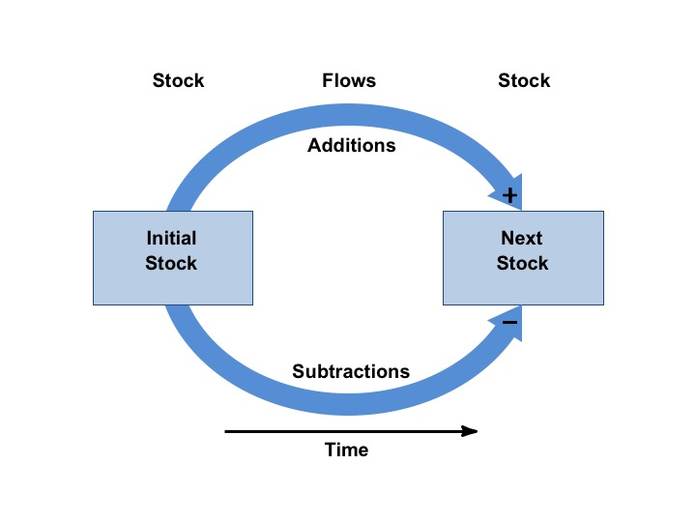
Figure 3.1 The General Stock-Flow Diagram

Slide 3
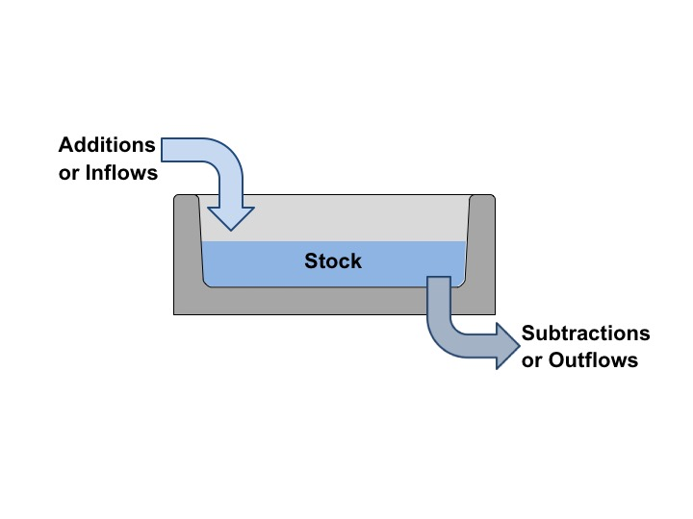
Figure 3.2 “Bathtub”-Style Diagram

Slide 4
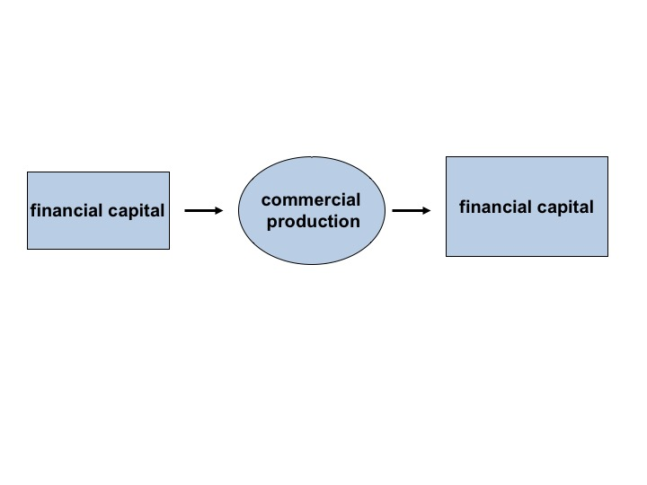
Figure 3.3 The Role of Financial Capital in Commercial Production

Slide 5
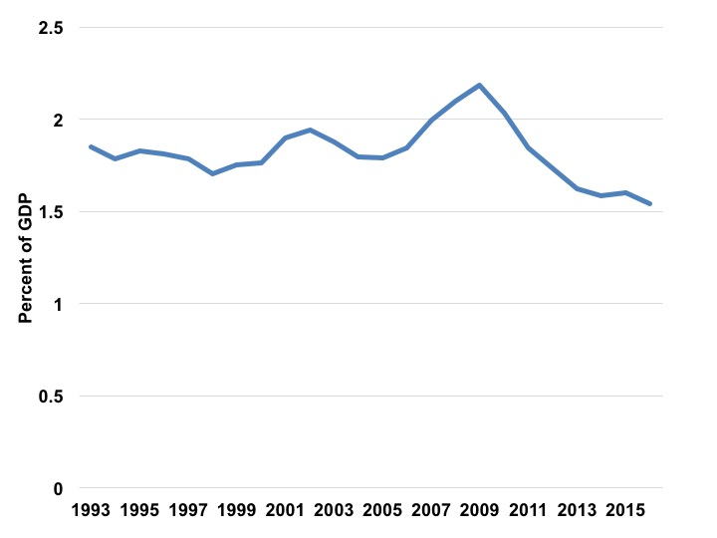
Figure 3.4 Public Construction Spending as a Percentage of GDP, 1993-2016
Figure source: U.S. Census Bureau.
Sources: The Economist, 2017; Thomas and Schoen, 2017.

Slide 6
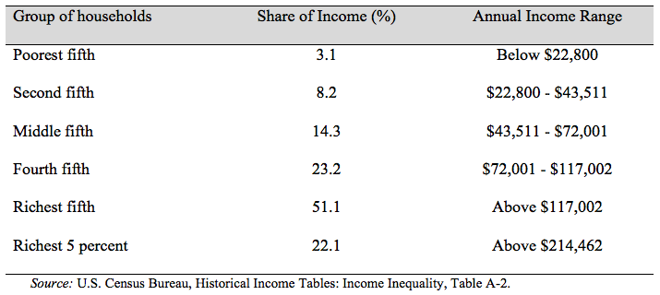
Table 3.1 Distribution of U.S. Household Income in 2015
Source: U.S. Census Bureau, Historical Income Tables: Income Inequality, Table A-2.

Slide 7
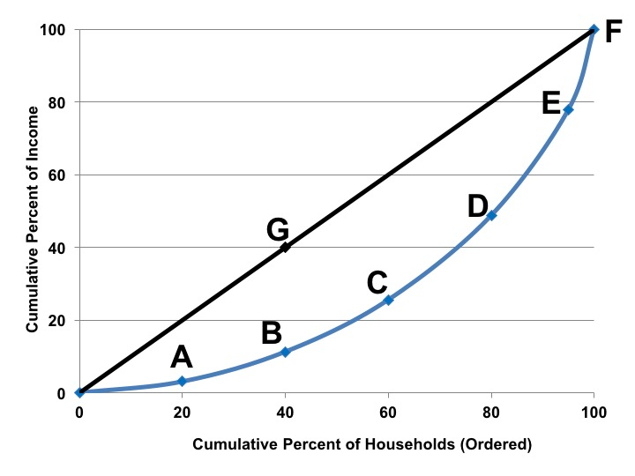
Figure 3.5 Lorenz Curve for U.S. Household Income, 2015
Source: U.S. Census Bureau, Historical Income Tables: Income Inequality, Table A-2.

Slide 8
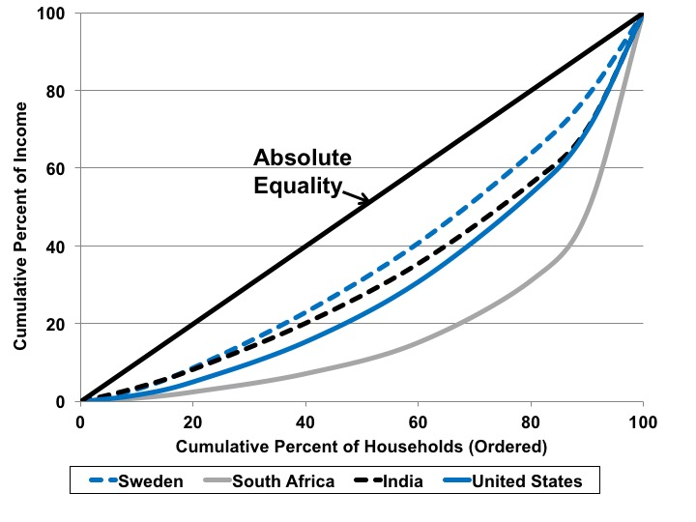
Figure 3.6 Lorenz Curve for Sweden, South Africa, India, and the United States
Source: World Bank, World Development Indicators database. Year of data varies from 2011 to 2013.

Slide 9
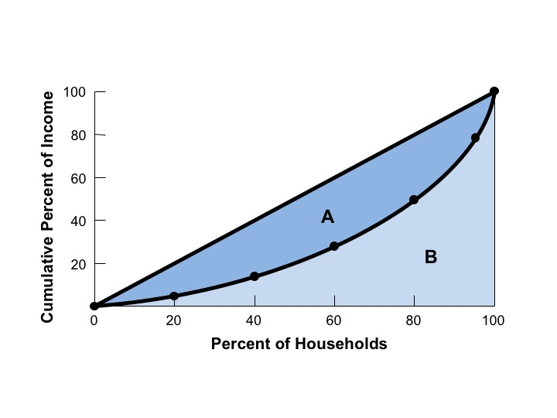
Figure 3.7 The Gini Ratio, A/(A+B)

Slide 10
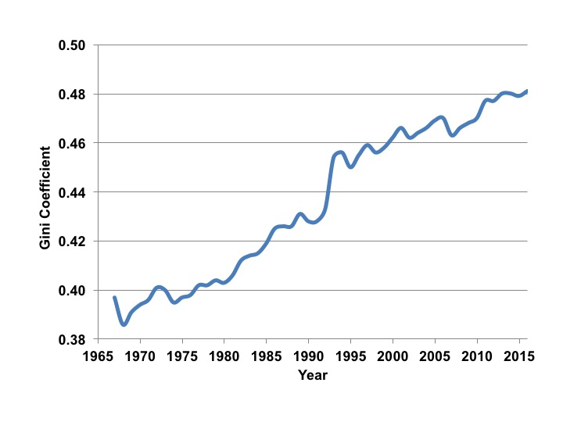
Figure 3.8 Gini Coefficient in the United States, 1968-2015
Source: U.S. Census Bureau, Historical Income Tables: Income Inequality, Table A-2.

Slide 11
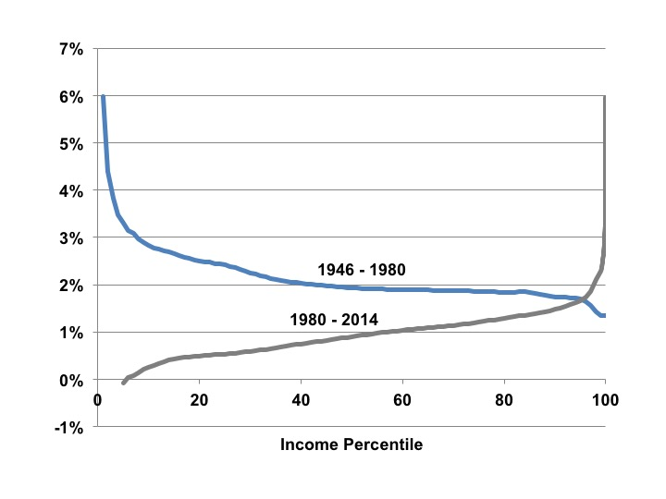
Figure 3.9 Growth in Income by Income Percentile
Source: Leonhardt, 2017 based on data by Piketty, Saez and Zucman.

Slide 12
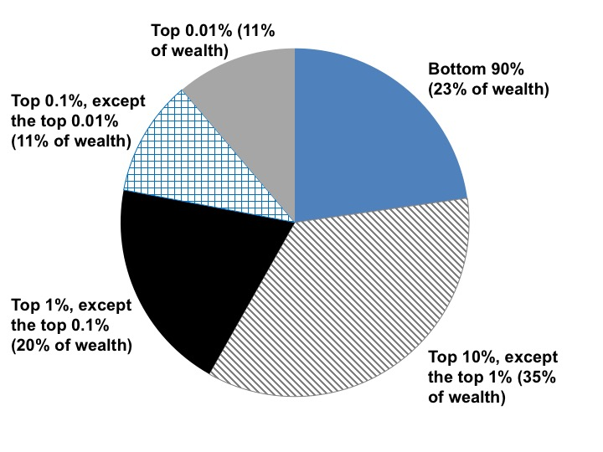
Figure 3.10 Wealth Distribution in the U.S.
Source: Saez and Zucman, 2016.

