Slide 1

Chapter 2
Useful Tools and Concepts

Slide 2
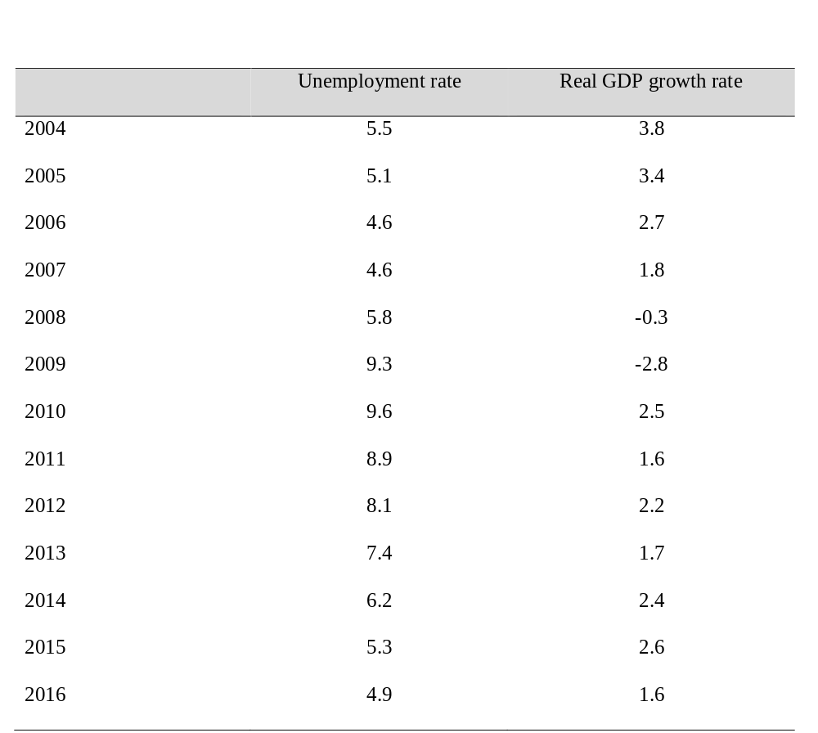
Table 2.1 Unemployment Rate and Real GDP Growth Rate, United States, 2004–2016 (in percent)
Sources: U.S. Bureau of Economic Analysis and U.S. Bureau of Labor Statistics.

Slide 3
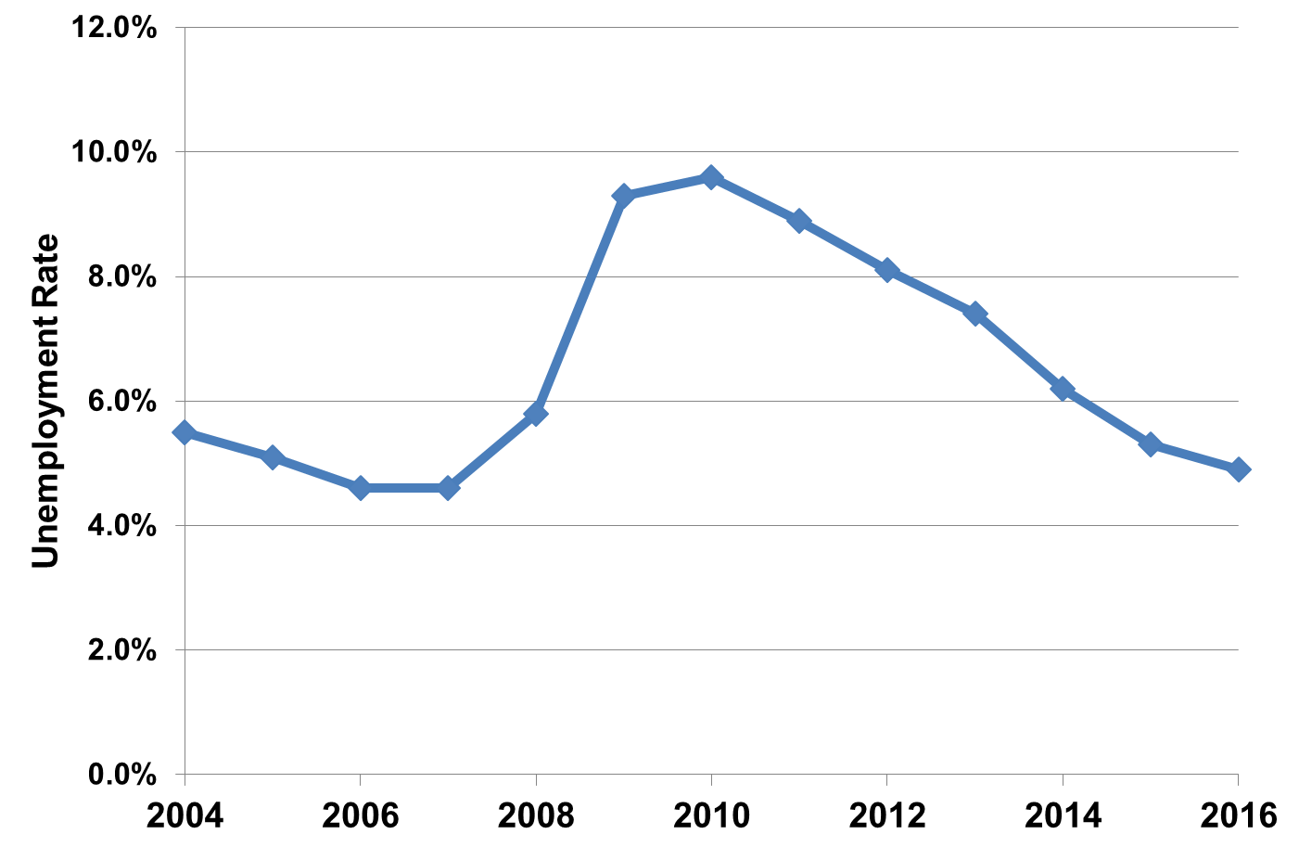
Figure 2.1 Unemployment Rate, United States 2004-2016

Slide 4
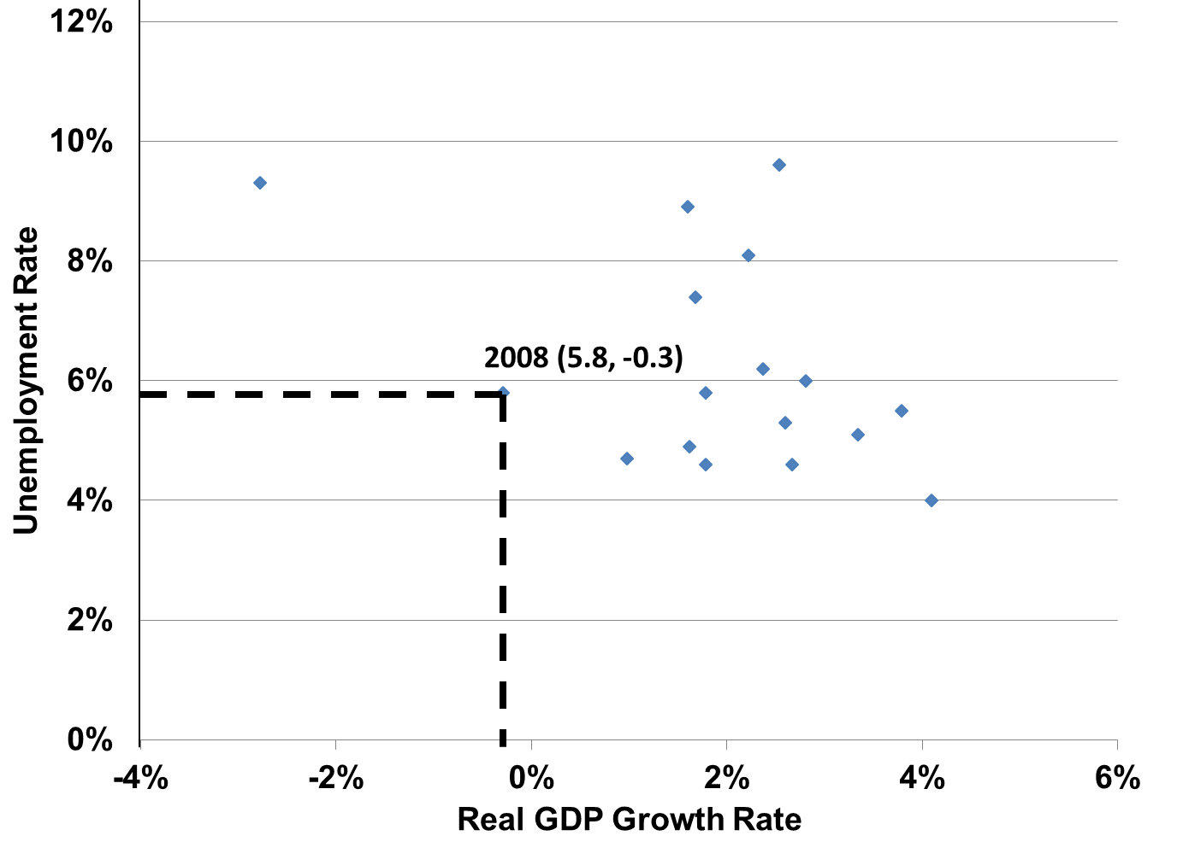
Figure 2.2 Relationship between Unemployment and GDP Growth Rate, United States, 2004-2016

Slide 5
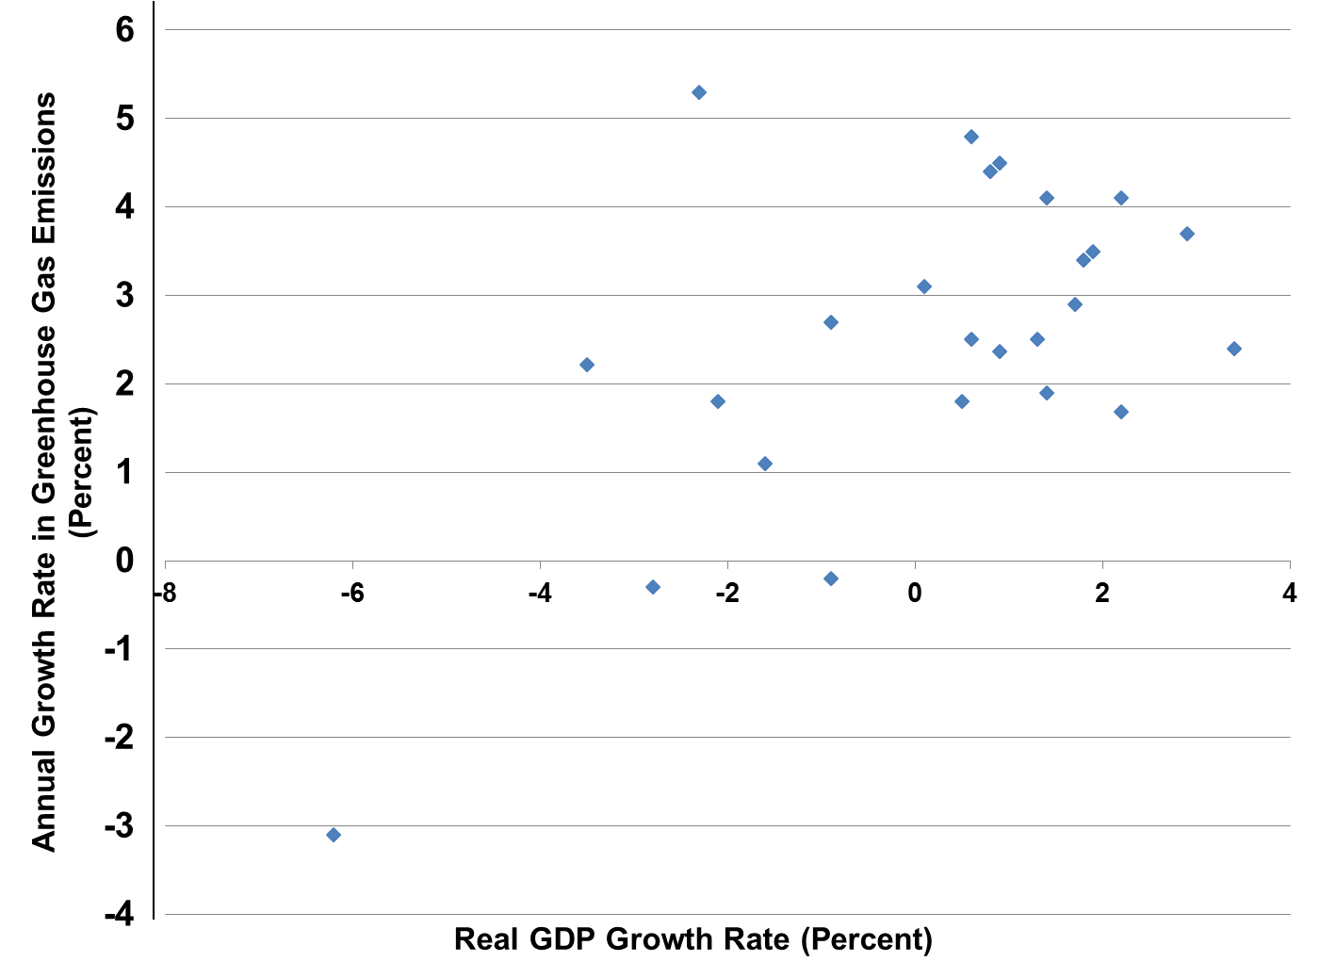
Figure 2.3 Relationship between GDP Growth Rate and Greenhouse Gas Emissions Growth Rate, United States, 1991-2015

Slide 6
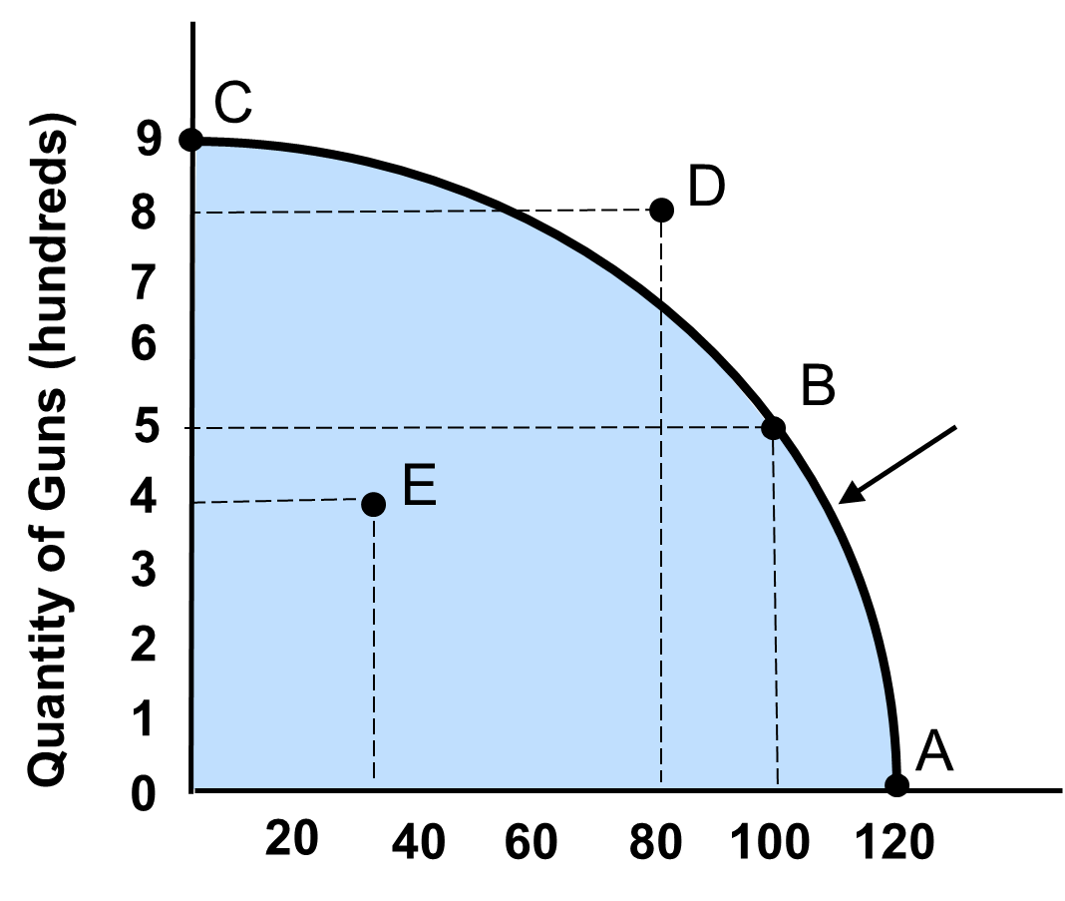
Figure 2.4 Society’s Production-Possibilities Frontier

Slide 7
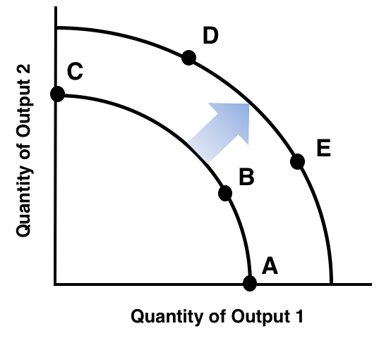
Figure 2.5 An Expanded Production-Possibilities Frontier

Slide 8
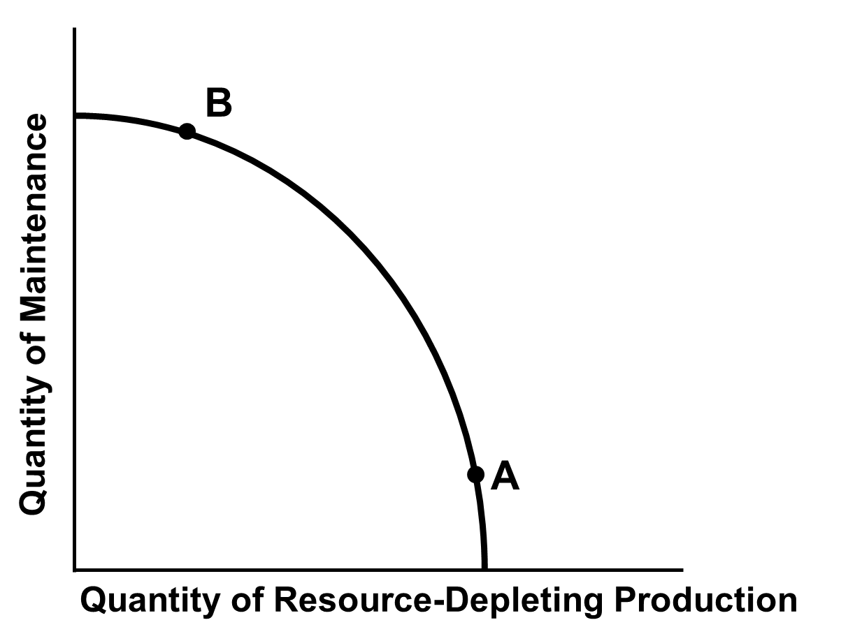
Figure 2.6 Society’s Choice between Current Production and Future Resource Availability

Slide 9
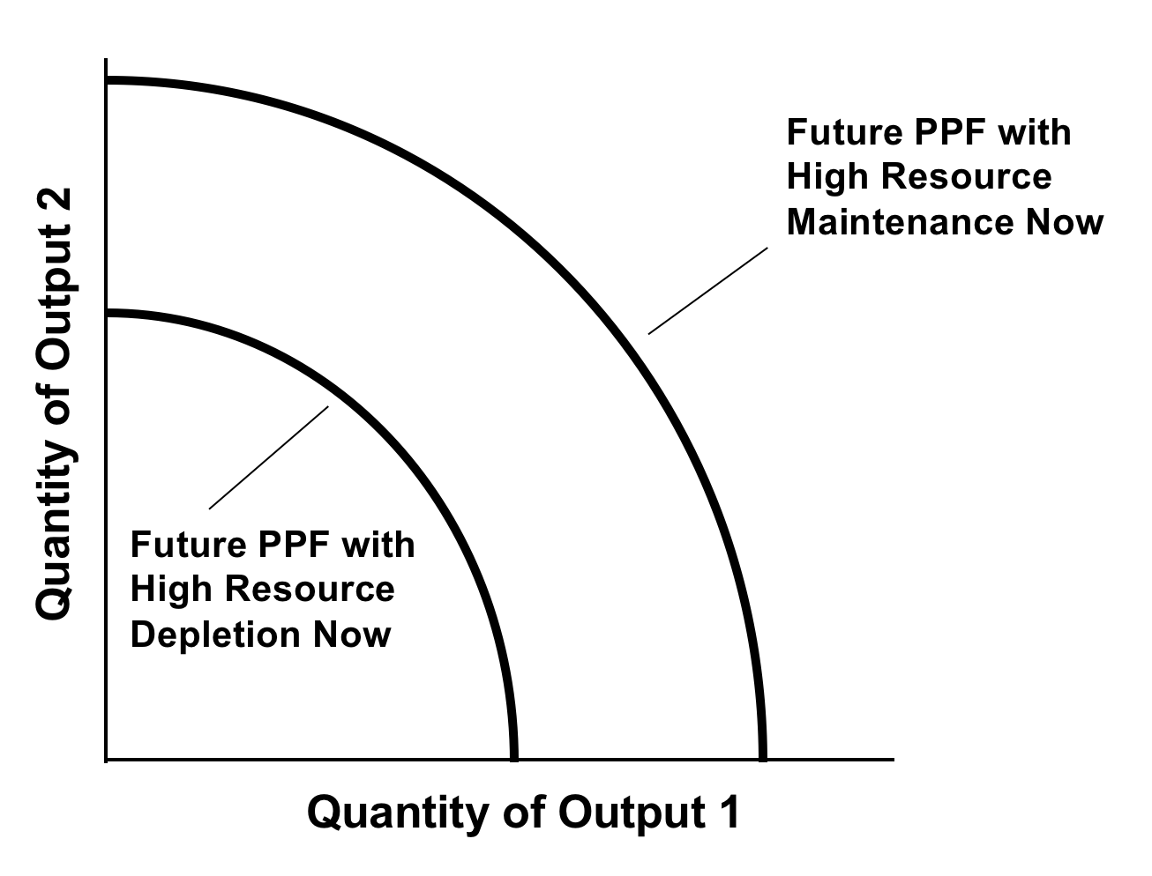
Figure 2.7 Potential Future Production-Possibilities Frontier

Slide 10
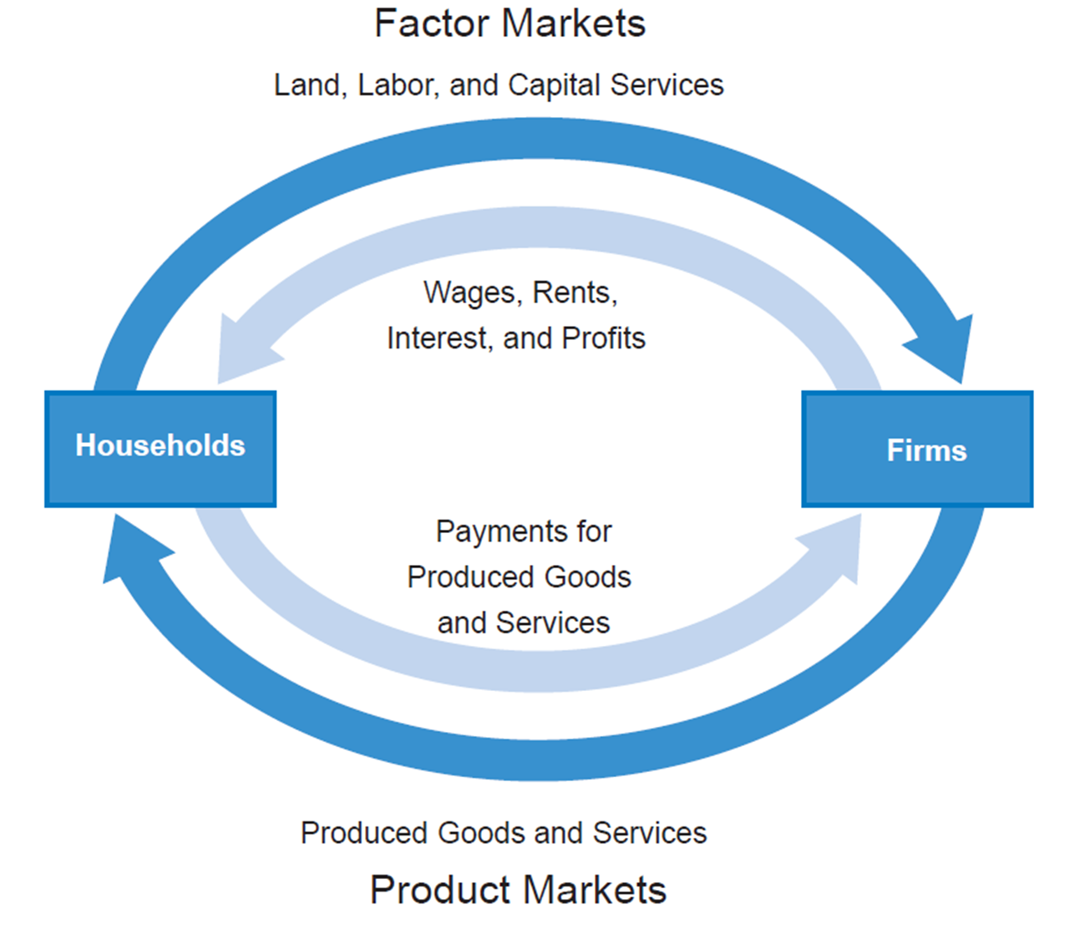
Figure 2.8 The Circular Flow Diagram for the Basic Neoclassical Model

Slide 11
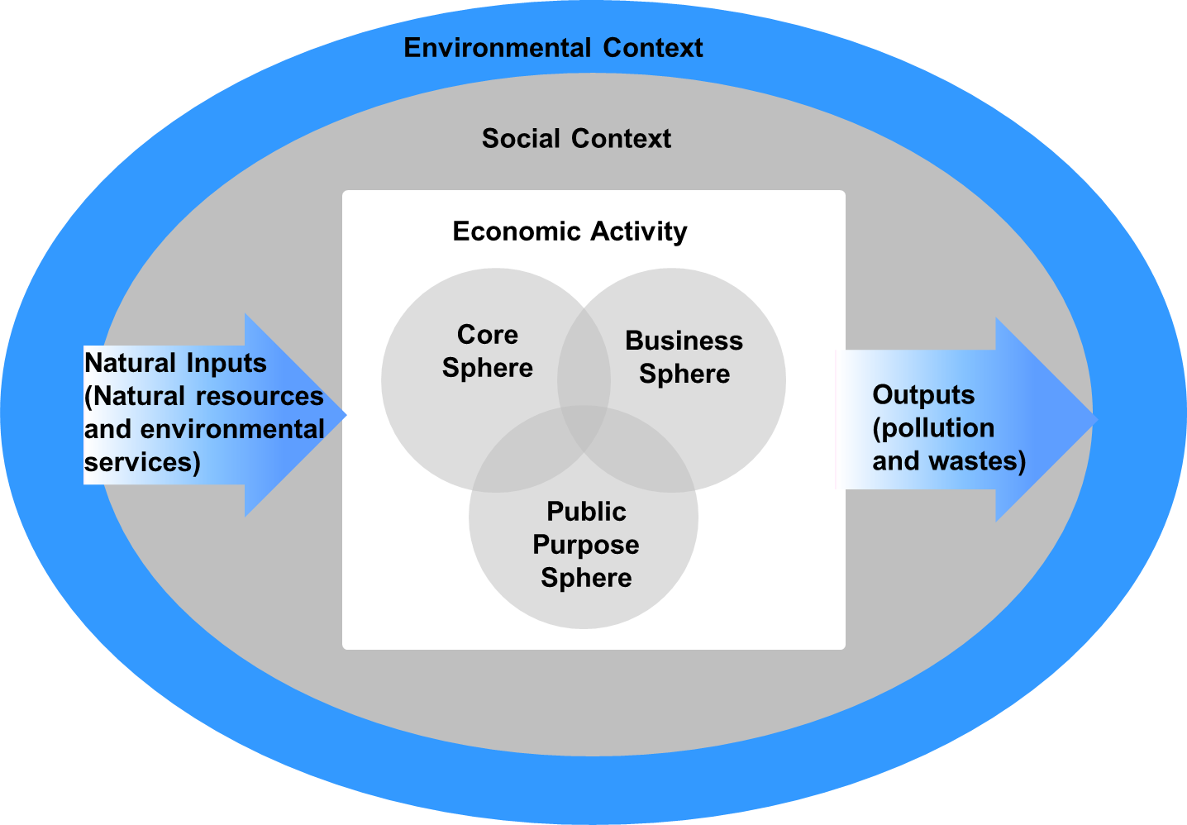
Figure 2.9 Social and Environmental Contexts of Economic Activity

Slide 12
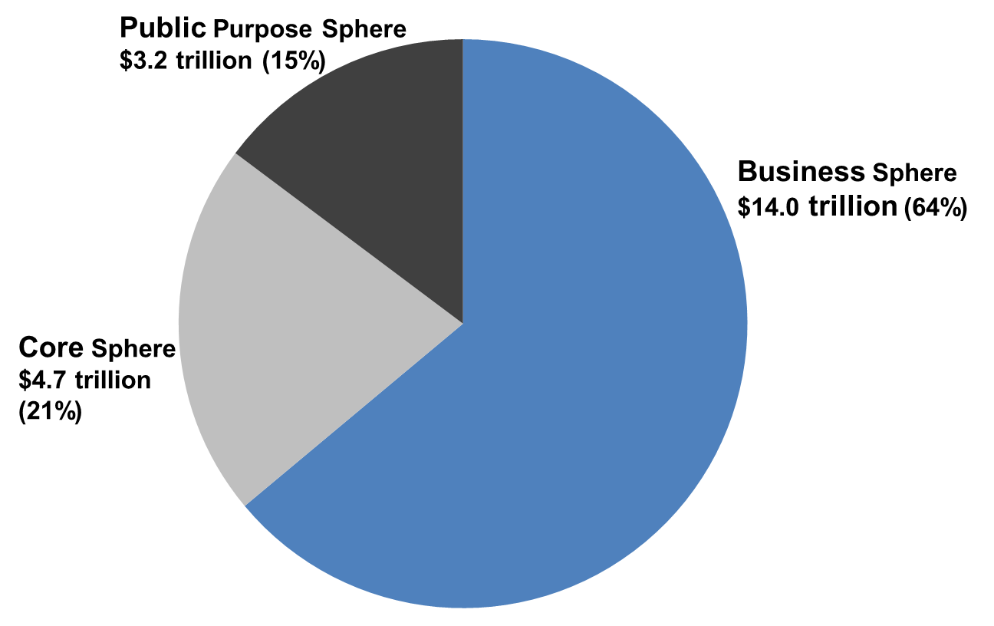
Figure 2.10 Estimates of the Size of the Three Spheres in the United States, 2016
Sources: U.S. Bureau of Economic Analysis, GDP and Personal Income database, and authors’ calculations.

Slide 13
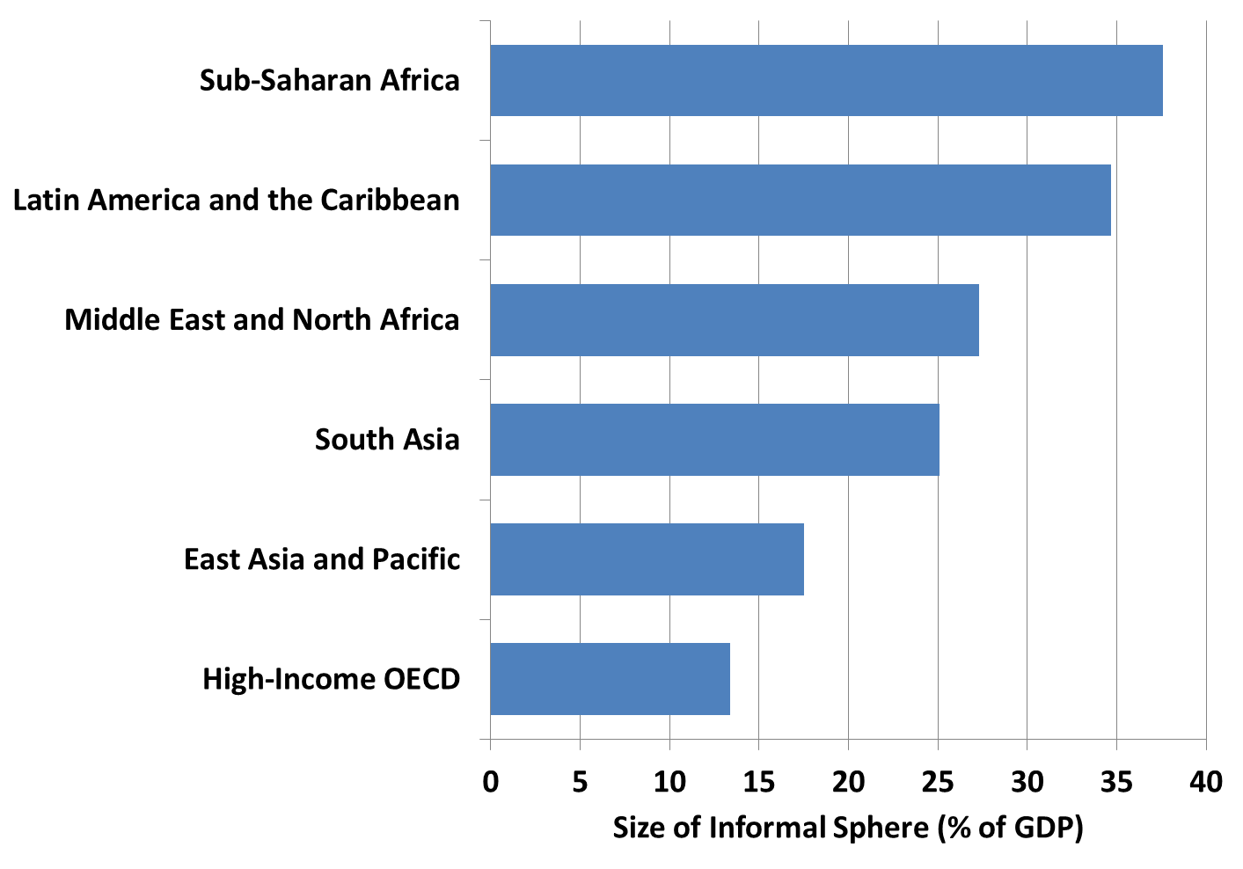
Figure 2.11 The Average Size of Information Sphere, Percent of GDP, by World Region
Source: Schneider and Williams, 2013, Table 7.

