Slide 1

Chapter 15
Financial Instability and Economic Inequality

Slide 2
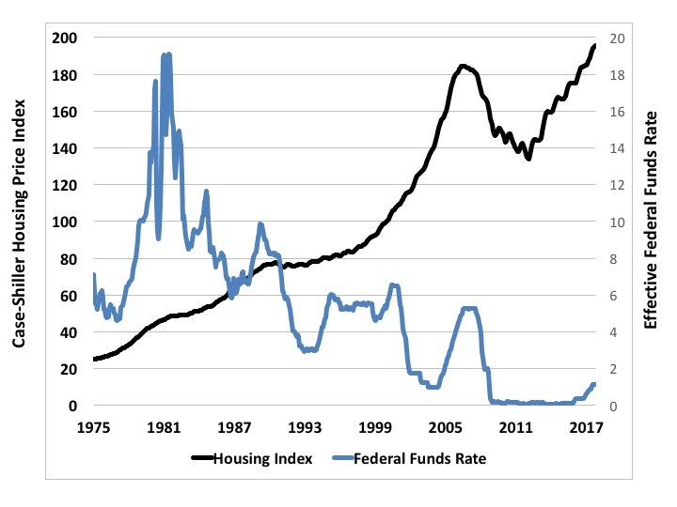
Figure 15.1 Housing Bubble and Credit Access, 1975-2017
Sources: Federal Reserve; Shiller dataset www.econ.yale.edu/~shiller/data.htm.

Slide 3
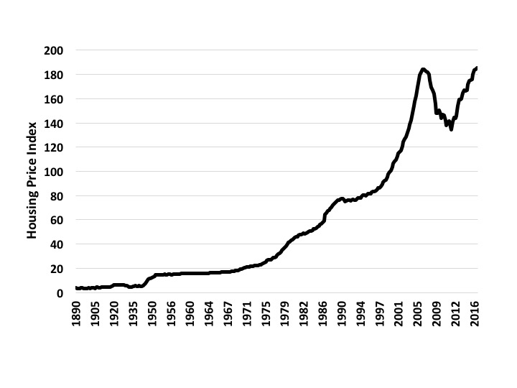
Figure 15.2 Historical Housing Prices, 1890-2016
Source: Shiller dataset.

Slide 4
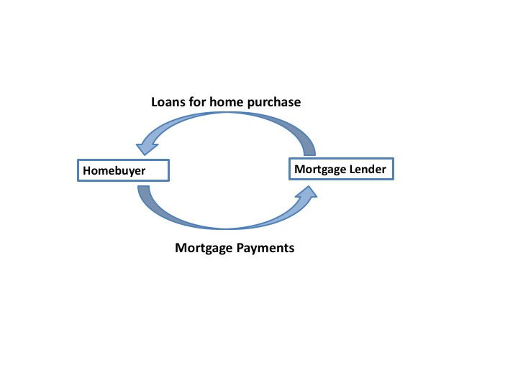
Figure 15.3a Traditional Mortgage Lending Structure

Slide 5
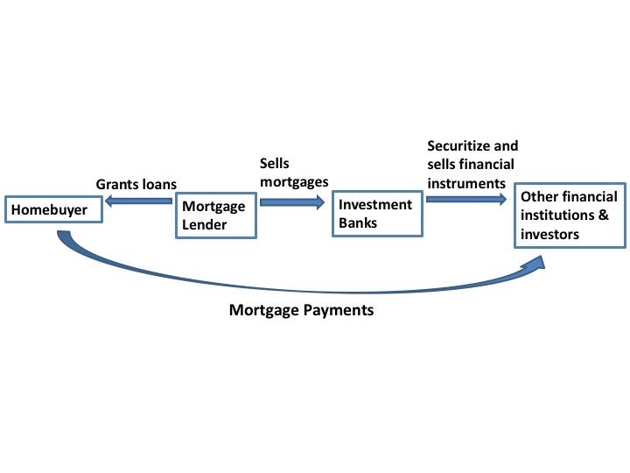
Figure 15.3b Basic Structure of Securitized Mortgage Lending System

Slide 6
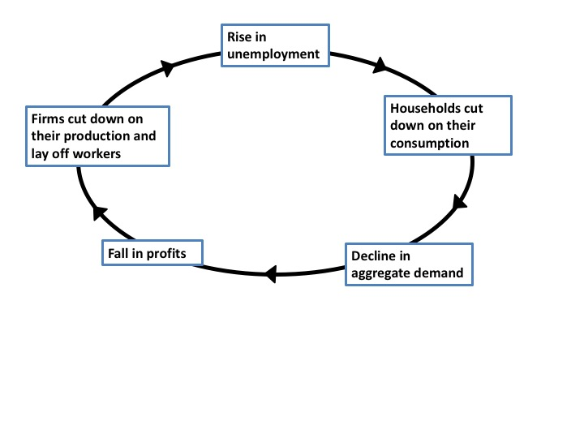
Figure 15.4 Vicious Cycle of Unemployment

Slide 7
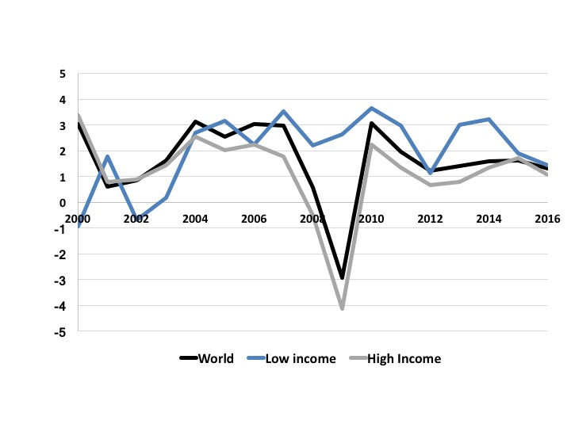
Figure 15.5 GDP Per Capita Growth Rates, 2000-2016
Source: World Development Indicators, World Bank.

Slide 8
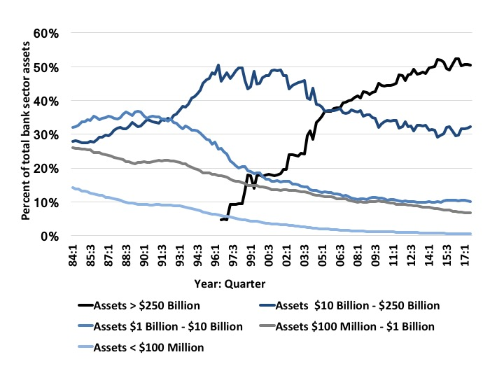
Figure 15.6 Increasing Bank Size, 1984-2017
Source: Federal Deposit Insurance Corporation.

Slide 9
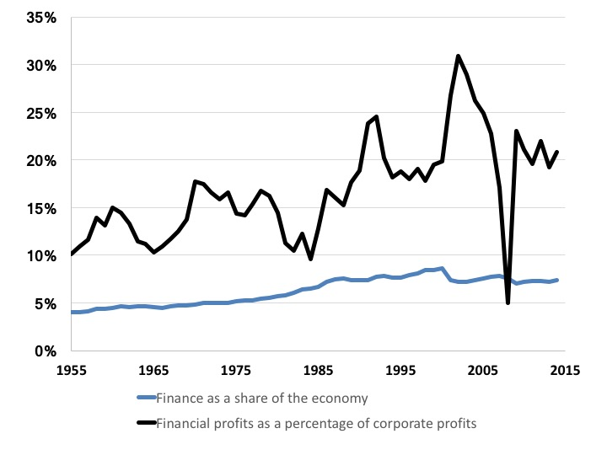
Figure 15.7 Finance as a Share of the Economy and Financial Profits as a Percentage of Corporate Profits, 1955-2015
Source: NIPA Tables 6.2A-6.2D, and Piketty, Saez, and Zucman’s Distributional National Accounts, Appendix tables II: Distributional series.

Slide 10
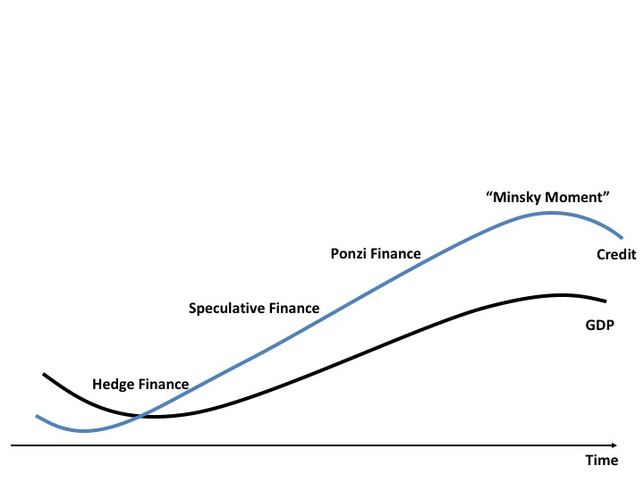
Figure 15.8 Minsky’s Financial Instability Hypothesis

Slide 11
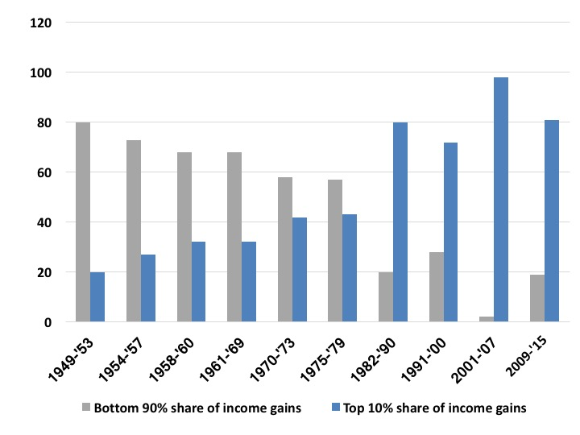
Figure 15.9 Income Gains during U.S. Expansions for the Richest 10% and the Bottom 90%
Source: Tcherneva, 2017, based on data from Thomas Piketty, Emmanuel Saez, and the National Bureau of Economic Research (NBER).

Slide 12
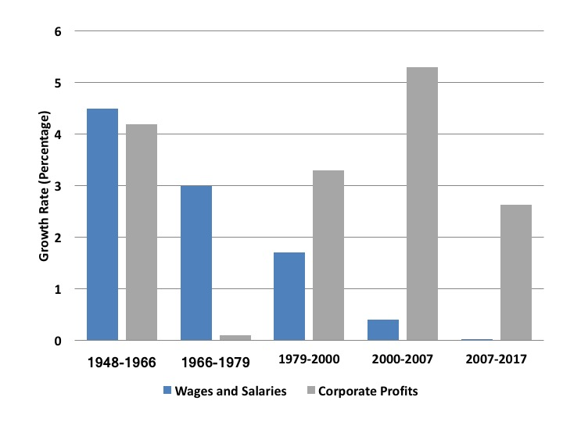
Figure 15.10 Annual Growth Rates of Wages and Salaries and Corporate Profit, 1948-2017
Source: U.S. Bureau of Economic Analysis (2017), NIPA Table 1.14, 1.1.4; Bureau of Labor Statistics (2017).

Slide 13
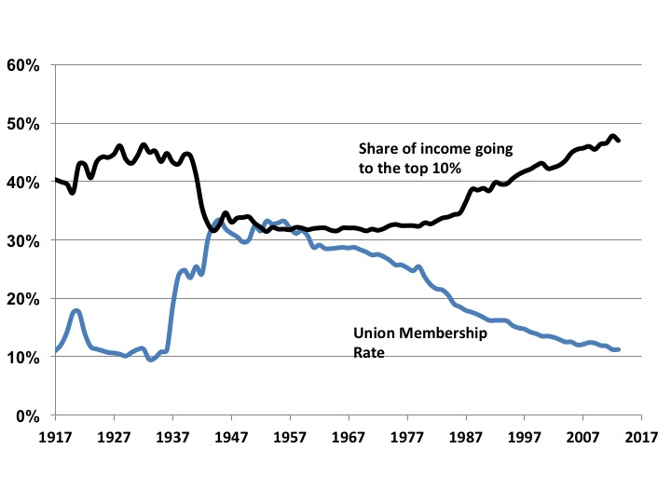
Figure 15.11 Union Membership and Income Inequality, 1917-2017

Slide 14
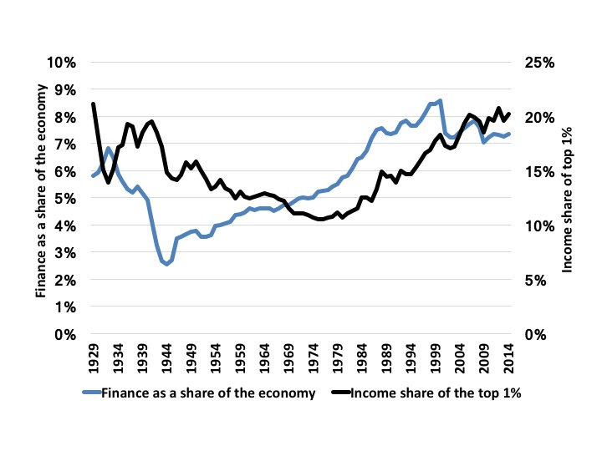
Figure 15.12 Financializing and Inequality, 1929-2014
Source: NIPA Tables 6.2A-6.2D, BEA; Piketty, Saez and Zucman, 2016.

Slide 15
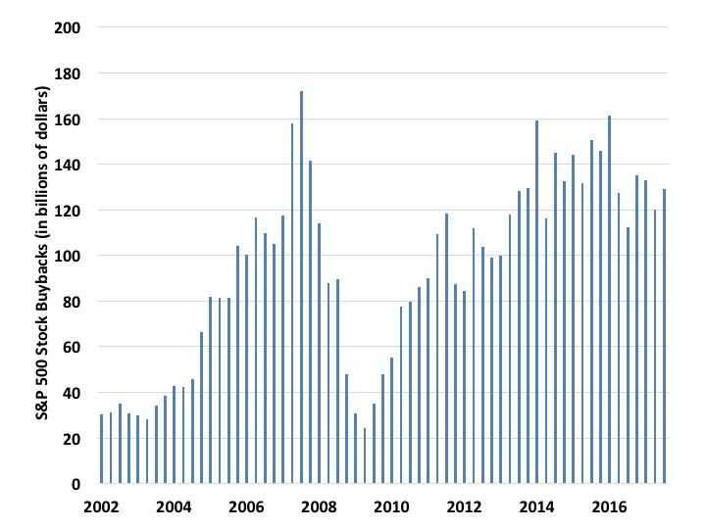
Figure 15.13 S&P 500 Stock Buybacks, 2002-2017 (Quarterly Data)
Source: Quarterly Press Releases of the S&P 500 Dow Jones.

Slide 16
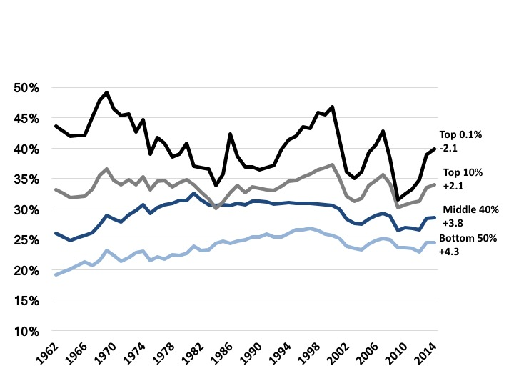
Figure 15.14 Change in Tax Rates by Income Group, 1962-2014
Source: Piketty, Saez and Zucman, 2016.

