Slide 1

Chapter 13
Aggregate Supply, Aggregate Demand, and Inflation: Putting It All Together

Slide 2
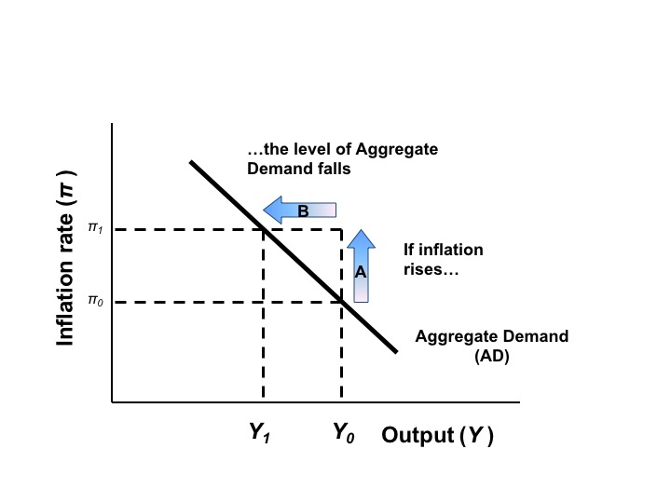
Figure 13.1 The Aggregate Demand Curve

Slide 3
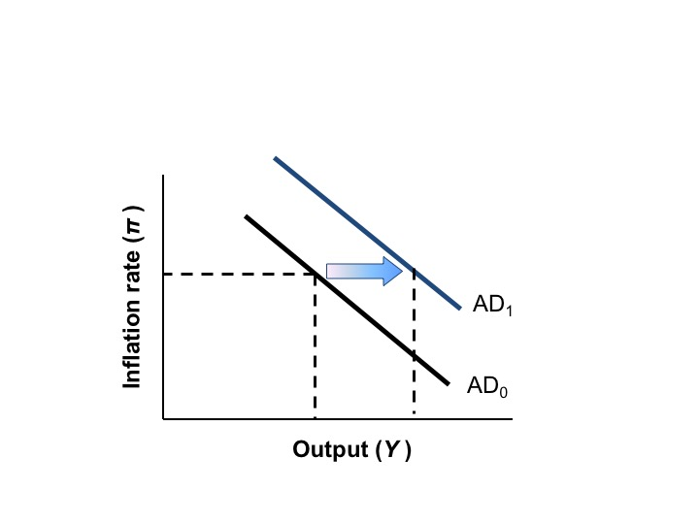
Figure 13.2 The Effect of Expansionary Fiscal Policy or Increase Confidence on the AD Curve

Slide 4
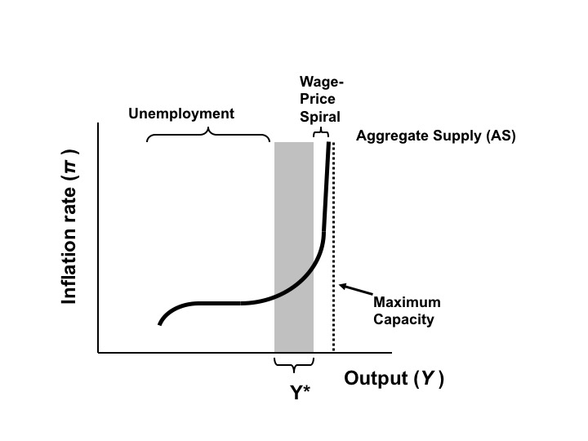
Figure 13.3 The Aggregate Supply Curve

Slide 5
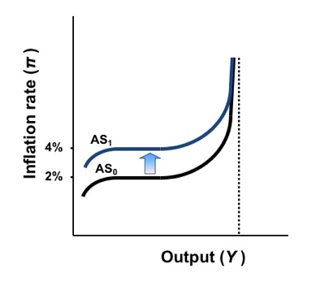
Figure 13.4 The Effect of an Increase in Inflationary Expectations on the Aggregate Supply Curve

Slide 6
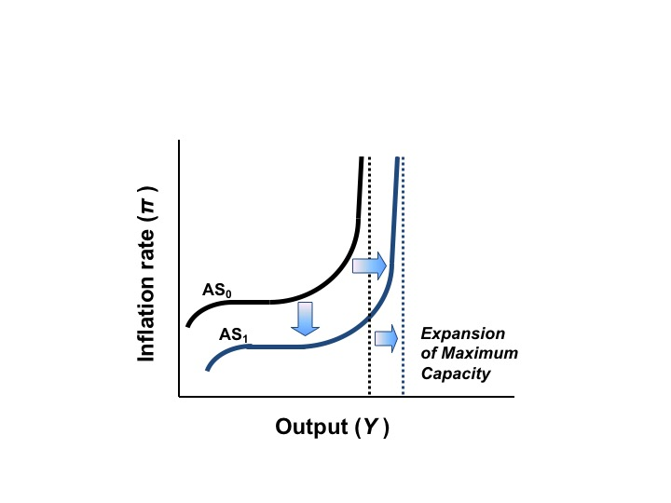
Figure 13.5 A Beneficial Supply Shock: Expansion of Output Capacity

Slide 7
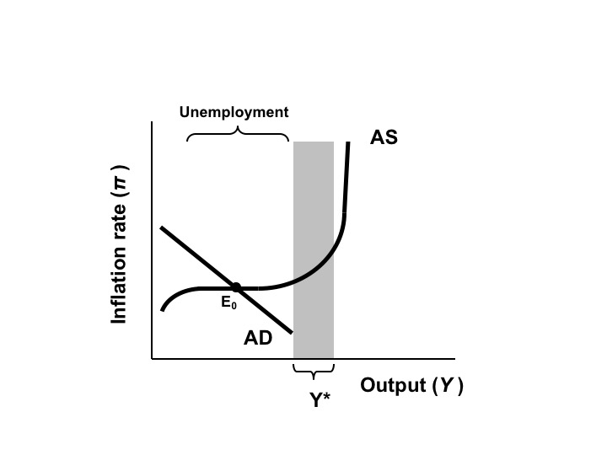
Figure 13.6 Aggregate Demand and Supply Equilibrium in Recession

Slide 8
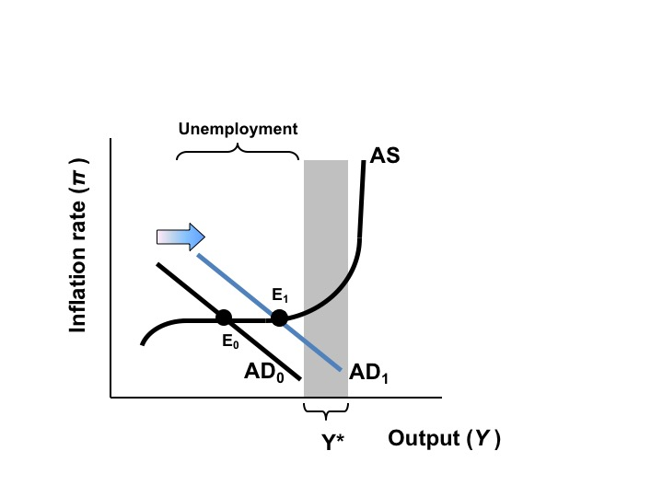
Figure 13.7 Expansionary Fiscal Policy in Response to a Recession

Slide 9
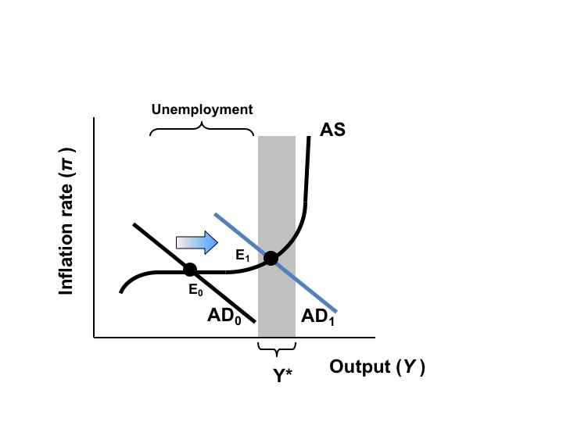
Figure 13.8 A Greater Expansion of Aggregate Demand

Slide 10
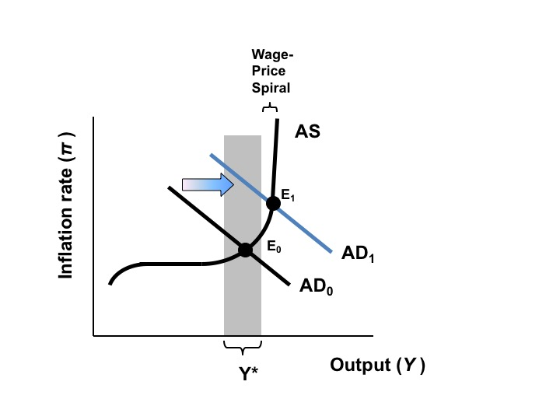
Figure 13.9 Excessively High Aggregate Demand Causes Inflation

Slide 11
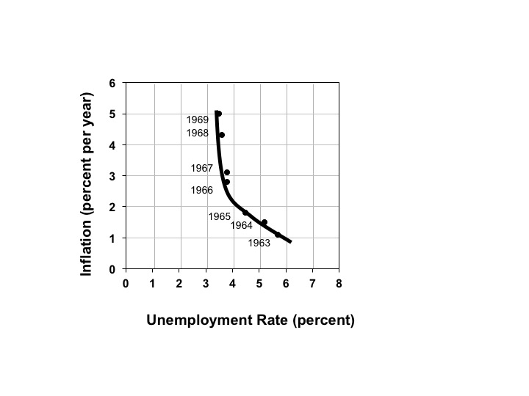
Figure 13.10 The Phillips Curve in the 1960s

Slide 12
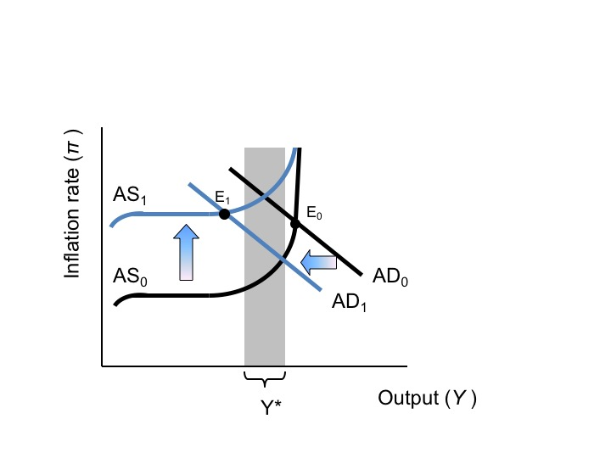
Figure 13.11 Rising Inflationary Expectations and Contractionary Fiscal Policy

Slide 13
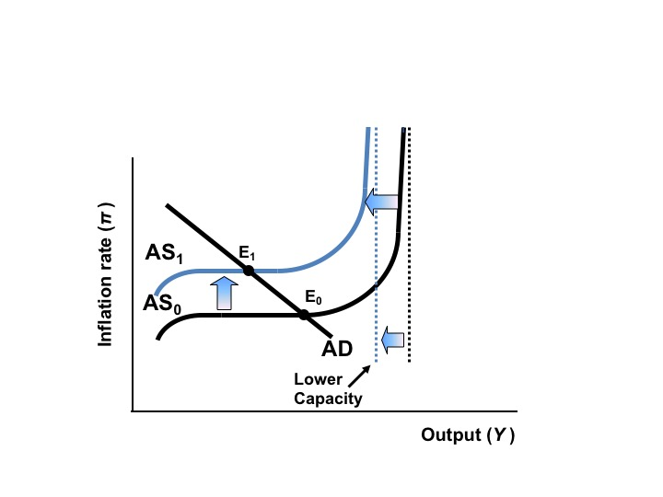
Figure 13.12 The Effect of the Oil Price Shock of the 1970s

Slide 14
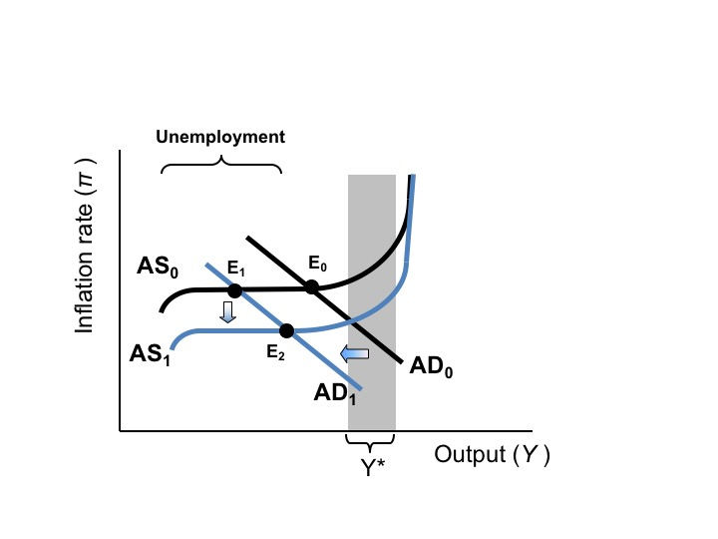
Figure 13.13 The Effects of the Fed’s “Tight Money” Policy in the 1980s

Slide 15
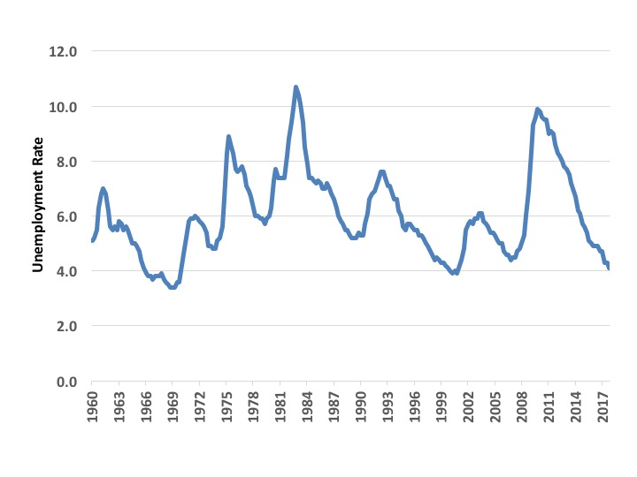
Figure 13.14 Unemployment Trends 1960-2017 (Percentage of Labor Force)
Source: Bureau of Labor Statistics, Current Population Survey, 2018.

Slide 16
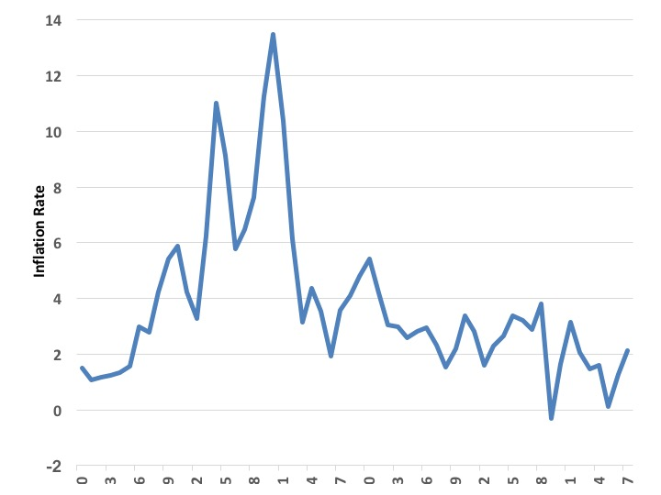
Figure 13.15 Inflation Trends 1960-2017 (Annual Percentage Inflation)
Source: Bureau of Labor Statistics, Consumer Price Index (CPI-U), 2018.

Slide 17
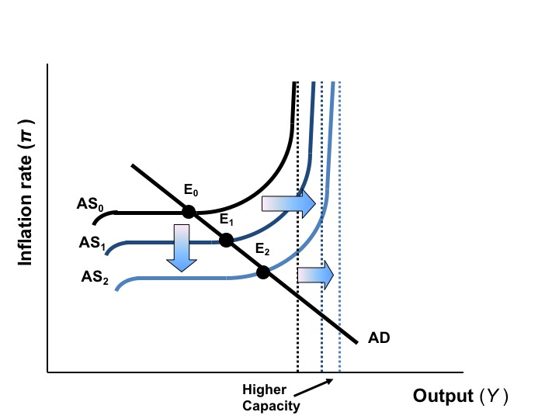
Figure 13.16 The Effects of Technological Innovation and Increased Efficiency

Slide 18
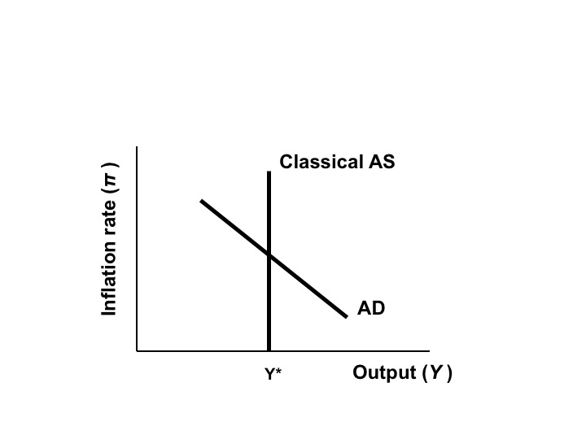
Figure 13.17 The Classical View of AS/AD

Slide 19
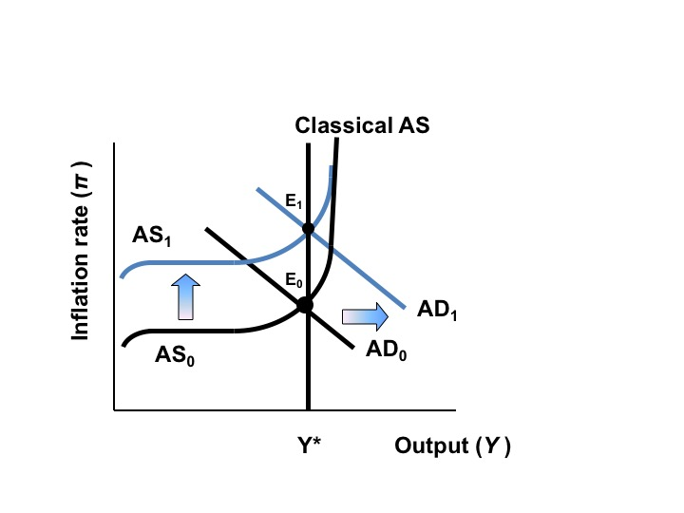
Figure 13.18 A New Classical View of Economic Fluctuations

