Slide 1

Chapter 12
The Federal Reserve and Monetary Policy

Slide 2
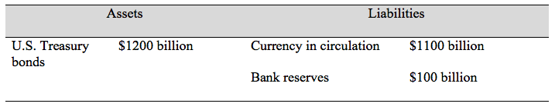
Table 12.1 A Simplified Balance Sheet of the Federal Reserve

Slide 3
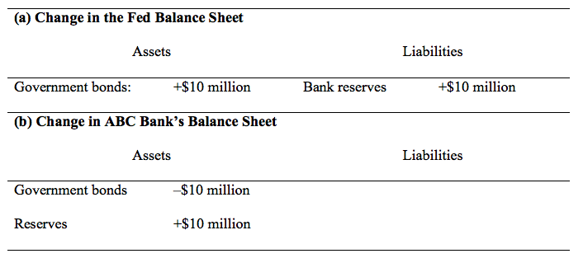
Table 12.2 An Open Market Purchase of Government Bonds by the Fed

Slide 4
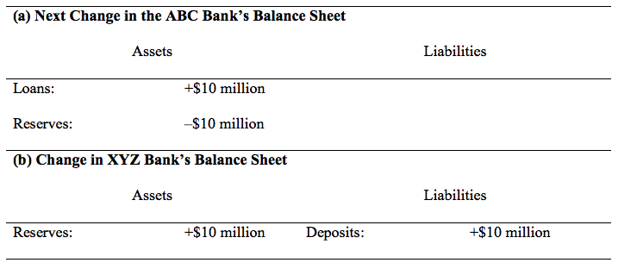
Table 12.3 A Loan by ABC Bank Becomes a Deposit in XYZ Bank

Slide 5
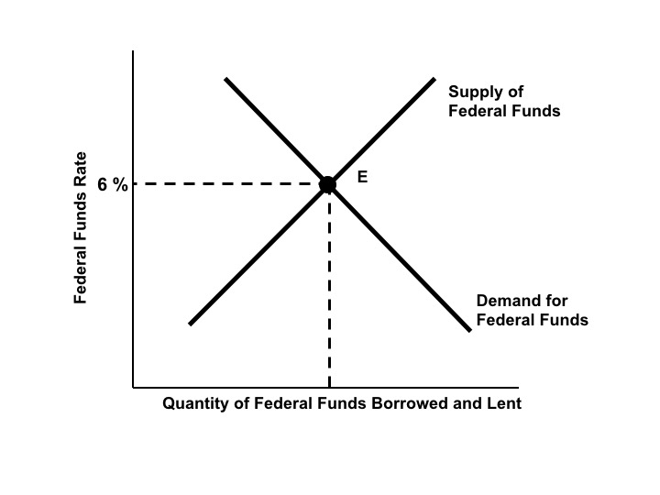
Figure 12.1a The Market for Federal Funds

Slide 6
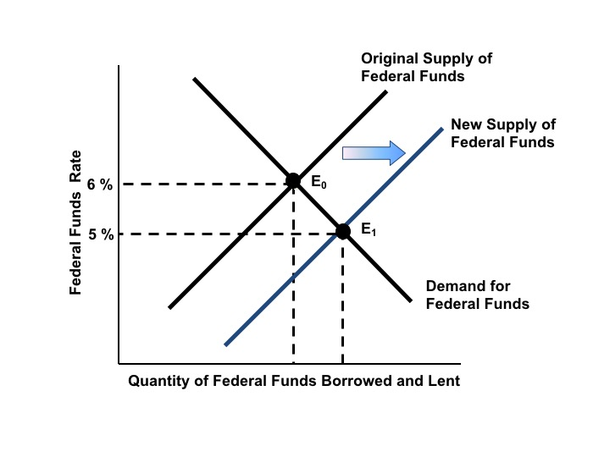
Figure 12.1b An Open Market Purchase Lowers the Federal Funds Rate

Slide 7
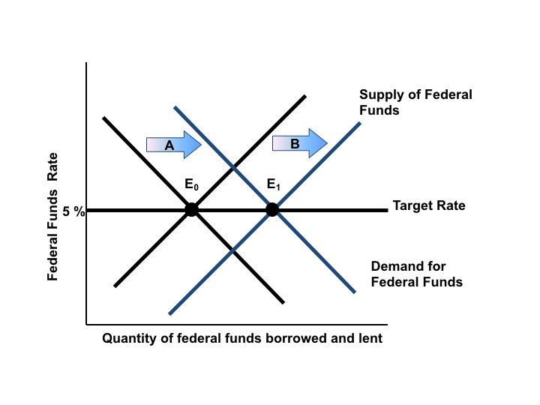
Figure 12.2 Maintaining the Federal Funds Target Rate

Slide 8
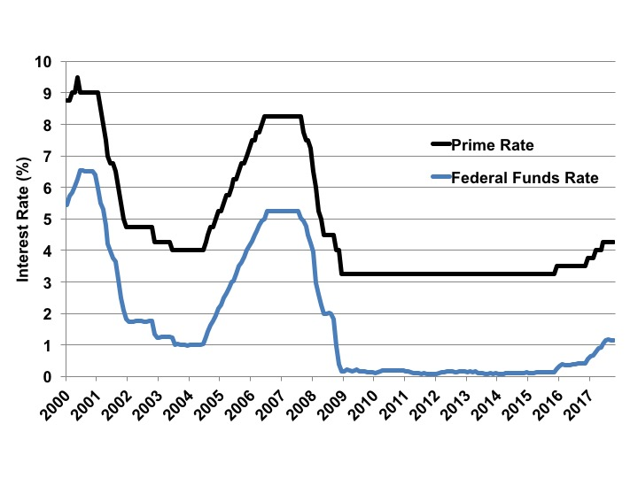
Figure 12.3 The Federal Fund and Prime Rates, 2000-2017
Source: Federal Reserve Board, Monthly data.

Slide 9
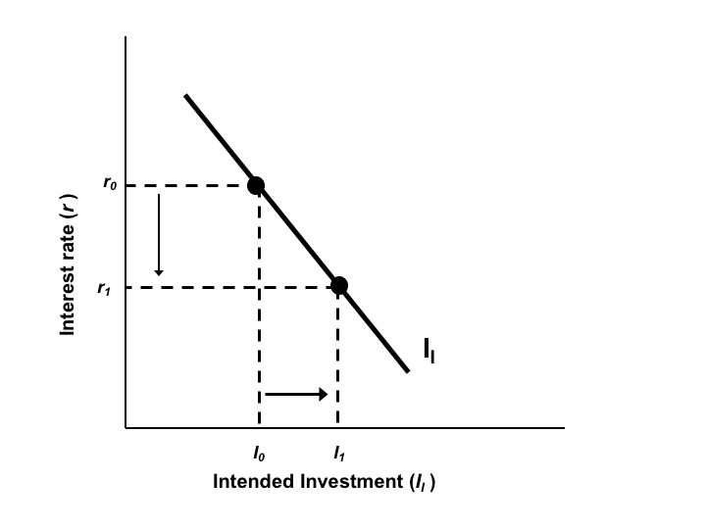
Figure 12.4 The Intended Investment Schedule

Slide 10
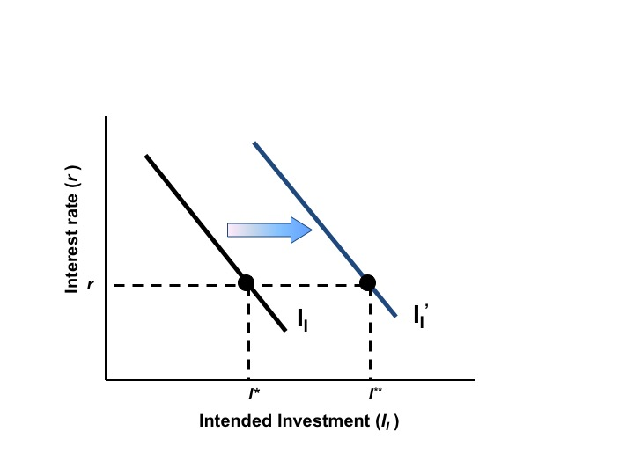
Figure 12.5 An Increase in Investor Confidence

Slide 11
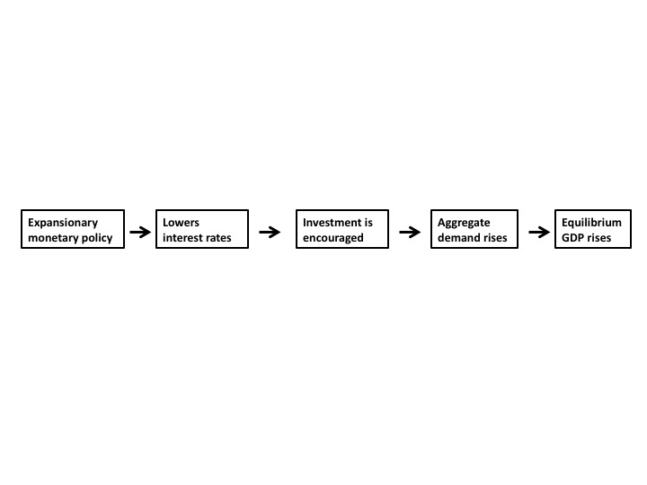
Diagram 12.1

Slide 12
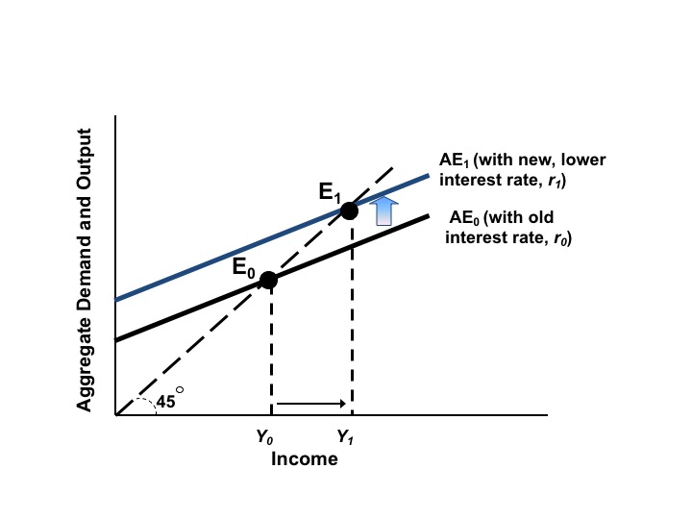
Figure 12.6 Expansionary Monetary Policy and the AE Curve

Slide 13
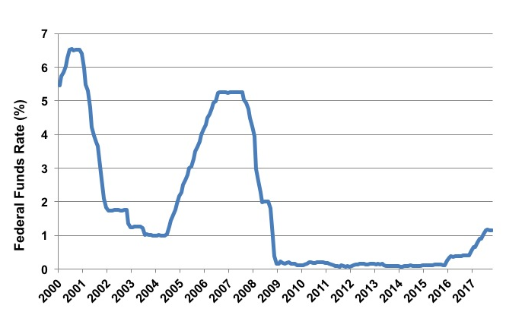
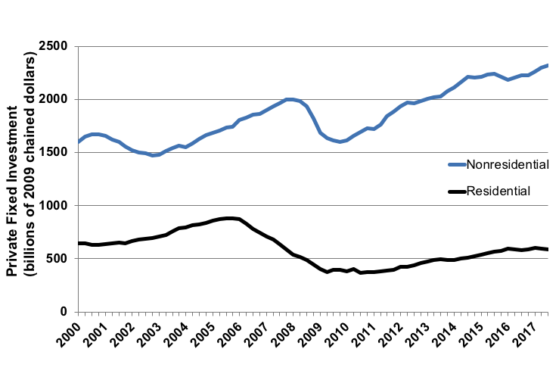
Figure 12.7 Monetary Policy and Investment, 2000-2017
Source: Federal Reserve and Bureau of Economic Analysis, 2017.

Slide 14
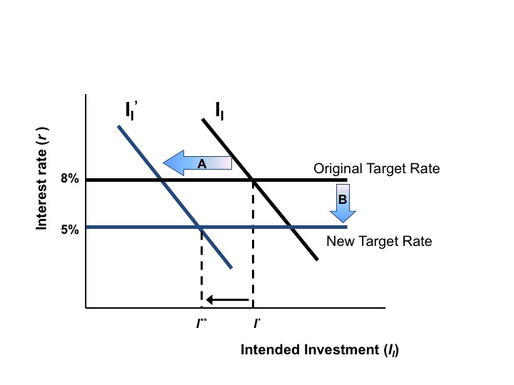
Figure 12.8 Expansionary Monetary Policy in an Environment of Pessimism

Slide 15
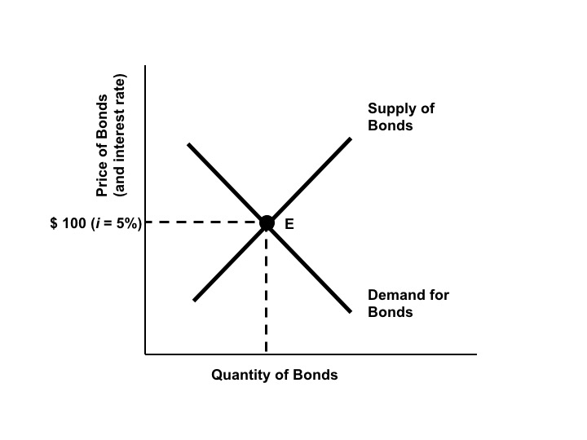
Figure 12.9a The Market for Government Bonds

Slide 16
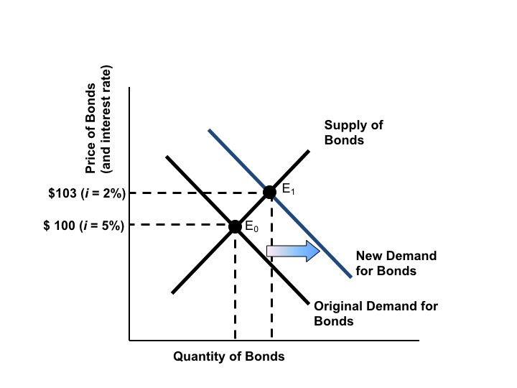
Figure 12.9b The Market for Government Bonds

Slide 17
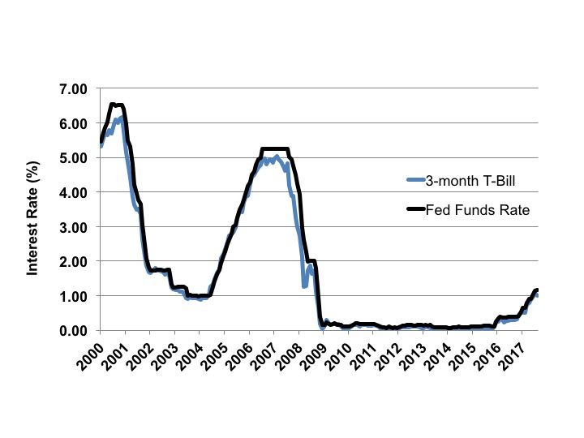
Figure 12.10 The Federal Funds and Three-Month Treasury Bill Rates, 2000-2017
Source: Federal Reserve Board, monthly data.

Slide 18
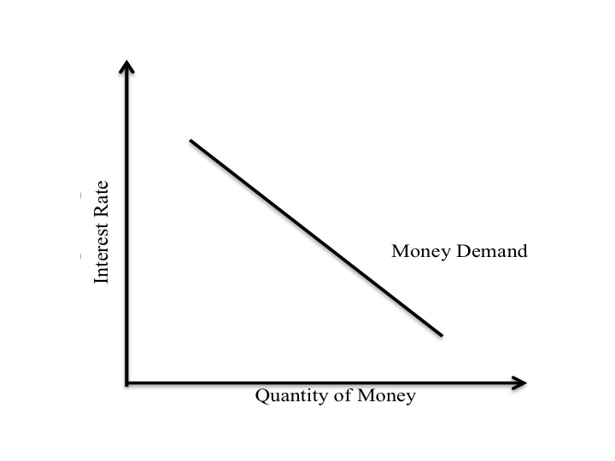
Figure 12.11 The Demand Curve for Money

Slide 19
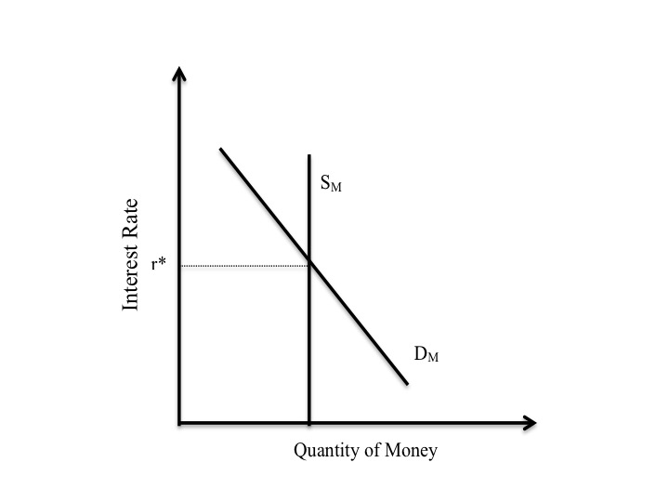
Figure 12.12 The Supply Curve for Money

Slide 20
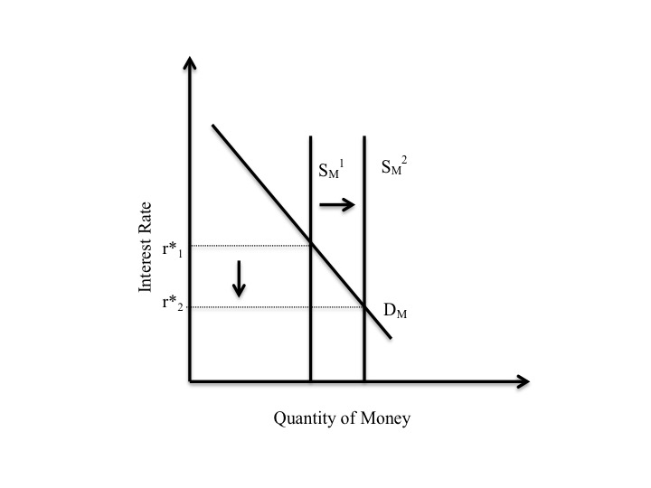
Figure 12.13 An Increase in the Supply of Money

