Slide 1

Chapter 11
Money, Banking, and Finance

Slide 2
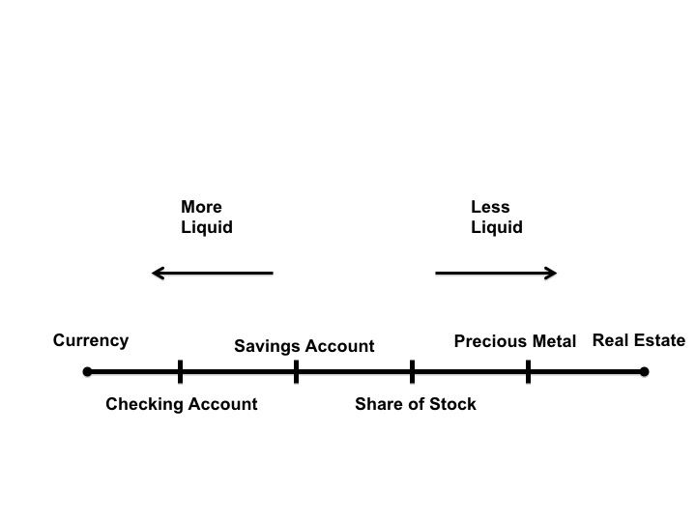
Figure 11.1 The Liquidity Continuum

Slide 3
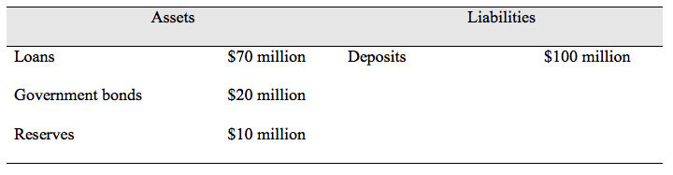
Table 11.1 A Simplified Balance Sheet of a Commercial Bank

Slide 4
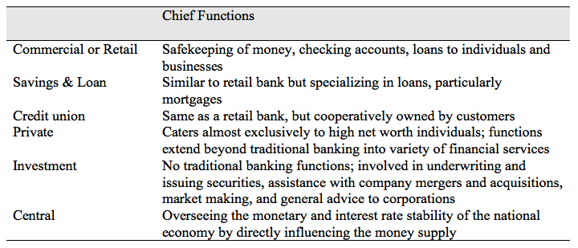
Table 11.2 Bank Types

