Slide 1

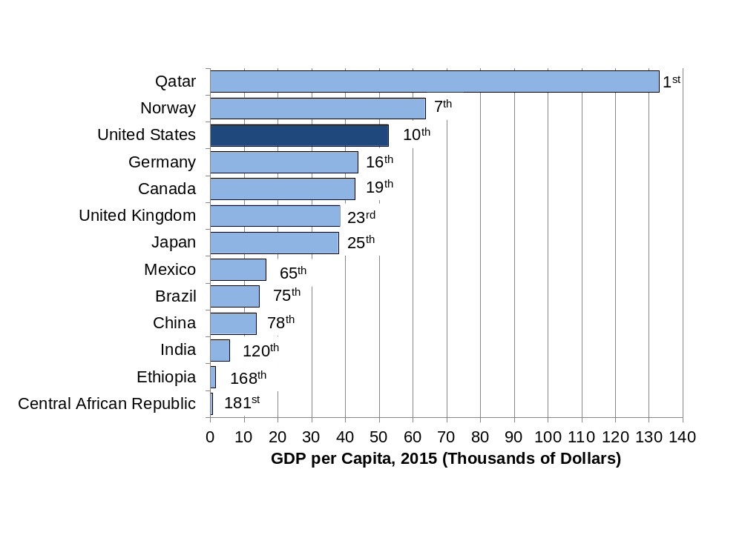
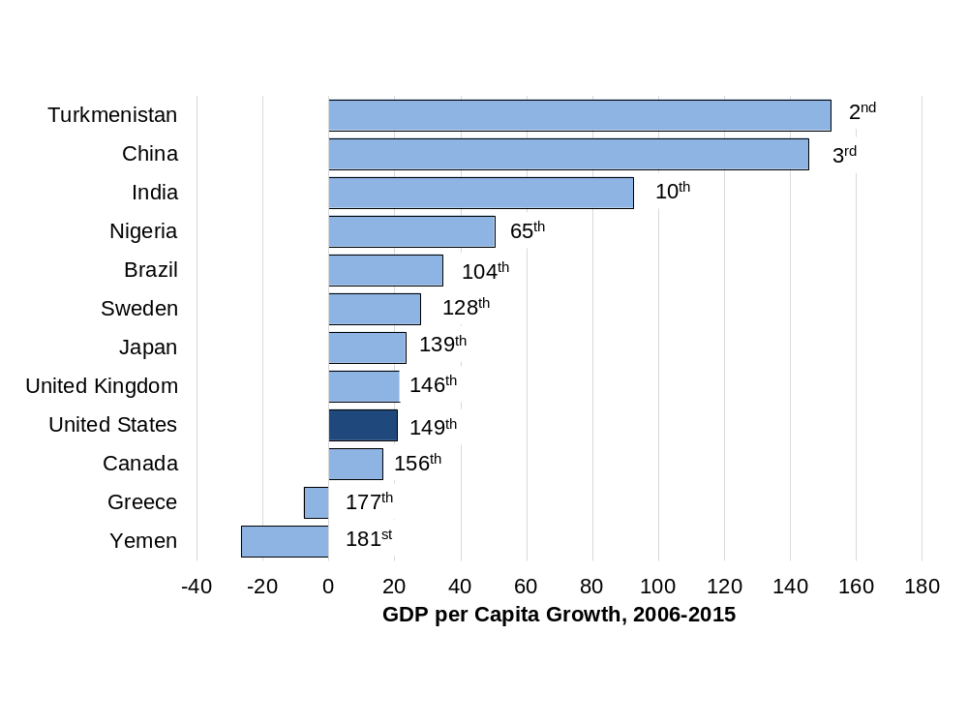

Slide 2
Figure 0.1 GDP per Capita, 2015 (Thousands of dollars)
Source: World Bank, World Development Indicators database.
Data are adjusted for purchasing power differences across countries (e.g., a dollar in India buys more than a dollar in the United States).
Notes:
What it is: Media stories of economic performance frequently refer to gross
domestic product (GDP). A country’s GDP per capita measures economic
production per person per year, which gives us an idea of the
average material living standards in the country. While GDP is perhaps
the most commonly used macroeconomic metric, it does not necessarily
measure well-being. We discuss how GDP is calculated in Chapter
5 and about the limitations of, and alternatives to, GDP in Chapter 6.
The results: The United States ranks tenth, with a GDP per capita of around
US$52,000. Qatar has the world’s highest GDP per capita at around
US$133,000, with the country’s economy driven by its oil and gas
sectors. The Central African Republic has the lowest GDP per capita,
at only US$580.

Slide 3
Figure 0.2 Growth in GDP per Capita, 2006 – 2015 (Percent)
Source: World Bank, World Development Indicators database.
Data are adjusted for purchasing power differences.
Notes:
What it is: In macroeconomics, we seek to explain not only why some countries
have a higher GDP per capita but also what conditions lead to strong
GDP growth rates. In this graph we compare the growth in GDP per
capita, after adjusting for inflation, across countries over the ten-year
period 2006–2015. We discuss measuring GDP growth rates in Chapter
5 and theories of GDP growth in Chapter 17.
The results: GDP per capita grew rapidly from 2006 to 2015 in some countries,
slowly in others, and even declined in several countries. The highest
growth in GDP per capita (excluding some tiny countries with
exceptional circumstances) occurred in Turkmenistan, primarily from
oil and gas development, with high growth also in China, Myanmar,
Ethiopia, and India. The fastest growth among developed countries
took place in Ireland as it recovered from a severe recession in 2007–
8. Countries with declines in GDP per capita include Yemen, Central
African Republic, United Arab Emirates, Kuwait, Greece, Brunei, and
the Bahamas.

Slide 4
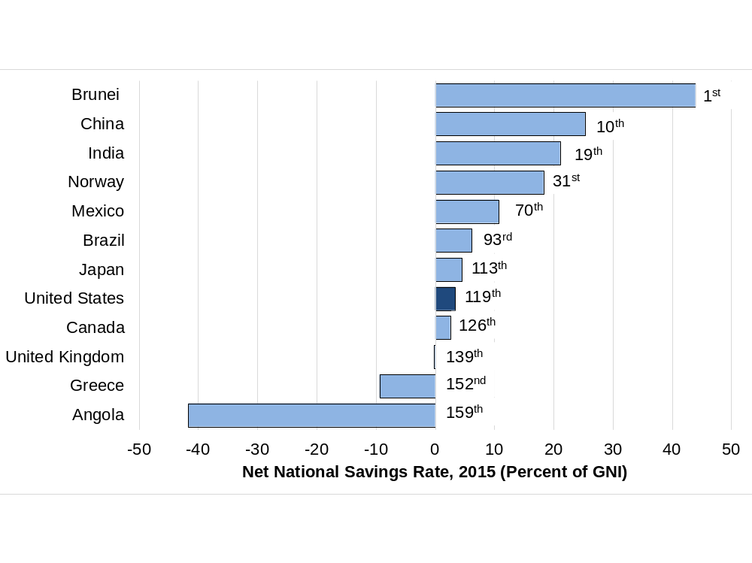
Figure 0.3 Net National Savings Rate, 2015 (Percent of GNI)
Source: World Bank, World Development Indicators database.
GNI is gross national income, a measure similar to gross domestic product, but including income from residents abroad and excluding income earned by foreigners within the country. GNI is also sometimes referred to as Gross National Product (GNP).
Notes:
What it is: How much a country saves and invests is widely considered an important
factor in explaining differences in GDP growth rates. Here we
present data on net national savings rates, which equal total national
savings minus the depreciation of productive capital such as factories
and machinery. A negative net national savings rate implies that a
country’s productive capacity is declining. We discuss saving, investment,
and growth in detail in Chapter 17.
The results: In 2015, Brunei—another country with oil and gas as major sources of
national income—had the highest net national saving rate. Other countries
with high savings rates include Singapore, Qatar, Philippines, and
China. Twenty-one countries (among those with data) had a negative
net savings rate in 2015, including the United Kingdom, Portugal, and
Greece.

Slide 5
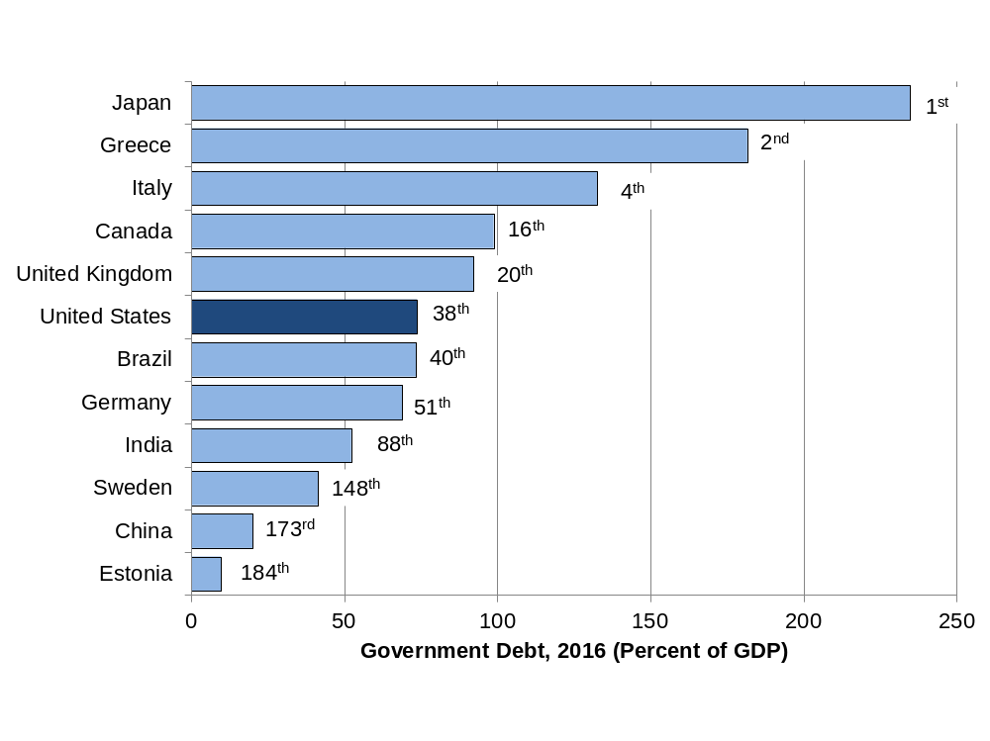
Figure 0.4 Government Debt (Percent of GDP)
Source: United States Central Intelligence Agency, CIA World Factbook.
Data are mostly 2016 estimates.
Notes:
What it is: The level of government debt has been a focus of media stories in
recent years. What matters is not so much the size of debt in dollars but
government debt relative to a country’s GDP. This variable portrays
the amount of debt owed by the governments of different countries,
including debts owed to domestic and foreign entities. What level of
debt should be considered a problem? This is a topic we discuss in
more detail in Chapter 16.
The results: In 2016, Japan had the highest government debt in the world, measured
as a percentage of GDP, followed by Greece and Lebanon. The
United States had the thirty-eighth-highest debt, but many other developed
countries had higher debt, including Singapore, Canada, France,
and United Kingdom. Some developing countries, such as Liberia and
Tajikistan, have relatively low government debt.

Slide 6
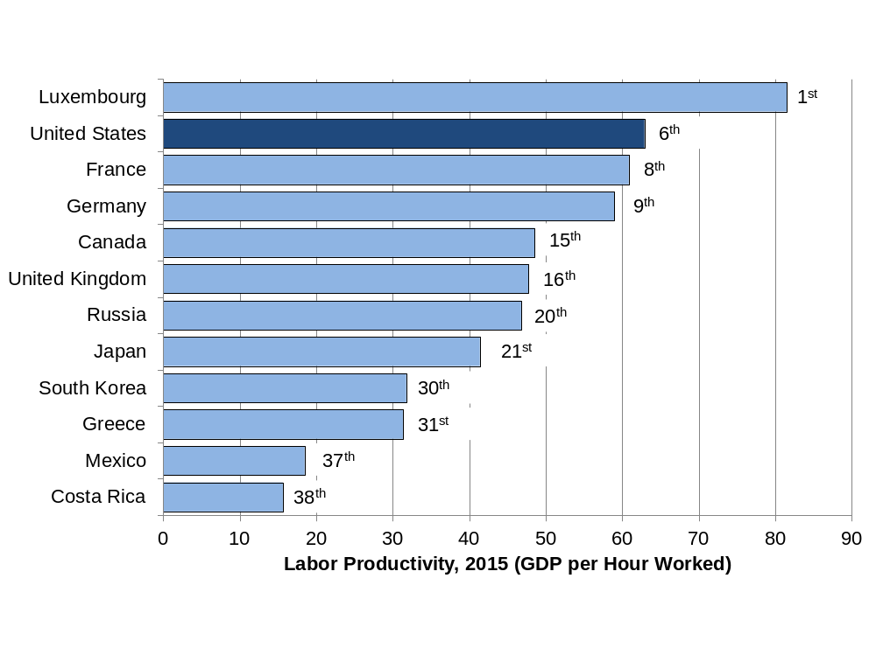
Figure 0.5 Labor Productivity, 2015 (GDP per Hour Worked)
Source: Organisation for Economic Co-operation and Development, OECD online statistical database.
Notes:
What it is: One measure of the economic efficiency of a country is labor productivity.
This is calculated by dividing a country’s GDP by an estimate
of the total number of hours worked. Thus, labor productivity tells us
how many dollars of GDP are generated for each hour worked. We
present more about labor productivity in Chapters 7 and 8.
The results: Data on labor productivity are available for only 38 countries. Luxembourg
has the highest labor productivity in the world. The United
States ranks sixth, behind Norway, Ireland, Belgium and Denmark.
Productivity is slightly lower in France and Germany. Less developed
countries have lower labor productivity. We see that productivity in
Mexico is only about one-third of the U.S. level.

Slide 7
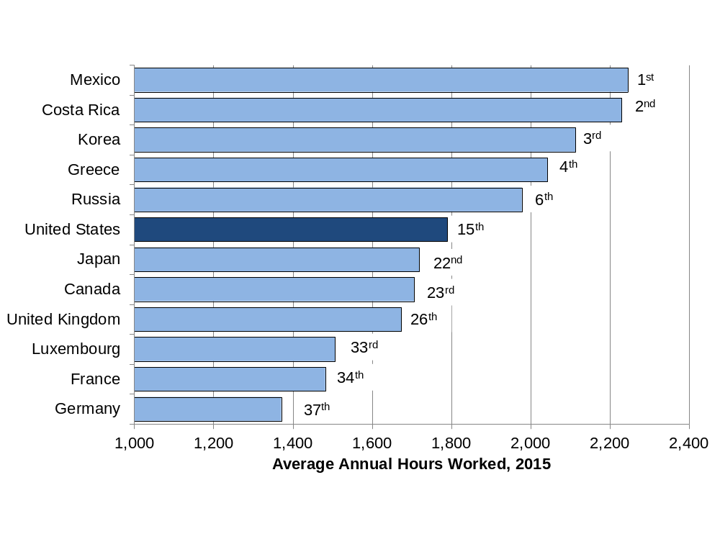
Figure 0.6 Average Annual Hours Worked, 2015
Source: Organisation for Economic Co-operation and Development. OECD online statistical database.
Notes:
What it is: Even if two countries have the same labor productivity, their GDP will
differ if the number of hours worked are different. This graph shows
the average number of hours worked each year per employee. Note
that this includes only hours actually worked; vacations, holidays, and
sick days are excluded. Thus, the average annual hours worked in a
country may be high if work expectations are more stringent and time
off is limited. Work hours may also be high if workers choose to work
long hours and there are very few part-time workers. We discuss work
hours further in Chapter 8.
The results: Data on hours worked are available for only 37 countries. The average
annual hours worked per employee are lowest in Germany. Other
countries with relatively low annual work hours are the Netherlands,
Norway, Denmark, and France. One reason for the relatively low work
hours in these countries is federal laws that mandate minimum vacation
times and paid holidays. In the United States, where such laws do
not exist, average work hours are higher. Work hours tend to be highest
among countries with lower levels of GDP per capita. In 2015, Mexico
had the highest average annual hours worked, followed by Costa Rica
and South Korea.

Slide 8
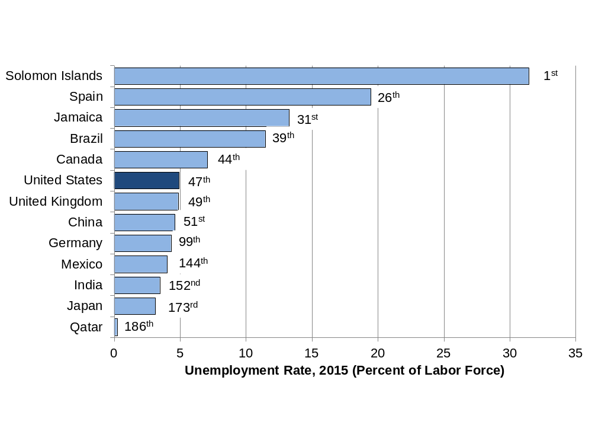
Figure 0.7 Unemployment Rate, 2016 (Percent of Labor Force)
Source: World Bank, World Development Indicators database.
Notes:
What it is: The unemployment rate in a country is an important macroeconomic
metric. Not only does having a job provide a source of income, but it
also provides a sense of identity and contributes to overall well-being.
Estimating the unemployment rate is somewhat complex, and the
method used to measure unemployment rate may differ across countries.
In Chapter 8 we discuss issues involved in estimating the unemployment
rate including defining what it means to be in the workforce.
The results: Unemployment rates vary tremendously across countries and they also
fluctuate a lot over time. In 2016, Qatar had the lowest official unemployment
rate at 0.2 percent and Solomon Islands—a small nation
located in the south Pacific Ocean—had the highest unemployment
rate at about 31 percent. While many poor countries, such as Mozambique,
Swaziland, and Lesotho, have very high unemployment rates
(20 percent or more), other poor countries such as Cuba and Bhutan
have rather low unemployment rates, at around 3 percent. The unemployment
rate in the United States, usually in the range of 4–6%, rose
considerably in the 2007–9 recession, and has since declined slowly to
return to the 4–6% range in late 2015.

Slide 9
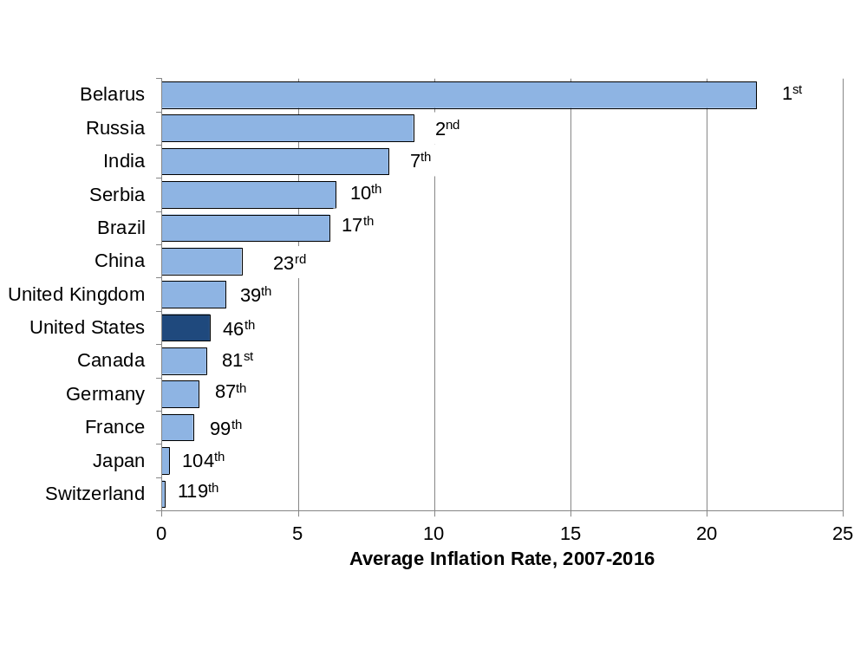
Figure 0.8 Average Annual Inflation Rate, 2007-2016
Source: World Bank, World Development Indicators database.
The average inflation rate is calculated as the average of the inflation rate for each year from 2007 to 2016.
Notes:
What it is: The rate of inflation summarizes how average prices change in a country
in one year. For example, an inflation rate of 5 percent means that
average prices increased by 5 percent that year. In Chapter 5 we discuss
how to adjust data from different years for inflation, and we focus
on macroeconomic theories of inflation in Chapters 12 and 13.
The results: Over the period 2007–2016, Switzerland and Japan had the lowest
inflation rates in the world, with prices actually declining slightly during
some years and hardly increasing overall. However, this is not necessarily
a good thing, as we see later in the book. A low and stable—
but not negative—inflation rate is generally considered an important
macroeconomic policy goal. Most developed countries have generally
been successful in controlling inflation in recent years. High and fluctuating
inflation rates in a country are a sign of macroeconomic instability.
With average inflation rate of over 20 percent between 2007 and
2016, Belarus had the highest inflation rate over this period. Extremely
high inflation rates of over 800 percent in Venezuela and over 24,000
percent in Zimbabwe have been observed in recent years.

Slide 10
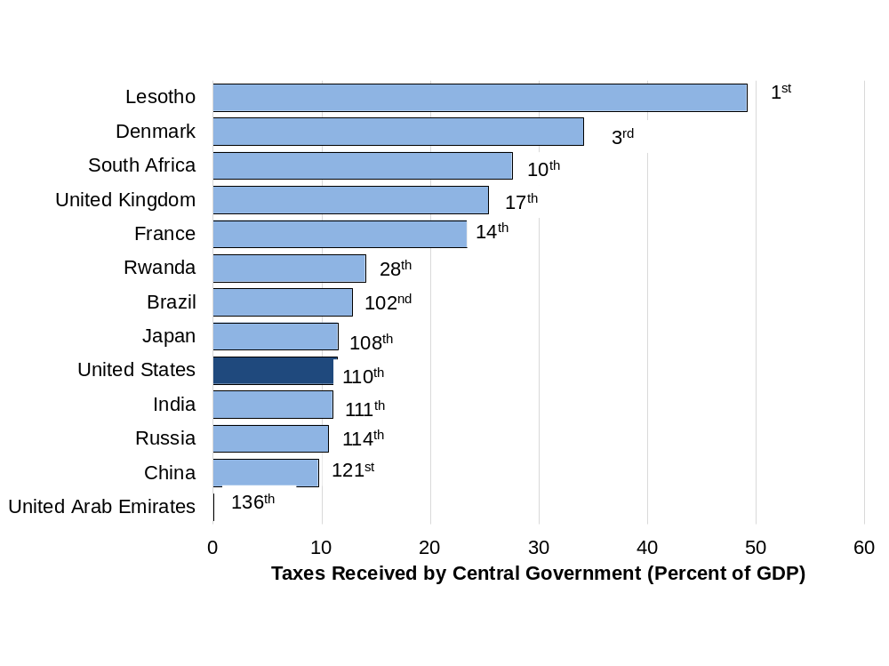
Figure 0.9 Taxes Received by Central Government (Percent of GDP)
Source: World Bank, World Development Indicators database.
Data are mostly 2015 estimates.
Notes:
What it is: Tax policies are among the most significant ways a government can
influence the well-being of the citizens, as we discuss in Chapter 10.
Taxes received by the central government, expressed as a percentage
of GDP, includes taxes collected at the federal level. Note that some
countries also collect significant amount of taxes at the local level.
The results: Overall tax revenues vary significantly across countries. While Western
European countries tend to have relatively high taxes, some other
countries with surprisingly high taxes (more than 25 percent of GDP)
include Jamaica, South Africa, and Botswana. The United States has
one of the lowest overall tax rates in the world—by far the lowest
of any major industrialized country. The countries with the lowest
tax revenues (less than 10 percent of GDP) tend to be relatively poor
countries in Africa and Asia.

Slide 11
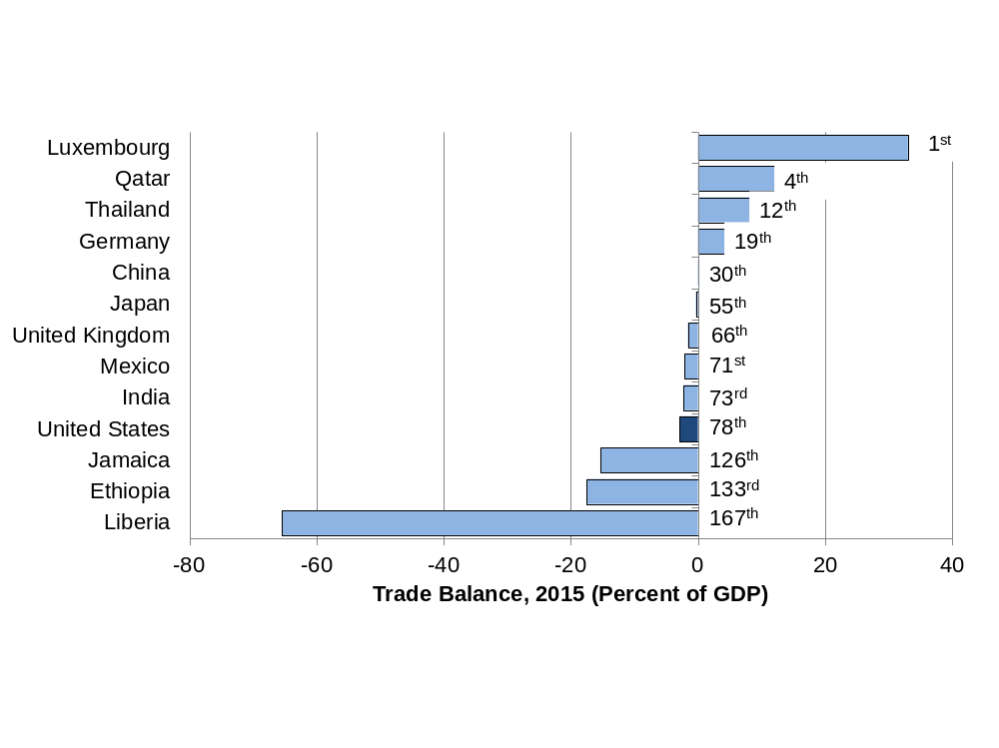
Figure 0.10 Trade Balance, 2015 (Percent of GDP)
Source: World Bank, World Development Indicators database, and authors’ calculations.
Notes:
What it is: The trade deficit of the United States is often considered a cause for
concern in media stories. A trade deficit means that a country imports
more than it exports. Economists refer to a country’s trade balance as
the dollar value of its exports minus its imports, normally expressed as
a percentage of GDP. Thus, a negative trade balance indicates a trade
deficit. A positive trade balance indicates a trade surplus. We discuss
trade balances, and other trade issues, in more detail in Chapter 14.
The results: Of the 168 countries with available data, 50 have a positive trade balance
(exports exceed imports) and 118 have a negative trade balance.
Those countries with the largest trade surpluses tend to be smaller
countries (such as Luxembourg and Singapore) or oil-producing countries
(such as Qatar and United Arab Emirates). The U.S. trade deficit is
about 3 percent of GDP, with other countries, such as Canada, Ecuador,
and Turkey, in a similar range. The countries with the largest trade
deficits tend to be poorer countries, although some poor countries do
have trade surpluses.

Slide 12
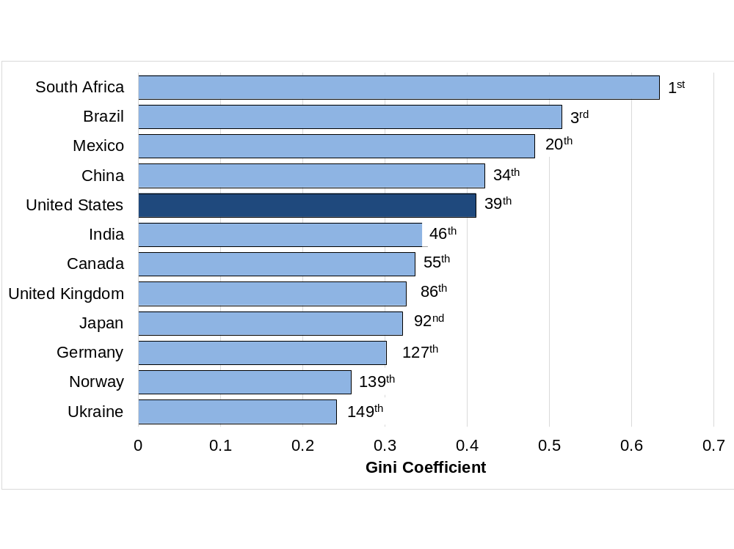
Figure 0.11 Gini Coefficient (Most Equal to Least Equal)
Source: World Bank, World Development Indicators database. Data for the most recent year available, between 2008 and 2014.
Notes:
What it is: A Gini coefficient is a measure of economic inequality in a country. It
is most commonly calculated according to the distribution of income
(as is done in the figure here), but it can also be calculated according
to wealth distribution or other variables. It can range from 0 (everyone
in the country has the same exact income) to 1 (one person receives all
the income in a country). We learn more about Gini coefficients and
economic inequality in Chapters 3, 15 and 17.
The results: Scandinavian countries such as Sweden, Norway, and Finland tend
to be the most equal countries in the world, by income (with the lowest
Gini coefficients). Several African countries, including Botswana,
Lesotho, Namibia, and South Africa are the most unequal countries in
the world. In general, countries with high GDP per capita have lower
inequality than those with low GDP per capita (compare figures 0.1
and 0.11). However, this is not always true. The United States, for
example, is among the most economically unequal of the developed
countries.

Slide 13
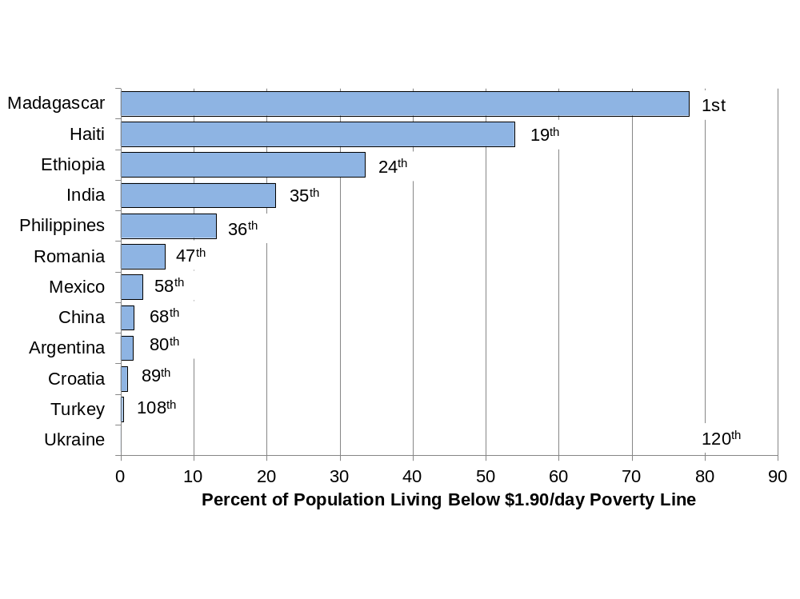
Figure 0.12 Percent of Population Living Below $1.90/day Poverty Line
Source: World Bank, World Development Indicators database. Data are for the most recent year available, between 2010 and 2014.
Notes:
What it is: The US$1.90-per-day poverty line has been defined by the United
Nations as a measure of absolute poverty. One of the Sustainable
Development Goals set by the United Nations is to eradicate absolute
poverty worldwide. Formerly, under the Millennium Development
Goals, the UN had aimed at halving the number of people in the
world living in absolute poverty between 1990 and 2015. This goal
has already been met, mainly due to progress in China and India. We
discuss poverty and economic development in Chapter 17.
The results: Note that this is one of the two graphs in this chapter that does not
include the United States or any other developed countries (few people
in developed countries live below the US$1.90-a-day poverty line,
though homelessness and food insecurity continue to plague many cities
in the U.S.). A majority of people do live below that poverty line in
17 countries, including Rwanda, Nigeria, Mozambique, and Haiti. A
small portion of the population lives in absolute poverty in some upper
middle-income countries such as Argentina, Costa Rica, Thailand, and
Turkey.

Slide 14
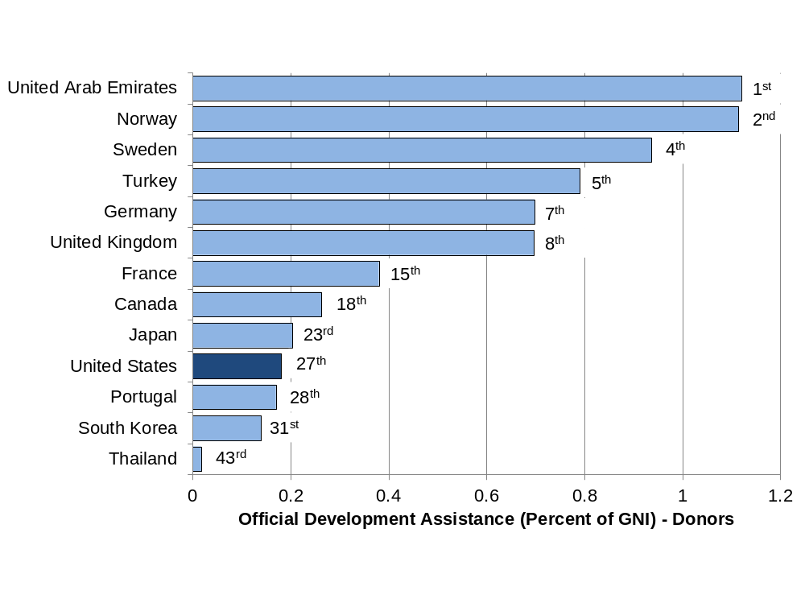
Figure 0.13 Official Development Assistance, 2016 (Percent of GNI)
Source: Organisation for Economic Co-operation and Development, Official Development Assistance—2016 Update.
Notes:
What it is: In 1970, the “economically advanced” countries agreed to a United
Nations resolution on foreign aid to developing countries. The resolution
set a target for official development assistance (ODA) of 0.7 percent
of gross national income (GNI). ODA is defined as government
flows to promote economic development and welfare in developing
countries. The 0.7 percent target has been reaffirmed at subsequent
international meetings. We discuss the role of foreign aid in promoting
economic development in Chapter 17.
The results: In 2016 only six countries met the 0.7 percent target: United Arab
Emirates, Norway, Luxembourg, Sweden, Turkey, and Denmark. Both
U.A.E and Turkey began giving aid recently, mostly to Muslim-majority
countries in the Middle-East and Sub-Saharan Africa. Though
U.A.E. ranks the highest among aid givers, it has received criticism for
the lack of transparency on how the aid is being used. ODA from the
United States was 0.18 percent of GNI. Israel and Russia had the lowest
ODA percentage, at 0.08 percent. A common criticism of foreign
aid is that it is given to gain political and economic influence. This
criticism, often leveled at countries like the U.S. and China, has also
been directed to new aid donors like Turkey. Note that ODA does not
include private charity donations or non-governmental organizations,
only official aid given by governments and support given to refugees
who come to the donor countries.

Slide 15
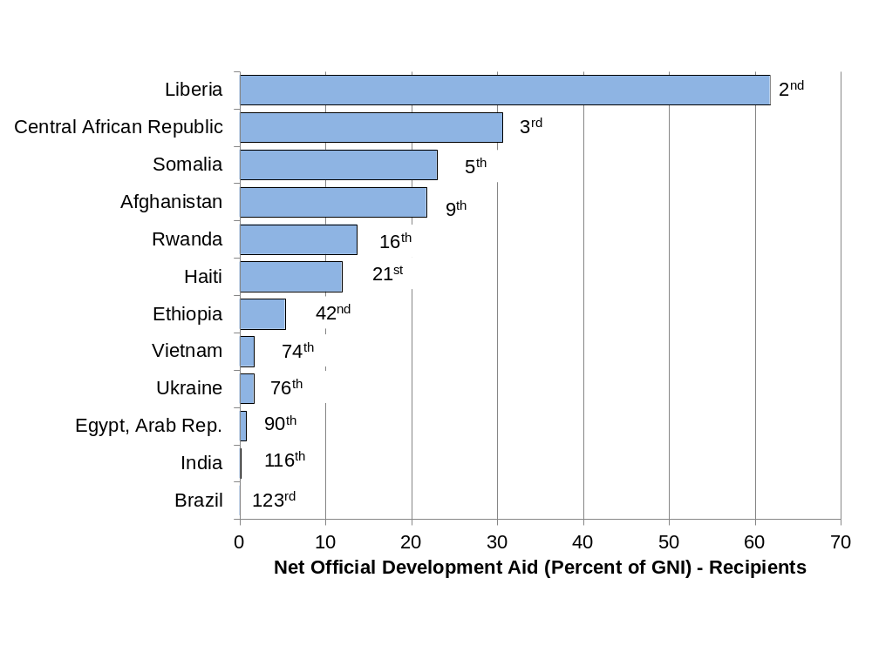
Figure 0.14 Official Development Assistance Received, 2015 (Percent of GNI)
Source: World Bank, World Development Indicators database.
Notes:
What it is: Official Development Aid (ODA) received by a country includes bilateral
aid from another country as well as multilateral aid from international
organizations. Net ODA as a percentage of GNI (Gross National
Income) shows the size of aid received by a country relative to the
country’s gross national income. It is an indicator of how dependent a
country is on foreign aid. Foreign aid may be an important source of
revenue for funding development programs and for providing relief
from natural disasters or conflicts in developing countries.
The results: This is one of the graphs in this chapter that does not include any
developed country, as developed countries do not usually receive aid.
Countries in Sub-Saharan Africa including Central African Republic,
Somalia, and Rwanda are highly dependent on foreign aid. A significant
amount of foreign aid is directed towards conflict-affected countries
such as Afghanistan and Syria. Some middle-income countries
such as Brazil and Vietnam also receive small amounts of foreign aid.

Slide 16
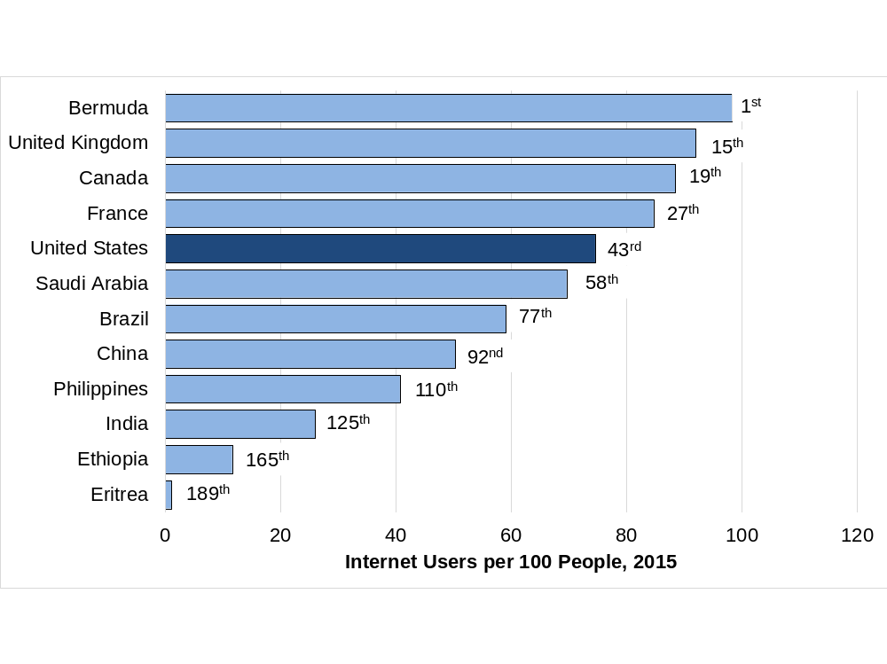
Figure 0.15 Internet Users per 100 People, 2015
Source: World Bank, World Development Indicators database.
Notes:
What it is: The percentage of people who have access to the Internet provides an
indication of a country’s level of technological development. As we
discuss in Chapter 17, technology has long been recognized as one of
the drivers of economic growth.
The results: Access to the Internet may not be as widespread as you think. While
near-universal access occurs in a few countries, such as Iceland, Norway,
and Denmark, in most developed countries access rates are about
70–85 percent. Middle-income countries generally have access rates
around 30–50 percent. Twenty countries, most of them poor African
countries, have access rates of less than 10 percent.

Slide 17
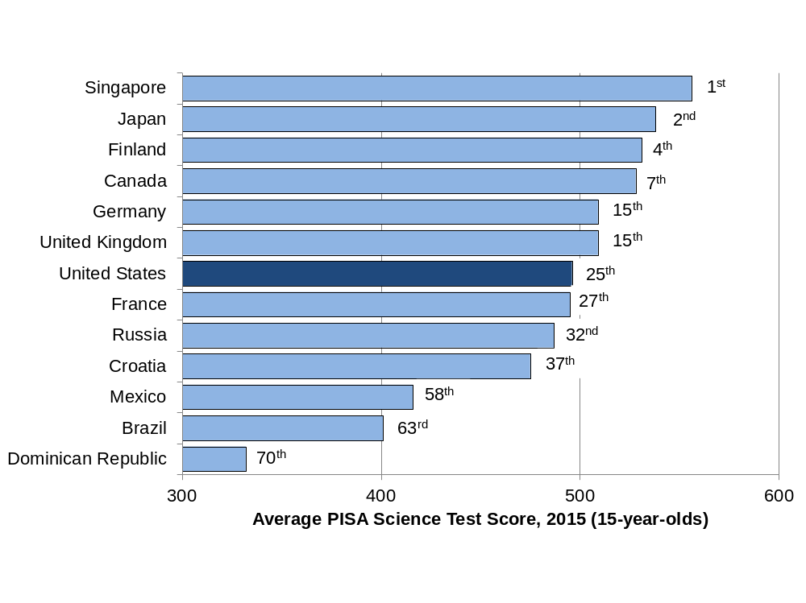
Figure 0.16 Average PISA Science Test Score, 2015 (15-year-olds)
Source: Organisation for Economic Co-operation and Development, Programme for International Student Assessment, PISA 2015 Key Findings.
Notes:
What it is: To compare the educational performance of students in different countries
we present data from the Programme for International Student
Assessment (PISA), which administers standardized math, science,
and reading tests to 15-year-olds in over 60 countries every three
years. The graph below provides results from the science test. The
country rankings were relatively similar for the math and reading tests,
with some variations (e.g., the United States ranked twenty-first on the
reading test and thirty-fifth on the math test).
The results: Students in Asian countries tended to achieve the highest test scores,
including China, Singapore, Japan, and South Korea. Among European
countries, students received high scores in Finland, the Netherlands,
and Germany. The scores from the United States were average
for developed countries. For less developed countries, scores tended to
be lower.

Slide 18
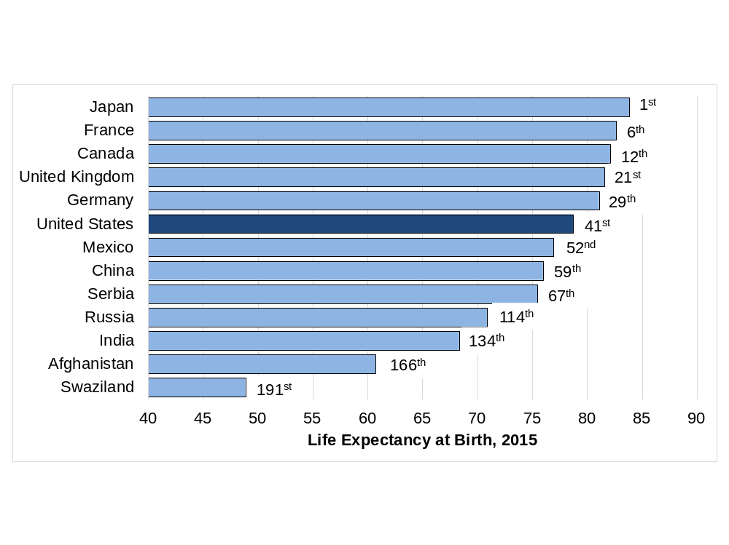
Figure 0.17 Life Expectancy at Birth, 2017
Source: World Bank, World Development Indicators database.
Notes:
What it is: Average life expectancy at birth is a common measure of health outcomes
in a country. We discuss health as one component of well-being
indices in Chapter 6 and as a topic of economic development in Chapter
17.
The results: Life expectancy at birth now exceeds 80 years in over 30 countries,
including Japan, France, Spain, and Greece. In 2010, only 20 countries
had life expectancy at birth that exceeded 80 years. For a developed
country, the United States has a comparatively low life expectancy,
even lower than some middle-income countries such as Costa Rica
and Cuba. Life expectancy is the lowest, below 55 years, in several
African countries, including Sierra Leone, Lesotho, and Swaziland.

Slide 19
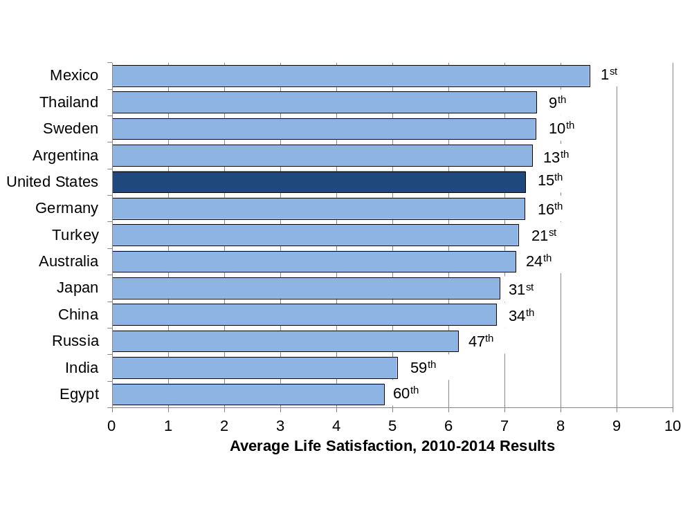
Figure 0.18 Average Life Satisfaction, 2010-2014 Results (1 = Dissatisfied, 10 = Satisfied)
Source: World Values Survey, online database.
Notes:
What it is: Researchers are increasingly using surveys to measure well-being or
happiness directly. The most common approach is to ask people to
rate their overall satisfaction with their lives, on a scale from 1 (dissatisfied)
to 10 (satisfied). The responses are referred to as “subjective
well-being.” We discuss subjective well-being in more detail in Chapter
6.
The results: According to the most recent data, which cover 60 countries, Mexico
has the highest level of average subjective well-being. Other relatively
happy countries include Colombia, Qatar, Ecuador, and Uzbekistan.
Happiness levels in the United States are about average for a developed
country. Happiness levels are relatively low in countries that
have recently experienced conflicts such as Egypt or Iraq, in the poorest
countries such as Zimbabwe, as well as in Eastern European countries,
such as Georgia and Estonia.

Slide 20
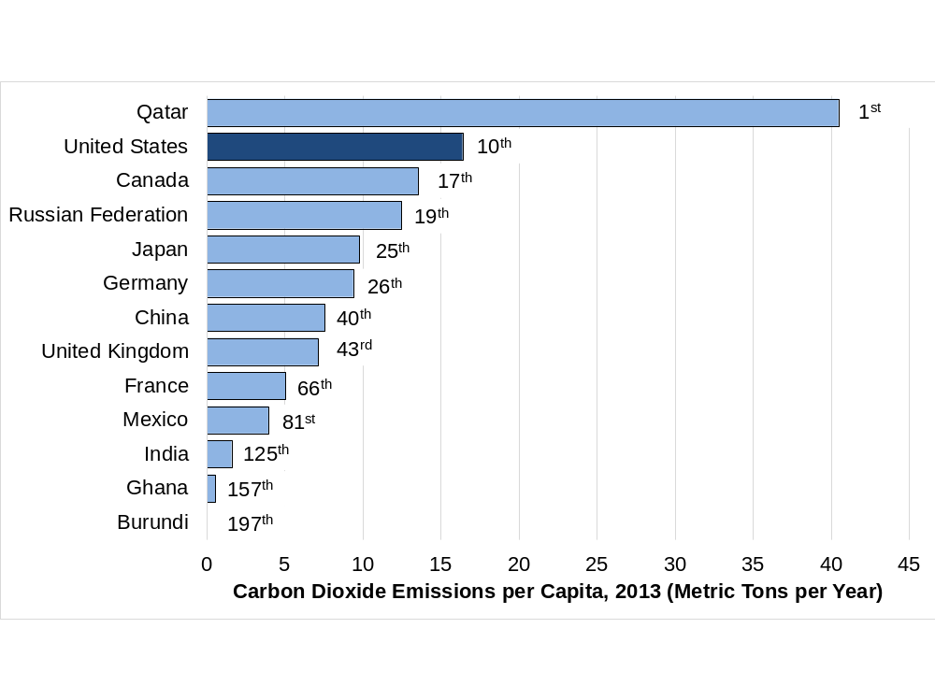
Figure 0.19 Carbon Dioxide Emissions per Capita, 2013 (Metric Tons per Year)
Source: World Bank, World Development Indicators database.
Notes:
What it is: Carbon dioxide (CO2) is the most important gas responsible for
global climate change. CO2 is emitted whenever fossil fuels are
burned. Scientific analysis indicates that the accumulation of CO2
in the atmosphere is raising global temperatures, leading to serious
negative impacts on human societies and ecosystems. CO2 per capita
gives us an idea of how much the average person in a country is
affecting the environment. We learn more about CO2 and climate
change in Chapter 18.
The results: The countries with the highest CO2 emissions per capita are several
oil-producing countries, including Qatar (the highest, at 41 tons per
person), Kuwait, and Bahrain. The United States has the tenth-highest
emissions per capita, around 17 tons per person. Emissions per person
in European countries such as the UK and Germany are about half of
U.S. levels. While China is the world’s largest emitter of CO2 overall,
on a per-capita basis its emissions are less than half of those in the
United States. CO2 emissions per capita are negligible in the world’s
poorest countries.

Slide 21
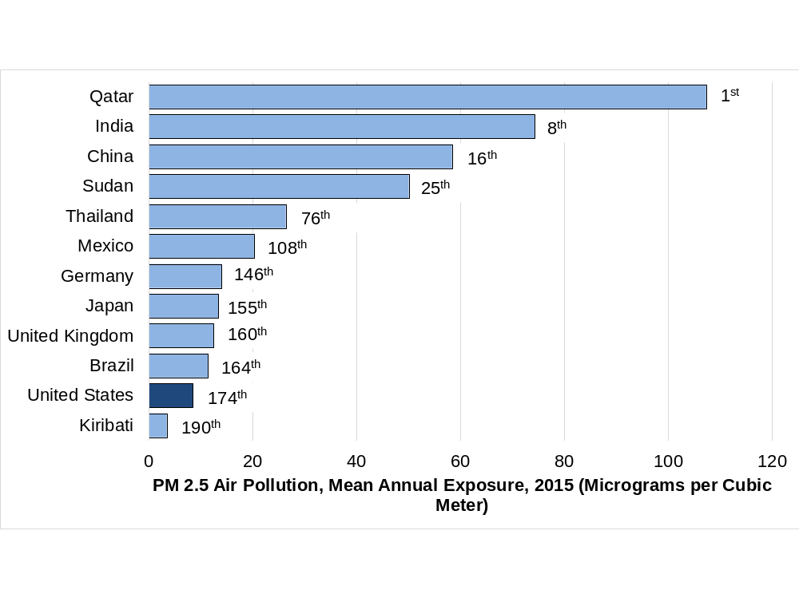
Figure 0.20 Average National Particulate Matter Concentration, 2015 (Micrograms per Cubic Meter)

