Slide 1

Green Macroeconomics:
Growth and Distribution in a Finite World
A GDAE Teaching Module on Social and Environmental Issues in Economics
by Eric Kemp-Benedict
Figures
www.gdae.org

Slide 2
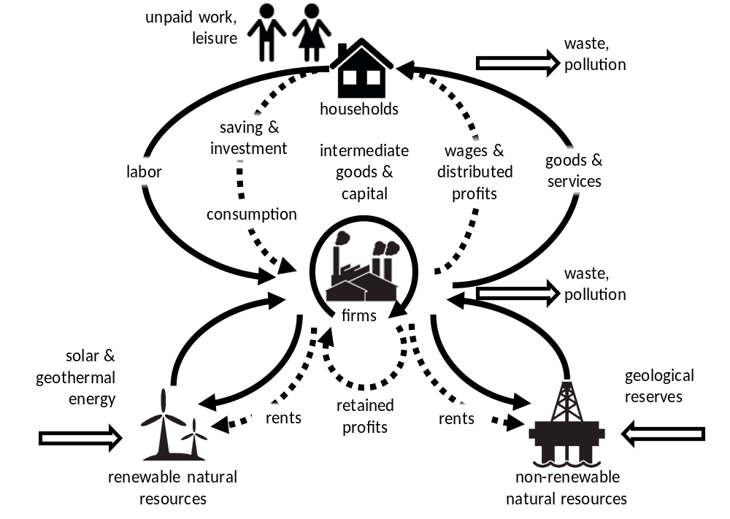
Figure 1. The one-way flow of energy and materials through the circulating monetary economy

Slide 3
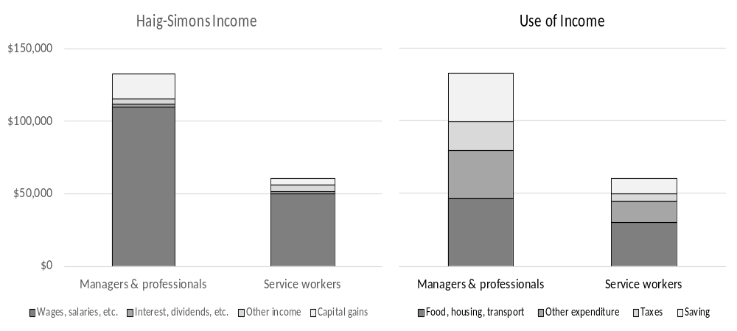
Figure 2. Haig-Simons Income and Use of Income, 2016
Note: Saving is calculated as a residual so that total use of income = total income.
Source: 2016 US Bureau of Labor Statistics’ Consumer Expenditure Survey

Slide 4
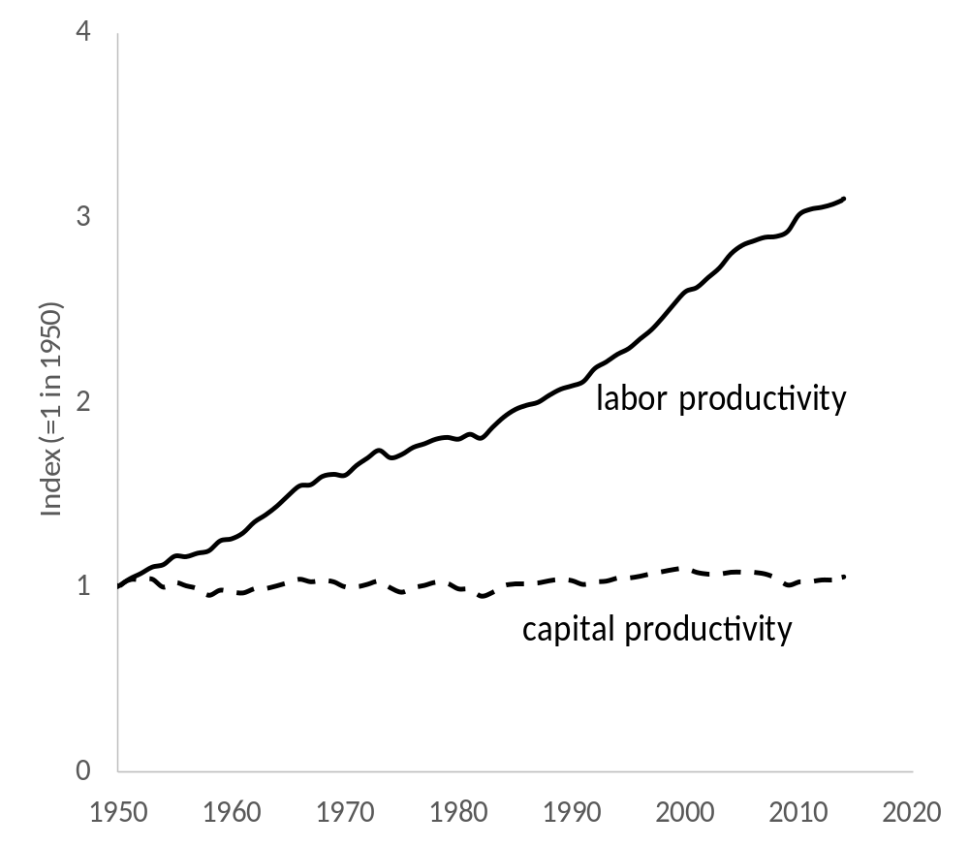
Figure 3. Trends in labor and capital productivity in the US from 1950 to 2014
Source: Penn World Tables 9.0

Slide 5
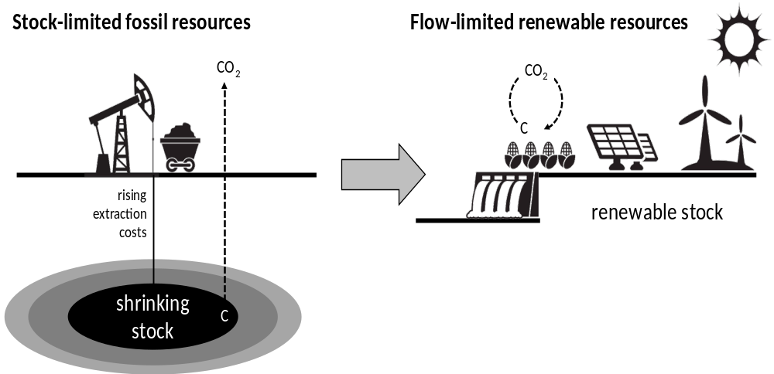
Figure 4. Differences between fossil and renewable resources

Slide 6
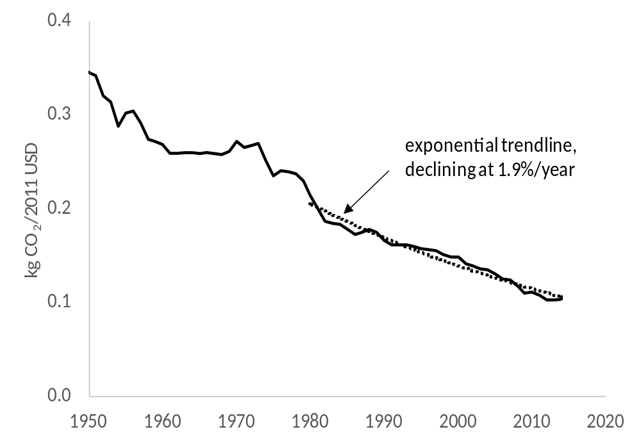
Figure 5. Carbon intensity of capital stock in the US, 1950-2014
Source: Capital stock from the Penn World Table (PWT) 9.0; carbon dioxide emissions from the
Carbon Dioxide Information Analysis Center (CDIAC)

Slide 7
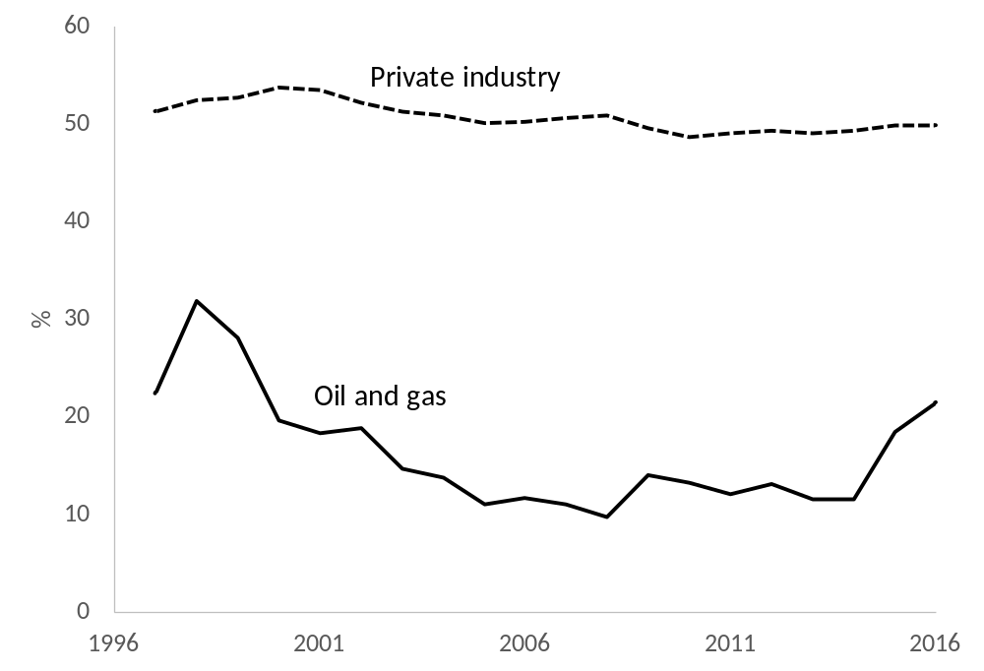
Figure 6. Employee compensation as a share of value added
Source: BEA/Kemp-Benedict 2018

Slide 8
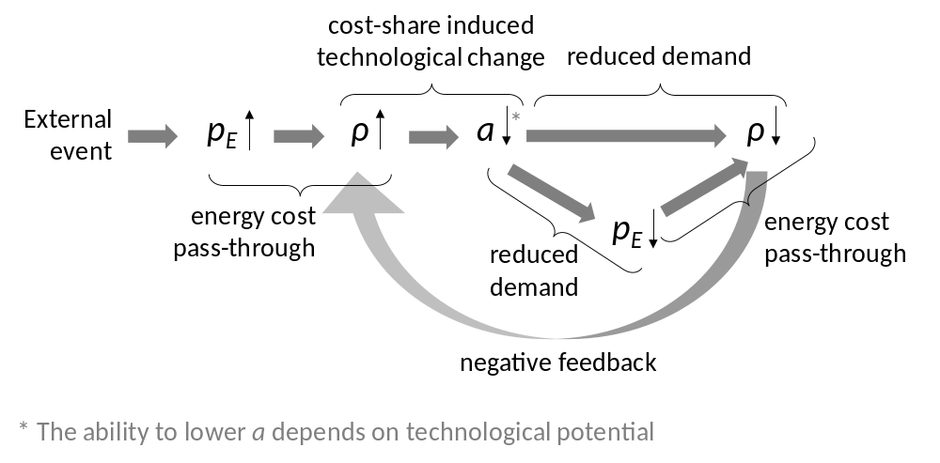
Figure 7. Stabilizing dynamics for resource rents with cost-share induced technological change

Slide 9
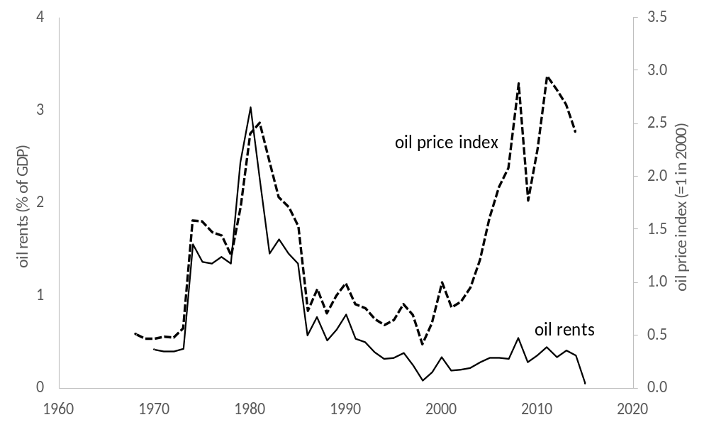
Figure 8. Oil rents and oil price in the US

