Slide 1
Data Visualization Basics

Slide 2
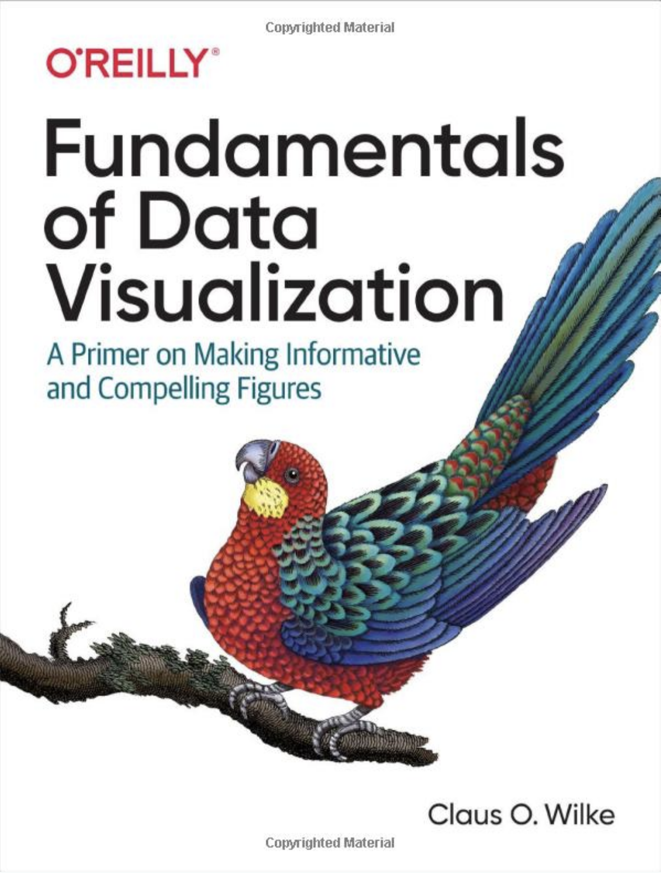
Outline
Distributions
Uncertainty
x-y relationships
Proportional ink
Overlapping points
Color
Redundant coding
https://projects.ecoforecast.org/
taskviews/visualization.html
esquisse::esquisser()

Slide 3
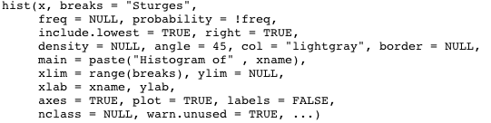
Histograms
age distribution of Titanic passengers
breaks
  number of groups
  vector of breakpoints
  name of algorithm
probability = TRUE
  standardizes so area = 1
Check different bin widths
ggplot(<data.frame>) + aes(x = <column>) +
geom_histogram(bins = 30, fill = "blue")

Slide 4
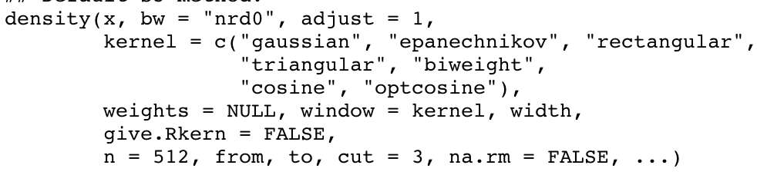
Kernel density plots
Check different bandwidths
plot(density(x))
bw = bandwidth
adjust = scale relative to bw
n = number of points in line
ggplot(<data.frame>) + aes(x = <column>) +
geom_density(adjust = 1, fill = "blue")

Slide 6
stacked histogram
easily confused with overlapping histogram
heights of higher groups hard to judge and compare with one another

Slide 7
Overlapping histogram
easily confused with stacked histogram
often looks like 3 colors

Slide 8
Overlapping density plot

Slide 9
Scales well to a moderate number of densities

Slide 10
Compare each to overall

Slide 11
Opposite directions

Slide 12
Uncertainties

Slide 13
Humans are bad at judging raw probabilities
Visualizing frequencies

Slide 14
Use of color within a density plot

Slide 15
quantile dotplot: color and frequency
n=50
n=10

Slide 16
Error Bars

Slide 17
Multiple Intervals

Slide 18
ggplot2: geom_errorbar
Figure 16.9: Mean chocolate flavor ratings for manufacturers from four different countries, relative to the mean rating of U.S. chocolate bars. Each panel uses a different approach to visualizing the same uncertainty information. (a) Graded error bars with cap. (b) Graded error bars without cap. (c) Single-interval error bars with cap. (d) Single-interval error bars without cap. (e) Confidence strips. (f) Confidence distributions.
https://bit.ly/35l9qzr

Slide 19
Boxplots
boxplot(x,…)
geom_boxplot(fill = “gray")

Slide 20
Strip chart
points are “jittered"
geom_point(position = position_jitter())

Slide 21
Violin plot
geom_violin(adjust = 1, scale = "area", fill = “gray”)

Slide 22
Sina plot
geom_violin() + ggforce::stat_sina()

Slide 23
ridgeline
geom_density_ridges

Slide 24
Movie lengths

Slide 26
x-y relationships

Slide 27
Scatterplot
plot(x, y, …)
ggplot(<data.frame>) +
aes(x = <xcol>, y = <ycol>) +
geom_point(size = 1)

Slide 28
Use color to distinguish groups
Notes:
Make sure to use palettes that are sensitive to color-blind viewers and have a meaningful contrasts. Will talk more about color in the next lecture
It’s also possible to use symbol type to distinguish groups, but visually not as sensitive

Slide 29
Facet & symbol size (bubble chart)
Disadvantage: We are visually less sensitive to size than position
Notes:
Will see more of the details of facets in lab
can be particularly handy for EDA because can generate lots of plots by site, date, etc
disadvantage, which we’ll go more into next lecture, is that it is harder to compare across plots than within plots

Slide 30
Pairs
pairs(x)
facet_grid(rows, cols)

Slide 31
Correlogram

Slide 32


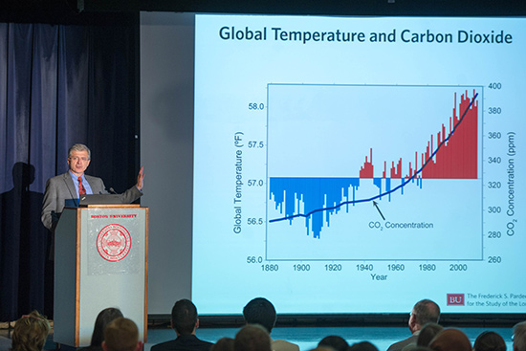
Design for Your User
What will users do with the results?
Notes:
same info may be visualized differently in a scientific publication, for decision makers, and for an audience.

Slide 33
One graph is more effective than another if its quantitative information can be decoded more quickly or more easily by most observers.

Slide 34
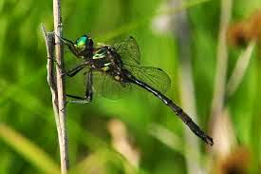
Example Question:
Consider the S. hineana dragonfly that we studied in Lab #3
Using the continuous equation for exponential growth, show how the population doubling time changes with different growth rates.
N0 = 38
r = c(.4, .8, .6, 1)

Slide 35
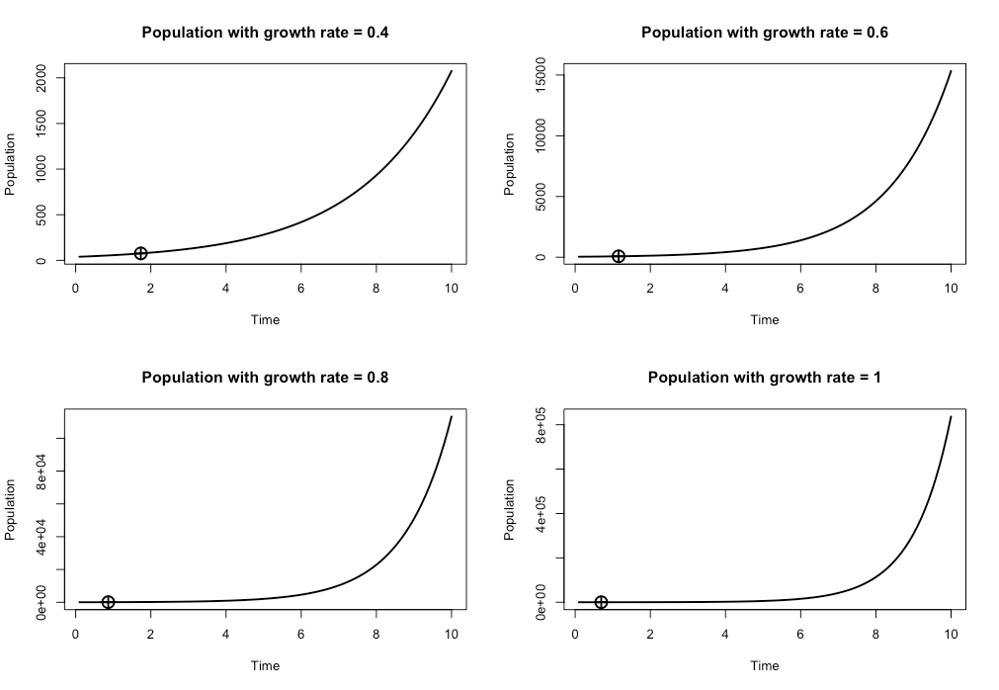
Notes:
As an example, here are some curves showing populations growing at different growth rates and the question of interest is how the populations vary in their doubling time.
visually all the curves look pretty similar, but that’s because they all have different axes, which is really misleading
Second, you’ll note that comparing doubling times across populations takes time and mental energy because you need to make comparisons across different panels

Slide 36
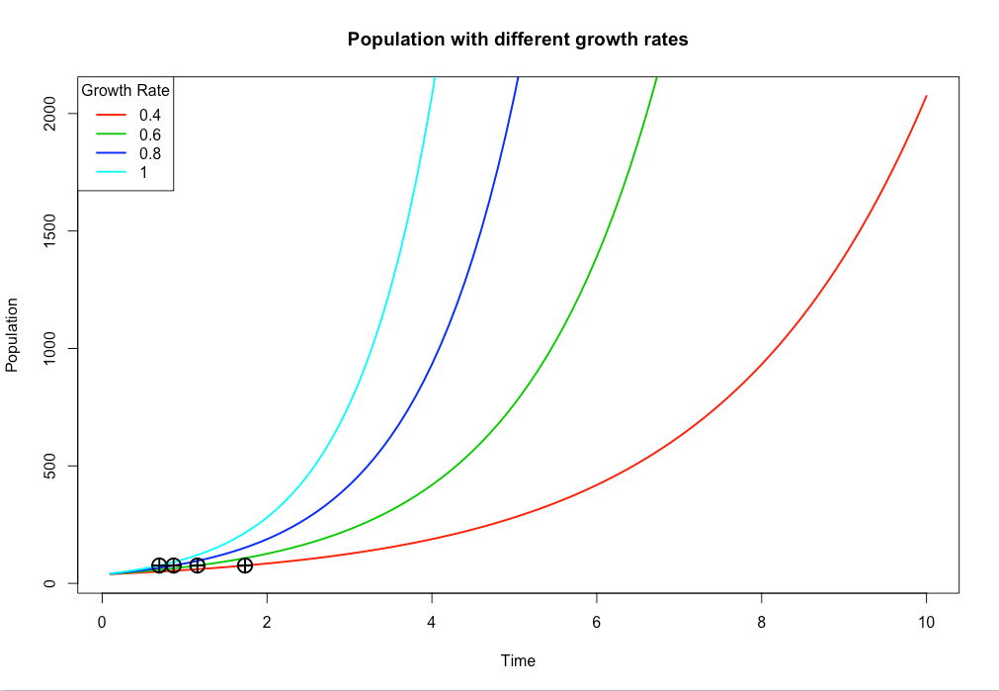
Notes:
So to begin with, let’s put the things we want to compare on the same figure!
Next, let’s note that the information we’re interested in is all crammed into one corner. Just because we have data or model output that covers the full time range, doesn’t mean that we have to show the full range. Note, what I’m saying here is very different from cherrypicking your data, which you should never do. In this case your initial visualizations should definitely look at all the data, and you should never hide information, but it’s also true that this specific visual is being designed to answer a specific question

Slide 37
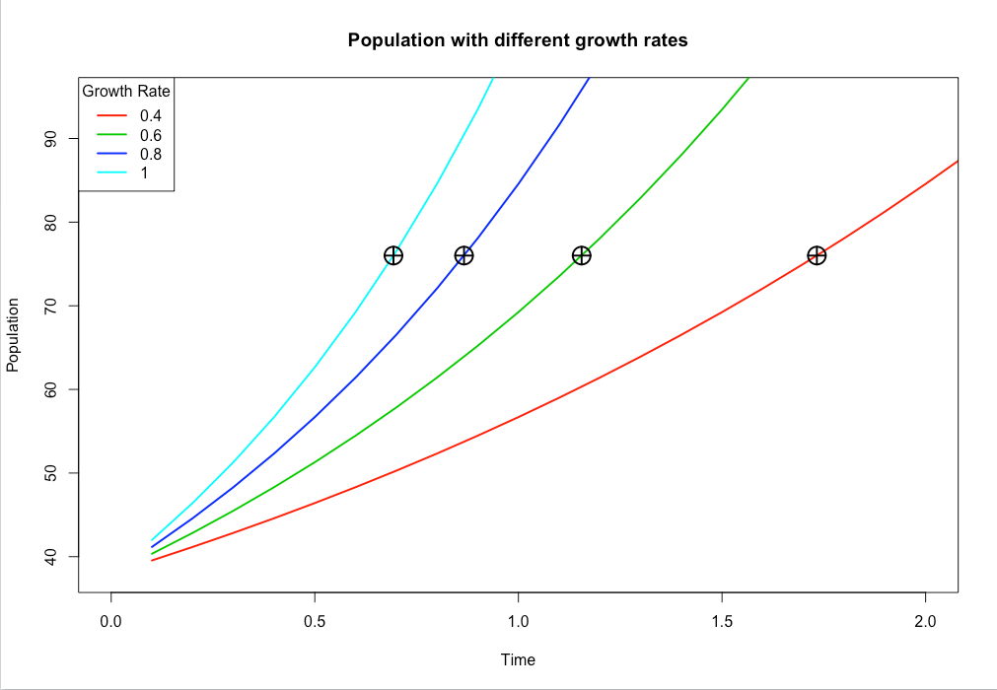
Always look at scaled-down versions of your figures to make sure the axis labels are appropriately sized.
Notes:
Here’s what we get when we zoom in. Now this visual is much better for answering the questions at hand, but it’s far for perfect, as the later videos in this series will address.

Slide 38
Spare your reader from mental gymnastics
Choose the scale with intention
Be mindful of axis when displaying related information horizontally & vertically to allow comparisons
Don’t fear whitespace

Slide 39
Edward Tufte
Displays should have high data:ink ratio
Avoid chart junk: useless, non-informative, or information-obscuring elements of quantitative information displays

Slide 40
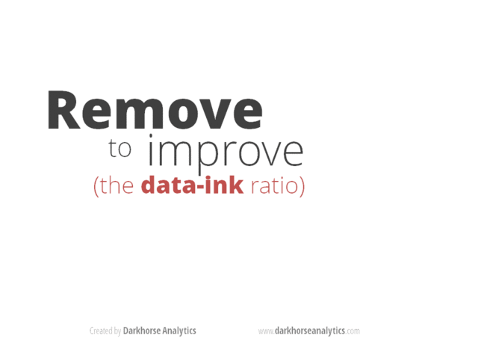
Notes:
This animation shows how, if done correctly, REMOVING things from a figure that use ink but don’t convey needed information can improve the figure and make it easier to understand.

Slide 41
Proportional Ink

Slide 42
Principle of proportional ink
sizes of shaded areas need to be proportional to the data values they represent
Bars on a linear scale should start at 0

Slide 43
Differences from reference
Caveat: people are not equally sensitive to losses and gains
Notes:
If the goal is to focus on comparisons among groups, not their absolute magnitudes, it can be OK to choose an explicit reference group or time. This does not violate the principle of prop ink. That said, you have to put real thought into the choice of reference group.

Slide 44
Human perception primarily judges distances, not areas
Pie Chart
Bar Chart
Notes:
There are better ways to visualize proportions

Slide 45
Overlapping Points

Slide 46
+ jitter
+ transparency
too much jitter

Slide 47
Data density
2D histogram: geom_bin2d
hex: geom_hex
contours: stat_density_2d

Slide 48
Color

Slide 49
Encoding too much info

Slide 50
Use direct labeling when you need to distinguish more than about eight categories.

Slide 51
Color not conveying additional info
Avoid overly saturated
(bright) colors
Color to distinguish vs scale?

Slide 52
Color not conveying additional info
Avoid overly saturated
(bright) colors
Color to distinguish vs scale?

Slide 53
Color to distinguish
Qualitative color scales
https://colorbrewer2.org/

Slide 54
Color to represent data
Sequential scales
Notes:
Often single hue (monochromatic) is a good choice; rainbow is a horrible choice

Slide 55
Colors need to clearly indicate which data values are larger or smaller
Differences between colors need to visualize the corresponding differences between data values

Slide 56
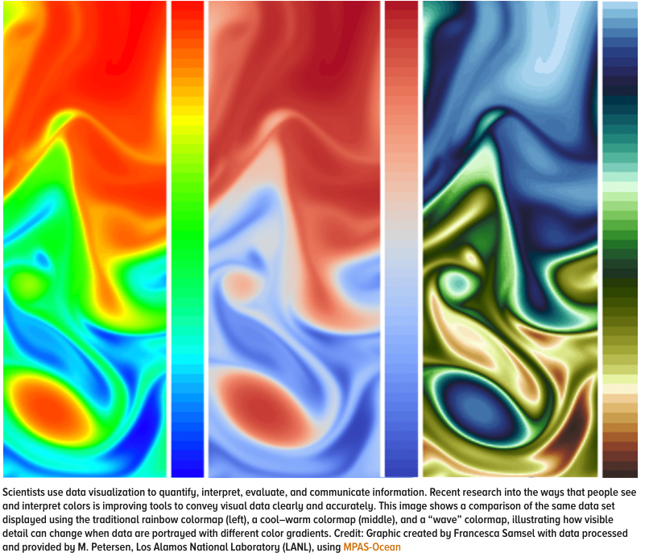

Slide 57
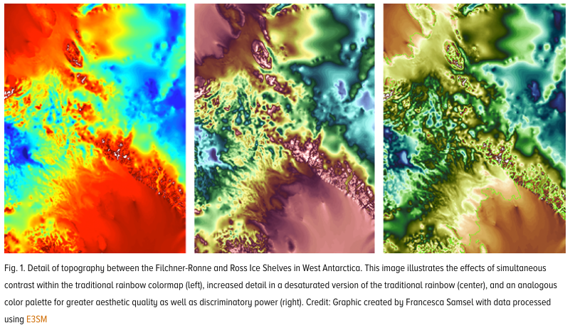
https://eos.org/features/visualizing-science-how-color-determines-what-we-see

Slide 58
Divergent scales
Notes:
frequently used when trying to visualize positive and negative data, where the center of the scale is set to zero and usually set to a light color. These scales need to be balanced so that magnitude is perceived correctly

Slide 59
Color to highlight

Slide 60
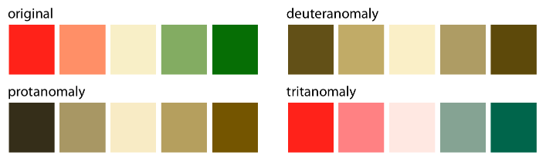
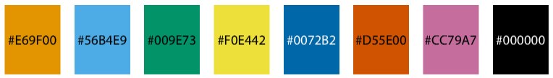
test your figures in a color-vision deficit simulator
Figure 19.10: Qualitative color palette for all color-vision deficiencies (Okabe and Ito 2008)

Slide 61
Redundant coding

Slide 63
Notes:
Can use symbols and color to reinforce each other; rearrange color assignments to increase contrast

Slide 64
Make sure to match order in the legend

Slide 65
Design figures so they don’t need legends

Slide 67
Notes:
Don’t have separate legends for different aesthetics; this example integrates the x-axis with the reference color bar.

Slide 68
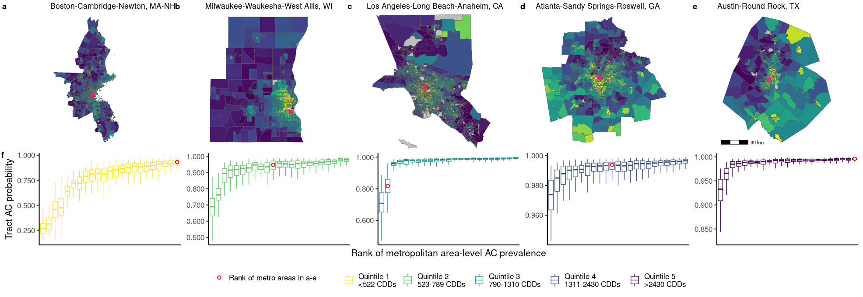

Slide 69
