Slide 1
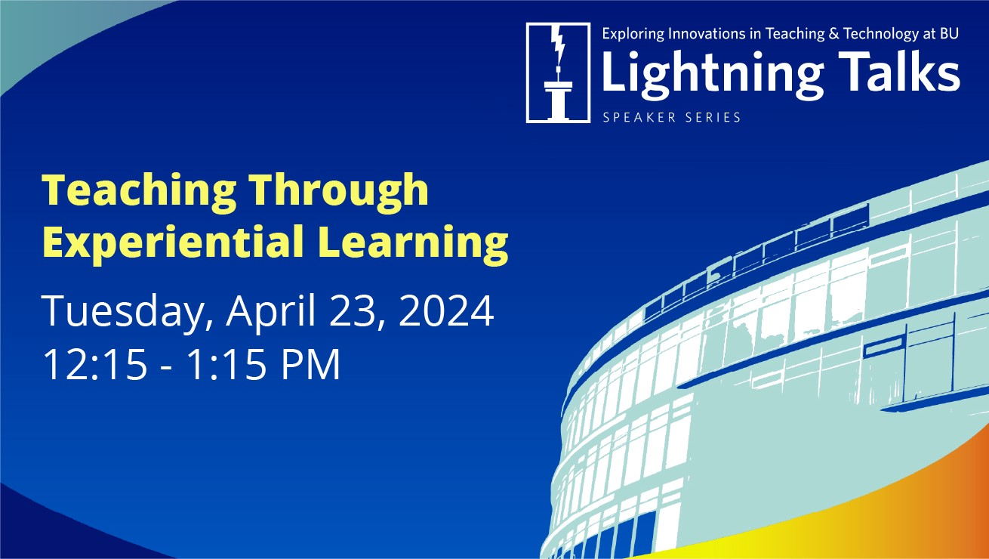

Slide 2
Recording
Today’s Lightning Talks are being recorded and will be available for viewing via bu.edu/dli later this month.

Slide 3
Q&A
Please share your questions in the chat feature and the moderator will address questions at the completion of all presentations.

Slide 4
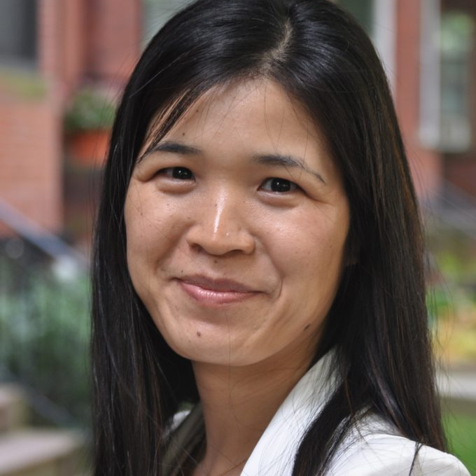
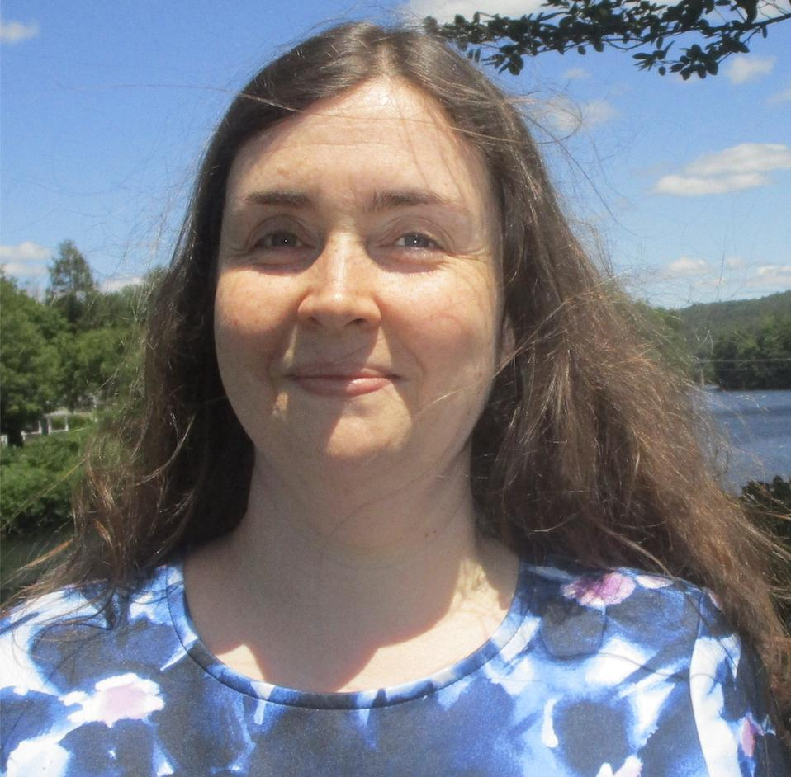
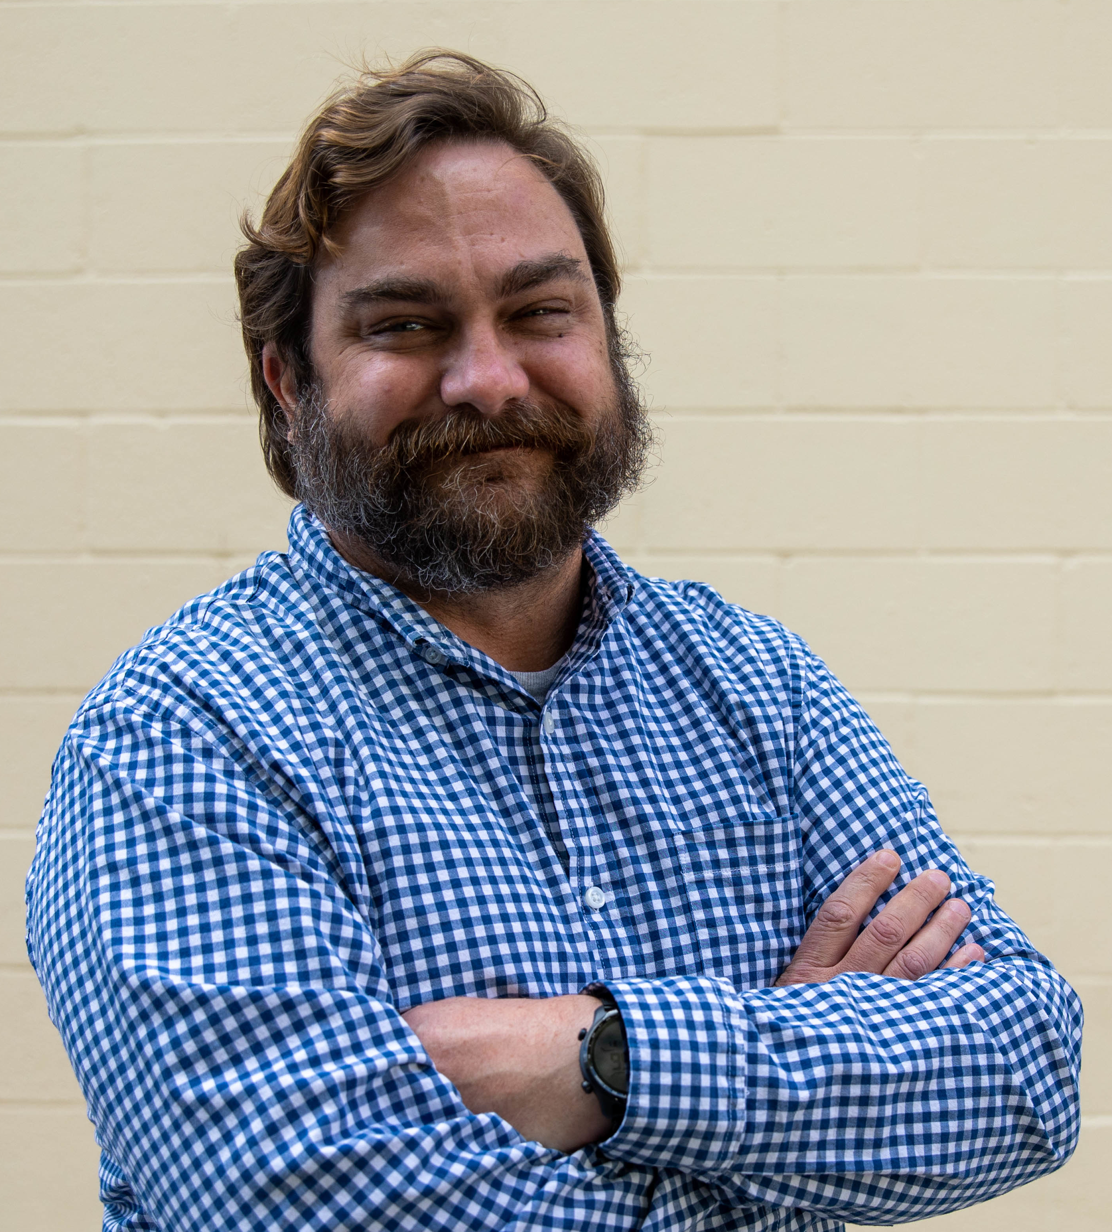
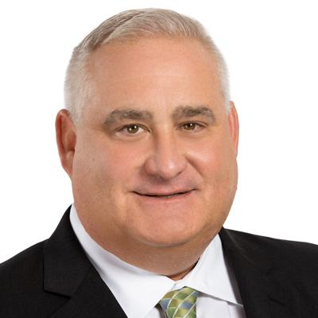
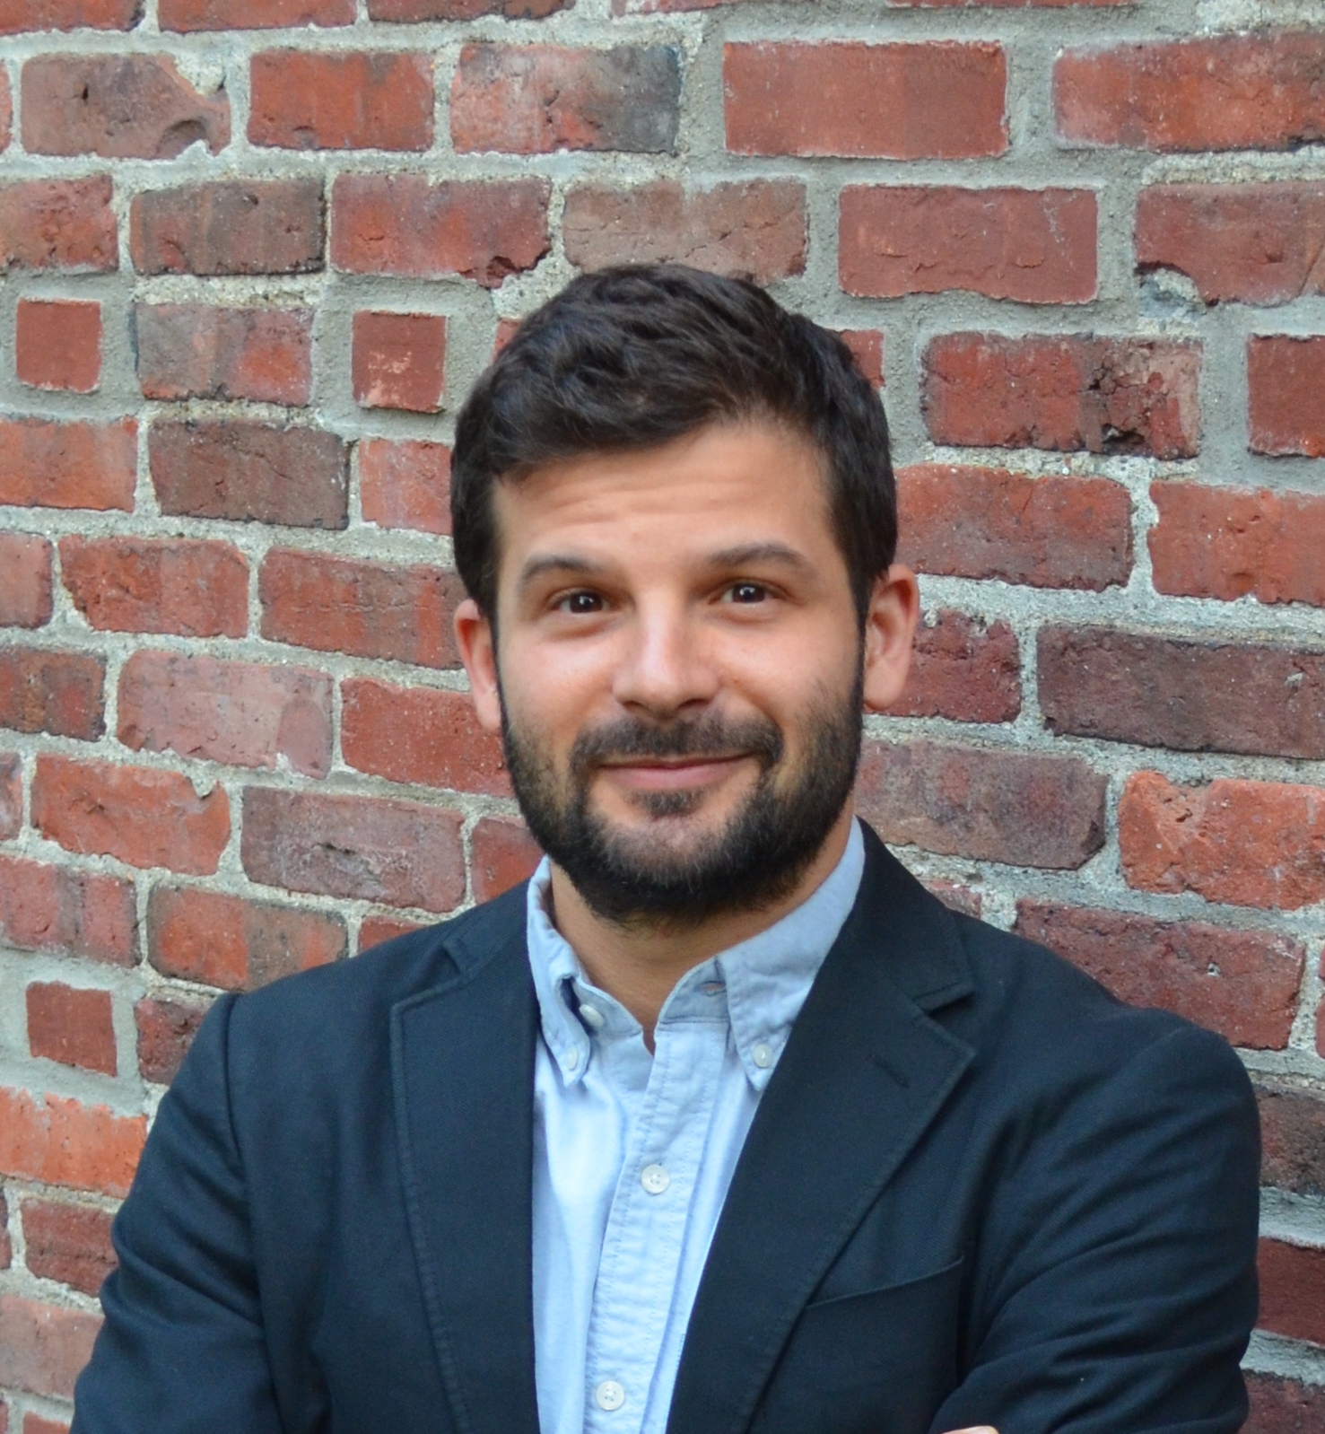
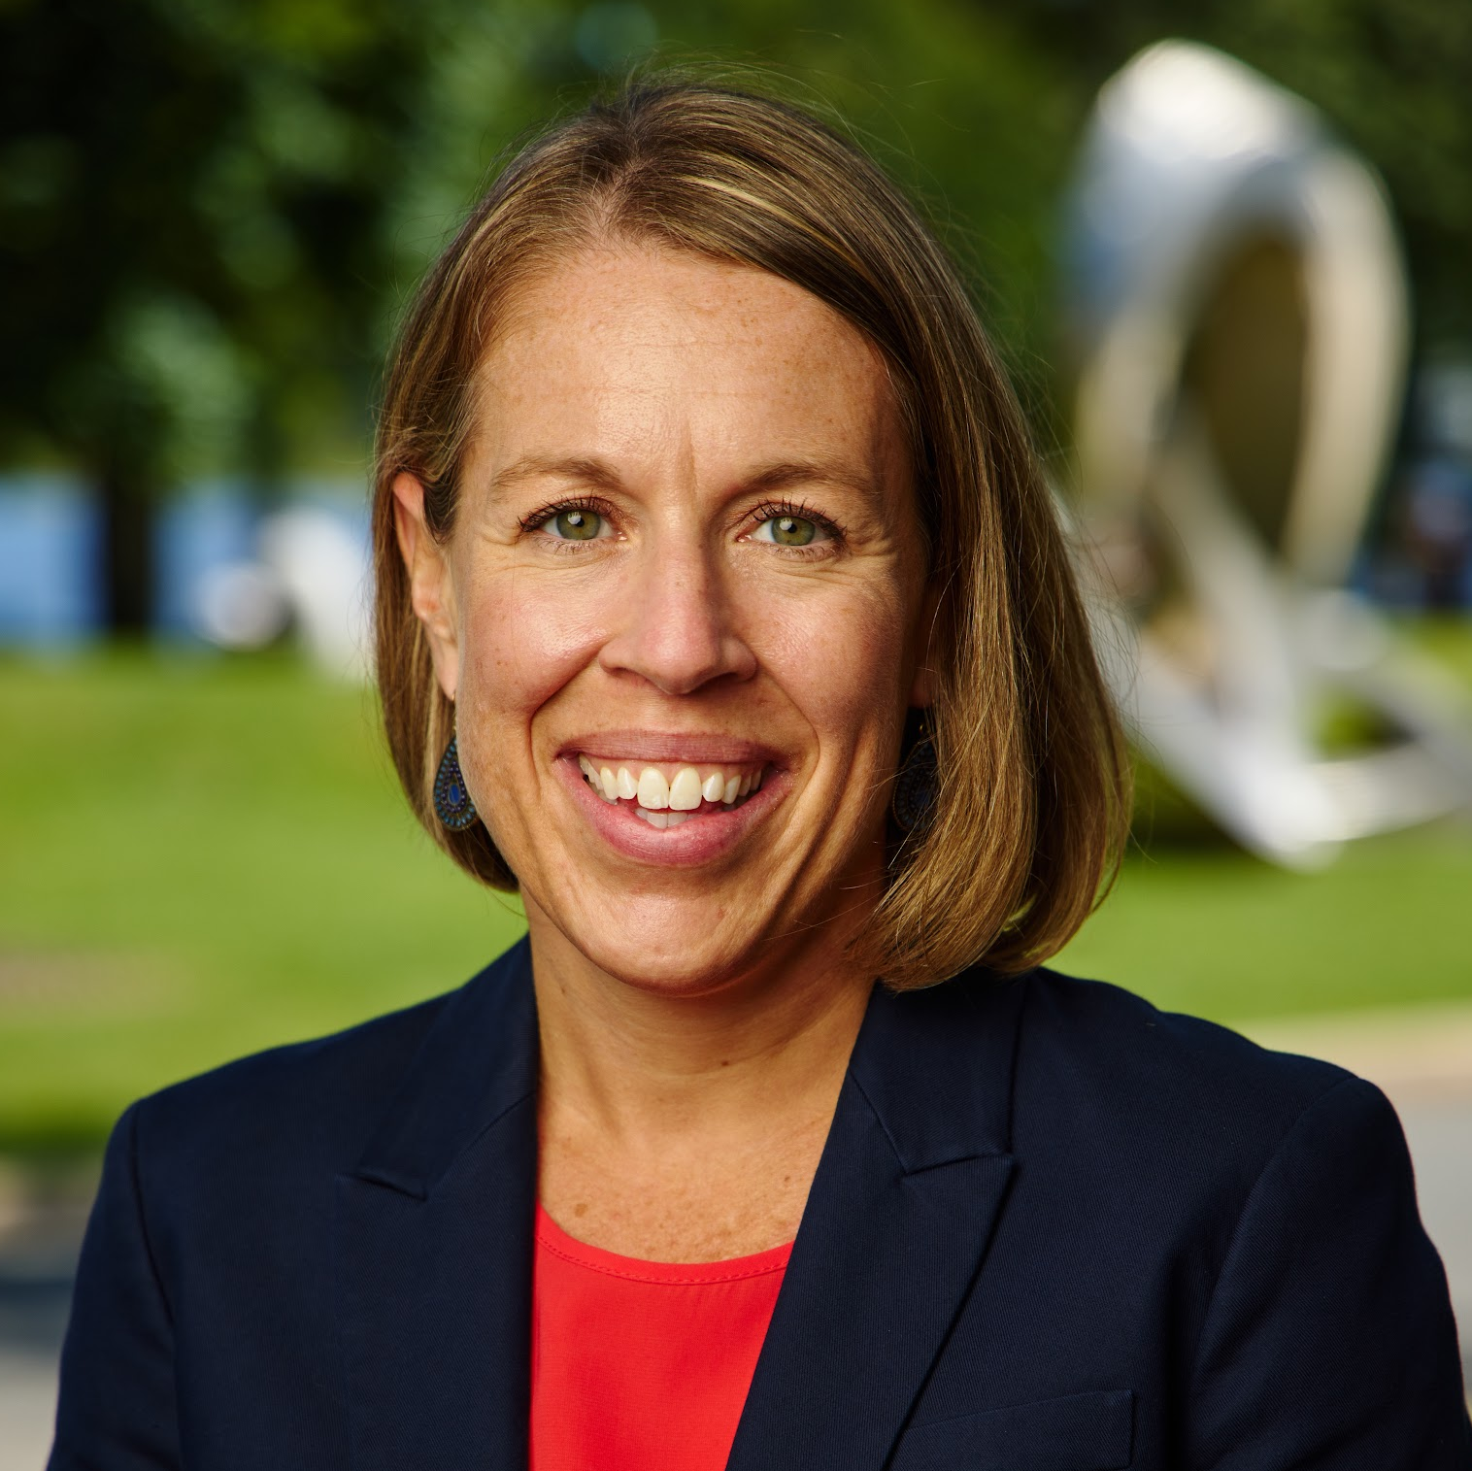
Min Ye
Professor
International Relations
Frederick S. Pardee School of Global Studies
Holly Schaaf
Senior Lecturer
Writing Program
College of Arts & Sciences
Langdon White
Clinical Assistant Professor
Computing and Data Sciences
Faculty of Computing & Data Sciences
Sean Kealy
Clinical Associate Professor
Law
School of Law
Max Greenberg
Senior Lecturer
Sociology
College of Arts & Sciences
Moderator
Erin Salius
Director of the CAS Experiential Learning Connector
College of Arts & Sciences

Slide 5
Min Ye
Professor
International Relations
Frederick S. Pardee School of Global Studies
Designing Experiential Learning

Slide 6
Different purposes in designing different EL modules
Illustration
Use projects (real or hypothetical) to demonstrate a theory, or a framework
The experiential design serves as supplementary learning
Application
A systematic and serious test of a body of content or knowledge
Simulation may be used
Practicum
Impart a real project experience
Internship
Capstone
Work study

Slide 7
The design parameters for different EL modules
If illustration:
a team or individual project
Brainstorming
Step-step drafting
Reporting
Assessing
If application:
A semester long, staged project
Frequent interventions and feedback
Submit parts of the assignment
Various reports
Feedbacks
If practicum:
The whole experience
Norming
Framing
Skill development
Hands off yet attentive supervision
Check in
Quality control

Slide 8
EL modules are flexible and adaptive
Experience-based
Project-based
A hybrid:
Experiential
Project
Experiences and projects can be real, or hypothetical, or mimicking
Studying abroad
Internship
Community engagement
Films and artifacts
Foreign news and documentaries
Simulation with a task
Guided project bid

Slide 9
Thank You

Slide 10
Holly Schaaf
Senior Lecturer
Writing Program
College of Arts & Sciences
EL and Student Reflection:
Predictions, Process, and Transfer

Slide 11
What Can Students Do by Reflecting on EL?
* Set their own initial goals for a course, experience, internship, practicum, etc.
* Analyze their predictions about a site or an event or a community partner
* Consider how their observing/thinking/writing strategies are transforming through EL
* Connect their experiences to experiences of classmates, colleagues, or community partners
* Figure out how data from their own fieldwork links to prior research
* Determine how they will use their experiences in specific assignments
* Choose what general skills it will help to transfer to specific future contexts
* Analyze situations they experienced that have parallels to specific future academic and professional contexts and plan future strategies to use in those contexts
* Gain clearer understandings of their own positionality in relation to a field or profession they are preparing to enter

Slide 12
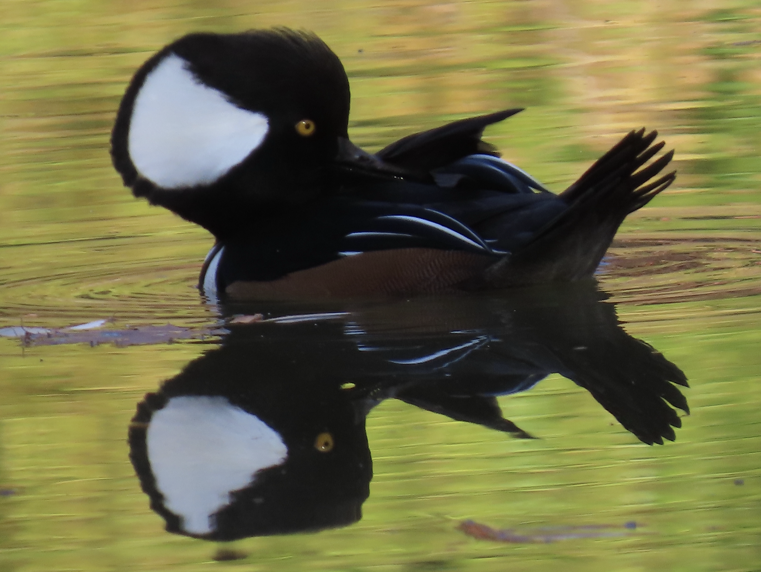
Before: Pre-Reflection
1. How do you expect the landscape of Hall’s Pond Sanctuary will look? Describe what you think a walk through the sanctuary will be like.
2. Hall’s Pond is an urban sanctuary. How do you expect that will affect your experience of nature there?
3. What kinds of animals and plants do you think you might encounter?
4. How do you expect people who visit the sanctuary will behave?

Slide 13
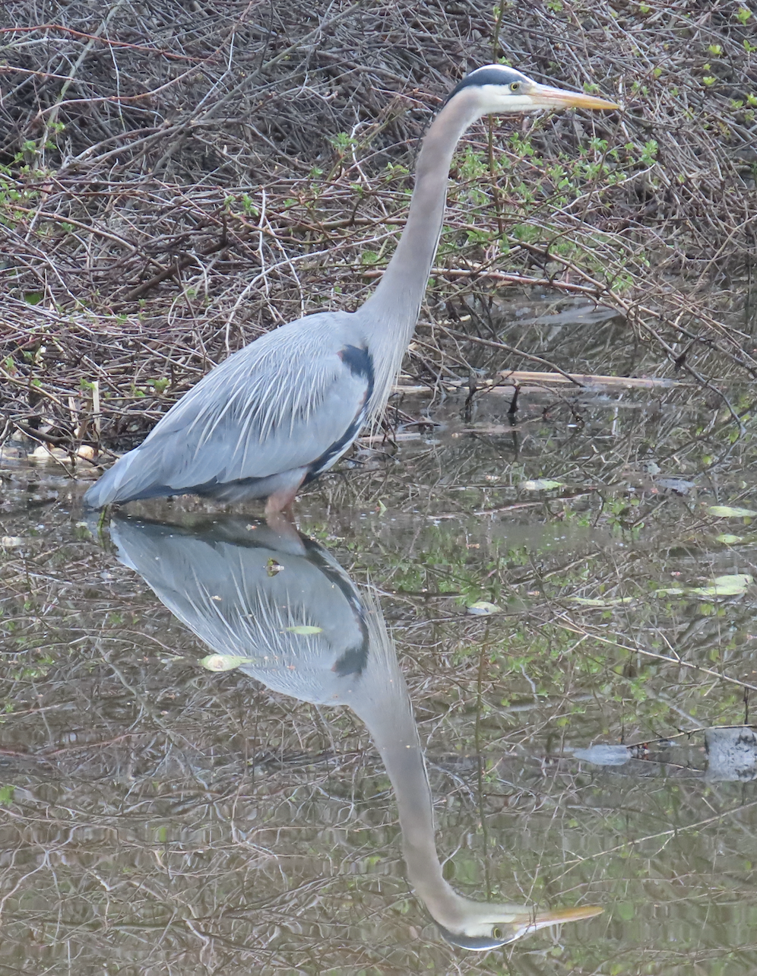
During: Processes in Progress
*A student notices a pile of branches left at the sanctuary and later reflects on how they initially saw it as a sign of neglect but then observed an Eastern cottontail rabbit and later an American robin using it to hide and realized the need to read landscapes through non-human eyes.
*In the process of conducting observations of Eastern gray squirrels at Boston Common and Hall’s Pond to prepare for writing a brief original research study, students look back at observation notes, reflect on patterns of behavior they observed in squirrels at each site, begin to put their data in conversation with trends highlighted in prior research, and make specific plans for further observation sessions.

Slide 14
After: Transitions and Transfer
“When looking for specific data, I found the squirrels were not behaving the way I wanted them to. (Which, no surprise there, they’re wild animals!) I had to learn to accept that my initial hypothesis would not always be proven correct (even if I wanted to look really smart and get everything right.) I also had to learn the skills of flexibility and patience. Not only are these life skills that will be used for the rest of my time on Earth (hopefully), but they are also important for writing specifically.”
“I will be doing extensive research in the future since I plan to go to grad school so it was a very valuable lesson to learn that data is not always quantitative and that observational data such as the appearance of the landscape can be compared to numerical data such as the percentage of canopy cover to achieve more detailed and precise conclusions.”
“In chemistry we do experiments and watch reactions occur. At first glance I could write that the reaction is fizzy and forms a precipitate. If I look in more detail, I could find that the precipitate is white clumps and makes a tiny fizzing noise. These detailed observations lead me to conclude that something in my reaction is insoluble. Paying attention to details can help me understand the larger concepts of the sciences that I study.”
“I am planning to be a veterinarian . . . These observation skills will come in handy when I do anatomy labs with animals and when I begin my career and have to carefully observe my patients.”

Slide 15
Thank You

Slide 16
Langdon White
Clinical Assistant Professor
Computing and Data Sciences
Faculty of Computing & Data Sciences
Teaming for Experiential Learning

Slide 17
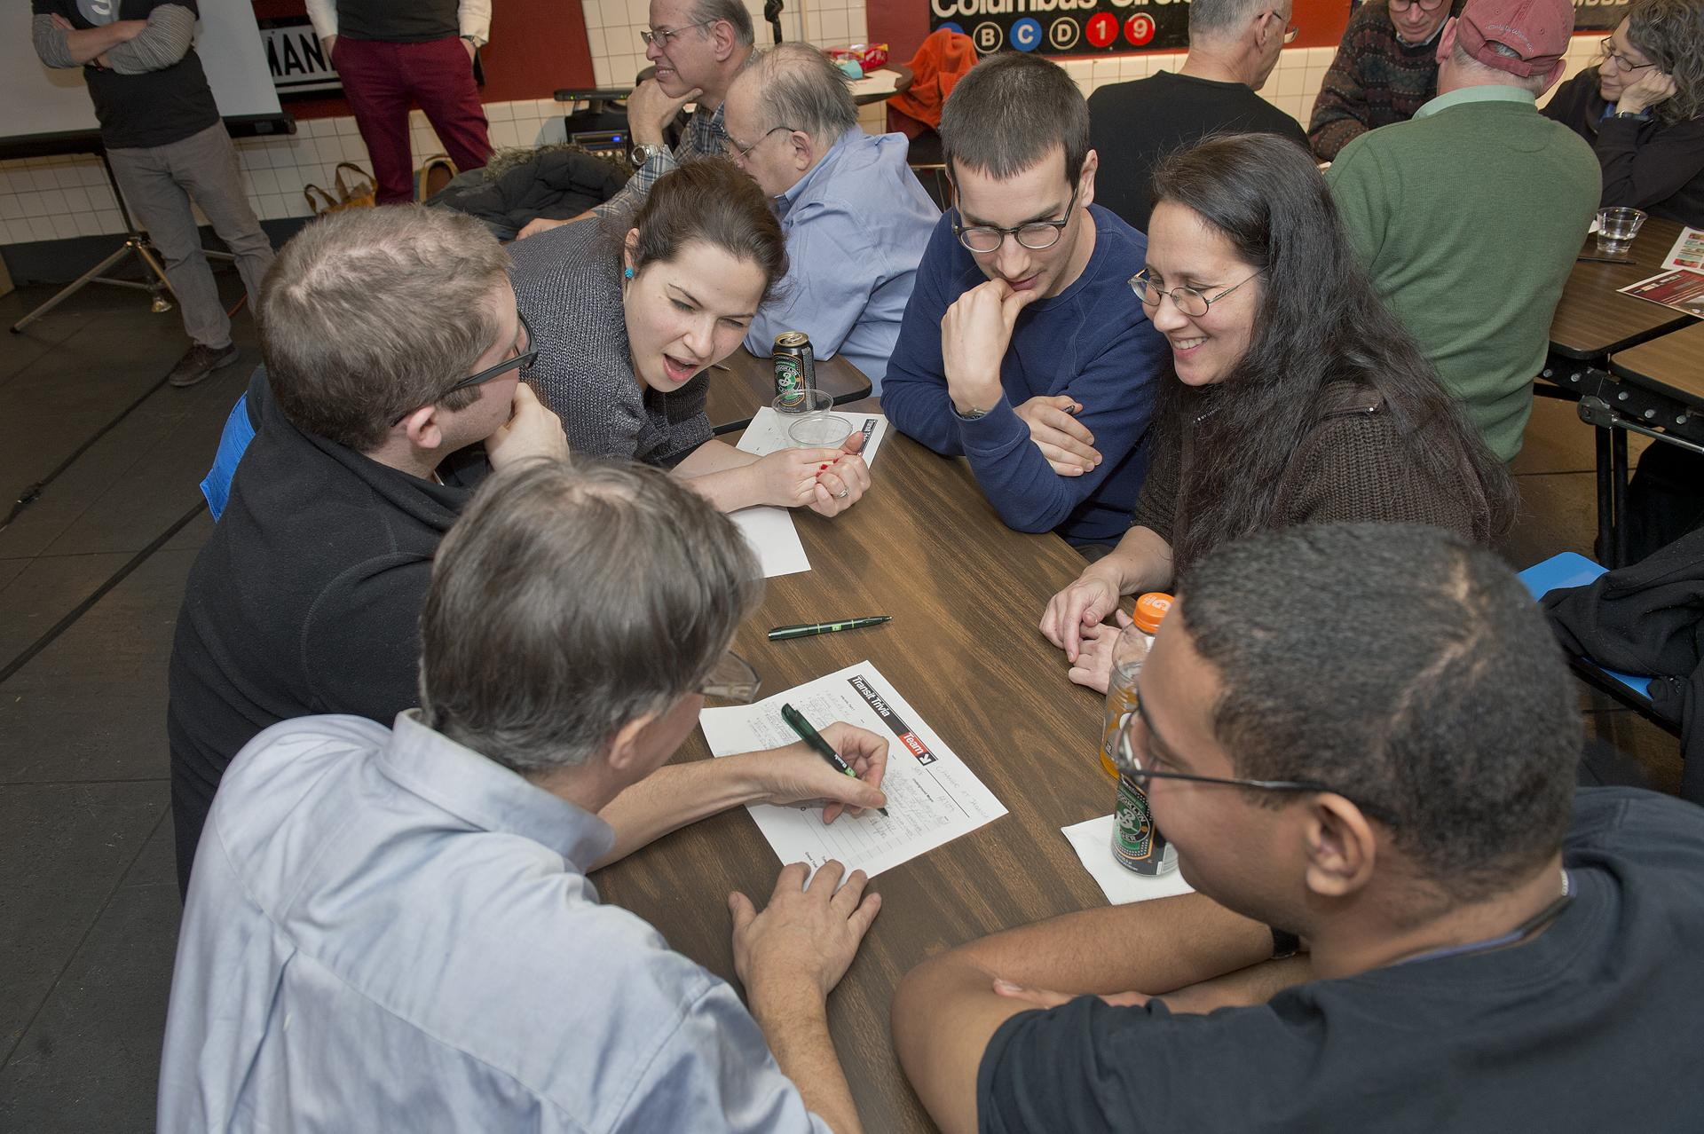
Keys To Strong Teams
Form Teams Carefully
Enforce Team Agreements
Set Clear Definitions
Schedule Feedback

Slide 18

Team Formation
Structure - Equitable Teaming
  Contribution Grading
  Team Meeting Photos
  Diversity of Perspectives
Creation Inputs
Participant Project Preferences
Teammate Schedules

Slide 19
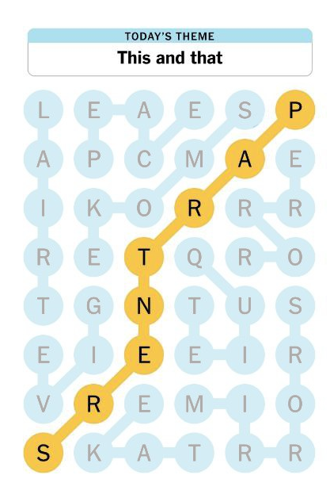
Clear Definitions
Communication Norms
Unified Channels
Response Time Expectation by Channel
Channel Content Types
Definition of Done
What does it mean when “Done”
Meetings
Agendas
Attendance Expectation / Notice

Slide 20

Scheduled Feedback
Multiple Times a Semester
Grading Impact
360 Style
Retrospectives

Slide 21
Attributions
"Transit Trivia Night" flickr photo by MTAPhotos shared under a Creative Commons (BY) license
“A lazy Sunday afternoon knitting” by Rebecca Grant on Unsplash
New York Times Strands
"Infinite loop" flickr photo by kurafire shared under a Creative Commons (BY-NC) license

Slide 22
Thank You

Slide 23
Sean Kealy
Clinical Associate Professor
Law
School of Law
EL in Law: Rubrics & Mock Hearings

Slide 24
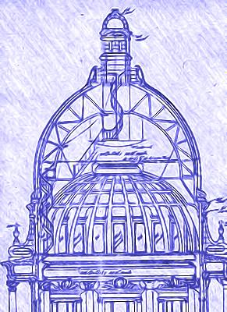
Boston University School of Law
Legislative Policy & Drafting Clinic

Slide 25
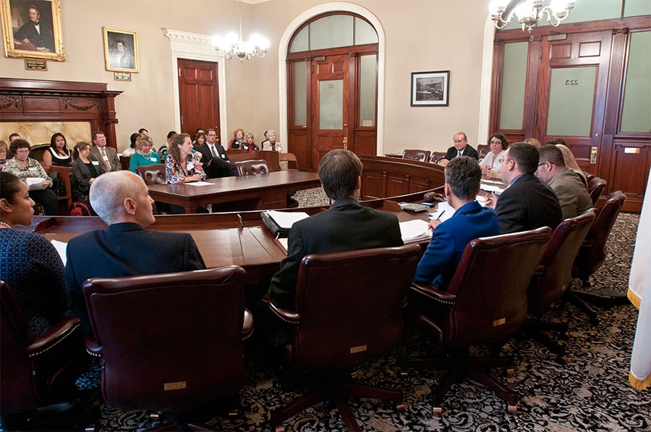
Mock Hearing
Held at State House
Panel composed of senior legislative staff
4 minute prepared testimony
6-10 minutes of questions
Testimony is filmed
Students write a reflection on what they did well / could improve

Slide 26
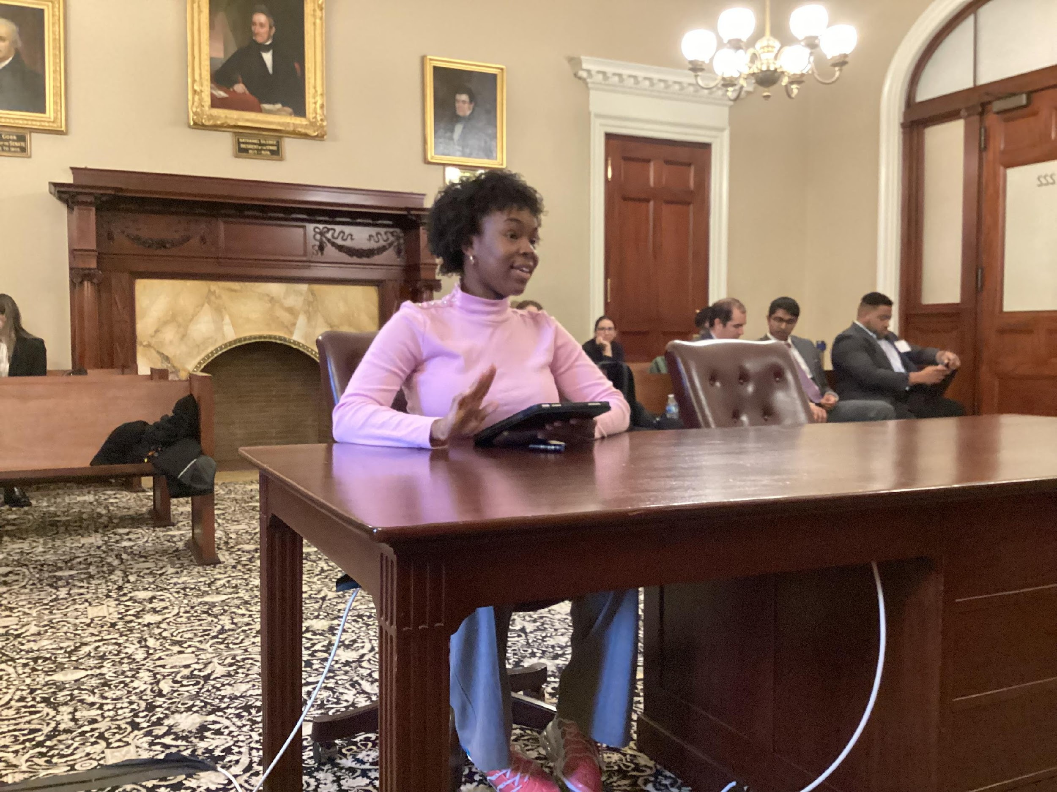
Mock Hearing

Slide 27
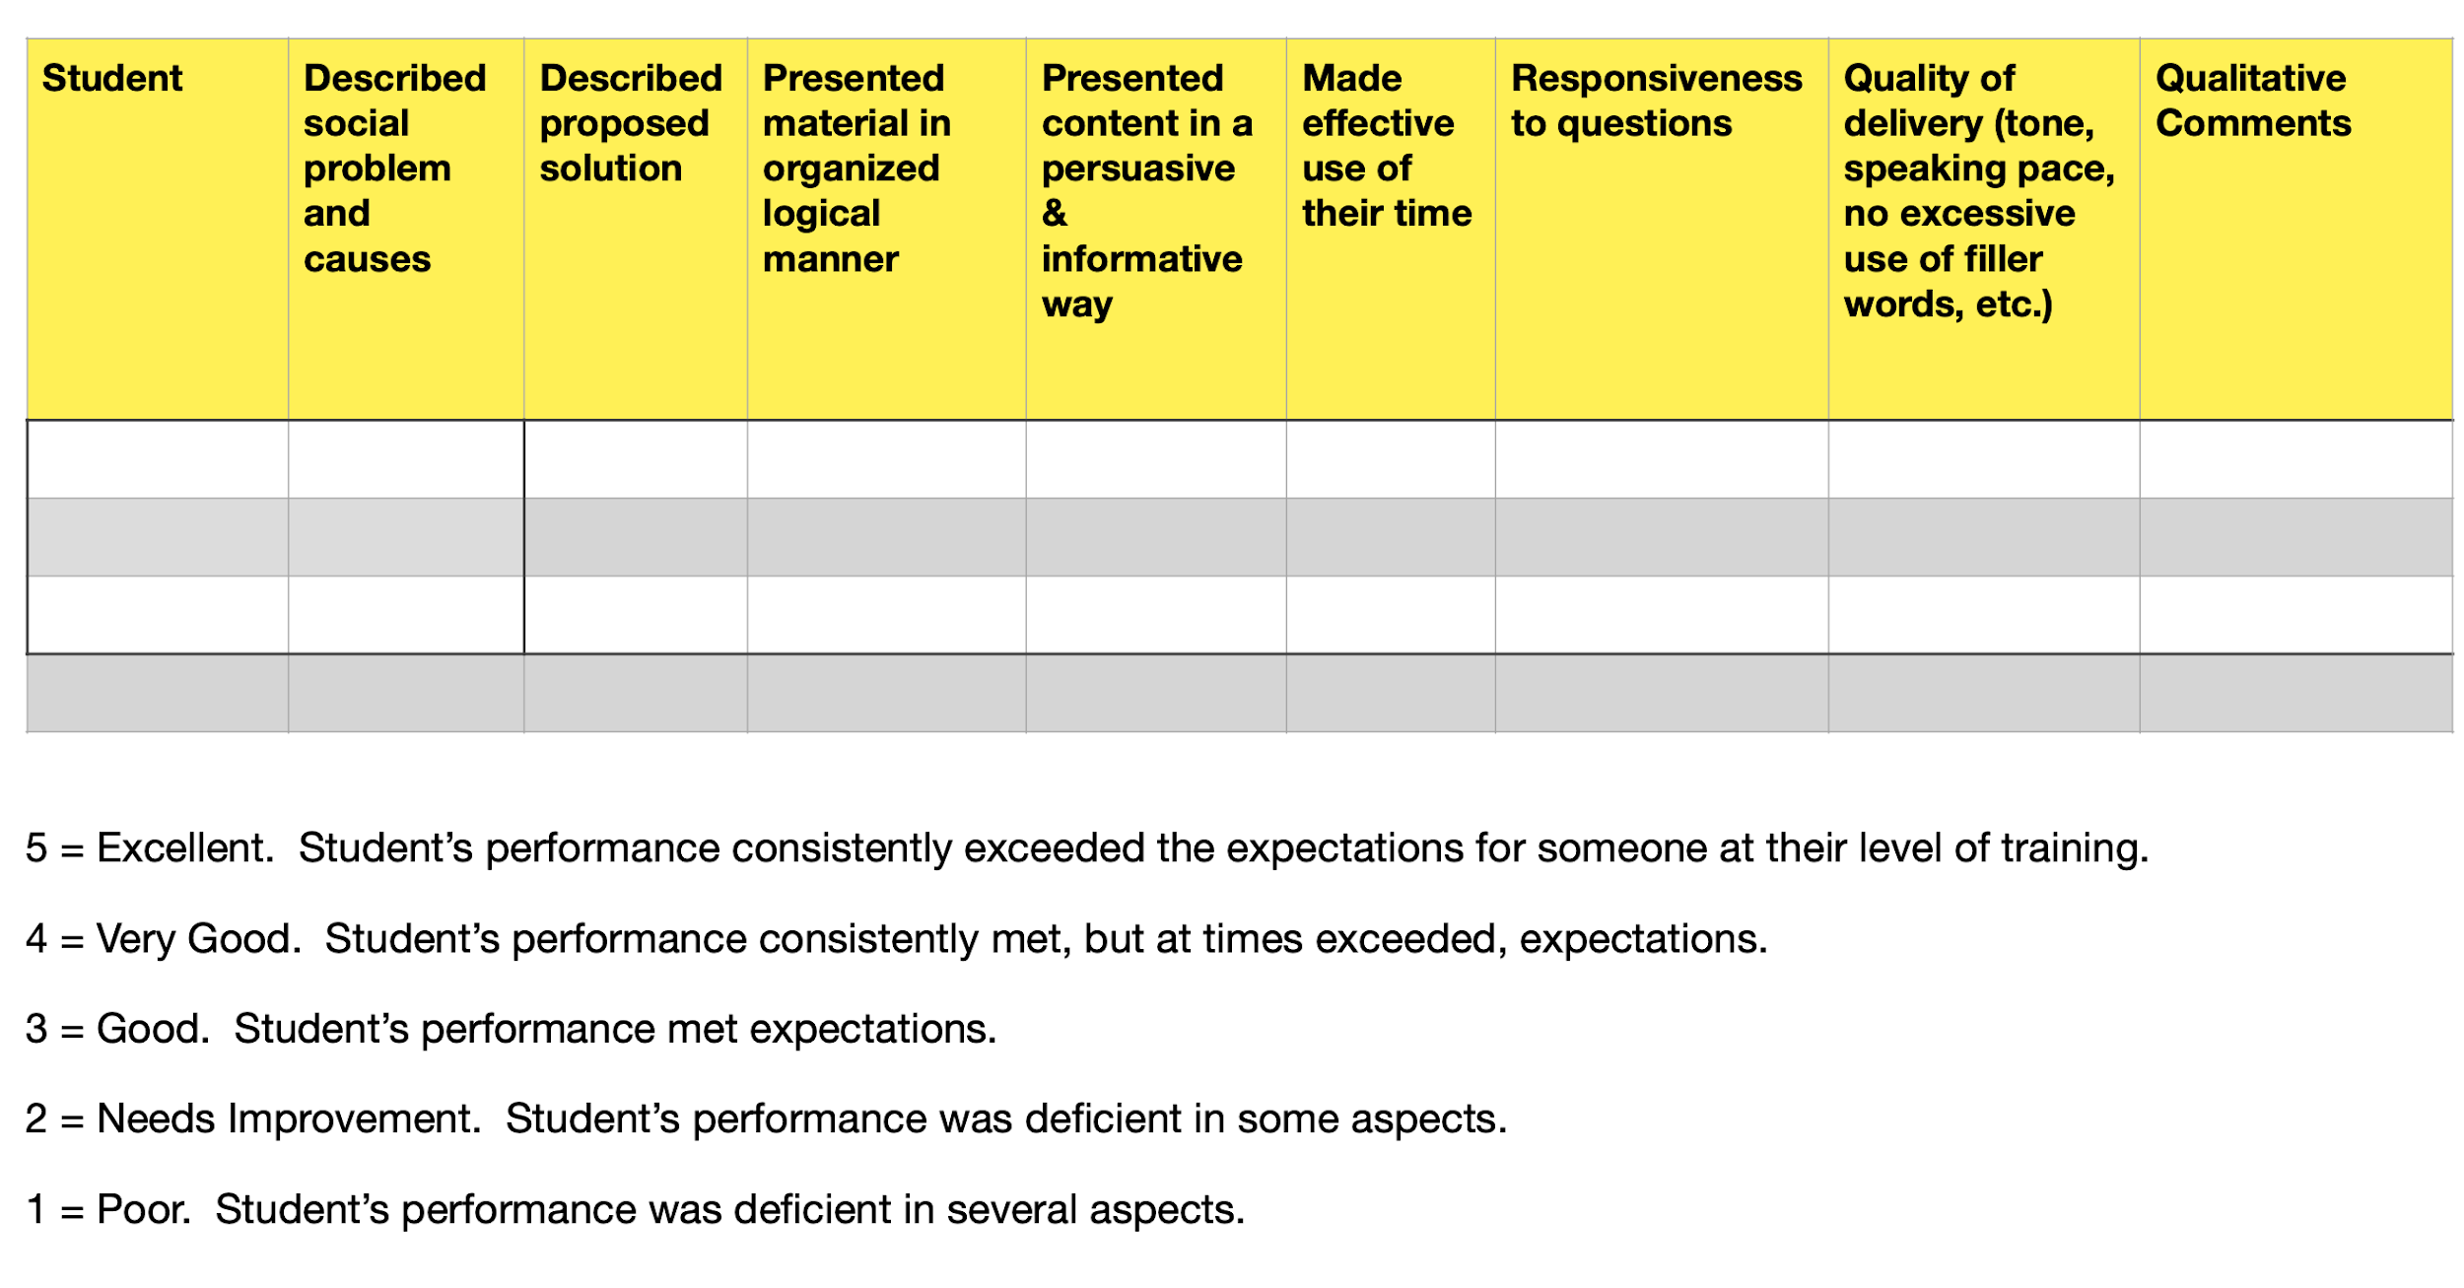
Oral Advocacy Rubric

Slide 28
Thank You

Slide 29
Max Greenberg
Senior Lecturer
Sociology
College of Arts & Sciences
Partnerships for Experiential Learning

Slide 30
What is a partnership good for?
Expanding horizons in relation to (but outside of) academic settings, allowing students to engage intellectually, creatively, and socially.
Practicing skills in structured real-world settings that allow students to take actions and learn from natural consequences, mistakes, and successes
Connecting with individuals and organizations, in order to build networks of future peers, mentors and colleagues

Slide 31
What can partnerships look like?
Community or Project-based
Practicum
Service-learning
Internship (with coursework)
Anything you can dream up!

Slide 32
How to prepare for a partnership
Work with partners to set expectations and plan logistics
Align students and partners
Set up mechanisms for ongoing feedback and accountability
Be ready to change direction
Case study: CAS SO 499: Internship & Fieldwork Practicum

Slide 33
Thank You

Slide 34
Q&A

Slide 35

INSTAGRAM:
@BU_CAS
STAY CONNECTED
WEBSITE:
bu.edu/cas-connector/
EMAIL:
casel@bu.edu
VISIT US
CAS 109

Slide 36


Slide 37
CAS EXPERIENTIAL LEARNING CONNECTOR PROGRAMS
CAS INTERNSHIP (IN 299)
SUMMER INTERNSHIP SUPPORT
EL AMBASSADORS
EL
MENTORSHIP
Helps fellow CAS undergraduates find and access opportunities through consultations and workshops.
Matches first-year CAS undergrads with an upperclass student mentor to build community, reflect on their experiences, and develop skills to maximize their experiential learning.
Offers undergraduates the opportunity to earn credit and a HUB Unit (through CAS IN 299) while interning in fall or spring semesters.
Provides on-campus housing & dining to CAS undergraduates with unpaid or low-paying internships in the Boston area.
NOW
BOOKING
APPOINTMENTS

Slide 38
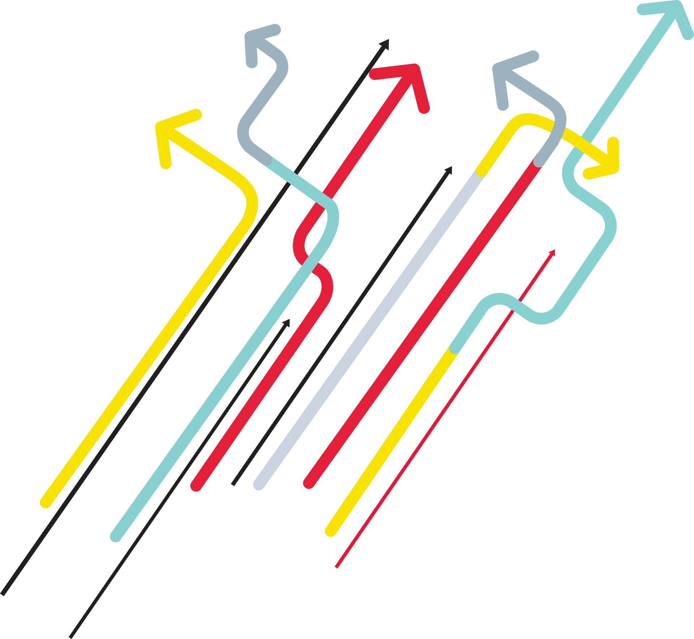
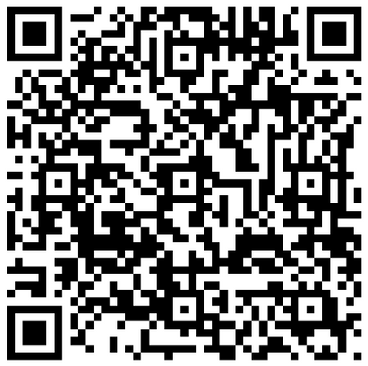
VIRGINIA SAPIRO ACADEMIC ENHANCEMENT FUND
APPLY NOW
AY24-25

Slide 39
Thank You for your participation in the
Lightning Talks Speaker Series.
Questions or Comments?
Center for Teaching
& Learning
ctl@bu.edu
www.bu.edu/ctl
Digital Learning & Innovation
digital@bu.edu
www.bu.edu/dli
Post-survey: https://bit.ly/3Q5Y3ly

