Slide 1
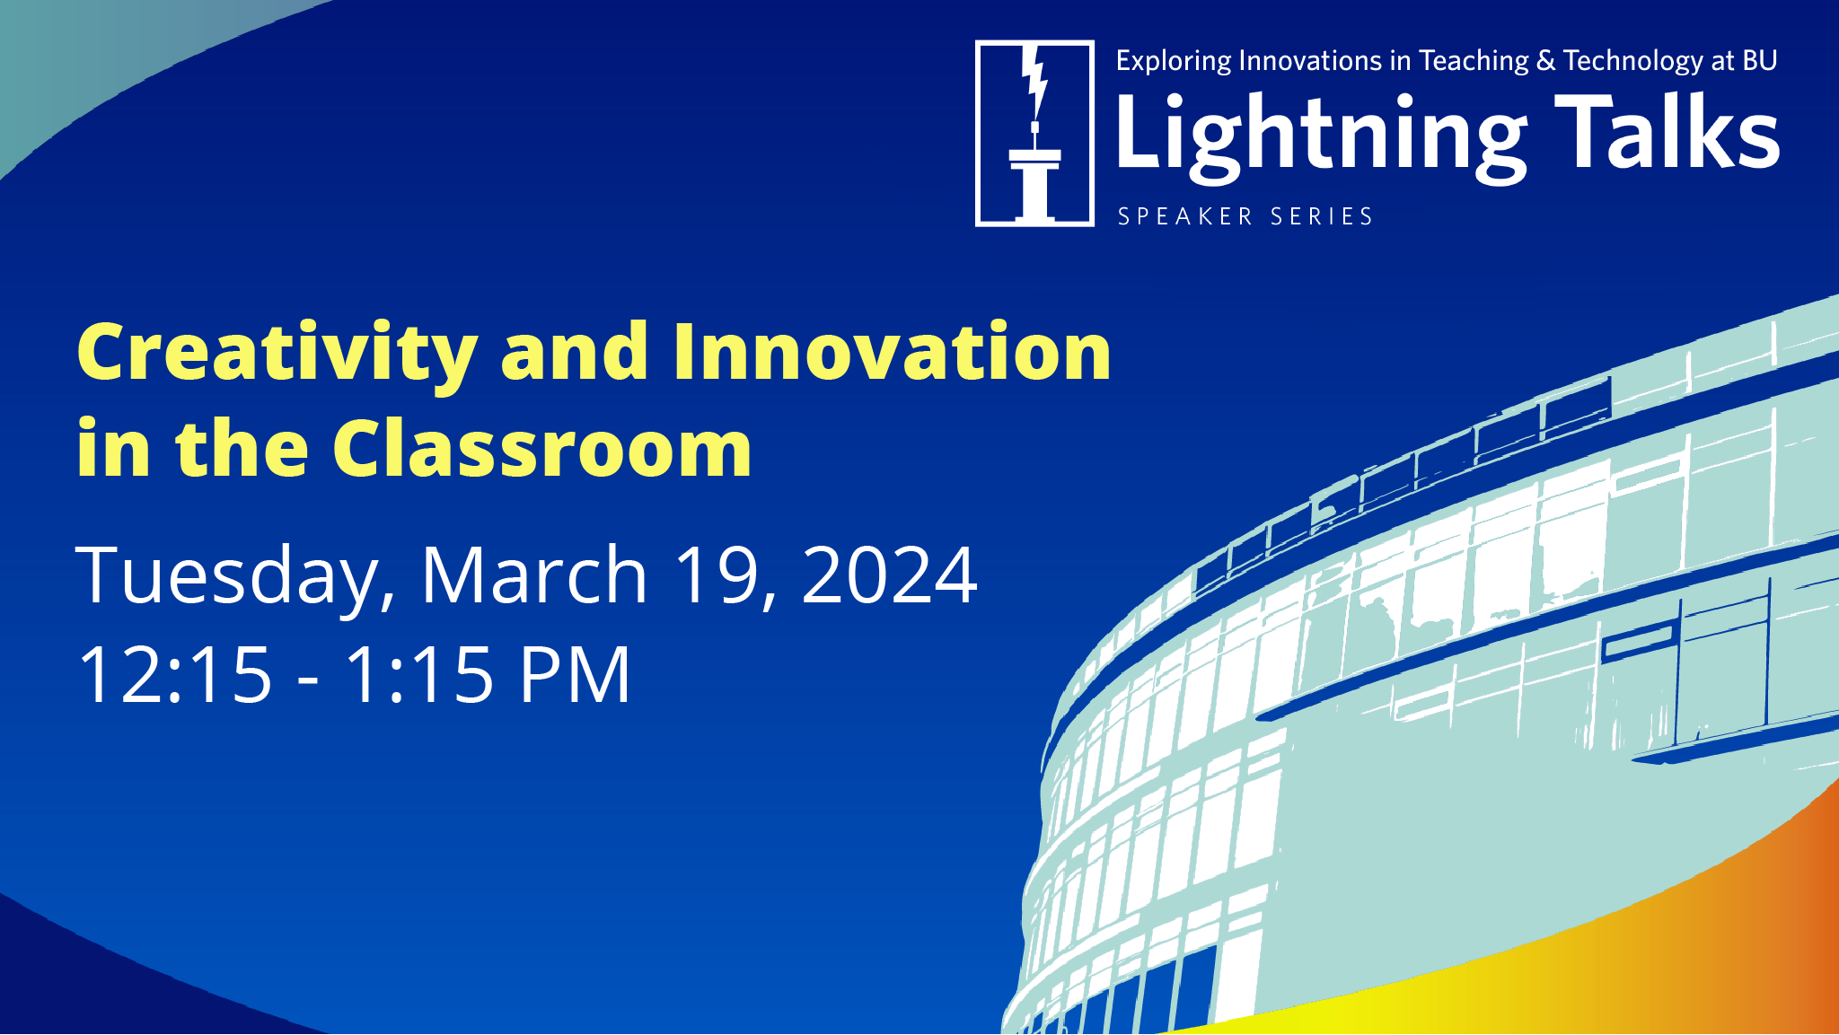

Slide 2
Recording
Today’s Lightning Talks are being recorded and will be available for viewing via bu.edu/dli later this month.

Slide 3
Q&A
Please share your questions in the chat feature and the moderator will address questions at the completion of all presentations.

Slide 4
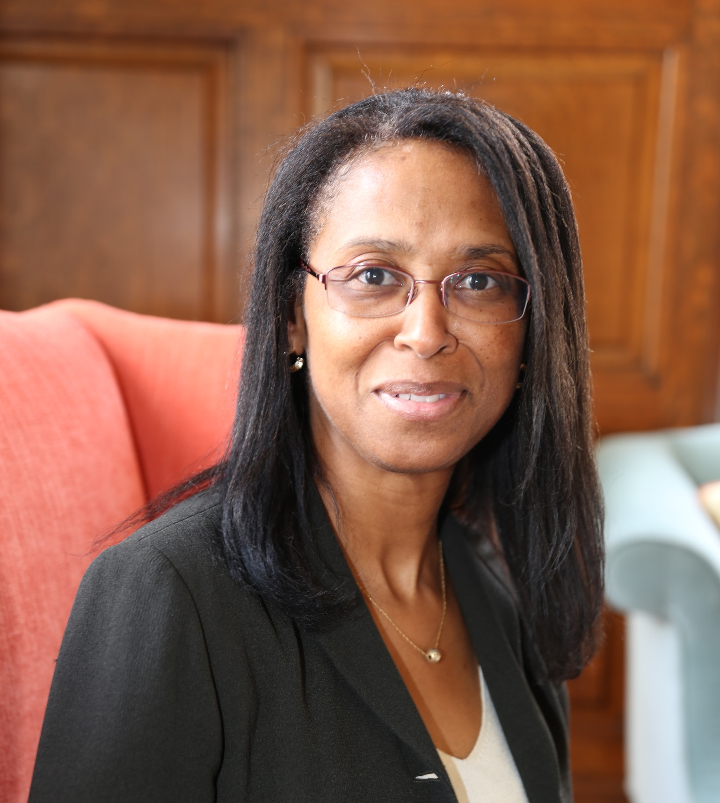
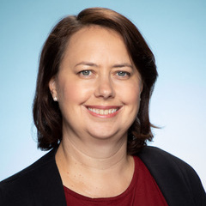
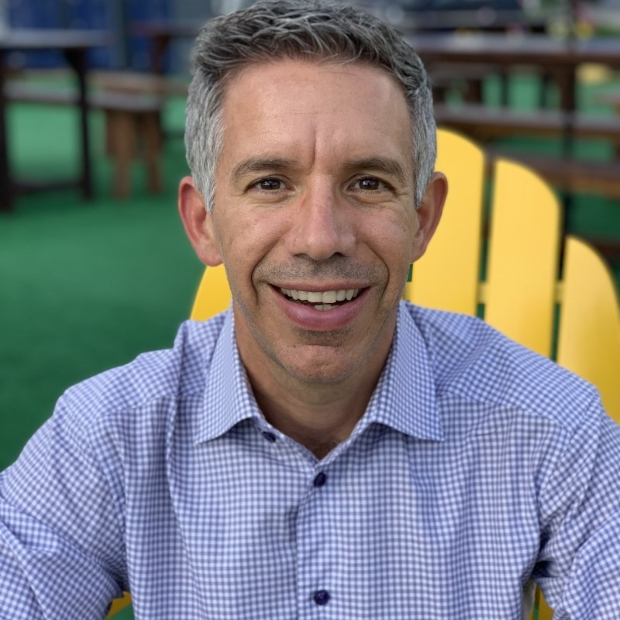
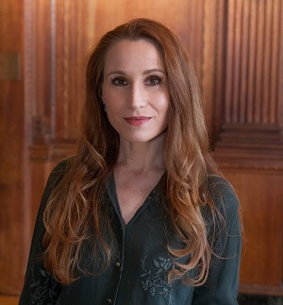
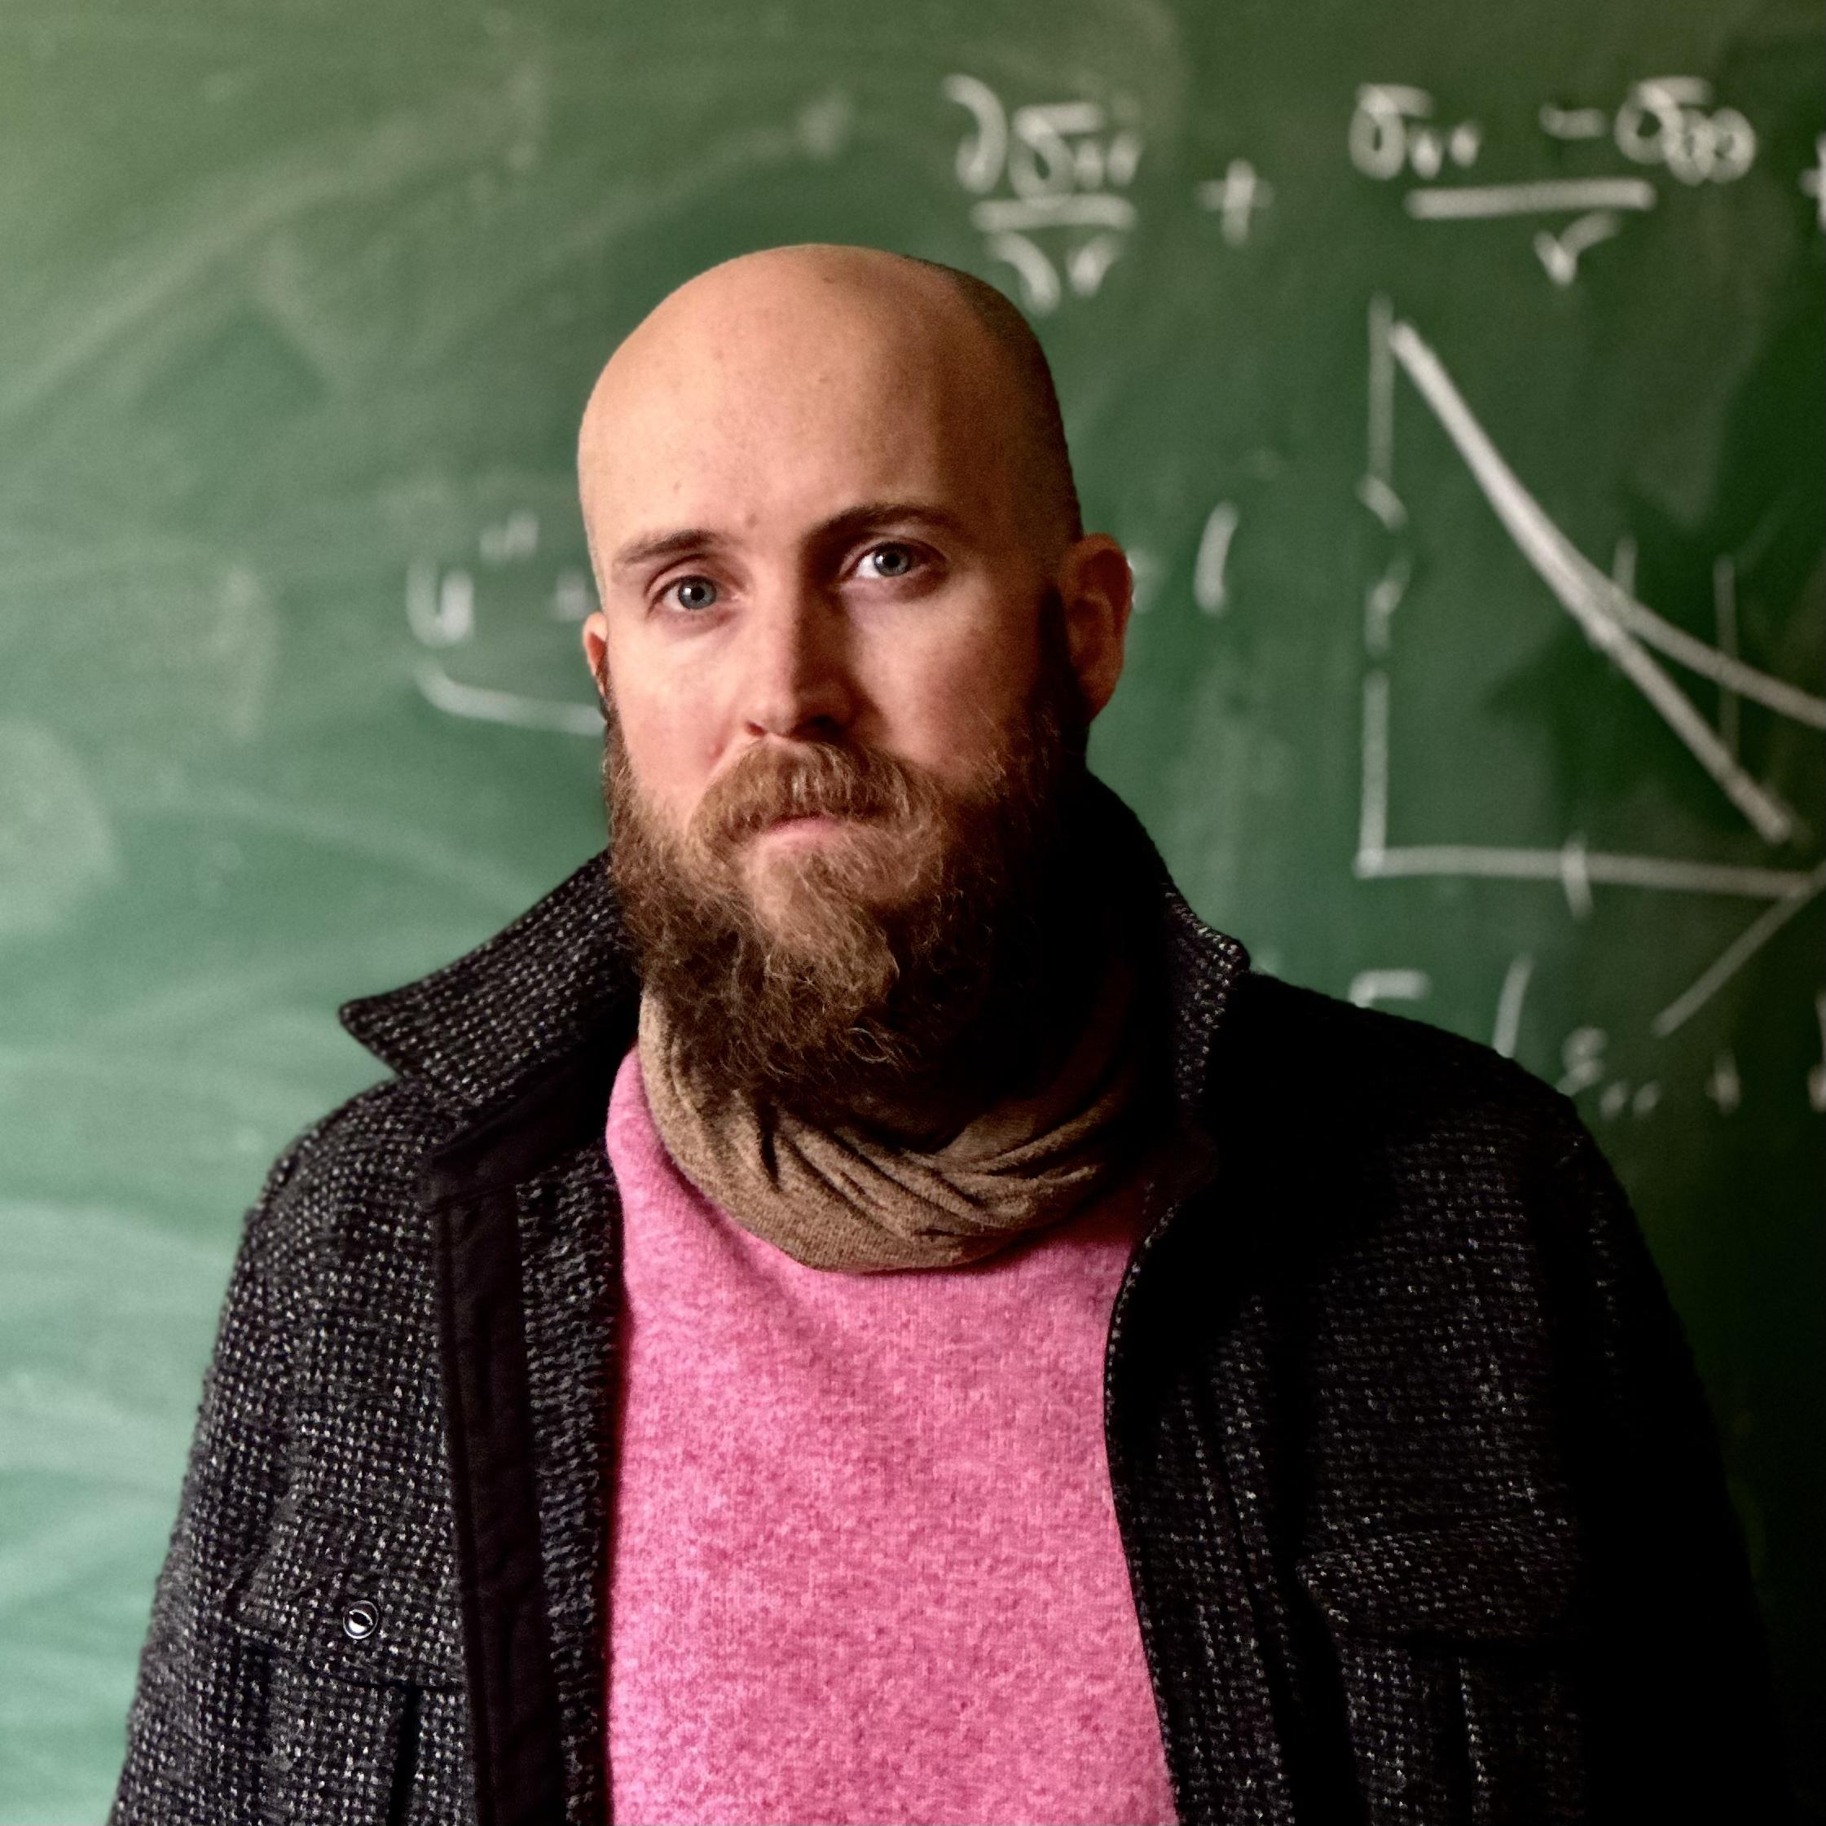

Detris Adelabu
Clinical Professor
Counseling Psychology & Applied Human Development
Wheelock College of Education and Human Development
Deborah Perlstein
Associate Professor
Chemistry
College of Arts & Sciences
Patrick Abouchalache
Lecturer
Strategy and Innovation
Questrom School of Business
Theodora Goss
Master Lecturer
Rhetoric
College of General Studies
Doug Holmes
Associate Professor
Materials Science and Engineering
College of Engineering
Moderator
James Grady
Assistant Professor
Art, Graphic Design
BU Spark! Creative Director

Slide 5
Detris Adelabu
Clinical Professor
Counseling Psychology & Applied Human Development
Wheelock College of Education and Human Development
Research, Creativity, & Innovation

Slide 6
Research, Creativity, & Innovation
Tasks Objectives
  Embrace research as achievable and within reach.
  Raise confidence.
  Ignite curiosity.
  Facilitate the transfer of knowledge.
  Foster classroom community and teamwork.
  Harness creativity and innovation.
  Set the tone for creativity and innovation early on.

Slide 7

Day 1 – Using Legos to Spark Creativity
Form two small groups (~4 students total). Group 1 will look away for 2-3 minutes while Group 2 builds a small structure. Group 1 should not see the structure. Group 2 will provide instructions to assist Group 1 in creating the identical structure. Group 1 will have 2-3 minutes to replicate the structure.
Examples of Discussion Questions:
Reflection as Researchers: Put yourselves in the role of researchers. What insights into human behavior can this activity offer?
  Follow-up Question: Consider aspects such as communication, teamwork, and adaptability, as well as the role of creativity in problem-solving.
Task Modifications: Brainstorm potential modifications to enhance or alter the activity while still focusing on creativity.
  Follow-up Question: How might allowing Group 2 to use unconventional materials or imposing time constraints affect the creative process and outcome?
Learning from Modifications: Discuss the potential lessons learned from your proposed modifications, particularly regarding creativity.
  Follow-up Question: How do these modifications influence the observed behaviors and the overall experience of the activity?
Alternative Assessments: Explore other activities or tasks that could shed light on similar aspects of human behavior, with a specific focus on creativity.
  Follow-up Question: How might encouraging divergent thinking or incorporating open-ended challenges provide insights into individual and group creativity?

Slide 8


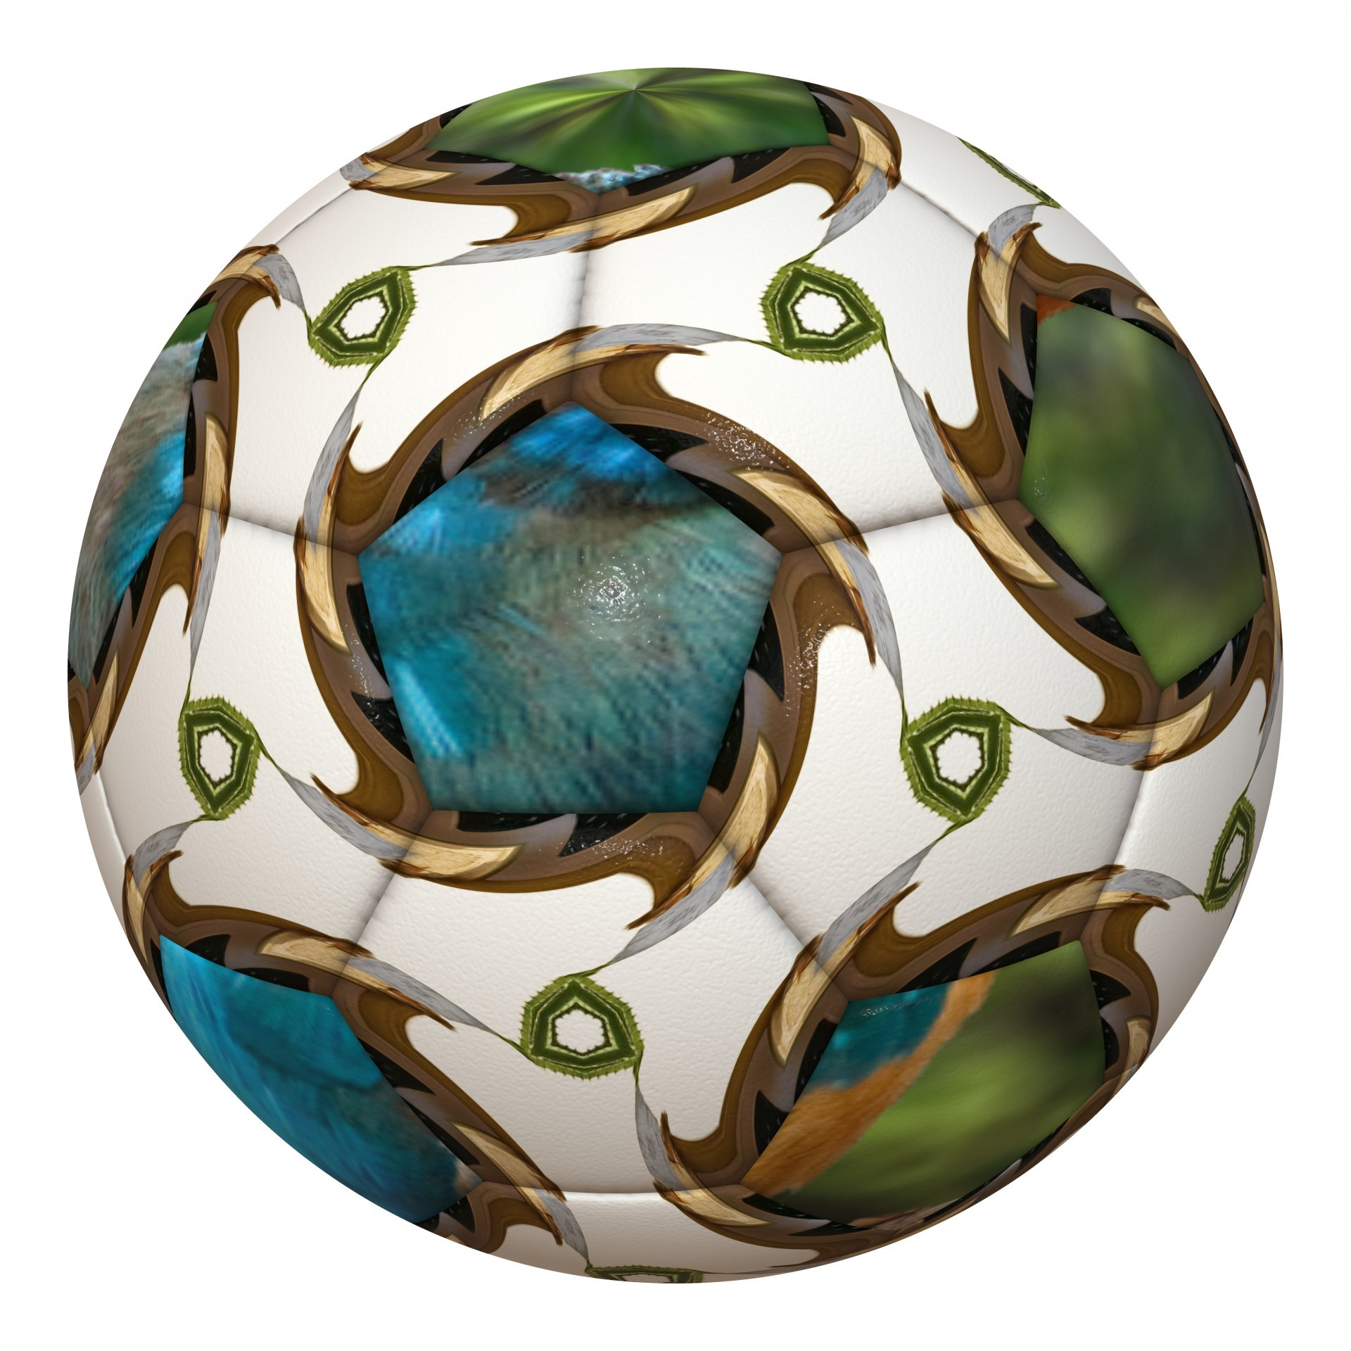




Day 2: Creativity and Innovation in Research Design
Teams collaboratively choose an object to develop an idea for a research study. At least two teams will use the same object to develop their idea.
Introduces varying approaches to research and to exploring a research topic.

Slide 9
Thank You

Slide 10
Deborah Perlstein
Associate Professor
Chemistry
College of Arts & Sciences
Sparking creativity and innovation in a science teaching laboratory

Slide 11



Why develop a laboratory course focused on creativity and innovation?
MY OWN EXPERIENCE
TRENDS IN STEM EDUCATION
EQUITABLE ACCESS

Slide 12
Course Design: moving students from “Hello Fresh” to Head Chef, but in a lab…and with biochemistry, not food
FROM…
Assessment Structure:
Weekly notebook checks
Scholarly midterm paper
Final poster session
TO…
Step by step “cookbook” style laboratory manual
Develop
protocol from primary literature
No
choices
Many choices each lab period informed by their knowledge and experimental goals

Slide 13




Lessons learned: Balance is key
Planning must be balanced with just trying things out
Both success and failure are important learning experiences
Embracing uncertainty while solidifying what they do know
Individual work integrated with group work

Slide 14
Thank You

Slide 15
Patrick Abouchalache
Lecturer
Strategy and Innovation
Questrom School of Business
How to Teach Creativity & Innovation

Slide 16


How to Teach Creativity & Innovation
Patrick Abouchalache pga4@bu.edu

Slide 17
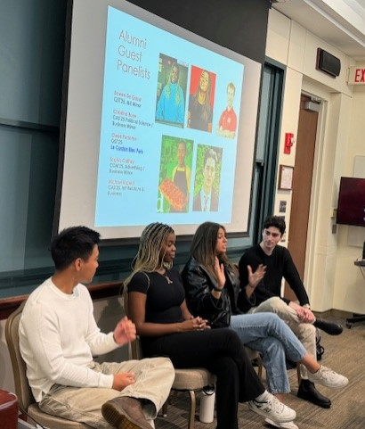
Removing artificial labels & INSTEAD collectively EMBRACING…
creativity
Motivation & JOY
Stay in moment
early
learn
lead
get out there
vulnerable
ideas
nervous
innovation
take your time
Design
empathy
VALUES
Missions
Goals
constructive criticism
curiosity
influence
methods
test & learn
communication
relationships
commitment
experience
community
people
Trust / Team
stages
cultures
skills
projects
patience
iterations
Thinking
TOO many problems
Sustainable solutions
Diversity
Inclusivity
phases
challenges
experiments
together

Slide 18
Design Thinking
The Process
01
02
03
04
05
Discovery
Interpretation
Ideation
Experimentation
Evolution
Empathy
Define
Brainstorming
Build a Prototype
Testing and Iteration

Slide 19
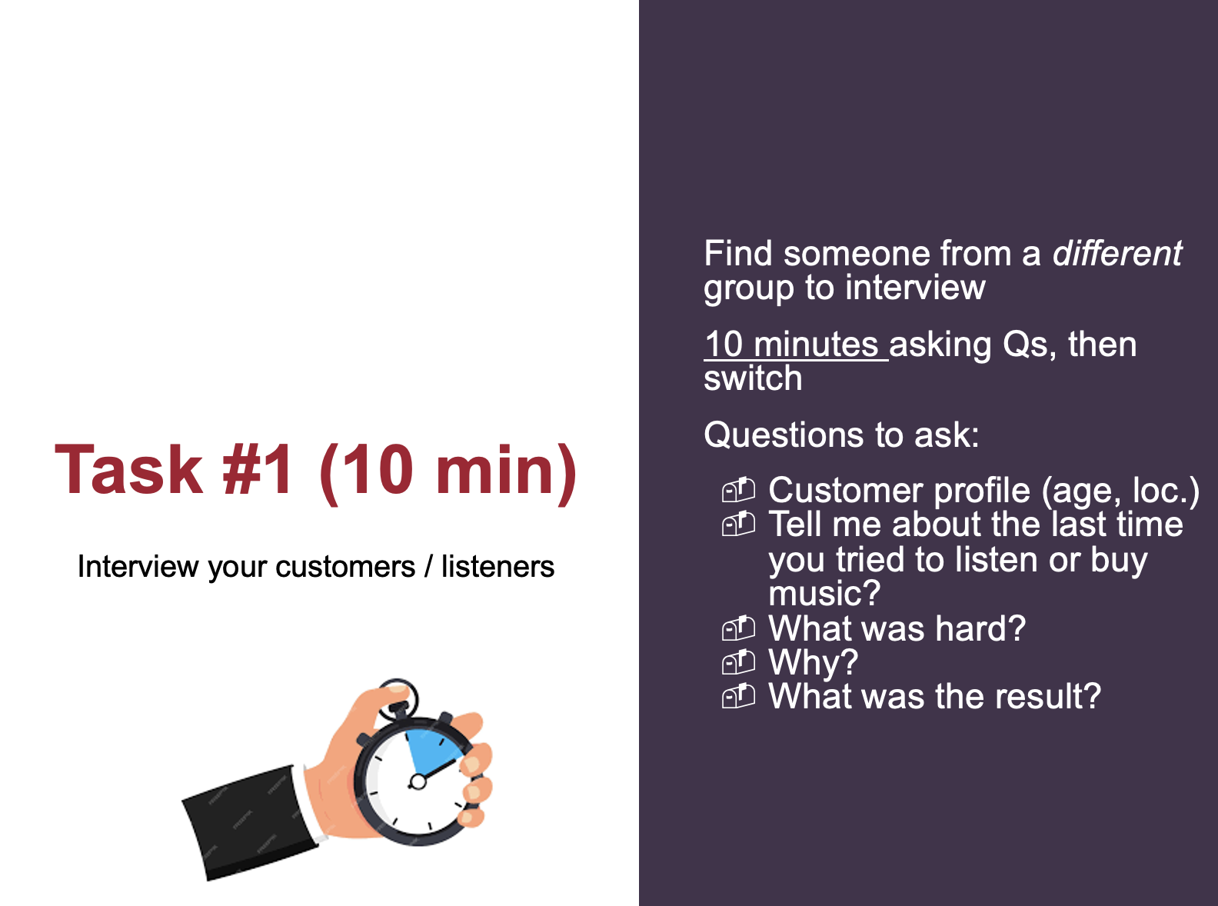
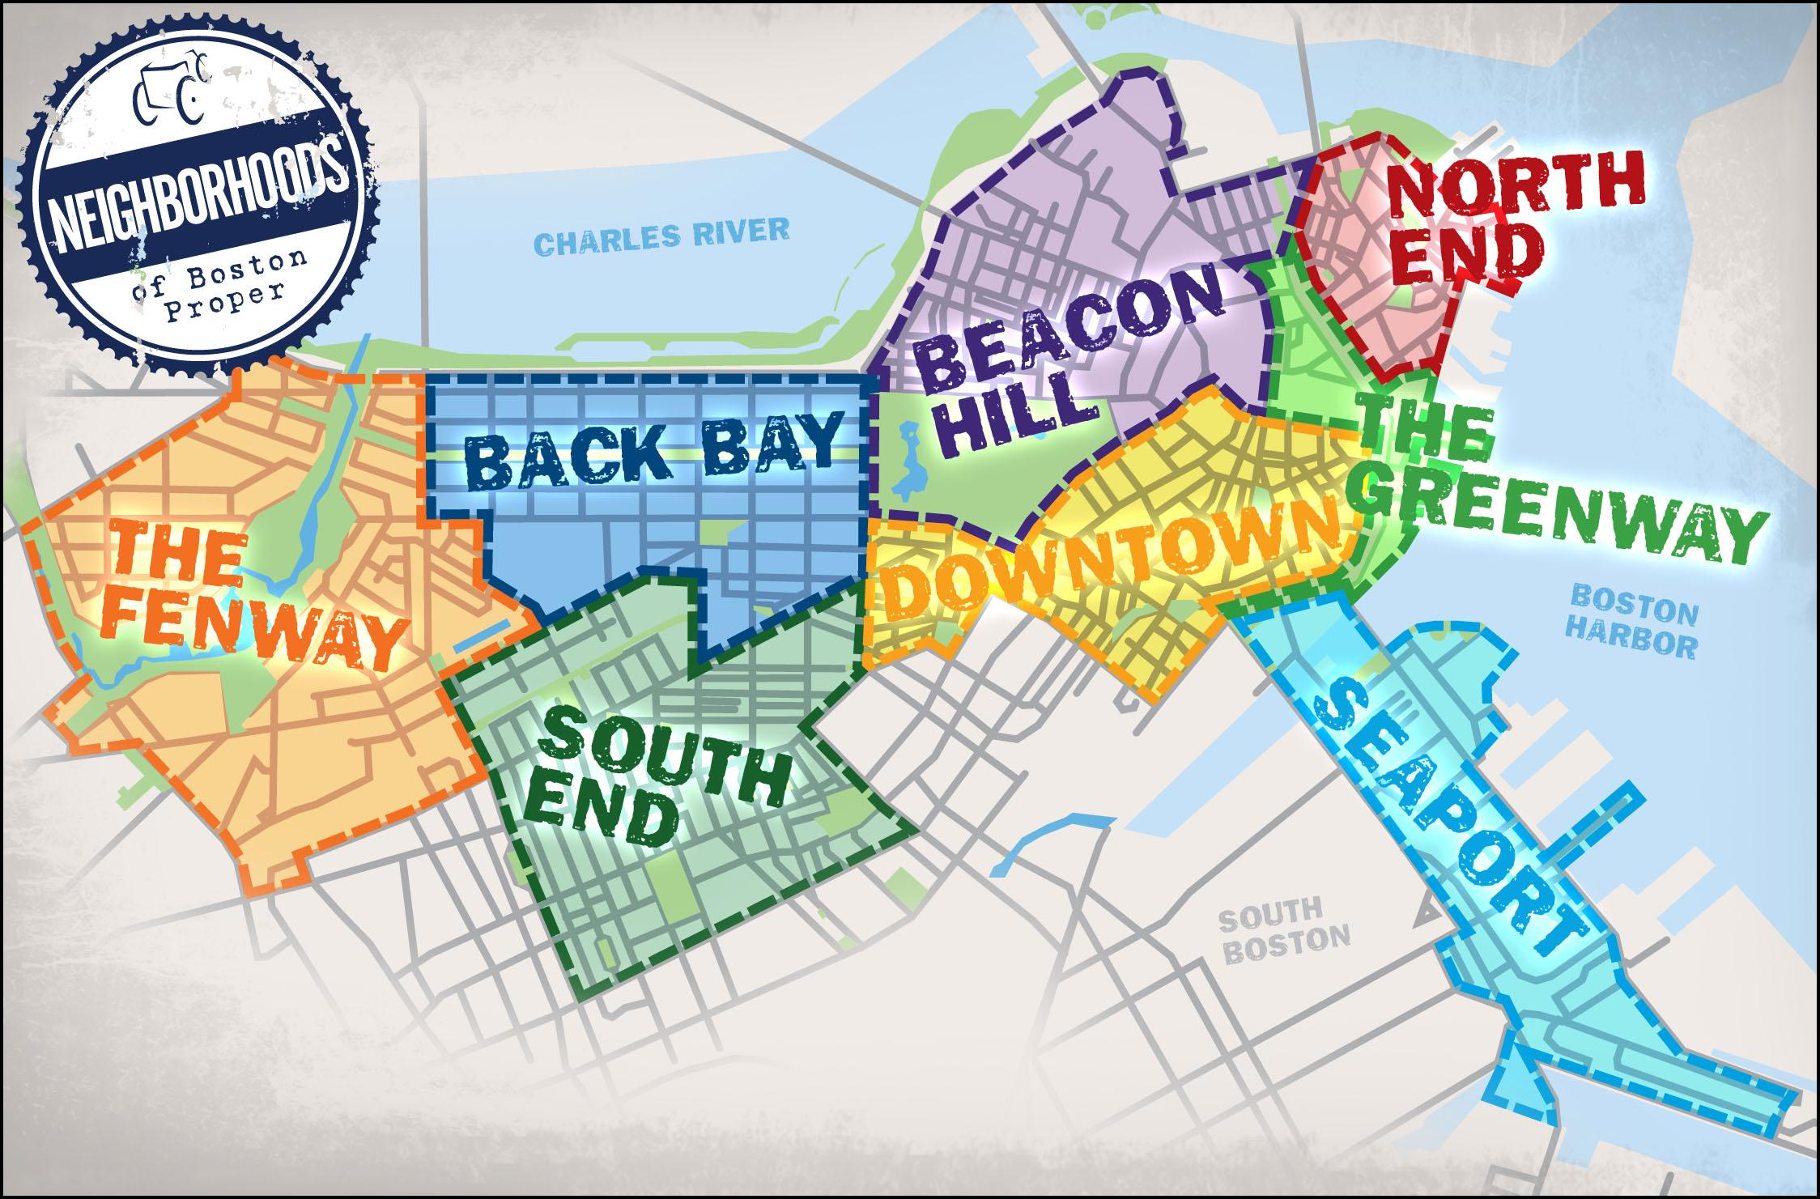
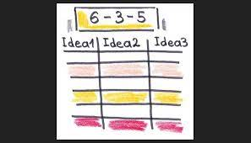




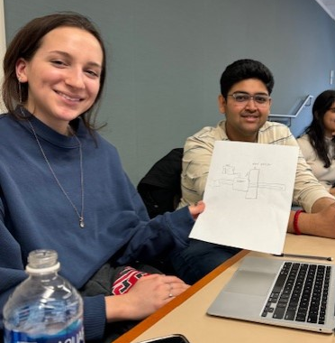

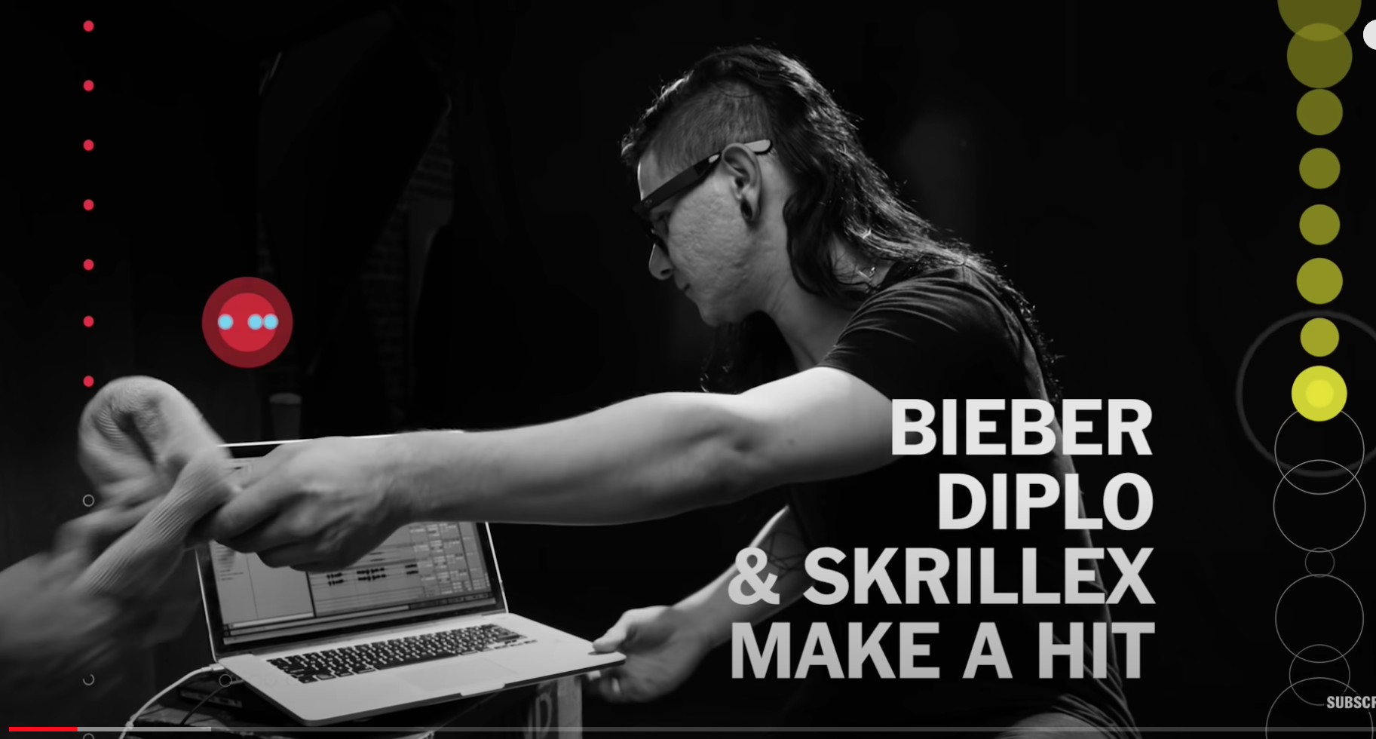
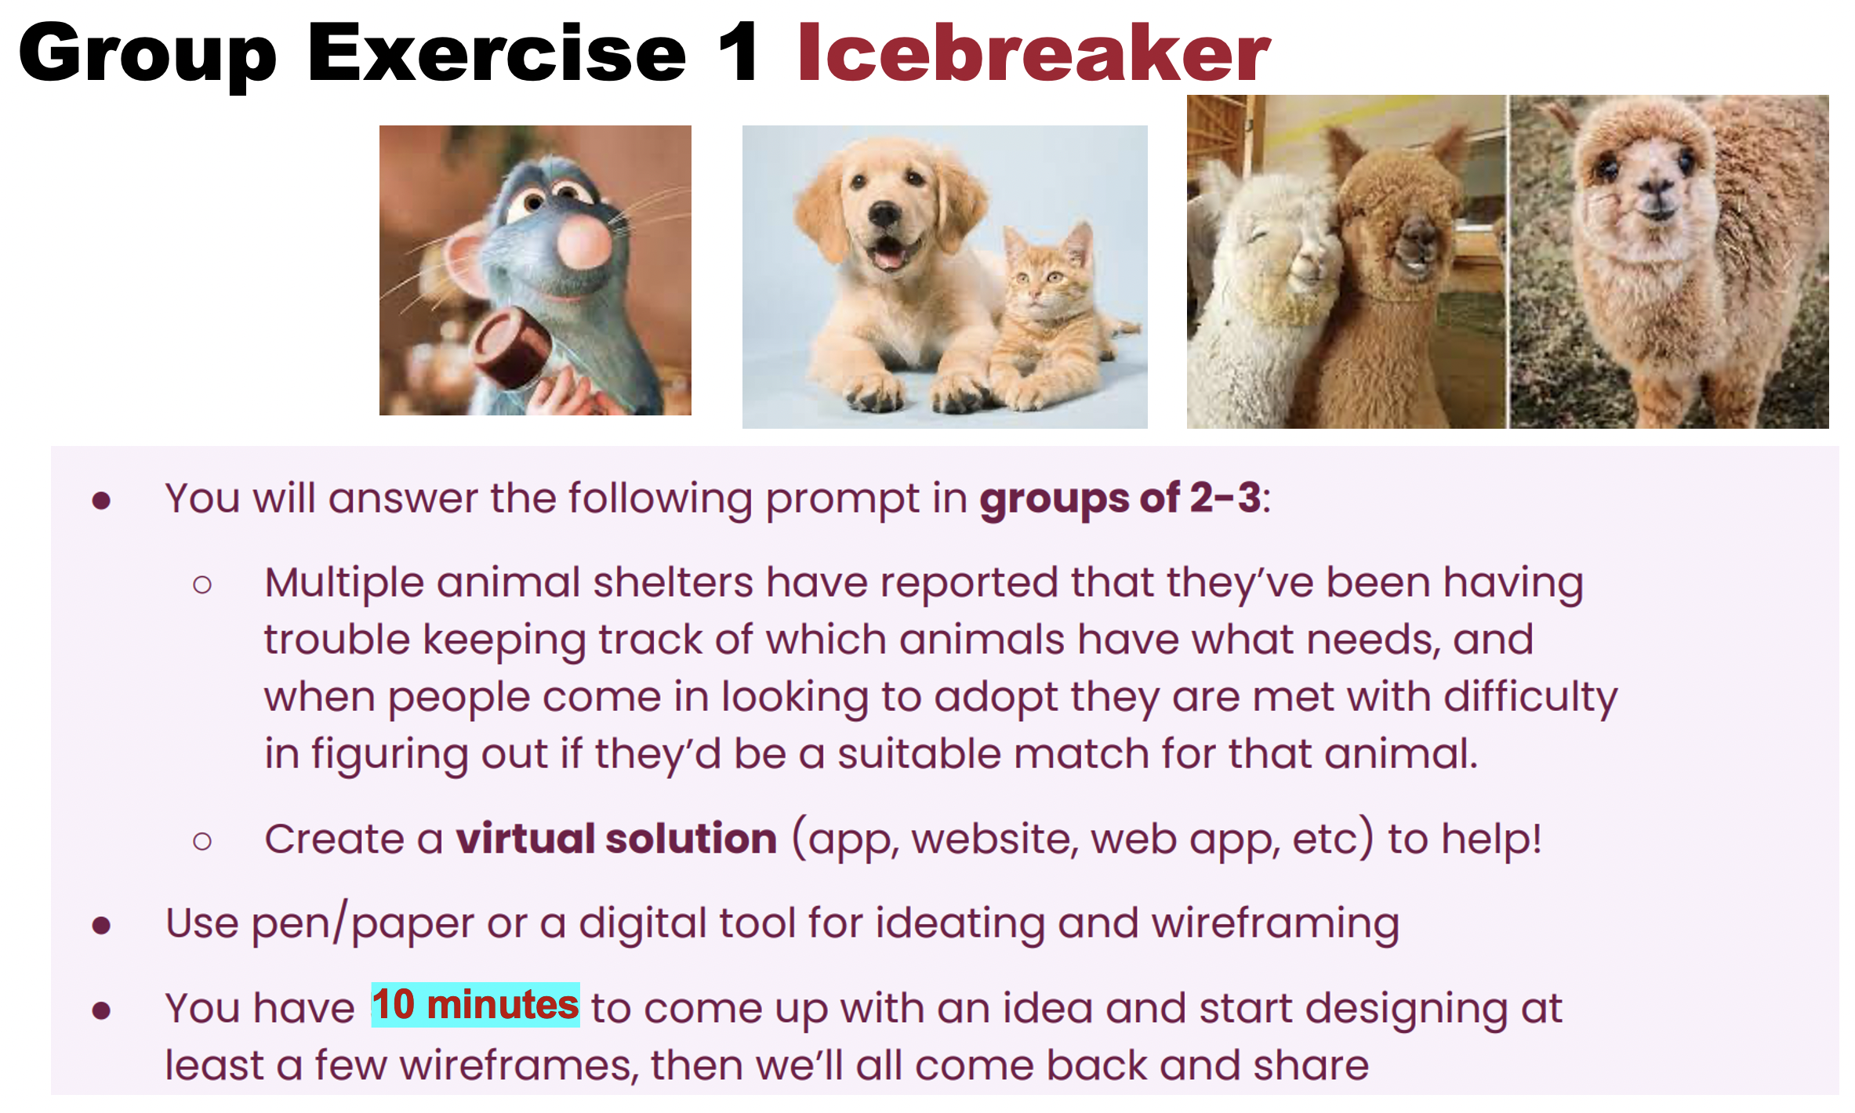
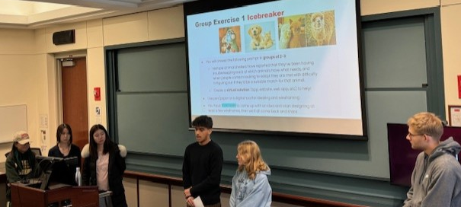

A Few Real World Application Exercises & Projects

Slide 20
Thank You

Slide 21
Theodora Goss
Master Lecturer
Rhetoric
College of General Studies
Creativity and Innovation in Student Writing

Slide 22
Creativity and Innovation in Student Writing
“Creativity is a central source of meaning in our lives for several reasons. Here I want to mention only the two main ones. First, most of the things that are interesting, important, and human are the result of creativity.”
“The second reason creativity is so fascinating is that when we are involved in it, we feel that we are living more fully than during the rest of life. The excitement of the artist at the easel or the scientist in the lab comes close to the ideal fulfillment we all hope to get from life, and so rarely do.”
—Mihaly Csikszentmihaly, Creativity: The Psychology of Creative Invention
How can we teach writing in a way that allows students to feel as though they are engaged in a meaningful activity, not only as college students but also as human beings? How can we get them excited about writing in (and hopefully outside of) a college classroom? How can we encourage them to use writing to learn not only about the world around them, but also about themselves?

Slide 23
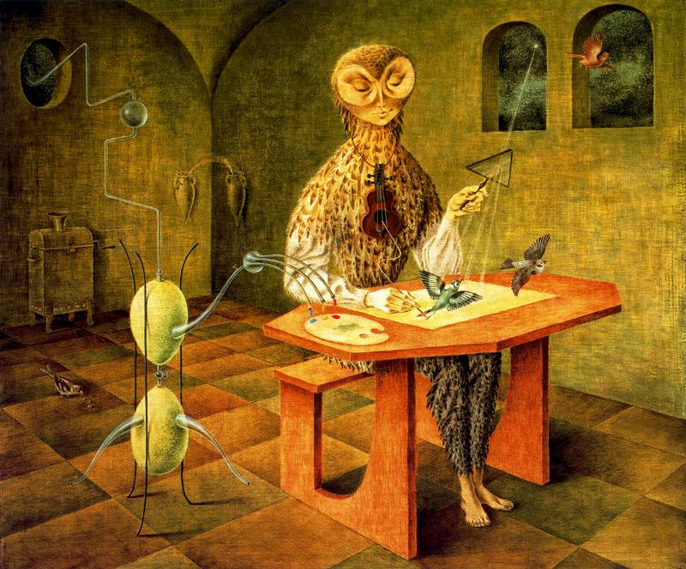
What I try to do in the classroom:
Allow students to create writing projects that are personally meaningful to them.
Give students the freedom to design those writing projects in ways that feel authentic, within the parameters of the assignment.
Provide students with extensive support through scaffolding (proposal, detailed outline, annotated bibliography, preliminary draft) and peer/instructor feedback (workshopping, conferences).
Incorporate additional elements, such as oral presentations, group work, and visual design, as appropriate.
Ask students to reflect throughout the semester on their writing practices.
Image: Creacion de las Aves by Remedios Varo

Slide 24
Examples of my assignments:
Spring semester in Boston:
Analytical Essay: Students are asked to go to the Boston Museum of Fine Arts and choose an artifact from BCE. They must analyze how it functioned rhetorically in its original historical context and how it functions rhetorically for us today. The final essay should incorporate photos of the artifact.
Exploratory Essay: Students are asked to write an essay exploring a topic that they are interested in, with the goal of themselves gaining, and hopefully providing their readers with, greater insight into that topic. Models for this type of essay include examples by Michel de Montaigne, David Foster Wallace, Gloria Anzaldua.
Virtual Museum Exhibit: Students work in groups to choose a set of museum artifacts that differ in significant ways, but can be related to each other. They use these artifacts to curate a virtual museum exhibit and present that exhibit to their classmates. This assignment also includes an individual reflective component.
Summer semester in London:
Photo Essay: See next slide!
Video Essay: Students are asked to create a video essay on a topic that relates in some way to the CGS curriculum, but deepens our understanding of that topic. They shoot film, write a script, edit their clips to create a video narrative, add a voiceover, and incorporate musical elements. The semester ends with a class film festival.

Slide 25
The photo essay assignment:
For this assignment, your goal is to create a photo essay that analyzes a London location of your choice. The term “location” can be broadly defined: it could be a neighborhood you want to visit, a museum or historical site, one of the London parks, a more social space such as a public market, etc. The most important thing is that you choose a place that interests you and take the time to observe it thoroughly. Then, create a photo essay consisting of 10-12 captioned photos and a narrative of 400-500 words. The photos and narrative should be arranged deliberately and with thought, so that each medium illuminates the other.
Scaffolding:
Trip to the Victorian & Albert permanent exhibition of historically important photographs.
Video on the history of photography and lecture on the visual language of photos (types of shots, camera angles, design principles such as the “rule of thirds,” etc.)
Proposal for photo essay, storyboard with photos and an explanation of design choices, first draft of photo essay with script for workshopping in class, final draft of photo essay on Adobe Express.
Examples:
“Notting Hill: The History of the Rainbow Streets” by Leanna Chun (https://new.express.adobe.com/webpage/3TtsoCiBdvcOe)
“Hyde Park and the Consequences of Urban Influence” by Isaac Agedoke (https://new.express.adobe.com/webpage/MbnpaL2F5Ngch)

Slide 26
Thank You

Slide 27
Doug Holmes
Associate Professor
Materials Science and Engineering
College of Engineering
Creativity in the Classroom

Slide 28
Creativity and Innovation in the Classroom: Constraints
Undergraduate Engineering Education: Technical Courses & Design Courses
Traditional Course Structure and Assessment for Technical Courses:
  Technical problem sets with objectively correct answers.
  Assignments are completed individually.
  Additional discussion sections provide students with help on problem sets.
  In some classes, laboratory sections give students hands-on experience and help develop intuition.
  Exams are typically a timed problem set completed in class.
Traditional Goals for Technical Courses:
  Skill acquisition in an engineering topic.
  Technical competency is rewarded, while conceptual competency is (often) overlooked.
  Creativity is not a primary learning objective.
GOAL: Bring creativity and innovation to the undergraduate engineering classroom
  Provide opportunity to develop teamwork and communication skills.
  Encourage and reward conceptual understanding.
  Give engineers a chance to showcase their creativity and demonstrate that it is a valuable skill.

Slide 29
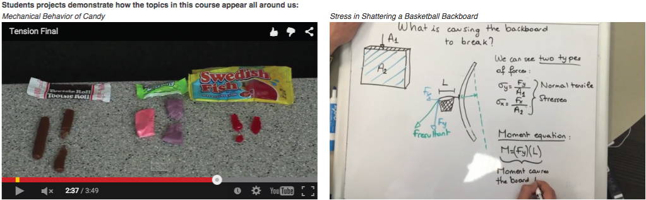
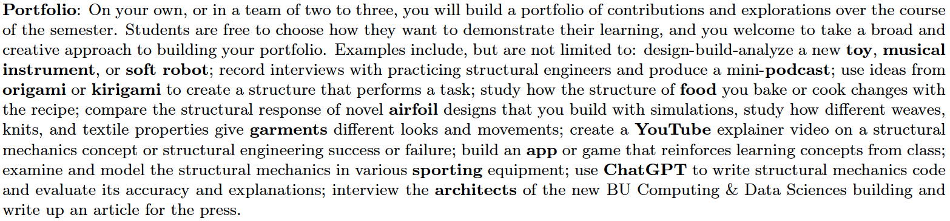
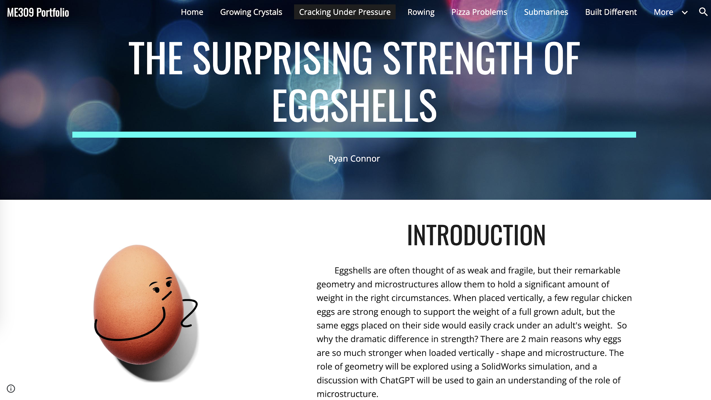
Creativity and Innovation in the Classroom: Constraints
Objective: Use Final Project to test students’ conceptual understanding
Mechanics of Materials (ME305 – Juniors):
SUCCESS!
Create a short, educational video that conveys an important concept from Mechanics of Materials in an insightful and enjoyable way.
Example Projects (links to videos)
Audience (pick one):
K-12 Students
First-year engineering students
Peer engineers, i.e. their classmates
Subjective Assessment:
Target audience should enjoy watching and learn something from the video.
A successful video will demonstrate the student’s understanding of a concept learned during the semester.
Rationale: “While we teach, we learn.” - L.A. Seneca
https://youtu.be/R1AbgapBIeI?si=wo36En-wPYFSoyIc
https://vimeo.com/127282946?share=copy
FAILURE!
Structural Mechanics (ME309 – Seniors/Juniors):
Example Project (link to website)
Subjective Assessment:
Final presentation of portfolio to class
Detailed Rubric [link]
Rationale: Montessori approach to foster self-motivated learning.
Inspired by: “Dead Ideas in Teaching & Learning” Podcast, Season 3, Ep. 6 (Prof. Denise Cruz) [transcript]
Creative Assignment Resources [link]
https://sites.google.com/bu.edu/me309-portfolio-ryandelaneymax/home?authuser=1

Slide 30
Creativity and Innovation in the Classroom: Constraints
What Went Wrong? Misunderstanding how constraints affect creativity and innovation
Constraints: Provide focus and a creative challenge.
Motivate us to seek and connect information from different sources to generate novel ideas.
Over-Constrained: Hampers motivation, reduces creativity and innovation.
Under-Constrained: We are complacent and often choose the path of least resistance.
How to use constraints to foster creativity in the classroom:
Identify where you want your students to direct their creativity:
  Portfolio: Students first had to be creative in choosing how to “package” their project, and then were asked to be creative in demonstrating their learning.
  Video: The “package” was clearly defined. Students’ effort was focused on demonstrating their learning.
Find balance with different types of constraints
  Example: Place more/less constraints on the problem/question (input) than the solution (output).
Students may interpret the same constraint in different ways.
  A motivating challenge vs. a frustrating roadblock.
Consider flexible constraints to provide a challenge for students who are up to it.
Reference:
O. A. Acar, M. Tarakci, & D. Van Knippenberg,
“Creativity and Innovation Under Constraints: A Cross-Disciplinary Integrative Review.”
Journal of Management, 45(1), 96-121, (2019).
Harvard Business Review:
https://hbr.org/2019/11/why-constraints-are-good-for-innovation

Slide 31
Thank You

Slide 32
Q&A

Slide 33
Thank You for your participation in the
Lightning Talks Speaker Series.
Questions or Comments?
The BU HUB
thehub@bu.edu
www.bu.edu/hub
Center for Teaching
& Learning
ctl@bu.edu
www.bu.edu/ctl
Digital Learning & Innovation
digital@bu.edu
www.bu.edu/dli
Post-survey: https://bit.ly/3Tezpjq

