Slide 1


Slide 2
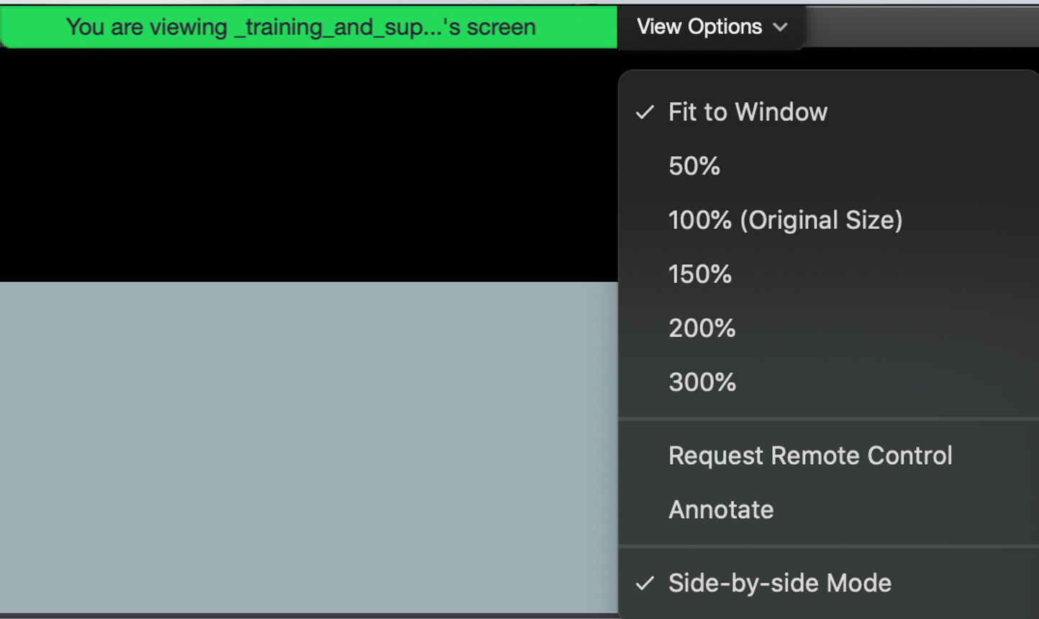
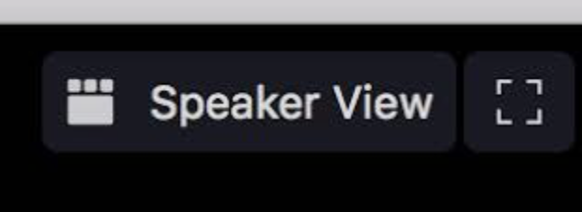
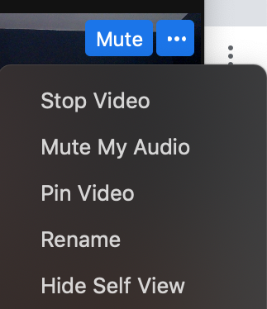
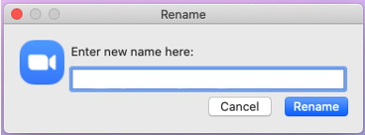
Quick Reminder
For optimal viewing experience, you can change your view options. We recommend Speaker View over Gallery View.
Optional: Add your department, program or school to your Zoom name.

Slide 3
Recording
Today’s Lightning Talks are being recorded and will be available for viewing via bu.edu/dli later this month.

Slide 4
Q&A
Please share your questions in the Q&A feature and the moderator will address questions at the end of the session.

Slide 5
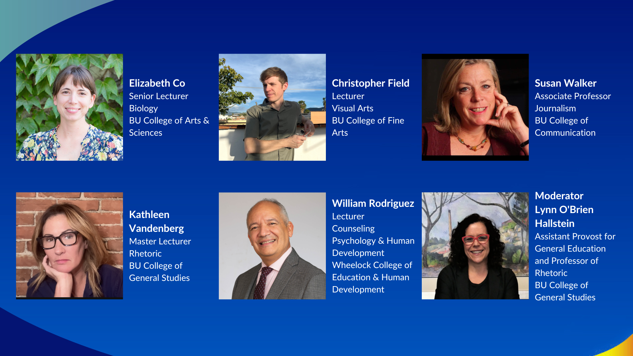

Slide 6
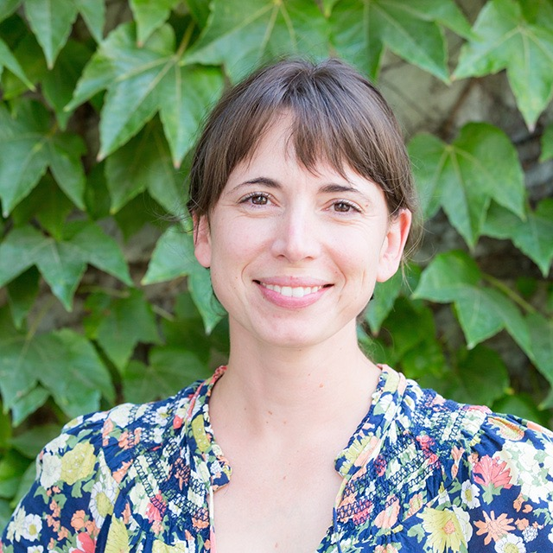
Elizabeth Co
Senior Lecturer
Biology
College of Arts & Sciences
Digital media projects in two anatomy courses

Slide 7
DME projects at the 200-level
Step One: Evaluate
Assignment: Students find and evaluate three videos on the web
Why: before beginning their own project, they can articulate their preferences in educational media.
Step Two: Infographic
Assignment: Students create an infographic on a topic
Why: in this course the infographic serves as a brainstorming/outline tool
Step Three: Video
Assignment: Students create a short educational video on their topic

Slide 8
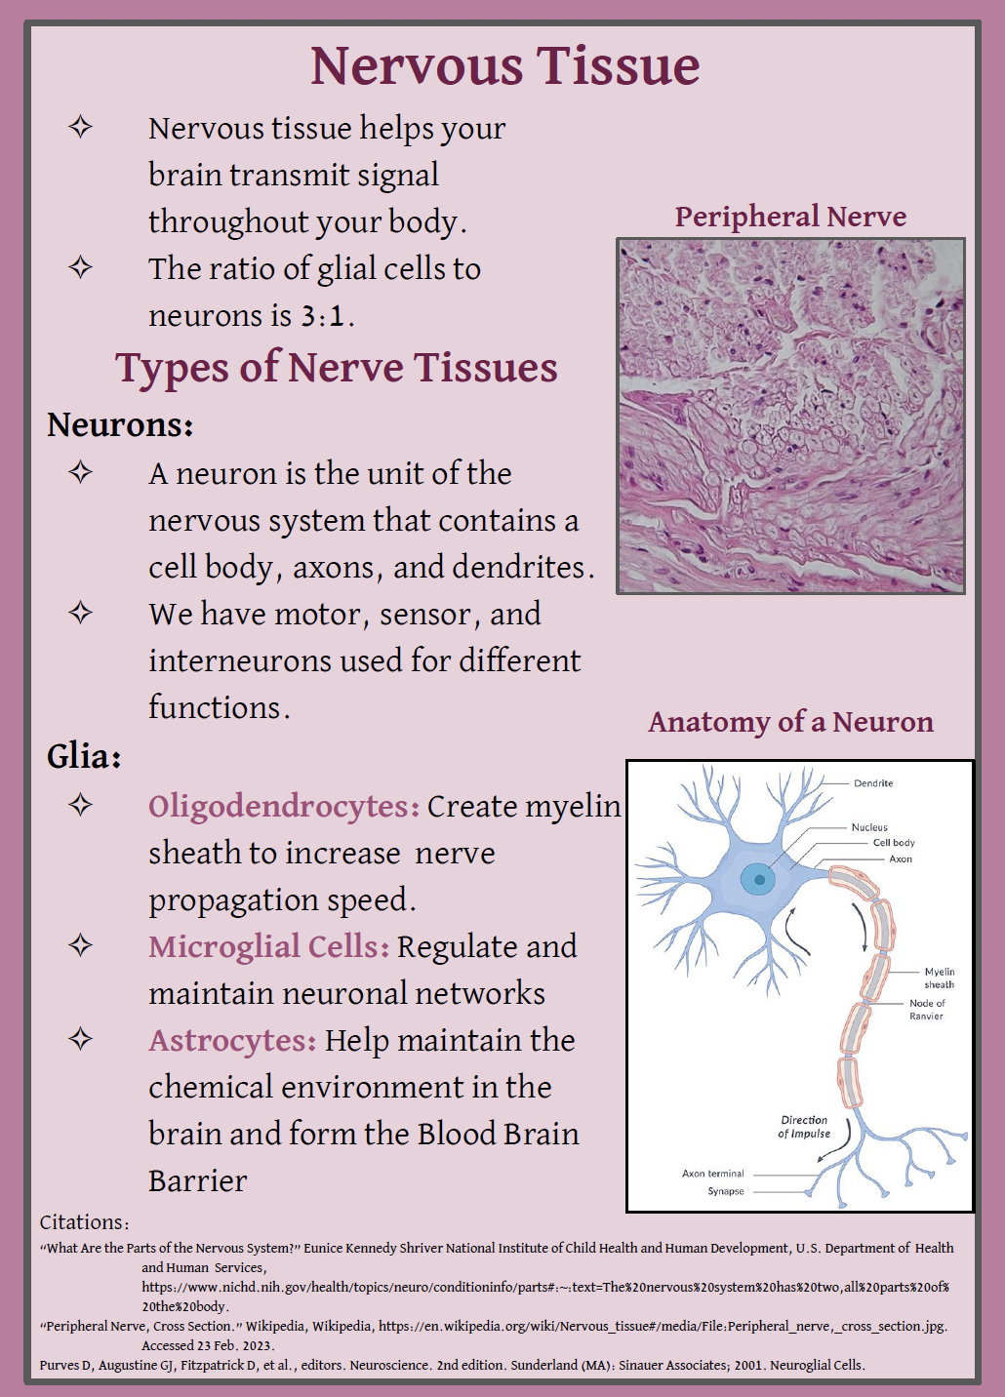

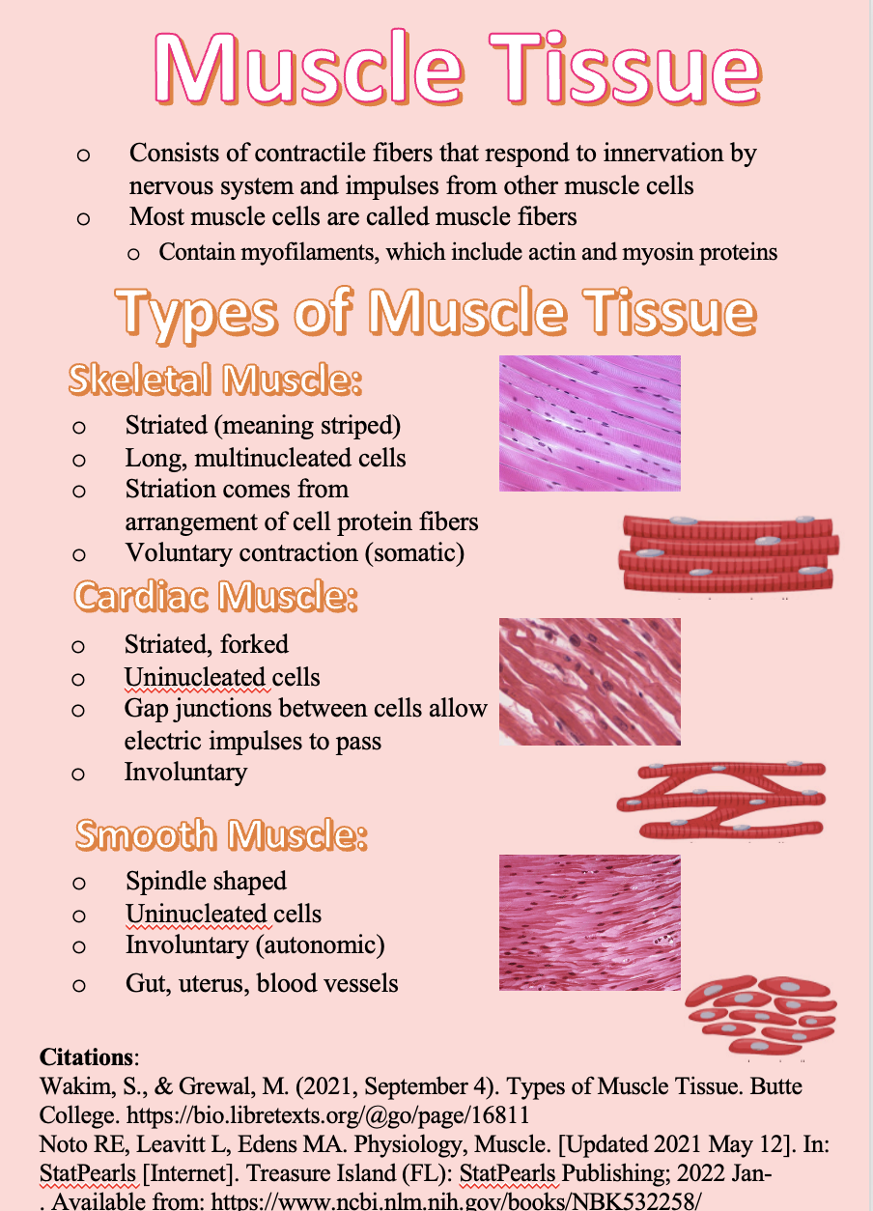
Examples from 210

Slide 9
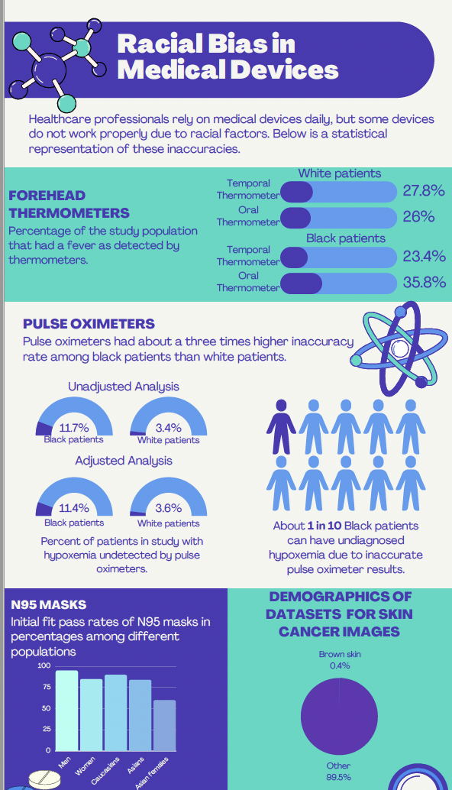


DME projects at the 300-level
Use the DME projects to facilitate a unit on racism in anatomical science and/or medicine.
Notes:
Anatomy has been used as a tool for racism in the past. In the present, gaps in research caused by bias have lead to disparate health outcomes for biological women vs biological men, cis-gendered folk vs trans-gendered folk, and among races. Students will pick a topic in which bias exists in our current medical practice or anatomical knowledge and create an infographic.

Slide 10
Thank You

Slide 11
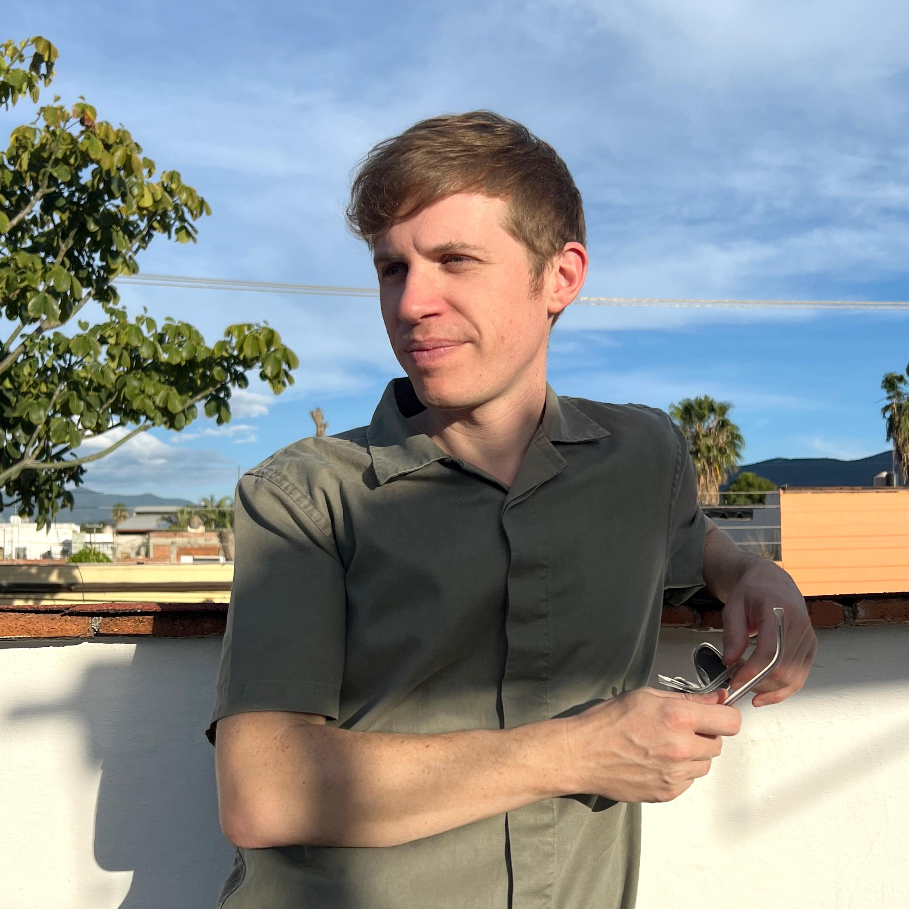
Christopher Field
Lecturer
Visual Arts
College of Fine Arts
Concept to Creation: Multimedia in Foundation Design

Slide 12
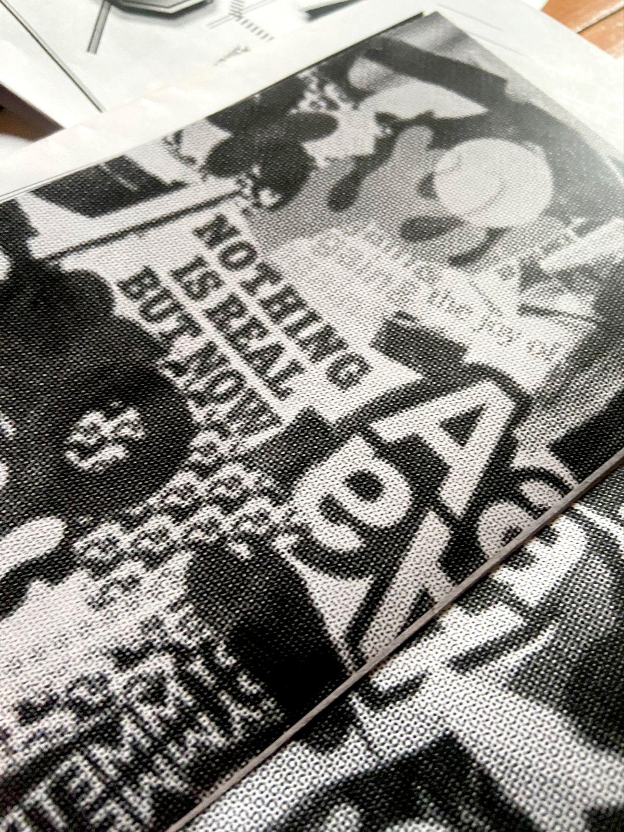
Concept to Creation:
Multimedia in Foundation Design
AR123 - Foundation Design
+ Hub Learning Outcomes: Digital/Multimedia Expression
+ Software: Adobe Photoshop, Illustrator and InDesign
Fundamental Design Concepts:
+ Contrast, Symmetry, Asymmetry, Balance, Repetition, Texture
Translation of Media
+ Linear multimedia vs. “Simultaneous” media

Slide 13





Concept to Creation:
Multimedia in Foundation Design
Christopher Field
Design Concept > Analog Sketch > Digital Composition > Sequence (book)
Fundamental Design Concepts:
+ Contrast, Symmetry, Asymmetry, Balance, Repetition, Texture

Slide 14
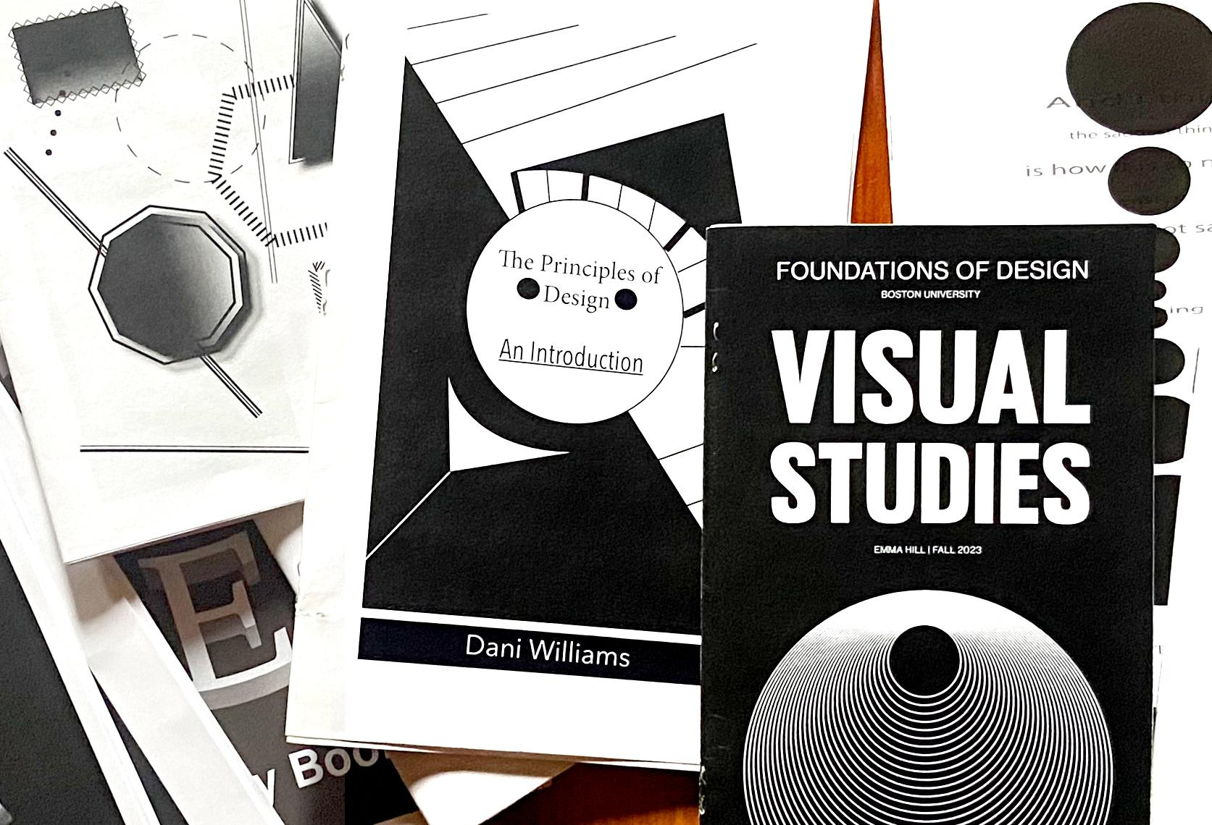


Concept to Creation:
Multimedia in Foundation Design
Christopher Field
Final format: sequential application of design principles

Slide 15
Thank You

Slide 16
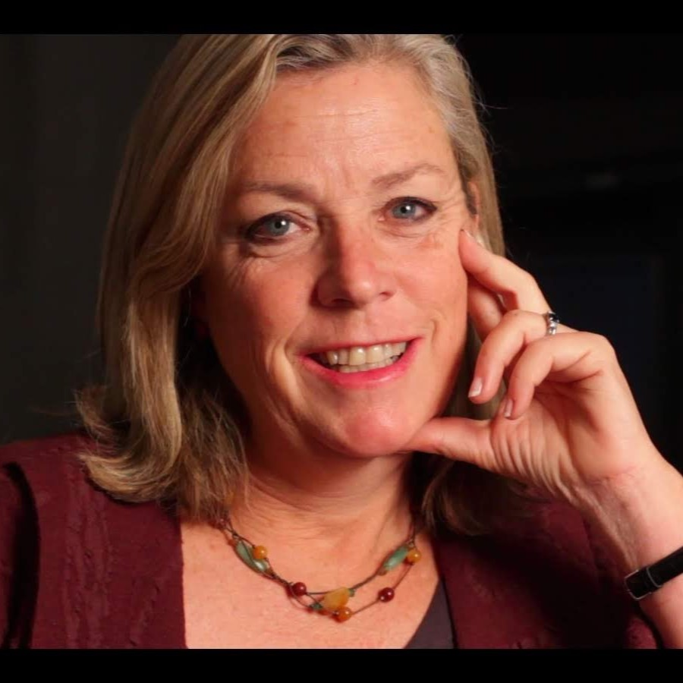
Susan Walker
Associate Professor
Journalism
College of Communication
1,000 Term Papers in Your Pocket

Slide 17
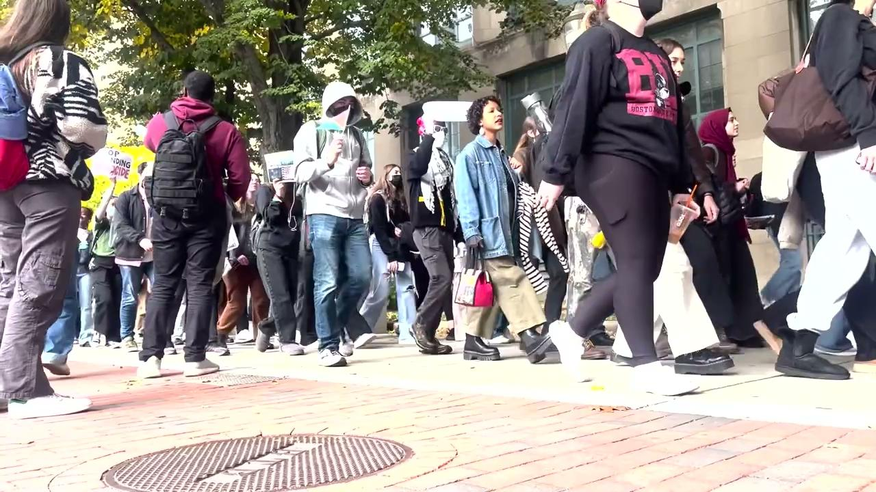
1,000 Term Papers in Your Pocket
JO 322- Smart Phone Reporting course
Students produce four news videos using:
Smart Phones & Adobe’s Rush app
Highlight reel of student assignments:
EASIER THAN YOU THINK:
BBC shows us how here
Notes:
1,000 Term papers, or assignments in Your Pocket, to paraphrase Steve Jobs. Students can produce video assignments for courses using the device that is always with them—the smart phone. Smart Phone Reporting is a journalism and HUB multimedia course launched four years ago. Students learn how to research, shoot, narrate and edit 4 news videos using only their smart phones and an Adobe all-in-one app called Rush.
-Goals of the class: develop news and visual literacy skills by showing, not just telling stories about issues, breaking news, events and trends. Learn shooting editing and writing on deadline. In the vein of show and tell- here are excerpts from assignments submitted just last week by students.
EASIER THAN YOU THINK: by now I’m sure all of you have experience shooting video and photographs on your Iphone—here is a link to a brief tutorial how to step up those skills provided by the pros at the BBC Network.
Adobe’s app Rush can be downloaded free to faculty and students available through BU’s license to Creative Cloud.

Slide 18
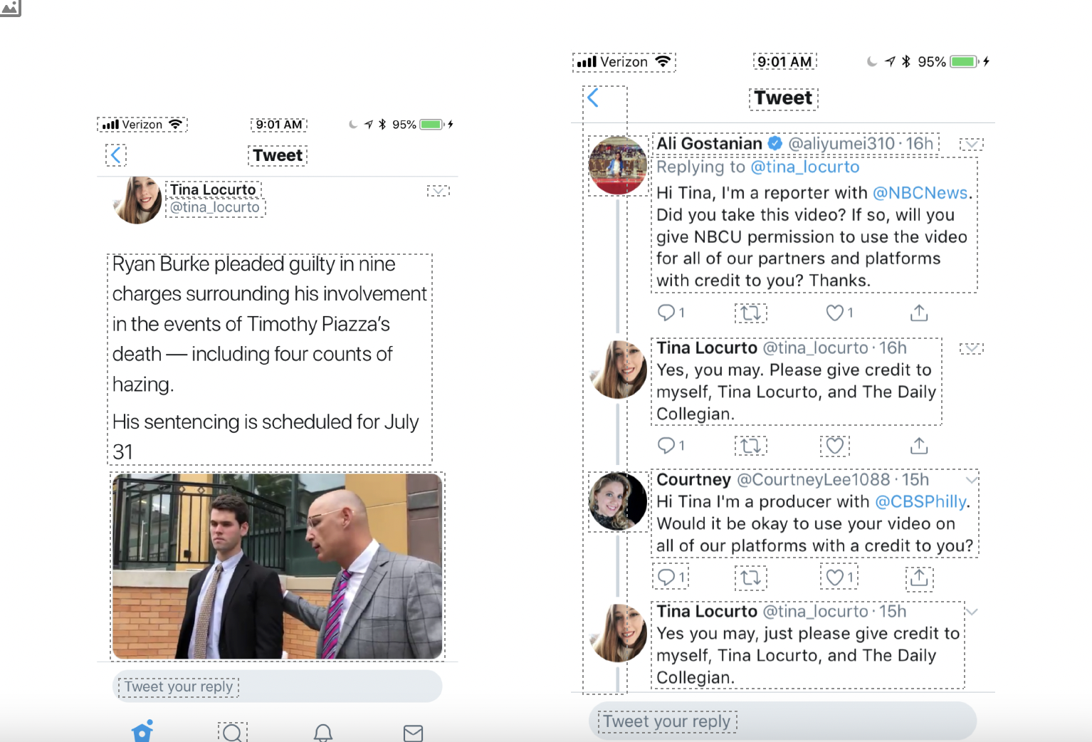
Hunting and gathering of video
Sources:
Historic and newsreel footage - Library of Congress link here
YouTube
Google Images
Zoom interviews
Cell phone video requests-
Use across disciplines.
Notes:
But smart phones produce videos can be used in student assignments in other disciplines. Here are some possible examples---
· Historical documentaries using newsreel or videos from media-rich archives such as the Library of Congress
· Climate change presentations, using time lapse, photographs or videos showing how a rainy summer affects climate change- Google images lists copyright free photographs
· Zoom recorded interviews, thank you pandemic, makes accessible experts from all over the world on political science topics, business and economics courses what interest rates are doing to the housing market, what Elon Musk is doing to social media, international relations, the roots of the Israeli-Hamas conflict.
Students can also ask for cell phone video from others….You see an example of an NBC news request on X/Twitter to a student reporter at Penn State-that’s how the networks are now using smart phone videos to show everything from attacks in Middle East, to first blizzards in the remote rockies…20-30 percent of video on network newscasts is now cell phone videos credited to just plain folk. Remember how the George Floyd beating was recorded? Or the Jan. 6th insurrection? Nobody notices a smart phone because everyone, everywhere is recording.

Slide 19
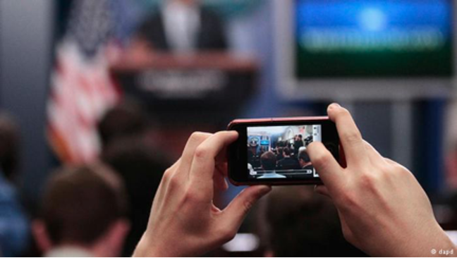
Challenges vs. Strengths
COPYRIGHT issues!
FAKE video even sound bites
See an example of a AI-generated
sound bite of Barack Obama here
Apple I-phone centric
Visual and information literacy Prepare for digital age
Replace exams, papers and silly cat videos on YouTube.
Photo Credit:DK Academie, Germany

Slide 20
Thank You

Slide 21
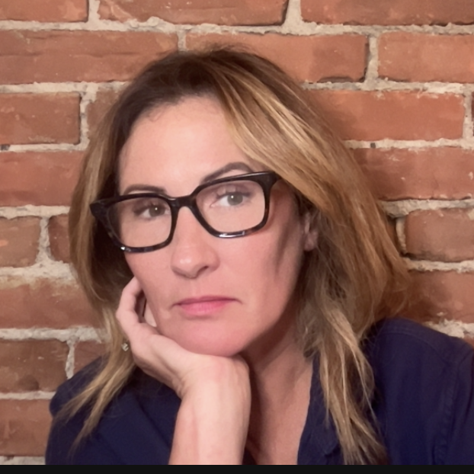
Kathleen Vandenberg
Master Lecturer
Rhetoric
College of General Studies
Stories in Sound: Composing Podcasts

Slide 22
Stories in Sound: Composing Podcasts
Why Podcasts?
-Oral Storytelling/Primary Orality (Ong) dominates human history: embodied, interactive, “magical”
-”The experience by an attentive person of [media] featuring a human voice (or voice and body), can sometimes create the illusion of a two-way communicative exchange to the point of even prompting some active emotional, even physical participation in the recipient.”-Robert MacDougall
-”Students should be able to attend and respond thoughtfully for others. They should also understand that public presentation serves an essentially civic function as a means of participating in collective debate and decision-making”--BU Hub/Oral and Signed Communication
-Sharpens students’ composition skills and rhetorical abilities
Privileges human intelligence and interaction
Can offer space/medium for marginalized voices
-

Slide 23
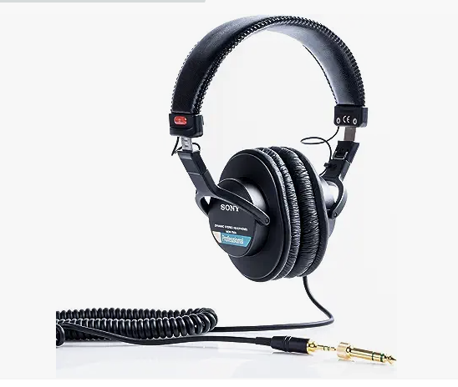
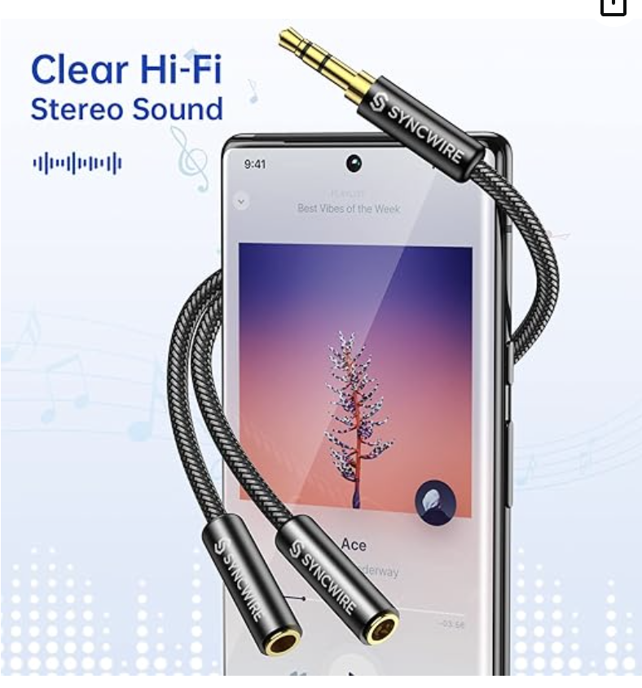
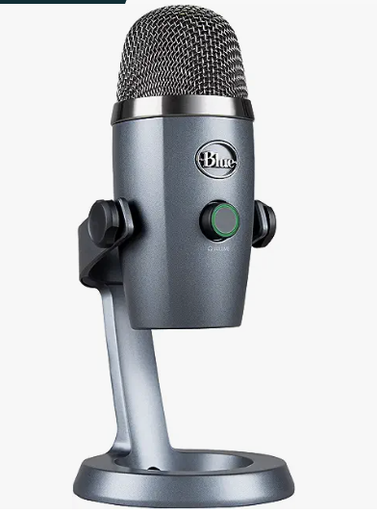
Equipment
Syncwire Headphone Splitter
~$8
SonyMDR 7506
Blue Yeti
~$85

Slide 24
A Range of Entry Points for Instructors
”Low” Production: Less emphasis on scripting and editing/More emphasis on oral communication (style &delivery) interview skills, extemporaneous speaking, and being in dialogue
Adobe Audition (provided for students and faculty by BU)—can keep it very basic/accessible
“High” Production: Incorporates “low” production skills and equipment, but there is also instruction emphasis on scripting, editing, and sound mixing
-prepare for interview by reading relevant materials and composing interview questions
Students:
-record initial interview, but try to keep it informal/conversational/oral
-transcribe the interview and then select pieces they want to keep and arrange them into a coherent and compelling narrative arc
-script and record intros/outros/narration
-use their transcripts as a guide to choose audio selects in Audition, and rearrange and edit those together on a track (silences, filler words, and background noise is removed and volume adjusted)
-add tracks with soundtrack, characteristic noises, and ambient noise to immerse listeners in a sound environment

Slide 25
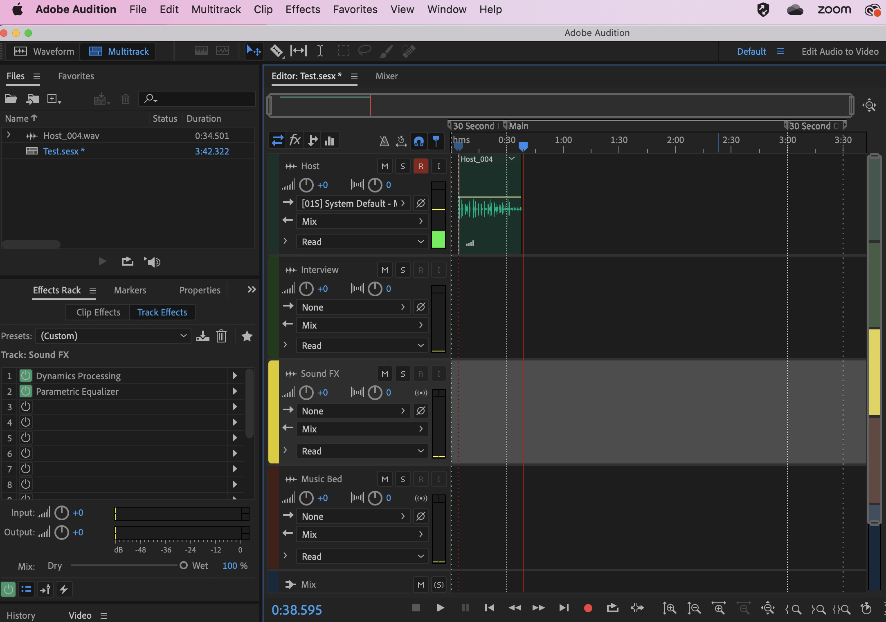
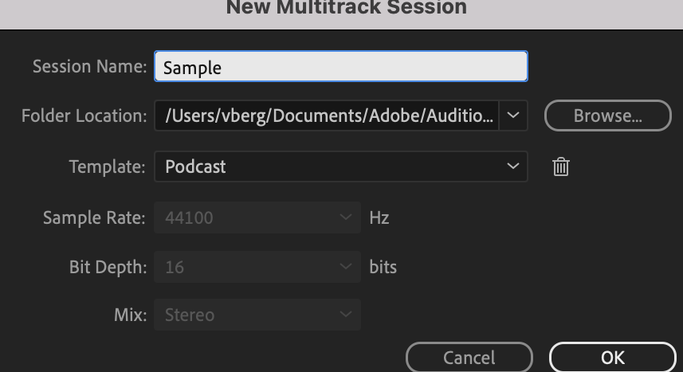
Multi-track
Select
Record
Low Production: Adobe Audition
Editing
Podcast
Template
Voices/Volume
Record
Stop

Slide 26
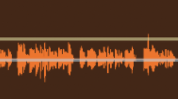



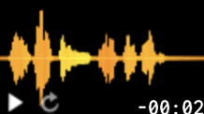

High Production: Adobe Audition Tracks
1.
Unedited Interview
2.
Audio Selects
3.
Characteristic sounds
4.
Narration/intro/outro
5.
Soundtrack
6.
Ambient noise

Slide 27
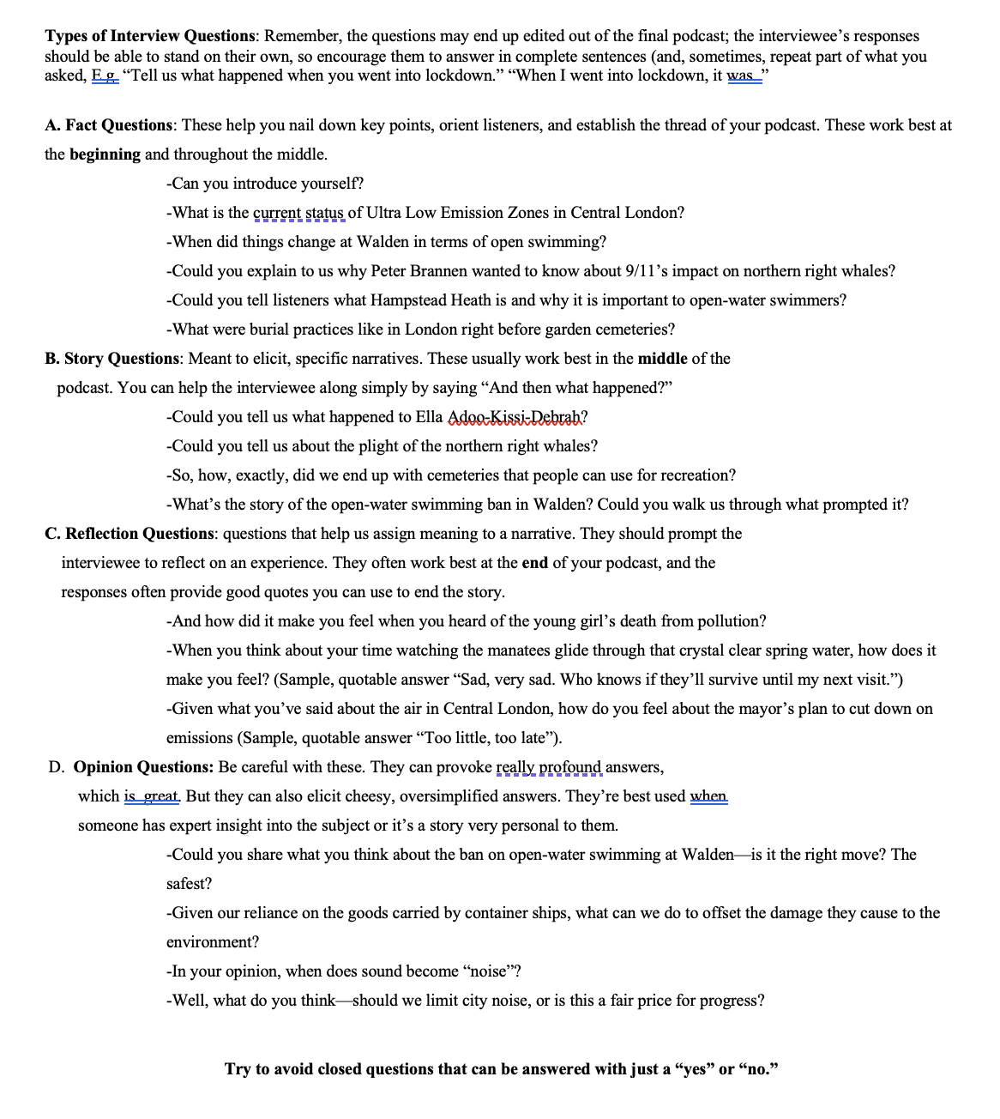
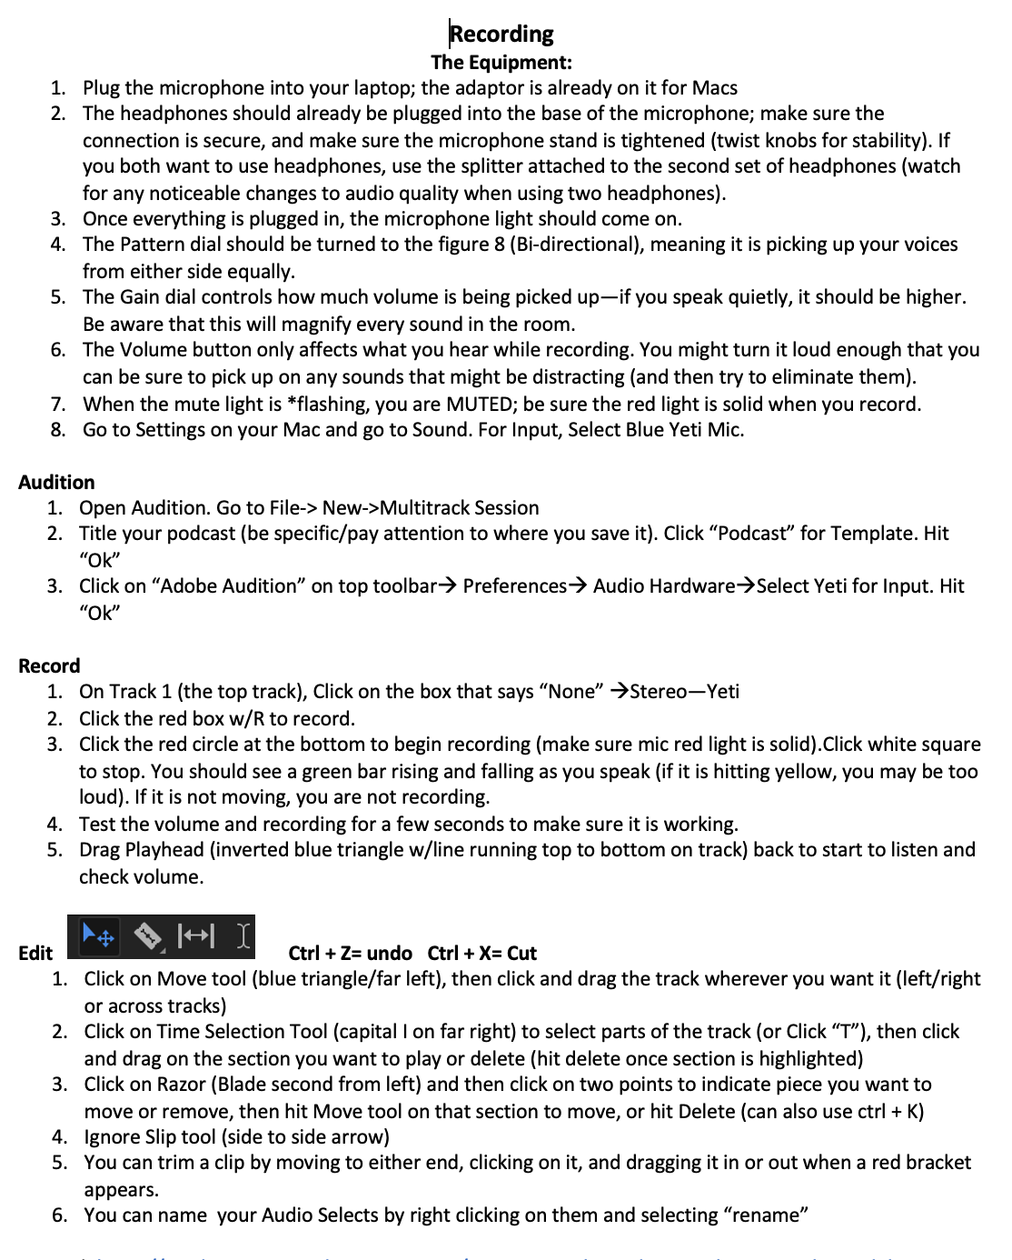
Sample Teaching Materials: Useful For Low & High
NYT: “When Podcast Hosts Speak, What Do We Hear?” https://www.nytimes.com/interactive/2021/02/25/arts/podcast-voice-sound.html

Slide 28
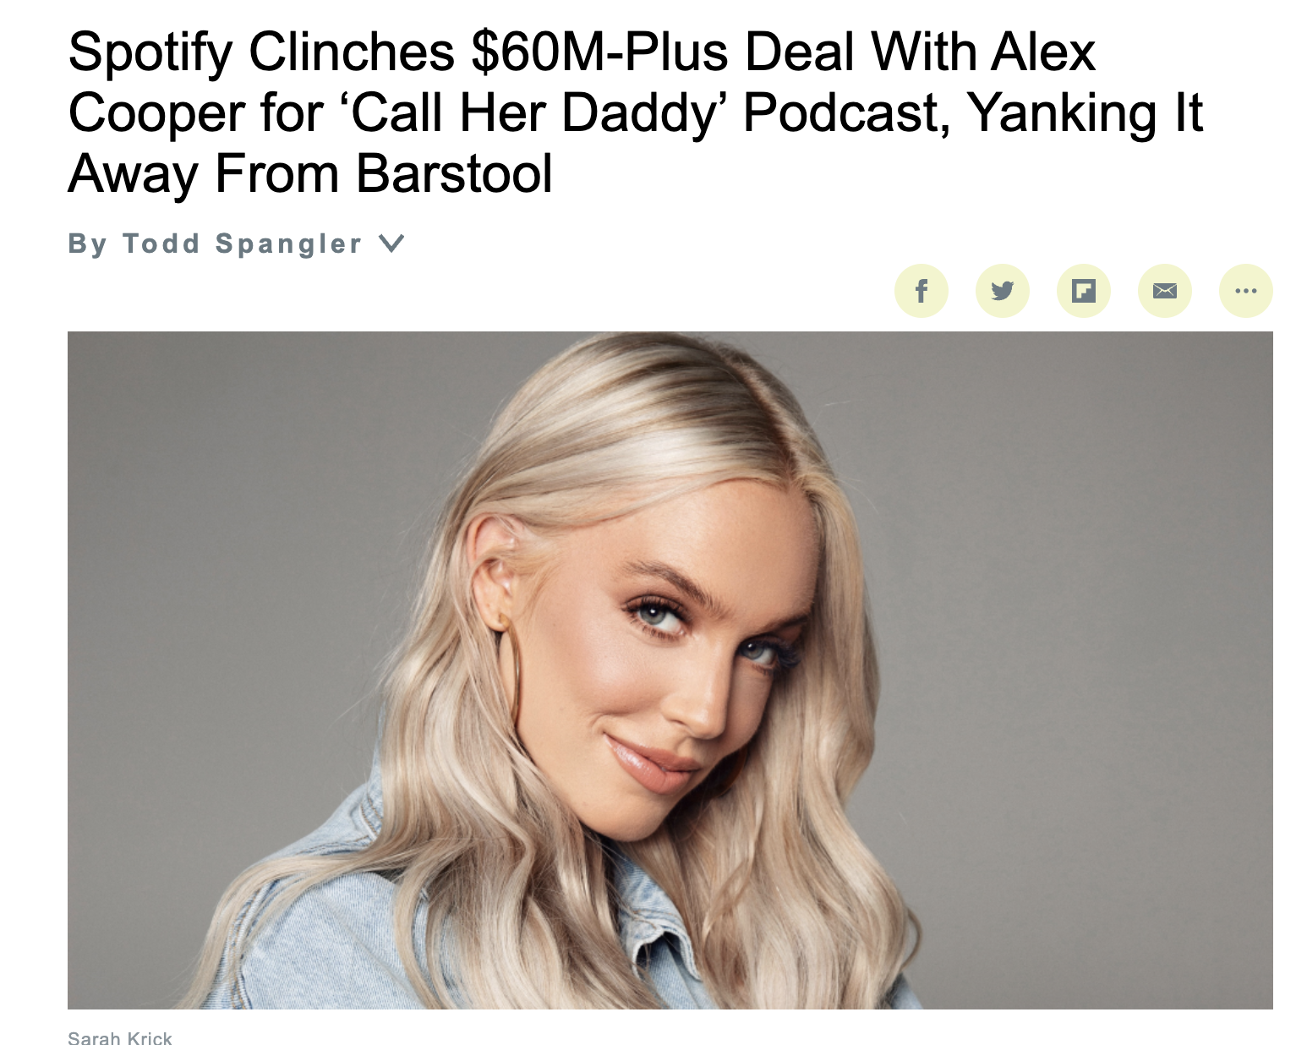
Biggest deal ever for a female podcast host
“
BU GRADUATE:
CGS 2015
COM 2017: degree in Film & Television
““Call Her Daddy” has consistently ranked in the top 15 podcasts across all platforms this year, and was the No. 5 most-listened-to podcast on Spotify in 2020. ”

Slide 29
Thank You

Slide 30
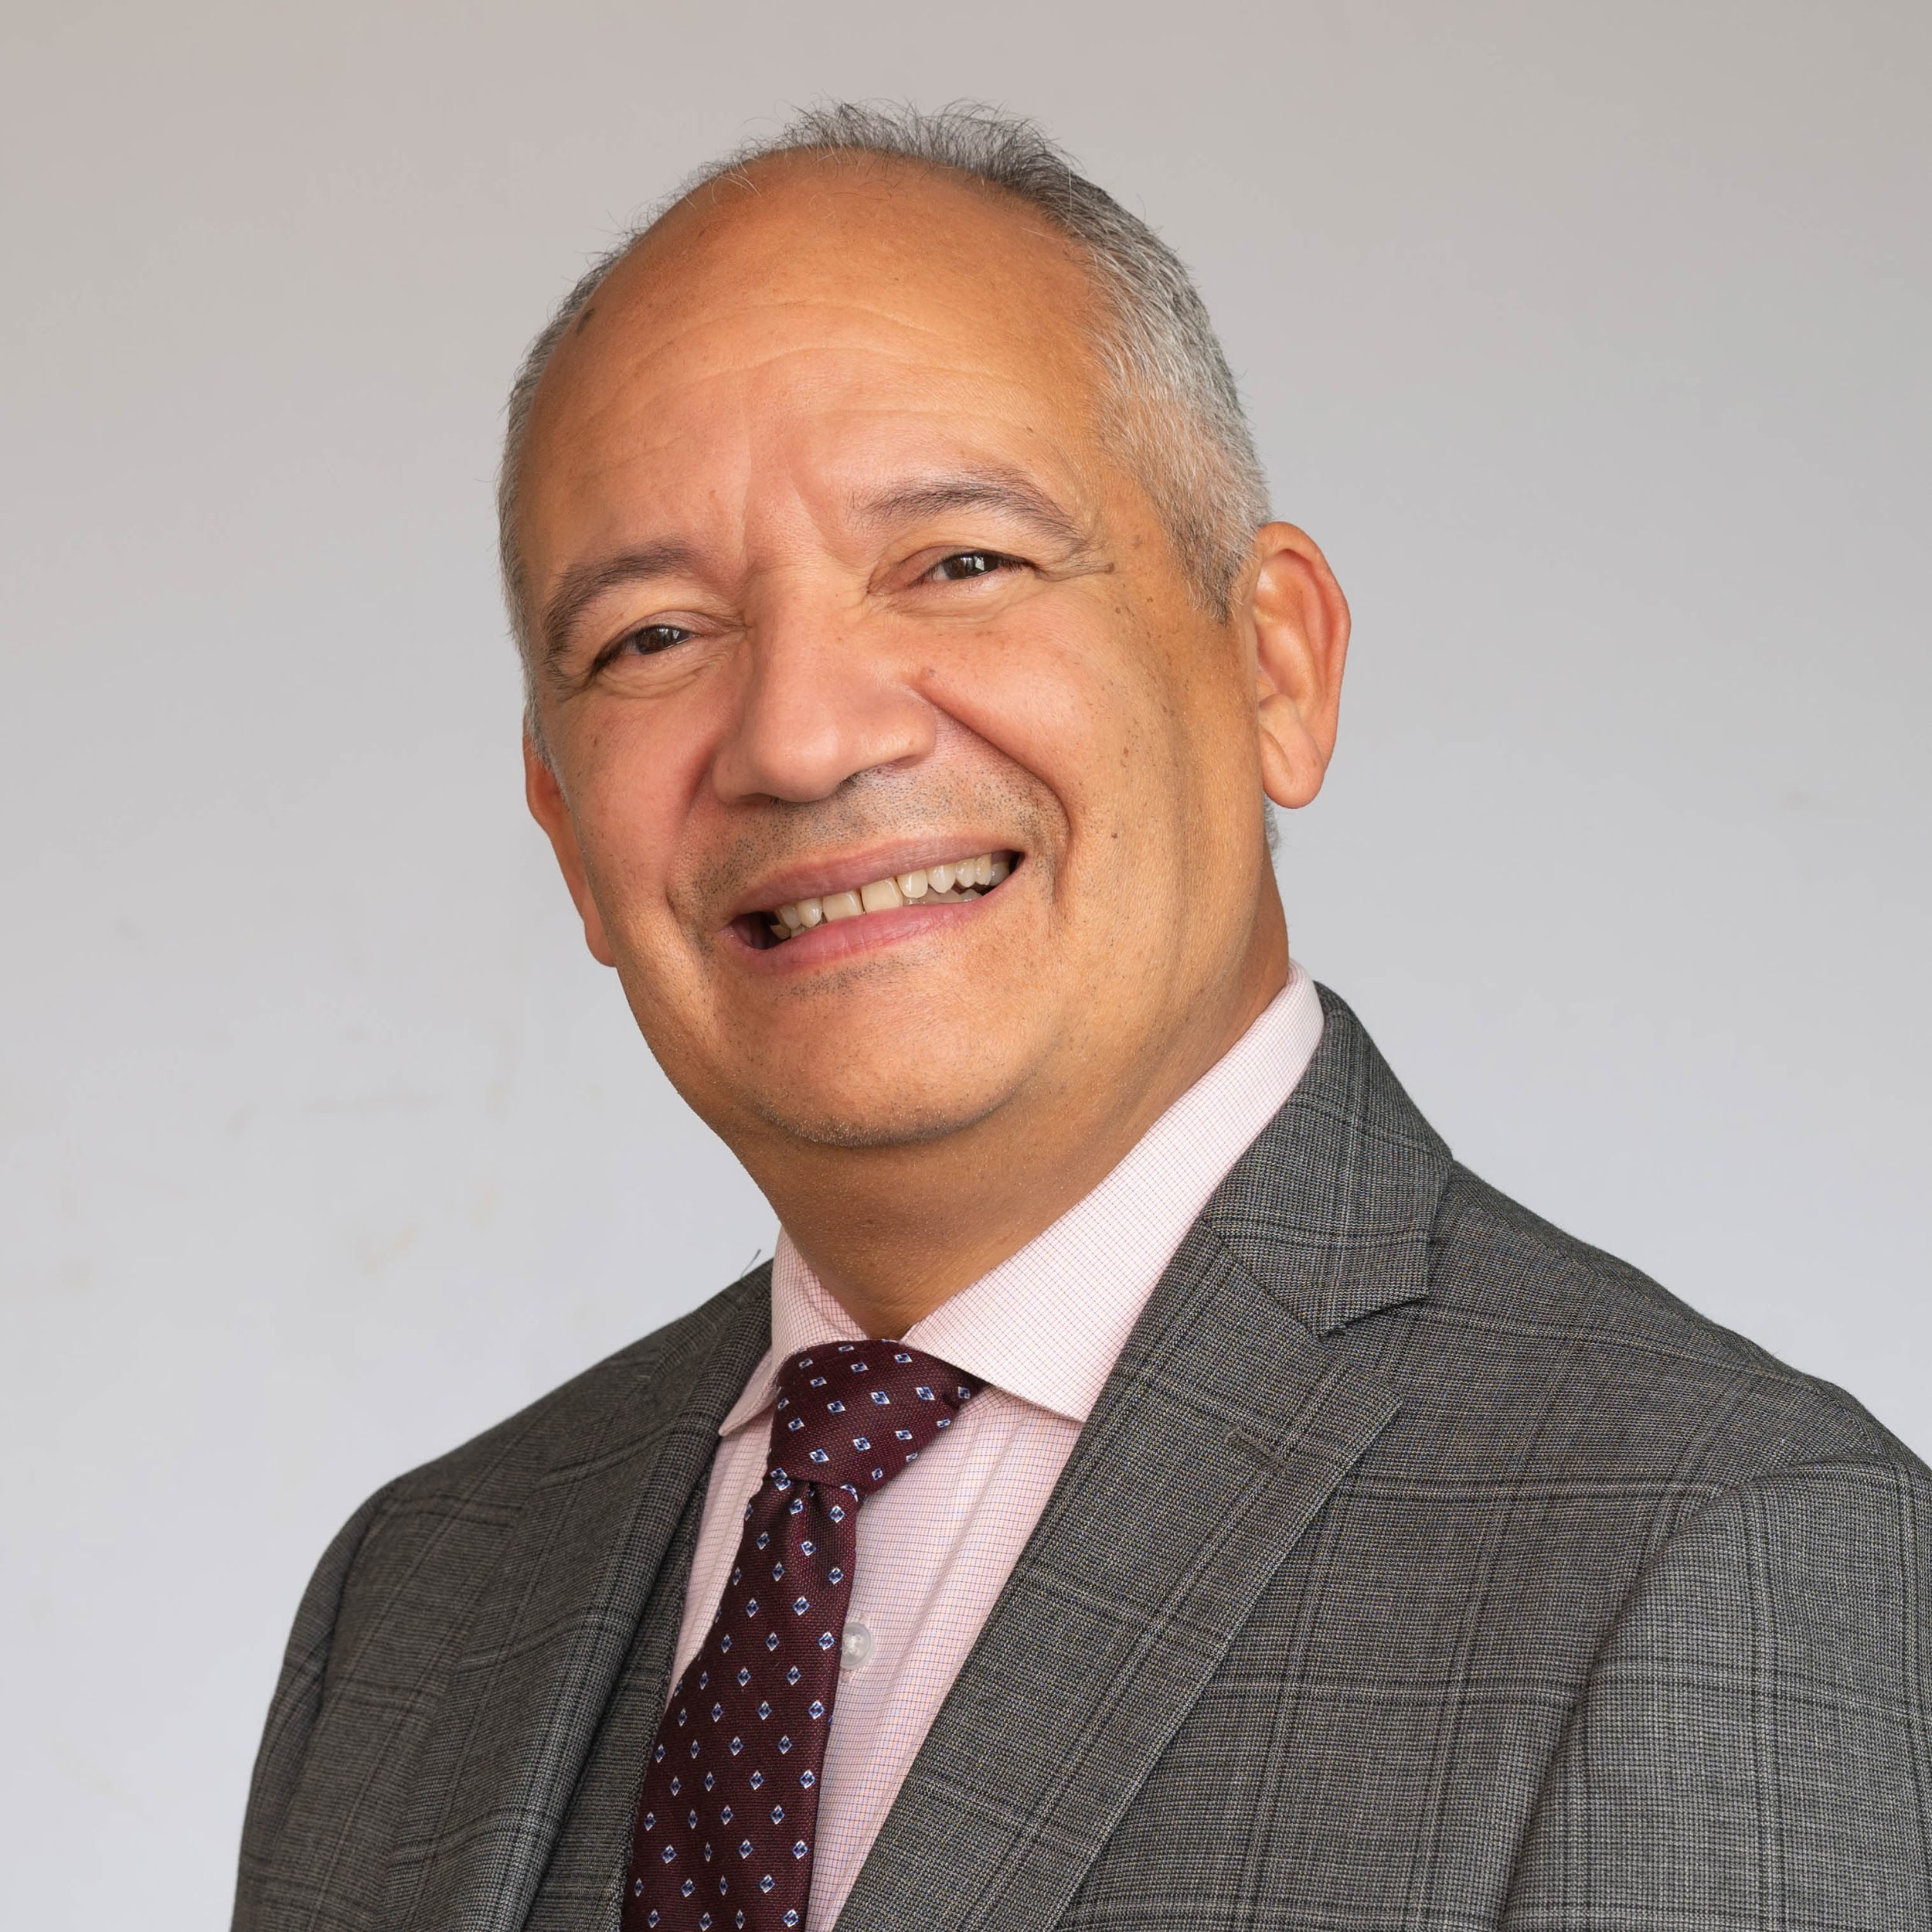
William Rodriguez
Lecturer
Counseling Psychology & Human Development
Wheelock College of Education & Human Development
Amplifying Voices, Advancing Equity: “The Power of Student-Driven Podcasts”

Slide 31
Amplifying Voices, Advancing Equity: “The Power of Student-Driven Podcasts”
Genesis of the XXC course: Unheard Voices: Deconstructing the Dominant Narrative by Inclusion
•Main Learning Goal (s)
•Students learning how to use podcasting that can be broadcast through the internet to larger audiences as a tool to advocate or amplify the voices of those communities that feel marginalized in American society.
•Providing an output (product) for partners to improve or enhance their ability to improve the lives of children and families in an equitable and just manner.

Slide 32
3 Main frameworks applied in the Course
•Race Equity Framework
•Person-Role-System Framework
•5 degrees of Culture (Awareness, Sensitivity, Humility, Responsiveness = (Compassionate Conversations)

Slide 33

How do Students formulate and select inquiries and conversations to use in their podcast dialogues?
•Students as:
•Text Experts
•Lead the conversation
•Create a safe space
•Ground Rules
•Get comfortable with uncomfortable conversations
•Practice Public Speaking

Slide 34
Choosing the Partner/Preparing for the Podcast
•Choosing the issue
•Choosing the partners to interview
•Relationship-building and Networking
•Choosing the Venue
•Type of digital recording (Audio/video) (Podcast platform) (Adobe, Apple, BuzzSprout etc.)
•Podcast preparation
•Recording and Importing
•Audio Editing
•Audio Enhancement
•Mixing and Balancing
•Music and Sound Effects
•Roles of Each member (Host, Director, Guest Organizer, Script Writer, Editor, etc.)

Slide 35
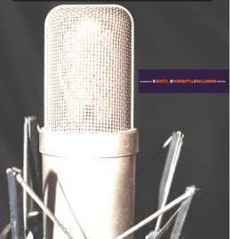
Unheard Voices
https://unheardvoices.buzzsprout.com
•Spring 2023
A conversation with BU's own Kasim-Seann - perspectives on today's education and mental health. 30:08
The Boston Re-engagement Center - Helping youth by re-engaging and reinvesting in their education 27:09
"An in-depth look at Sociedad Latina Inc. - Transforming Latinx youth into the social justice change agents of tomorrow." 17:30
BUxCTown Podcast - A conversation with Marvin Moore long time advocate for youth in the Boston public schools 25:28
Spring 2022
Part 1 - "For Future Generations: Indigenous Perspectives on the Environment" 21:04
Part 2 – “For Future Generations: Indigenous Perspectives on the Environment” 21:29
Unheard Voices in the Carceral State – Barriers to Education while Incarcerated 14:36
Trans at BU 37:52
Racism and Discrimination in Medicine 35:59
Critical Race Theory 26:12

Slide 36
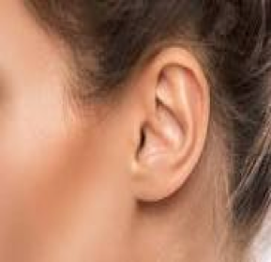
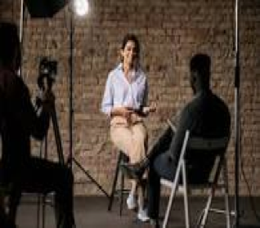
The Power of Audio vs. Visual

Slide 37
Thank You

Slide 38
Q&A

Slide 39
Thank You for your participation in the
Lightning Talks Speaker Series.
Questions or Comments?
The BU HUB
thehub@bu.edu
www.bu.edu/hub
Center for Teaching
& Learning
ctl@bu.edu
www.bu.edu/ctl
Digital Learning & Innovation
digital@bu.edu
www.bu.edu/dli
Post-survey: https://bit.ly/3Qo9qok

