Slide 1


Slide 2

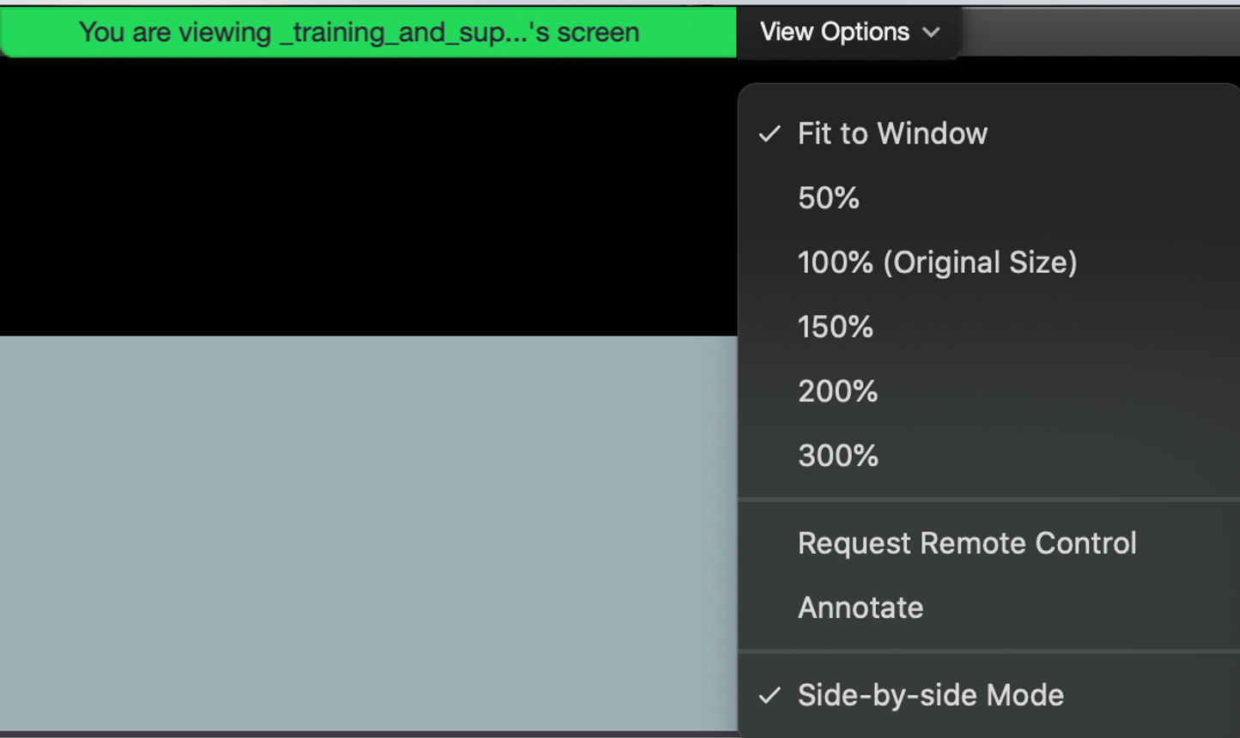
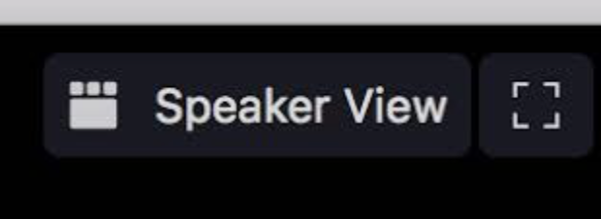
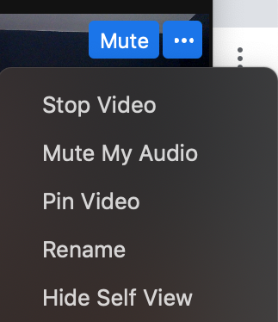
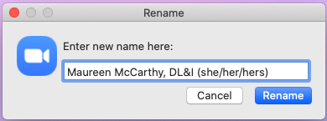
Quick Reminder
For optimal viewing experience, you can change your view options. We recommend Speaker View over Gallery View.
Optional: Add your department, program or school to your Zoom name.

Slide 3

Recording
Today’s Lightning Talks are being recorded and will be available for viewing via bu.edu/dli within 1-2 weeks.

Slide 4
Q&A
Please share your questions in the chat feature and the moderator will address questions at the completion of all presentations.

Slide 5
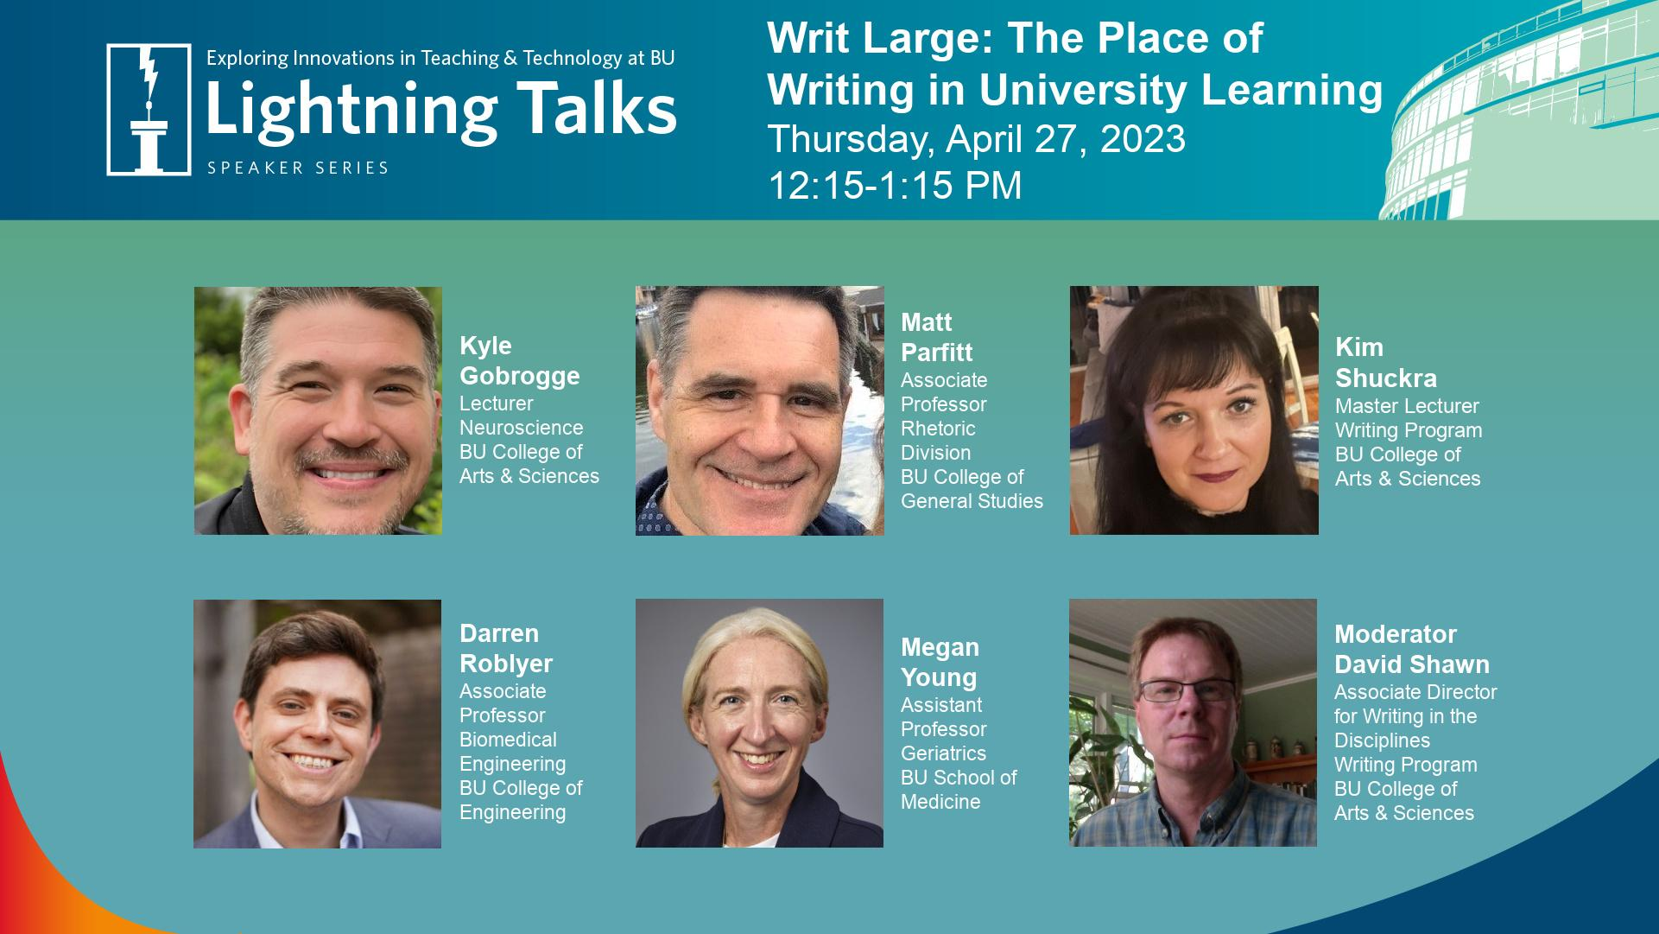

Slide 6
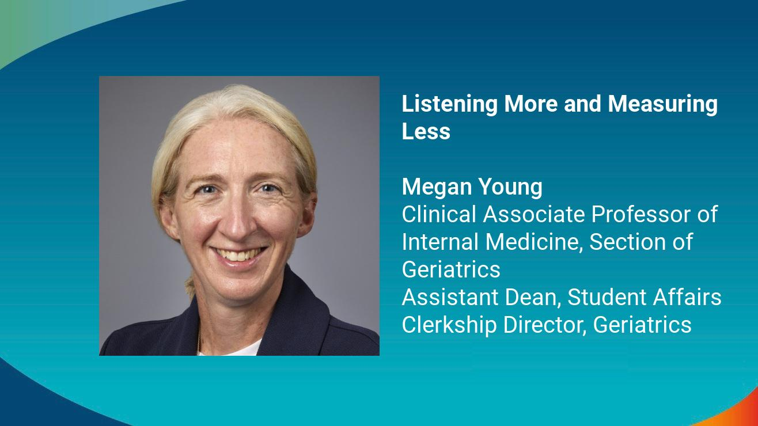

Slide 7
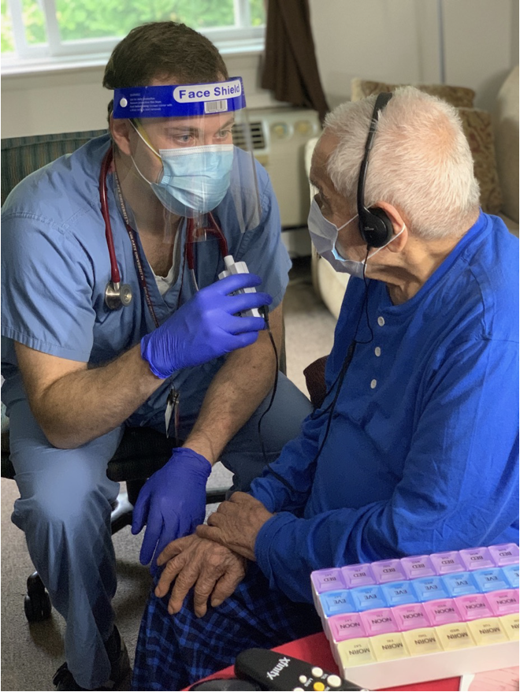
What is My Life, My Story?
Narrative medicine program that brings the written life stories of patients into the medical record

Slide 8

MLMS as a learning tool
All students at the medical school complete this during their geriatrics rotation
Question Prompts:
When did you move to Boston? Where did you live previously? What was your favorite place you have lived, traveled and why? What accomplishment are you the most proud of so far? What were your parents like? Was there a major history event that has happened in your lifetime? What advice do you have for future generations?
Notes:
standardized introduction scripts and sample questions to guide a student's interview of a patient.

Slide 9
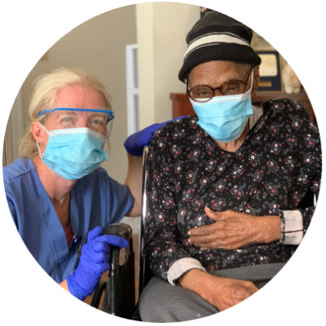
Student and faculty perspectives
Student: “If you take an interest in a patient's life, then it's really easy to build rapport and trust. People really light up when you start asking them questions about where they were born and their culture. Going forward, I'll definitely continue to practice trying to build a more personal relationship [with my] patients.”
Faculty: “We as geriatricians love understanding our patients and their stories and their backgrounds and how that informs their choices, and so the more that I know about that, the more I can put their decisions into context and guide them, especially as they are nearing the end of life.”

Slide 10
Thank You

Slide 11
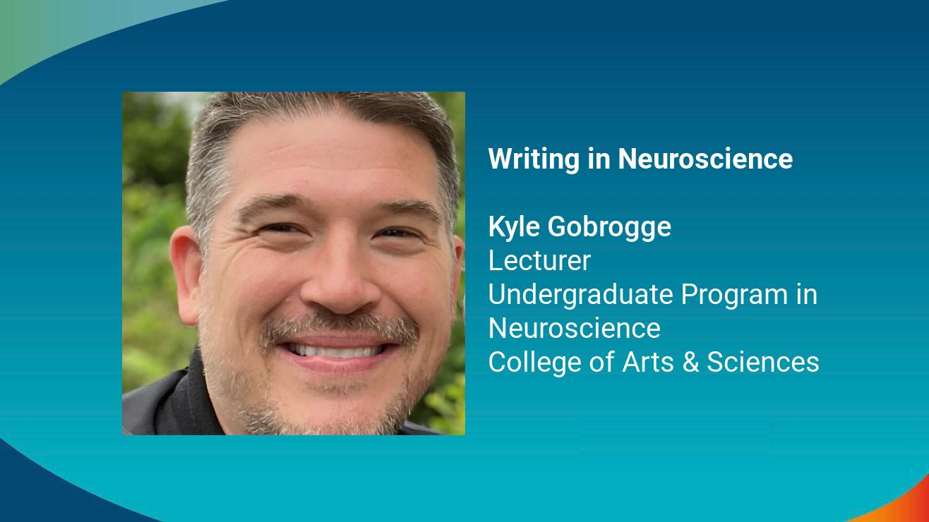

Slide 12

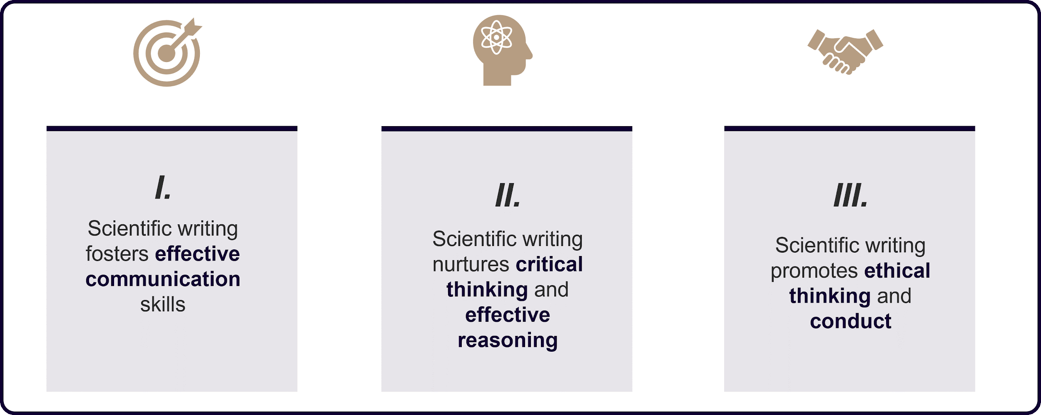
Emphasizing the importance of scientific writing in undergraduate Neuroscience

Slide 13
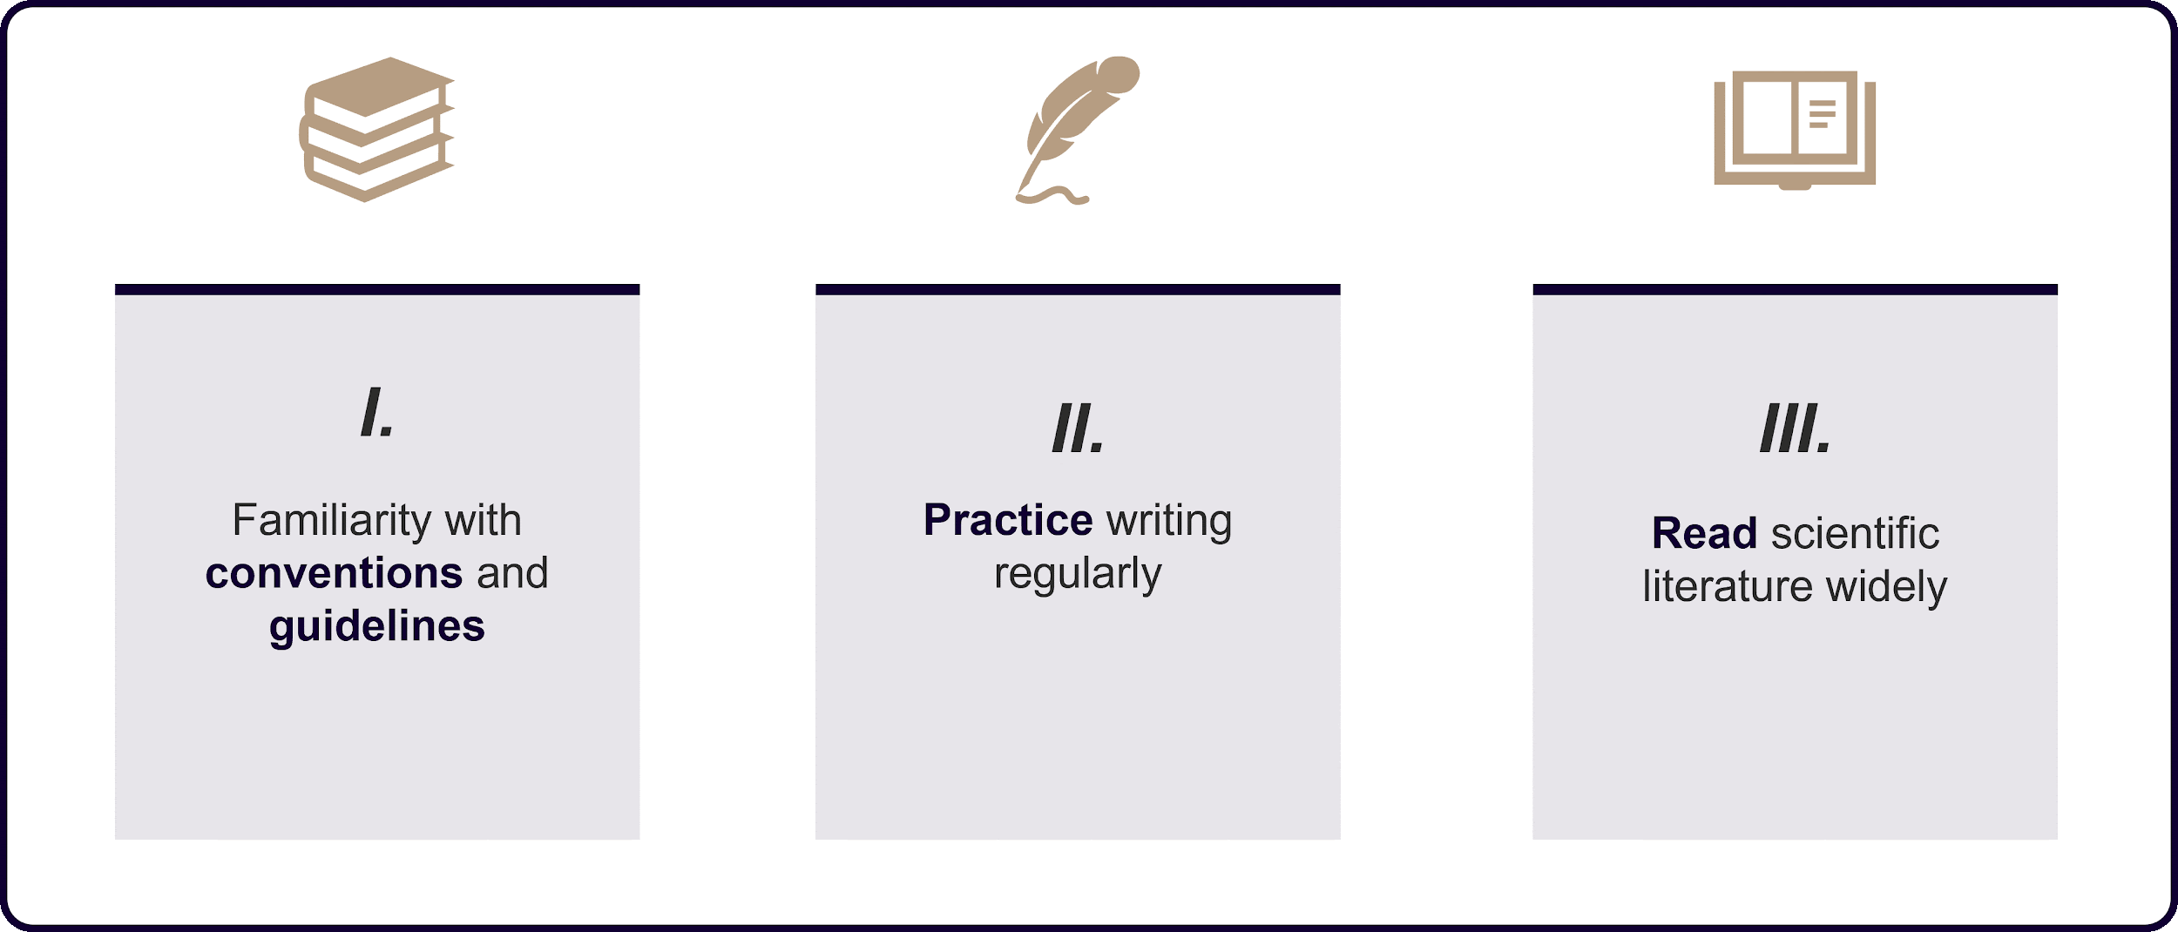
How to excel in scientific writing

Slide 14
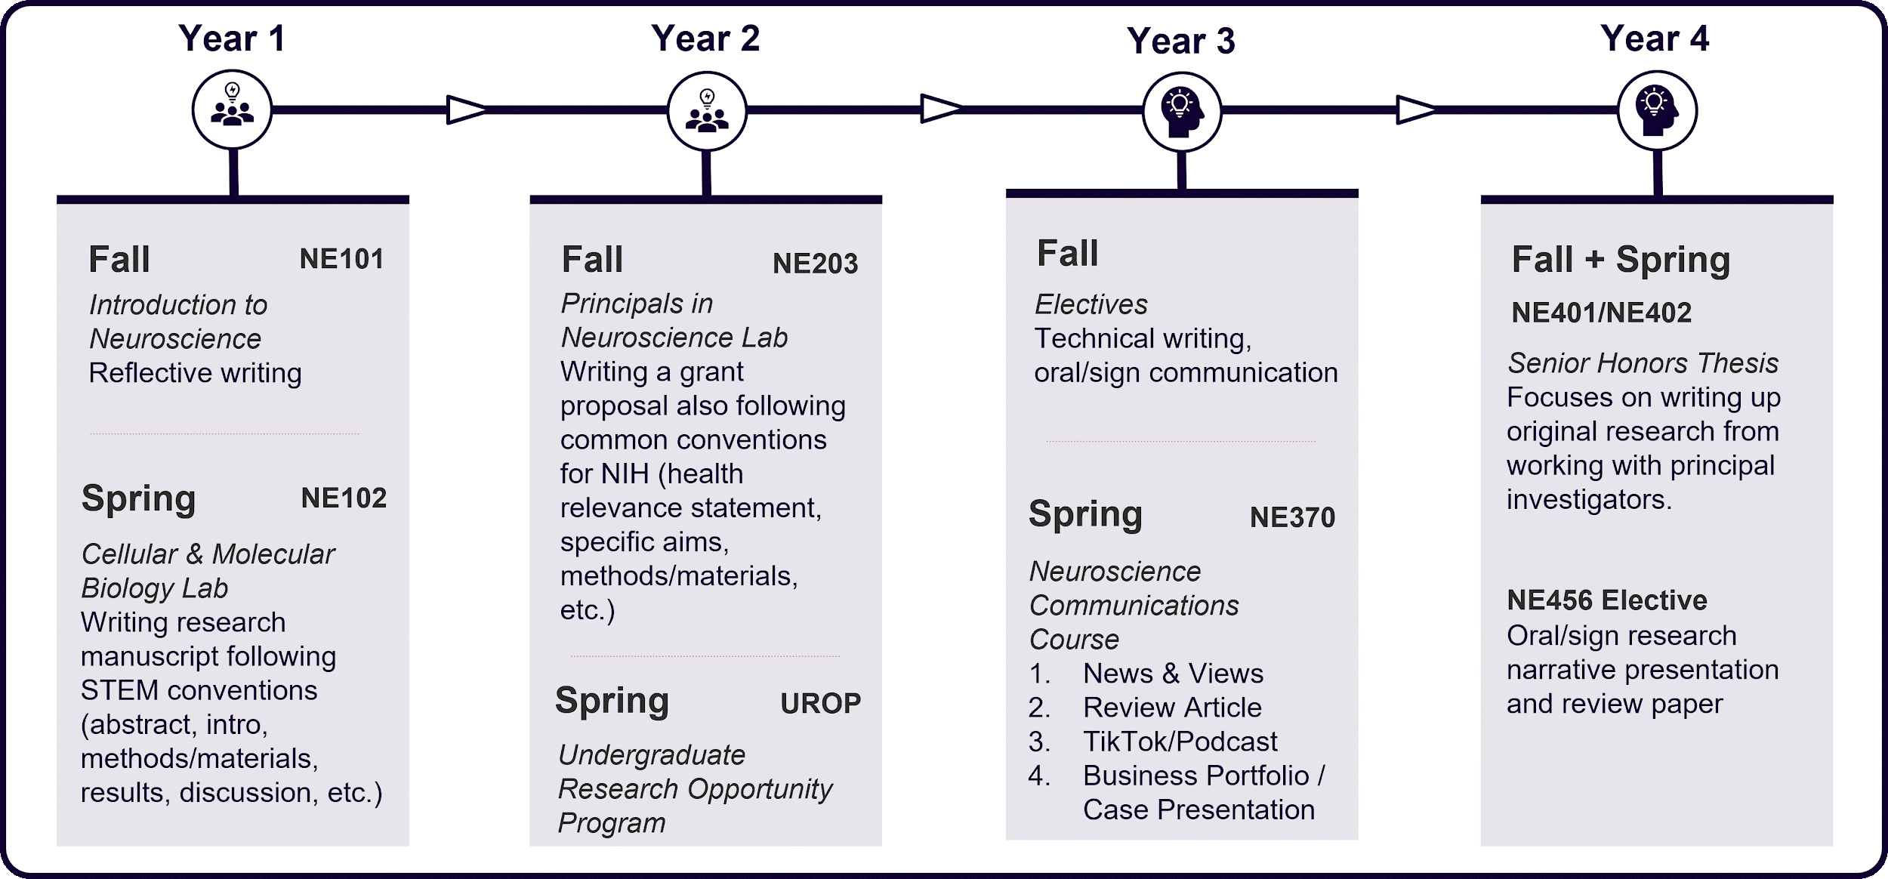
Timeline of writing curriculum in UPN

Slide 15
References
Smith, J. W., & Johnson, A. B. (2019). Writing Neuroscience: The Neuroscience of Writing. PLOS ONE, 14(3), 1-15.
Burch, A. M. (2019). Teaching Scientific Writing in Neuroscience: Exploring the Use of Peer Review and Feedback in Undergraduate Courses. Journal of Undergraduate Neuroscience Education, 17(2), A176-A182.
Harris, C. R., & Wilke, A. (2018). Teaching Writing in Undergraduate Neuroscience Courses. Journal of Undergraduate Neuroscience Education, 17(1), A27-A33.
Deans, M. R., & Smith, M. K. (2018). Student engagement with writing: Stimulating neural pathways for professional growth in neuroscience. Journal of Undergraduate Neuroscience Education, 16(1), A52-A58.
Kilgard, M. P., & Meliza, C. D. (2017). Teaching writing in neuroscience: The neuroscientifically educated brain. Journal of Undergraduate Neuroscience Education, 16(1), R1-R8.
Yocco, V. S. (2016). A Scaffolded Approach to Teaching Scientific Writing in the Neurobiology Classroom. Journal of Undergraduate Neuroscience Education, 15(2), A115-A122.
Crisp, K. M. (2016). Fostering scientific literacy and critical thinking skills through science writing. CBE-Life Sciences Education, 15(2), es3.
Schwartz, R. S. (2015). Advantages of a service-learning approach to scientific writing in a neuroscience curriculum. Journal of Undergraduate Neuroscience Education, 14(2), A104-A111.
Ward, J. (2014). Writing Across the Neuroscience Curriculum. Journal of Undergraduate Neuroscience Education, 13(1), A12-A15.
American Psychological Association. (2019). Publication Manual of the American Psychological Association (7th ed.). Washington, DC: American Psychological Association.

Slide 16
Thank You

Slide 17
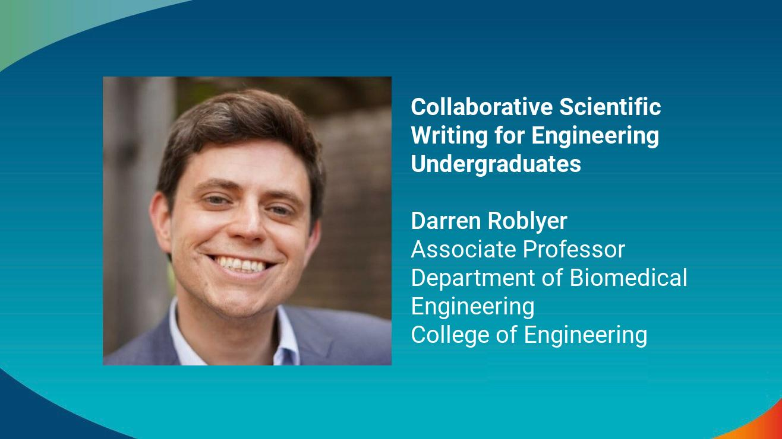

Slide 18
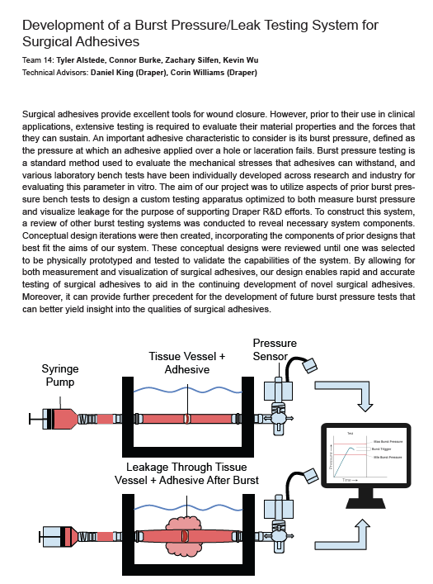
What is engineering senior design?
A year-long team project/course sequence with an academic, clinical, or industrial mentor/client
Example project in biomedical engineering
BME
MechE
Interdisciplinary
ECE

Slide 19

Writing assignments in engineering senior design
Biomedical engineering:
Final Report Structure
Abstract
Introduction/Background
Aims
Writing Assignment 1: Project Proposal
Prototype development and testing
Writing Assignment 2: Project Report
Oral Presentation
Oral Presentation
Semester 1
Pick a project
Methods
Results
Discussion
Semester 1
Semester 2
Semester 2

Slide 20
Meeting challenges in engineering senior design writing
Challenges
Our strategies
Rapid familiarization to the language of a new technical field
Communication to a general engineering audience
Properly identify and describe key aspects of the project:
  Significance, Innovation, Approach, Results, Discussion
Integrate data visualizations with writing
Proper citations
Confidentiality
Scaling feedback (133 students/40 teams)
Model examples
Storytelling (guest lecture)
Collaboration with the BU Writing Program
  David Shawn (Lecture)
  Writing tutors (Iterative feedback)
Feedback from design faculty
Feedback from technical mentors
Feedback from peers

Slide 21
Thank You

Slide 22
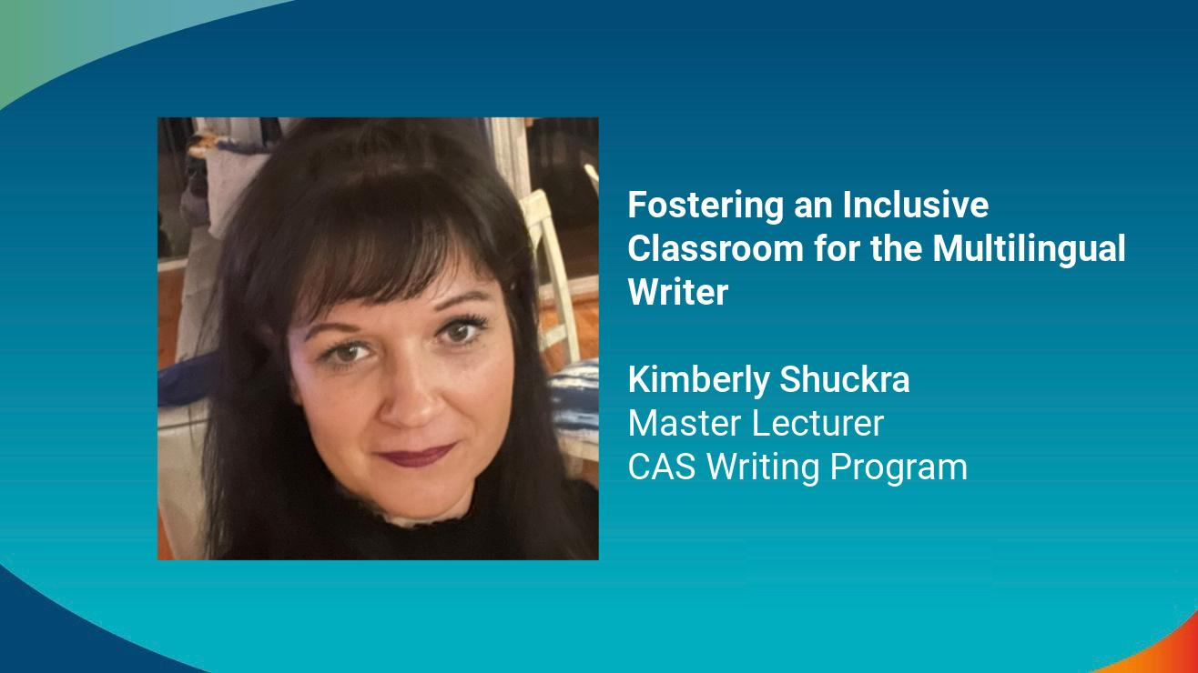

Slide 23

23% of the Class of 2026 are international
South East Asia/ East Asia​ 61.6%
Central Asia 16.7%
Europe 7.5%​
Canada 4.5 %​
Latin America/The Caribbean​ 4.4%​
North Africa/ Middle East​ 3.7%​
Oceania 0.7%​
Sub-Saharan Africa​ 0.5%

Slide 24

The Research:​ Why inclusive teaching is essential to a welcoming and equitable classroom environment
​“…the very kind of clarity, accessible language, careful explanation, and effort that faculty want students to demonstrate are the kinds of assistance students are asking of faculty”​ - Vivian Zamel ​
“students can exercise critical facility in analyzing culture through writing frequently about the contrasts and connections between course materials and their own native cultures, about the history of their own experiences as immigrants, refugees, or international students, and about the contrasts and contradictions between their original cultures and the demands of their lives and their educations within U.S. society—especially when they are allowed or encouraged to do so”​ -Tim Sieber ​
“Cultivating a culturally responsive classroom can enhance learning outcomes by generating support and awareness for international students’ unique experiences. Alex Oxner and Joe Bandy; Vanderbilt CFT ​

Slide 25

Fostering an inclusive classroom for the multilingual writer
Names: Acknowledging the importance of names generates a sense of belonging​
Make an effort to learn the correct spelling and pronunciation​
Careless misuse of a name may create a sense of Isolation ​
Avoid jokes or showing relief if students use a more “American” name ​
​
Community Building Exercises: Promotes cross cultural perspectives ​
Builds an inclusive classroom community/enriches intercultural perspectives​
Creates an awareness of unconscious bias ​
Encourages important dialogue among all populations of students ​
Builds a trusting environment. ​
​
Group Work: Benefits both populations of writers ​
Create a community that crosses linguistic and cultural barriers ​
Nurture multilingual students’ power and control​
Understand:​
Teacher-centered vs Student-centered Classroom Culture Experiences ​
Cultural Bias​
Possible Obstacles Facing Multilingual Writers

Slide 26
Thank You

Slide 27
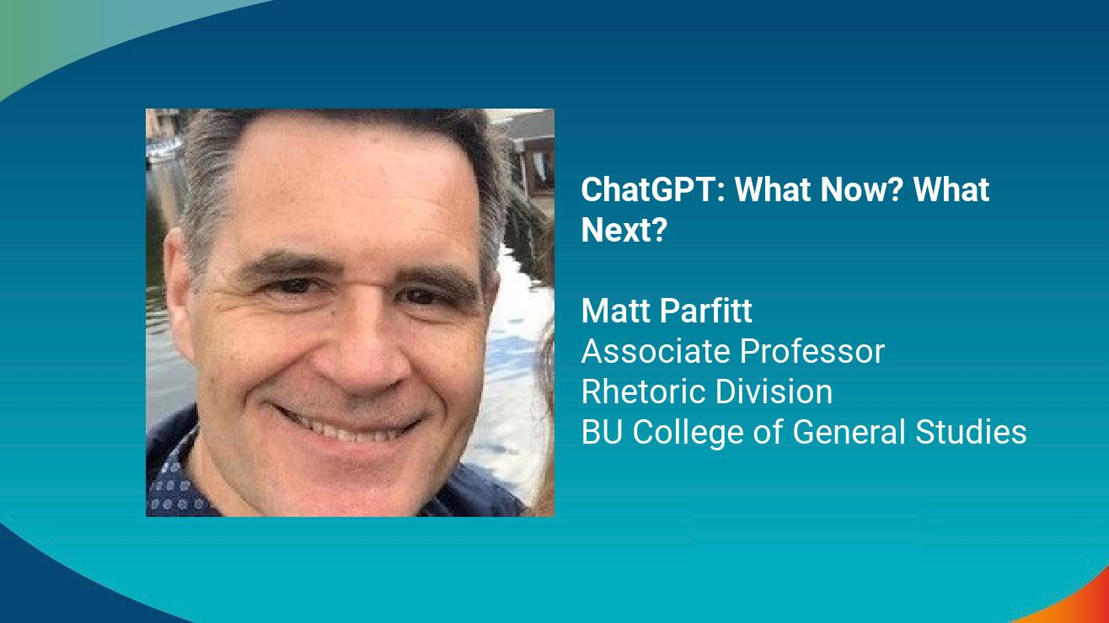

Slide 28
We can’t rely on AI detectors…
… such as Turnitin, GPTZero, OriginalityAI, etc.
Very little trustworthy data
Technology is moving too quickly

Slide 29
So let’s make abuse less tempting…
“Localize” assignments:
Require references to recent lectures/discussions, current events, specific passages in a (not too familiar) text.
Use exploratory genres:
Integrate personal reflection and narrative into academic genres.

Slide 30
And encourage appropriate uses…
As research tool or study aid:
Getting started with good search terms
Getting to know the existing “conversation” on a topic
Grasping difficult concepts
As Socratic tutor
As grammar, citation, and formatting checker

Slide 31
Thank You

Slide 32
Q&A

Slide 33

Thank You for your participation in the
Lightning Talks Speaker Series.
Questions or Comments?
Email digital@bu.edu.

