Slide 1


Slide 2

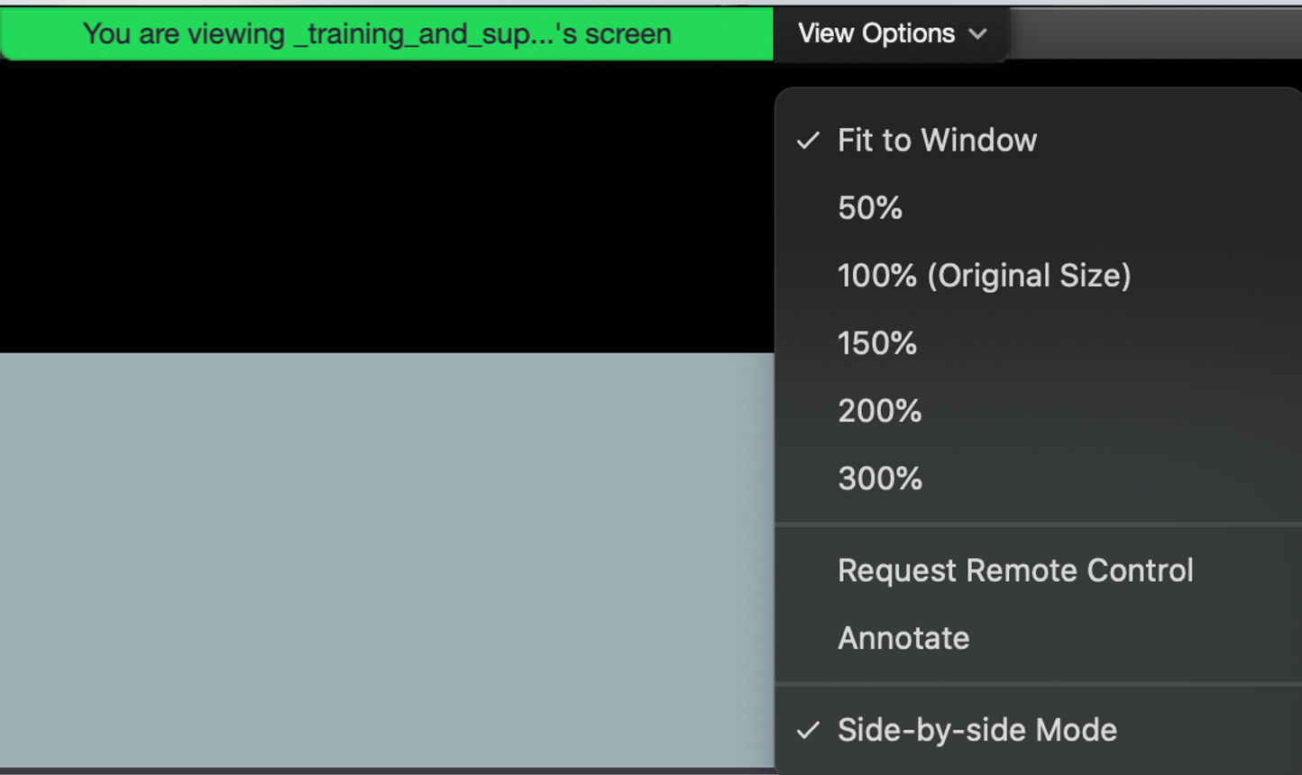

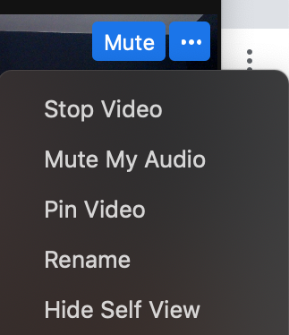
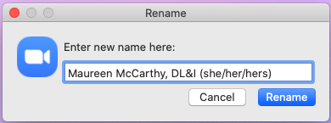
Quick Reminder
For optimal viewing experience, you can change your view options. We recommend Speaker View over Gallery View.
Optional: Add your department, program or school to your Zoom name.

Slide 3

Recording
Today’s Lightning Talks are being recorded and will be available for viewing via bu.edu/dli later this month.

Slide 4
Q&A
Please share your questions in the chat feature and the moderator will address questions at the completion of all presentations.

Slide 5
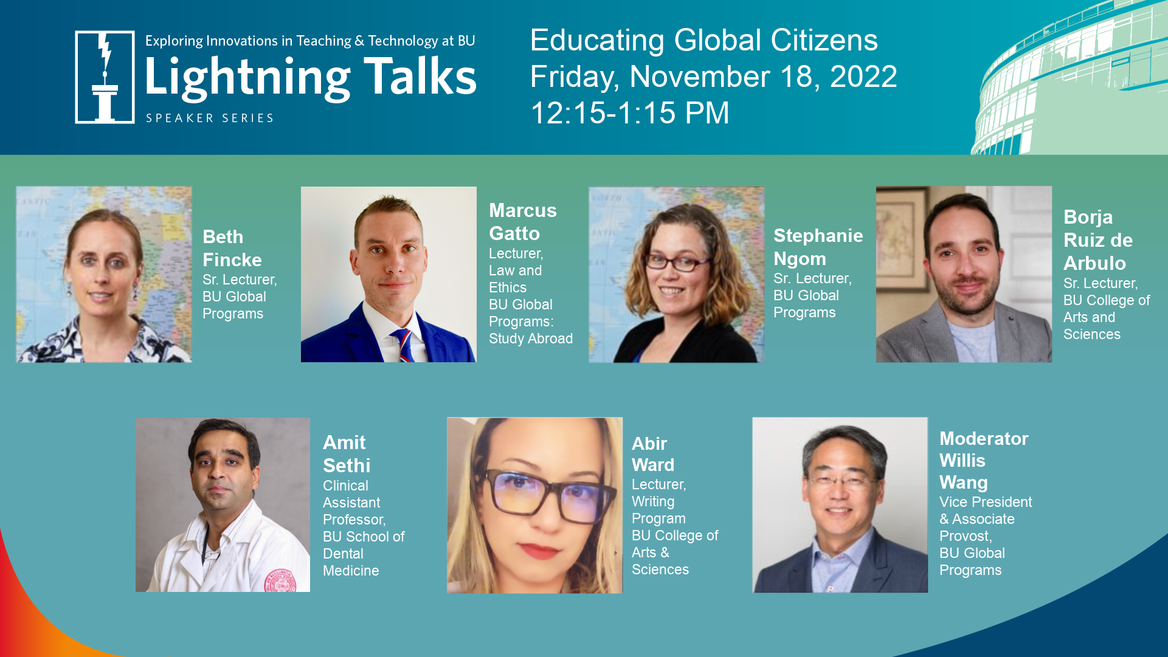

Slide 6



Building Community with International Students
through Classroom Contracts
Beth Fincke
Senior Lecturer
CELOP/
Global Programs
Stephanie Ngom
Senior Lecturer
CELOP/
Global Programs
Headshot

Slide 7


Class Contract:
Creating a Safe & Inclusive Space
Professor introduces contract using a model
Student-led brainstorming
Students develop a customized contract for their class

Slide 8
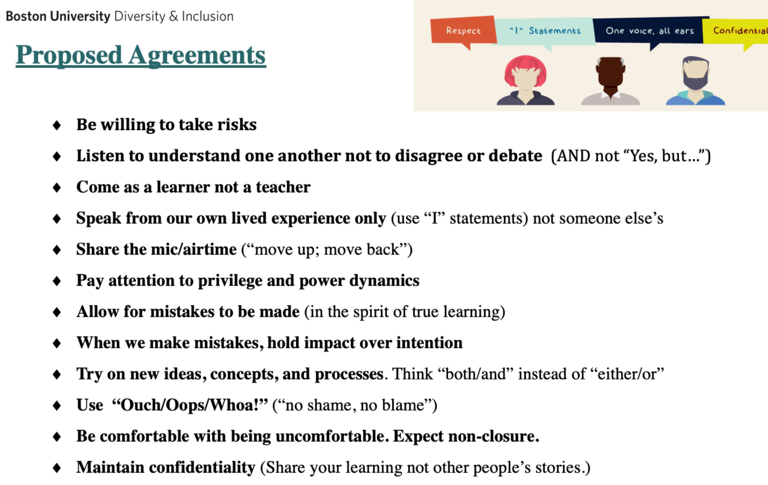
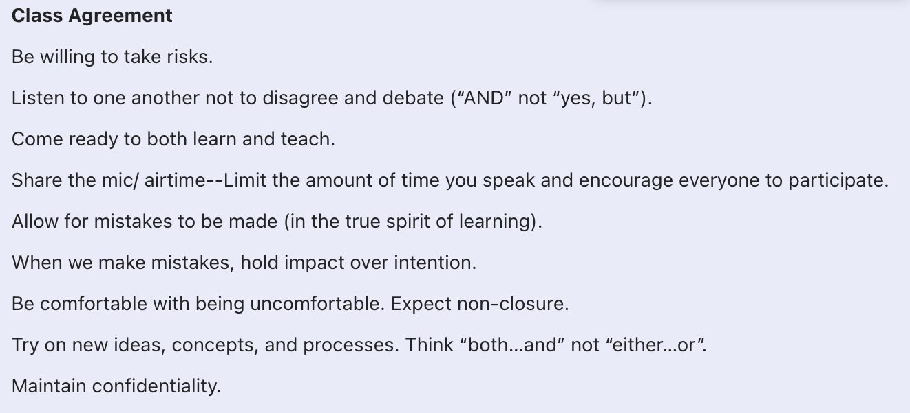
Class Contract Examples:

Slide 9
Takeaways
Other ways we have created community both synchronously and asynchronously:
Students present their cities and special aspects of their cultures
Using the following technology: Perusall, Pronto, Discussion Boards
Connect with Us!
Beth Fincke
bethf@bu.edu
Stephanie Ngom
sngom@bu.edu

Slide 10
Thank You

Slide 11
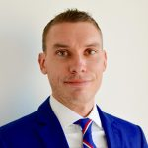
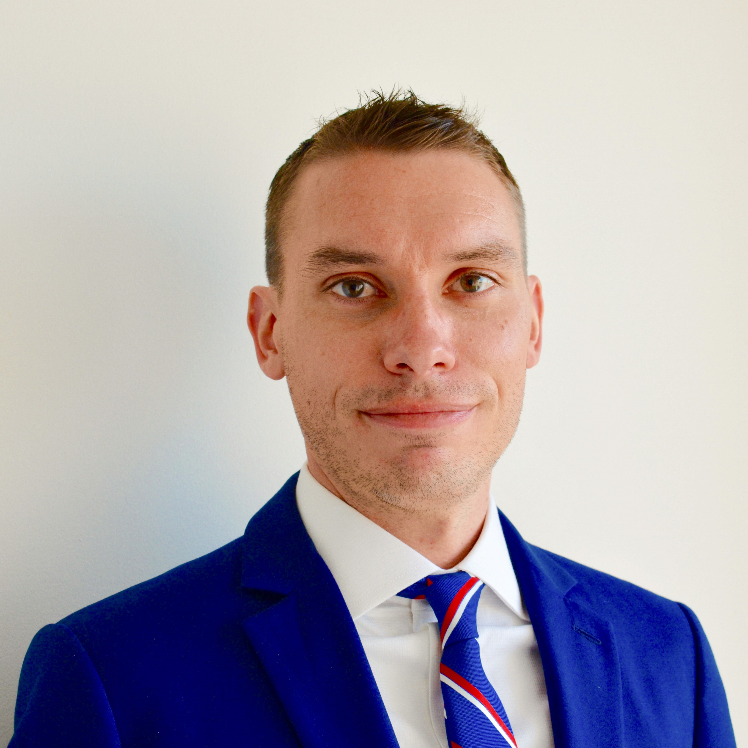
Marcus Gatto
Lecturer, Law and Ethics
BU Global Programs: Study Abroad, Dublin
Community, Care, and the Classroom: Ethics and Pedagogy in Study Abroad

Slide 12
Boston University Dublin Internship Program
Ethics in Health Care
Class Scheduled Three Times per Week (Intensive)
Generally 5 - 12 Students Total
Variety of Student Profiles
Classical and Modern Schools of Ethics
Sensitive Ethical Issues Examined Through a Variety of Media
Program in General:
Fixed and Elective Requirements
Ethics Course Specific to Health Science Track
Variety of Work Experience

Slide 13
Ethics in Health Care: Subject and Subjectivity
Nursing Ethics by Joan McCarthy Principal Text in Course
Generally Three Dimensions to Materials Presented:
  Cultural (Societal Structures and Influences)
  Institutional (Professional Governing Bodies; Codes of Ethics)
  Interpersonal Narratives (Case Studies)
Example: Narrative Ethics
Application in Health Care
Example: Ethic of Care
Application in Student (Personal) Experience
Defining “Care”
Building Community Abroad

Slide 14
Takeaways
Unique Pedagogical Dimensions of Study Abroad
Ethics as a Learning Outcome as well as Outcome of Learning
Broadening and Developing Sense of Self and Community

Slide 15
Thank You

Slide 16
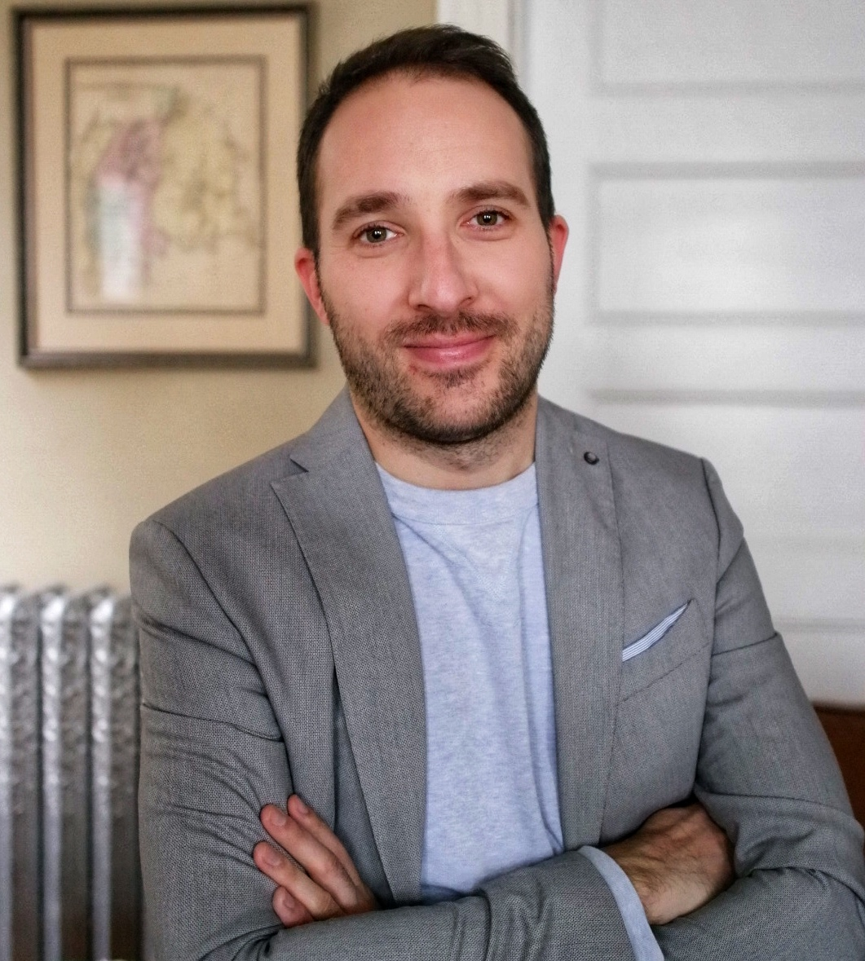
Borja Ruiz de Arbulo
Senior Lecturer in Spanish
BU College of Arts & Sciences
Digital Talks: Bringing the Culture Into the Second Language Classroom
Headshot
How to pronounce my name.

Slide 17



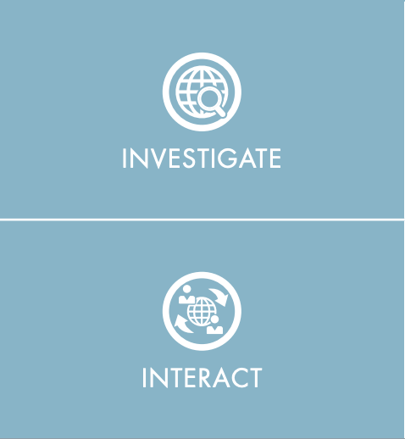

Spanish 211 (LS 211)
Interpretive
Communication
Intercultural
Communication
Interpersonal
Communication
In my own and other cultures I can make comparisons between products and practices to help me understand perspectives
Presentational
Communication
I can interact at a functional level in some familiar contexts
https://www.actfl.org/sites/default/files/can-dos/Intercultural%20Can-Do_Statements.pdf

Slide 18

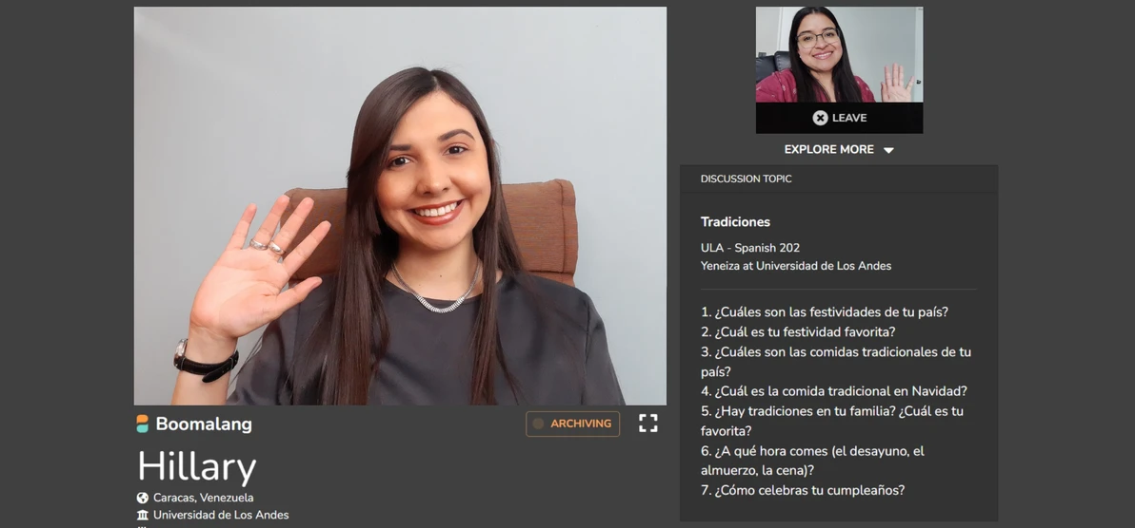
Intercultural
Communication
Task
Goal
2 Unscripted conversations
15-minute each
Written or spoken reflection
Learner as a proactive communicator
Comparison and reflection
https://www.boomalang.co/
LS 211
Cultural
Competence
Language
Proficiency

Slide 19




Takeaways
After speaking of Monterrey, we were able to share what classes we are taking this semester since we're both University students! We are both studying in STEM-related fields and can share the struggle of taking difficult, time-consuming classes. Lastly, we spoke about each of our experiences being in a field that not many people in our family can relate to, which helped me in feeling less alone with my own difficulties. Ultimately, I feel that my conversation with _________ flowed very smoothly, and was a nice refresher to a very long day

Slide 20
Thank You

Slide 21
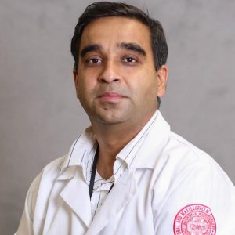
Amit Sethi
Oral & Maxillofacial Surgery
BU School of Dental Medicine
“Where Are You From?”

Slide 22
Microagressions
“Subtle, verbal or non-verbal (behavioral) exchanges that infringe on person’s space, energy and mobility.. .and often “communicate hostile, derogatory or negative slights and insults that potentially have a harmful or unpleasant psychological impact on the target person or group”
“Where are you from”, “That name is not a common name for “you people”, “When you finish training are you going back to your country?”, “It’s surprising that you speak English really well!”
Black, Latinos, Native Americans, Asian Americans, and LGBTQs among the most susceptible groups
In medical and dental schools besides the faculty, patients may commit “microaggressions”

Slide 23
“Price of having to stay and study/teach here”
International students and scholars, who often have to face multiple challenges during the process of admission and acceptance and moving to a new country often “reconcile these incidents” as a “price of getting to stay and study in the United States”.
Students and Scholars find themselves unable to “fit in” despite their best efforts
Reminded of being of an “outsider” continuously
Low self esteem and lack of confidence which continues well beyond their time in our institutions

Slide 24
How Can We Do Better?
Acknowledging the fact that “microaggressions” exist and creating awareness among faculty members and graduate/undergraduate students. One may be a receiver or aggressor and sometimes both
Using real-life examples and case studies to highlight and provide space and time for scholars and students to share their experiences
Response based on three frameworks
Open The Front Door ( Observe, Think, Feel, Desire)
ACTION ( Ask, Come from Curiosity, Tell what you observed, Impact, Own your thoughts, Next Steps)
XYZ ( I feel X when you say Y because Z)
“Kindness, mutual understanding”, thoughtfulness, empathy, and inclusivity are keys to giving a sense of true belonging to our colleagues, scholars, and students

Slide 25
References
Pierce CM, Carew JV, Pierce-Gonzales D, Willis D. An experiment in racism: TV commercials. Edu Urban Soc 1977. 10:61-87. Doi:10.1177/0013124577010000105.
Sue DW, Capodilupo CM, Torino GC, et al. Racial microaggressions in everyday life: Implications for clinical practice. Am Psychol. 2007. 62(4):271-286.

Slide 26
Thank You

Slide 27
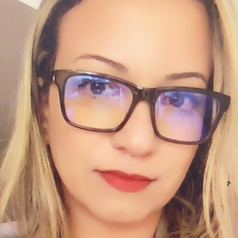
Abir Ward, PhD
Lecturer
BU College of Arts & Sciences Writing Program
Linguistic Justice: The Myth that became a Buzzword

Slide 28
Good News!
Bad News!

Slide 29
Writing and publishing in
English is 25% more burdensome for NNES
(Hanauer, Sheridan, & Englander, 2019)

Slide 30
Recognize
Acknowledge
Commend
Invite

Slide 31
abirward@bu.edu

Slide 32
Thank You

Slide 33
Q&A

Slide 34

Thank You for your participation in the
Lightning Talks Speaker Series.
Questions or Comments?
Email digital@bu.edu.

