Slide 1
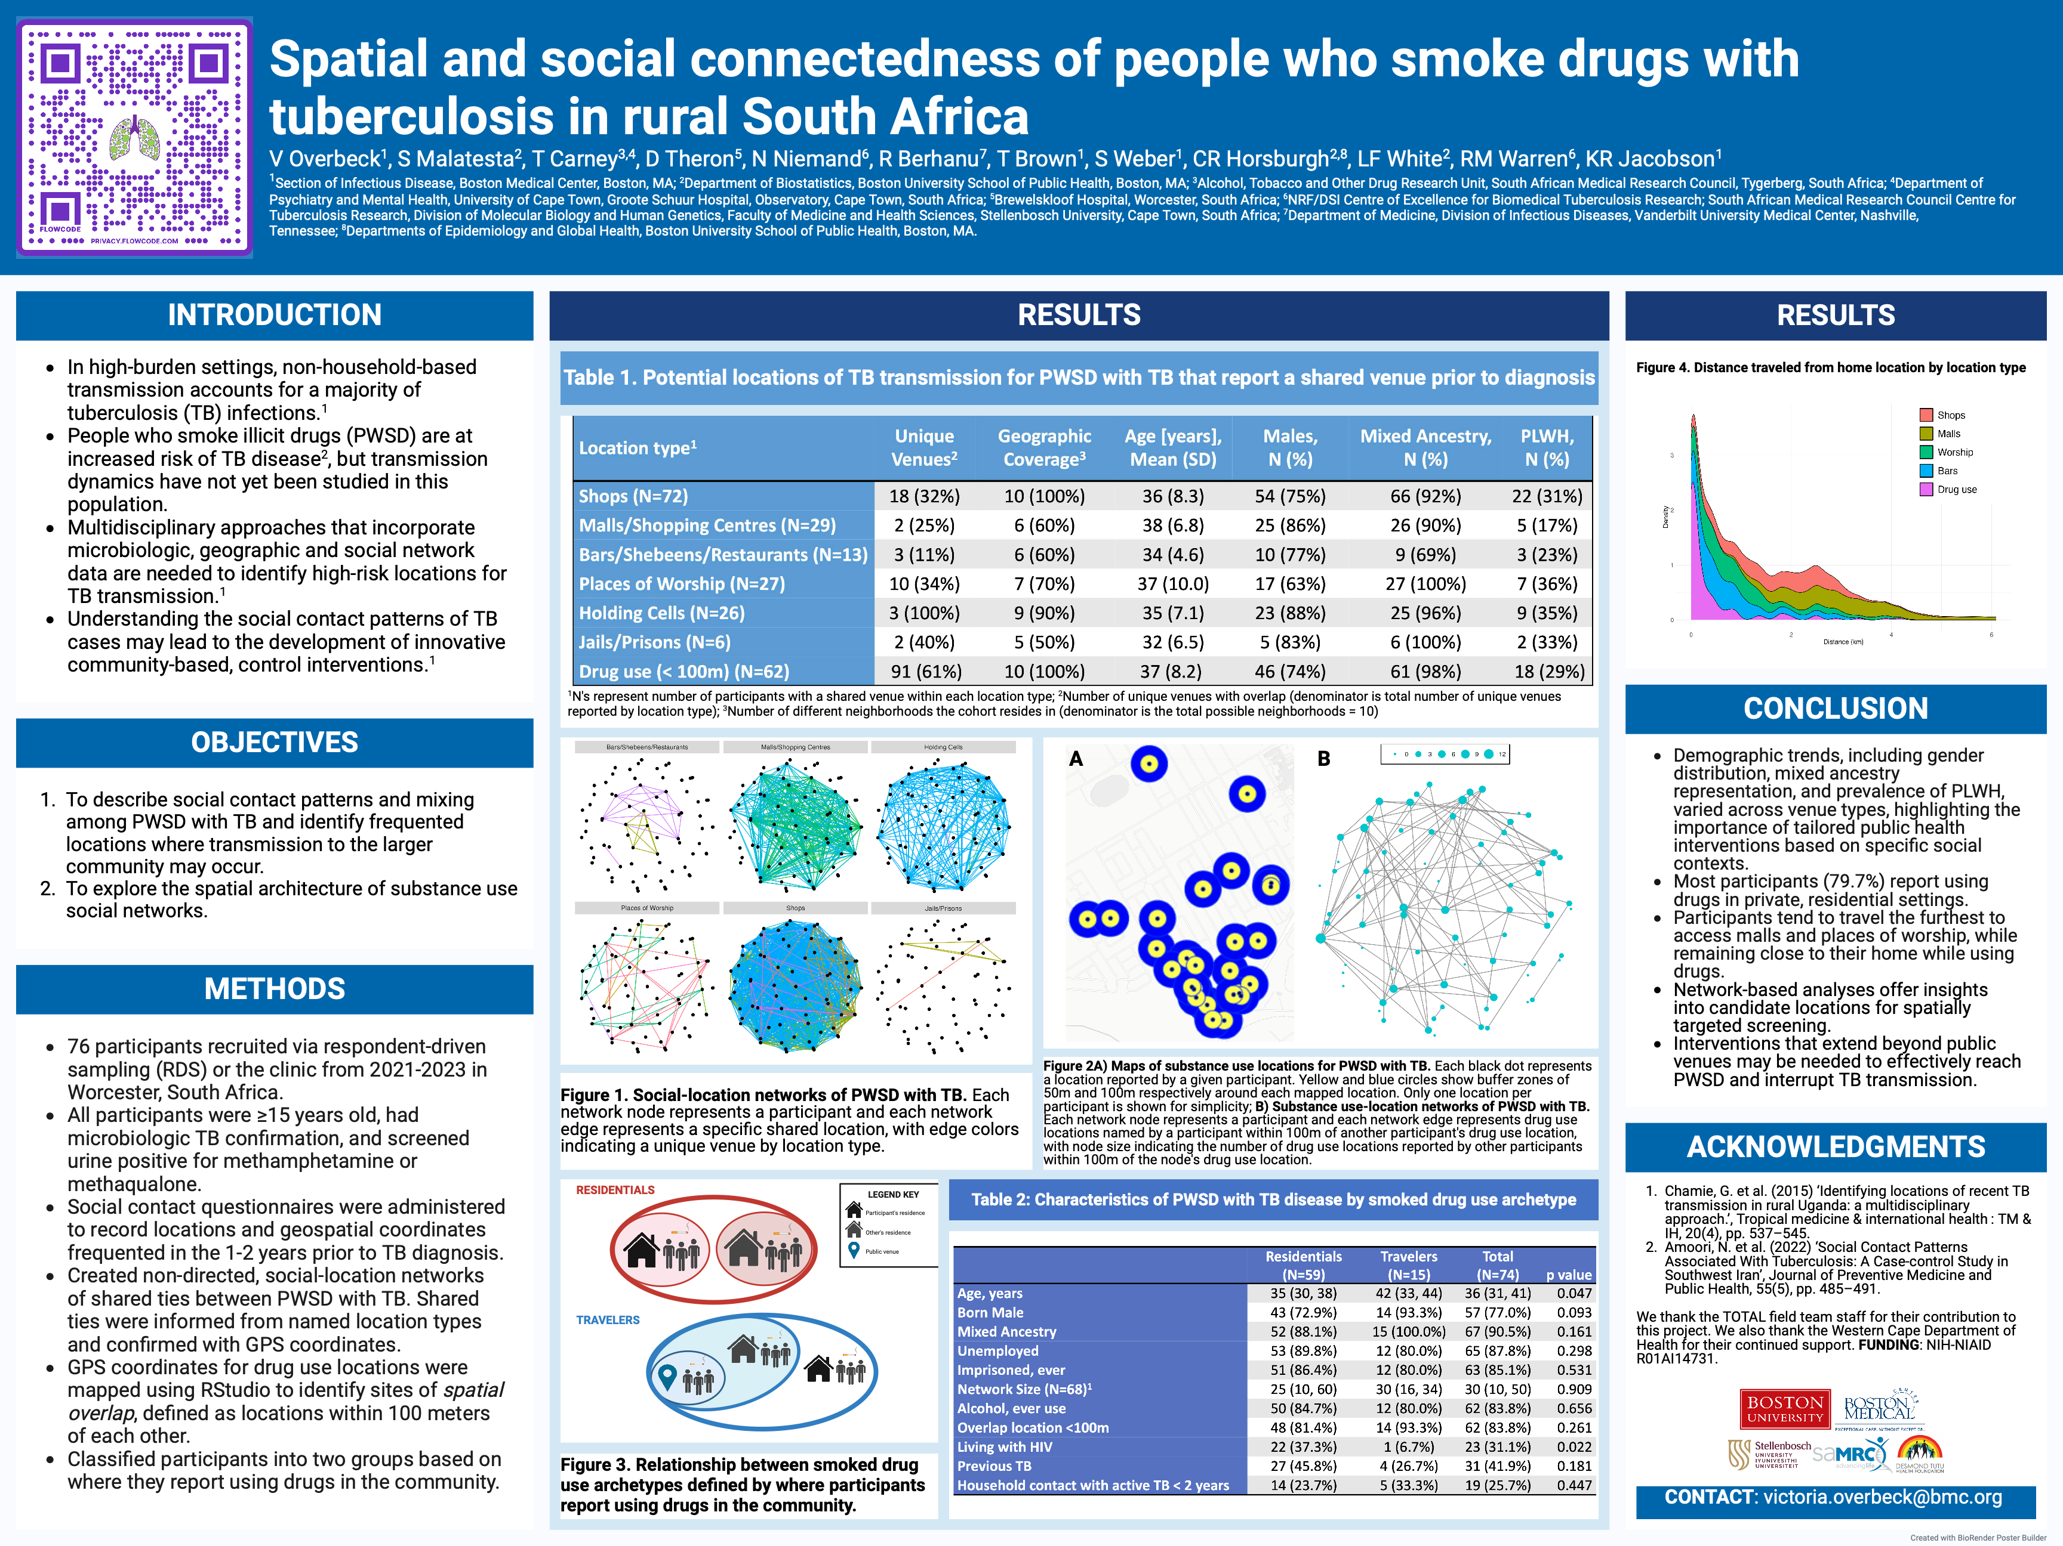

Slide 2
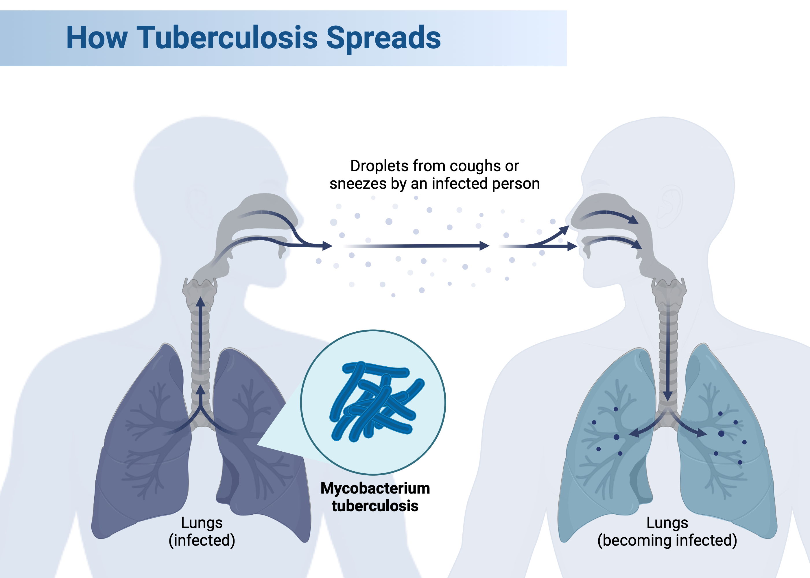

Slide 3
Introduction
People who smoke illicit drugs (PWSD) are at increased risk of TB disease, but transmission dynamics have not yet been studied in this population.
Understanding the social contact patterns of people with TB may lead to the development of innovative community-based, control interventions.
Multidisciplinary approaches that incorporate microbiologic, geographic and social network data are needed to identify high-risk locations for TB transmission.

Slide 4
Objectives
To describe social contact patterns and mixing among PWSD with TB and identify frequented locations where transmission to the larger community may occur.
To explore the spatial architecture of substance use social networks.

Slide 5
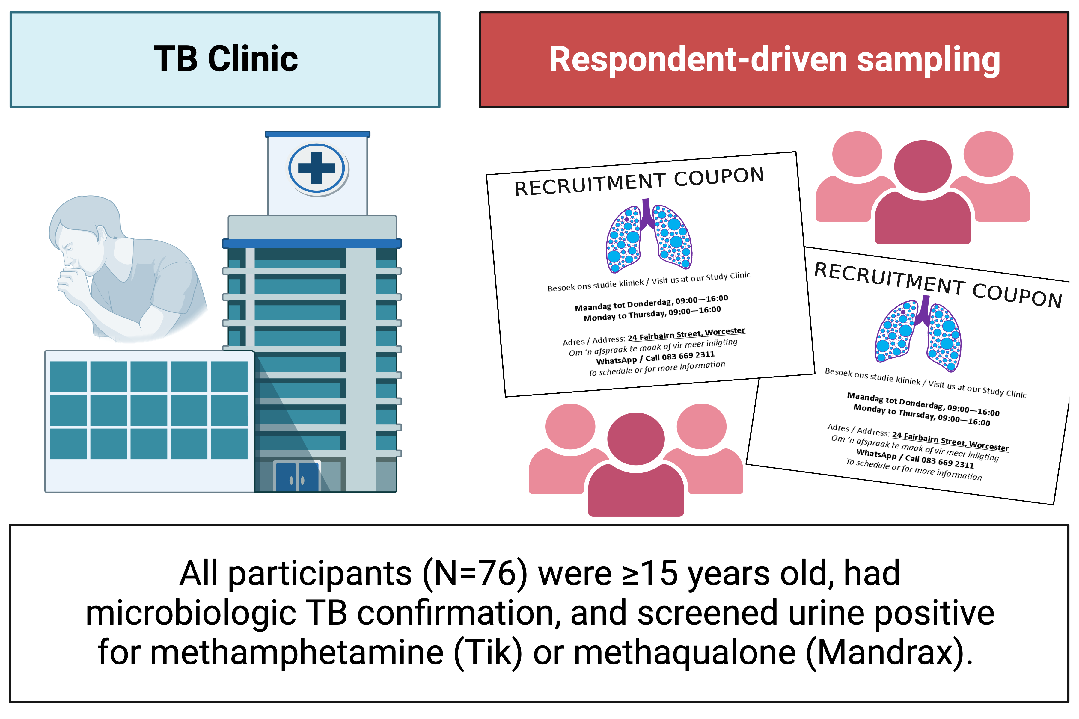
Methods

Slide 6
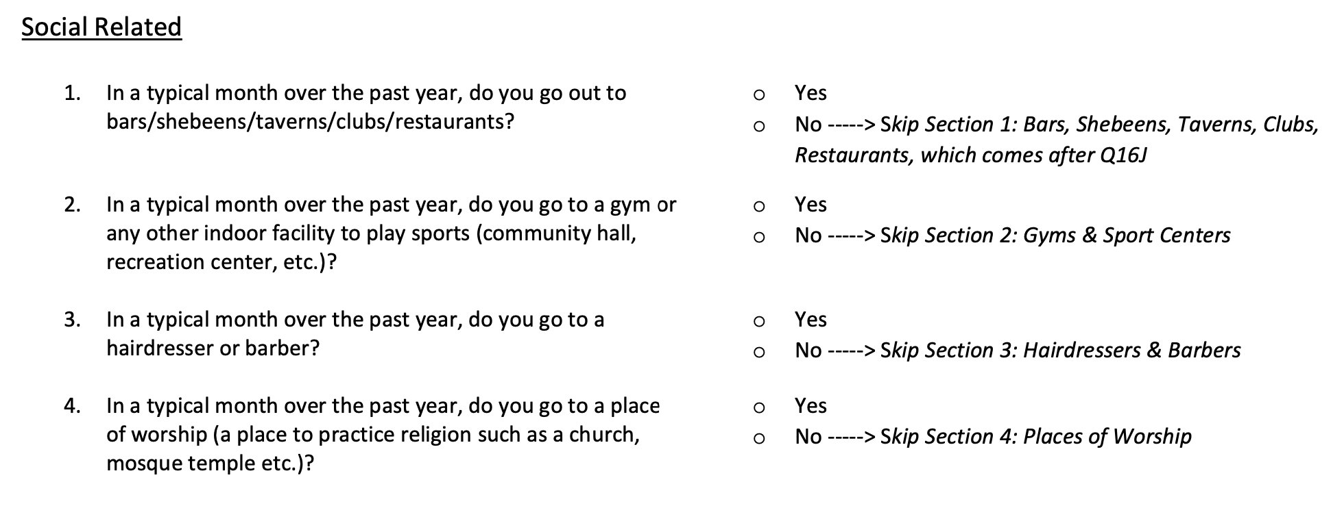
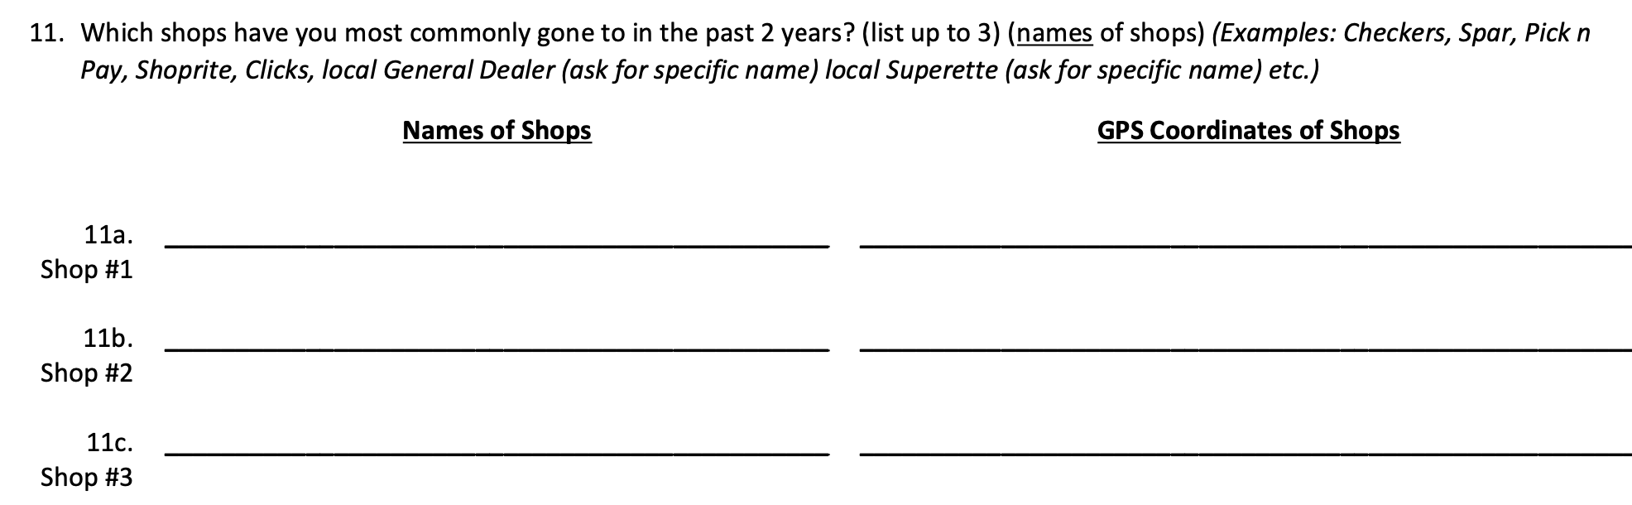
Social contact questionnaires

Slide 7
Methods
Created non-directed, social-location networks of shared ties between PWSD with TB.
  Shared ties were informed from named location types and confirmed with GPS coordinates.
GPS coordinates for drug use locations were mapped using RStudio to identify sites of spatial overlap, defined as locations within 100 meters of each other.
Quantified sex, age, race/ethnicity, and HIV status assortative mixing within the social-location and substance-use location networks.
Classified participants into two groups based on where they report using drugs in the community.

Slide 8
Table 1: Potential locations of TB transmission for PWSD with TB that report a shared venue prior to TB diagnosis
Location type¹ | Unique Venues² | Geographic Coverage³ | Age [years], Mean (SD) | Males, N (%) | Mixed Ancestry, N (%) | PLWH, N (%)
Shops (N=72) | 18 (32%) | 10 (100%) | 36 (8.3) | 54 (75%) | 66 (92%) | 22 (31%)
Malls/Shopping Centres (N=29) | 2 (25%) | 6 (60%) | 38 (6.8) | 25 (86%) | 26 (90%) | 5 (17%)
Bars/Shebeens/Restaurants (N=13) | 3 (11%) | 6 (60%) | 34 (4.6) | 10 (77%) | 9 (69%) | 3 (23%)
Places of Worship (N=27) | 10 (34%) | 7 (70%) | 37 (10.0) | 17 (63%) | 27 (100%) | 7 (36%)
Holding Cells (N=26) | 3 (100%) | 9 (90%) | 35 (7.1) | 23 (88%) | 25 (96%) | 9 (35%)
Jails/Prisons (N=6) | 2 (40%) | 5 (50%) | 32 (6.5) | 5 (83%) | 6 (100%) | 2 (33%)
Drug use (< 100m) (N=62) | 91 (61%) | 10 (100%) | 37 (8.2) | 46 (74%) | 61 (98%) | 18 (29%)
¹N's represent number of participants with a shared venue within each location type. ²Number of unique venues with overlap (denominator is total # of unique venues reported by location type). ³Number of different neighborhoods the cohort resides in (denominator is the total possible neighborhoods = 10)

Slide 9
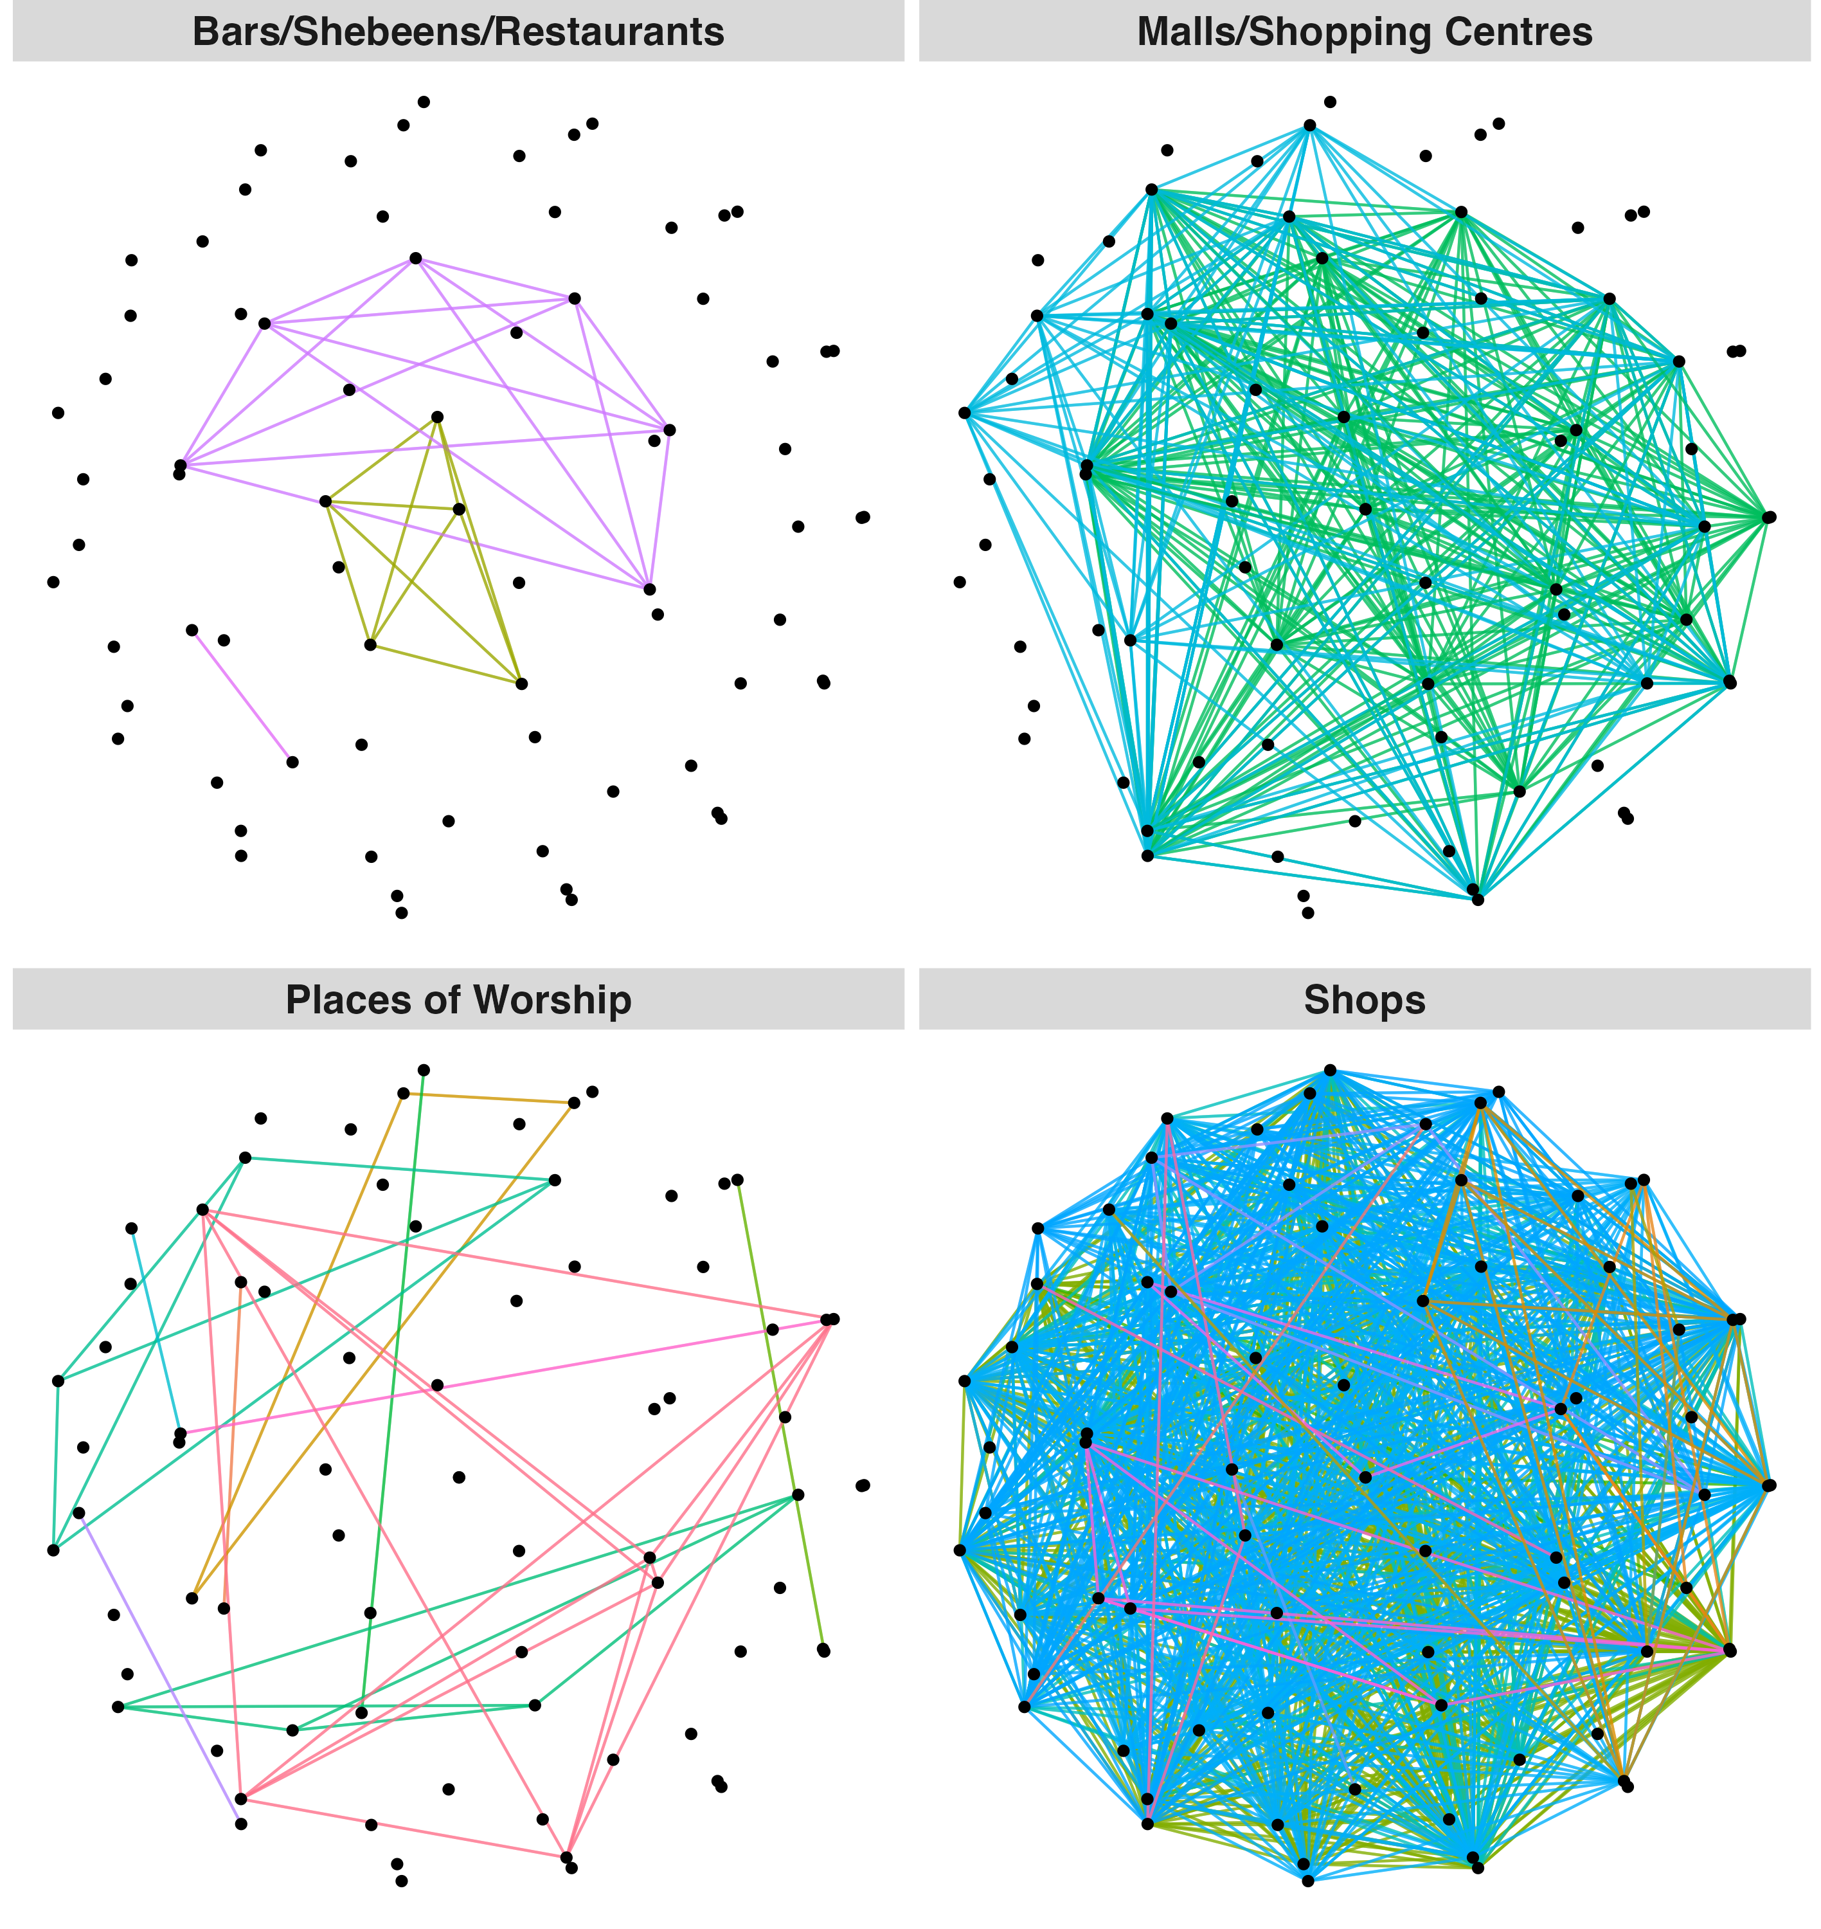
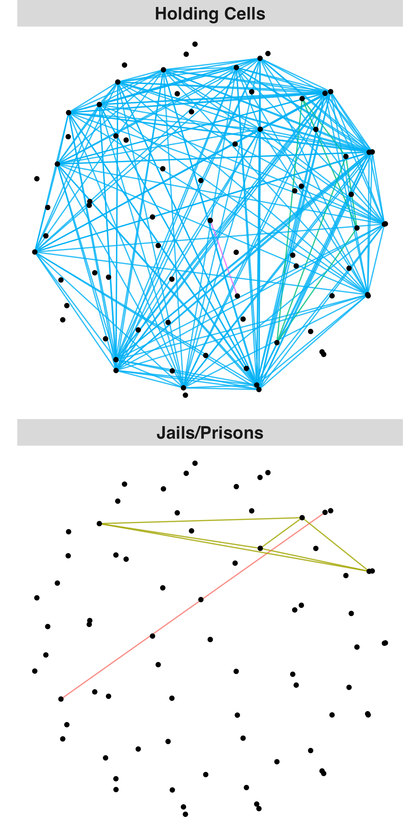
Figure 1: Social-location networks of PWSD with TB
Each network node represents a participant, and each network edge represents a specific shared location, with edge colors indicating a unique venue by location type.

Slide 10
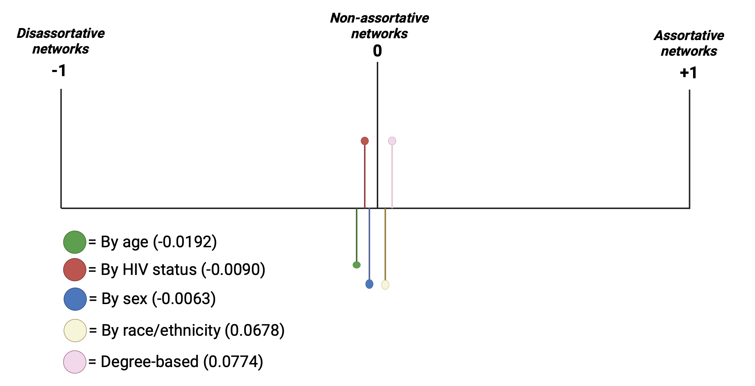

Assortativity coefficients ($r$)

Slide 11
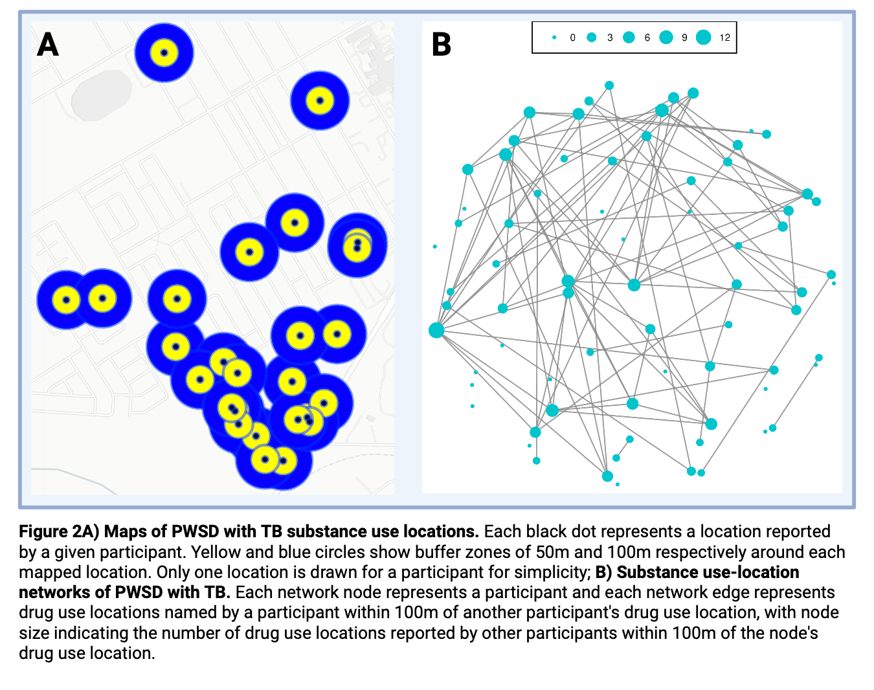
Figure 2A: Maps of substance use locations
Figure 2B: Substance use-location networks
Each black dot represents a location reported by a given participant. Yellow and blue circles show buffer zones of 50m and 100m respectively around each mapped location. Only one location per participant is shown for simplicity.
Each network node represents a participant, and each network edge represents drug use locations named by a participant within 100m of another participant's drug use location, with node size indicating the number of drug use locations reported by other participants within 100m of the node's drug use location.

Slide 12
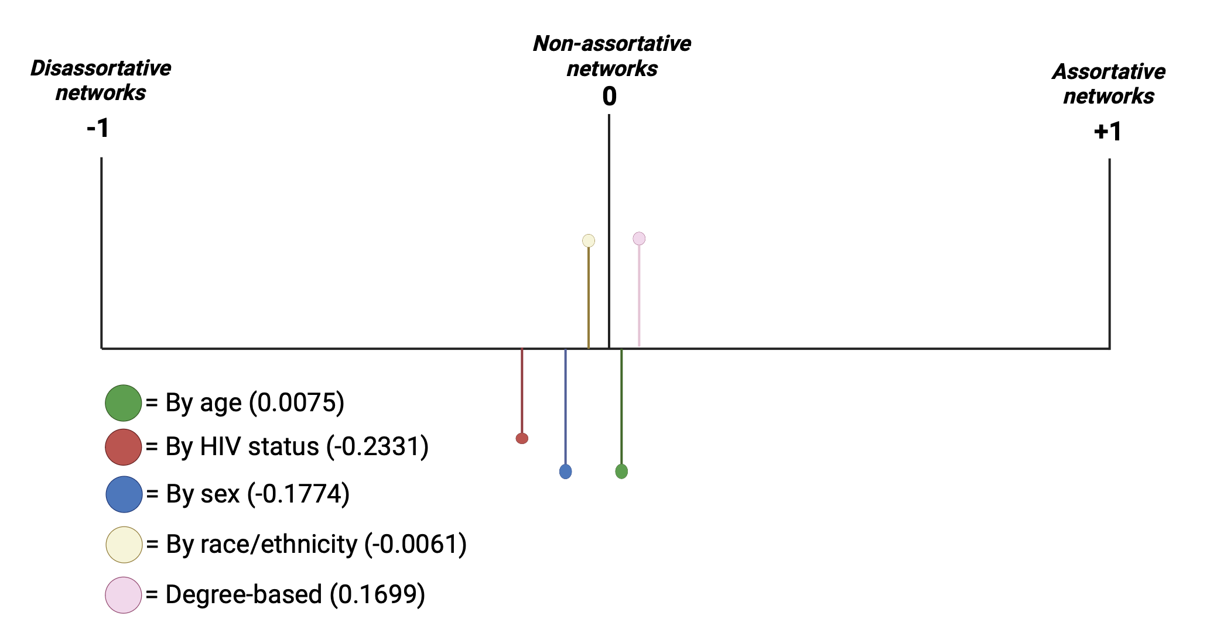
Assortativity coefficients ($r$)

Slide 13
Figure 3: Relationship between smoked drug use archetypes defined by where participants report using drugs in the community.
Residentials encompass individuals whose drug consumption is primarily confined to private settings (N=59).
Travelers represent a diverse group of PWSD known for their inclination towards exploring various environments when consuming substances (N=15).

Slide 14
Table 2: Characteristics of PWSD with TB disease by smoked drug use archetype
 | Residentials (N=59) | Travelers (N=15) | Total (N=74) | p value
Age, years | 35 (30, 38) | 42 (33, 44) | 36 (31, 41) | 0.047
Born Male | 43 (72.9%) | 14 (93.3%) | 57 (77.0%) | 0.093
Mixed Ancestry | 52 (88.1%) | 15 (100.0%) | 67 (90.5%) | 0.161
Unemployed | 53 (89.8%) | 12 (80.0%) | 65 (87.8%) | 0.298
Imprisoned, ever | 51 (86.4%) | 12 (80.0%) | 63 (85.1%) | 0.531
Network Size (N=69)¹ | 25 (10, 60) | 30 (16, 34) | 30 (10, 50) | 0.909
Alcohol, ever use | 50 (84.7%) | 12 (80.0%) | 62 (83.8%) | 0.656
Overlap location <100m | 48 (81.4%) | 14 (93.3%) | 62 (83.8%) | 0.261
Living with HIV | 22 (37.3%) | 1 (6.7%) | 23 (31.1%) | 0.022
Previous TB | 27 (45.8%) | 4 (26.7%) | 31 (41.9%) | 0.181
Household contact with active TB < 2 years | 14 (23.7%) | 5 (33.3%) | 19 (25.7%) | 0.447

Slide 15
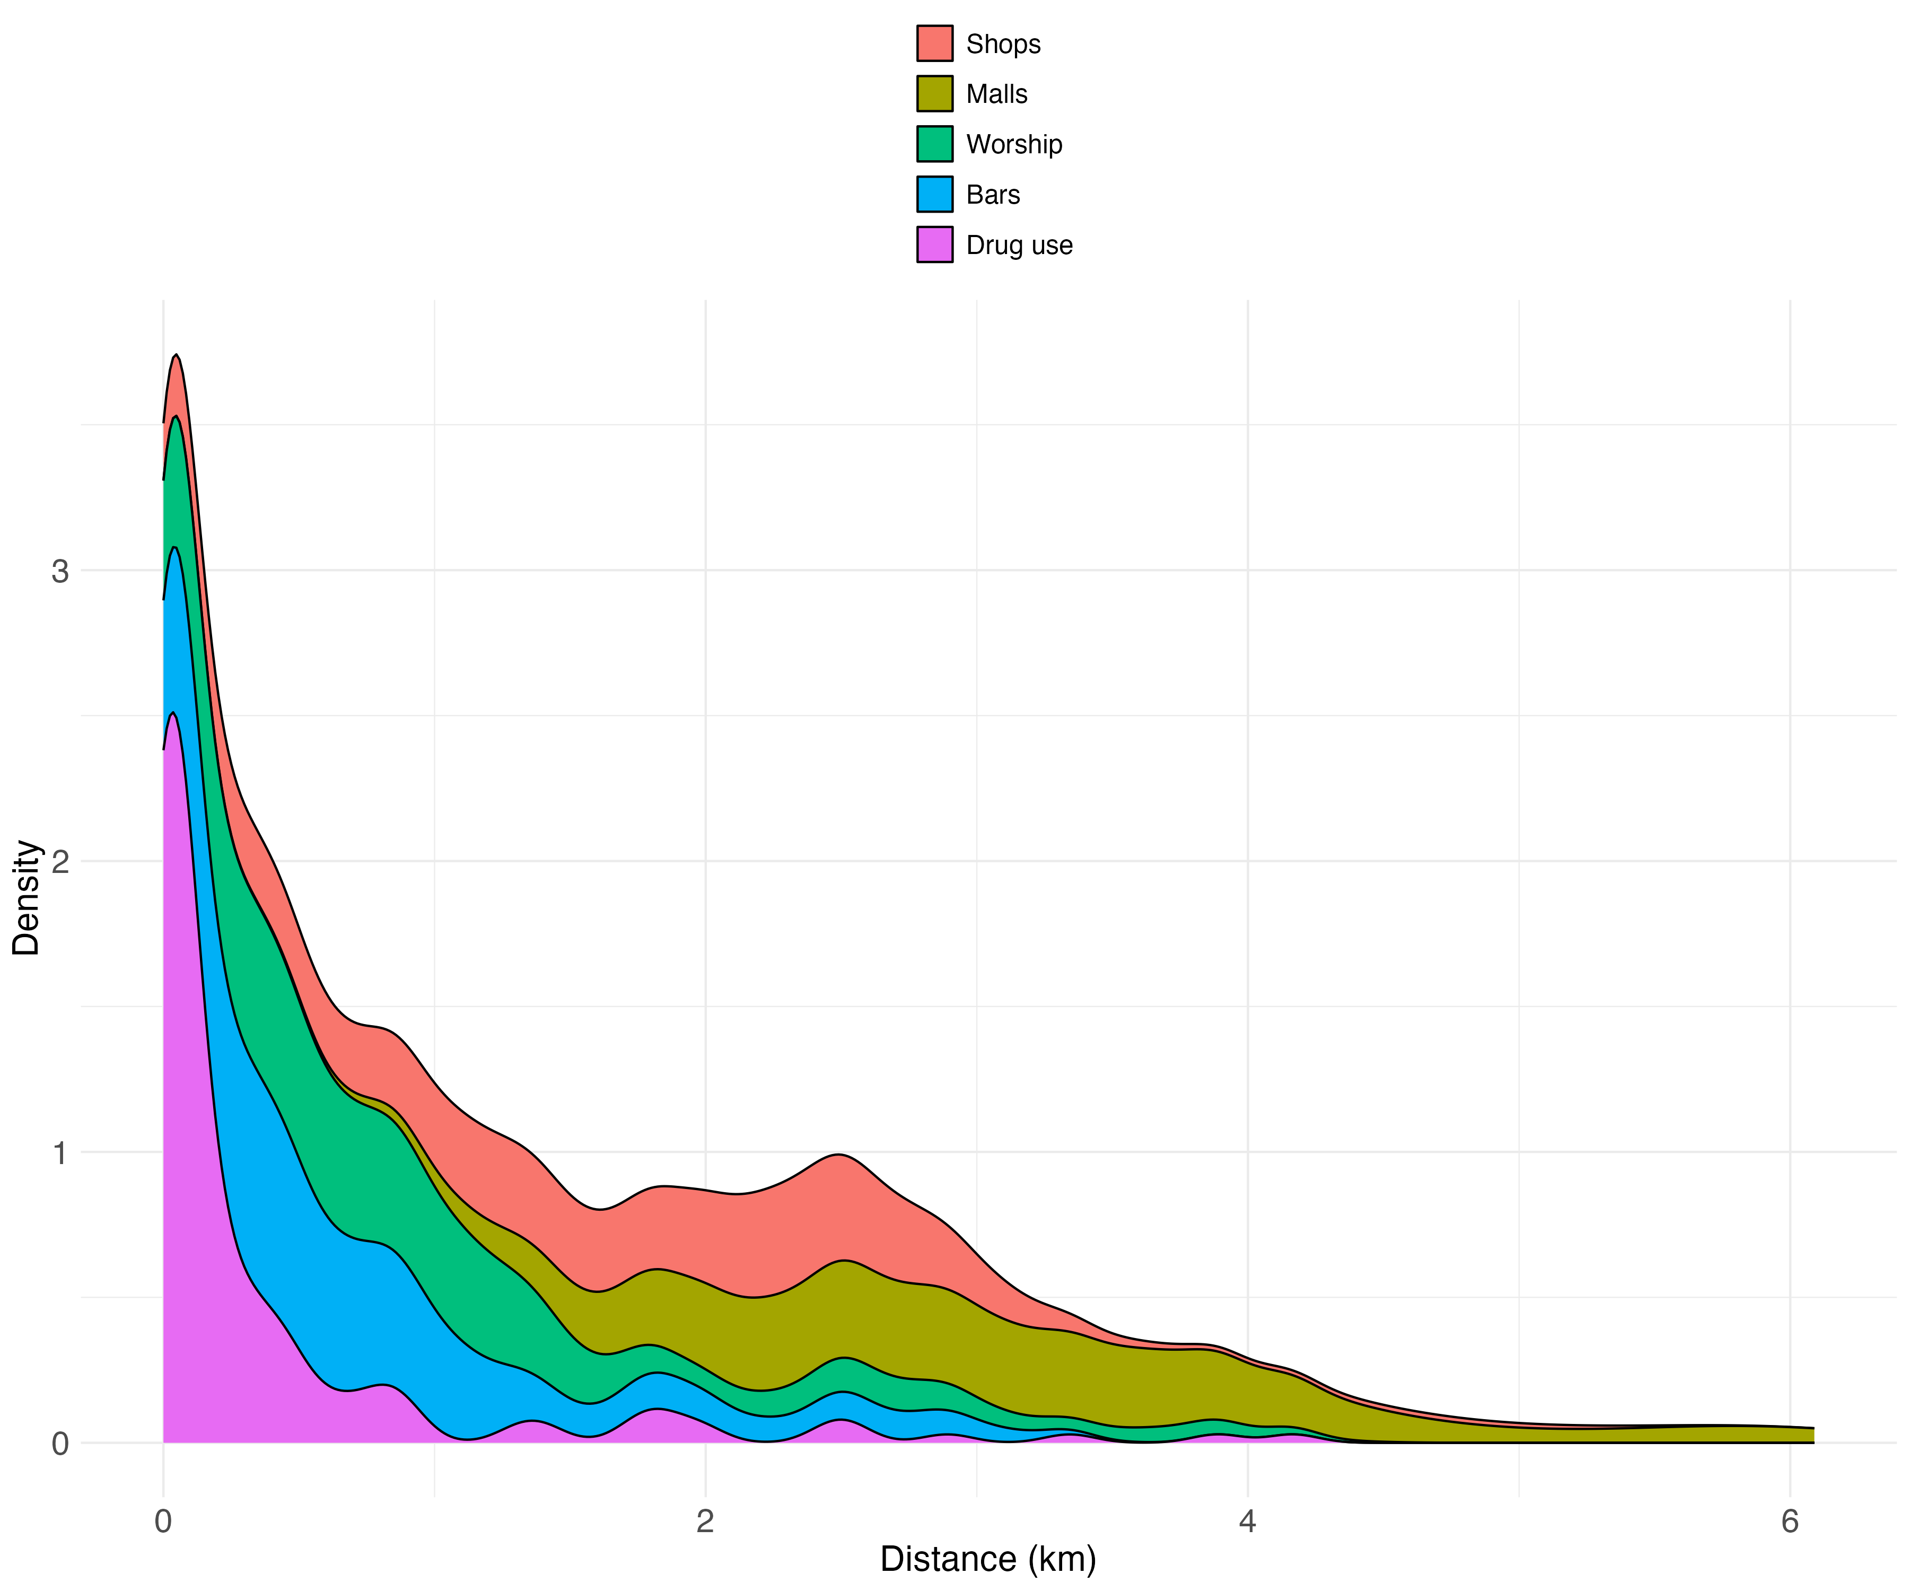
Figure 4: Distance traveled from home location by location type

Slide 16
Conclusion
Using social network and geographic data, we identified potential locations where TB transmission could be occurring among and from this high-risk population.
Demographic trends, including gender distribution, mixed ancestry representation, and prevalence of HIV, varied across venue types.
Interventions that extend beyond public venues may be needed to effectively reach PWSD and interrupt TB transmission.
Network-based analyses offer insights into candidate locations for spatially targeted screening.

Slide 17
Acknowledgements
Chamie, G. et al. (2015) ‘Identifying locations of recent TB transmission in rural Uganda: a multidisciplinary approach.’, Tropical medicine & international health : TM & IH, 20(4), pp. 537–545.
Amoori, N. et al. (2022) ‘Social Contact Patterns Associated With Tuberculosis: A Case-control Study in Southwest Iran’, Journal of Preventive Medicine and Public Health, 55(5), pp. 485–491.
We thank the TOTAL field team staff for their contribution to this project. We also thank the Western Cape Department of Health for their continued support. FUNDING: NIH-NIAID R01AI14731.

Slide 18
Thank you for listening! ☺
Please reach out if you have any questions regarding this project: victoria.overbeck@bmc.org

