Slide 1


Adaptation and Dissemination of a Race-Based Stress, Trauma, and Empowerment (RBSTE) Class for Community Churches
Nuha Alshabani PhD ¹; Devin Cromartie MD MPH ^{1,2}; Joryan Franklin MPH ¹; Shania Rimpel ¹; Sarah Valentine PhD ^{1,2}
1 Department of Psychiatry, Boston Medical Center 2 Boston University Chobanian and Avedisian School of Medicine
Objectives
Methods
Findings
We present findings and process details from our systematic and iterative approach to adaptation in phase 1. Themes from field notes of meetings with stakeholders yielded:
The need to adapt RBSTE for spiritual bypassing
Culturally adapting incongruent practices (e.g mindfulness)
Adapting the material to fit in the context of immigration
This study aims to adapt the Race-based Stress, Trauma, and Empowerment (RBSTE)
curriculum for Boston Community Churches and Boston Medical Center patients.
We will translate observations and feedback from our four stakeholder groups to implement an adapted version of RBSTE that will improve health equity for Black patients. Integration of feedback from the four stakeholder groups will occur over three phases:
Background
Racism is a public health problem that drives a range of health disparities among racially marginalized people. Black people in the US endure a higher stress burden and lower access to quality care caused by structural racism. That is, Black people in the US endure the additive burden of racism-based stress (RBS)—defined as psychological stress or emotional
injury reactions that are experienced in response to structural and individual racism.
Intervention was selected & revised
Trial
Post-Trial
consultation meeting notes with clinicians and church leaders characterize reactive modifications to RBSTE and its implementation
The manual and program implementation design was further revised based on feedback from the four stakeholder groups
Pre-Trial
Revision is based on feedback from 4 stakeholder groups
We will have pre/post well-being measures for those who participate in the group
Next Steps
Launch meetings with the Church Community Advisory Board
Recruitment for the Patient Advisory Board
Dissemination of the adapted RBSTE manual
Assessing the outcomes of RBSTE groups
References
Hypothesis
Carlson, M., Endlsey, M., Motley, D., Shawahin, L. N., & Williams, M. T. (2018). Addressing the impact of racism on veterans of color: A race-based stress and trauma intervention. Psychology of Violence, 8(6), 748–762.
Chambers, D. A., & Norton, W. E. (2016). The Adaptome: Advancing the Science of Intervention Adaptation. American journal of preventive medicine, 51(4 Suppl 2), S124–S131.
Israel, Barbara, et al. “Introduction to Methods in Community-Based Participatory Research for Health.” Methods in Community-Based Participatory Research for Health, Jossey-Bass, 2003, pp. 3–26.
Rislin, J. L. & Martinez, A. M. (2019). Healing from racial stress/trauma: A race-based stress/ trauma and empowerment (RBSTE) group intervention manual. Adapted from "Addressing the impact of racism on veterans of color: A Race-Based Stress & Trauma Intervention," by M. Carlson, M. Endsley, D. Motley, L. N. Shawahin, M. T. Williams, (2018). Adapted with permission.
The contextual information gathered from stakeholders (i.e., RBSTE developers, clinicians, patients, and church members) will improve our understanding of the local population’s needs and how to tailor RBSTE’s curriculum and implementation plan. We use Chambers and colleagues’ Adaptome Model to systematically adapt the intervention for setting, audience, and delivery.
Notes:
Hello, I am Shania Rimpel, a 3rd year biology student from Northeastern University. I am currently a research assistant at Boston Medical Center's REcovery from Stress and Trauma through Outpatient care, Research, and Education (RESTORE) Center working with Dr. Alshabani on the Adaptation and Dissemination of a Race-Based Stress, Trauma, and Empowerment (RBSTE) Class for Community Churches. We are currently on the pre-trial phase of this ongoing research study.

Slide 2


Introduction:
Background, Objectives, and Hypothesis
Background
Racism is an issue that has plagued the U.S. for hundreds of years and can now be described as a public health problem. Black people in the U.S. endure a higher stress burden and lower access to quality care caused by structural racism. While stressors are common in everyday life, Black people have the added race-based stress (RBS) — defined as psychological stress or emotional experienced in response to structural and individual racism. RBS is not always defined by one specific event but can also be described as a chronic stressor – found in both individuals and systems.
Objective
This study aims to adapt and disseminate a race-based stress, trauma, and empowerment class for community churches to help address RBS. This study derives from the current study: Intersections between the Black Church and Mental Health: Establishing a Community Based Project, which aims to explore the barriers, facilitators, needs and potential focus of mental health intervention, relating to the COVID-19 pandemic and police brutality, for a Black Church in Roxbury.
Notes:
Racism is an issue that has plagued the U.S. for hundreds of years and it can now be described as a public health problem. Black people in the U.S. endure a higher stress burden and lower access to quality care caused by structural racism. While stressors are common in everyday life, Black people have the added race-based stress (RBS) — defined as psychological stress or emotional injury responses that are experienced in response to structural and individual racism. RBS is not always defined by one specific event but can also be described as a chronic stressor – found in both individuals and systems.
This study aims to adapt and disseminate a race-based stress, trauma, and empowerment class for community churches to help address RBS. Our RBSTE research study is derived from Dr. Cromartie's study: Intersections between the Black Church and Mental Health: Establishing a Community Based Project

Slide 3

Introduction:
Background, Objectives, and Hypothesis
Hypothesis
Information gathered from our three advisory boards: Clinician, Church, and Patient, will improve our understanding of the needs of the local population.
Information from these advisory boards will improve our understanding of how to best tailor RBSTE's curriculum and implementation plan
Chambers' and colleagues' Adaptome Model will be instrumental in systematically adapting the intervention for setting, audience, and delivery
Notes:
As we work towards the adaptation and dissemination of the RBSTE class, we expect that information gathered from our clinician, church, and patient advisories will aid in better understanding the needs of the local population, as well as helping us understand the best way to tailor RBSTE's curriculum and implementation plan. Chambers' et al's Adaptome (adapt-ohm) Model will also be helpful in adapting the intervention for setting, audience, and delivery

Slide 4
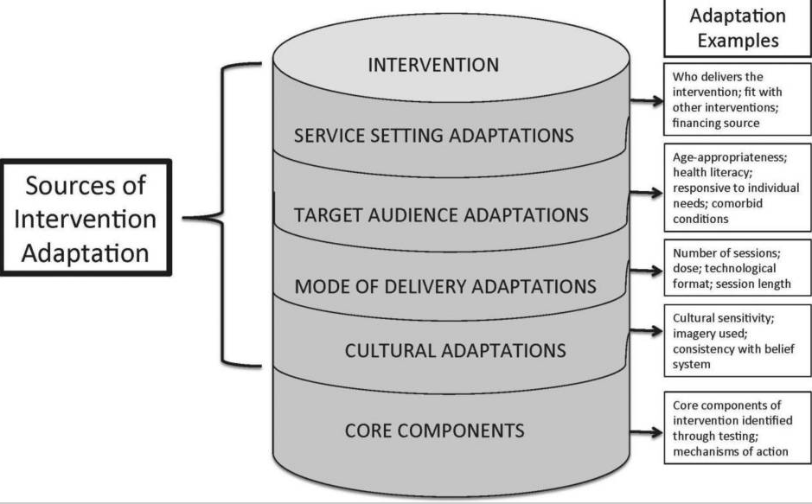
Methods: Adaptome Model (Chambers & Norton, 2016)
Notes:
The Adaptome (adapt-ohm) model recognizes that at times, an intervention may warrant evolution "within and across contexts". The Adaptome is also able to recognize that different adaptations of the intervention may exist, each providing benefits and disadvantages to the populations and systems that may receive it. The adaptation of an intervention using this model may choose to adapt the intervention based on 5 sources: service setting, target audience, mode of delivery, cultural, and/or core.

Slide 5
Methods: Community-Based Participatory Research (CBPR)
CBPR Principles (Israel 2003)
Recognizes the community as a unit of identity.
Build on strengths and resources in the community.
Facilities collaboration & equitable partnership in all phases of the research; involve an empowering and power-sharing process that attends to social inequalities.
Fosters co-learning and capacity building among all partners.
Integrates and achieves a balance between knowledge generation and intervention for mutual benefits of all partners.
Focuses on the relevance of public health problems and ecologic perspectives that recognize and attend to the multiple determinants of health.
Involves systems development using a cyclical and iterative process.
Disseminate results to all partners and involve them in the dissemination process.
Involves a long-term process and commitment to sustainability.
Notes:
As RBSTE is focusing on the needs of the local community, the addition of a church community advisory board was the best route to go. We will be able to discover the needs of the church in terms of race-based stress in ways that we, otherwise, may not be able to do. Community-Based Participatory(part-ti-si-pa-tory) Research gives the local community the ability to have a voice in a study that will directly affect them.

Slide 6
Methods: Project Aims
Aim 1: Adapting Content and Implementation
Aim 2: Piloting Intervention
Aim 3: Refining and Sustaining
Recruit for advisory boards
Host CAB meetings for patients, providers, and community
Adapting for cultural context (e.g., migration; stigma)
Adapting for delivery (e.g., how to get patients engaged)
Develop plan for implementation at BMC
Develop plan to implement in the church setting
Identify important/relevant evaluation targets
Field notes and rapid coding of notes will be used to make adaptations
8-session version of RBSTE
2 separate groups general and migrant populations
Any patient who experiences anti-Black racism
Evaluate feasibility and acceptability
Enrollment, retention, and participant satisfaction
Mental health functioning and RBS (to be defined by CAB)
Exit interviews/focus groups with participants
Present CAB with pilot data to further refine for church
Train church members to co-facilitate RBSTE groups
Provide ongoing consultation to church members
Collaborate on post-award plan to sustain RBSTE in community and BMC clinics
  Ongoing training/consultation
  Continue to host CAB
  Identify next steps in addressing RBS (further adapt, add additional services)
Notes:
The aims of the RBSTE study is three-fold:
Aim 1: Adapting Content and Implementation
This aim involves recruiting and hosting community advisory board for patients, providers, and church members
Adapting the content for both cultural context and delivery
Plans of implementation for both BMC and in the church setting
Field notes, taken at meetings, and rapid coding of notes will be used to make adaptations
Aim 2: Piloting the intervention
Piloting the intervention will involve an 8-session version of RBSTE which will aim to have patients who have experienced anti-Black racism
During this pilot, feasibility and acceptability will be evaluated & enrollment, retention and participant satisfaction will be tracked
Aim 3: Refining and Sustaining
After piloting the intervention, we will present the Community Advisory Boards with data to continue refining for the church
Church members will be trained to facilitate RBSTE groups and we will continue to provide ongoing consultation
Plans to sustain RBSTE post-award include:
Ongoing training/ consultation
Continue hosting community advisory board
Identifying next steps in addressing race-based stress

Slide 7
Methods: Recruitment
Clinician Advisory Board
Church Advisory Board
Recruitment was done through pastoral buy-in and gaging interest in the study
Church leaders were asked to nominate members of their congregation that they believed would be best fit to represent the community
Patient Advisory Board
Patients will be nominated by their providers from programs at BMC including: the Immigrant Refugee Health Center, General Internal Medicine, Family Medicine, and the Recovery from Stress and Trauma through Outpatient Care, Research, and Education (RESTORE) Center.
Clinical supervisors were asked to nominate clinicians they believed would be interested in joining the board
The nominated clinicians were outreached and information regarding the study and their role was shared
The PI met with the nominees and explained the project after reviewing materials
Those who were interested voluntarily participated
The nominated members reached out to the research team via email or phone call to ask for more information about their role in the study
IRB approval was obtained prior to initiating recruitment
IRB approval was obtained prior to initiating recruitment
Notes:
Presently, we have obtained IRB approval prior to initiating recruitment for both the clinician and church advisory boards.
In recruiting the clinician advisory board, clinical supervisors nominated clinicians who they believed would be interested in joining. We outreached nominated clinicians, sharing more information about the study and their prospective role. The principle investigator further explained the project after reviewing materials. Clinicians that were interested in making up part of the advisory board voluntarily participated.
Recruitment for the church advisory board was done via pastoral buy-in in order to gage interest. Church leaders, such as pastors and priests, were asked to nominate members of their congregation who could be best represent the community. Members that were nominated and interested reached out to the research team via email or phone to ask for more information about their role in the study.
The patient advisory board awaits IRB approval, thus we have not started recruitment. Patients will be nominated by their providers from programs at BMC: The immigrant refugee health center, general internal medicine, family medicine, and the recovery from stress and trauma through outpatient care, Research, and Education (RESTORE) center

Slide 8
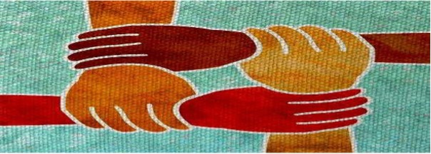
Methods: RBSTE Manual and Adaptation
Developed by psychologists within the Veteran Health Administration to provide support for veterans of color who have experienced racial stress and trauma.
Adaptation of RBSTE Manual to focus on Churches of Color in the Boston community and BMC Clinics.
  Church Community Advisory Board
  Clinician Expert Panel
  Patient Advisory Board
The RBSTE Group is an 8-week session lasting 90 minutes.
  Session 1: Establishing the Space
  Session 2: How Do We Begin to Address Race
  Session 3: Resistance to Learning About Race/Racism
  Session 4: Overt Racism &Microaggressions
  Session 5: Aversive Racism, Institutional Racism, &White Privilege
  Session 6: Validating & Depathologizing the Impact of Race-Based Traumatic Experiences
  Session 7: Stress, Anxiety, & the Alarm System
  Session 8: Resilience & Empowerment
Notes:
The RBSTE intervention that we are adapting was originally developed to support veterans of color who have experienced racial stress and trauma within the Veteran Health Administration. The RBSTE in an 8-week session, with each session lasting 90 minutes, with topics ranging from addressing race, white privilege, validating the impact of race-based traumatic experiences, and empowerment.

Slide 9
Findings:
Clinician CAB
Church CAB
Difficulties recruiting based on logistics
Hesitancy to join a research study based on historical mistrust in the medical research community
Importance of fostering a safe/brave space
Being intentional about integrating mindfulness with spirituality
Addressing mistrust in psychology
Adapting mindfulness depending on the group being centered
Adapting the manual to meet needs depending on political climate, local experiences, etc
Importance of intersectionality
Inclusion as a big part of focus and delivery of care
Importance of adapting the manual to fit the BIPOC community as whole
Notes:
Our Clinician CAB is the most far along of our advisory boards at this point. Clinicians have expressed the importance of fostering a safe/brave space for BIPOC, intentionality regarding integrating mindfulness and spirituality, as well as acknowledging the mistrust that BIPOC may have regarding psychology.
We are in the process of forming our church CAB, however, some difficulties have arisen such as finding suitable meeting times for all advisory board members as well as hesitancy to join a research study based on a history of mistrust

Slide 10
Next Steps
Launch meetings with the Church Community Advisory Board
IRB approval and recruitment for the Patient Advisory Board
Dissemination of the adapted RBSTE manual
Assessing the outcomes of RBSTE groups
Notes:
As we progress through the next steps of the adaptation and dissemination of an RBSTE class for community churches, we plan to launch meetings with the church community advisory board, await IRB approval to begin recruitment for the patient advisory board, the dissemination of the adapted RBSTE manual, and finally assessing the outcomes of RBSTE groups.
Thank you so much for the opportunity to present our abstract. I hope you enjoyed!

Slide 11
References
Carlson, M., Endlsey, M., Motley, D., Shawahin, L. N., & Williams, M. T. (2018). Addressing the impact of racism on veterans of color: A race-based stress and trauma intervention. Psychology of Violence, 8(6), 748–762. https://doi.org/10.1037/vio0000221
Chambers, D. A., & Norton, W. E. (2016). The Adaptome: Advancing the Science of Intervention Adaptation. American journal of preventive medicine, 51(4 Suppl 2), S124–S131. https://doi.org/10.1016/j.amepre.2016.05.011
Israel, Barbara, et al. “Introduction to Methods in Community-Based Participatory Research for Health.” Methods in Community-Based Participatory Research for Health, Jossey-Bass, 2003, pp. 3–26.
Rislin, J. L. & Martinez, A. M. (2019). Healing from racial stress/trauma: A race-based stress/ trauma and empowerment (RBSTE) group intervention manual. Adapted from "Addressing the impact of racism on veterans of color: A Race-Based Stress & Trauma Intervention," by M. Carlson, M. Endsley, D. Motley, L. N. Shawahin, M. T. Williams, (2018). Adapted with permission. San Antonio, TX: South Texas Veterans Health Care System.

