Slide 1
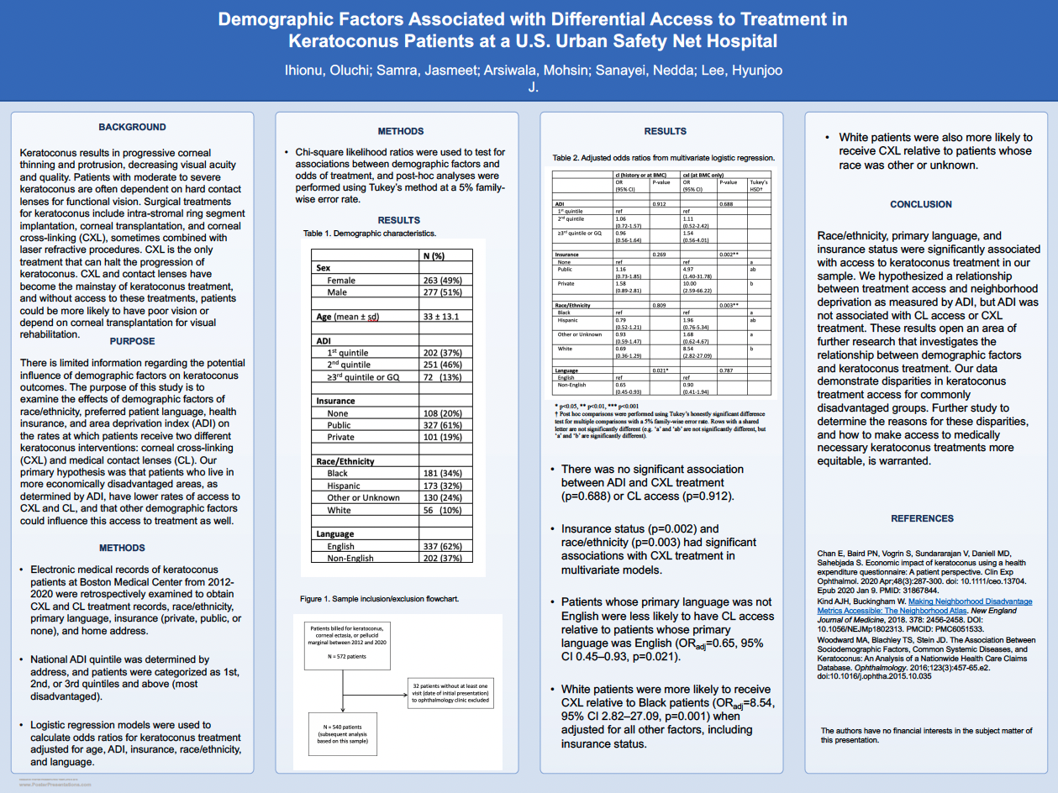

Slide 2
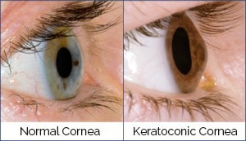

Background
Keratoconus is a type of corneal ectasia characterized by bulging and thinning of the cornea
Results in myopia (near-sightedness) and irregular astigmatism resulting in decreased visual acuity
Prevalence in the U.S. is 1/2000
Current standards of care include non-surgical treatment (eg. rigid gas permeable (RGP) contact lenses and scleral lenses) and surgical interventions such as corneal crosslinking (CXL), corneal grafting, intra-stromal ring segments, or photorefractive keratectomy—corneal transplant used in severe cases
There is limited information regarding the potential influence of demographic factors on keratoconus outcomes.

Slide 3
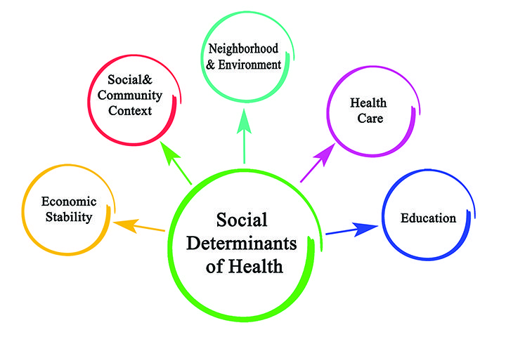

Objectives
Explore of how social determinants of health affected patients with keratoconus and their access to treatment
Social determinants of health are the non-medical factors that influence health outcomes
Demographic information of interest: race/ethnicity, insurance status, area deprivation index (ADI), patient preferred language
Area Deprivation Index (ADI) allows for rankings of neighborhoods by socioeconomic disadvantage in a region of interest either at the state or national level

Slide 4
Methods
Electronic medical records of keratoconus patients at Boston Medical Center from 2012- 2020 were retrospectively examined to obtain CXL and CL treatment records, race/ethnicity, primary language, insurance and home address for ADI classification
Thirty-two of 572 patients were excluded due to lack of complete clinical notes
National ADI quintile was determined by address, and patients were categorized into 1st, 2nd, or 3rd quintiles and above (most disadvantaged)
Logistic regression models were used to calculate odds ratios for keratoconus treatment adjusted for age, ADI, insurance, race/ethnicity, and language

Slide 5
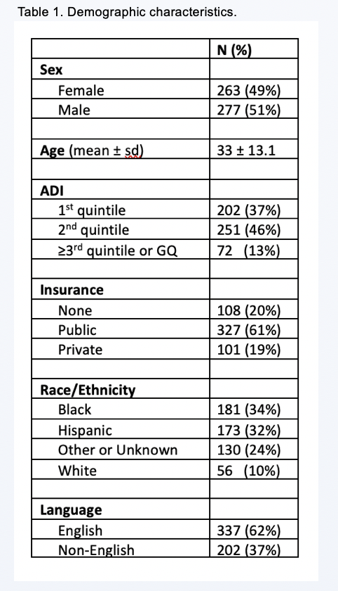
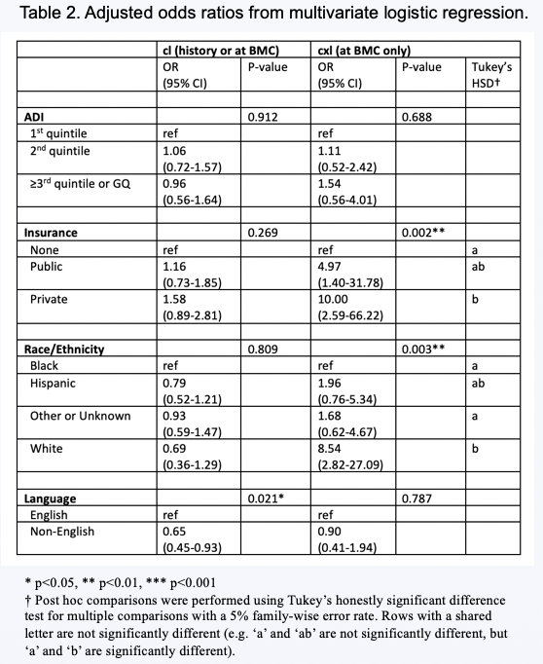
Results
There was no significant association between ADI and CXL treatment (p=0.688) or CL access (p=0.912)
Insurance status (p=0.002) and race/ethnicity (p=0.003) had significant associations with CXL treatment in multivariate models
Patients whose primary language was not English were less likely to have CL access relative to patients whose primary language was English (OR_{adj}=0.65, 95% CI 0.45-0.93, p=0.021)
White patients were more likely to receive CXL relative to Black patients (OR_{adj}=8.54 95% CI 2.82-27.09, p=0.001) when adjusted for all other factors, including insurance status
White patients were also more likely to receive CXL relative to patients whose race was other or unknown

Slide 6

Discussion
Race/ethnicity, primary language, and insurance status were significantly associated with access to keratoconus treatment in our sample
ADI was not associated with CL access or CXL treatment
These results open an area of further research that investigates the relationship between demographic factors and keratoconus treatment
Further study to determine the reasons for these disparities, and how to make access to medically necessary keratoconus treatments more equitable, is warranted
Limitations:
  Small sample size, which could affect generalizability
  Severity at presentation was not determined at this time, as CXL is only available for patients with non-severe disease

Slide 7
Thank you

Slide 8
References
Text:
  Rabinowitz YS. Keratoconus. doi:10.1016/S0039-6257(97)00119-7
  Munir SZ, Munir WM, Albrecht J. Estimated Prevalence of Keratoconus in the United States From a Large Vision Insurance Database. Eye & Contact Lens. 2021;47(9):505. doi:10.1097/ICL.0000000000000812
  Bakkar MM, Haddad MF, Qadire MA. Patient-related barriers to Rigid Gas Permeable (RGP) lens wear among keratoconus patients in Jordan. Contact Lens and Anterior Eye. 2018;41(3):267-272. doi:10.1016/j.clae.2017.12.007
  Bilgin LK, Yılmaz Ş, Araz B, Yüksel SB, Sezen T. 30 years of contact lens prescribing for keratoconic patients in Turkey. Contact Lens and Anterior Eye. 2009;32(1):16-21. doi:10.1016/j.clae.2008.07.001
  May 10 EHP, 2018. Beyond Health Care: The Role of Social Determinants in Promoting Health and Health Equity. KFF. Published May 10, 2018. Accessed April 9, 2023. https://www.kff.org/racial-equity-and-health-policy/issue-brief/beyond-health-care-the-role-of-social-determinants-in-promoting-health-and-health-equity/
  Kind AJH, Buckingham WR. Making Neighborhood-Disadvantage Metrics Accessible — The Neighborhood Atlas. N Engl J Med. 2018;378(26):2456-2458. doi:10.1056/NEJMp1802313
Images:
  https://www.clevelandeyeclinic.com/eye-disease-ohio/keratoconus/
  https://www.moranmaurieyecenter.com/contact-lenses.html
  https://www.nursingcenter.com/ncblog/november-2019/social-determinants-of-health
  https://economictimes.indiatimes.com/jobs/pushing-for-diversity-more-firms-to-hire-women-for-shop-floor-jobs-in-2023/articleshow/96670663.cms?from=mdr
  https://medium.com/@gprash77/tpm-interview-tips-8464756e56e
  https://business.cornell.edu/hub/2022/09/26/nolan-hotel-school-dei-hospitality-research/

