Slide 1




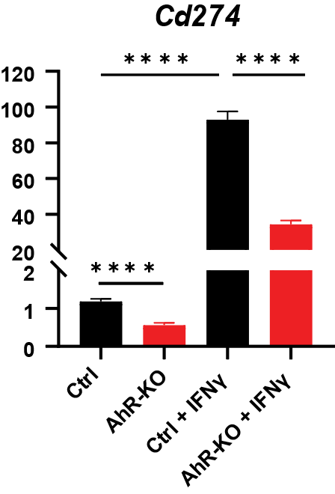
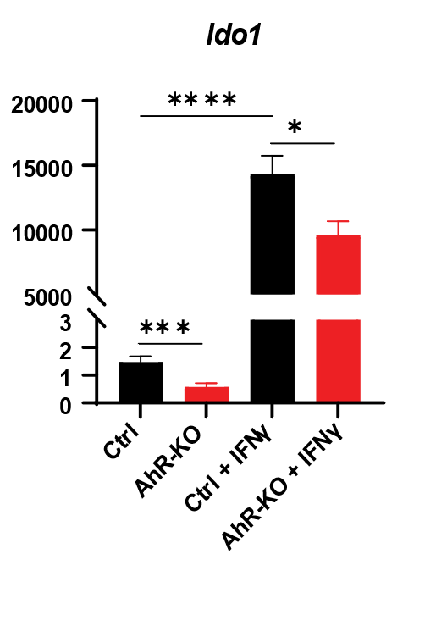
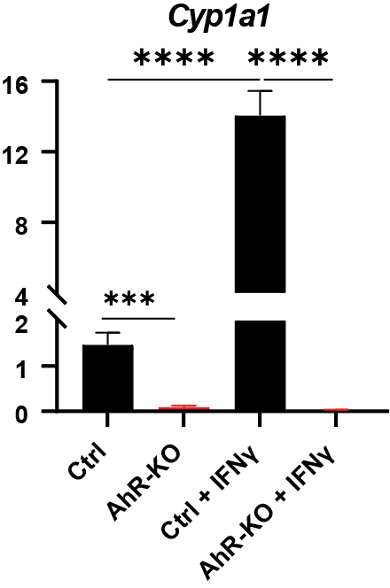
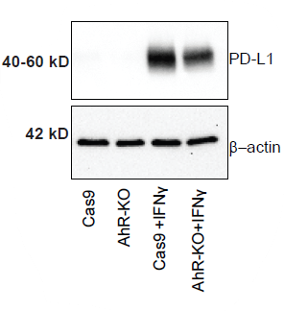
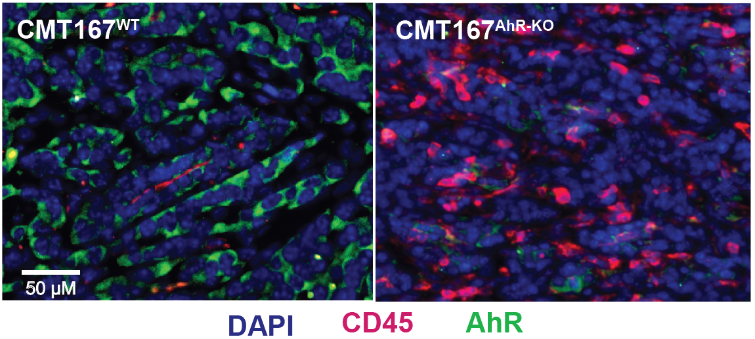
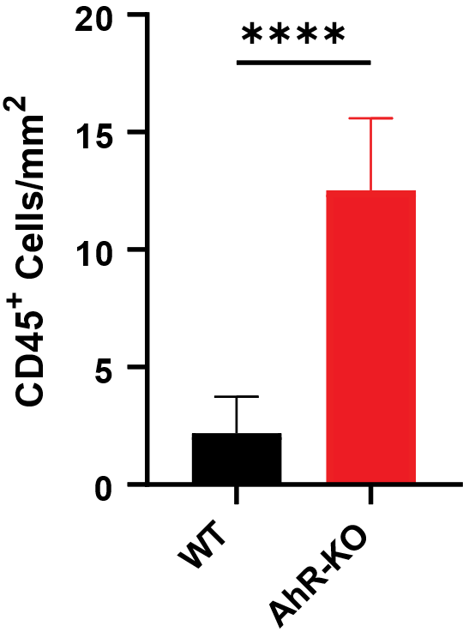
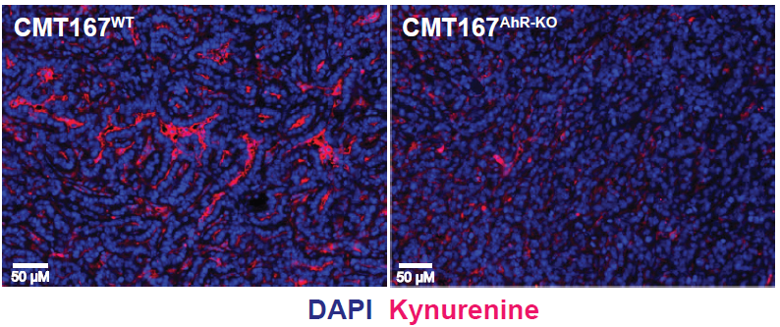
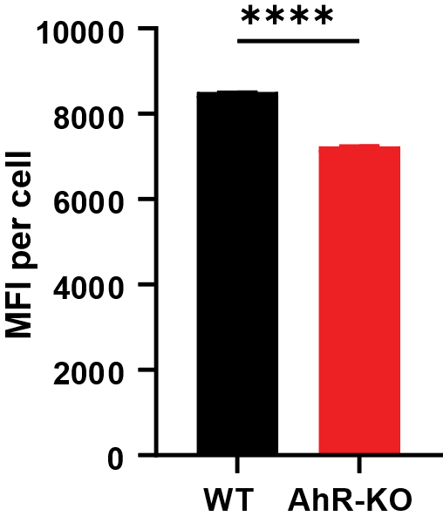
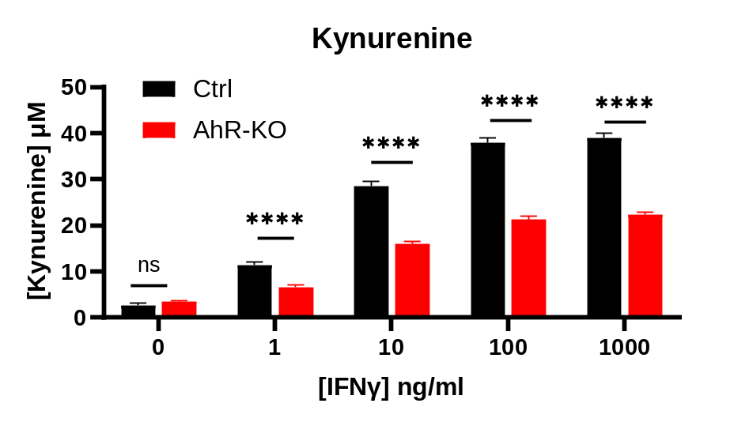
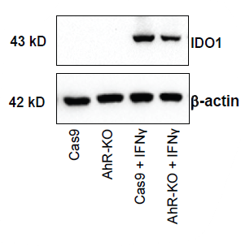
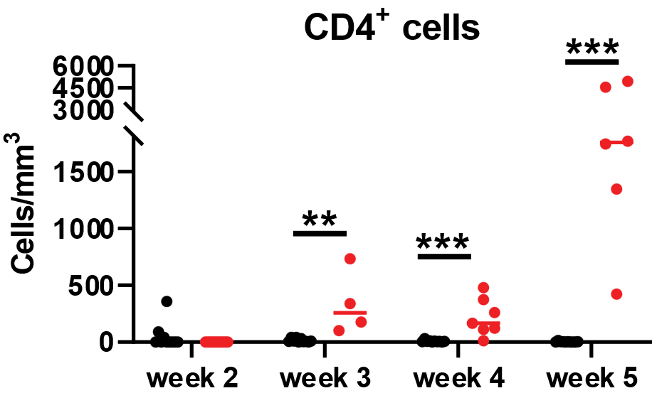
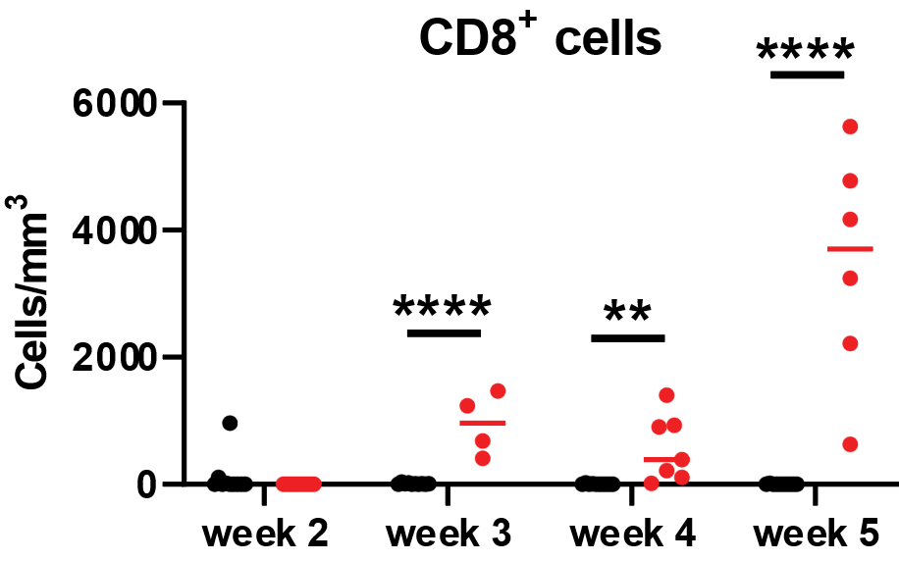

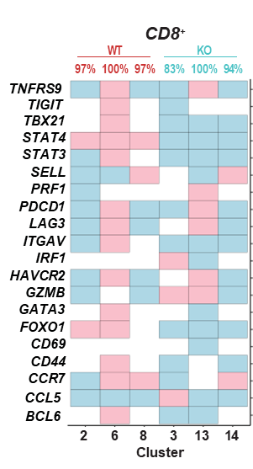
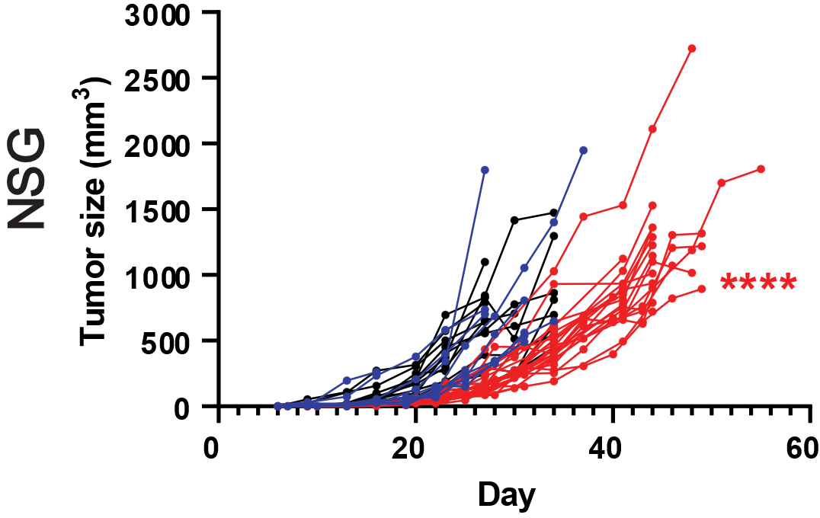
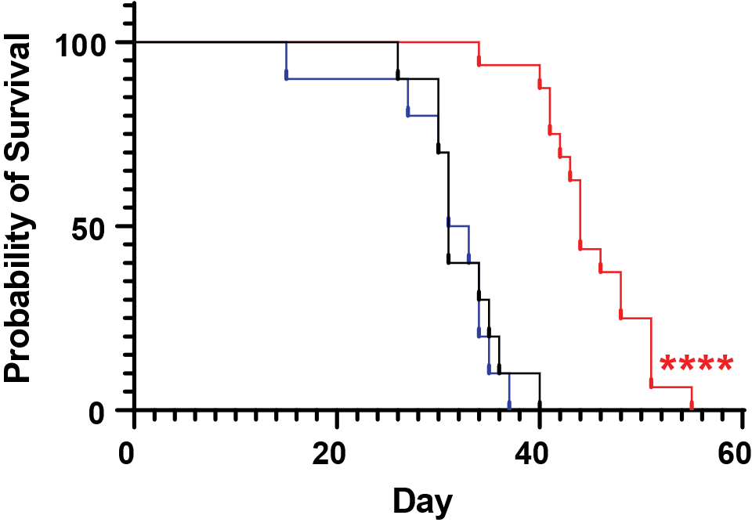
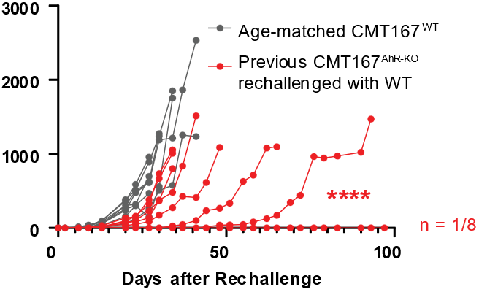

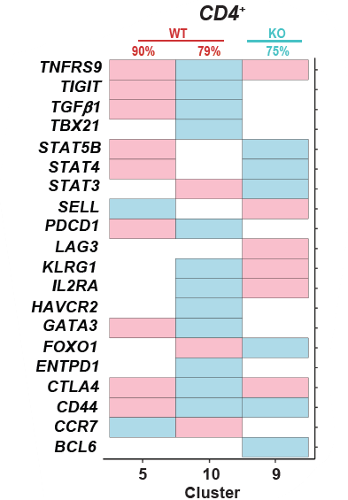

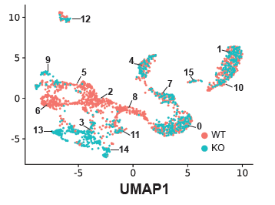
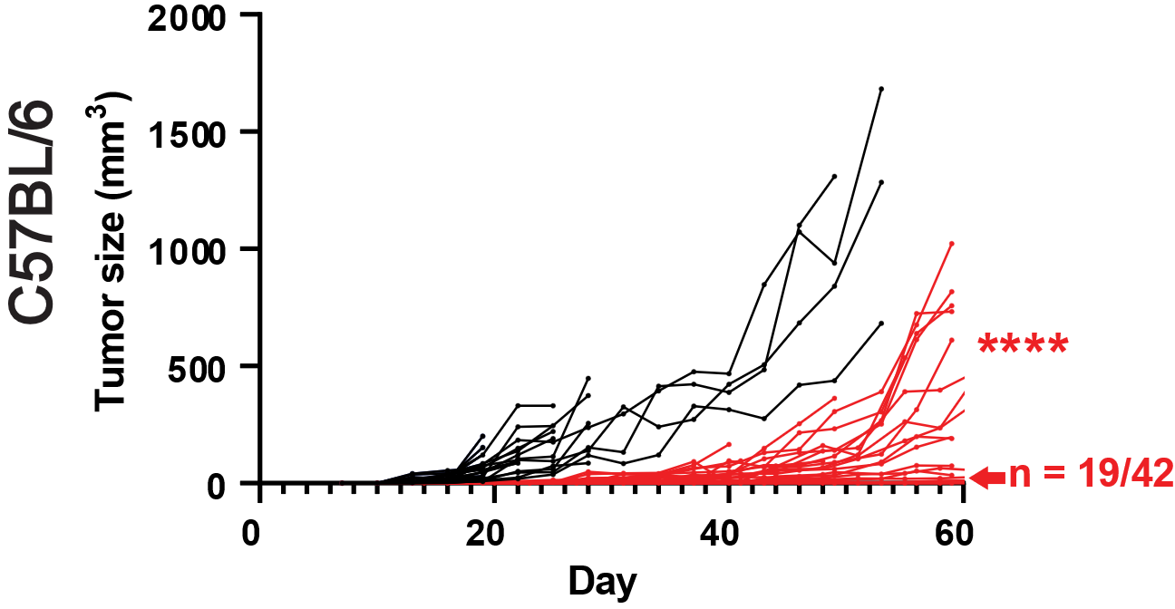
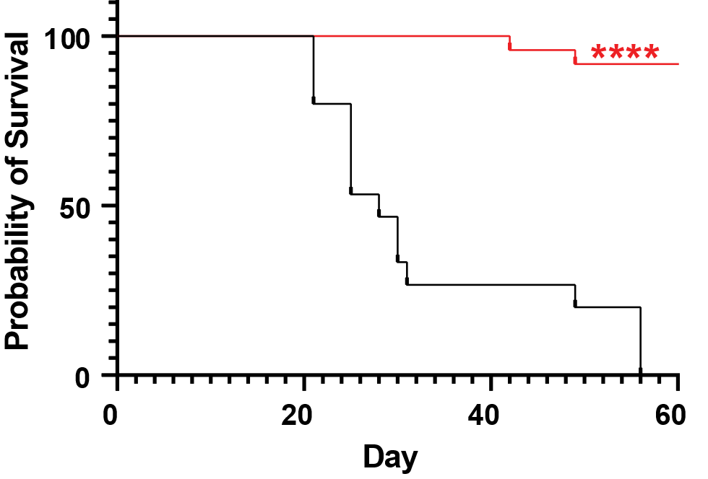
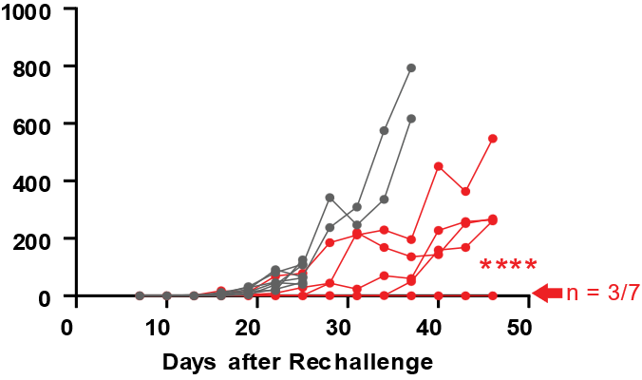
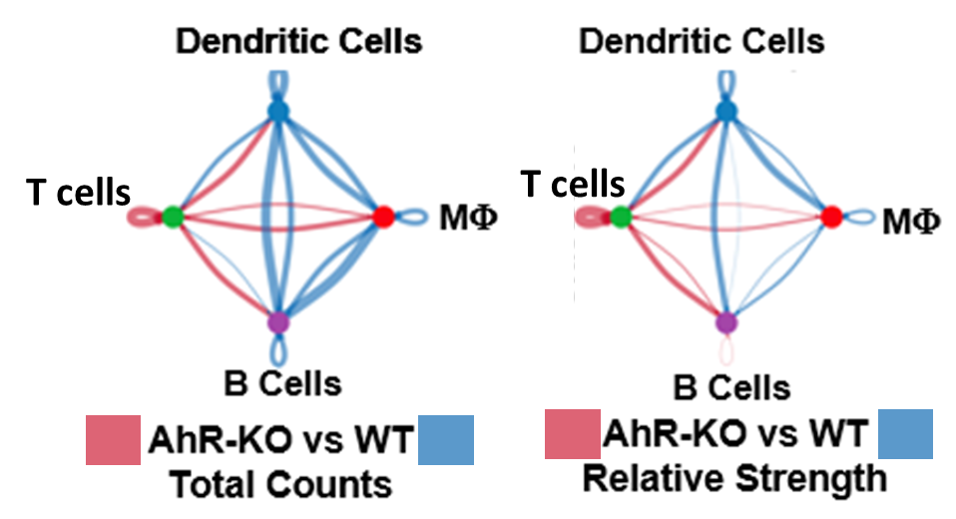
Lung Adenocarcinoma Expression of the AhR
Promotes Immunosuppression in the TME
Megan Snyder, Brian Lara, Zhongyan Wang, Jocelyn Fimbres, Muzamil Khan, Stefano Monti, and David Sherr
Boston University School of Medicine, Graduate Program in Genetics and Genomics
Introduction
Cancer immunotherapy has shown dramatic results only in a minority of patients. The aryl hydrocarbon receptor (AhR) is a potential regulator of immune checkpoints in lung cancers. Here we show evidence that AhR knockout (KO) in a lung adenocarcinoma cell line leads to increased anti-tumor immunity.
Conclusions
AhR deletion in the CMT167 lung cancer model leads to a decrease in expression of immunosuppression-related signaling genes IDO1 and Cd274/PD-L1, which extends to the protein level in vitro. IFNγ, a cytokine known to induce PD-L1 and IDO-1 expression, regulates their expression in an AhR-dependent manner. This is important as IFNγ is expected to be present due to anti-tumor activity of CD8⁺ T cells and granulocytes in the tumor microenvironment. Challenge of WT and AhR-KO CMT167 cells in vivo results in an increase in tumor immunity. CMT167^{AhR-KO} tumors have a greater density of tumor infiltrating CD4⁺ and CD8⁺ T cells, suggesting the AhR may play a role in lymphocyte migration. Single cell RNA sequencing of unique immune infiltrates from AhR-KO tumors revealed infiltrating T cell phenotypes that are more activated with granzyme- and perforin-producing capabilities compared to the exhausted phenotypes found in WT tumor infiltrates. This suggests a more effective immune response in AhR-KO tumors. PD-L1 and IDO-1 expression modulated by AhR-KO or agonists suggests one pathway through which AhR promotes immune suppression. Further work is necessary to characterize exhaustion phenotypes in these populations and to elucidate AhR’s role in PD-L1 regulation more fully.
A)
B)
A)
B)
Relative Expression
(Fold Change)
Figure 3. AhR-KO tumors have greater immune cell infiltration and less kynurenine expression. A) Tumors were excised after 5 weeks and randomly selected sections from seven CMT167^{WT} and four CMT167^{AhR-KO} tumors were stained for DAPI (blue), AhR (green), and CD45 (pink). Mean density (number of cells/tumor mm²) on right. B) Tumors stained with DAPI or Kyn-specific antibody (pink). The mean fluorescence index is presented as average mean fluorescence index (MFI)/cell + SE. ****p<0.0001 (Student’s t test, equal variance).
D)
C)
Figure 1. The AhR mediates IFNγ induction of immune-related genes Cd274 and Ido1, in CMTT167 cells.
A) CMT167Ctrl or CMT167AhR-KO cells were treated with 100 ng/mL IFNγ. mRNA was quantified by qPCR 24h (Cd274) or 72h (Ido1, Cyp1a1) later and expressed as fold change of Gapdh-normalized means + SE. B-C) Protein expression was assayed by western immunoblotting under the same conditions. D) CMT167^{Ctrl} or CMT167^{AhR-KO} cells were treated with 1-1000 ng/ml IFNγ for 24h and Kyn released into the media quantified via colorimetric assay. *p<0.05, ***p<0.001, ****p<0.0001 (Student’s t test, equal variance).
Methods
WT and AhR^{KO} CMT167 (lung adenocarcinoma) cells were injected into C57BL/6 mice subcutaneously. Every 7 days, if a subcutaneous CMT167 tumor was able to be resected, it was digested and tumor infiltrating lymphocytes were isolated. Lymphocytes were phenotyped via flow cytometry and analyzed by single cell RNA sequencing. Tumor measurement was also taken via caliper and mouse survival tracked. In vitro analysis of PD-L1 and IDO-1 expression in the presence or absence of IFNγ was determined via flow cytometry and qPCR.
Figure 4. CMT167^{AhR-KO} tumors have a higher density of infiltrating CD4+ and CD8+ T cells
than CMT167^{WT} tumors. C-E) Tumor infiltrating cells were recovered, counted, and stained for CD45, CD4, CD8, PD-1, and CD44 and analyzed by flow cytometry. Each dot represents cell density (cells/mm3) data from one tumor. Data were obtained from two to 10 mice per group per week depending on tumors available to excise. PD-1⁺ and CD44⁺ T cells followed similar patterns (not shown). **p<0.01, ***p<0.001, ****p<0.0001 (Multiple comparisons t tests).
A)
B)
E)
2 weeks
Tumor size (mm³)
C)
D)
8 weeks
Tumor size (mm³)
Figure 2. AhR deletion in CMT167 cells leads to decreased tumor burden and immune-driven survival
A) 10⁶ CMT167^{WT} (black lines), CMT167^{Cas9} (blue lines), or CMT167^{AhR-KO} (red lines) cells were injected subcutaneously into NSG mice and tumor growth determined over 60 days. CMT167^{AhR-KO} tumors grew more slowly in immunodeficient NSG mice than either control tumor (****p<0.0001, nonlinear best fit curve comparison). B) Survival of mice in (A). NSG mice receiving CMT167AhR-KO cells survived significantly longer than controls (****p<0.0001, Kaplan-Meier). C) Cells were injected into immunocompetent C57BL/6 mice and tracked as in (A). CMT167^{AhR-KO} tumors, when they grew at all, grew more slowly in C57BL/6 mice than control tumors (****p<0.0001, nonlinear best fit curve comparison). Of the 42 C57BL/6 mice receiving CMT167AhR-KO cells, 19 failed to grow tumors (red arrow, X axis). D) Survival of mice in (C). C57BL/6 mice receiving CMT167AhR-KO cells survived significantly longer than controls (****p<0.0001). E) Eight to 16 age-matched naïve mice (gray lines) or 8-17 mice injected subcutaneously in the right flank two or eight weeks previously with 10⁶ CMT167^{AhR-KO} cells (red lines) were challenged in the left flank with 106 CMT167^{WT} cells and tumor growth in the left flank tracked over 50-100 days. Red numbers and arrows at the end of the X axes indicate the number of mice that never grew tumors. ****p<0.0001 (comparison of nonlinear best fit curves).
Figure 5. scRNA-seq of T cells from CMT167^{WT} or CMT167^{AhR-KO} five-week tumors reveals differences in T cell composition. A) CMT167^{WT} or CMT167^{AhR-KO} tumors excised five weeks after transplantation were digested, sorted, and RNA from single cells sequenced. A total of 2,205 CD3+ T cells were identified using the Immunological Genome Project (ImmGen) reference compendium. Sixteen unique CD3⁺ Seurat clusters (#0-15) were identified and tumor origin determined. B) MAST was used to analyze immune-related gene expression differences (p<0.05) between T cell clusters 5, 9,10 and C) 2, 3, 6, 8,13 and
14. The percentage of cells originating from wildtype (pink) or AhR-KO tumors (teal) is at the top of the column. D) The CellChat Cell-Cell Communication method was used to determine the relative number and strength based on ligand-receptor activity between cluster 13 and cluster 6 T cells and dendritic cells, macrophages, and B cells. Since CD8a+ cluster 13 is 100% derived from CMT167^{AhR-KO} tumors we used CD8a+ cluster 6 which is 100% derived from CMT167^{WT} tumors as a comparison. Red and blue lines indicate differential interactions (in AhR-KO relative to WT cells) between APCs versus cluster 6 and cluster 13 CD8⁺ T cells. Line thickness indicates differential number (left) and strength (right) of interactions.
Acknowledgments
Thank you to Dr. Anna Belkina of the BUMC flow cytometry core.
Funding: Find the Cause Breast Cancer Foundation and R01ES033692.

Slide 2

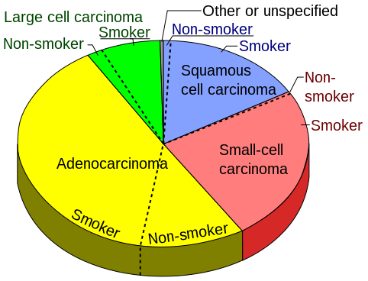
Lung cancer statistics
C3 for Change, LUNGevity Foundation

Slide 3
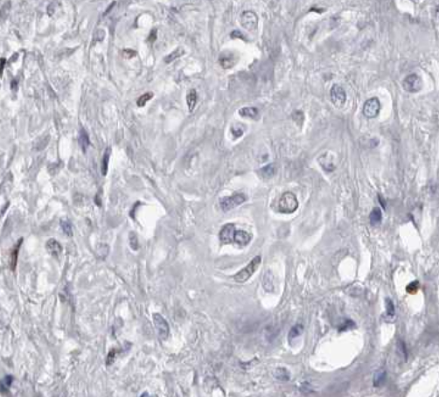
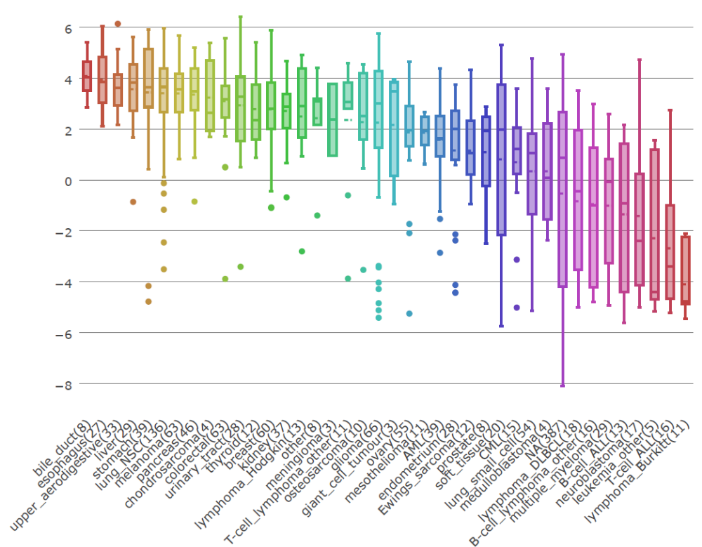
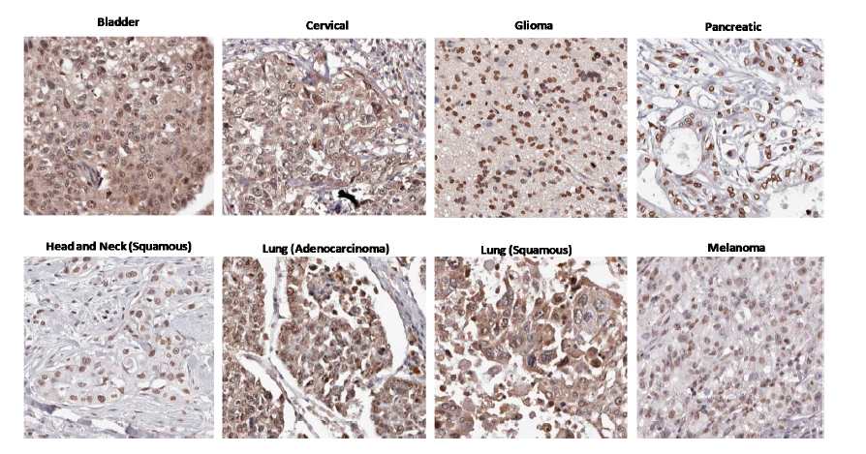
Healthy Lung
Human Protein Atlas reveals high AhR expression in most human cancers
Relative AhR Protein Expression
Normal cell expression
NSCLC
Melanoma
Breast
OSCC
GBM
Human Protein Atlas
Monti & Sherr

Slide 4
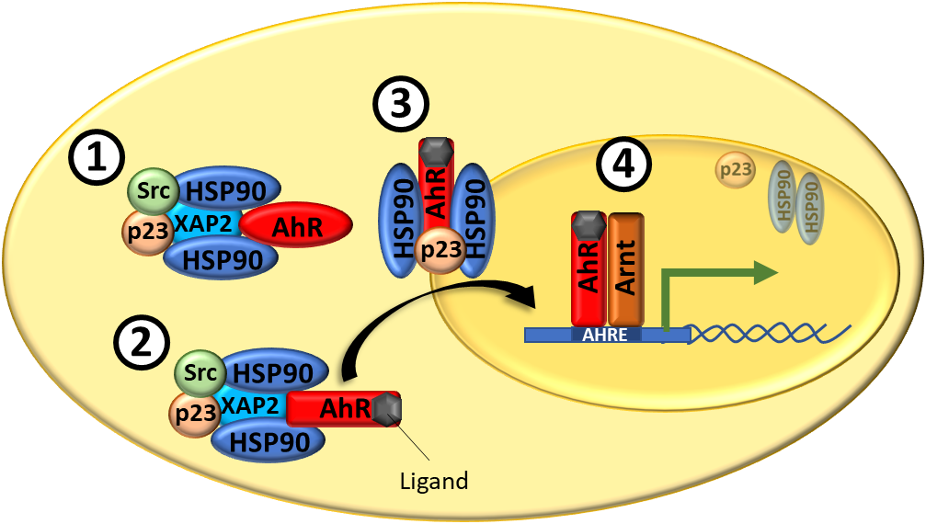
The AhR is a ligand activated transcription factor that regulates many genes

Slide 5
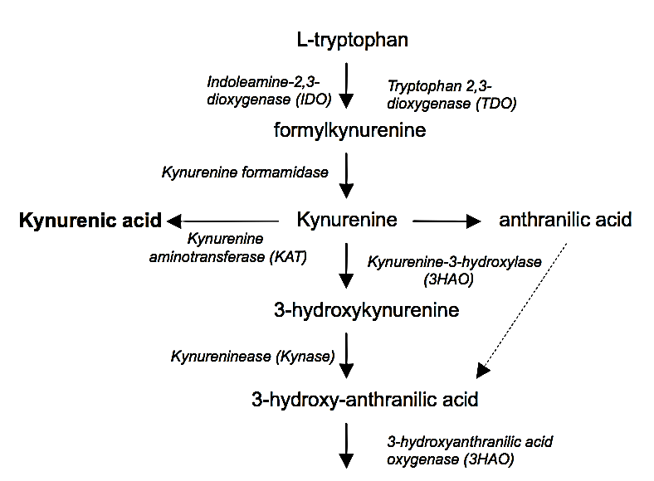
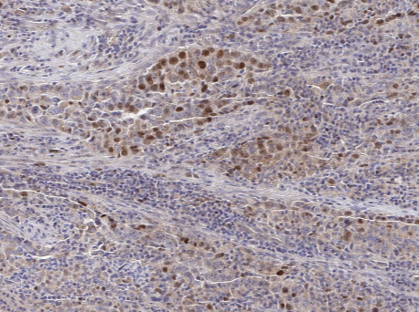
Tryptophan metabolism correlates with human cancers
IDO⁺ human lung tumor, Human Protein Atlas

Slide 6
Working model: the AhR amplification loop in cancer drives immune checkpoint expression in the TME
Effector T cells
TME
IFNγ
AhR^{high}
Tryptophan
Kynurenine
PD-L1
IDO
Malignant cell

Slide 7
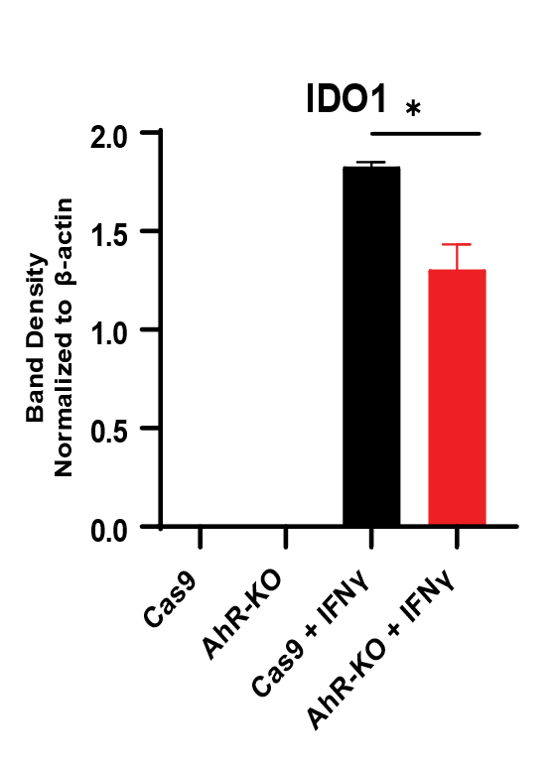
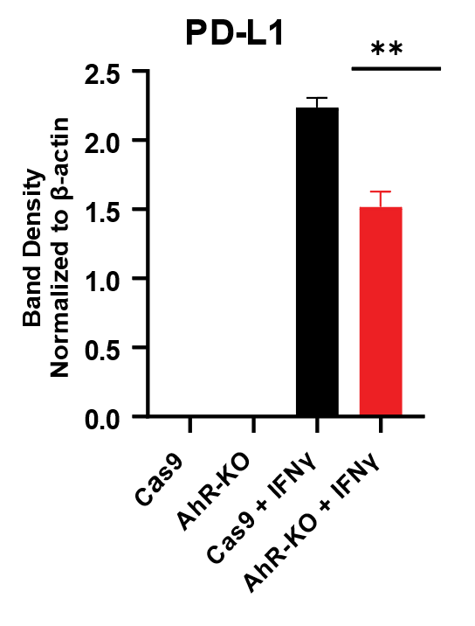
AhR regulates immune-related genes in murine CMT167 cells
Relative Expression
(Fold Change)

Slide 8
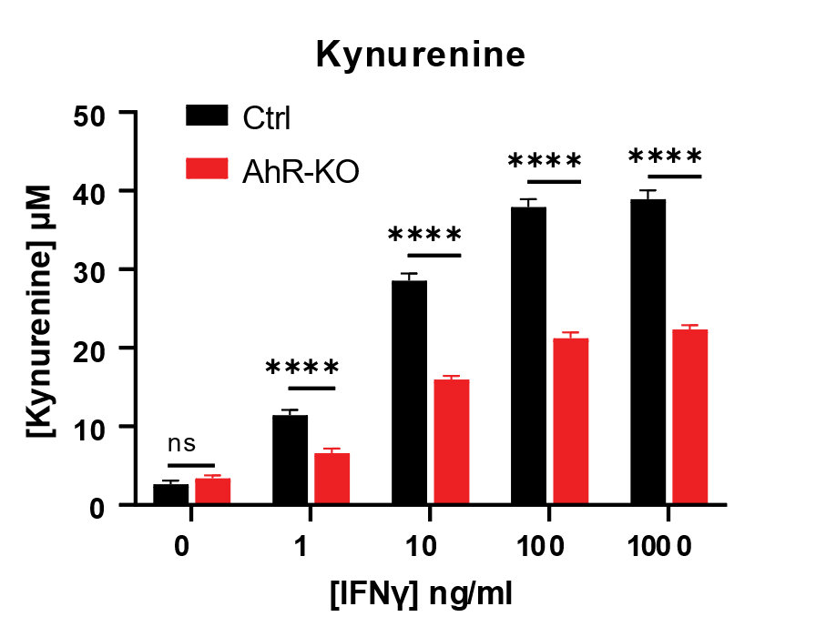
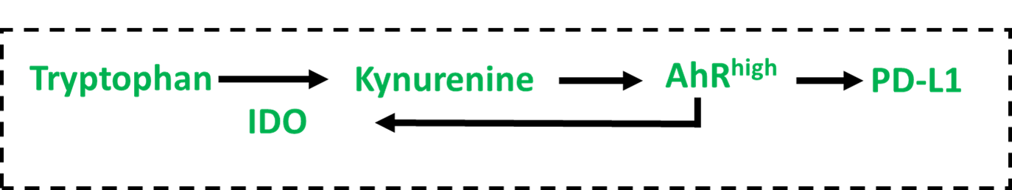
AhR mediates IFNγ induced kynurenine in murine CMT167 cells

Slide 9





Experimental design
CMT167^{AhR-KO}
or
CMT167^{WT}
OR
Week 2
Week 3
Week 4
Week 5
scRNA-seq
*
*
*
Y
Y
Y
Flow cytometry
Immunofluoresence

Slide 10
AhR deletion in malignant cells leads to lessened tumor burden and a significant survival advantage in immune competent mice

Slide 11
CMT167^{AhR-KO} tumors have a higher density of infiltrating CD45⁺

Slide 12
TME of AhR-KO tumor contains less kynurenine than WT

Slide 13
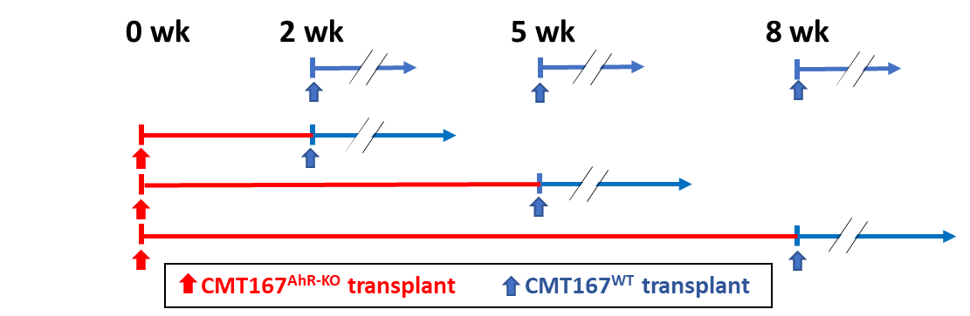
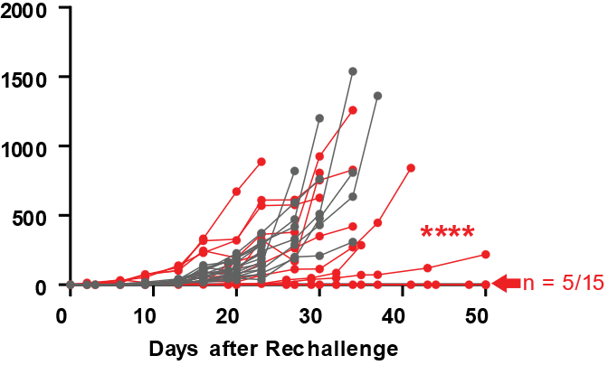
AhR knockout in CMT167 cells confers tumor-specific immunity
2 weeks
5 weeks
8 weeks
Tumor size (mm³)

Slide 14
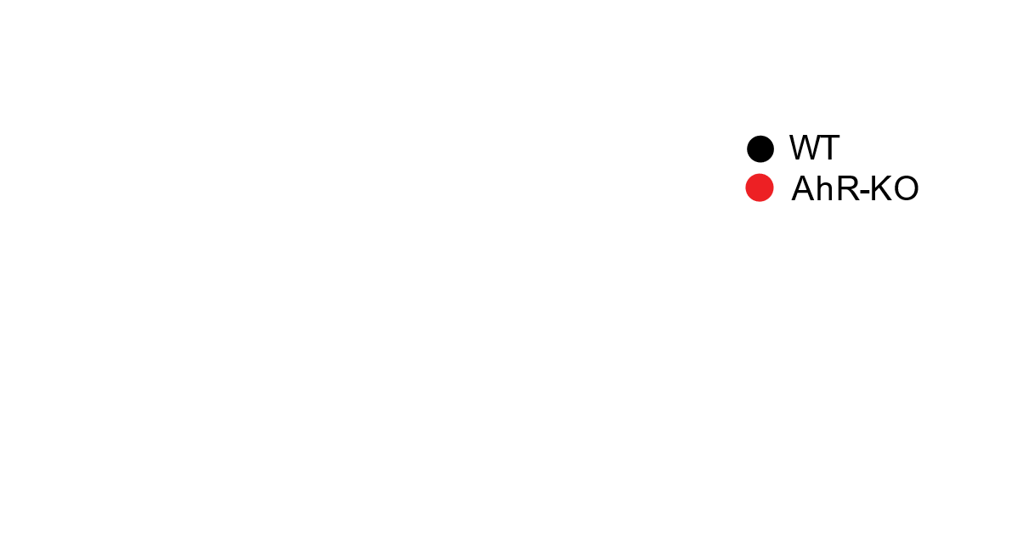
CMT167^{AhR-KO} tumors have a higher density of infiltrating CD4⁺ and CD8⁺ T cells than CMT167^{WT} tumors with an increase in T cell activation markers

Slide 15
scRNA-seq of TILs reveals T cell populations unique to each tumor type that correlate with inflammatory and suppressive activity
UMAP2
5-week TILs from AhR-KO vs WT tumors

Slide 16
Transcriptomes point to functional differences between clusters

Slide 17
Summary
The AhR regulates Cd274/PD-L1 and IDO in lung adenocarcinoma malignant cells
IFNγ signaling may benefit malignant cell survival at least partially through AhR signaling
AhR deletion in malignant cells provides a significant, sometimes complete, survival advantage in subcutaneous mouse models characterized by increased immune cell infiltration
T cells from AhR-KO tumors are more likely to express perforin and granzyme b, whereas WT TILs express transcriptomes associated with exhaustion
AhR modulation may help to improve immune checkpoint drugs
Effector T cells
IFNγ
TME
AhR^{high}
Tryptophan
Kynurenine
PD-L1
IDO
Malignant cell

