Slide 1

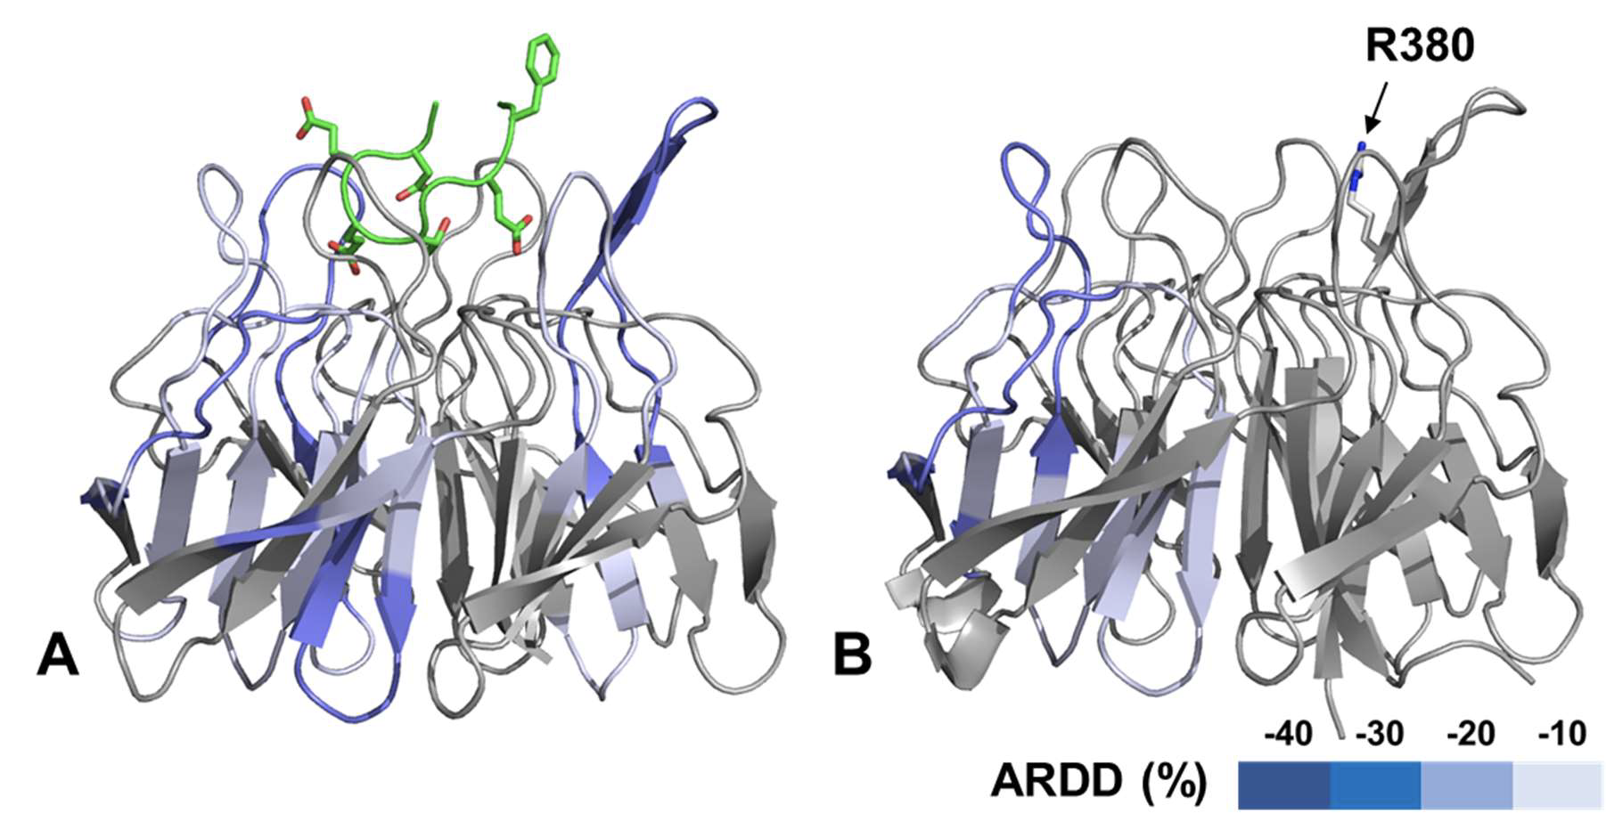
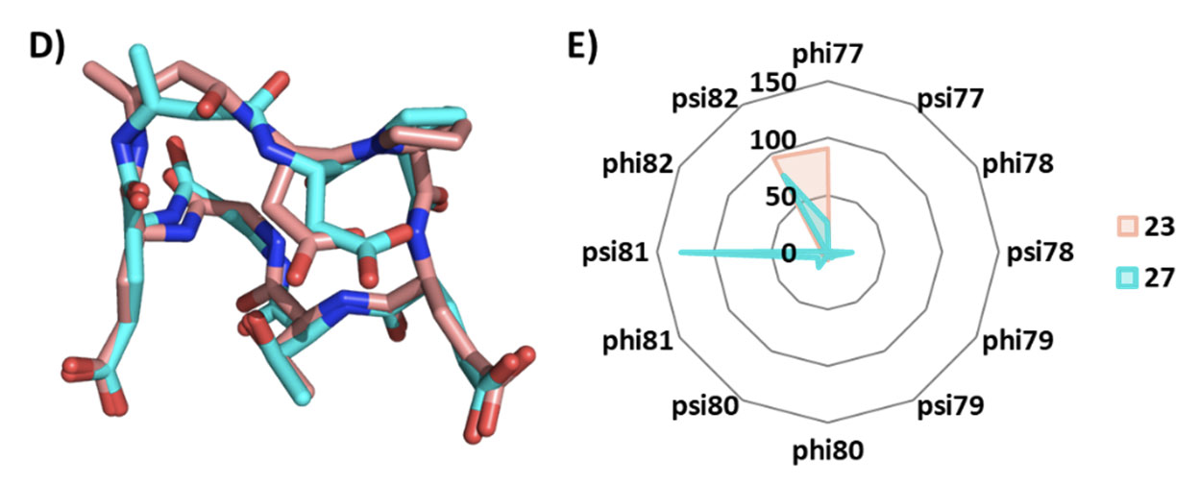
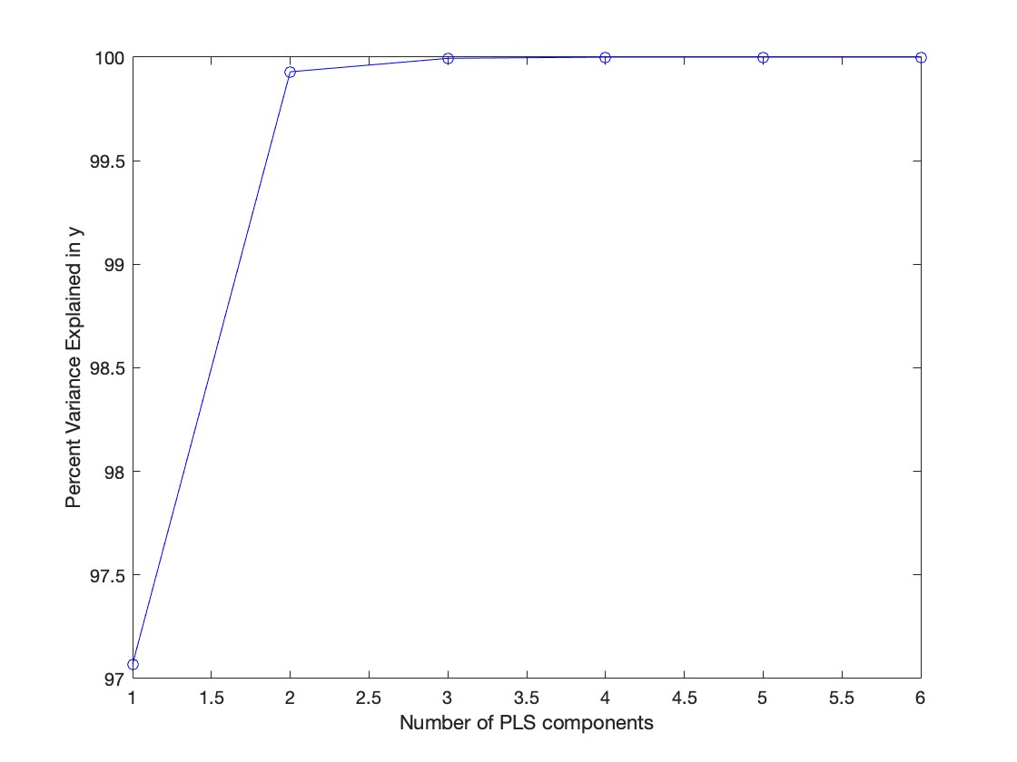
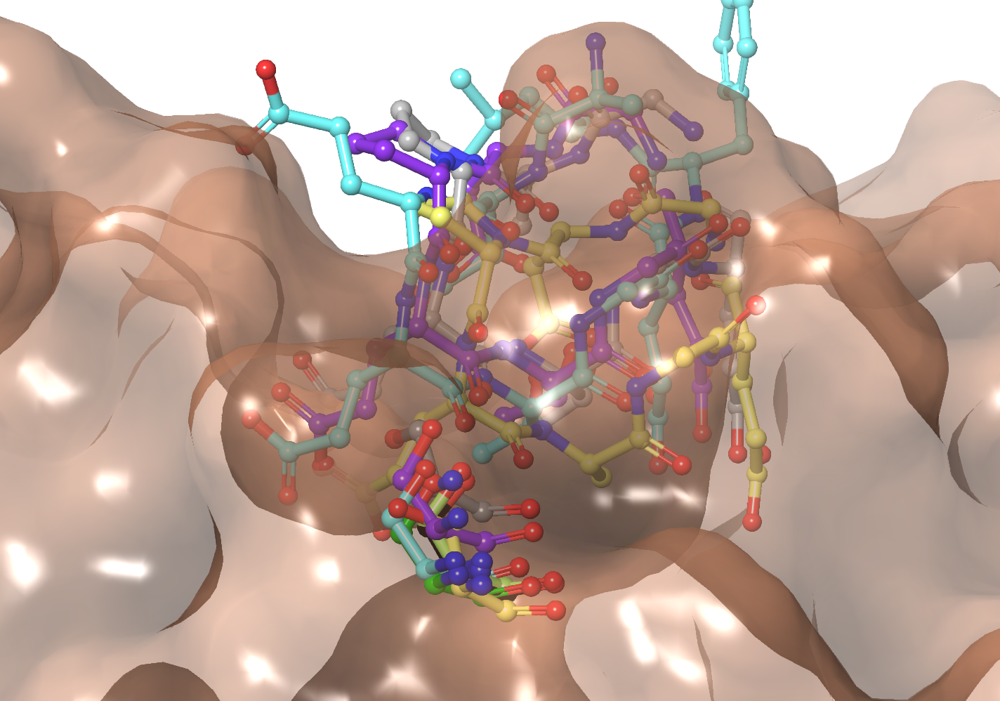
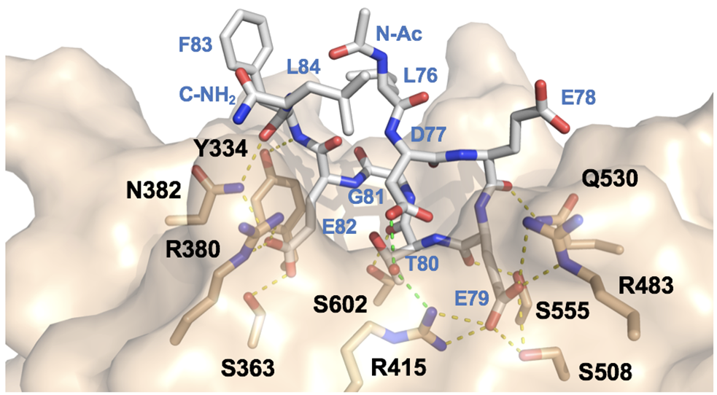
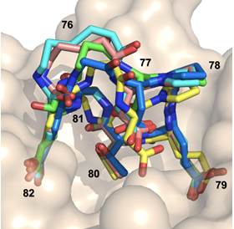
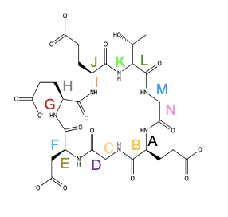
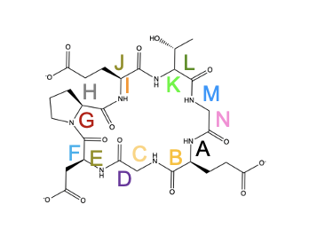
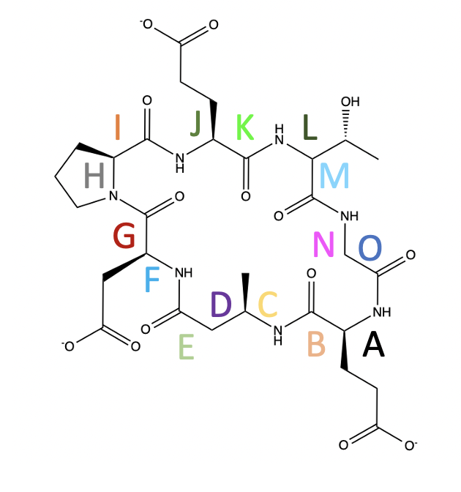
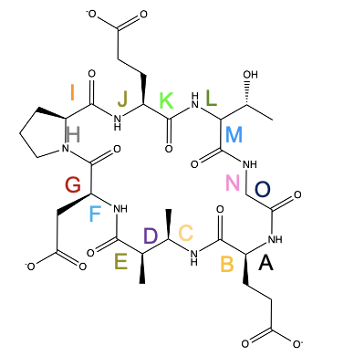
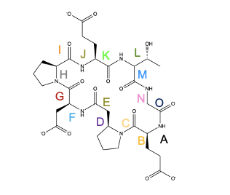
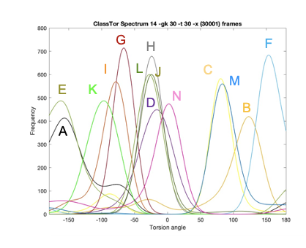
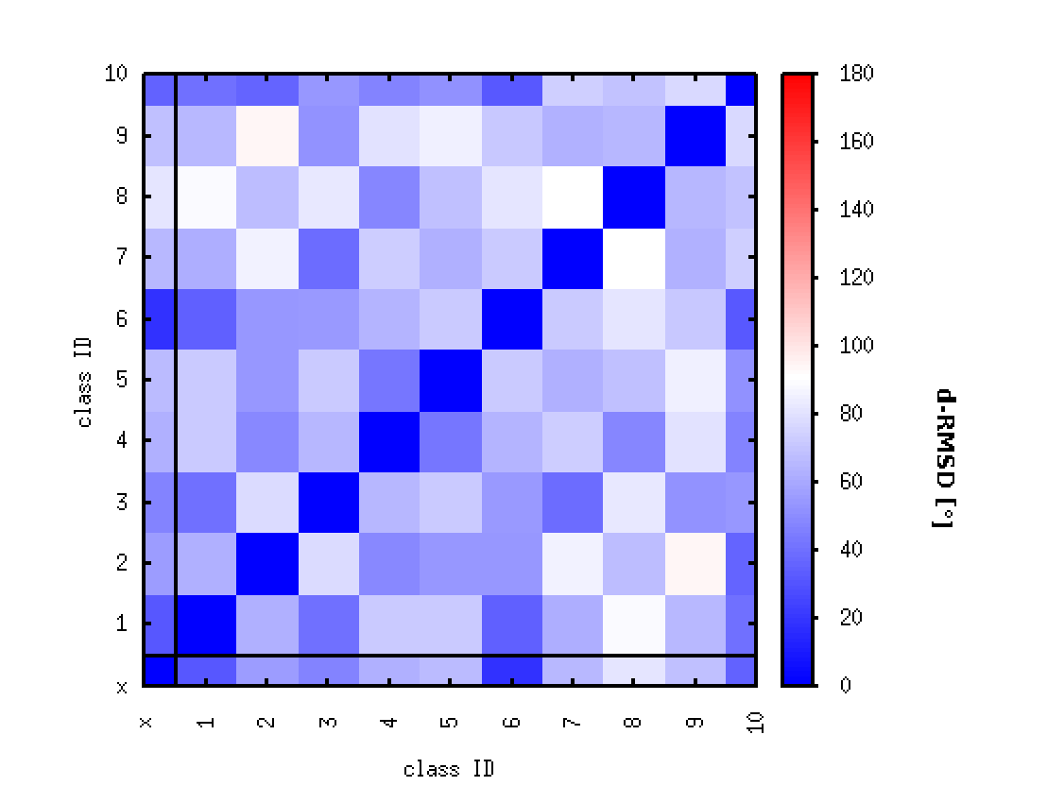
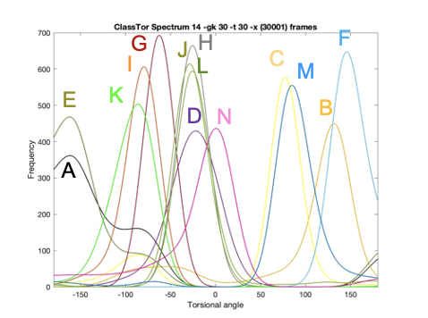
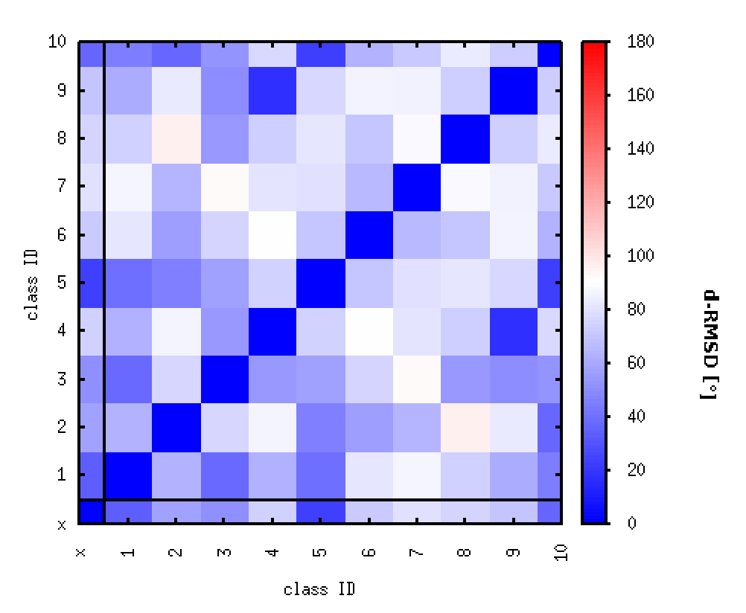
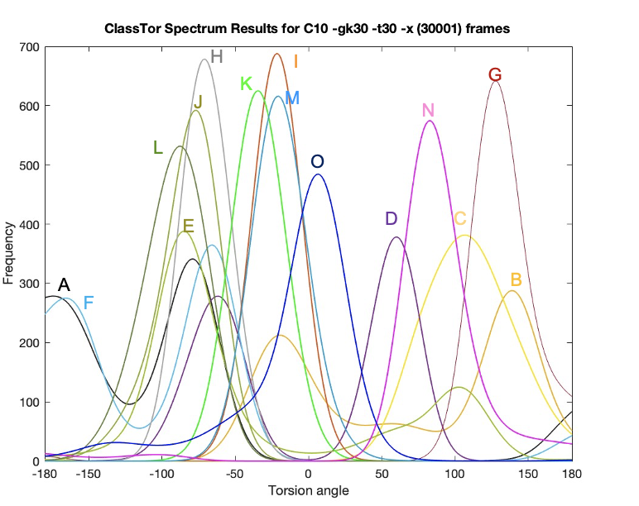
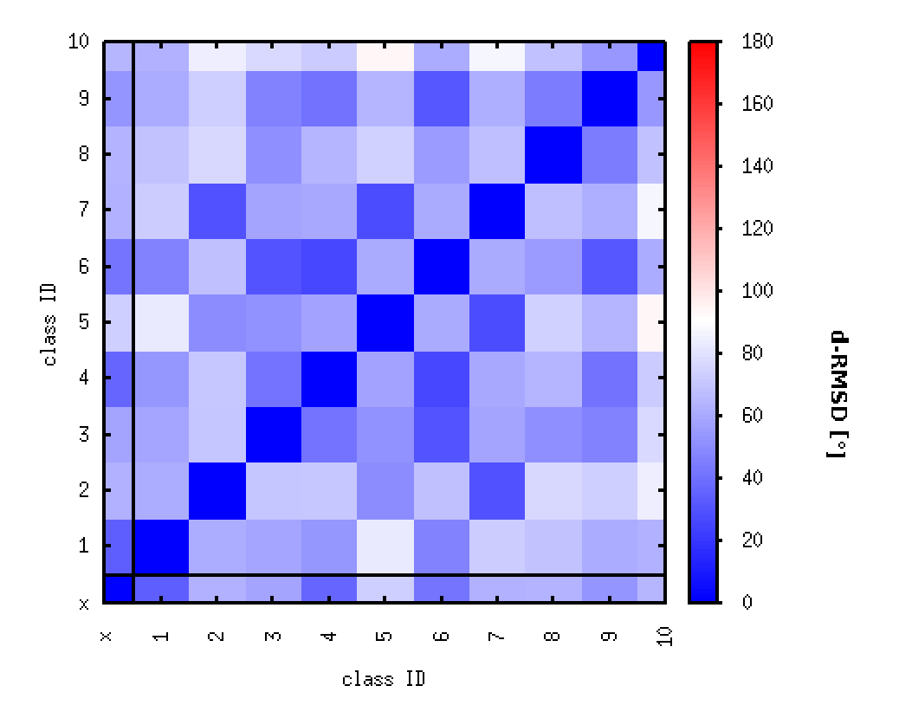
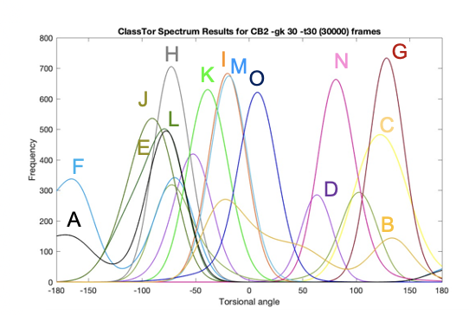
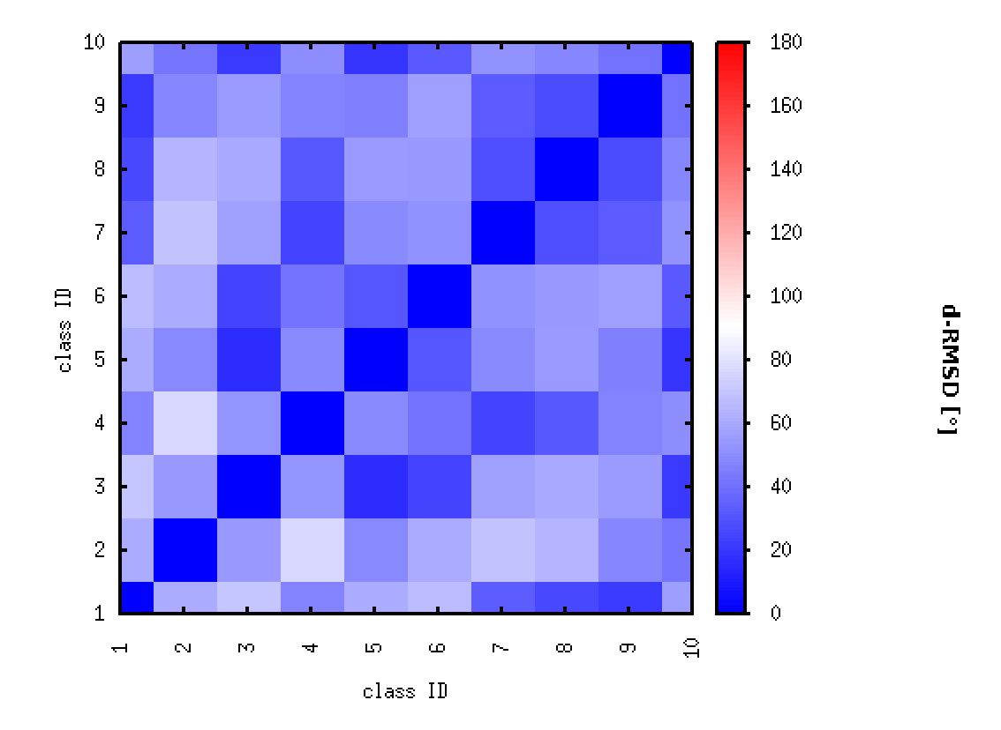
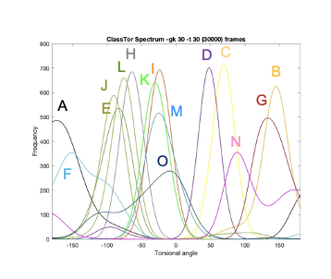
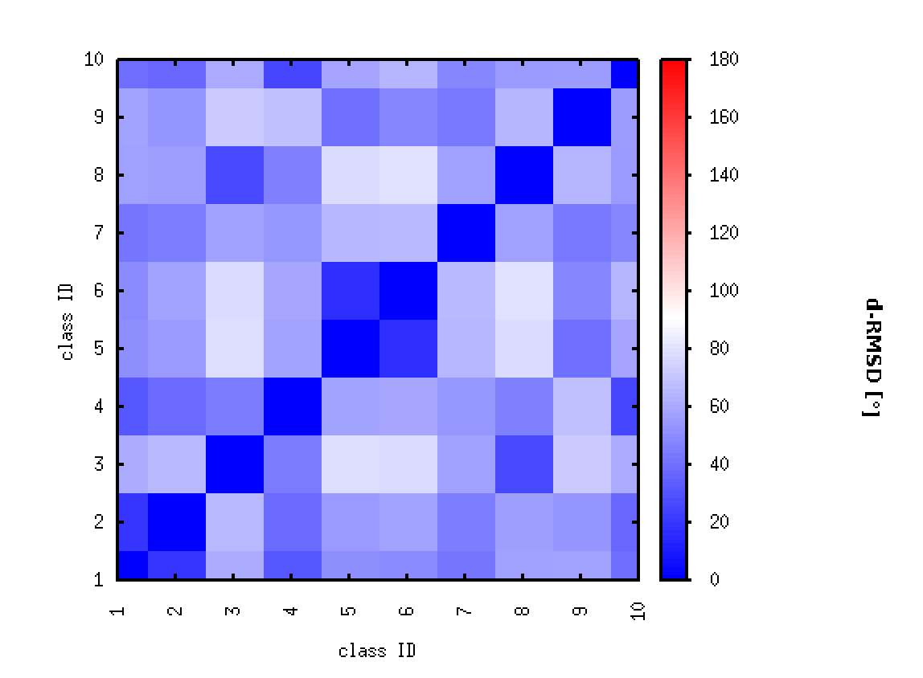
Insights into the Design of Keap1 Inhibitors from Machine Learning and Molecular Dynamics
Matthew J.K. Vince, Samantha N. Muellers, James McNeely, Adrian Whitty
Department of Chemistry; Boston University, Boston, MA 02215
Abstract
Previous Results
ML and MD
Conclusions
Kelch-like ECH-associated protein 1 (Keap1) is an important drug target for inflammation, multiple sclerosis, and Alzheimer’s Disease. Keap1 binds the transcription factor nuclear factor erythroid 2-related factor 2 (Nrf2) via a high affinity DxETGE motif (K_{D} ~ 20 nM) and at a low affinity DLG motif. Under basal conditions, Keap1 mediates the ubiquitination and degradation of Nrf2, thus keeping Nrf2 levels low. Under conditions of oxidative stress, Keap1 is inactivated by reaction with Reactive Oxygen Species, causing Nrf2 to accumulate and migrate to the nucleus where it upregulates antioxidant response element (ARE) genes. Our lab is interested in targeting the DxETGE binding site on Keap1 using macrocyclic peptides. Here, we describe how machine learning (ML) and molecular dynamics (MD) are being used to elucidate how conformational effects in Keap1 and in the cyclic peptide ligands relate to ligand binding affinity. Specifically, we use the ML method of Partial Least Squares Regression to show that subtle local changes in Keap1 structure upon ligand binding distinguish between high affinity and low affinity ligands. The results suggest aiming for ligands that optimally complement the “high affinity conformation state” of Keap1 could be a useful principle for designing next-generation cyclic peptide ligands. We are also using MD simulations of a set of existing cyclic peptide ligands with different binding affinities to understand how structural changes to the linker region of these macrocyclic ligands affects the conformational preferences of the Keap1-binding regions. The results show that our lead inhibitor accesses several distinct conformations, a degree of flexibility that likely diminishes its affinity for Keap1. Different linker structures impose different conformational constraints on the Keap1-binding regions of the ligand. This analysis potentially provides a route to designing linkers that would constrain the Keap1-interacting region in the optimal conformation for binding to this target.
A
B
ML study design:
7 of our lab’s macrocycle:Keap1 bound complexes selected that provided large enough landscape of binding affinities.
13 residues present in all 7 structures were selected that interact with the peptide macrocycles (Y334, S363, G364, R380, N382, R415, R483, Q530, S555, A556, Y572, F577, and S602).
11 descriptors calculated using VADAR⁶ plus an additional 3 B-factor related descriptors for each residue; main chain res. ASA, main chain frac. ASA, main chain res. vol, main chain frac. vol, phi, psi, omega, side chain surface ASA, side chain frac. surface ASA, side chain SFE, CHI1 angle, B-factor backbone, B-factor side chain, and B-factor all (182 total descriptors).
MD study design:
Four linkers were used in our study (WT glycine linker, D-homoalanine [DhA], CB2, and DβPro) and an additional Nrf2 variant (E78P).
Productions runs conducted for 400 ns with frames being collected each ps (400000 total frames).
30000 frames selected.
“Binned” and classified torsional angles.
ML results:
It appears that S555’s side chain is critical in obtaining a high affinity interaction between our macrocycles and Keap1. Careful consideration of S555’s side chain will need to be evaluated when designing new Keap1 inhibitors.
ClassTor results:
Flexibility results:
The MD results indicate that the replacement of proline at position E78 rigidifies ɸG76, ɸG81, ΨG81 while making ɸE79 more flexible.
The overall flexibility ranking of our lead inhibitor’s dihedral angles with the DhA linker are as follows; ΨE82 > ΨDhA76 > βDhA76 > ɸ77D > ΨG81 > ɸE82 > ɸG81.
The DhA linker ΨE79 become 3-fold more flexible than in the c[WT].
With the DhA linker ɸG81 and ΨG81 flexibility is restored compared to the c[WT].
The β-methyl group in CB2 raises flexibility of Ψ76 in the linker but reduces flexibility in ΨE82 compared to DhA.
The DβPro linker is too rigid but maintains the flexibility in ΨG81.
Classification results:
Our lead candidate inhibitor (DhA linker), has only ~1/3rd of all favorable conformations fit in the bound conformation class.
Classes 2-5 for the DhA linker contain more than 50% of all conformations.
In DβPro, class 1 (~53%) is the same as class 2 (~37%) other than ɸG81 being in class 1.
Interestingly, class 1 of DβPro (~53%) is the same as class 4 of the DhA linker except ɸG81 is favored in bin 0 and ΨG81 is favored in bin 1 in the DhA linker class.
C
D
Figure 2: HDX results mapped onto Keap1 A) WT Keap1 bound to the Nrf2 peptide (green). B) 380 mutant of Keap1 average relative deuterium uptake difference (ARDD) (image adapted from Mengqi Zhong, online dissertation)⁵. C) Overlay of DhA linked macrocycle (cyan) with β-alanine linker (salmon). D) radar plot displaying dihedral angle strain between DhA, and β-alanine linked macrocycles (image adapted from Samantha Muellers, online dissertation)⁴.
Machine Learning Results
Introduction
Before PLSR analysis, comparisons were made between the descriptors values for all shared residues to determine any values that significantly differed among the seven complexes. Uniquely, the two lowest affinity binding inhibitors (12 and 30 µM) used in this study, displayed significantly different chi angles for S555 compared to the mid to low nM inhibitors. Optimal chi angles are normally positioned at 60°, 180°, or -60°⁶ while the chi angle for our two µM binding inhibitor’s S555 were -170° and -80°, respectively. The other complexes' S555 chi angle was on average 54° ± 5. Furthermore, the S555 side chain’s fractional surface ASA was determined as the top VIP score of all 182 possible descriptors (Figure 3).
Additionally, a recent study has highlighted on the importance of S555’s side chain in designing Keap1 inhibitors⁷. In their study, the addition of a single fluorine to their small molecule inhibitor abolished an intramolecular bond between S555’s side chain and the side chain of the nearby Q530 by creating an intermolecular bond between the fluorine and Q530. This added interaction between fluorine and Q530 caused a considerable increase in affinity from 40 µM to 89 nM. These results support the importance in considering S555 when designing new macrocyclic inhibitors.
A
B
Machine learning (ML) is a powerful tool for understanding hidden features in data sets that are not always visible at the surface level. Partial Least Square Regression (PLSR) is a powerful ML method that has many uses in analyzing macrocycle:protein bound complexes. PLSR uses variables containing X data and attempts to explain the variance in a Y variable set of numbers, in this case binding affinity of our peptide macrocycle inhibitors. Variable Importance in Projection (VIP) is another powerful ML tool that is normally supplemented alongside PLSR that determines the most influential descriptors in determining one’s Y values¹. Here within we demonstrate the use of PLSR to survey the conformational effects of shared interacting site residues in Keap1 between different linkers present in our bound peptide macrocyclic inhibitors. Several PDB structures of macrocyclic:Keap1 bound structures from our lab were surveyed to determine local changes in the protein structure among different linker containing macrocycles (Figure 1).
Molecular Dynamics (MD) is also used to determine strain on the linker region of our Nrf2 macrocycles in this work. A more extensive study is conducted here within to evaluate global changes accompanied to each macrocycle’s backbone dihedral angles. To achieve this the novel, recently published, suite program DynaDock (ClassTor.Py) is used to bin and classify the torsional angles of a set of 30000 frames from our previously performed MD simulations².
Descriptor | VIP score
S555 side chain frac surf ASA | 1.6946
Y334 B-factor sidechain | 1.6429
R380 Phi | 1.6255
F577 CHI1 angle | 1.6232
Y334 B-factor all | 1.6205
530 B-factor sidechain | 1.6148
R415 B-factor sidechain | 1.6042
382 B-factor Backbone | 1.5965
382 B-factor all | 1.5935
Q530 B-factor all | 1.5884
S363 side chain SFE | 1.5817
R415 B-factor all | 1.5754
Q530 B-factor Backbone | 1.5496
R380 B-factor all | 1.5433
R380 B-factor sidechain | 1.5404
334 B-factor Backbone | 1.5387
S555 main chain Res. ASA | 1.5264
S555 side chain surface ASA | 1.5264
R415 Omega | 1.5196
F577 B-factor sidechain | 1.5157
Future Directions
We plan to extend our ML analysis to all residues and complexes in our macrocycle:Keap1 complexes to elucidate further global conformational changes that are occurring within Keap1. Further studies plan to be conducted on looking at the correlations and VIP scores between multiple descriptors to determine if other variables are significant for determining binding affinity and if variables may be co-dependent on other variables for their effect. We plan on running further MD on other linkers in our Keap1 macrocycles to determine added structural effects and their contributions on global backbone flexibility.
C
Figure 3: A) Our PLSR model with six PLS components shown. B) VIP scores of the top 20 descriptors in this study. C) Comparison of our seven PDB structures used in this study overlaid with S555 shown. Gray and yellow indicate our 12 and 30 µM inhibitors, respectively.
Acknowledgments
Thank you to the Boston University Department of Chemistry for funding and the Boston University Center for Molecular Discovery (BU CMD) for accessibility to the Schrödinger software suite of programs.
A
B
Molecular Dynamics Results
A
WT
C
D
CB2
E
DβPro
rank | torsion | flexscore
1 | c | 12.0161
2 | n | 12.0143
3 | m | 10.018
4 | b | 10.0112
5 | l | 1.0034
B
E78P
bins | rank | torsion | flexscore
3 | 1 | l | 1.0036
2 | 1 | b | 9.0152
 | 2 | c | 4.0081
 | 3 | m | 1.0037
DhA linker (lead candidate)
rank | torsion | flexscore
1 | e | 20.37
2 | b | 12.06
3 | f | 10.64
4 | d | 6.04
5 | a | 1
References
rank | torsion | flexscore
1 | b | 30.12
2 | e | 18.04
3 | d | 12.05
4 | f | 10.04
5 | o | 8.01
6 | a | 7.03
7 | n | 7.02
rank | torsion | flexscore
1 | o | 9.0218
2 | e | 8.0142
3 | n | 4.0129
4 | d | 2.0061
Greener, J.G., et al. A guide to machine learning for biologists. Nat Rev Mol Cell Biol 23, 40–55 (2022).
Meixner, M., et al. Dynamic Docking of Macrocycles in Bound and Unbound Protein Structures with DynaDock. Journal of chemical information and modeling, 62(14), 3426–3441 (2022).
Zhong, M., et al. Interaction Energetics and Druggability of the Protein-Protein Interaction between Kelch-like ECH-Associated Protein 1 (KEAP1) and Nuclear Factor Erythroid 2 Like 2 (Nrf2). Biochemistry, 59 (4), 563–581 (2020).
Muellers, S. N. Synergistic Application of Machine Learning and Structural Biology to Understand Protein-Ligand. Online dissertation OpenBU (2023).
Zhong, M. Energetics and inhibition of the KEAP1/NRF2 protein-protein interaction interface. Online Dissertation OpenBU (2017).
Willard, L., et al. VADAR: a web server for quantitative evaluation of protein structure quality. Nucleic Acids Res. 13: 3316–3319 (2003).
Otake, K., et al. Methyl and Fluorine Effects in Novel Orally Bioavailable Keap1-Nrf2 PPI Inhibitor. ACS medicinal chemistry letters, 14(5), 658–665 (2023).
Figure 1: A) The wild-type Nrf2 peptide (gray) bound to Keap1 (Figure adapted from Zhong et al., 2020)³. B) Overlay of the E78P macrocyclic peptide inhibitor (blue [K_{i} 140 nM]) compared with βala/E78P (yellow [K_{i} 70 nM]), γBut/E78P (green [K_{i} 230 nM]), Ava/E78P (salmon [K_{i} 120 nM]), and Ahx/E78P (cyan [K_{i} 330 nM]) bound to Keap1 (wheat) (figure adapted from Samantha Meullers, online dissertation)⁴.
class | size | classifier | frac[%]
1 | 22877 | [0, 1, 1, 0, 0, 0, 0, 0, 0, 0, 0, 0, 0, 1] | 76.26
2 | 2335 | [0, 0, 0, 0, 0, 0, 0, 0, 0, 0, 0, 0, 0, 1] | 7.78
3 | 1686 | [0, 1, 1, 0, 0, 0, 0, 0, 0, 0, 0, 0, 0, 0] | 5.62
class | size | classifier | frac[%]
1 | 23101 | [0, 0, 1, 0, 0, 0, 0, 0, 0, 0, 0, 1, 0, 0] | 77
2 | 5272 | [0, 1, 0, 0, 0, 0, 0, 0, 0, 0, 0, 1, 0, 0] | 17.57
class | size | classifier | frac[%]
1 | 9500 | [1, 1, 0, 1, 0, 1, 0, 0, 0, 0, 0, 0, 0, 0, 1] | 31.67
2 | 4927 | [1, 1, 0, 0, 1, 0, 0, 0, 0, 0, 0, 0, 0, 0, 1] | 16.42
3 | 4682 | [0, 0, 0, 0, 0, 1, 0, 0, 0, 0, 0, 0, 0, 0, 1] | 15.61
4 | 3743 | [0, 0, 0, 1, 0, 0, 0, 0, 0, 0, 0, 0, 0, 0, 1] | 12.48
5 | 2608 | [0, 0, 0, 0, 1, 0, 0, 0, 0, 0, 0, 0, 0, 0, 1] | 8.69
class | size | classifier | frac[%]
1 | 11980 | [1, 1, 0, 0, 1, 0, 0, 0, 0, 0, 0, 0, 0, 0, 0] | 39.93
2 | 10461 | [1, 1, 0, 1, 0, 1, 0, 0, 0, 0, 0, 0, 0, 0, 0] | 34.87
3 | 5255 | [0, 0, 0, 0, 0, 1, 0, 0, 0, 0, 0, 0, 0, 0, 0] | 17.52
4 | 1057 | [0, 0, 0, 0, 1, 0, 0, 0, 0, 0, 0, 0, 0, 0, 0] | 3.52
class | size | classifier | frac[%]
1 | 15909 | [0, 0, 0, 1, 0, 0, 0, 0, 0, 0, 0, 0, 0, 1, 0] | 53.03
2 | 11099 | [0, 0, 0, 1, 0, 0, 0, 0, 0, 0, 0, 0, 0, 0, 0] | 37
3 | 2392 | [0, 0, 0, 0, 1, 0, 0, 0, 0, 0, 0, 0, 0, 1, 0] | 7.97
Figure 4: ClassTor results for the four linkers tested in our study and E78P. Structures display the residue labels for each phi, psi, and β (if permitted) torsional angles. Flexscores are represented by the table adjacent to the macrocycle structure. Spectrums of each torsional angles plotted against frequency with their respective label and heatmaps are displayed. The class ID “x” in the heatmap is a comparison to the reference frame of the bound macrocycle in the crystallized structure to each classifier. Only the predominant fractional percent of classifiers are displayed for each macrocycle. Classifiers denote the highest frequency torsional angle (bin) as “0”. Comprehensive ClassTor results are displayed for A) Wild-type Nrf2 macrocycle (glycine linker) (K_{i} 470 nM) B) E78P (K_{i} 140 nM) C) our lead candidate Nrf2 macrocycle with a DhA linker (K_{i} 20 nM) D) CB2 linker E) DβPro linker.

Slide 2
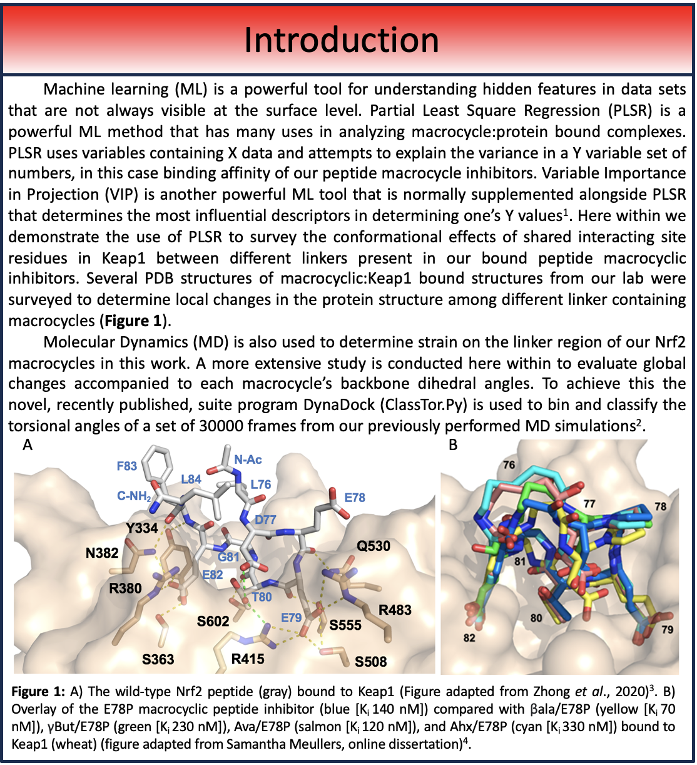

Slide 3
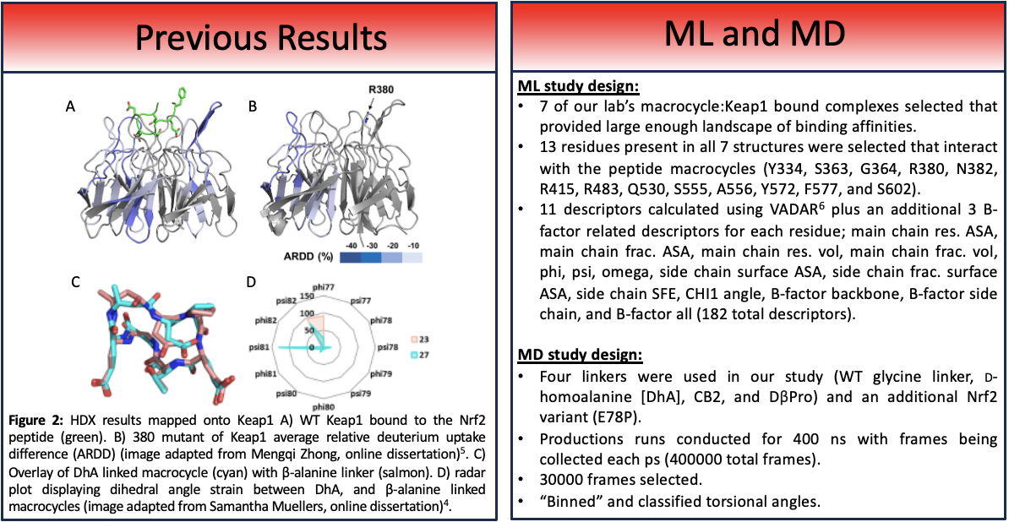

Slide 4
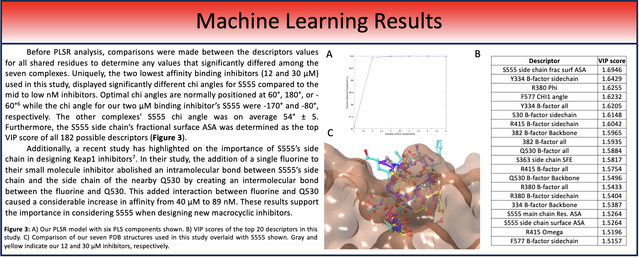

Slide 5
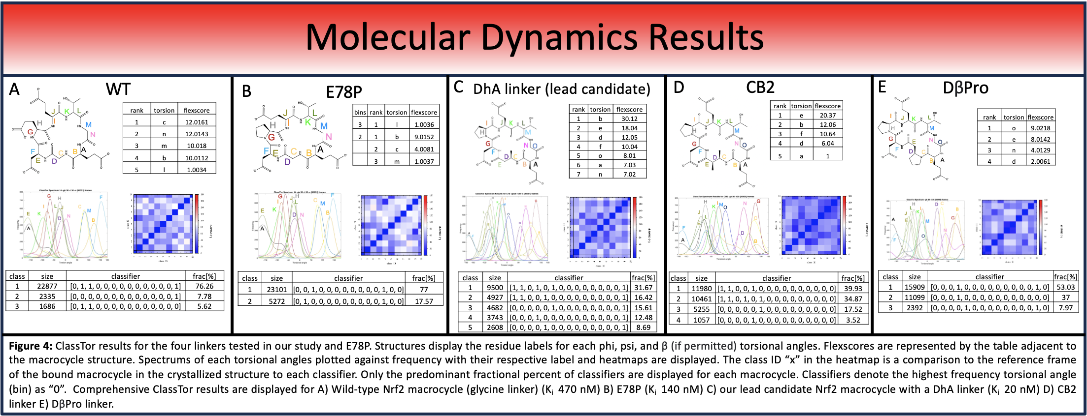

Slide 6
