Slide 1




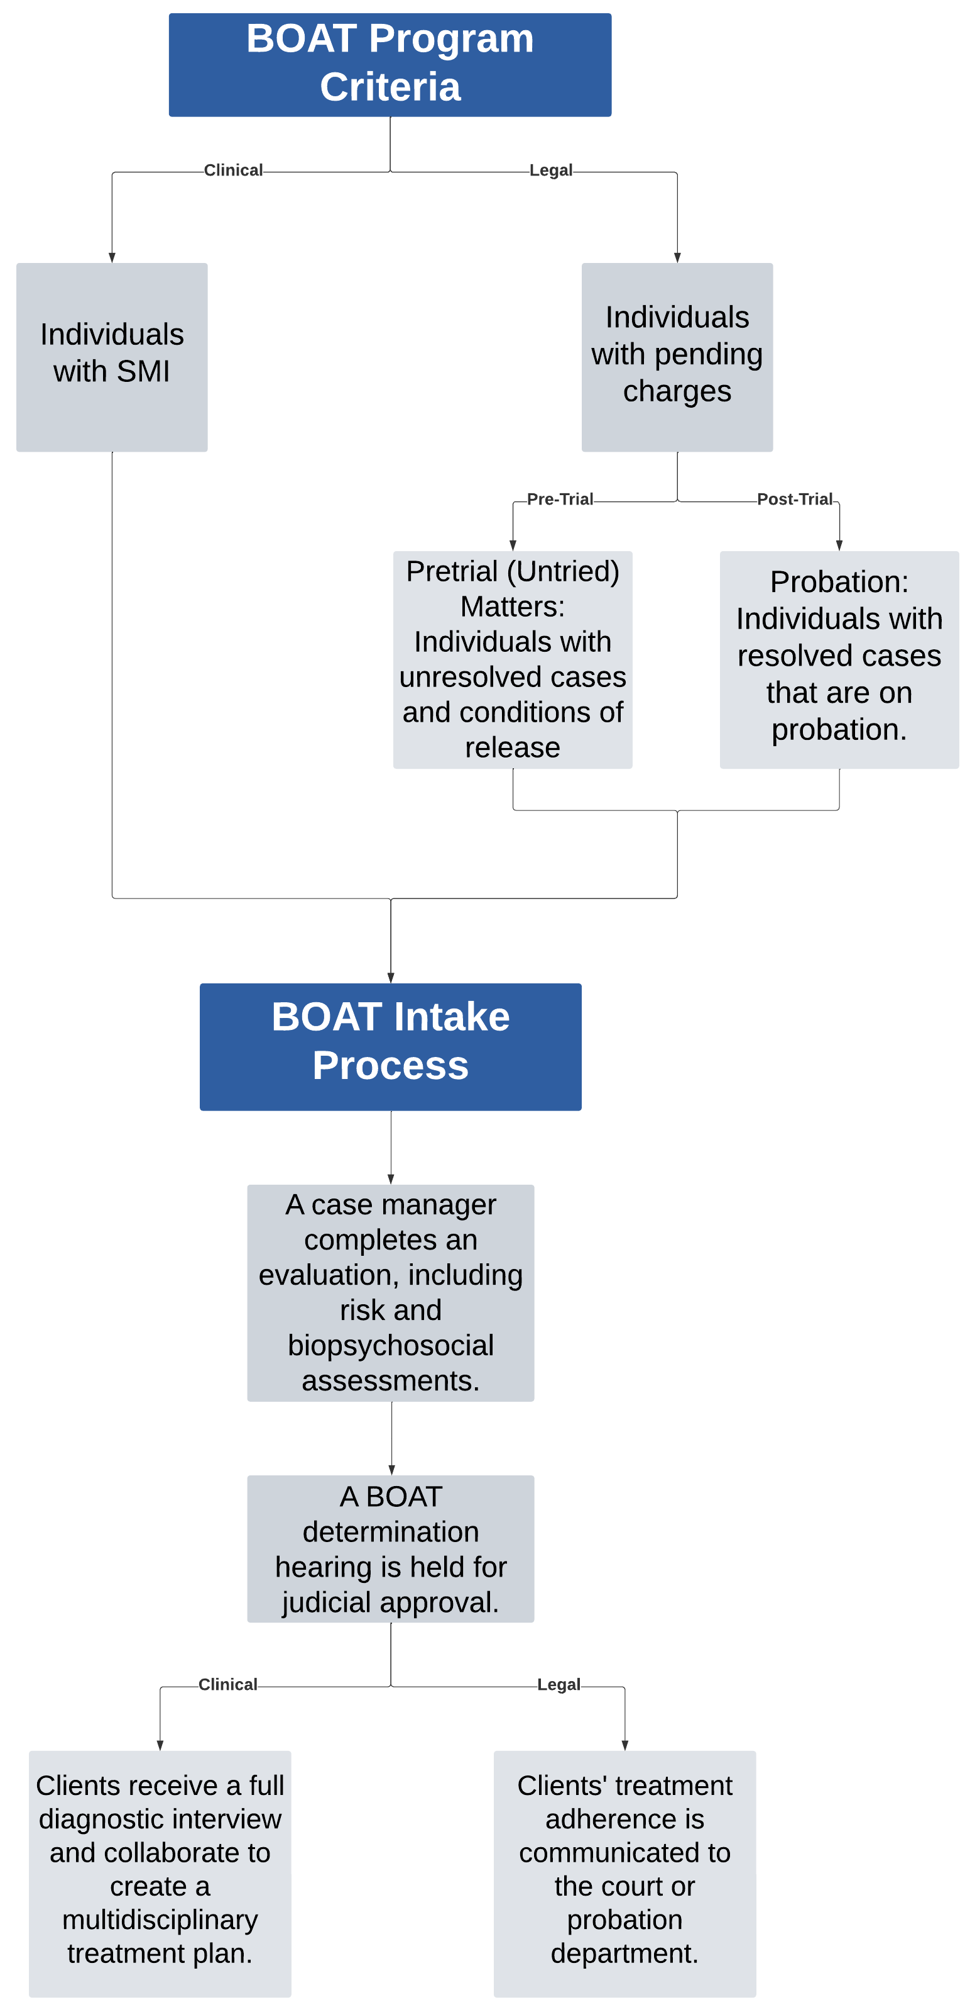
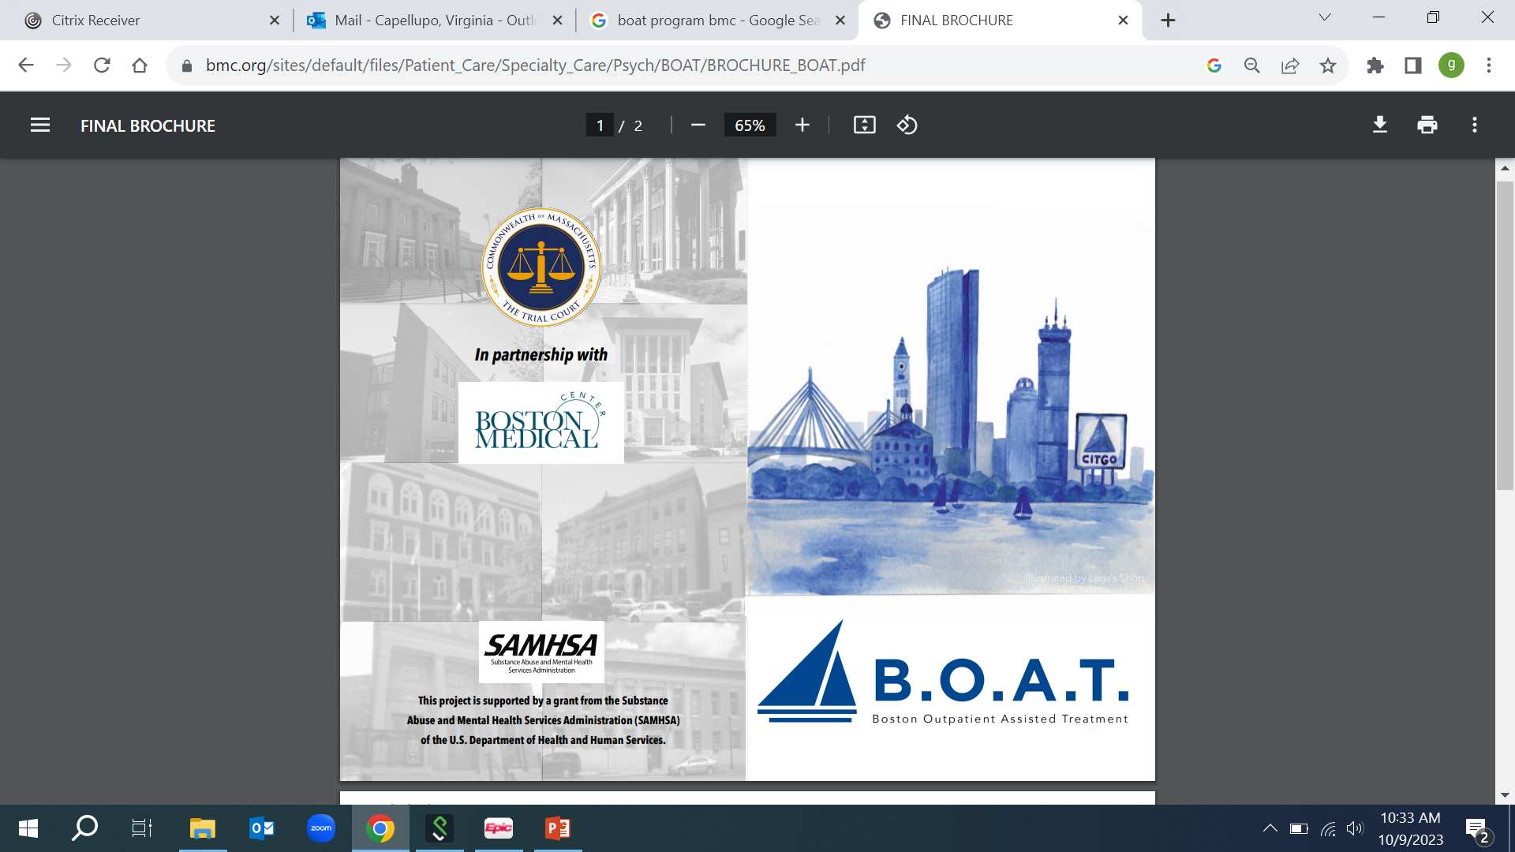
Substance Use and Functionality Among Court-Involved Patients with Mental Illness
Lucinda Shotts;¹ Tithi D. Baul, MPH;^{1,2} Virginia Capellupo;¹ Nandini Agarwal, MPH;¹ Hannah E. Brown, MD;^{1,2} Leila Spencer, LMHC¹
¹Boston Medical Center, ²Dept. of Psychiatry, Chobanian and Avedisian Boston University School of Medicine
Background
Figure 1. BOAT Program Overview.
Table 1. Patient Characteristics.
Figure 3. Physical and Mental Health Functioning Scores
Assisted Outpatient Treatment (AOT) is a civil procedure,¹ providing court-ordered, community-based, mental health treatment.²
The Boston Outpatient Assisted Treatment (BOAT) program is a modified, voluntary, criminal case-based, AOT program that provides patients with serious mental illness (SMI) social, mental health, and substance use treatment to achieve recovery and avoid incarceration. ³ (Figure 1).
There is a bidirectional relationship between SMI and co-occurring substance use and alcohol use disorders (SUD and AUD).
Individuals with an SMI, co-occurring SUD/AUD, and criminal history have significantly higher risks of reincarceration, hospitalization, and attempted suicide,^{4,5} which in turn effects their physical and mental health functionality. ^{6,7}
Patient Characteristics | N = 85
Age: Mean (SD) | 35.8 (10.4)
Gender: n(%) Male Female | 57 (82.6%) 12 (17.4%)
Ethnicity: n(%) Latino | 15 (21.7%)
Race Black or African-American White Asian Alaskan Native American More than one race | 32 (46.4%) 17 (24.6%) 2 (2.9%) 1 (1.5%) 15 (23%)
Living conditions: n(%) Owned or rented or someone else’s place Homeless (shelter, street/outdoors, park) Group home Transition living facility Hospital/ detox inpatient or residential treatment facility Other | 37 (56.9%) 14 (21.5%) 5 (7.7%) 2 (3.1%) 3 (4.6%) 3 (4.6%)
Education: n(%) Less than 12th grade 12 grade/high school diploma/ GED Vocational/technical diploma Some college or university Bachelor’s degree Graduate work/degree | 15 (23.1%) 23 (35.4%) 3 (4.6%) 19 (29.2%) 4 (6.2%) 1 (1.5%)
Employment: n(%) Full-time + part-time Unemployed (looking for work, disabled, retired not looking for work) | 18 (27.7%) 47 (72.3%)
*
US population average
Key Findings
Objective
Fifty-two percent of patients were diagnosed with SUD or AUD.
Patients with SUD or AUD had a significantly lower mean physical health score compared to patients without SUD or AUD (45 ±10.7 vs 50.3 ± 8.4; p-value = 0.0193).
Patients with SUD or AUD had a lower mean mental health score compared to patients without SUD or AUD (41.7 ±11.5 vs 45.2; p-value = 0.078).
Although the mental health score was not statistically significant between the two groups, there was still a 4 point mean score difference. Additionally, the mental health mean scores for both groups were lower than the United States population average of 50 points. ¹⁰
We investigated the impact of substance and alcohol use on physical and mental health functionality within a cohort of BOAT patients.
Methods
Settings and Study Participants
We conducted a cross-sectional study within the BOAT program, which is based in the Department of Psychiatry at the Boston Medical Center.
The study population consists of individuals enrolled in the BOAT program with and without co-occurring SUD/AUDs.
Clinical Assessments
A total of 180 patients enrolled in the BOAT program from 2021-2023, 85 of which completed the Short Form Health Survey (SF12). ⁸
The ICD-10-CM was used to define disorders: alcohol use (F10.10-F10.99), opioid use (F.11.10-F11.99), cannabis use (F12.1-F12.99), sedative use (F13.1-F13.99), cocaine use (F14.1-F14.99), and stimulant use (F15.10-F15.99). ⁹
We performed bivariate analyses to compare patients with SUD or AUD versus without SUD or AUD.
Conclusions
Figure 2. Substance and Alcohol Use Diagnoses
The elevated rates of SUD or AUD had a negative impact on BOAT patients’ physical and mental health functionality.
Future Directions
The BOAT program continues to expand SUD and AUD services, including recovery coaching, certified peer specialist support, and addiction focused medication management to address the full scope of patient needs.
We will perform multivariable regression analyses with functionality as the outcome.
We will also assess the differences in functionality scores among baseline, 6-month, and program discharge.
Contact Information
References
Acknowledgements
Lucinda Shotts
BOAT Program Coordinator
Email: Lucinda.shotts@bmc.org
Website: https://www.bmc.org/boat
Phone: (617) 414-1391
Swartz, M. S., Wilder, C. M., Swanson, J. W., Van Dorn, R. A., Robbins, P. C., Steadman, H. J., Moser, L. L., Gilbert, A. R., & Monahan, J. (2010). Assessing outcomes for consumers in New York's assisted outpatient treatment program. Psychiatric services (Washington, D.C.), 61(10), 976–981. https://doi.org/10.1176/ps.2010.61.10.976
Fuller, D. A., & Pinals, D. A. National Center for State Courts. (2020, January). Assisted Outpatient Treatment (AOT) Community-Based Civil Commitment [Fact sheet]. Retrieved from https://www.ncsc.org/__data/assets/pdf_file/0026/16964/mhf2-assisted-outpatient-treatment-jan-2020.pdf
Boston Outpatient Assisted Treatment Program (BOAT) | Boston Medical Center. (n.d.). Boston Medical Center. https://www.bmc.org/boat
Baranyi, G., Fazel, S., Langerfeldt, S. D., & Mundt, A. P. (2022). The prevalence of comorbid serious mental illnesses and substance use disorders in prison populations: a systematic review and meta-analysis. The Lancet Public Health, 7(6), e557–e568. https://doi.org/10.1016/s2468-2667(22)00093-7
Hunt, G. E., Large, M., Cleary, M., Lai, H. M. X., & Saunders, J. B. (2018). Prevalence of comorbid substance use in schizophrenia spectrum disorders in community and clinical settings, 1990–2017: Systematic review and meta-analysis. Drug and Alcohol Dependence, 191, 234–258. https://doi.org/10.1016/j.drugalcdep.2018.07.011
Townley, G., Terry, R., Brusilovskiy, E., Snethen, G., & Salzer, M. S. (2019). Associations between physical health limitations and community participation among people with and without serious mental illnesses. Psychiatric Services, 70(8), 689–695. https://doi.org/10.1176/appi.ps.201800407
Osborne, B., Larance, B., Ivers, R., Deane, F. P., Robinson, L., & Kelly, P. J. (2022). Systematic review of guidelines for managing physical health during treatment for substance use disorders: Implications for the alcohol and other drug workforce. Drug and Alcohol Review, 41(6), 1367–1390. https://doi.org/10.1111/dar.13504
Ware, J., Jr, Kosinski, M., & Keller, S. D. (1996). A 12-Item Short-Form Health Survey: construction of scales and preliminary tests of reliability and validity. Medical care, 34(3), 220–233. https://doi.org/10.1097/00005650-199603000-00003
World Health Organization. 2020. ICD-10-CM: International Classification of Diseases, 10th Edition, Clinical Modification (10-CM ed.). https://icd.who.int/
Soh, SE., Morello, R., Ayton, D. et al. Measurement properties of the 12-item Short Form Health Survey version 2 in Australians with lung cancer: a Rasch analysis. Health Qual Life Outcomes 19, 157 (2021). https://doi.org/10.1186/s12955-021-01794-w
We would like to thank our grant funder, SAMSHA; our project director, Judge Kathleen Coffey; our PI Tasha Ferguson; as well as the BOAT staff members for all of their hard work and dedication to the program.

