Slide 1



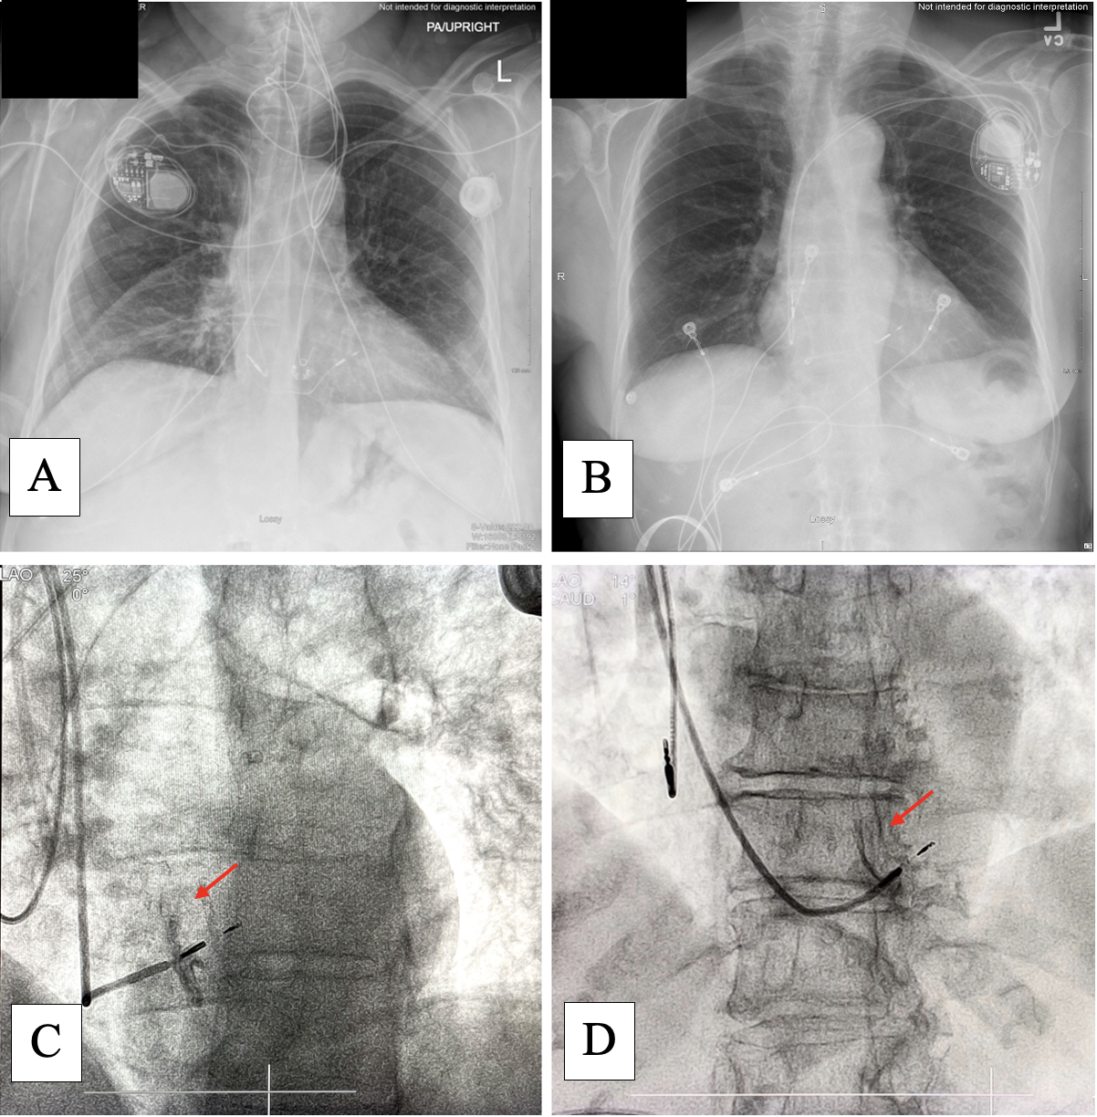
RIGHT-SIDED VS. LEFT-SIDED LEFT BUNDLE AREA LEAD IMPLANTS
Karina Demchuk, BS; Michael Orlov, MD, PhD; Ioannis Koulouridis, MD; Vybhav Jetty, MD, MHA; Roop Dutta, MD; Danylo Zorin, MD;
Artem Astsaturov, MD; Amy Hicks, RT; John Wylie, MD
Steward St. Elizabeth’s Medical Center/Tufts University School of Medicine/Boston University School of Medicine, Boston, USA
BACKGROUND
RESULTS
RESULTS (CONT.)
His bundle pacing has been challenging for right-sided (RS) access. Success rate for RS left bundle area pacing (LBAP) lead implants is unknown.
Thirty-one patients had RS implants and 214 were LS. Medtronic C315™ sheaths were used in all implants. Procedural and pacing characteristics between the RS and the LS implants were comparable and excellent with high success rates for left bundle area pacing in both groups.
No acute lead dislodgment were seen in the RS group. In the LS group, 5 (2%) patients had an acute lead dislodgement. No other procedural complications were found in either group.
One RS patient had revision surgery due to a micro-dislodgement which caused loss of left bundle capture. Twelve LS patients had revision surgery (5 left bundle lead dislodgements, 4 atrial lead dislodgements, 1 battery depletion, 1 upgrade to an ICD, and 1 pocket hematoma drainage).
Patients were followed in the outpatient clinics at routine intervals. There was no difference in chronic pacing characteristics between the RS and LS groups.
Figure: Top row displays X-rays after successful implantations. Bottom row shows angiograms taken during the procedures.
OBJECTIVE
To explore the feasibility and safety of RS implants compared to left-sided (LS) implants and any differences in techniques and to compare pacing parameters acutely and chronically.
METHODS
Procedural and pacing characteristics and electrophysiology parameters in 245 patients who underwent LBAP at SSEMC were extracted from medical records.
No special procedural or tool modifications were applied during the RS procedures.
Data on RS implants were compared to LS.
Anatomical implant failure was defined as inability to advance the lead into the septum.
Electrophysiologic failure was defined as QRS > 130 msec and/or left ventricular activation time > 90 msec.
Table: Procedural and pacing characteristics in patients with right-sided vs. left-sided direct conduction system pacemaker implantation.
 | Right-sided n = 31 | Left-sided n = 214
Anatomic failure | 0% | 2%
Electrophysiological failure | 13% | 11%
Capture threshold, Volts | 0.5 [0.3] | 0.5 [0.3]
QRS width, msec | 119 [15] | 114 [12]
Ventricular activation time, msec | 75 [18] | 78 [11]
Procedure time, min | 70 [29] | 80 [37]
Fluoroscopy time, min | 8.7 [5.6] | 8.0 [5.9]
Revision surgery | 3% | 6%
Binary variables described as percentage. Continuous variables are given as median [interquartile range].
A and C belong to an RS group patient, while B and D belong to a patient from the LS group.
CONCLUSIONS
RS LBAP is highly successful and comparable to the LS access.
Sheath modification is not required for RS approach.
Acute and chronic pacing characteristics between both anatomical approaches are similar.
Notes:
Hello! My name is Karina Demchuk. I am Dr. Michael Orlov's research assistant. I work in the cardiology department at Steward St. Elizabeth's medical center. And today I will be discussing RS vs LS Left bundle area lead implants.

Slide 2
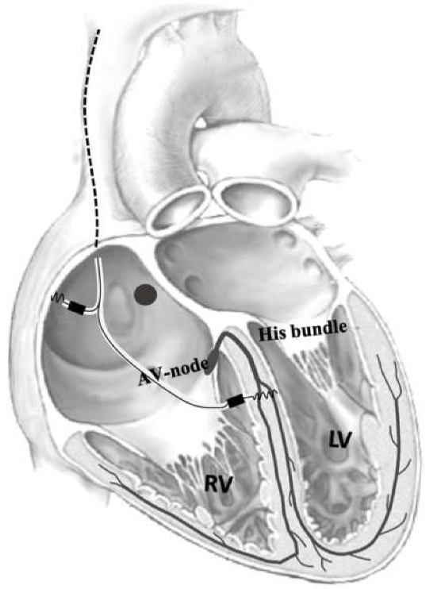
BACKGROUND
Conduction system pacing
  Symptomatic bradycardia
  Cardiac resynchronization therapy
Older technique: His bundle pacing (HBP)
  Rising thresholds
Newer technique: Left bundle area pacing (LBAP)
  Wider target site
  Direct pacing capture = narrow paced QRS
  Lower procedure and fluoroscopy times
  Higher success rate
  Consistent lead parameters
Image: https://www.mdpi.com/2077-0383/10/4/822
Notes:
Before I jump into my project, I would like to take a moment to familiarize you with Conduction system pacing. This is a technique that involves implanting permanent pacing leads along different sites of the cardiac conduction system.
Conduction system pacing has been rapidly gaining popularity for treating patients with sympt. brady. and for patients requiring cardiac resynchronization therapy.
HBP is an older pacing technique, which has been replaced with LBAP. LBAP have higher success rates. This is because the LBA is a wider target site which allows for direct capture causing a narrow paced QRS. The resulting pacing parameters are consistent throughout, unlike HBP where there have been threshold rises. Also, LBAP procedures has lower procedure and fluoro times.

Slide 3
BACKGROUND
Typically, HBP and LBAP are preformed via a left-sided (LS) approach
One study¹ reported a right-sided (RS) approach for HBP
  Procedural/tool modifications were applied
    Acute lead dislodgements still occurred
Concluded that HBP has been challenging for RS access
One case report² demonstrated the efficacy of RS access with tool modification
Currently, the success rate for RS LBAP lead implants is unknown
Notes:
One study (ref) reported a right-sided (RS) approach for HBP with delivery sheaths originally crafted for LS approach
- delivery sheath required manual modifications and distinct manipulation
Typically, HBP and LBAP are preformed via the LS approach. Meaning the pacemaker or icd is implant on the patients left side.
There is one study reported on a RS approach for HBP. This study explained that their operators made modifications during the procedure to access the target site. however even with modifications, acute lead dislodgements still occurred. Therefore it was concluded that using the RS approach for HBP is challenging.
For LBAP, there are no known studies that mention the success rate for RS approach. However, there is a case report of an anatomically complex case that resulted in the operators using a RS approach for LBAP. In their report they mentioned modifying their tool during the procedure.
When it comes to RS access for LBAP in bigger studies, the success rate is unknown.

Slide 4
OBJECTIVES
To explore the feasibility and safety of RS implants compared to left-sided (LS) implants and any differences in techniques.
To compare pacing parameters acutely and chronically.
Notes:
Now, this is where my projects comes into play. the objectives for the study are
OBJECTIVES
1) Explore feasibility (easiness) and safety of RS implants
2) See if there are any differences in techniques (Does RS approach deviate from LB LBAP? Do we need to make procedural/tool modifications like with HBP?)
3) Evaluate/compare stability of chronic (6- and 12-month) pacing parameters for LS and RS LBAP procedures

Slide 5
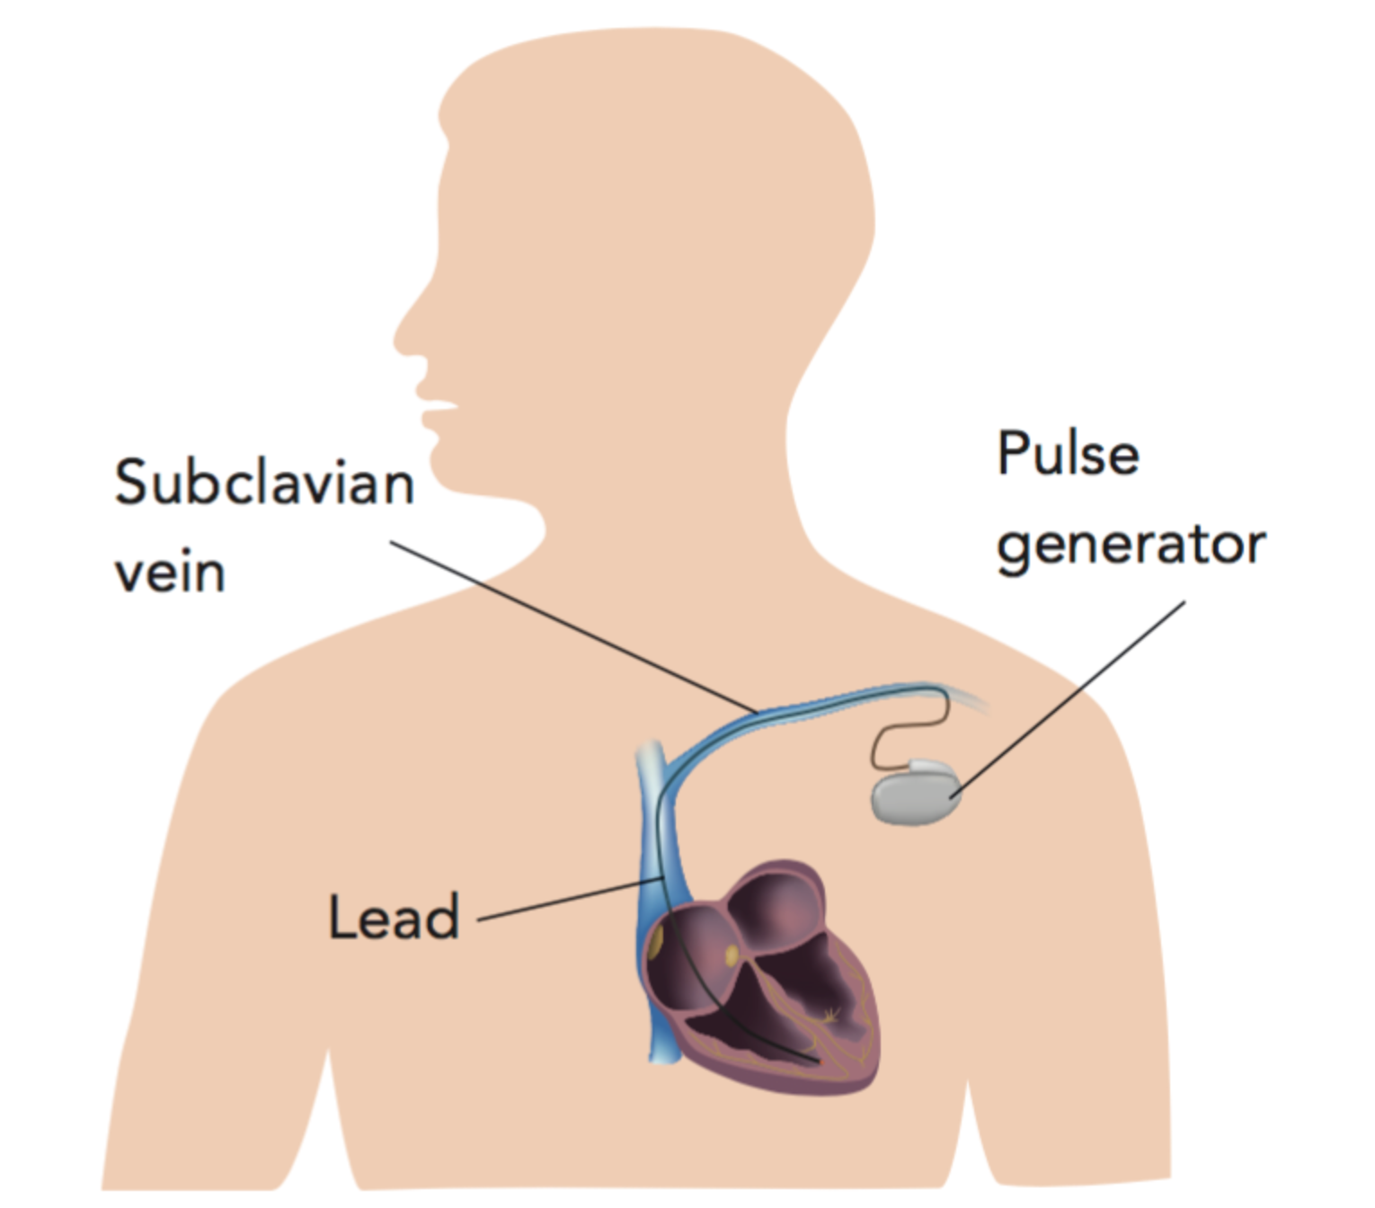
METHODS
Implant Procedure
Confirm right or left approach for implantation
Venous access was obtained through the left or right subclavian veins/tributaries
Medtronic 3830 pacing lead delivered using the Medtronic C315™ sheath
  NO MODIFICATIONS
Sheath manipulated through the tricuspid valve and towards the RV septum
Unipolar pacing from both the tip and the ring
Contrast injection was used to confirm lead location and depth
  Impedance-approach³
Image: https://blog.teleme.co/2019/09/13/pacemaker-insertion-for-the-heart/
Notes:
While this was is a restrospective analysis, I would still like to go over the implantation process for LBAP.
So to start off, the operator meets with the patient and confirms a RS or LS approach. Some reasons for RS aproaches would include if the patient is left handed or if there is an infection where the device was on the left side.
Next, during the procedure, the operator would obtain venous access on the left or right side. Then a Medtronic 3830 pacing lead in a delivery sheath would be manuvered towards the right ventricular septum.
While the operator is looking for the best spot for the lead, they are pacing from the tip and ring which helps the operator monitor the lead progression and depth within the septum.
Finally, in most of the cases here, contrast was injected to confirm the location and depth of the lead. Later, when operators became more familiar with the procedure, they monitored impedance to check the depth of the lead

Slide 6
METHODS
This is a retrospective analysis
LBAP procedures between October 2019 and December 2021
  245 consecutive patients
Procedural and pacing characteristics and electrophysiology parameters were extracted from medical records
Data on RS implants were compared to LS
  Anatomical implant failure was defined as inability to advance the lead into the septum
  Electrophysiologic failure was defined as QRS > 130 msec and/or left ventricular activation time > 90 msec
Notes:
METHODS
Data Collection
- Patients’ demographic characteristics, pacing indications, clinical and ECG parameters
- Procedural characteristics (paced QRS (depolarization of R/L ventricles and contraction of the ventricular muscles), VAT (ventricular conduction time from His to lower part of heart), thresholds (the minimum amount of energy required for the pacemaker to cause the cardiac muscle to depolarize), impedance (ratio of voltage to current), procedure/fluoro times, etc) – DID ANYTHING HAPPPEN DURING THE SURGERY? WERE THERE ANY MODIFICATIONS MADE?
- Chronic pacing characteristics
Data Analysis
- Anatomical failure = acute dislodgements (inability to advance the lead into the septum) or contrast/fluoro and xray (figure)
- Electrophysiologic failue = unsuccessful LBAP (table)

Slide 7
RESULTS
PROCEDURE INFORMATION
31 patients had RS implants and 214 were LS.
  Medtronic C315™ sheaths were used in all implants.
Procedural and pacing characteristics between the RS and the LS implants were comparable and excellent with high success rates for LBAP in both groups
Acute lead dislodgment:
  NONE in the RS group
  5 (2%) patients from the LS group
No other procedural complications were found in either group.

Slide 8
RESULTS
 | Right-sided n = 31 | Left-sided n = 214
Anatomic failure | 0% | 2%
Electrophysiological failure | 13% | 11%
Capture threshold, Volts | 0.5 [0.3] | 0.5 [0.3]
QRS width, msec | 119 [15] | 114 [12]
Ventricular activation time, msec | 75 [18] | 78 [11]
Procedure time, min | 70 [29] | 80 [37]
Fluoroscopy time, min | 8.7 [5.6] | 8.0 [5.9]
Revision surgery | 3% | 6%
Binary variables described as percentage. Continuous variables are given as median [interquartile range].
Notes:
Table: Procedural and pacing characteristics in patients with right-sided vs. left-sided direct conduction system pacemaker implantation.
This table compares procedural and pacing characteristics for the RS and LS groups in this study

Slide 9
RESULTS
Notes:
Figure: Top row displays X-rays after successful implantations. Bottom row shows angiograms taken during the procedures.
A and C belong to an RS group patient, while B and D belong to a patient from the LS group.
Top row: Chest X-rays of successful RS (A) and LS (B) cases.
Bottom row: Still frames from contrast cine angiograms in 25° (C) and 14° (D) LAO view. The red arrows point towards the contrast opacification when confirming the LB lead depth and placement within the septum. Both leads demonstrate category D depth. Abbreviations: LAO = left anterior oblique.

Slide 10
RESULTS
POST-PROCEDURE INFORMATION
Revision surgery
  1 RS patient
    Micro-dislodgement which caused loss of left bundle capture.
  12 LS patients
    5 left bundle lead dislodgements
    4 atrial lead dislodgements
    1 battery depletion
    1 upgrade to an ICD
    1 pocket hematoma drainage
Patients were followed in the outpatient clinics at routine intervals
  No difference in chronic pacing characteristics between the RS and LS groups
Notes:
RESULTS
- The demographic and procedural characteristics were comparable for both RS and LS groups
- Sheath modification was not required in any patient
- E. failure = other type of pacing is performed depending on patients’ indications/needs
- battery depletion = overworked pacemaker, needs an update/adjustment
-ICD = patient needs cardiac resynchronization therapy (ICD) due to worsening heart failure = protection from having/getting abnormal heart rhytm
When monitoring the cohort chronically, we foudn that 13/245 needed revision surgery.

Slide 11
CONCLUSIONS
RS LBAP is highly successful and comparable to the LS access.
Sheath modification is not required for RS approach.
Acute and chronic pacing characteristics between both anatomical approaches are similar.

Slide 12
REFERENCES
Vijayaraman P, Ellenbogen KA. Approach to permanent His bundle pacing in challenging implants. Heart Rhythm 2018;15:1428-1431.
Prolič Kalinšek T, Žižek D. Right-sided approach to left bundle branch area pacing combined with atrioventricular node ablation in a patient with persistent left superior vena cava and left bundle branch block: a case report. BMC Cardiovasc Disord 2022;22:467.
Orlov MV, Nikolaychuk M, Koulouridis I, et al. Left bundle area pacing: Guiding implant depth by ring measurements. Heart Rhythm 2023;20:55-60.
Notes:
Before ending, I would like to thank all of the participating medical staff -- including nurses, techs, fellows, and attendings for making this restrospective study possible. Also, I would like to thank CTSI for this opportunity to present our work.
If you have any questions, fee free to email me at Karina.Demchuk@steward.org.
Thank you all for listening. Bye!

