Slide 1



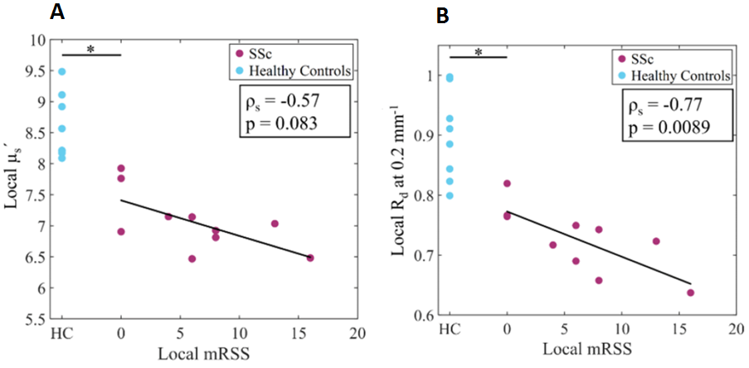
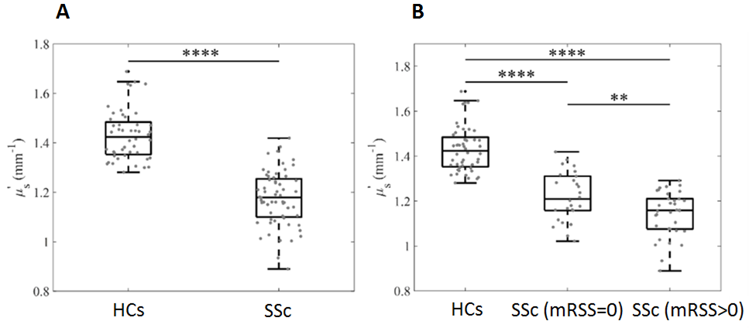
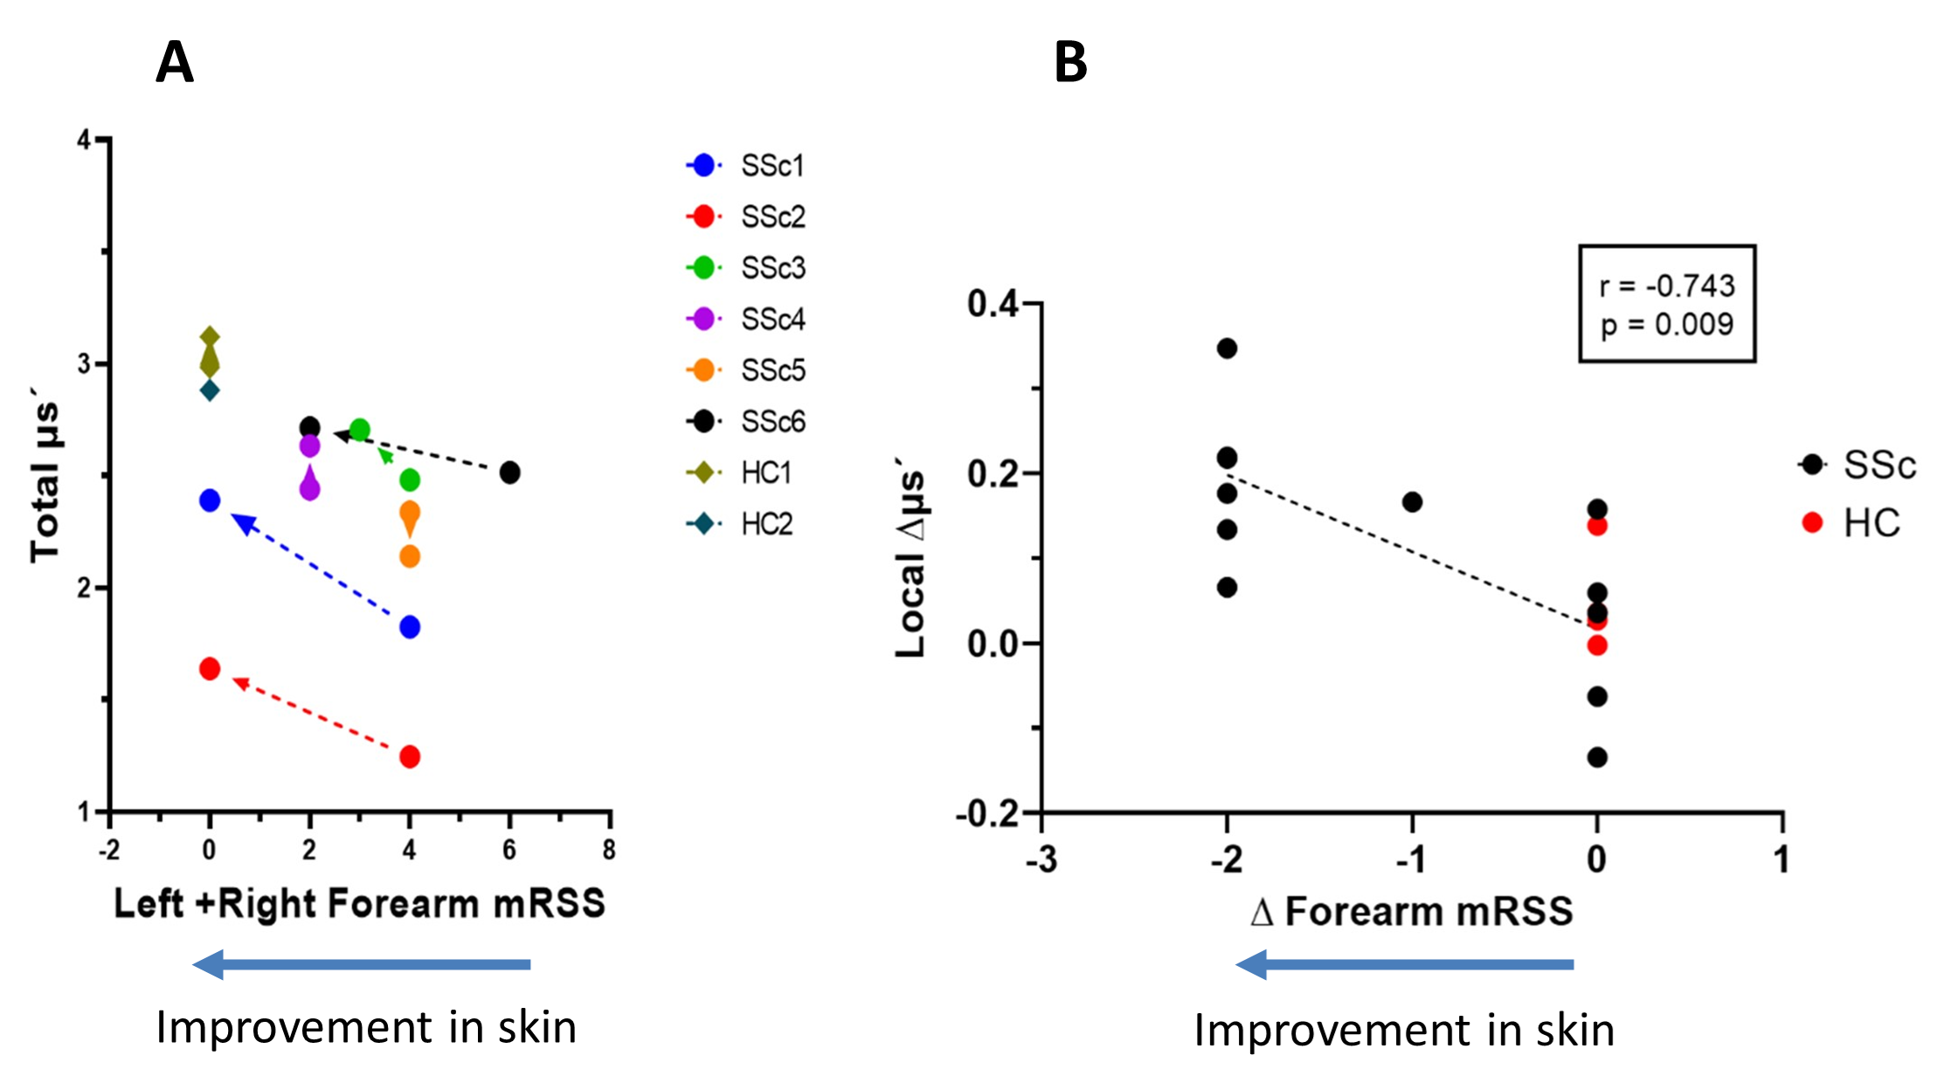
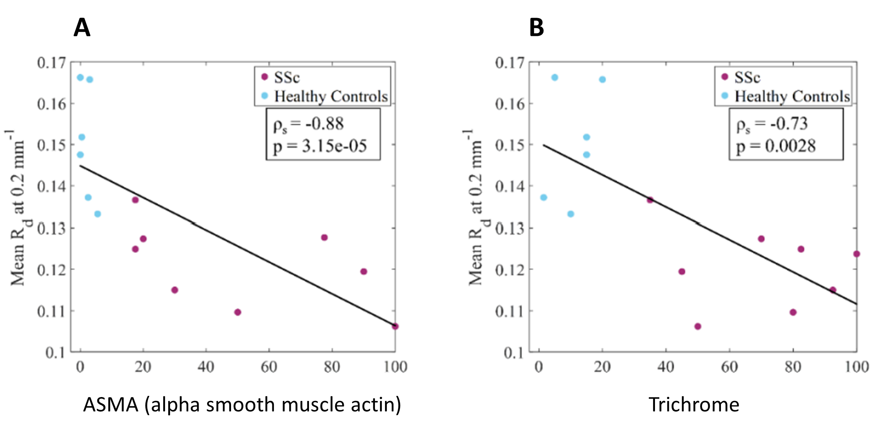
Spatial Frequency Domain Imaging as a Novel Method to Quantify Skin Changes in Scleroderma
Hung Vo MD¹; Aarohi M. Mehendale²; Anahita Pilvar², Michael York MD¹, Marcin Trojanowski MD¹, Eugene Kissin MD¹, Darren Roblyer PhD², and Andreea M. Bujor MD, PhD¹
1. Division of Rheumatology, Boston University Chobanian & Avedisian School of Medicine, Boston, MA 02118, USA
2. Department of Biomedical Engineering, Boston University, Boston, MA 02215, USA
Background
Results
SFDI correlates with mRSS
Conclusion
Systemic sclerosis (SSc) is an autoimmune disease characterized by excessive collagen deposition
Gold standard for evaluating skin fibrosis in SSc is the modified Rodnan skin score (mRSS) which has notable limitations
Spatial Frequency Domain Imaging (SFDI) is a non-invasive optical technique that can provide objective and quantitative assessment of skin fibrosis
SFDI can differentiate controls from SSc patients
Our studies suggest SFDI as a promising quantitative and objective method for scleroderma skin assessment
SFDI can differentiate early skin changes in SSc patients with an mRSS of 0 from those observed in healthy controls
SFDI measurements exhibit a significant correlation with both mRSS and histology scores
SFDI can detect longitudinal skin changes in SSc patients
Objective
Figure 2 – Correlation of SFDI reduced scattering (μs’) and diffuse reflectance (Rd) with mRSS A) Correlation between the local µs´ and local mRSS in SSc. B) Correlation between local Rd and local mRSS . The local values were calculated by adding the SFDI or mRSS parameters from all 6 measurement sites. Star * shows significant difference between SSc and controls (A and B).
Figure 1 – Association between SFDI reduced scattering (μs’) and mRSS A) µs´ difference between healthy controls and SSc patient. B) µs´ difference between healthy controls, SSc skin with (mRSS = 0, and SSc skin with fibrosis (mRSS > 0). ****p < 0.0001, **p ≤ 0.01.
To correlate SFDI with mRSS and histology scores and evaluate its use in detecting longitudinal skin changes in SSc patients
Future Works
Methodology
SFDI correlates with histological markers of fibrosis
SFDI can track longitudinal changes in SSc skin
Validate SFDI in a larger cohort with more enrolled patients
Refine our protocol to enhance sensitivity for assessing skin changes in arms, hands, and fingers
Create a portable handheld device for easier imaging acquisition
Cross-sectional SFDI data and mRSS were collected at six measurement sites (left/right forearms, hands, and fingers) from 8 healthy controls (HCs) and 10 SSc patients. A forearm skin biopsy was obtained after SFDI data and mRSS were obtained. Longitudinal forearm measurements were also obtained at subsequent time points for 6 SSc and 2 control patients. Wilcoxon rank sum tests and Wilcoxon signed rank tests were used to investigate differences in SFDI parameters between groups of HCs and SSc patients, and between SSc skin regions with mRSS = 0 and regions with mRSS > 0, respectively. Spearman was used to calculate correlation. A p-value < 0.05 was considered statistically significant
Acknowledgements
Funding sources: ARC BU – connecting tissues and investigators (Fibrosis in Pathology), Scleroderma Clinical Trials Consortium, National Scleroderma Foundation Established Investigator Award
Figure 3 – Correlation between SFDI diffuse reflectance (Rd) and histology scores for skin fibrosis A) Correlation between Rd and ASMA (a histological marker of activated fibroblasts). B) Correlation between Rd and Trichrome staining (a histological marker for collagen deposition).
Figure 4 – Longitudinal measurements of SSc versus Healthy controls A) Trajectory of total μs' and total mRSS (sum of left and R forearms) from t1 to t2 in each individual patient. B) Correlation between the longitudinal change (t2-t1) in μs' at each forearm and the corresponding change in mRSS at the same t1-time of first measurements, t2-time of second measurements
Notes:
83% of SSc patients were females, with a mean age of 44 ± 18.4 years
Mean disease duration was 4.3 ± 2.6 years and mean follow up interval between measurements was 23 months ± 4.8 months
µs´ difference between healthy controls, SSc patient at locations where there is no skin fibrosis (mRSS = 0), and SSc patients at measurement sites with skin fibrosis (mRSS > 0)

