Slide 1



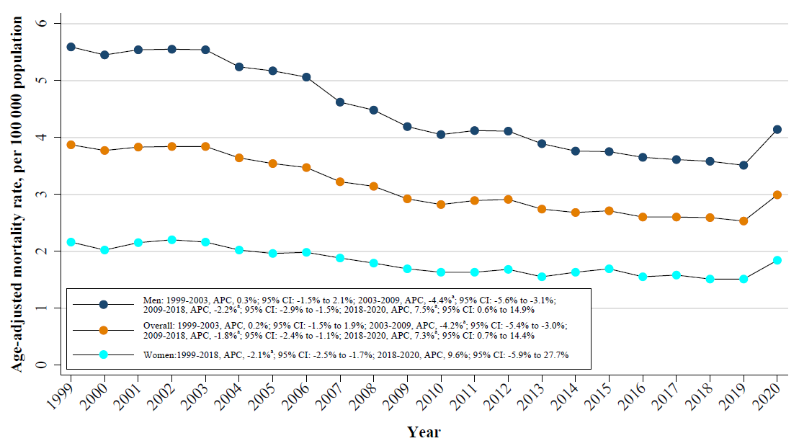
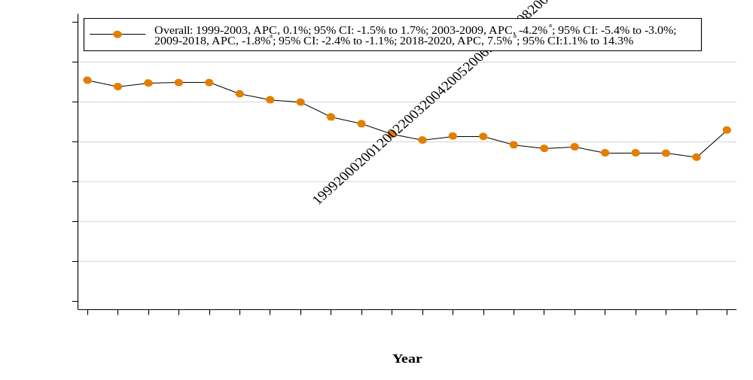
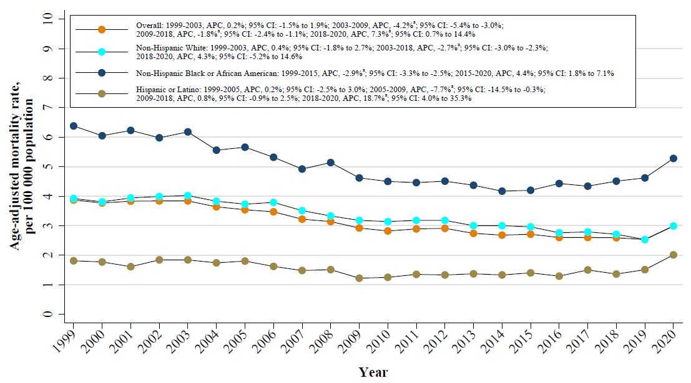
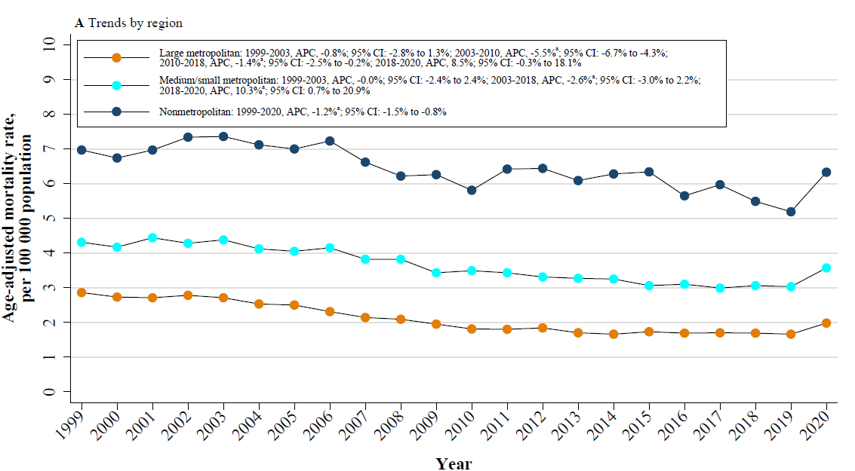
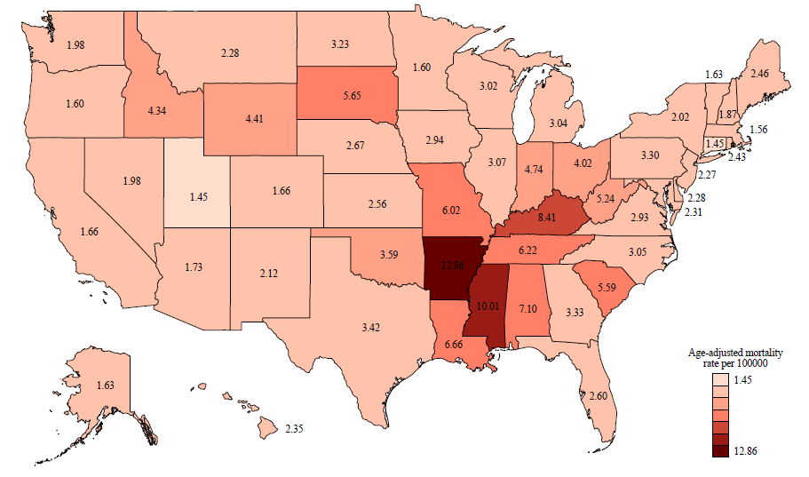
Demographic and Regional Trends of Acute Myocardial Infarction-Related Mortality in Young Adults in the United States, 1999-2020
Frank Qian,¹ Haibin Li^{2,3}
¹Section of Cardiovascular Medicine, Department of Medicine, Boston Medical Center and Boston University Chobanian & Avedisian School of Medicine, Boston, MA, USA
²Department of Cardiac Surgery, Beijing Chaoyang Hospital, Capital Medical University, Beijing, China
³Heart Center and Beijing Key Laboratory of Hypertension, Beijing Chaoyang Hospital, Capital Medical University, Beijing, China
Background
Results
There has been a considerable reduction in deaths from acute myocardial infarction (AMI) in the middle-aged and elderly population over the past several decades, but whether AMI-mortality rates have similarly declined in the young adult population is not known
Furthermore, it is also not known whether existing disparities in AMI-related mortality rates in racial/ethnic minority groups and certain geographical regions has improved over time
Between 1999 and 2020, a total of 81,272 AMI-related deaths occurred in young adults
Of these, 23,474 (28.9%) were among women and 57,798 (71.1%) were among men
Additionally, 54,379 (66.9%) were White, 17,022 (20.9%) were Black, and 6,859 (8.4%) were Hispanic
Figure 2. Trends in acute myocardial infarction-related age-adjusted mortality rates for young adults in the United States, 1999-2020, stratified by sex.
Objective
To evaluate the AMI-related mortality trends for young adults
To characterize demographic and geographical sources of disparities in AMI-related mortality trends
To investigate whether mortality trends appreciably changed in 2020, during the beginning of the COVID pandemic
Figure 3. Trends in acute myocardial infarction-related age-adjusted mortality rates for young adults in the United States, 1999-2020, stratified by race/ethnicity.
Figure 1. Trends in acute myocardial infarction-related age-adjusted mortality rates for young adults in the United States, 1999-2020.
Methods
We used the Centers for Disease Control and Prevention’s Wide‐Ranging Online Data for Epidemiologic Research (WONDER) death certificate database, spanning the years of 1999 to 2020
Included individuals aged 15 to 44 years of age at the time of death
AMI-related mortality was determined based on death certificate review, either as a contributing or underlying cause of death, using the International Statistical Classification of Diseases and Related Health Problems-10th Revision (ICD-10) codes I21-I22
Crude and age-adjusted mortality rates (AAMR) per 100,000 persons with corresponding 95% confidence intervals (CI) and standardized to the 2000 US population
We calculated the annual percent change (APC) with 95% CI in AAMR using the Joinpoint Regression Program version 5.0.2 (National Cancer Institute) to assess for inflection points in mortality rates
Figure 4. Trends in acute myocardial infarction-related age-adjusted mortality rates among adults aged 15 to 44 years from 1999 to 2020 in the United State, stratified by urbanization status
Figure 5. State-specific age-adjusted acute myocardial infarction-related mortality rates, 1999-2020
Conclusions
Acknowledgments
There was a general decrease in AMI-related mortality rates for young adults from 1999 to 2019 with persistent disparities by race/ethnicity, urbanization status, and geographical region
Our study confirms prior findings of a possible uptick in AMI-related mortality in the first year of the COVID-19 pandemic
The authors declare no relevant conflicts of interest
Contact information:
          Twitter/X handle: @frankq1368
          Email: frank.qian@bmc.org
Notes:
1

