Slide 1

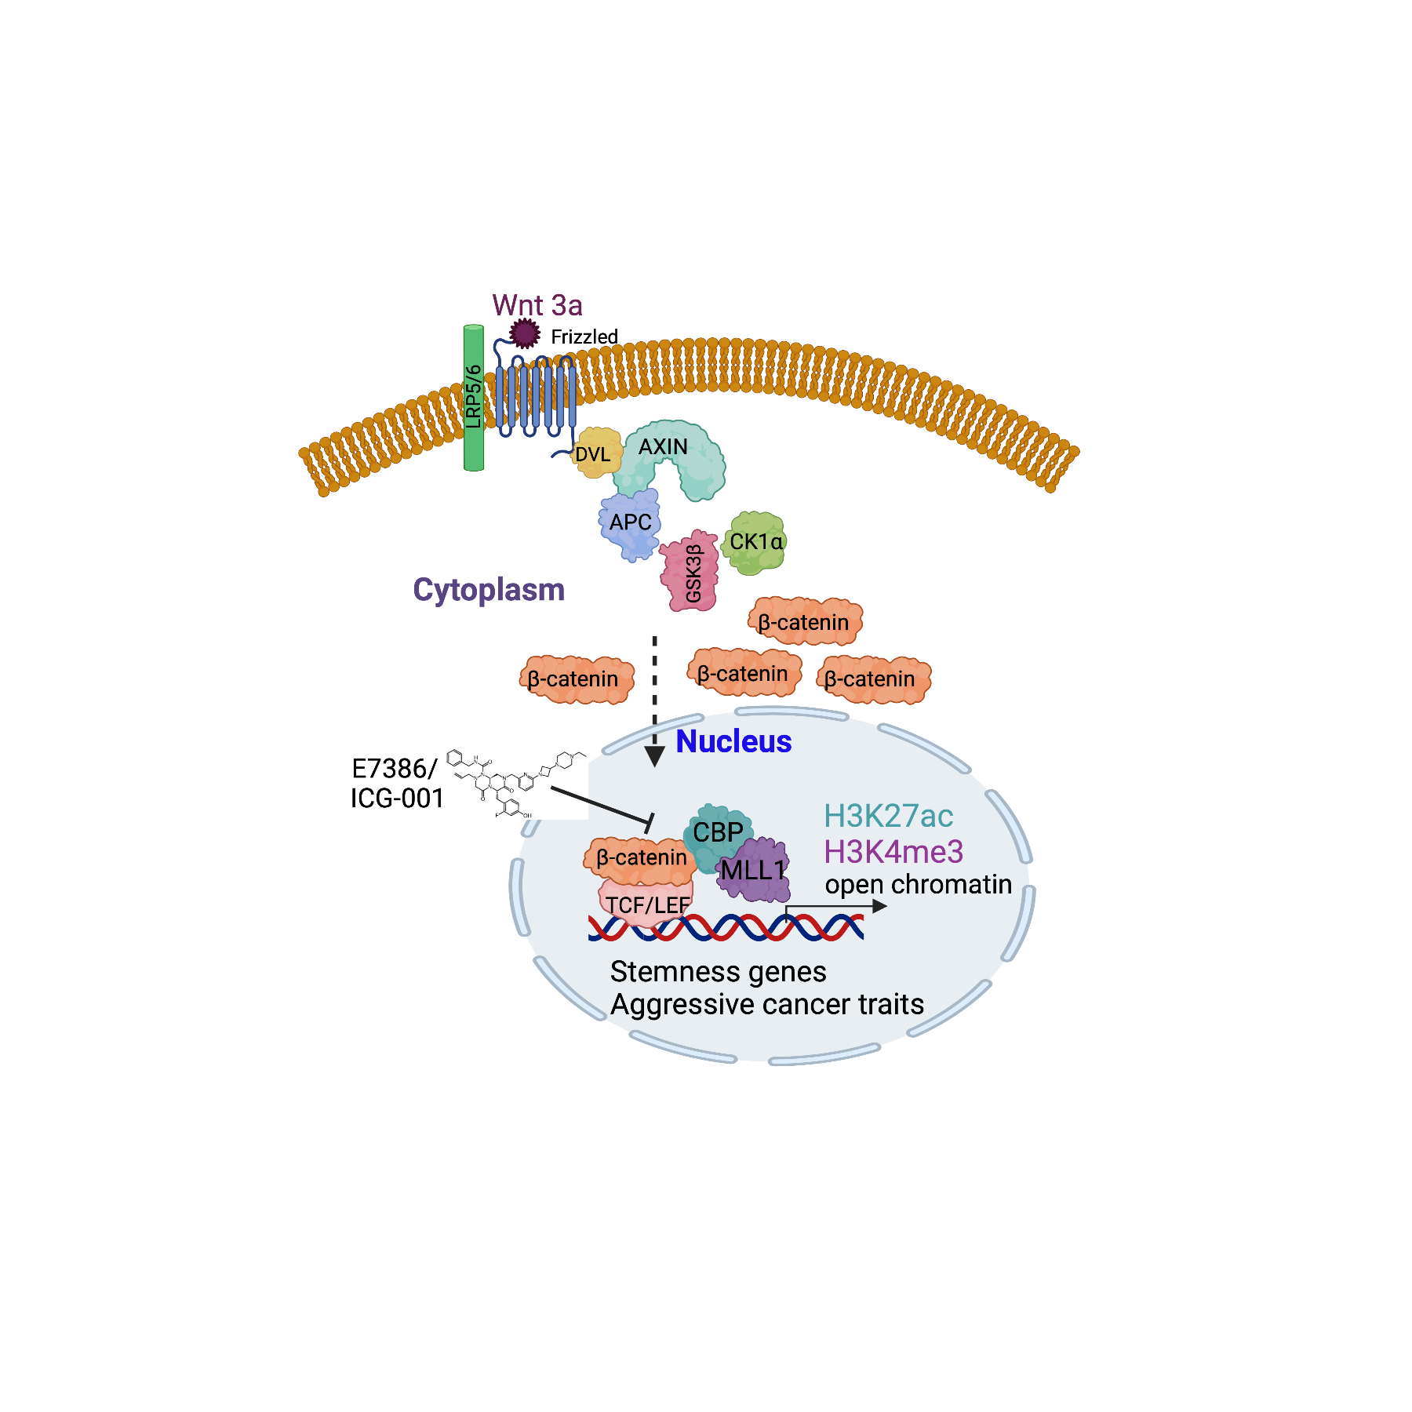
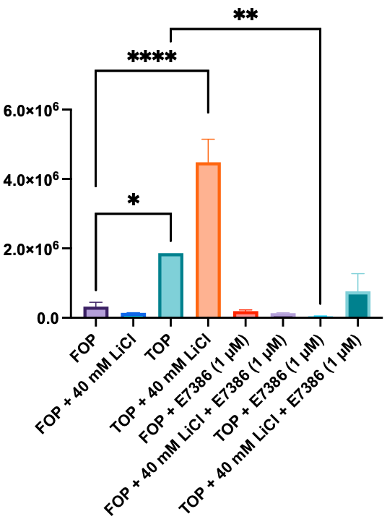
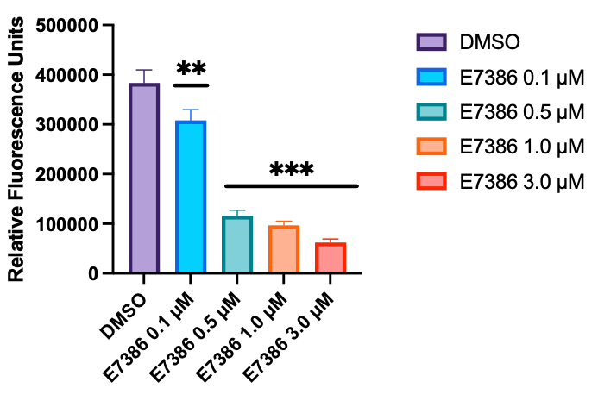
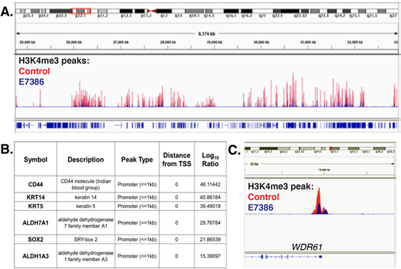
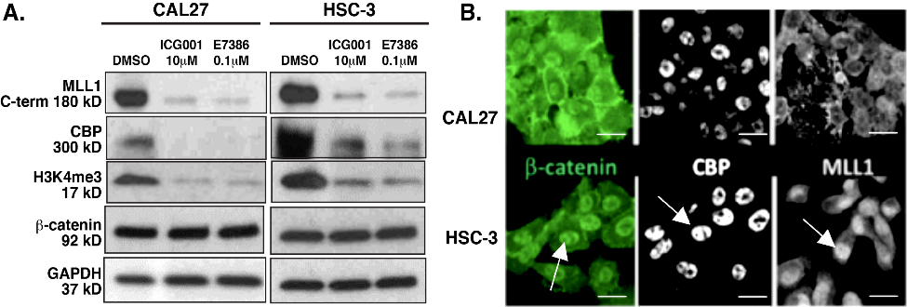
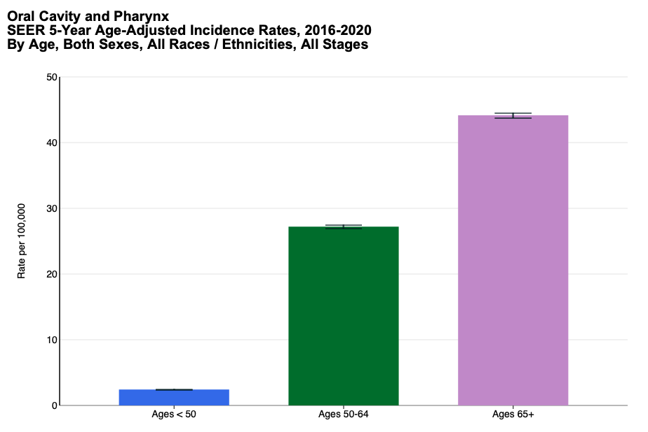
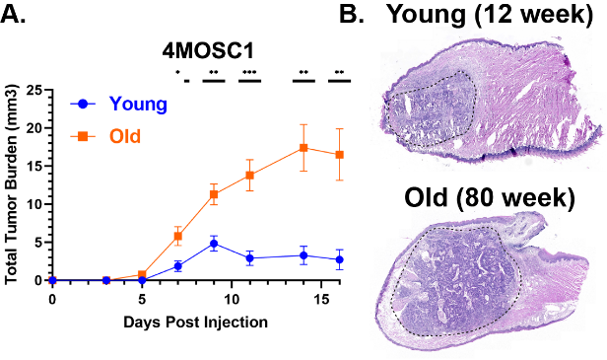
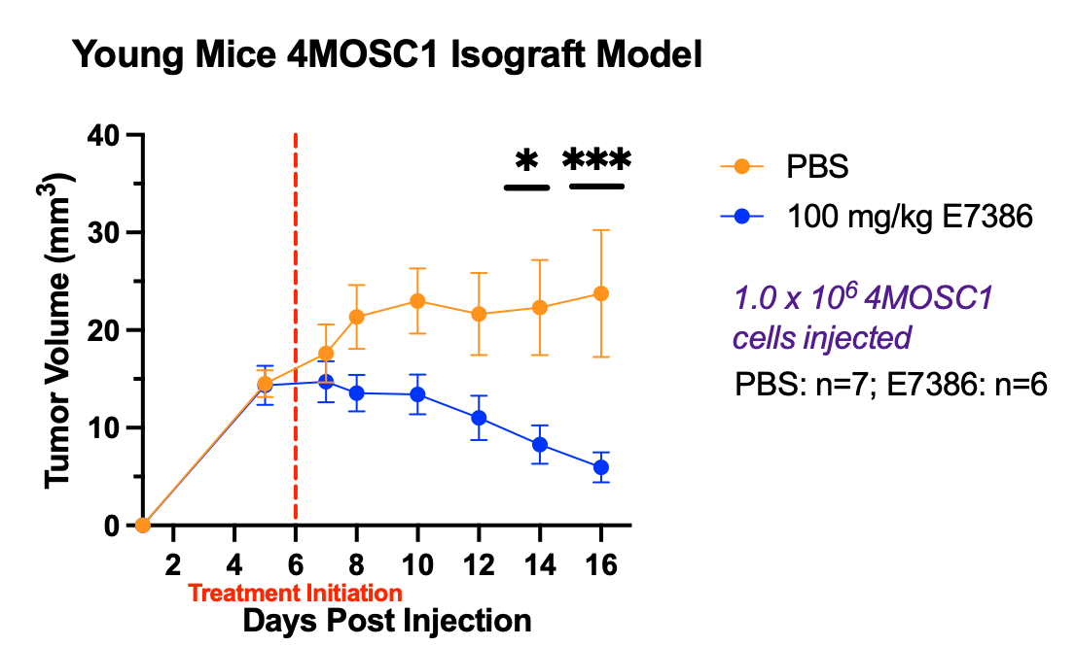
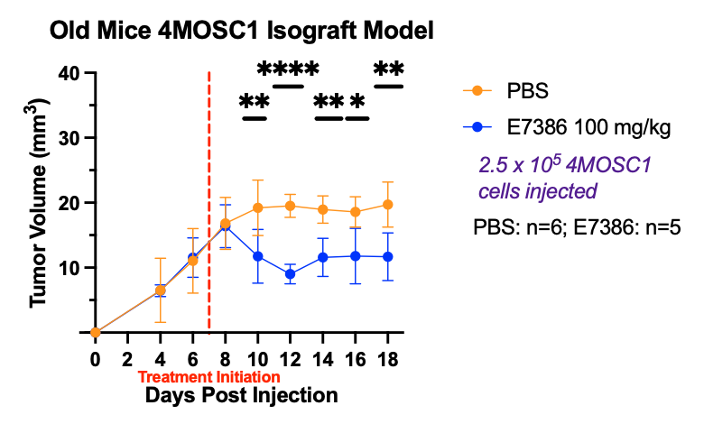

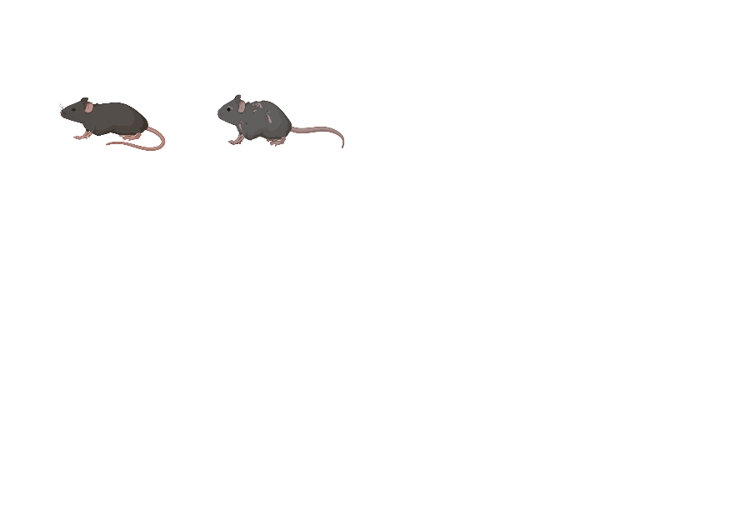

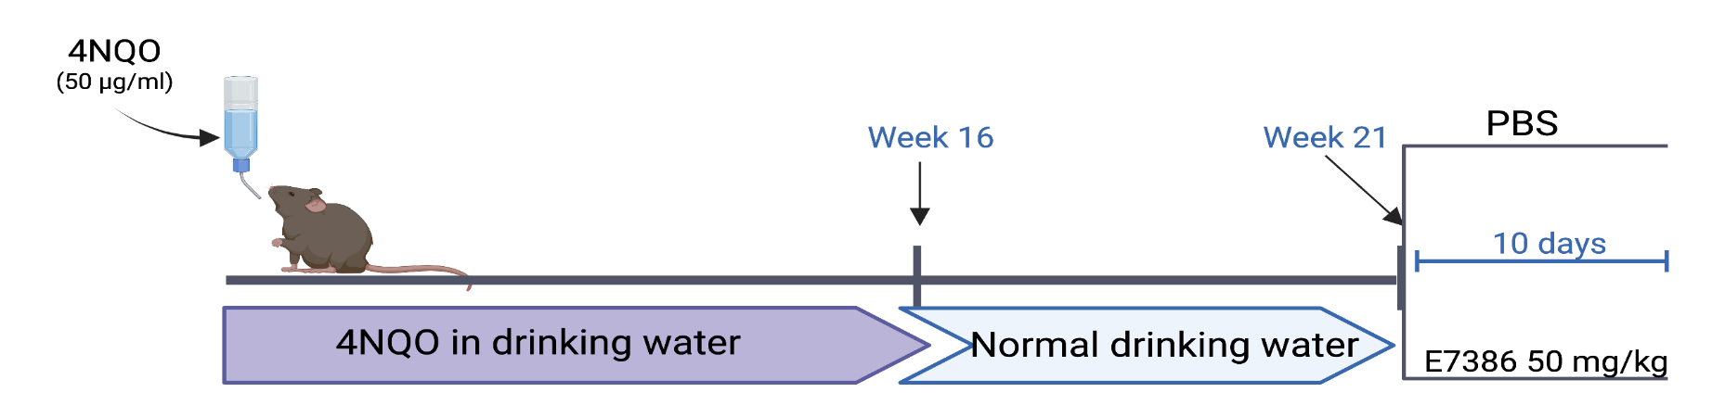
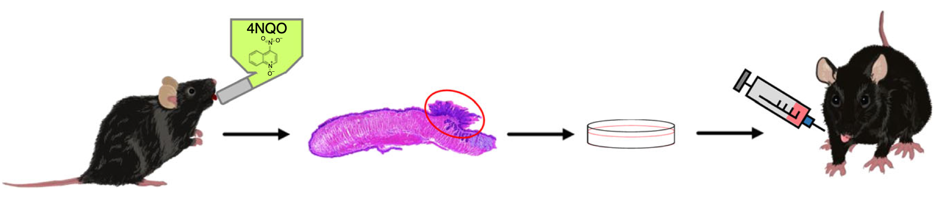
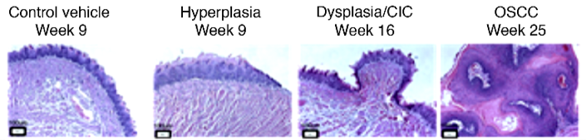
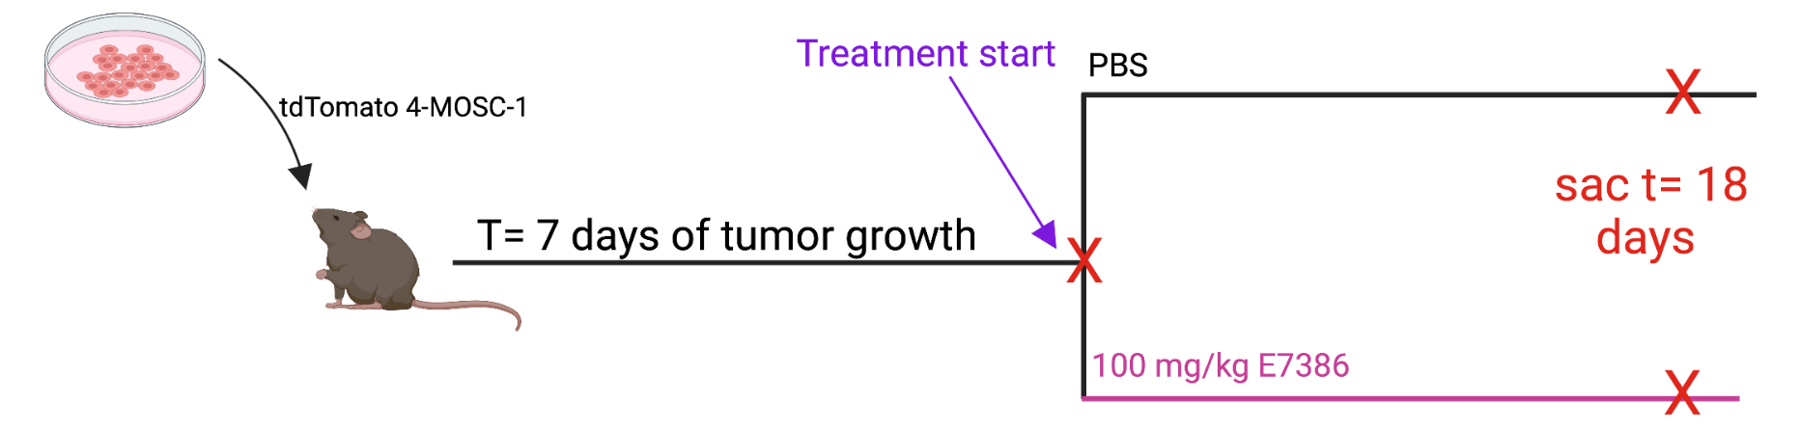
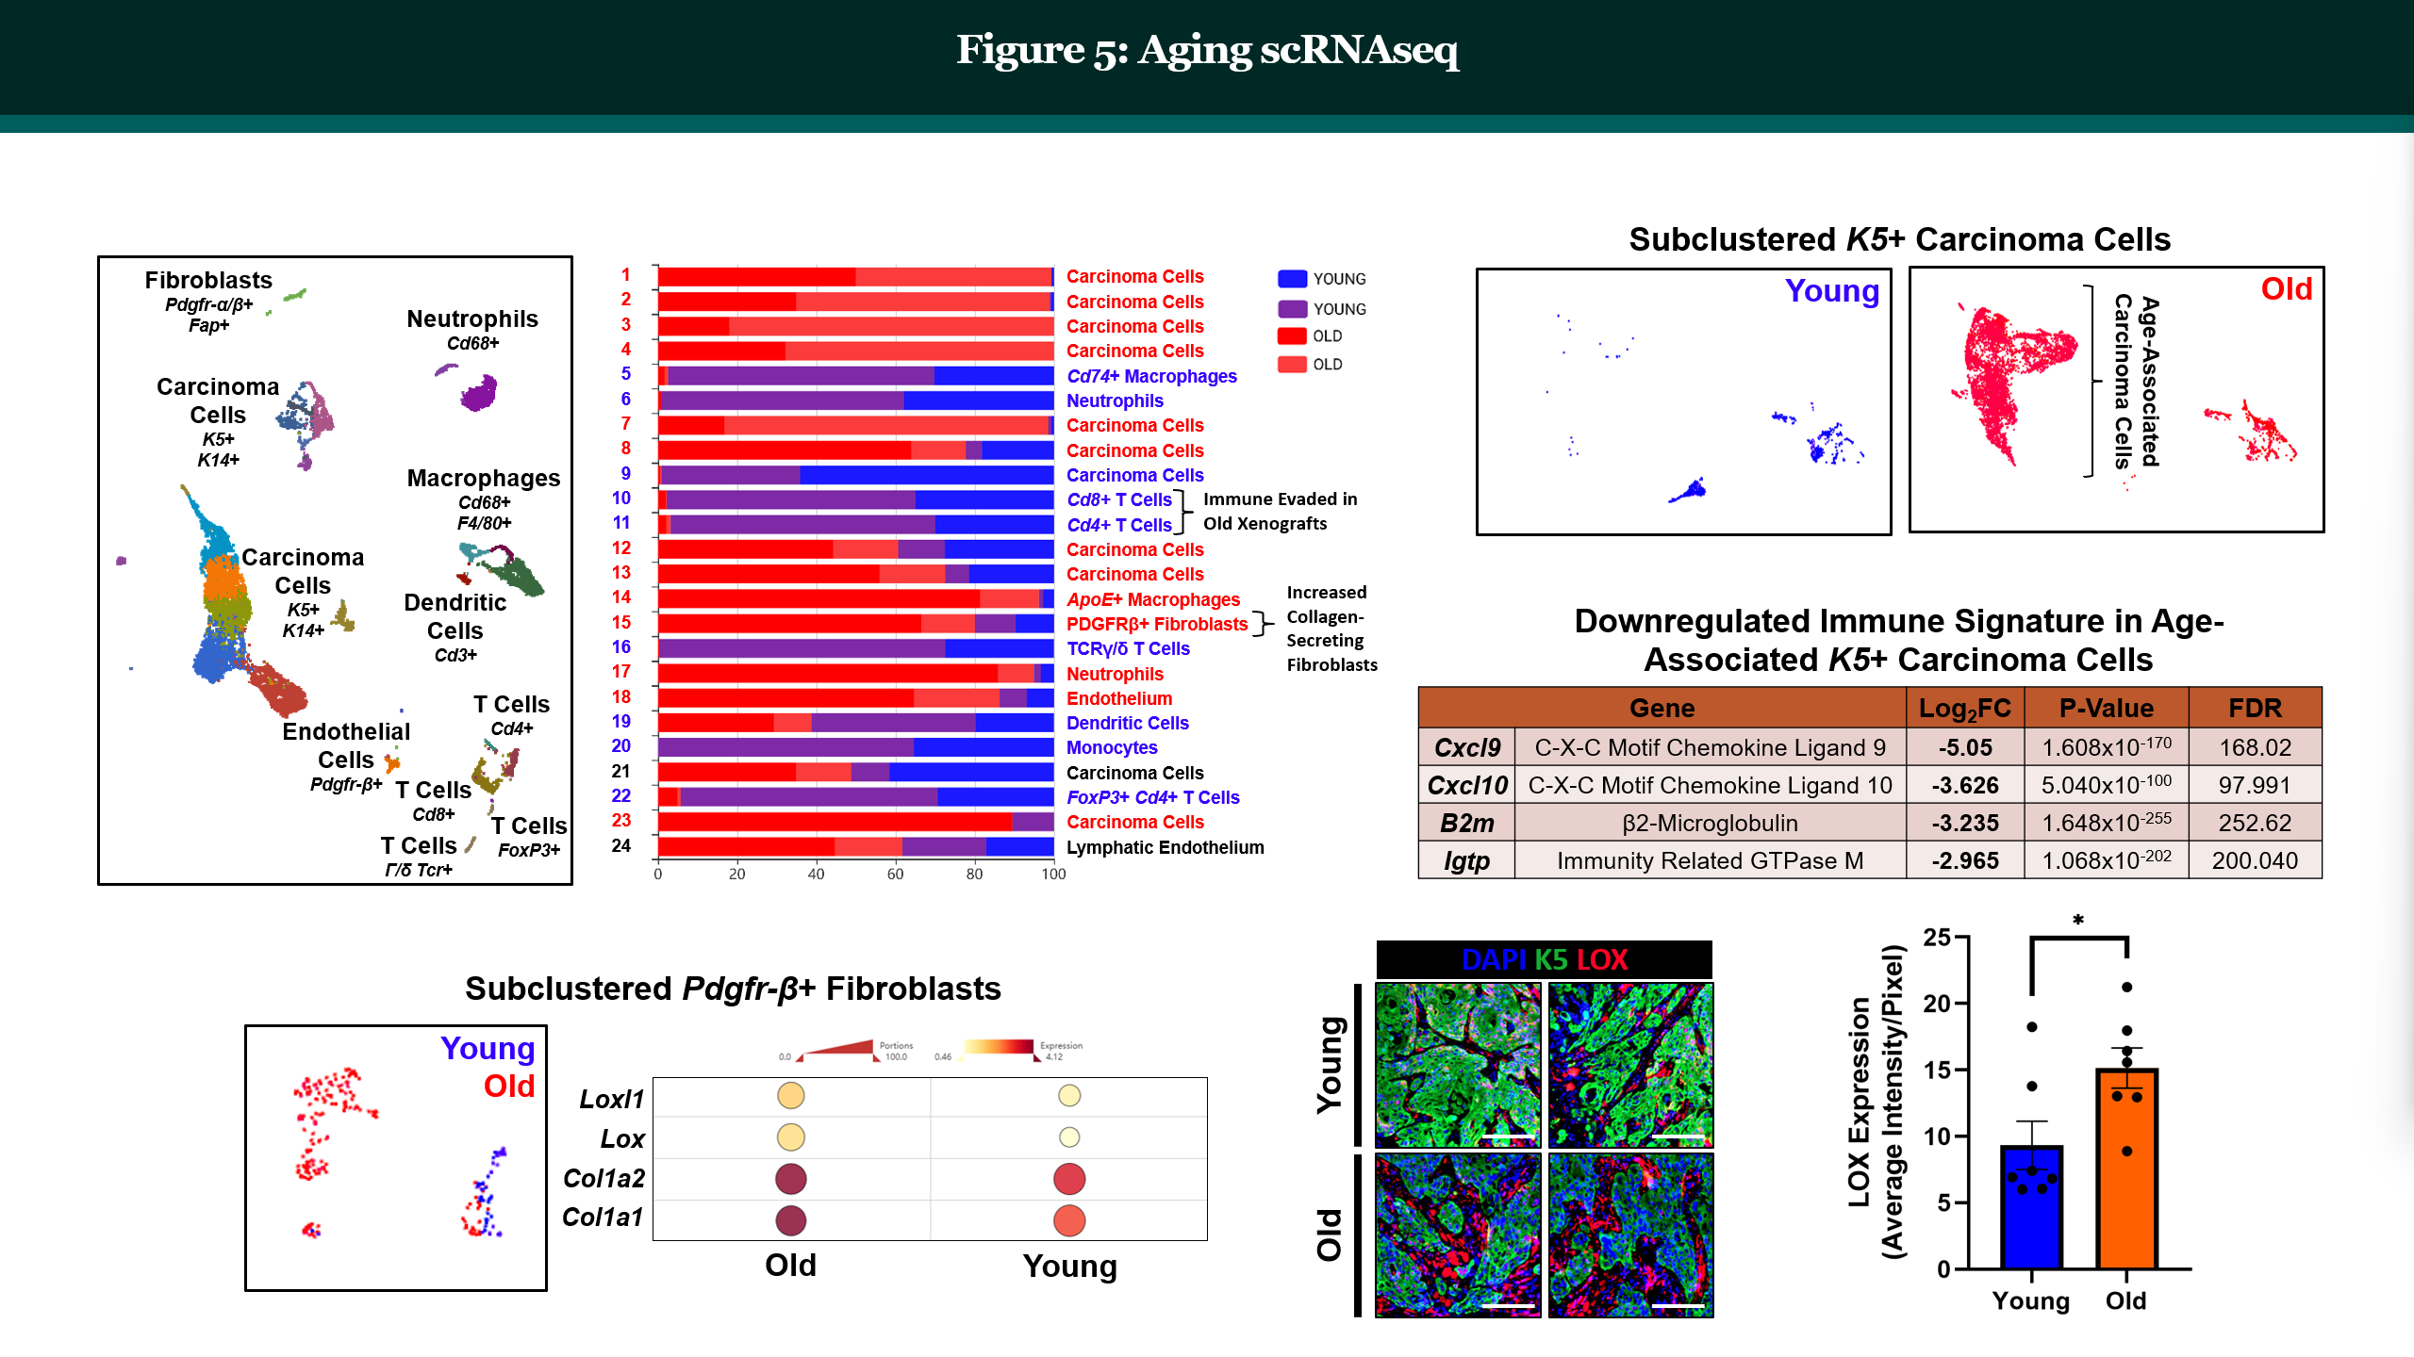
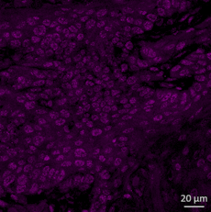
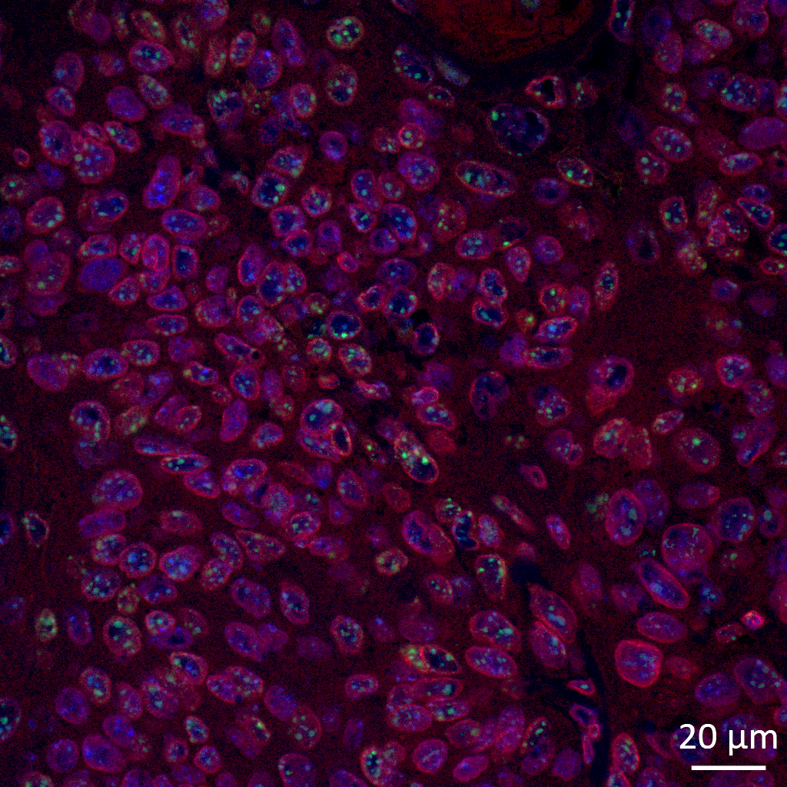
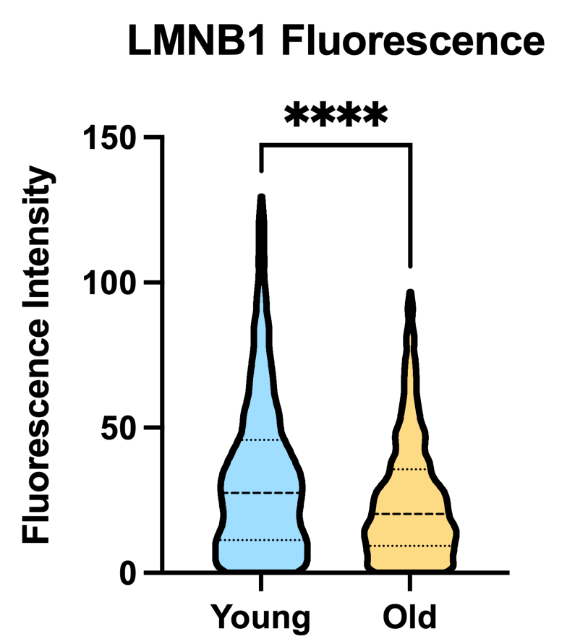
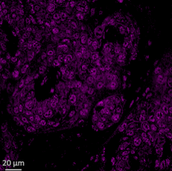
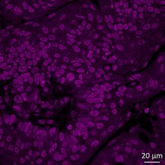
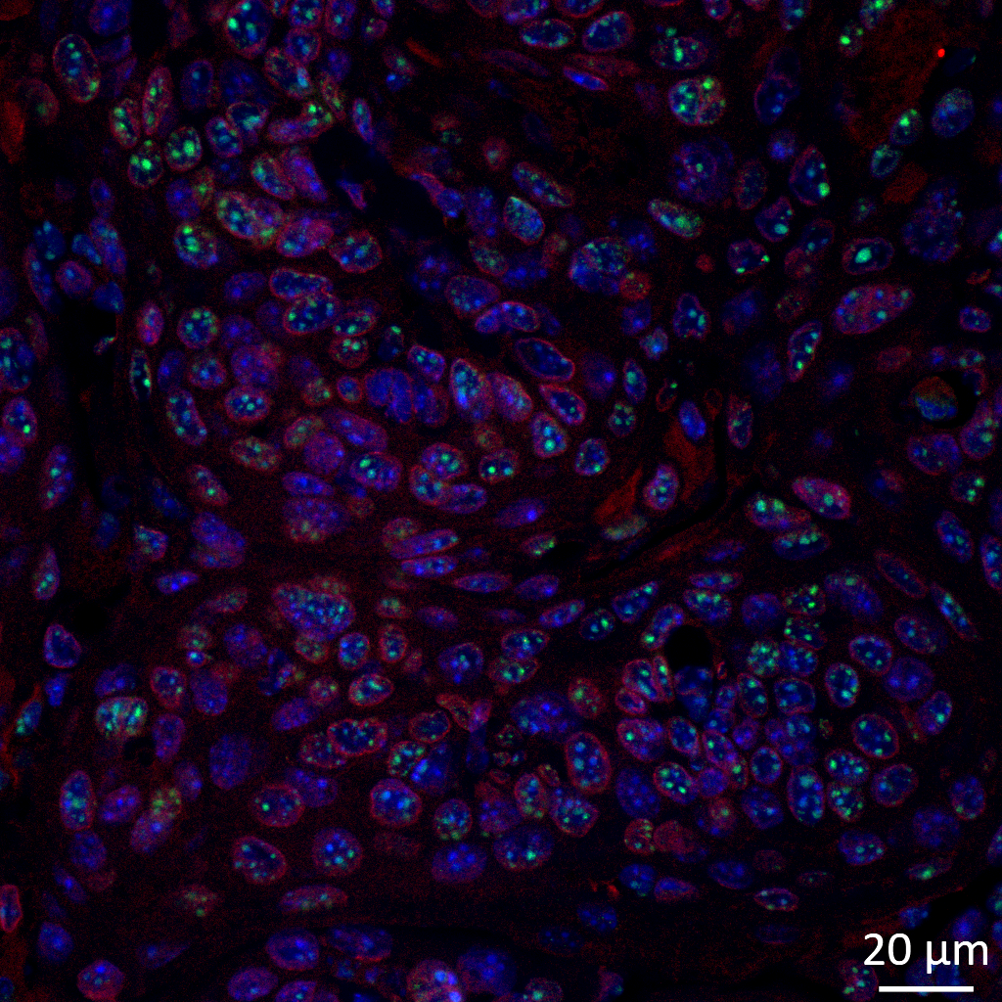
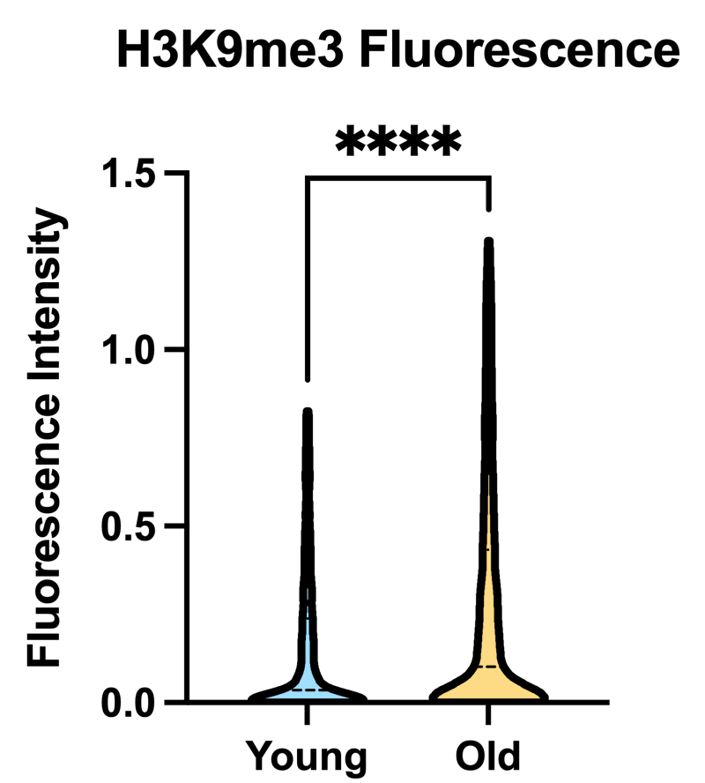
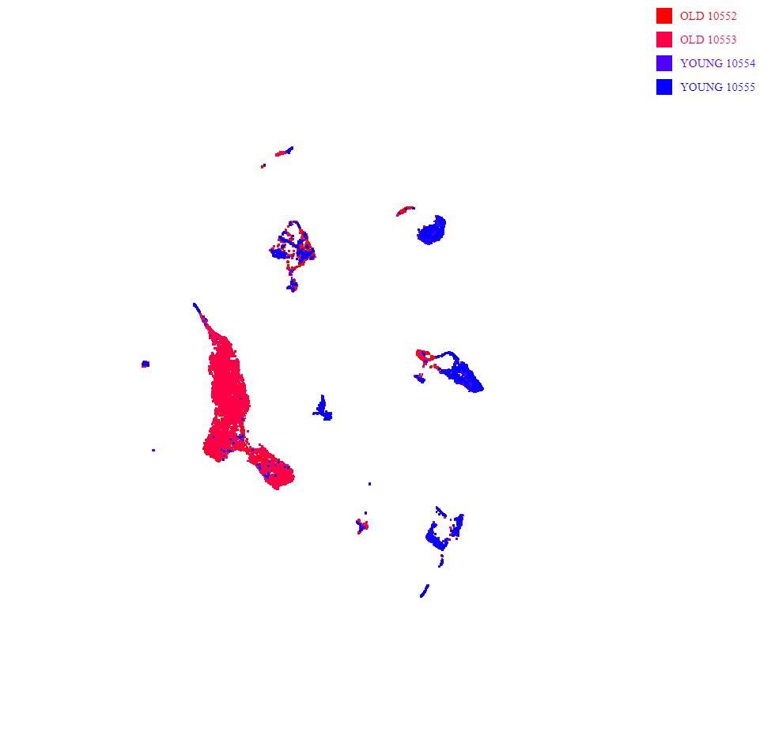

Wnt/β-Catenin Signaling Drives Age-Dependent OSCC Evolution
Emily R. Fisher¹, Anthony Spinella², Xaralabos Varelas³, Manish Bais⁴, Maria A. Kukuruzinska⁴
1. Department of Pharmacology, Boston University School of Medicine; 2. Department of Stem Cell and Regenerative Biology, Boston University School of Medicine; 3. Department of Biochemistry, Boston University School of Medicine; 4. Department of Translational Dental Medicine, Boston University School of Dental Medicine
Abstract
Results
Oral Squamous Cell Carcinoma (OSCC) is a devastating disease associated with high morbidity, poor survival, and few therapeutic options. This malignancy is driven, in part, by epigenetic reprogramming of the chromatin landscape directed by β-catenin in complex with CREB-binding protein (CBP) and mixed lineage leukemia methyltransferase 1 (MLL1). The β-catenin/CBP/MLL1 complex promotes an open chromatin structure by enabling transcription of genes associated with cell plasticity, including cancer stem cells and cells with partial EMT (p-EMT) phenotypes. Growing evidence indicates that cell plasticity and cellular senescence are integral processes shared by cancer and aging. Given that the median age of OSCC diagnosis is 66 years, it is likely that aging promotes OSCC evolution to advanced disease.
To examine the effects of aging on OSCC evolution, we adapted a syngeneic mouse model of tobacco-associated oral carcinogenesis. This model utilizes a mouse cell line, 4MOSC1, derived from 4-nitroquinoline-1 oxide- (4NQO)-induced tongue tumor which, when implanted into mouse tongues, generates tumors that recapitulate human OSCC mutanome. The growth of 4MOSC1 derived orthotopic tumors was studied in 6- and 80-week-old mice. Tumors were allowed to develop for 18 days, after which they were harvested and processed for single cell RNA sequencing, histopathology and immunofluorescence (IF) analyses.
Results showed that tumors grew at a faster rate and to a greater overall size in old mice compared to their young cohorts. OSCC harvested from the old mice displayed statistically significant reduction in membranous E-cadherin concomitant with increased Cbp and H3K4me3 abundance, suggesting an age-associated upregulation of β-catenin/Cbp/Mll1 epigenetic activity. Increased expression of Bmi1, keratin 14, and podoplanin supported increased cell plasticity in OSCC from aged mice. Further, these tumors exhibited augmented cellular senescence, as judged by the disruption of lamin B1-associated nuclear membrane integrity, and by an increased cell population with markers of senescence from single cell sequencing analyses.
These data suggest that aging is associated with increased β-catenin/Cbp/Mll1 epigenetic signaling, cell plasticity and cellular senescence, which collectively contribute to the evolution of OSCC.
1) 4MOSC1 Cells Are Dependent on Wnt Signaling
2) E7386 Promotes Epigenetic Remodeling
4MOSC1 TOP/FOP Assay
In Vitro Treatment of 4MOSC1 Cells with E7386
Luciferase Activity
Symbol | Distance from TSS | Log₁₀ Ratio
CD44 | 0 | 46.11442
KRT14 | 0 | 40.86184
KRT5 | 0 | 39.49018
ALDH7A1 | 0 | 29.76784
SOX2 | 0 | 21.86539
ALDH1A3 | 0 | 15.29097
Age & Oral Cancer Risk
(Left): Wnt reporter activity increased in TOP compared to the scrambled control (FOP vs. TOP) 4MOSC1 cells. Treatment with E7386 reduced Wnt reporter activity for all conditions
(Left): Global ChIP-seq analysis of H3K4me3 in human OSCC HSC-3 cells reveals inhibitory effects of E7386 on genes associated with stemness. (Right): Treatment with E7386 (and 2nd generation ICG-001) leads to reduced steady-state protein levels of CBP and MLL1 in human OSCC CAL27 (indolent) and HSC-3 (metastatic) cell lines.
(FOP and TOP) compared to their untreated controls. (Right): PrestoBlue Cell Viability assay showed a dose-dependent response in 4MOSC1 cell proliferation in vitro compared to control (DMSO).
3) E7386 Inhibits OSCC Tumor Growth In Vivo
Equal number of cells injected
Materials & Methods
Young C57BL/6J
Age: 6-13 wks
Aged C57BL/6J
Age: 60-65 wks
Old C57BL/6J
Age: >80 wks
2.5 x 10⁵ cells injected
4NQO-Induced Model of Oral Carcinogenesis
4NQO-induced murine oral squamous carcinoma 4MOSC1 Isograft Model
(Left): Old mice tumor isografts grow to a larger volume with faster growth kinetics compared to young mice when injected with equal numbers of 4MOSC1 cells. (Center) E7386 treated young mice showed a 75% reduction in average tumor volume compared to PBS treated (control) mice. (Right): PBS treated old mice tumor growth plateaued around day 12, and at the time of sacrifice, E7386 treated mice had ~40% decrease in average tumor volume.
4) Epigenetic Targets of E7386 Are Upregulated in Aged Mice 4MOSC1 Isografts Along with Markers of Senescence
CBP
CBP + DAPI
H3K4me3
H3K4me3 + DAPI
LMNB1 + H3K9me3 + DAPI
10 wks
10 wks
10 wks
Conclusions
Epigenetic modifications directed by β-catenin/CBP/MLL1 complex promote expression of genes associated with cancer stemness.
4MOSC1 isografts reproduce the molecular changes observed in human OSCC cell lines.
Increases in IF associated with senescent markers suggests the potential involvement of β-catenin/CBP signaling in this age-related, pro-tumorigenic cellular phenotype.
64 wks
64 wks
64 wks
References
Neutrophils
Chen Y, Bravo JI, Son JM, Lee C, Benayoun BA. 2020. Remodeling of the h3 nucleosomal landscape during mouse aging. Transl Med Aging. 4:22-31.
De Blander H, Morel AP, Senaratne AP, Ouzounova M, Puisieux A. Cellular Plasticity: A Route to Senescence Exit and Tumorigenesis. Cancers (Basel) 2021;13(18). DOI: 10.3390/cancers13184561
Johnson DE, Burtness B, Leemans CR, Lui VWY, Bauman JE, Grandis JR. 2020. Head and neck squamous cell carcinoma. Nat Rev Dis Primers. 6(1):92.
Kartha VK, Alamoud KA, Sadykov K, Nguyen BC, Laroche F, Feng H, Lee J, Pai SI, Varelas X, Egloff AM et al. 2018. Functional and genomic analyses reveal therapeutic potential of targeting beta-catenin/cbp activity in head and neck cancer. Genome Med. 10(1):54.
Lopez-Otin C, Blasco MA, Partridge L, Serrano M, Kroemer G. 2013. The hallmarks of aging. Cell. 153(6):1194-1217.
Wang Z, Wu VH, Allevato MM, Gilardi M, He Y, Luis Callejas-Valera J, Vitale-Cross L, Martin D, Amornphimoltham P, McDermott J et al. 2019. Syngeneic animal models of tobacco-associated oral cancer reveal the activity of in situ anti-ctla-4. Nat Commun. 10(1):5546.
Zabransky DJ, Jaffee EM, Weeraratna AT. 2022. Shared genetic and epigenetic changes link aging and cancer. Trends Cell Biol. 32(4):338-350.
Zhang W, Qu J, Liu GH, Belmonte JCI. 2020. The ageing epigenome and its rejuvenation. Nat Rev Mol Cell Biol. 21(3):137-150.
Zhu Q, Fang L, Heuberger J, Kranz A, Schipper J, Scheckenbach K, Vidal RO, Sunaga-Franze DY, Muller M, Wulf-Goldenberg A et al. 2019. The wnt-driven mll1 epigenome regulates salivary gland and head and neck cancer. Cell Rep. 26(2):415-428 e415.
DCs & Macrophages
v
(Left): Immunofluorescence of 4MOSC1 isografts in young and aging mice show older mice have increased CBP and H3K4me3 fluorescence expression and intensity. Aging mice also have increased markers of senescence including elevated H3K9me3 fluorescence, a senescence-associated repressive mark concomitant with decreased LaminB1 expression. Fluorescence intensity is quantified using Cell Profiler pipelines and statistics are performed using Student’s T-test. (Right): scRNA-seq analysis of 4MOSC1 isografts in young and old mice show old mice have fewer immune cells within the tumor microenvironment than young mice. The majority of T-cells, neutrophils, dendritic cells (DCs) and macrophages were all isolated from young mice isografts.
T-cells
Young
Old

Slide 2
Head & Neck Squamous Cell Carcinoma (HNSCC)
Over 900,000 new cases diagnosed annually (worldwide)
OSCC is the most common anatomical subsite of HNSCC cases (~85% present in oral cavity)
Focus is HPV negative OSCC
Etiology includes tobacco use, alcohol consumption
Age is an acknowledged risk factor
  Median age of diagnosis is 66 years
  but the majority of research is done
  in young patients/ animals or in vitro

Slide 3
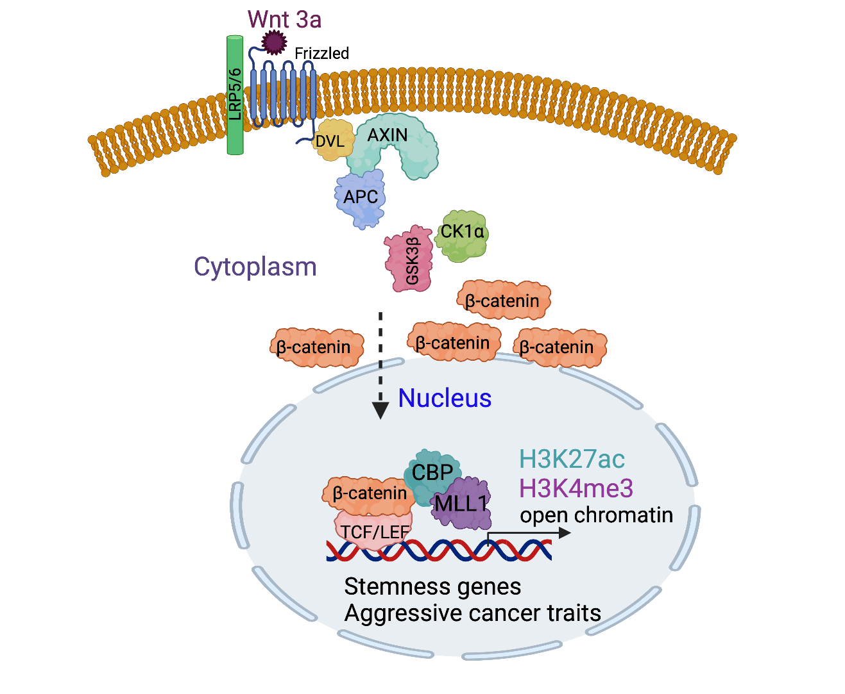
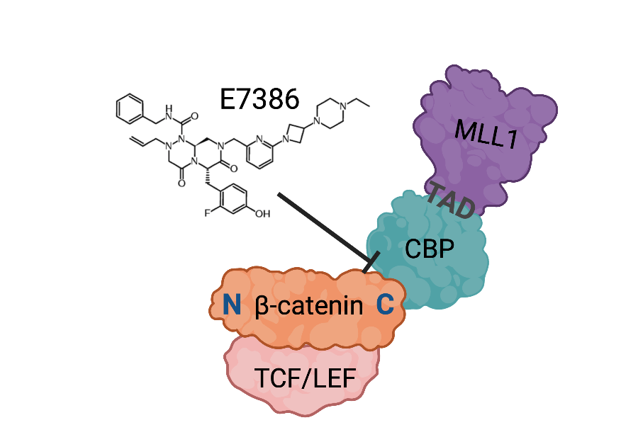
Nuclear β-Catenin Activity Promotes OSCC Tumorigenesis
Canonical Wnt Signaling in OSCC:
  Transcription complex formation & epigenetic remodeling
    β-catenin + CREB- binding protein (CBP)
    β-catenin/CBP+ mixed lineage leukemia 1 (MLL1)
Transcriptional program of genes associated with stemness (CD44, ALDH7A1, Sox2)
E7386: 3rd generation, small molecule ⊥ that decreases OSCC tumor growth
  Binds directly to CBP (reversible, competitive)

Slide 4
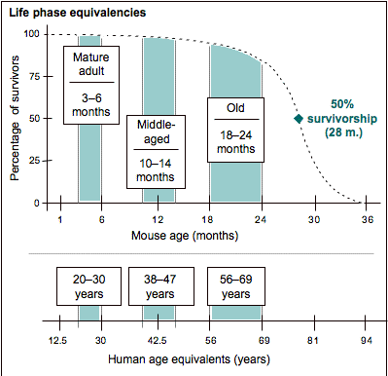
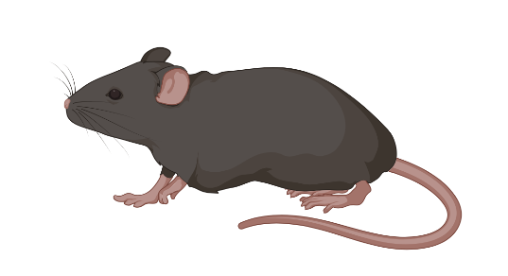
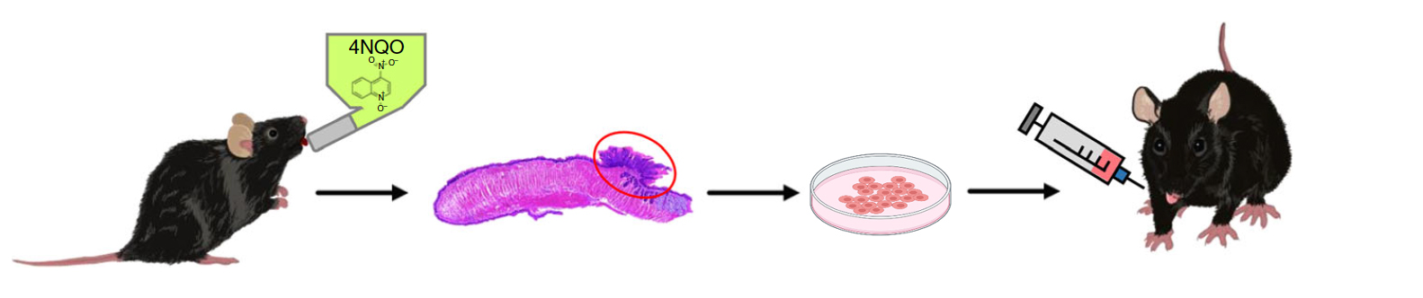
Animal Models of OSCC
Young C57BL/6J
Age: 6-13 wks
Aged C57BL/6J
Age: 60-65 wks
Old C57BL/6J
Age: >80 wks
Jackson Labs
4NQO-Induced Model of Oral Carcinogenesis
4MOSC1 Isograft Model
Gutkind et al., Nat Comm, 2019

Slide 5
4MOSC1 Cells Are Responsive to Wnt/β-catenin/CBP Signaling Inhibition
4MOSC1 TOP/FOP Assay
Effect of E7386 on 4MOSC1 Cell Viability
Luciferase Activity
Fisher, unpublished

Slide 6
E7386 Promotes Epigenomic Remodeling in Vitro
H3K4me3 ChIP-seq
CAL27: human OSCC; primary site
HSC3: human OSCC; metastatic lymph nodes
No change in β-catenin protein with E7386 treatment
Symbol | Distance from TSS | Log₁₀ Ratio
CD44 | 0 | 46.11442
KRT14 | 0 | 40.86184
KRT5 | 0 | 39.49018
ALDH7A1 | 0 | 29.76784
SOX2 | 0 | 21.86539
ALDH1A3 | 0 | 15.29097
Reduced H3K4me3 histone occupancy upon treatment with E7386 at CSC genes.
ICG-001 is the second generation compound of E7386. E7386 is significantly more potent than ICG-001
Unpublished. Please do not post.

Slide 7
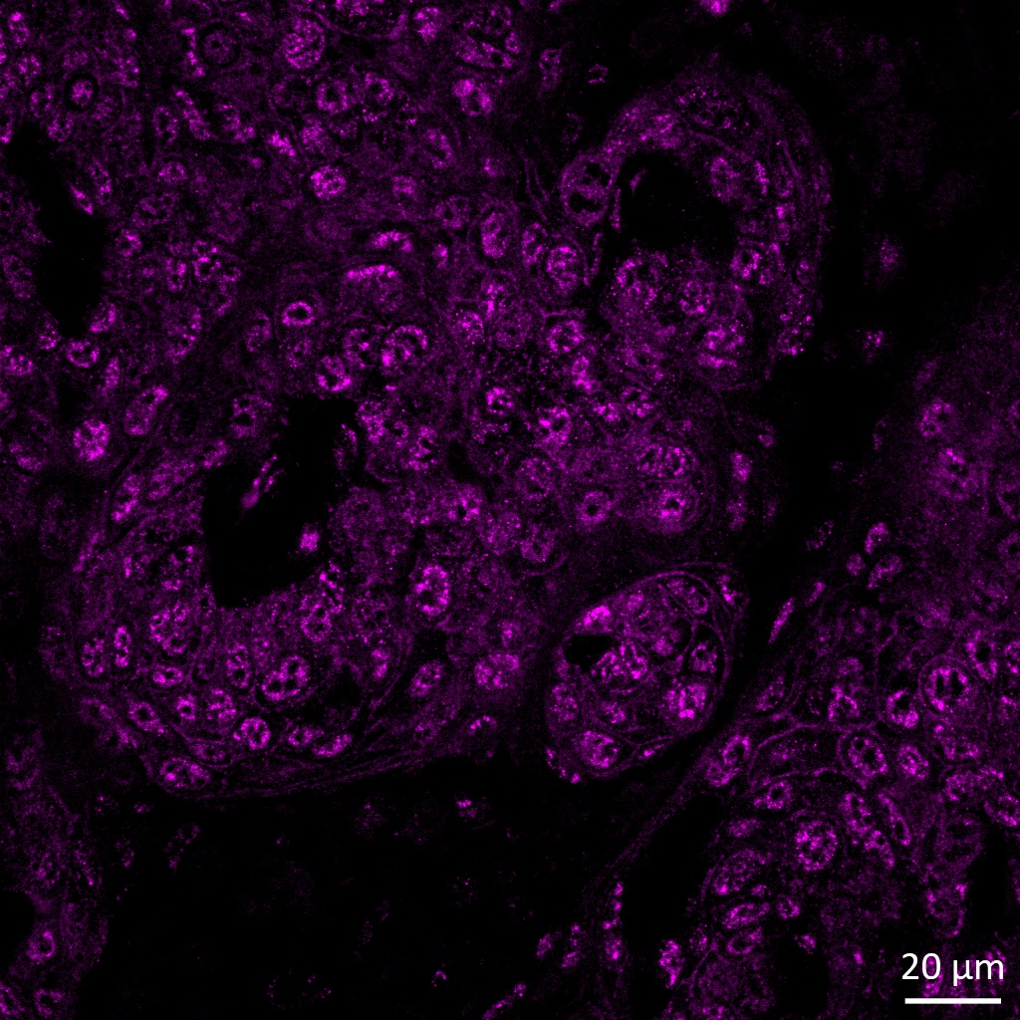
Aging Mice Have Higher Expression of CBP and H3K4me3 Compared to Young Mice
10 wks
10 wks
CBP
CBP + DAPI
H3K4me3
H3K4me3 + DAPI
64 wks
64 wks
CBP
CBP + DAPI
H3K4me3
H3K4me3 + DAPI
Unpublished. Please do not post.

Slide 8

Age-Associated Differences in OSCC Tumorigenesis
Equal number of cells injected
Normalizing Tumor Size to Elucidate Effect of Age
2.5 x 10⁵ cells injected
From Anthony Spinella
~70% reduction of tumor vol.
Experimental Plan:
Stage tumors: (Old mice have 4 times fewer tumor cells injected )
Treatment begins when tumors are about the same volume
Unpublished. Please do not post.

Slide 9
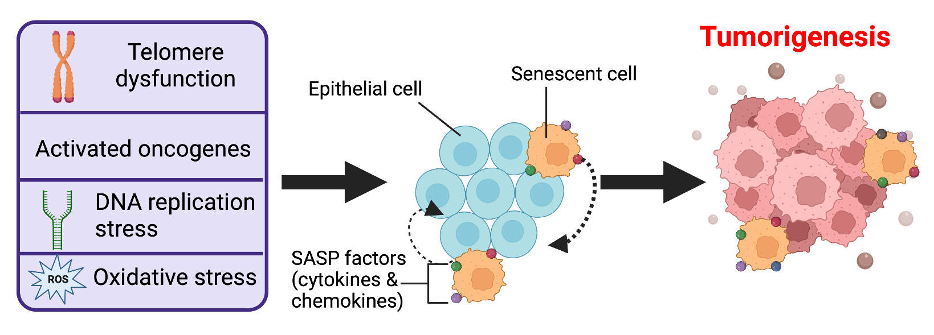
Age Associated Factors Contributing to OSCC Tumorigenesis: Senescence & Immune Aging
Is the presence of senescent cells contributing to the response of aged mice to E7386 treatment?
Aged mice have fewer immune cells compared to young mice
Neutrophils
LMNB1 + H3K9me3 + DAPI
APCs
10 wks
T Cells
Young
Old
64 wks
Anthony Spinella & Lina Kroehling
Normalizing Tumor Size to Elucidate Effect of Age
Unpublished. Please do not post.

Slide 10
Conclusions
Epigenetic modifications directed by β-catenin/CBP/MLL1 complex promote expression of genes associated with cancer stemness.
While OSCC is driven by the β-catenin/CBP/MLL1 signaling axis—as evidenced by the tumor volume reduction upon treatment with E7386—the microenvironment of older mice tumors may be more complex.
Increases in IF associated with senescent markers suggests the potential involvement of β-catenin/CBP signaling in this age-related, pro-tumorigenic cellular phenotype.
Aged mice have fewer immune cells in the tumor microenvironment potentially contributing to OSCC tumor growth.

Slide 11
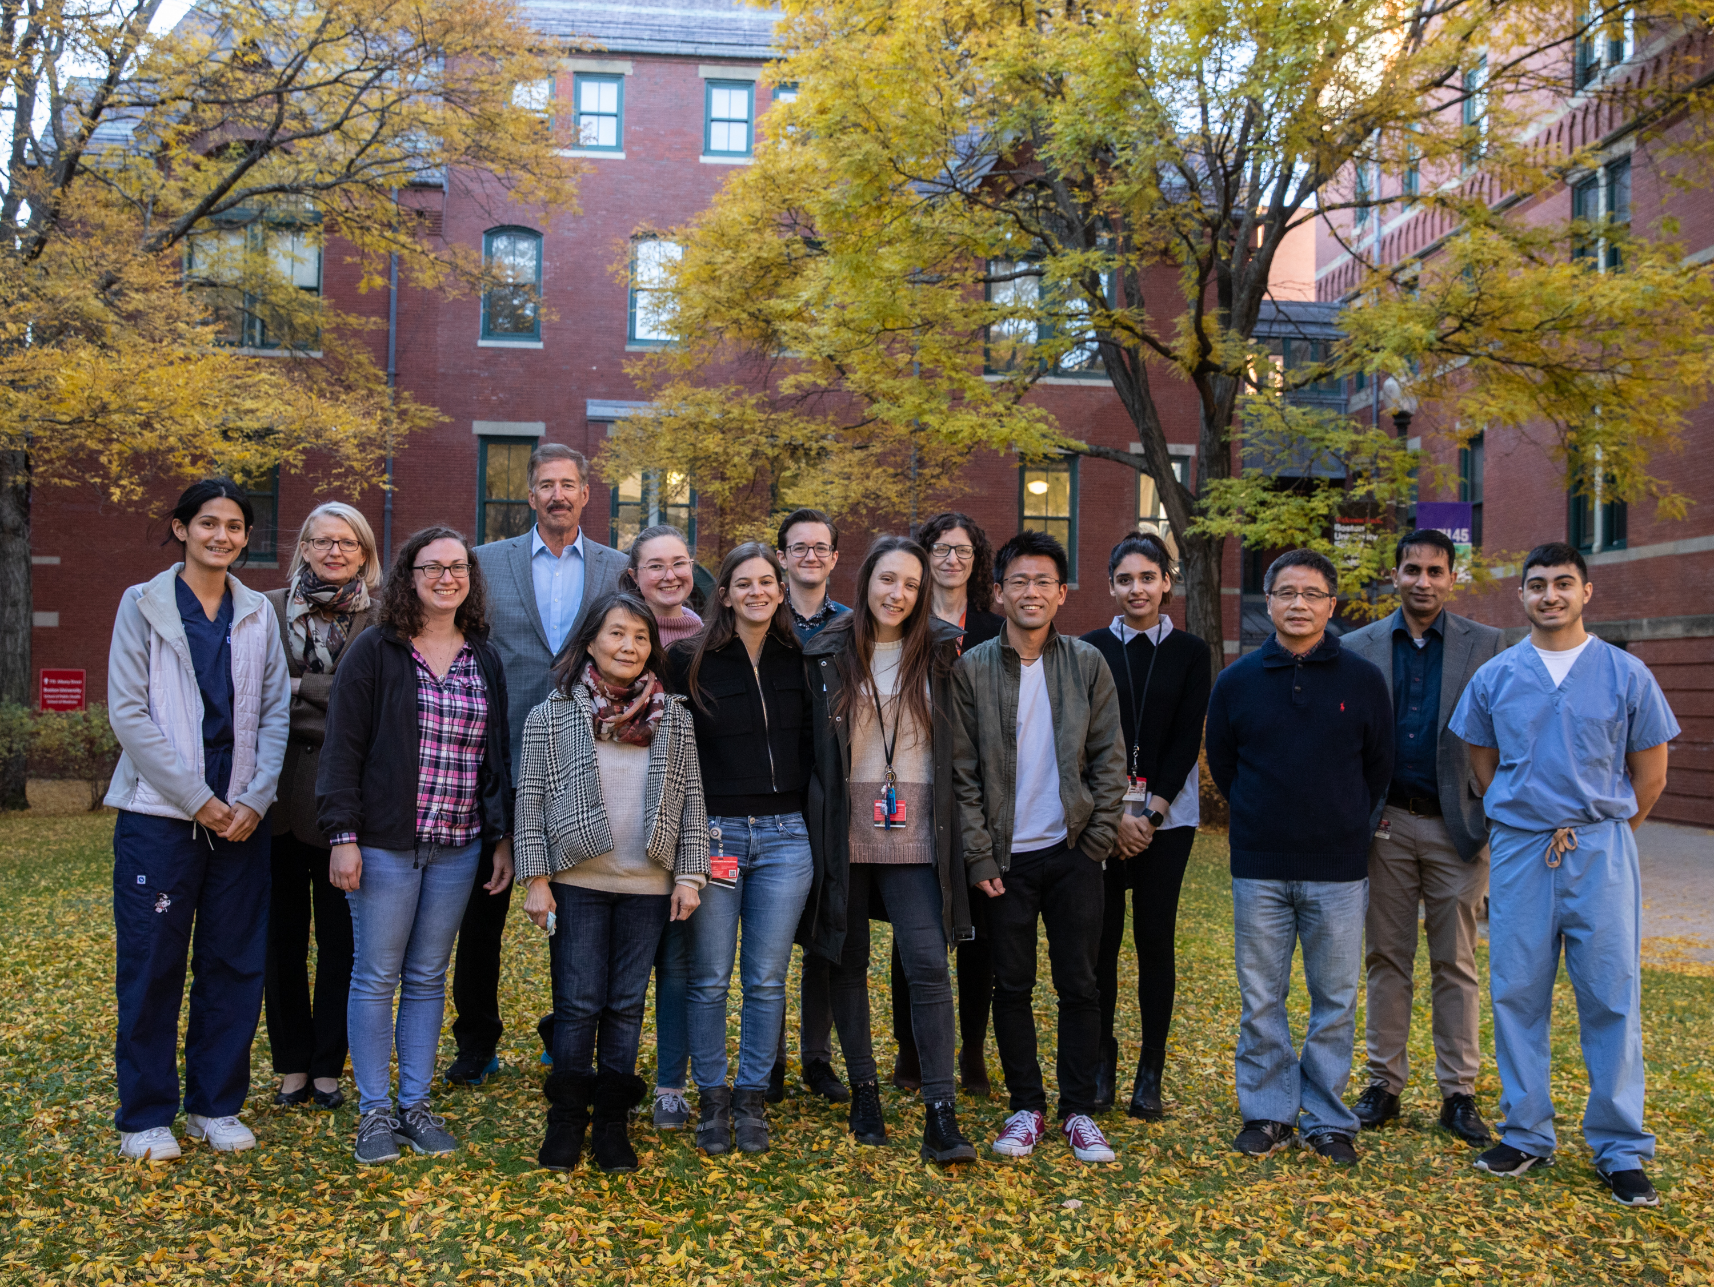


Acknowledgements
Translational Dental Medicine
Kukuruzinska Lab
Maria A. Kukuruzinska, PhD
Bach-Cuc Nguyen, PharmD, PhD
Stacy Jankowski
Guoxian Wei
Nina C. Hardy
Divieti Pajevic Lab
Paola Divieti Pajevic, MD, PhD
Yuhei Uda, PhD
Giulia Montagna
Chris Constantinou
Manish Bais, PhD, DVM
Biochemistry
Varelas Lab
Xaralabos (Bob) Varelas, PhD
Anthony Spinella
Andrew Tilston-Lunel
Computational Biomedicine
Monti Lab
Stefano Monti, PhD
Eric Reed, PhD
M. Muzamil Khan
Lina Kroehling
Dissertation Advisory Committee
Maria A. Kukuruzinska, PhD
Rachel Flynn, PhD
Xaralabos (Bob) Varelas, PhD
Neil Ganem, PhD
Department of Pharmacology

