Slide 1
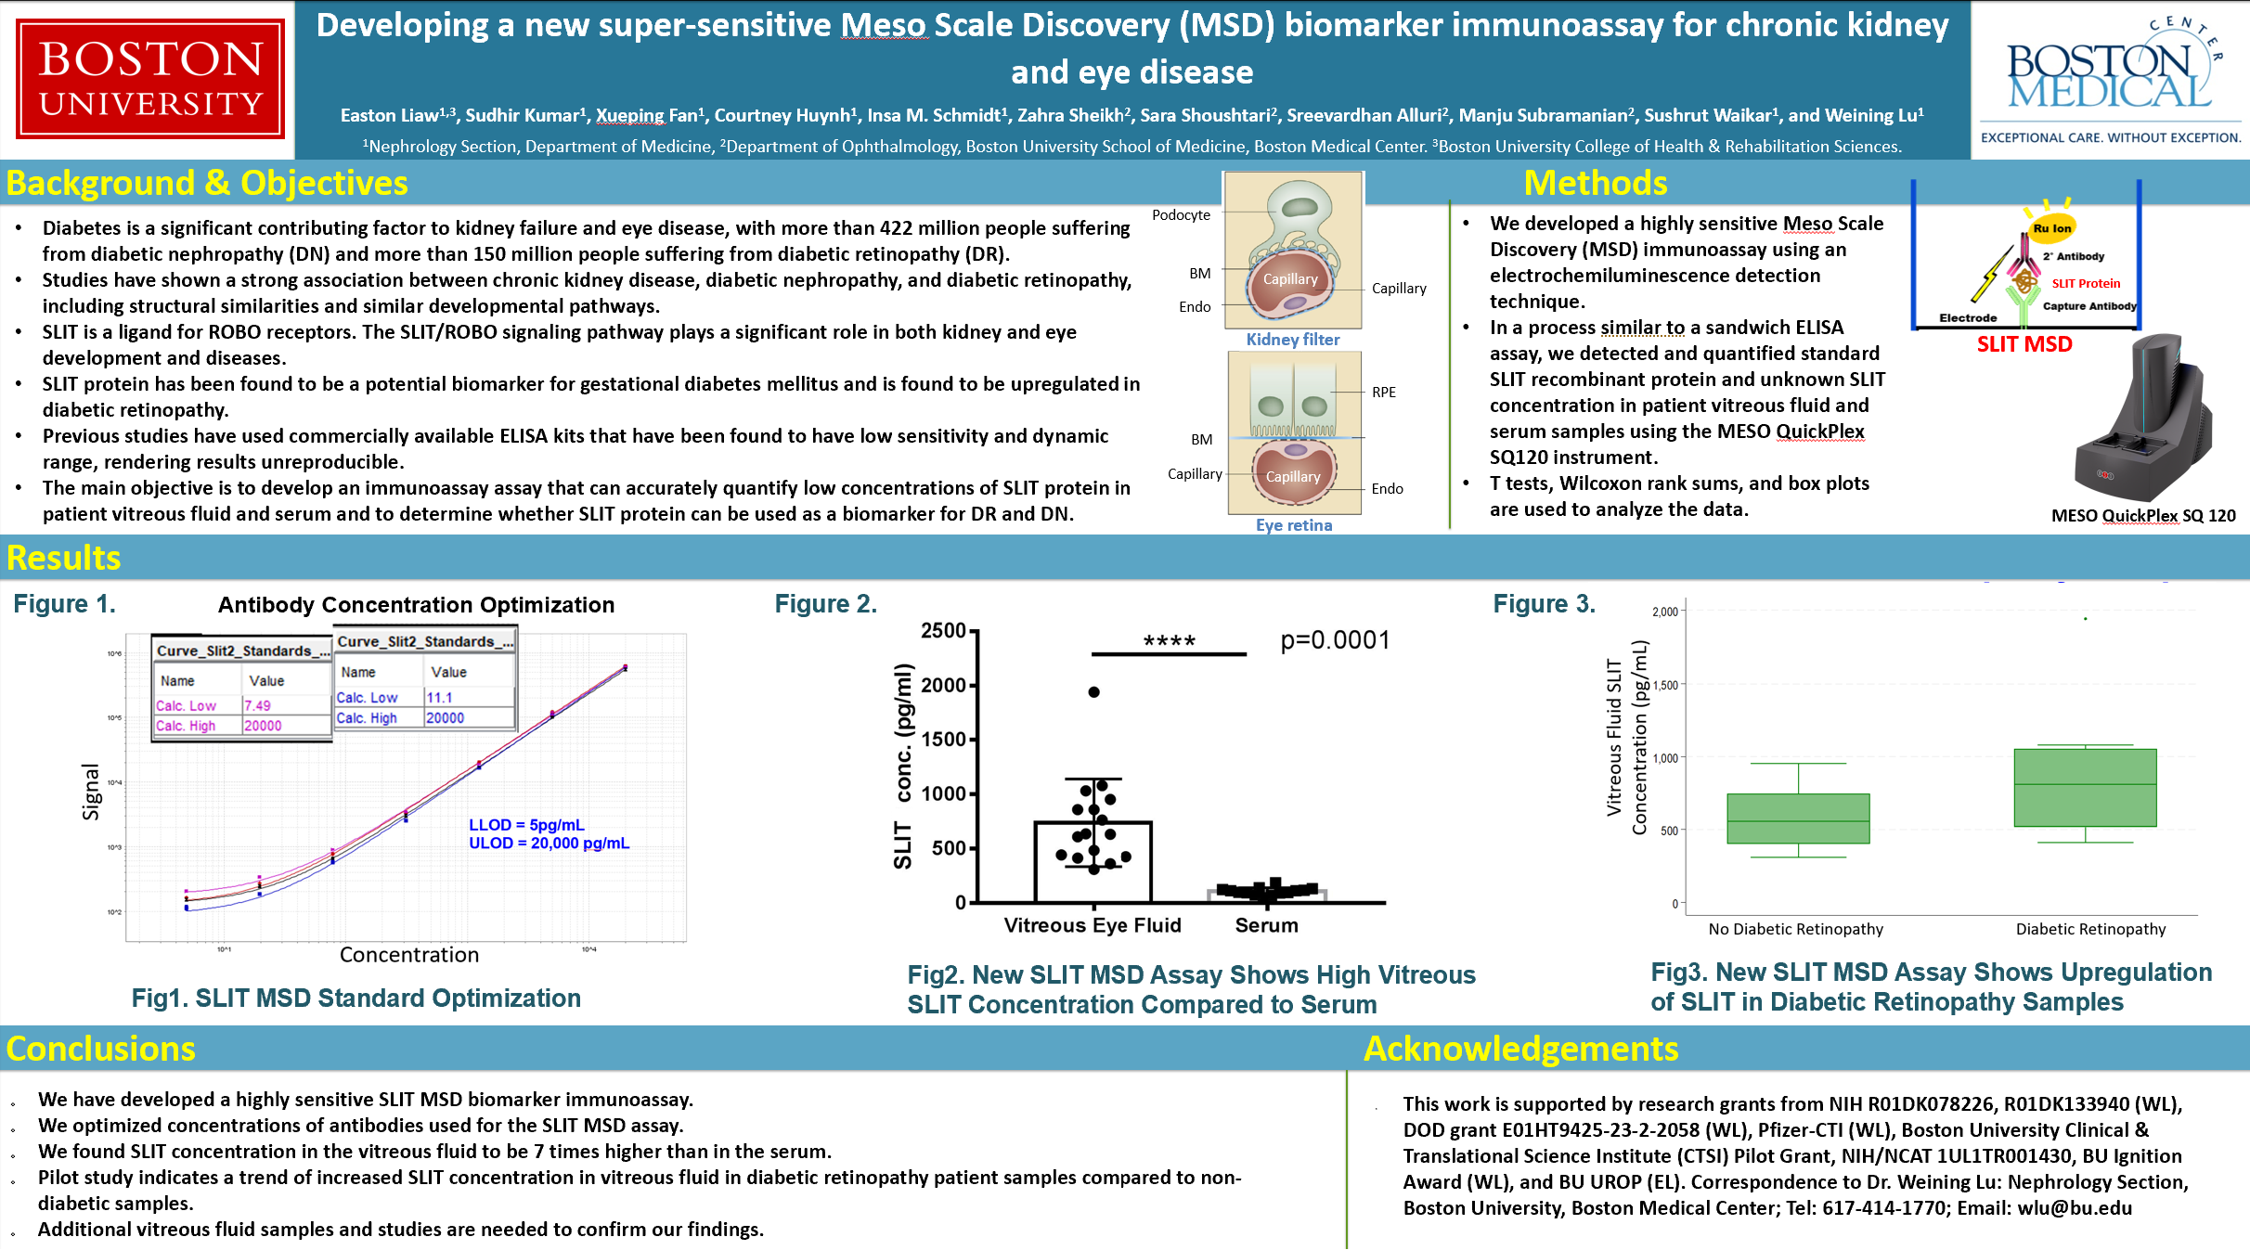

Slide 2
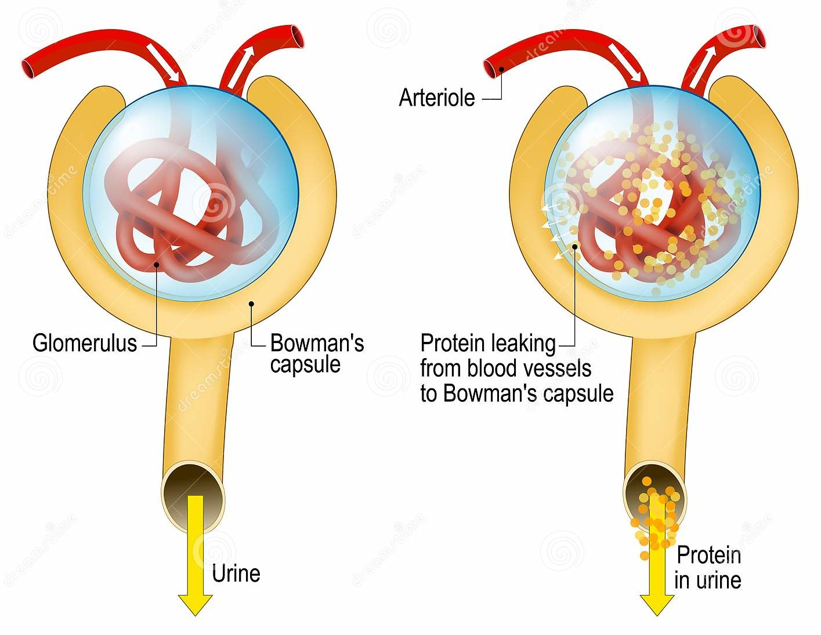
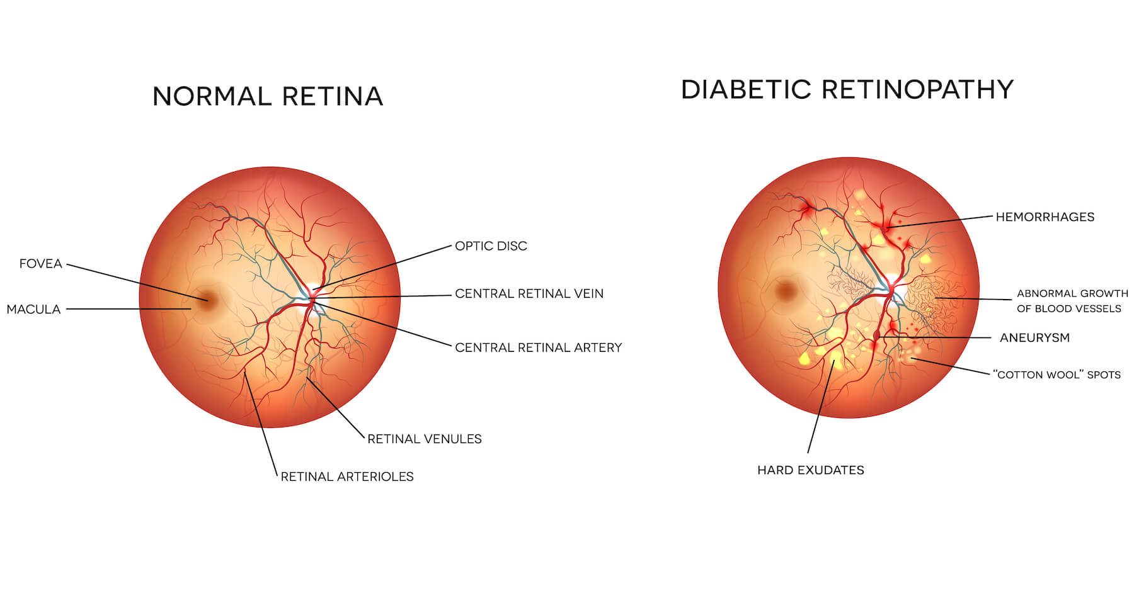
Diabetic Nephropathy and Retinopathy

Slide 3
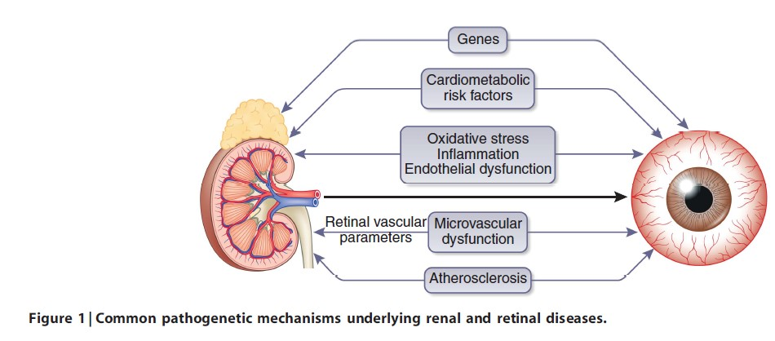
Published studies show a strong association between CKD and diabetic retinopathy (DR)
Common risk factors and pathogenetic mechanisms underlying both kidney and eye diseases
Kidney International (2014) 85, 1290–1302

Slide 4
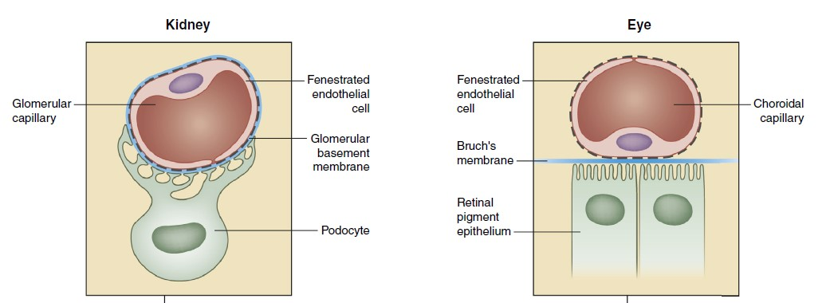
Similar structure between the glomerular filtration barrier (blood-urine barrier) in the kidney and the retinochoroidal junction (blood-retina barrier) in the eye
Glomerular filtration barrier (blood-urine barrier) in the kidney
Retinochoroidal junction (blood-retina barrier) in the eye
Kidney International (2020) 98, 323–342

Slide 5
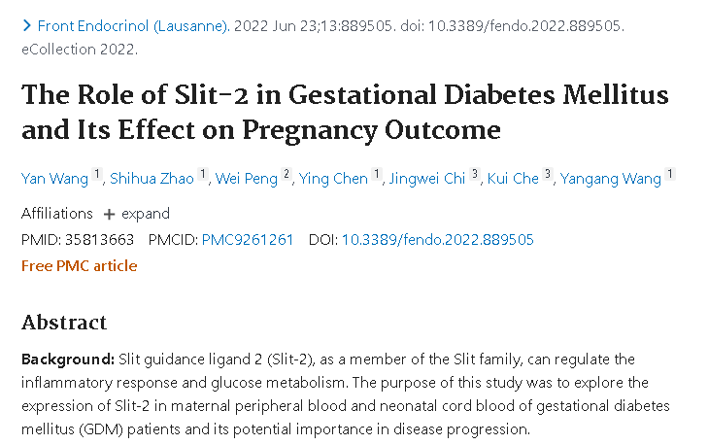

SLIT is a potential biomarker for gestational diabetes mellitus (GDM)

Slide 6

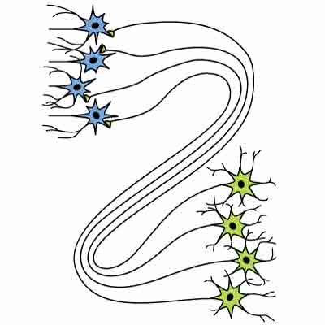
SLIT-ROBO signaling
SLIT
ROBO
Cell membrane
CC0
CC1
CC2
CC3
SRGAP1
Axon pathfinding
Cell migration, adhesion
neurons, cancer cells, neutrophils, etc.

Slide 7
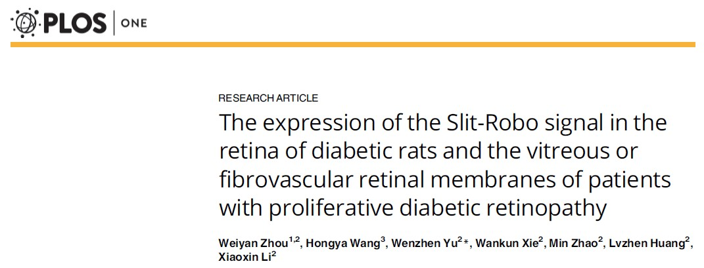
SLIT expression is upregulated in diabetic retinopathy

Slide 8
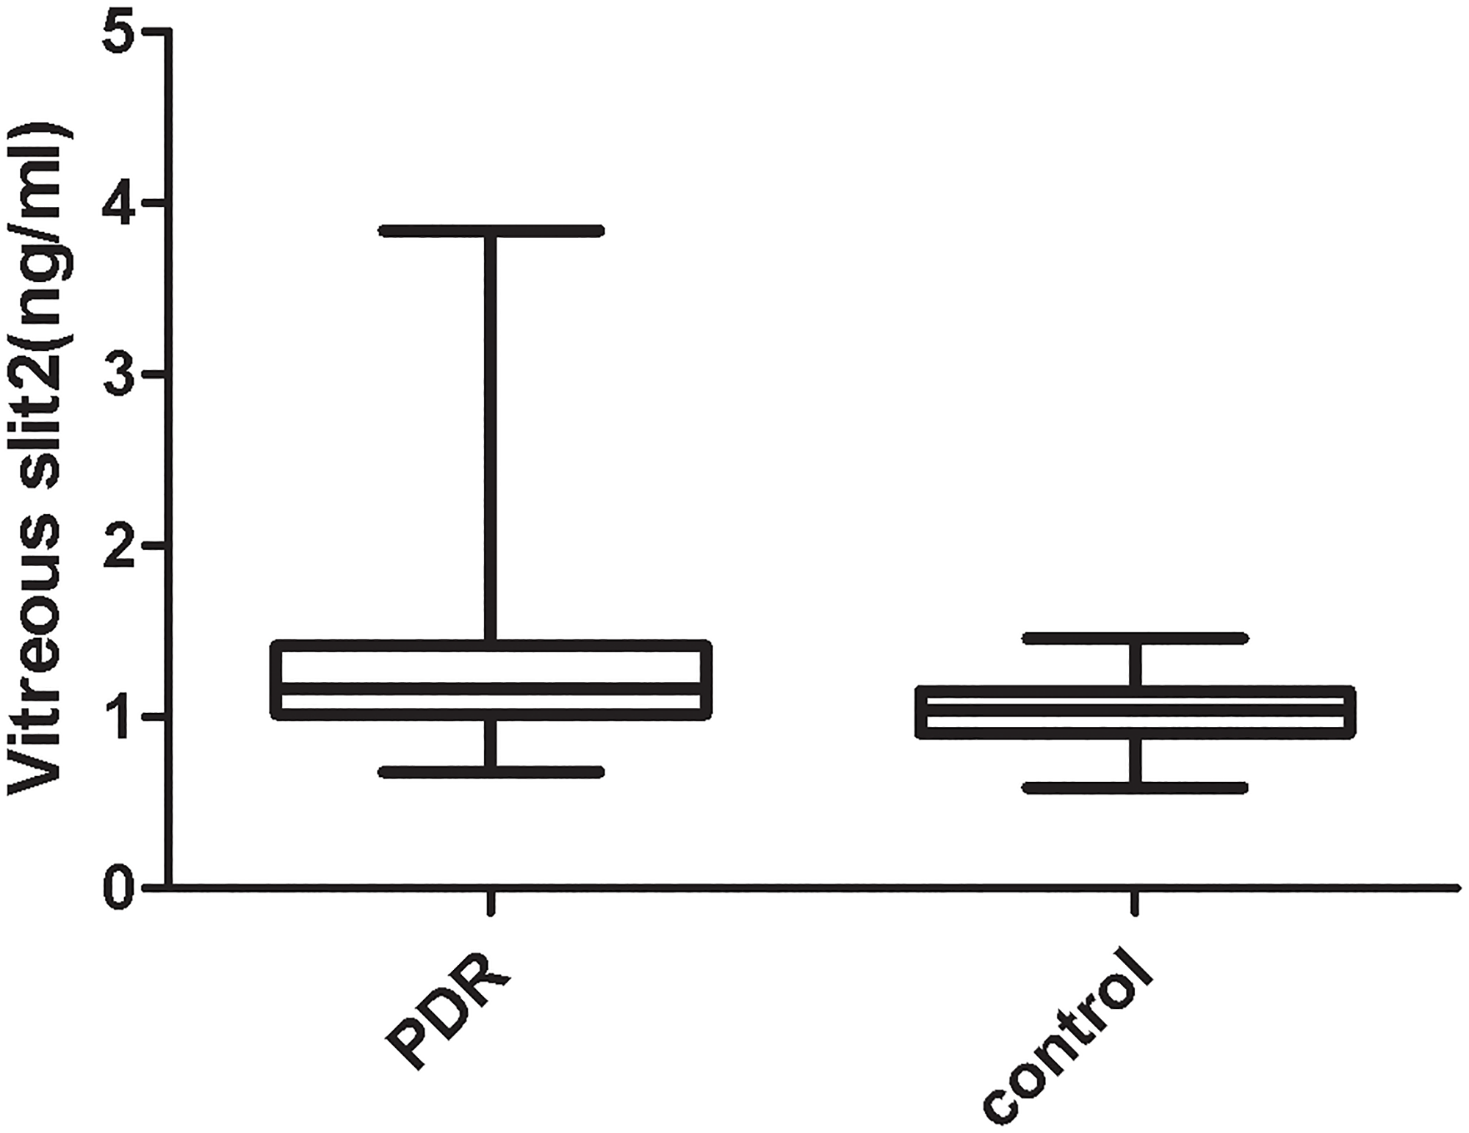
SLIT Expression is Upregulated in Proliferative Diabetic Retinopathy (PDR)
Measured by sandwich ELISA
LLOD = 1,000 pg/mL
ULOD = 50,000 pg/mL

Slide 9
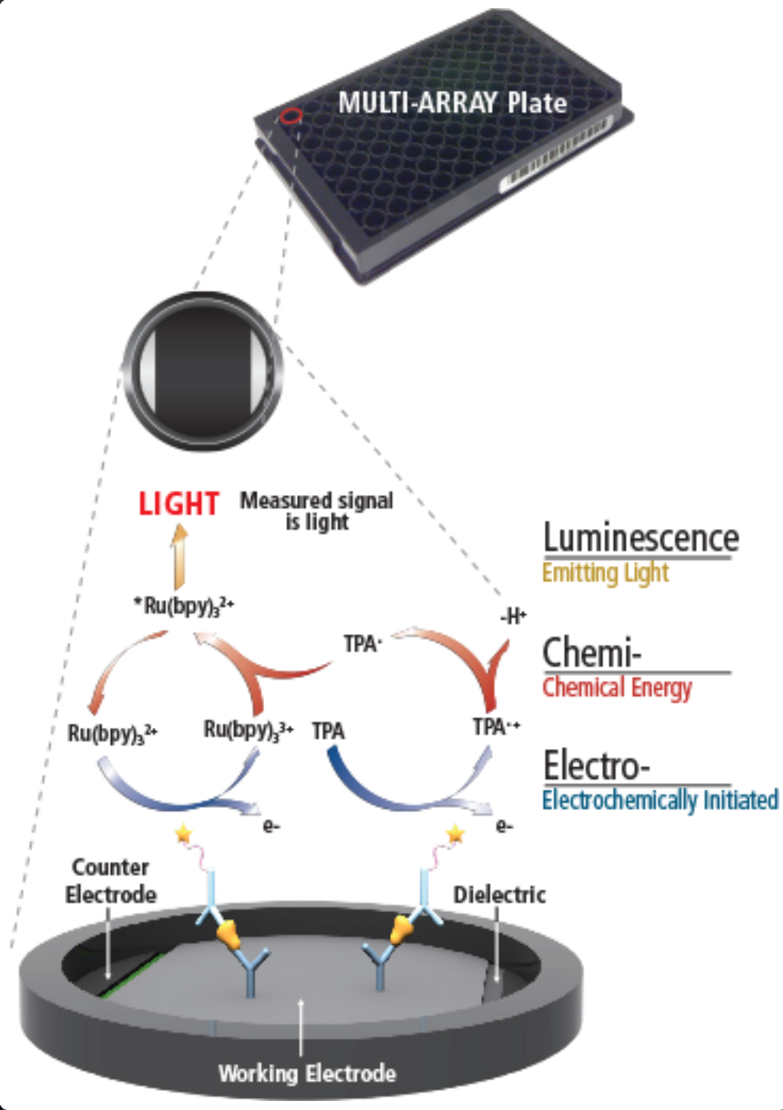
MSD Immunoassay
Technology

Slide 10
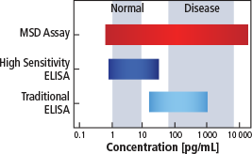
MSD vs Traditional ELISA
Require far less sample
Provide more sensitive and precise results
Handle complex biological matrices easily
Use simpler, faster protocols
Quantify up to 10 analytes per well
Measure elevated and normal expression samples without multiple dilutions

Slide 11
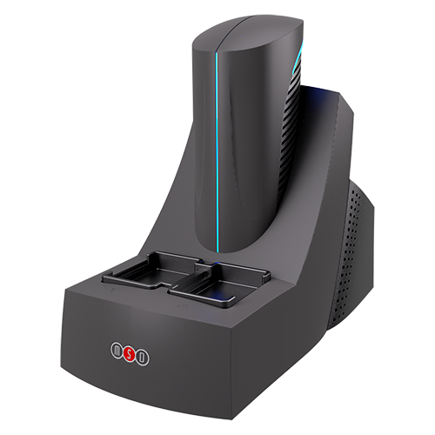
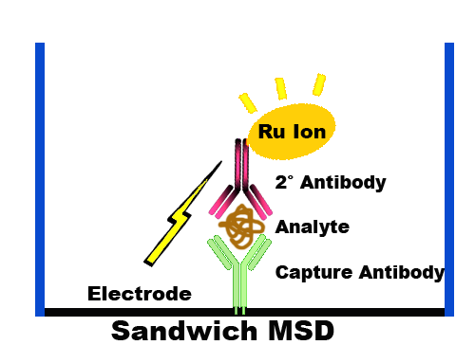
Developing Highly Sensitive SLIT MSD Biomarker Immunoassay
MESO QuickPlex SQ 120
SLIT Protein
SLIT MSD

Slide 12
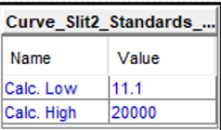
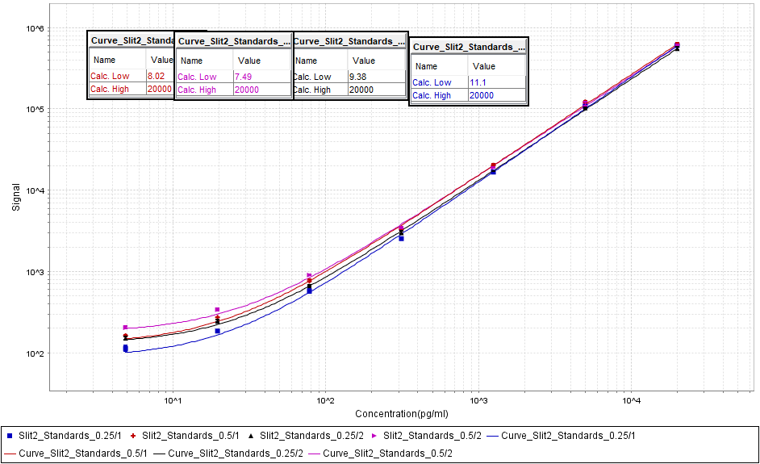
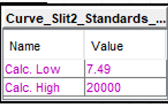
SLIT MSD Standard Optimization
Signal
LLOD = 5pg/mL
ULOD = 20,000 pg/mL
Concentration

Slide 13
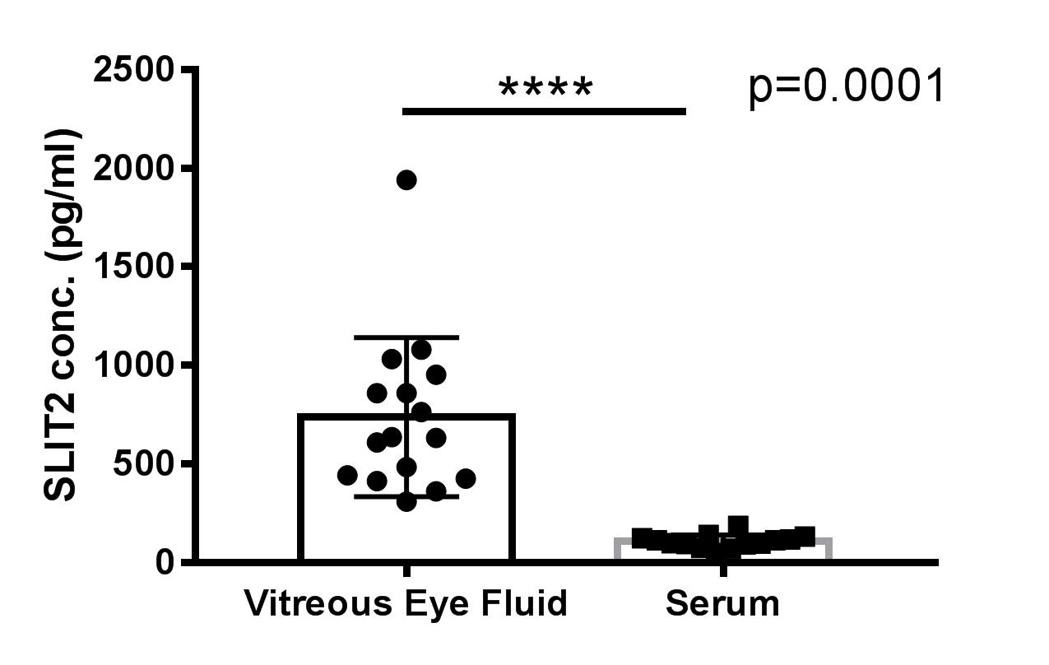
New SLIT MSD Assay Shows High Vitreous SLIT Concentration Compared to Serum

Slide 14
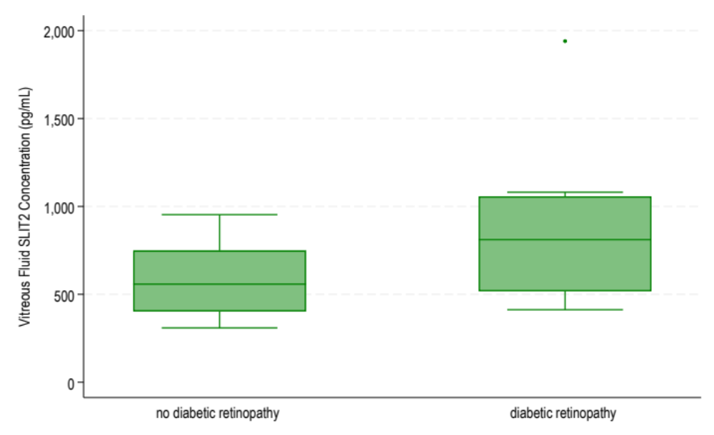
New SLIT MSD Assay Shows Upregulation of SLIT in Diabetic Retinopathy Samples
Vitreous Fluid SLIT Concentration (pg/mL)
No Diabetic Retinopathy
Diabetic Retinopathy

Slide 15
SUMMARY
We have developed a highly sensitive SLIT MSD biomarker immunoassay
We optimized concentrations of antibody used for assay
We found SLIT concentration in vitreous fluid to be 7 times higher than in the serum
Pilot study indicates trend of increased SLIT concentration in vitreous fluid in diabetic retinopathy patient samples compared to non-diabetic samples
Additional vitreous fluid samples are needed to confirm our findings

Slide 16
Acknowledgement
Dr. Weining Lu’s Lab
Weining Lu
Sudhir Kumar
Xueping Fan
Jacqueline Alford
Olivia Kierul
Dr. Sushrut Waikar’s Lab
Sushrut Waikar
Insa Schmidt
Courtney Huynh
Dr. Manju Subramanian Lab
Manju Subramanian
Sara Shoushtari
Zahra Sheikh
Sreevardhan Alluri
MSD
Virginie Esain
Grant Funding
NIH/NIDDK, DOD, Pfizer CTI, BU CTSI Pilot Grant, BU UROP, BU Ignition Award

