Slide 1





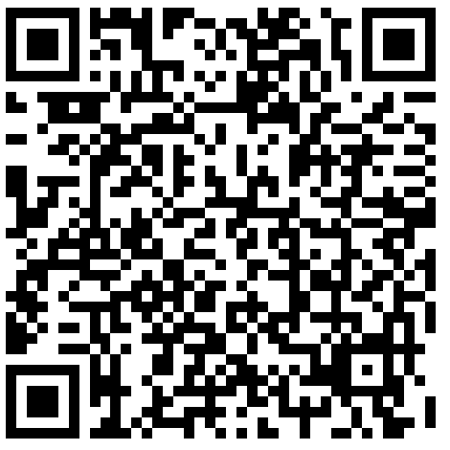
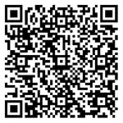
Comorbidity Burden Among Individuals with a Schizophrenia Spectrum Disorder:
An Exploration of Sociodemographic Characteristics
Brittany Gouse MD MPH^{1,2}, Tithi Baul, MPH^{1,2}, Toshiaki Komura, BS^{2,3}, Luisa Camacho MPH² , Elijah Boliver MPH²,
Jennifer Lancet MBA MS CPS², Nandini Agarwal MPH², Hannah Brown MD^{1,2}
1: Department of Psychiatry, Boston University Chobanian & Avedisian School of Medicine, Boston, MA
2: Wellness & Recovery After Psychosis Program, Boston Medical Center, Boston, MA​
3: Boston University School of Public Health, Boston MA
BACKGROUND:
RESULTS:
METHODS (cont):
Schizophrenia spectrum disorders (SSDs) are associated with a reduction of 13-15 years of life expectancy compared to the general population.¹
Chronic physical illness is the largest driver of premature mortality in this patient population globally. Most of this burden is from cardiovascular and pulmonary disease.²
Premature mortality in this patient population is driven in part by (1) higher rates of cardiometabolic disease secondary to antipsychotic treatment, (2) higher nicotine use, (3) lower rates of preventative healthcare, including cancer screening.
Individuals with lower socioeconomic (SES) status face greater structural barriers to sustained engagement in healthcare.
  Emerging evidence has found neighborhood SES as a major driver of health outcomes.
Due to societal factors such as entrenched structural inequality and discrimination in the US, individuals from racial/ethnic minority groups experience socioeconomic disadvantage.
  This has had a profound and pervasive impact on health and is a driver of health disparities.
The impact of social determinants of health on physical comorbidity in schizophrenia is not well understood.
Figure 1. Severity of Comorbidity Burden Among Patients With Schizophrenia or Schizoaffective Disorder
Individual-level EMR demographic data was connected to American Community Survey data to calculate neighborhood-level deprivation.
Demographic SnapShot of 1,739 included patients:
SVI
SES
Score
% Below Poverty
% Unemployed
Per Capita Income
Mean age was 63.47 (SD 8.7)
40.9% were assigned female at birth
16% had a primary language other than English
53.9% were non-Hispanic Black
14% were Hispanic
28.8% were non-Hispanic white
3.3% were another race/ethnicity
Median SES SVI 0.76
(IQR 0.39)
% No High School Diploma
Sociodemographic characteristics were compared between individuals with and without severe comorbidity burden (defined as CCI > 4) using chi-square tests and independent t-tests where appropriate.
Logistic regression was used to explore the relationship between key demographic factors and severe comorbidity burden. Correlation matrix of predictors was used to explore multicollinearity.
Series of sensitivity analyses were conducted: all ages, with SES SVI as a continuous variable, with CCI of 0 missing or excluded.
For detailed demographic characteristics across degree of comorbidity burden:
Figure 2. Proportion of Total Cohort with Severe Comorbidity Burden
by Individual-Level Demographic Factor
Figure 3. Proportion of Total Cohort with Severe Comorbidity Burden by Neighborhood Socioeconomic Vulnerability
CONCLUSIONS:
Physical comorbidity is common among individuals with schizophrenia or schizoaffective disorder over 50 years old
.
  68% of the cohort had at least a mild comorbidity burden defined by CCI.
  12% had severe comorbidity burden, which has been associated with 85% mortality rate among medically hospitalized patients.
Non-Hispanic Black individuals with had higher odds of severe comorbidity than non-Hispanic white individuals schizophrenia or schizoaffective disorder.
  Further work is critically needed to examine the precipitating and perpetuating factors driving increased comorbidity among non-Hispanic Black individuals.
We did not find an association between comorbidity severity and neighborhood SES vulnerability.
However, these findings should be interpreted with caution given the uncertainty around the extent of missing comorbidity data in this sample.
OBJECTIVES:
Percentage of Comorbidity Burden
To explore the proportion of patients with schizophrenia spectrum disorder (SSD) who have severe comorbidity burden at our urban safety net hospital
To compare individual and neighborhood-level sociodemographic characteristics of individuals with a SSD with and without severe comorbidity burden.
Percentage of Comorbidity Burden
Individual-Level Demographic Factor
Neighborhood-Level Socioeconomic Vulnerability
HYPOTHESIS:
Table 1. Multivariate Analysis of Associations between Sociodemographic Factors and Severe Comorbidity
We hypothesize that a higher proportion of individuals from neighborhoods with low SES and individuals from racial/ethnic minority groups will have a severe comorbidity burden compared to other groups.
 | Unadjusted |  |  | Adjusted
 | OR | CI | p-value | OR | 95% CI | P-value | P-value
Age | 1.04 | 1.03-1.06 | 0.001** | 1.05 | 1.028-1.067 | <0.001***
Sex Assigned at Birth
Male (ref)
Female | 1.13 | .848-1.502 | .405 | .931 | 0.66-1.3 |  | .679
Race/Ethnicity |  |  | .016* |  |  |  | .059
white (ref)
Non-Hispanic Black | 1.75 | 1.22-2.52 | .002** | 1.78 | 1.167-2.71 |  | .008**
Hispanic | 1.73 | 1.07-2.80 | .026* | 1.63 | .905-2.93 |  | .104
Other | 1.02 | 0.38-2.696 | .967 | 1.16 | .387-3.47 |  | .794
Neighborhood SES Vulnerability |  |  | .907 |  |  |  | .741
Q1 (ref)
Q2 | 1.179 | .648-2.147 | .589 | 1.20 | .641-2.24 |  | .573
Q3 | .954 | .549 -1.66 | .867 | .868 | .488-1.54 |  | .629
Q4 | 1.02 | .64-1.62 | .934 | .931 | .566-1.53 |  | .780
METHODS:
We leveraged an electronic medical record derived data set of all individuals who had at least one billed encounter with a SSD disorder (ICD-10 code F20-F29) between 2015 and 2022 at Boston Medical Center.
Inclusion criteria:
  Age 50 years old or older
  Either Schizophrenia (F20) or Schizoaffective Disorder (F25) in active problem list
Charlson Comorbidity Index (CCI) was used as a measure of physical comorbidity burden. CCI severity was graded as: None or Missing (CCI=0), Mild (CCI=1-2), Moderate (CCI=3-4), Severe (CCI>4)
REFERENCES:
ACKNOWLEDGEMENTS:
This project was supported by the National Center for Advancing Translational Sciences, National Institutes of Health, through BU-CTSI Grant Number KL2TR001411. Its contents are solely the responsibility of the authors and do not necessarily represent the official views of the NIH
*p<.05, **p<.01, ***p<.001

Slide 2
Schizophrenia is associated with a 13-15 year reduction in life expectancy

Slide 3
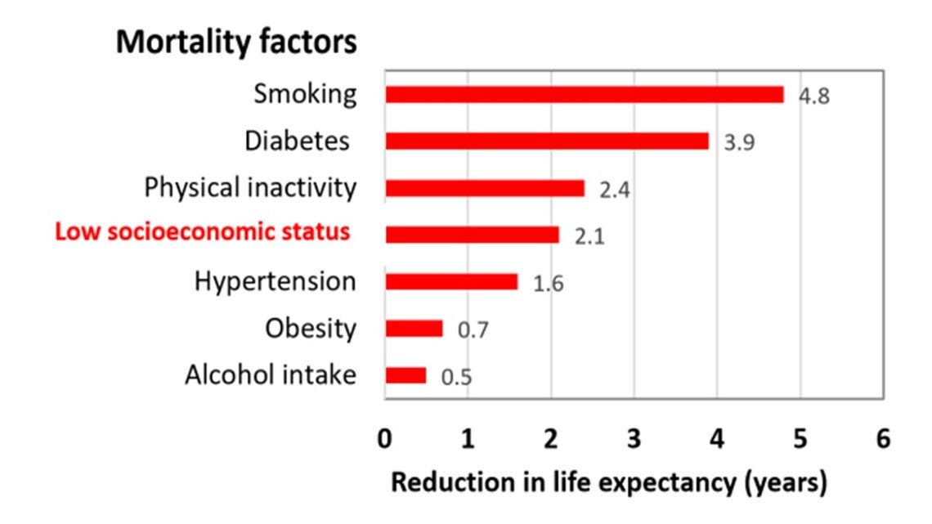
Schizophrenia is associated with a 13-15 year reduction in life expectancy

Slide 4
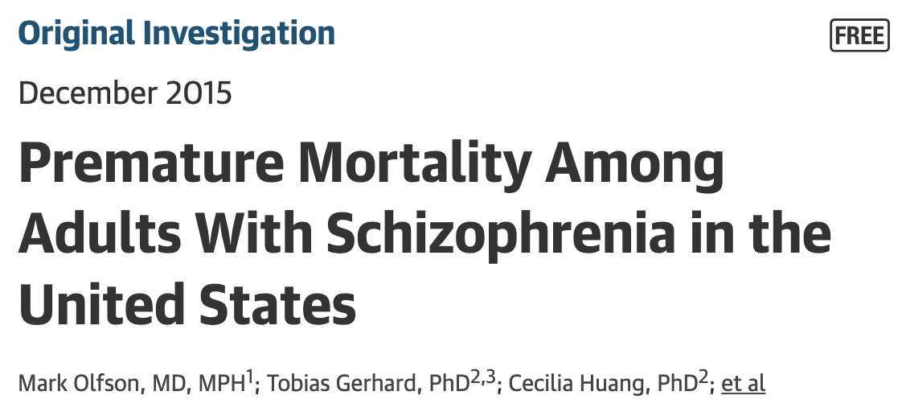
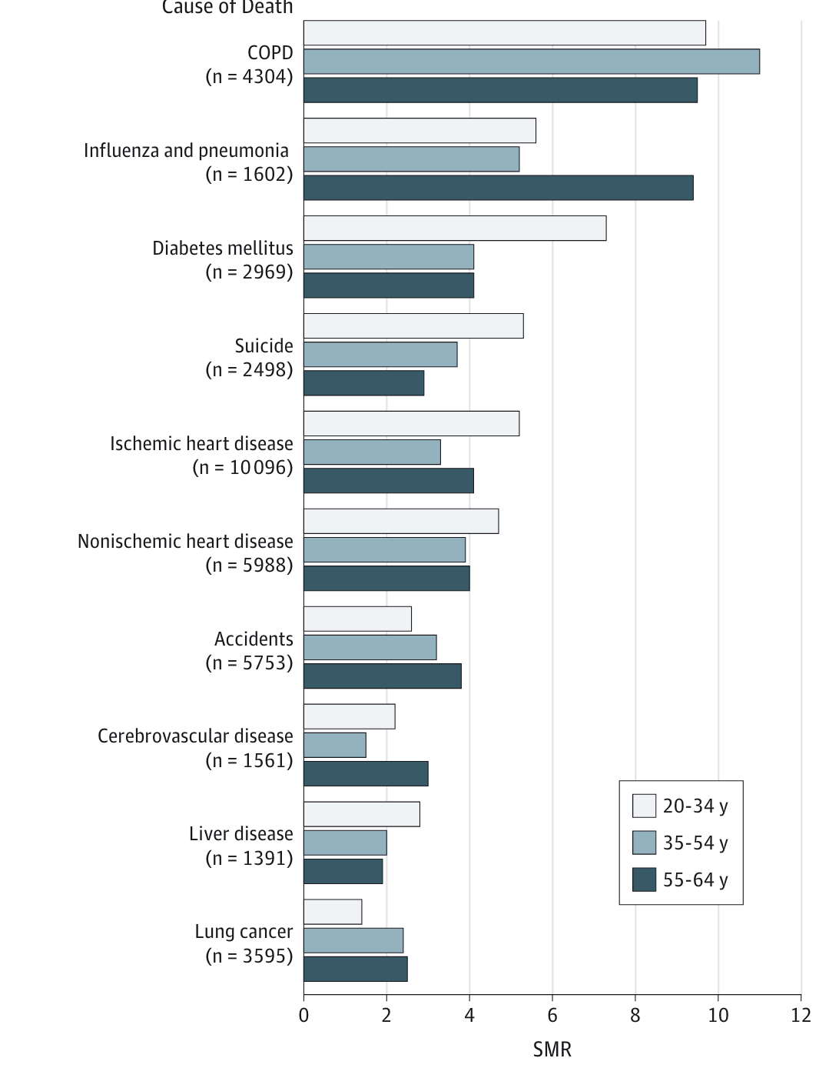
“…marked excess of deaths in schizophrenia, particularly from cardiovascular and respiratory disease, that is evident in early adulthood and persists into later life.
Especially high risks of mortality were observed from diseases for which tobacco use is a key risk factor.”

Slide 5


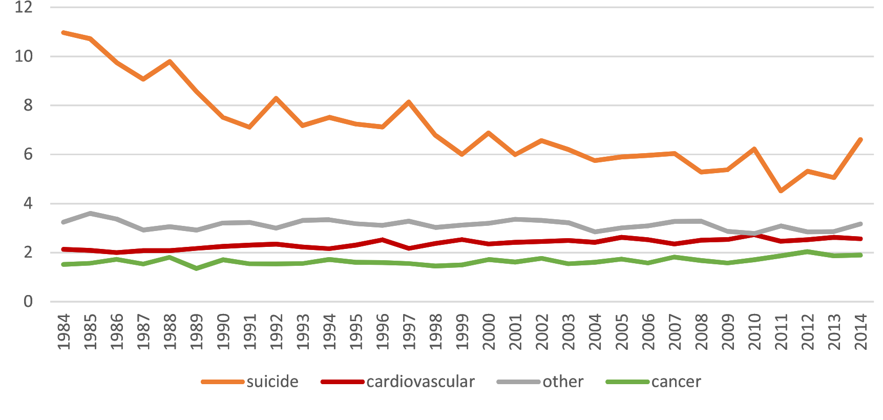
Moderate increase in deaths due to cardiovascular disease and deaths due to cancer.
Notes:
Finish register study
ll-cause SMR remained stable during the follow-up

Slide 6
In the United States, there are notable disparities and inequities in access to preventative healthcare according to socioeconomic status.

Slide 7
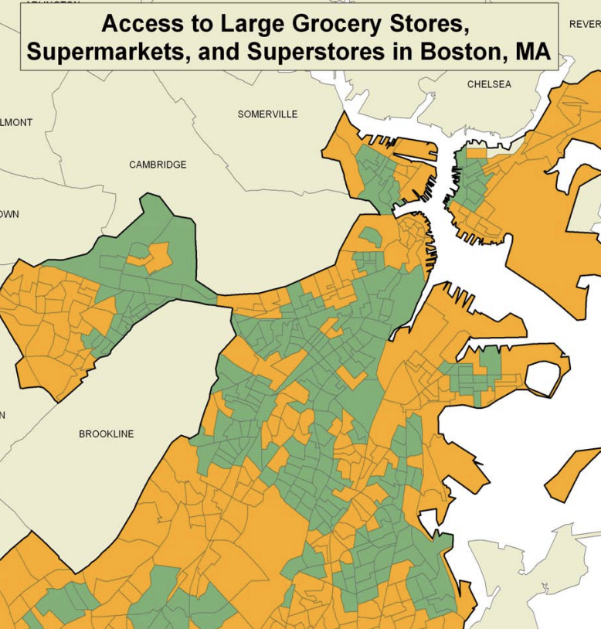
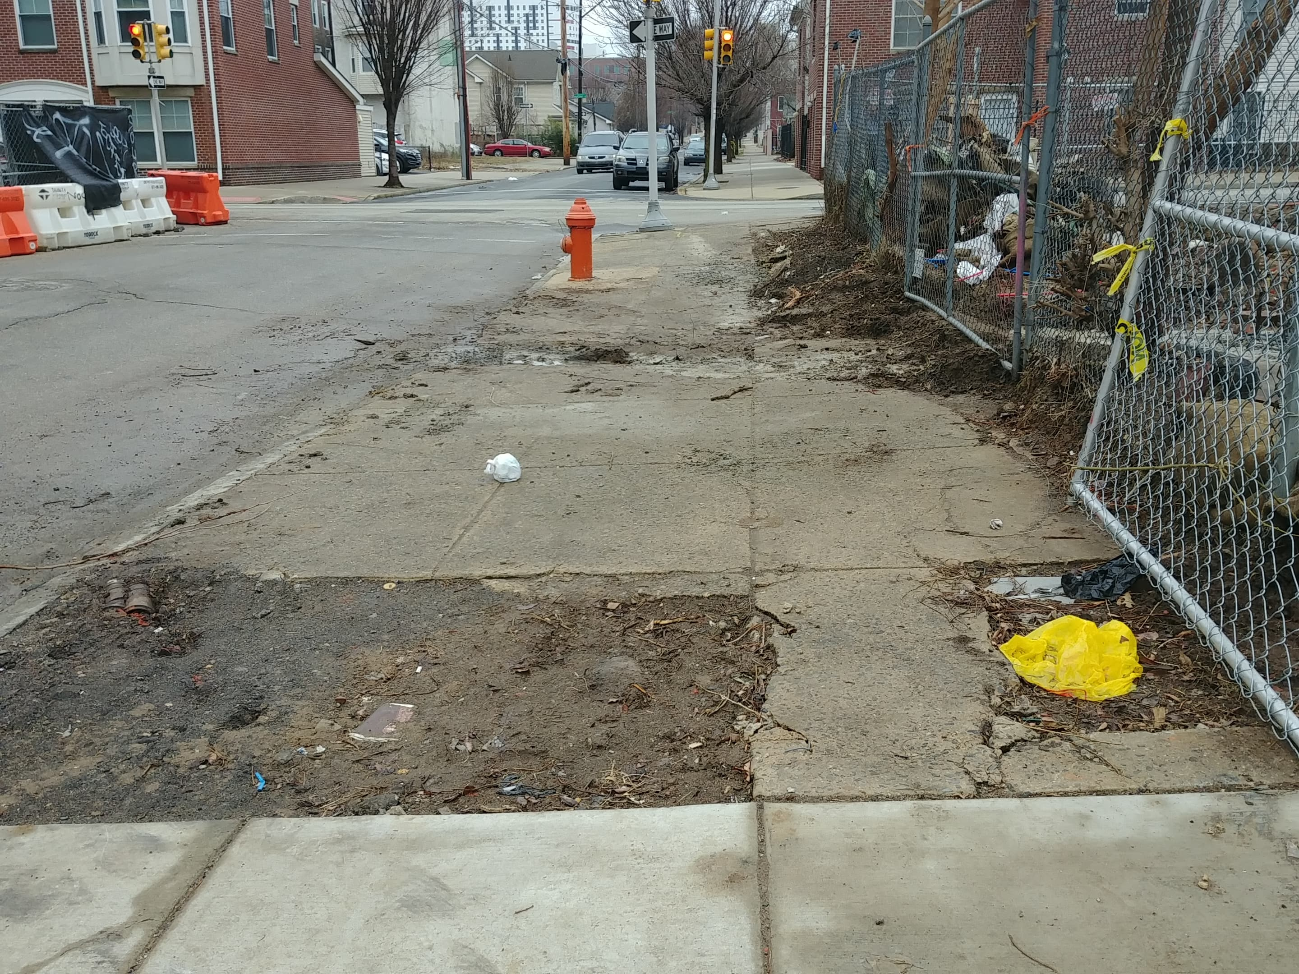
In the United States, there are notable disparities and inequities in access to preventative healthcare across socioeconomic strata.
Both individual and neighborhood-level socioeconomic factors are important to health.
E.g. Food deserts
E.g. Infrastructure that prevents safe physical activity

Slide 8
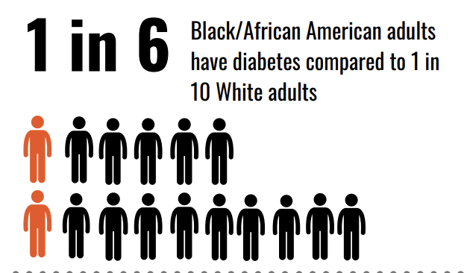
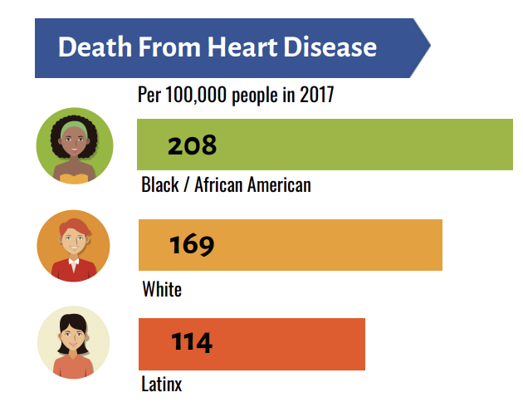
Due to societal factors such as entrenched structural inequality and discrimination in the US, individuals from racial/ethnic minority groups experience disproportionate amount of socioeconomic disadvantage.
  This has had a profound and pervasive impact on health.

Slide 9
Objective:
To explore the proportion of patients with a schizophrenia spectrum disorder (SSD) who have severe physical comorbidity burden at an urban safety net hospital.
To compare individual and neighborhood-level sociodemographic characteristics between individuals with SSD with and without severe physical comorbidity burden.

Slide 10
Hypothesis:
We hypothesized that both belonging to a racial/ethnic minority group and living in a neighborhood with high socioeconomic vulnerability will be associated with severe physical comorbidity burden in a population of individuals with a SSD.

Slide 11
Methods – Data Source
We leveraged an electronic medical record derived data set of all individuals who had at least one billed encounter with a SSD disorder between 2015 and 2022 at Boston Medical Center.
SSD was defined by international disease code 10th edition code of F20-F29
Data was extracted by our colleagues in BMC’s Clinical Data Warehouse
ACCESS: Advancing Coordinated Care through Epidemiologic Studies in Schizophrenia

Slide 12
Methods – Study Population
Inclusion criteria:
  Age 50 years old or older
  Either Schizophrenia (F20) or Schizoaffective Disorder (F25) on active problem list

Slide 13
Methods – Sociodemographic Factors
Individual level demographic factors pulled from EMR:
  Age
  Sex Assigned at Birth
  Primary language
  Race/Ethnicity
  Neighborhood level sociodemographic factors:
  Socioeconomic Social Vulnerability Index Score

Slide 14
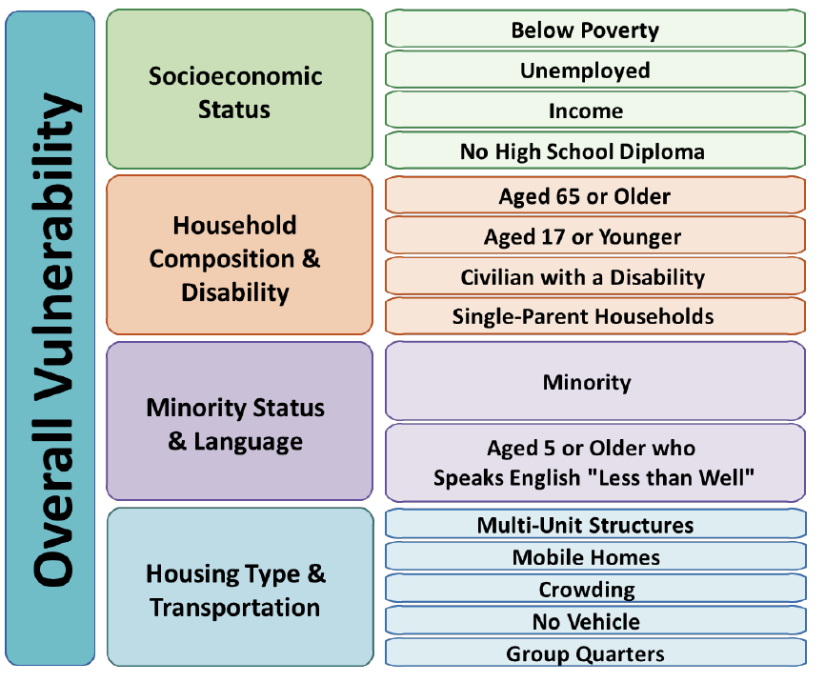

Social Vulnerability Index
Highest SES
Lowest SES
Lowest SVI
Highest SVI

Slide 15
Methods – Outcome
Charlson Comorbidity Index
Developed in 1987
Initially validated in hospitalized patients
Composed of comorbidities assigned weights based on 1-year mortality
Considered to be the gold-standard measure to assess comorbidity in clinical research

Slide 16
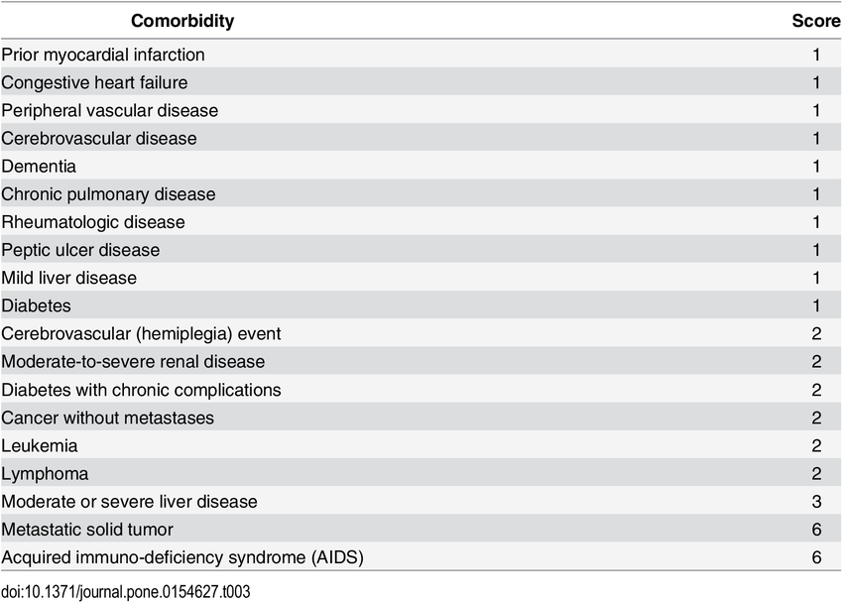
Methods – Outcome
Notes:
The CCI is a measure of the number and severity of medical conditions. Conditions included in the score are weighted by adjusted mortality

Slide 17
Methods – Outcome
CCI Score | Severity | 1-year mortality rate in original study
0 | None or Missing | 12%
1-2 | Mild | 26%
3-4 | Moderate | 52%
>4 | Severe | 85%

Slide 18
Methods – Analysis
Sociodemographic characteristics were compared between individuals with and without severe comorbidity burden (defined as CCI > 4) using chi-square tests and independent t-tests where appropriate.
Logistic regression was used to explore the relationship between key demographic factors and severe comorbidity burden. Correlation matrix of predictors was used to explore multicollinearity.
Series of sensitivity analyses were conducted:
            all ages
            SES SVI as a continuous variable
            CCI of 0 as missing data

Slide 19
Results
Of 1,739 included patients:
Figure 1. Severity of Comorbidity Burden Among Patients With Schizophrenia or Schizoaffective Disorder
Mean age was 63.47 (SD 8.7)
40.9% were assigned female at birth
16% had a primary language other than English
53.9% were non-Hispanic Black
14% were Hispanic
28.8% were non-Hispanic white
3.3% were another race/ethnicity
Median SES SVI 0.76
(IQR 0.39)

Slide 20
Results
Table 1. Individual Sociodemographic Factors by Degree of Comorbidity Burden
 | None or Missing (CCI=0) | Mild (CCI=1-2) | Moderate (CCI=3-4) | Severe Burden (CCI>4) | Severe Burden (CCI>4) | Total | Total | P-value
Age, M (SD) | 60.99 (7.848) | 63.38 (8.697) | 65.98 (8.387) | 66.46 (9.244) | 66.46 (9.244) | 63.47 (8.691) | 63.47 (8.691) | <0.001***
Sex Assigned at Birth, n (row %)
Female | 211 (29.7) | 273 (38.4) | 133(18.7) |  | 94 (13.2) |  | 711 | .405
Male | 338 (32.9) | 393 (32.9) | 174 (16.9) |  | 122 (11.9) |  | 1027
Primary Language, n (row %) |  |  |  |  |  |  |  | .474
English | 460 (31.6) | 555 (38.1) | 257 (17.6) |  | 185 (12.7) |  | 1457
Another Language | 89 (32.0) | 111 (39.9) | 47 (16.9) |  | 31 (11.2) |  | 278
Race, n (row %) |  |  |  |  |  |  |  | 0.015*
Non-Hispanic Black | 250 (27.7) | 352 (39.1) | 167 (18.5) |  | 132 (14.7) |  | 901
Hispanic | 73 (31.1) | 94 (40.0) | 34 (14.5) |  | 34 (14.5) |  | 235
Non-Hispanic white | 170 (35.3) | 181 (37.6) | 88 (18.3) |  | 43 (8.9) |  | 482
other | 23 (41.8) | 17 (30.9) | 10 (18.2) |  | 5 (9.1) |  | 55
Figure 2. Proportion of Total Cohort with Severe Comorbidity Burden
by Individual-Level Demographic Factor
Percentage of Comorbidity Burden
Individual-Level Demographic Factor

Slide 21
Results
 | None or Missing (CCI=0) |  | Mild (CCI=1-2) | Moderate (CCI=3-4) |  | Severe Burden (CCI>4) | Total
SES SVI Quartile, n (%) |  |  |  |  |  |  |  | 0.907
Q1 (Highest SES) |  | 77 (33.5) | 88 (38.3) | 39 (17.0) | 39 (17.0) | 26 (11.3) | 230
Q2 |  | 53 (30.1) | 69 (39.2) | 31 (17.6) | 31 (17.6) | 23( 13.1) | 176
Q3 |  | 107(37.4) | 97(33.9) | 51(17.8) | 51(17.8) | 31(10.8) | 286
Q4 (Lowest SES) |  | 227 (30.7) | 285 (38.6) | 142 (19.2) | 142 (19.2) | 85 (11.5) | 739
Figure 3. Proportion of Total Cohort with Severe Comorbidity Burden by Neighborhood Socioeconomic Vulnerability
Percentage of Comorbidity Burden
Neighborhood-Level Socioeconomic Vulnerability

Slide 22
Results
Table 1. Multivariate Analysis of Associations between Sociodemographic Factors and Severe Comorbidity
 | Unadjusted |  |  | Adjusted
 | OR | CI | p-value | OR | 95% CI | P-value | P-value
Age | 1.04 | 1.03-1.06 | 0.001*** | 1.05 | 1.028-1.067 | <0.001***
Sex Assigned at Birth
Male (ref)
Female | 1.13 | .848-1.502 | .405 | .931 | 0.66-1.3 |  | .679
Race/Ethnicity |  |  | .016* |  |  |  | .059
white (ref)
Non-Hispanic Black | 1.75 | 1.22-2.52 | .002** | 1.78 | 1.17-2.71 |  | .008**
Hispanic | 1.73 | 1.07-2.80 | .026* | 1.63 | .905-2.93 |  | .104
Other | 1.02 | 0.38-2.696 | .967 | 1.16 | .387-3.47 |  | .794
Neighborhood SES Vulnerability |  |  | .907 |  |  |  | .741
Q1 (ref)
Q2 | 1.179 | .648-2.147 | .589 | 1.20 | .641-2.24 |  | .573
Q3 | .954 | .549 -1.66 | .867 | .868 | .488-1.54 |  | .629
Q4 | 1.02 | .64-1.62 | .934 | .931 | .566-1.53 |  | .780
Results from sensitivity analyses (all ages, SVI as continuous, CCI of 0 treated as missing) were comparable

Slide 23
Conclusions
68% of the cohort had at least a mild comorbidity burden 12% had severe comorbidity burden | Physical comorbidity is common among individuals with a SSD. This suggests a critical need for psychiatrists to play an active role in physical healthcare.
Non-Hispanic Black individuals with had 1.78 higher odds of severe comorbidity burden compared to Non-Hispanic white individuals We did not find any association between neighborhood SES and severe morbidity burden | These findings suggest that Non-Hispanic Black individuals with SSD may higher unmet healthcare needs and translates to higher severe comorbidity burden. Neighborhood SES at our urban safety net hospital may not directly impact disease burden in this population

Slide 24
Limitations
These early findings should be interpreted with caution given the uncertainty around the extent of missing comorbidity data in this sample.
Our sample was limited to SSD defined by problem list only – we need to do quality control to ascertain if unintentionally excluded any patients by limiting to the problem list.
Further, our work is significantly impacted by the single-center nature of this study. I aim to explore this further using BMC HealthNet Claims data.

Slide 25

Thank you!
Brittany.gouse@bmc.org
BU Profile:
Works referenced:

