Slide 1



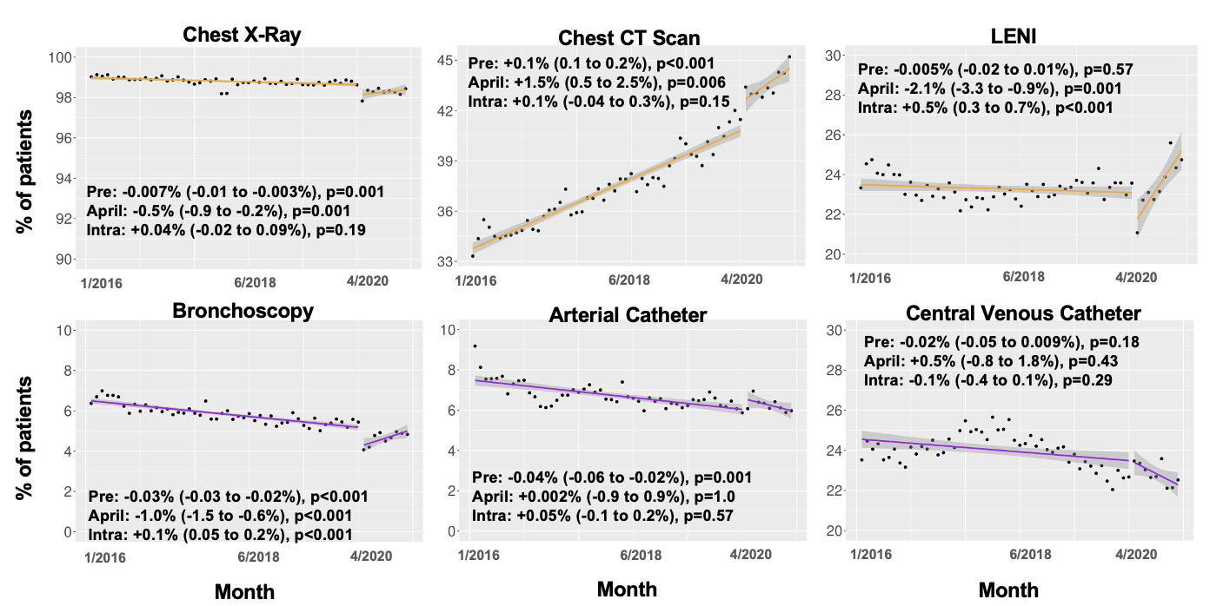
Practice Changes Among Patients Without COVID-19 Receiving Mechanical Ventilation During the COVID-19 Pandemic
Divya Shankar MD¹, Nicholas A Bosch, MD , MS¹, Allan Walkey MD MSc¹, Anica Law MD MS¹
1- The Pulmonary Center, Boston University School of Medicine, Boston, MA, United States
Background
Results
Key Findings
The COVID-19 pandemic led to clinical strain, changing staff roles, changes in care locations in the intensive care unit (ICU)
The impact on care processes for patients without COVID-19 is unclear
Table 1. Patient Characteristics by Year
Patient and hospital characteristics remained stable except for the Combined Comorbidity Score
Imaging:
  Pre-pandemic: ↓CXR, ↑Chest CT, no change in LENI
  Pandemic start : ↓CXR ↓LENI, ↑Chest CT
  Intra- pandemic: ↑LENI , no change in CXR, CT
Bedside procedures:
Pre-pandemic: ↓ bronchoscopy, ↓ arterial catheter, no change in central venous catheter
Pandemic start: ↓ bronchoscopy
Intra- pandemic: ↑ bronchoscopy
No change in arterial or central venous catheters at/intra pandemic
 | 2016 (N=144675) | 2017 (N=149345) | 2018 (N=152467) | 2019 (N=154716) | 2020 (N=140893) | Overall (N=742096)
Age, mean ± SD | 62.1 ± 16.9 | 62.2 ± 16.9 | 62.5 ± 16.7 | 62.4 ± 16.7 | 61.9 ± 16.7 | 62.2 ± 16.8
Male (%) | 80298 (55.5) | 83386 (55.8) | 85345 (56.0) | 87316 (56.4) | 80820 (57.4) | 417165 (56.2)
Urban Hospital (%) | 128807 (89.0) | 132901 (89.0) | 135688 (89.0) | 137425 (88.8) | 125016 (88.7) | 659837 (88.9)
Teaching Hospital (%) | 79639 (55.0) | 82142 (55.0) | 83815 (55.0) | 84943 (54.9) | 78241 (55.5) | 408780 (55.1)
Combined Comorbidity Score, mean ± SD | 3.72 ± 2.03 | 3.82 ± 2.06 | 3.90 ± 2.06 | 3.95 ± 2.07 | 4.02 ± 2.08 | 3.88 ± 2.06
Objective
Assess changes in common ICU practices among mechanically ventilated patients with acute respiratory failure before and after the start of the COVID-19 pandemic
Methods
Figure 1. Rates of change for common ICU practices before and after the beginning of the COVID-19 pandemic
Design: Retrospective cohort study, Premier Healthcare Database, 2016-2020 (~25% of US hospitalizations)
Cohort: Adult patients (≥18) admitted to an ICU or step down unit receiving mechanical ventilation for acute respiratory failure
Excluded: COVID-19 (ICD-10 U07.1)
Primary Outcomes, Rates:
Imaging: chest x-ray (CXR), chest CT, lower extremity non-invasive vascular testing (LENI)
Bedside procedures: bronchoscopy, arterial catheters, central venous catheters
Analysis: Interrupted time-series analysis assessing: (1) trend before COVID-19 pandemic, (2) level change in trend at the onset of the US pandemic (April 2020), and (3) trend change intra-pandemic
Limitations
Risk of misclassification when using ICD-10 and charge codes in administrative databases
Implications
Imaging practices and bedside procedures changed at the start of and during the COVID-19 pandemic, perhaps due to concern for missed COVID-19 diagnoses or attempts to decrease bedside exposures, and shifting staff roles
Future studies should assess whether patient-centered outcomes were impacted by these practice changes
Unadjusted trends are plotted before and after April 2020. Rates adjusted for seasonality and autocorrelation are noted for pre-pandemic, at April 2020, and intra-pandemic
Funding Source: NIH T32 HL007035

Slide 2
Table 1: Patient Characteristics by Year
 | 2016 (N=144675) | 2017 (N=149345) | 2018 (N=152467) | 2019 (N=154716) | 2020 (N=140893) | Overall (N=742096)
Age, mean ± SD | 62.1 ± 16.9 | 62.2 ± 16.9 | 62.5 ± 16.7 | 62.4 ± 16.7 | 61.9 ± 16.7 | 62.2 ± 16.8
Male (%) | 80298 (55.5) | 83386 (55.8) | 85345 (56.0) | 87316 (56.4) | 80820 (57.4) | 417165 (56.2)
Urban Hospital (%) | 128807 (89.0) | 132901 (89.0) | 135688 (89.0) | 137425 (88.8) | 125016 (88.7) | 659837 (88.9)
Teaching Hospital (%) | 79639 (55.0) | 82142 (55.0) | 83815 (55.0) | 84943 (54.9) | 78241 (55.5) | 408780 (55.1)
Combined Comorbidity Score, mean ± SD | 3.72 ± 2.03 | 3.82 ± 2.06 | 3.90 ± 2.06 | 3.95 ± 2.07 | 4.02 ± 2.08 | 3.88 ± 2.06
Key Findings
Patient and hospital characteristics remained stable except for Combined Comorbidity Score

Slide 3
Figure 1: Rates of change for common ICU practices before and after the beginning of the COVID-19 pandemic
Key Findings
Imaging:
  Pre-pandemic: ↓CXR, ↑Chest CT, no change in LENI
  Pandemic start : ↓CXR ↓LENI, ↑Chest CT
  Intra- pandemic: ↑LENI , no change in CXR, CT
Bedside procedures:
Pre-pandemic: ↓ bronchoscopy, ↓ arterial catheter, no change in central venous catheter
Pandemic start: ↓ bronchoscopy
Intra- pandemic: ↑ bronchoscopy
No change in arterial or central venous catheters at/intra- pandemic
Unadjusted trends are plotted before and after April 2020. Rates adjusted for seasonality and autocorrelation are noted for pre-pandemic, at April 2020, and intra-pandemic

