Slide 1


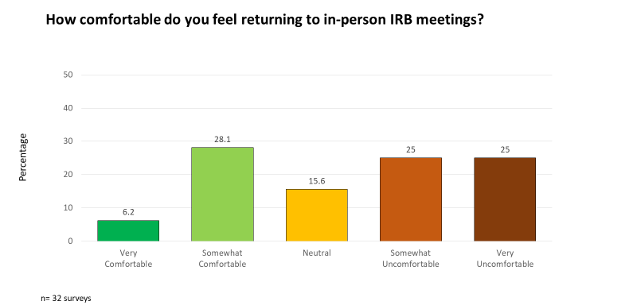
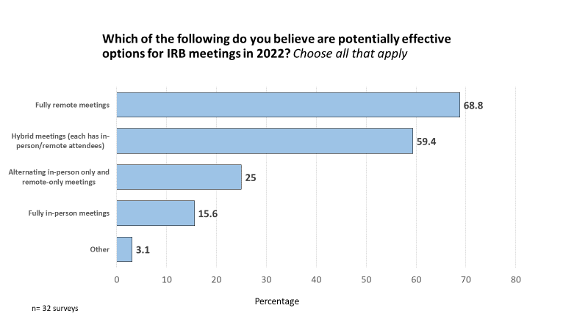
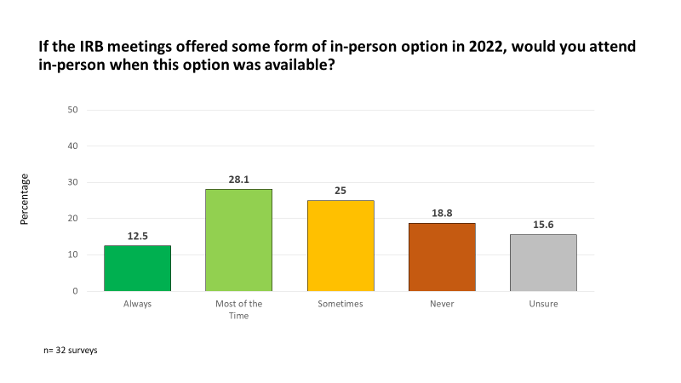
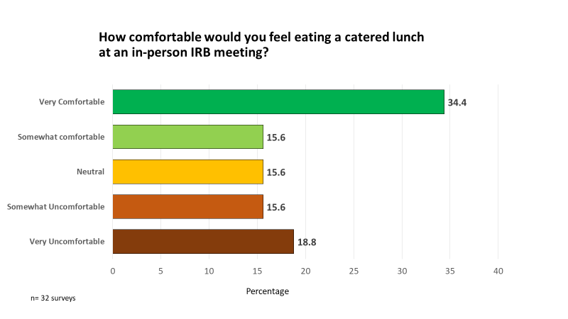
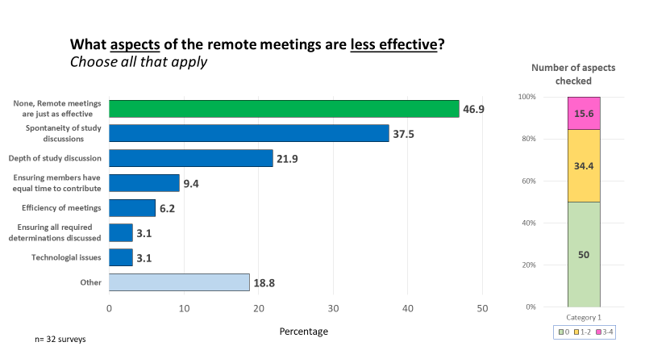
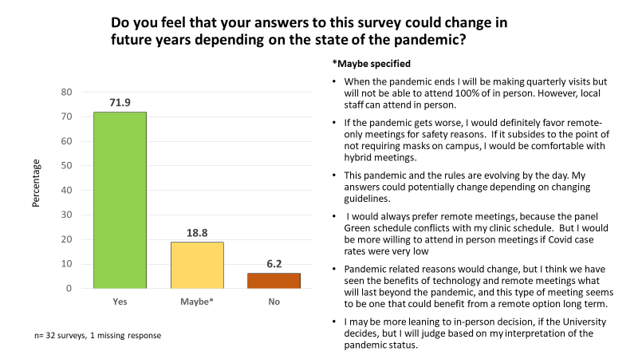
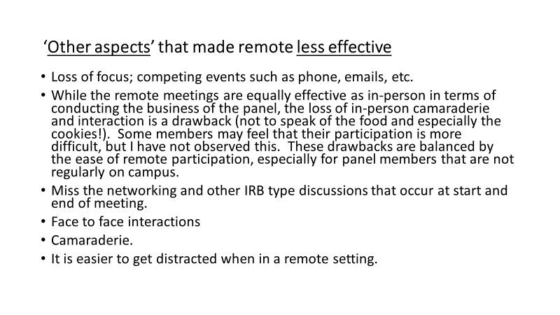
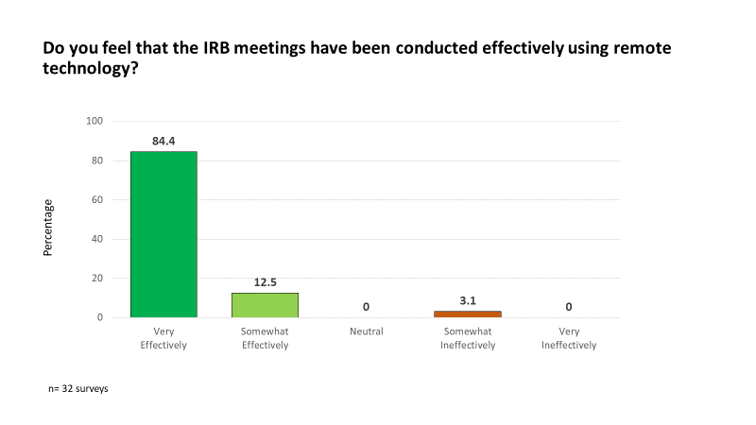
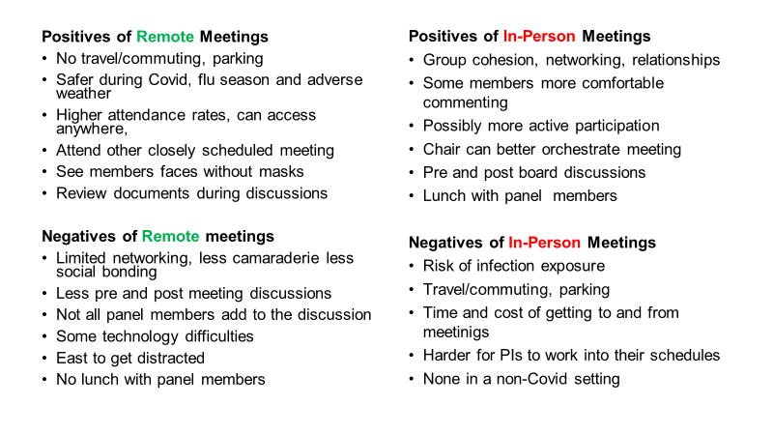
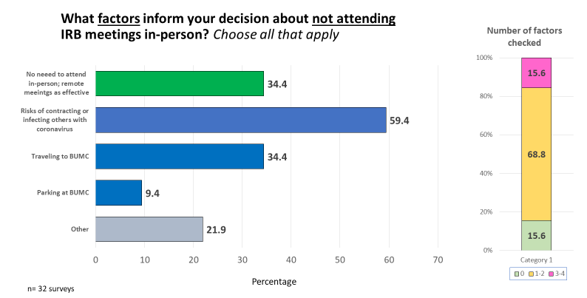
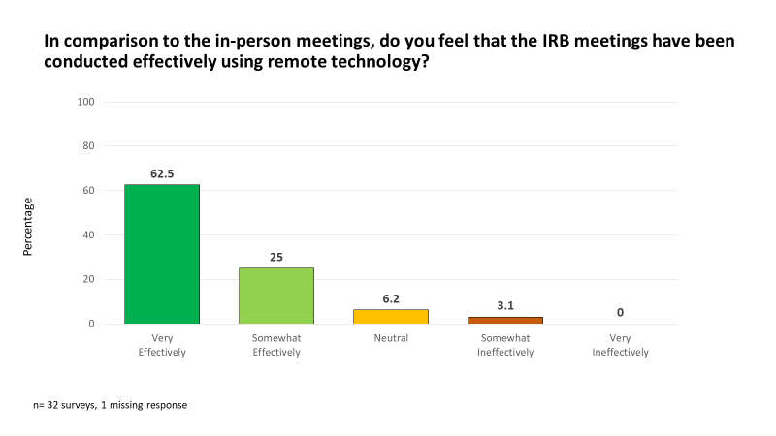
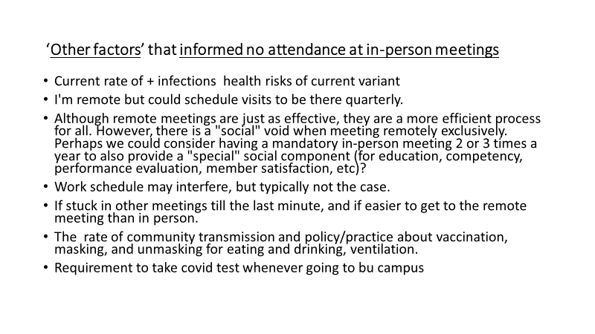
IRB Meetings during the Covid Pandemic and Post-Covid Options:
Results from the 2022 Survey of BMC/BUMC IRB Panel Members
Matthew Ogrodnik MS CIP, Jamie Merrill MPH CIP, James Feldman MD MPH, Stephen Pelton MD, David Kaufman ScD, Sanford Auerbach MD,
Eric Devine PhD, Brandon Finn BS, Karla Damus PhD RN
Office of Human Research Affairs, BUMC/BMC Institutional Review Board
ABSTRACT
METHODS
RESULTS
RESULTS
Background: Due to the Covid pandemic, since March 2020 all Institutional Review Board (IRB) meetings have been conducted via Zoom instead of in-person. Although this format has been successful, a study was needed to assess options to conduct safe, inclusive, engaging future IRB meetings.
Objective: To assess optimal policies and procedures for conducting IRB panel meetings post-Covid.
Methods: In January 2022, a 21-item REDCap survey was emailed to all IRB Chairs and members to obtain their anonymous input on the format/procedures of future IRB meetings. Descriptive statistical analyses were conducted on the returned surveys (32/42, 76% response rate). Stratified analyses by the four IRB panels, IRB member affiliation, and voting status were done using NCSS-9. Results were presented and discussed with each IRB panel to further inform the format/procedures for future meetings.
Results: 84% reported remote IRB meetings had been conducted ‘Very effectively’, 13% ‘Somewhat effectively’, and 3% ‘Somewhat ineffectively’. Comparing remote meetings to in-person meetings, 62.5% said they were conducted ‘Very effectively’, 25% ‘Somewhat effectively’, 6% ‘Neutral’, and 3% ‘Somewhat ineffectively’. 34% felt ‘Very/Somewhat’ comfortable about returning to in-person meetings, 16% were ‘Neutral’ and 50% were ‘Very/Somewhat’ uncomfortable. Asked if they would attend in-person meetings in 2022, 13% said ‘Always’, 28% ‘Most of the time’, 25% ‘Sometimes’, 19% ‘Never’ and 16% were ‘Unsure’. Preferences for future format options were: 69% fully remote, 59% hybrid, 25% alternating, 16% fully in-person. Asked if their responses could change in the future- 79% responded ‘Yes’, 19% ‘Maybe‘, and 6% ‘No’. What made IRB meetings more or less effective, factors informing whether to attend in-person meetings, and the positives and negatives about remote/in-person meetings will also be presented.
Conclusions: Remote IRB meetings are effective and should continue as a future option. Regular IRB surveys are important to cultivate inclusive procedures that reflect the perspectives of IRB members.
A 21-item survey with closed- and open-ended questions was developed in REDCap
An exempt human subjects research determination was granted by the IRB on 1/4/2022
On 1/6/2022, the survey was emailed to the members of the BMC/BUMC IRB members requesting their participation
Reminders were emailed to potential respondents at 3 timepoints (1/12/22; 1/21/2022; and 1/28/2022) with the last response received on 2/4/2022
Frequency distributions and cross tabulations were created from the cleaned database for all responses, truncated responses, and responses stratified by respondents’ primary panel of service
Analyses were done using the statistical software NCSS9
Results were presented and discussed with each IRB panel
Informed by the results and discussion, recommendations were developed regarding IRB procedures and format for the post-Covid pandemic
SURVEY RESPONDENTS
A total of 32 surveys were completed which gave a response rate of 76.2% (32/42)
All respondents read the consent statement and agreed to participate
5 respondents (15.6%) identified as Chairs or Vice Chairs
The primary panel distribution was: Blue 28.1% (n=9), Green 31.2% (n=10), Orange 25.0% (n=8) and 15.6% (n=5) did not specify a primary panel
56.2% were affiliated, 18.8% were unaffiliated, and 25% did not respond or preferred not to respond.
68.8% were full time voting members, 9.4% selected ‘other’, 18.8% did not respond, and 3.1% selected ‘unsure’
RESULTS
BACKGROUND
The BMC/BUMC Human Research Protection Program (HRPP) requires that annually the HRPP Director develop a Quality Improvement (QI) plan for the coming year in consultation with other HRPP members. The operational goal for 2021-22 was to determine the optimal policies and procedures for conducting IRB panel meetings moving forward.
To address this goal, in January 2022, a survey was emailed to all IRB Chairs and IRB panel members (n=42) to obtain their anonymous input on the format and potential resumption of in-person IRB meetings.
Survey results were analyzed and presented to each of the IRB panels ( Blue, Green, Orange) for discussion. The input from each panel was integrated with the results to develop procedures for conducting future, post pandemic IRB panel meetings.
CONCLUSIONS
Remote IRB meetings are an effective option. Many IRB panel members stated they would not be comfortable returning in-person due to exposure risk. Members also noted that while their perspectives could change in the future, a remote option should continue to be offered.
Implementation of regular IRB surveys to obtain member feedback is important to cultivate an inclusive HRPP QI plan that integrates the important voices of IRB members.
ACKNOWLEDGEMENTS
CONTACT
Gratitude to all IRB members for the vital work they do to promote and facilitate ethical research, for their flexibility and resilience during the pandemic despite many challenges, and for participating in this research and completing the survey.
For questions and more information contact the OHRA Director:
Matt Ogrodnik, maogrodn@bu.edu, (617) 358-6559

