Slide 1


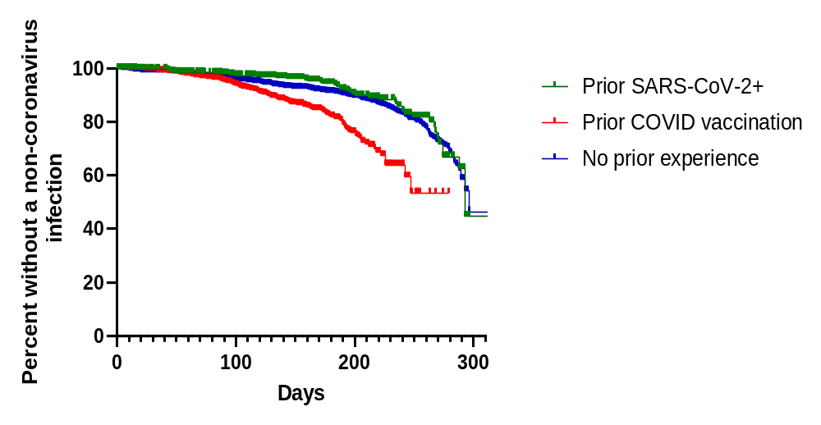
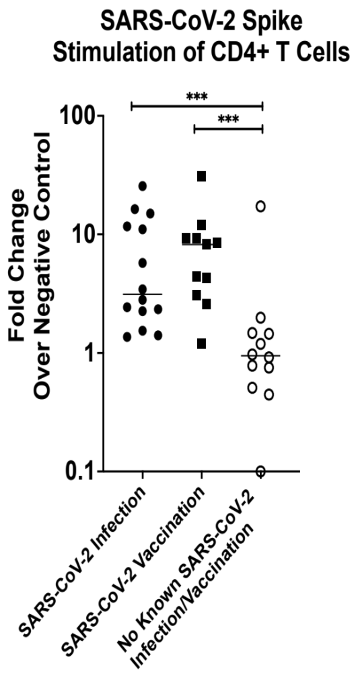
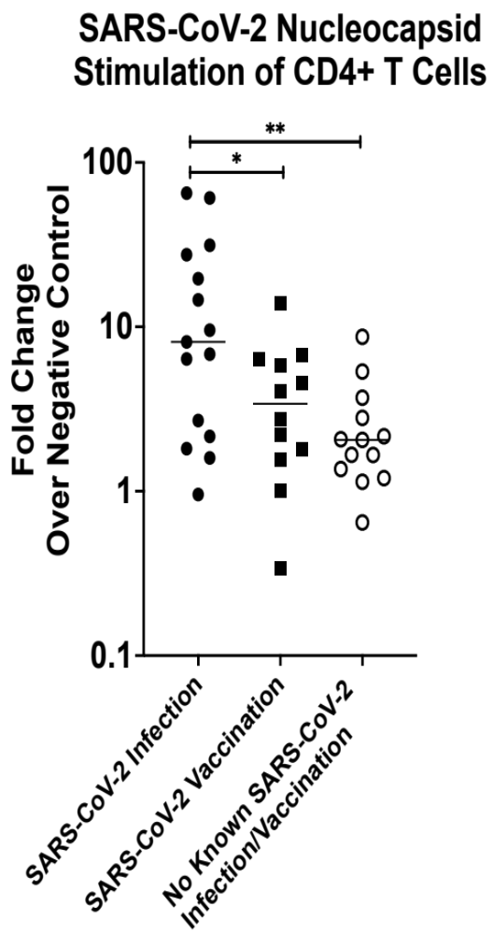
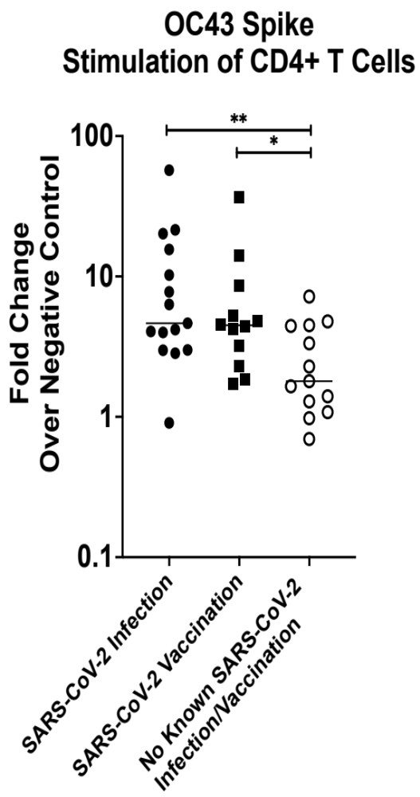
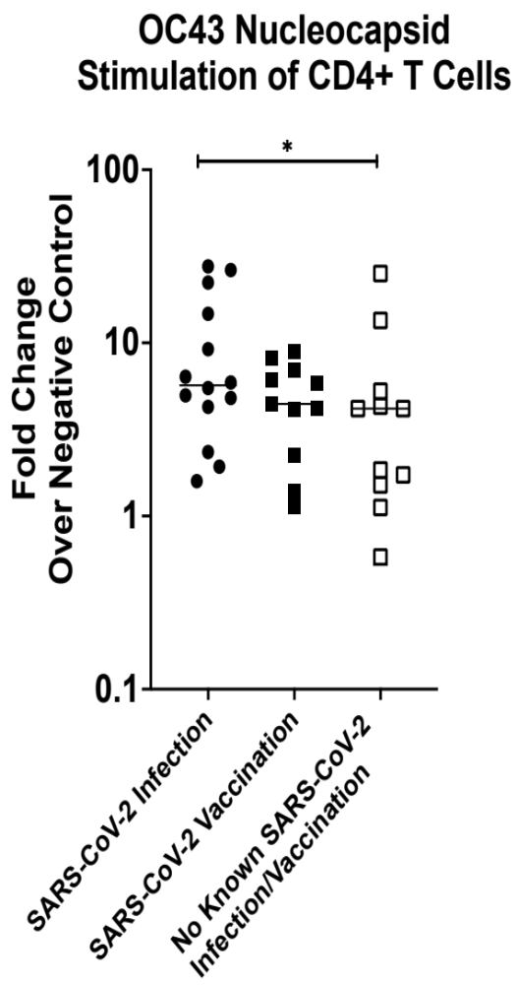
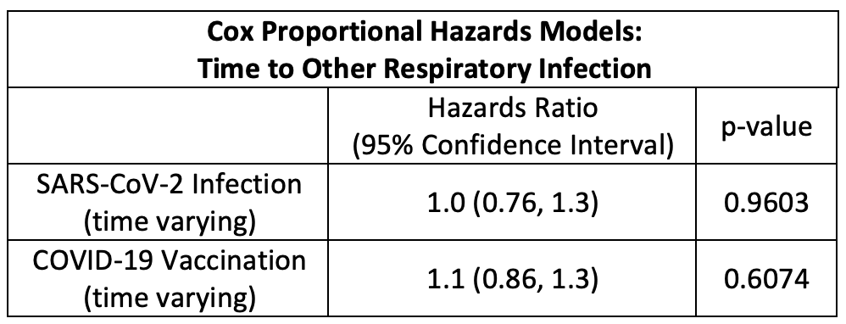
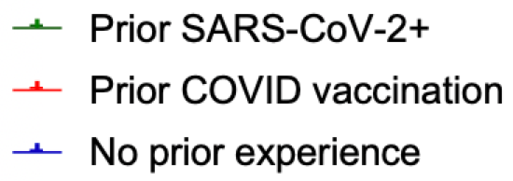
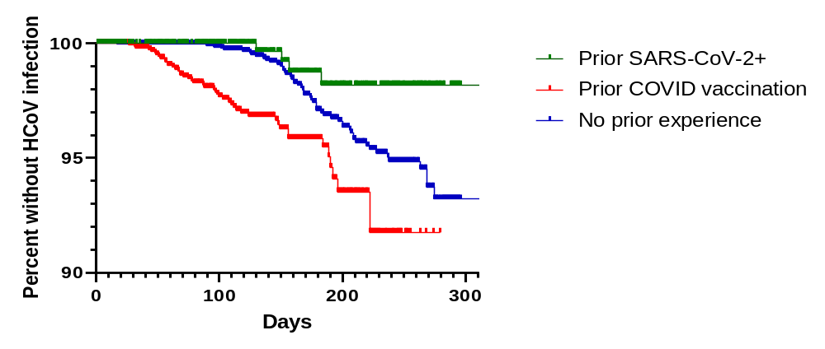
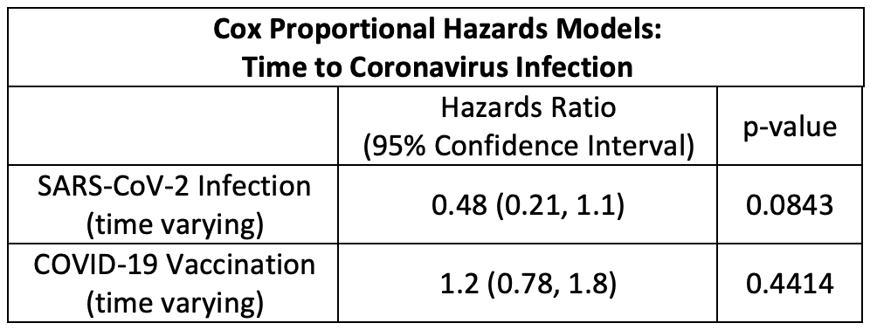
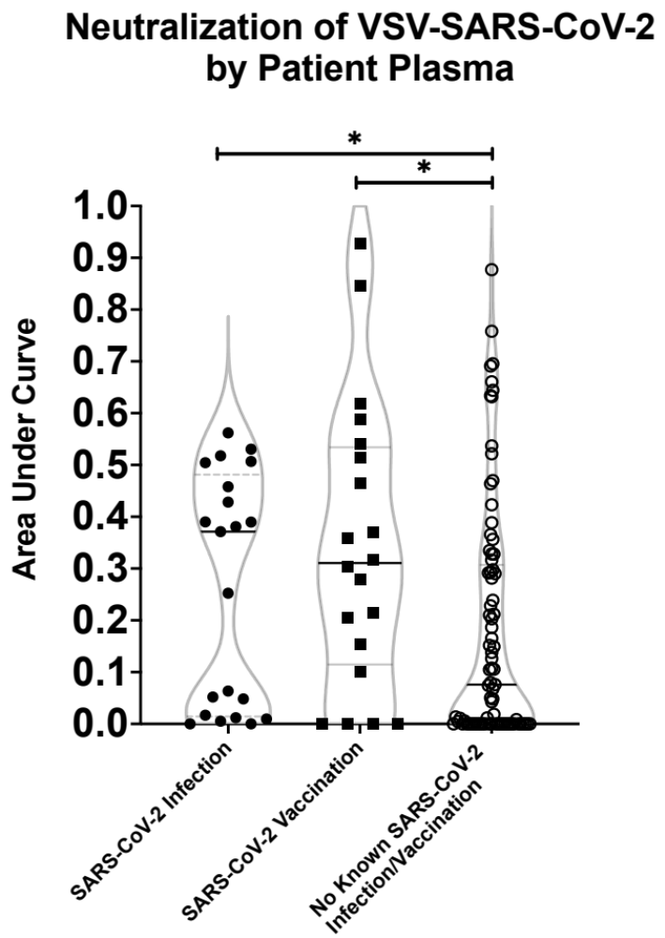
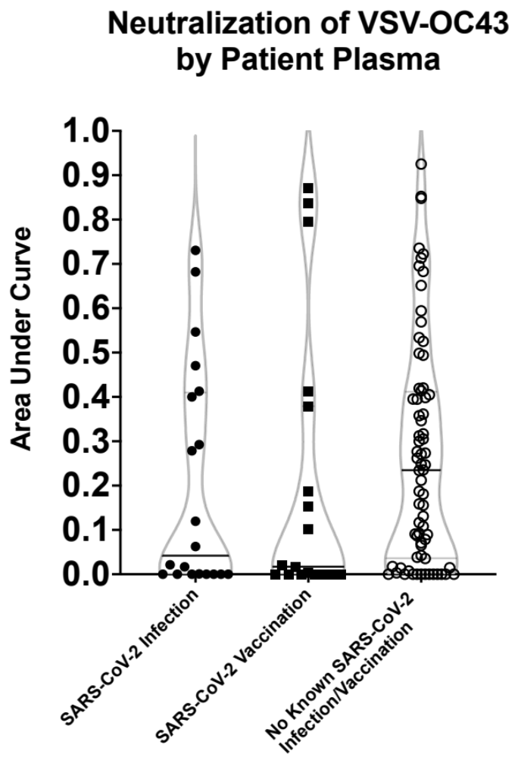
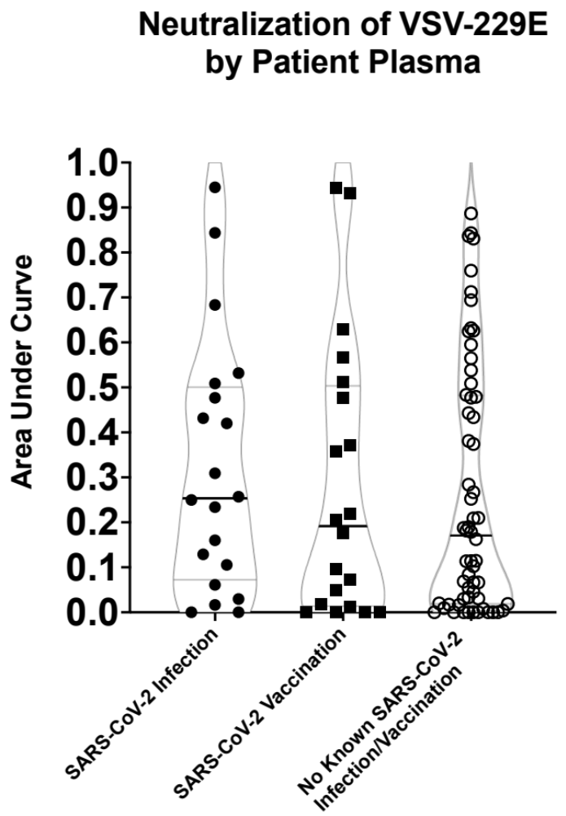
Prior SARS-CoV-2 infection more than COVID-19 vaccination associates
with lower incidence of subsequent symptomatic endemic coronavirus infection
David Bean¹, Janet Monroe², Alex Olson², Janice Weinberg³, Manish Sagar^{1,2}
¹ Department of Microbiology, BUSM, ² Department of Medicine, BUSM, ³ Department of Biostatistics, BUSPH
Background
Results
Results (cont.)
Immune responses elicited by either SARS-CoV-2 infection or vaccination protect against severe COVID-19 in subsequent SARS-CoV-2 infections
It is currently unknown whether these immune responses will protect against symptomatic infections caused by other human coronaviruses
Incidence of Respiratory Infections Post SARS-CoV-2 Exposure
Viral Peptide Specific T Cell Activation
A
A
B
C
D
Objective
Examine incidence of and immune differences against related but different human coronaviruses (CoV) among individuals with SARS-CoV-2 infection, COVID-19 vaccination, or neither exposure
B
Methods
Patient Recruitment and Sample Collection from BMC
Dec 2019 – Oct 2021
Figure 1. Time between SARS-CoV-2 exposure and a subsequent respiratory infection. The incidence of a non-CoV (A) or HCoV (B) infection was compared dependent on the time since a prior SARS-CoV-2 infection (green), COVID-19 vaccination (red), or neither exposure (blue). Hazard ratios were calculated comparing the incidence rate of respiratory infections between the group of interest to the group of individuals with no SARS-CoV-2 exposure. The models were adjusted for factors such as age and existing co-morbidities.
Figure 3. CD4⁺ T cell activation after CoV peptide stimulation. The percent of activated CD4⁺ T cells (CD134⁺, CD137⁺) was measured after stimulation with viral protein derived peptide pools: SARS-CoV-2 spike (A), SARS-CoV-2 nucleocapsid (B), OC43 spike (C), OC43 nucleocapsid (D). The fold change was calculated from the ratio of virus specific T cell responses to the negative control T cell responses. Univariate comparisons between groups were done by Mann-Whitney U tests. *, **, and *** denotes p≤0.05, p≤0.01, and p≤0.001 respectively.
SARS-CoV-2 infection (n=493), COVID-19 vaccination (n=1,568), or neither exposure (n=2,874).
Dec 2020 – Oct 2021
Dec 2019 – Oct 2021
Plasma Neutralization of CoV-Spike Pseudovirus
Conclusions
Signs of a respiratory infection. Underwent a comprehensive respiratory pathogen test at BMC
Blood was collected from a subset of patients without a symptomatic respiratory infection
A
B
C
Prior SARS-CoV-2 infection, but not COVID-19 vaccination, protects against subsequent symptomatic infection against related but different CoVs
Immune responses to CoV spike are similar between SARS-CoV-2 infected and COVID-19 vaccinated individuals
CD4⁺ T cell responses to CoV nucleocapsid are elevated in SARS-CoV-2 infected individuals
Addition of CoV non-spike antigens to future vaccines could improve pan-CoV vaccine efforts
Tested positive for an endemic human coronavirus
(229E, HKU1, NL63, OC43)
Tested positive for a different respiratory pathogen
(rhinovirus, enterovirus, etc.)
SARS-CoV-2 infection (n=21), COVID-19 vaccination (n=20), or neither exposure (n=81).
Plasma was tested for the ability to neutralize
CoV spike pseudovirus
(Figure 2)
Levels of T cell activation was measured in the presence of various CoV peptide pools (Figure 3).
Acknowledgements
Analyzed incidence of respiratory infections dependent on the time since SARS-CoV-2 exposure (infection, vaccination, or neither) (Figure 1)
Figure 2. Neutralization of CoV spike pseudotyped virus by patient plasma. A series of dilutions of patient plasma was tested for the ability to neutralize various VSV-CoV-spike pseudoviruses: VSV-SARS-CoV-2-spike (A), VSV-OC43-spike (B), and VSV-229E-spike (C). Neutralization curves were created from the dilution series and area under the curve (AUC) was calculated. Univariate comparisons between groups were done by Mann-Whitney U tests. * denotes p≤0.05.
We would like to thank all the patients of BMC for donating blood to our study. We would also like to thank the study funding sources, K24-AI145661 and P30-AI042853, and the NIH T32-5T32AI00730928 for my funding in the lab.

Slide 2
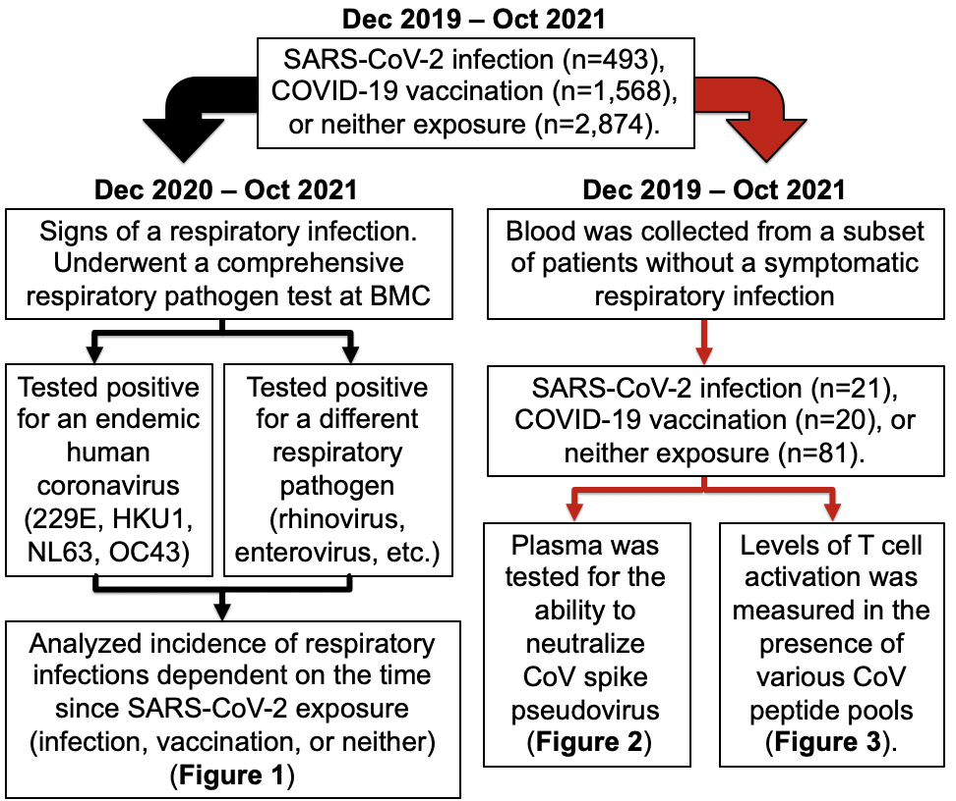
Methods
Patient Recruitment and Sample Collection from BMC

Slide 3
Prior SARS-CoV-2 infection more than COVID-19 vaccination associates
with lower incidence of subsequent symptomatic endemic coronavirus infection
David Bean¹, Janet Monroe², Alex Olson², Janice Weinberg³, Manish Sagar^{1,2}
¹ Department of Microbiology, BUSM, ² Department of Medicine, BUSM, ³ Department of Biostatistics, BUSPH
Background
Results
Results (cont.)
Immune responses elicited by either SARS-CoV-2 infection or vaccination protect against severe COVID-19 in subsequent SARS-CoV-2 infections
It is currently unknown whether these immune responses will protect against symptomatic infections caused by other human coronaviruses
Incidence of Respiratory Infections Post SARS-CoV-2 Exposure
Viral Peptide Specific T Cell Activation
A
A
B
C
D
Objective
Examine incidence of and immune differences against related but different human coronaviruses (CoV) among individuals with SARS-CoV-2 infection, COVID-19 vaccination, or neither exposure
B
Methods
Patient Recruitment and Sample Collection from BMC
Dec 2019 – Oct 2021
Figure 1. Time between SARS-CoV-2 exposure and a subsequent respiratory infection. The incidence of a non-CoV (A) or HCoV (B) infection was compared dependent on the time since a prior SARS-CoV-2 infection (green), COVID-19 vaccination (red), or neither exposure (blue). Hazard ratios were calculated comparing the incidence rate of respiratory infections between the group of interest to the group of individuals with no SARS-CoV-2 exposure. The models were adjusted for factors such as age and existing co-morbidities.
Figure 3. CD4⁺ T cell activation after CoV peptide stimulation. The percent of activated CD4⁺ T cells (CD134⁺, CD137⁺) was measured after stimulation with viral protein derived peptide pools: SARS-CoV-2 spike (A), SARS-CoV-2 nucleocapsid (B), OC43 spike (C), OC43 nucleocapsid (D). The fold change was calculated from the ratio of virus specific T cell responses to the negative control T cell responses. Univariate comparisons between groups were done by Mann-Whitney U tests. *, **, and *** denotes p≤0.05, p≤0.01, and p≤0.001 respectively.
SARS-CoV-2 infection (n=493), COVID-19 vaccination (n=1,568), or neither exposure (n=2,874).
Dec 2020 – Oct 2021
Dec 2019 – Oct 2021
Plasma Neutralization of CoV-Spike Pseudovirus
Conclusions
Signs of a respiratory infection. Underwent a comprehensive respiratory pathogen test at BMC
Blood was collected from a subset of patients without a symptomatic respiratory infection
A
B
C
Prior SARS-CoV-2 infection, but not COVID-19 vaccination, protects against subsequent symptomatic infection against related but different CoVs
Immune responses to CoV spike are similar between SARS-CoV-2 infected and COVID-19 vaccinated individuals
CD4⁺ T cell responses to CoV nucleocapsid are elevated in SARS-CoV-2 infected individuals
Addition of CoV non-spike antigens to future vaccines could improve pan-CoV vaccine efforts
Tested positive for an endemic human coronavirus
(229E, HKU1, NL63, OC43)
Tested positive for a different respiratory pathogen
(rhinovirus, enterovirus, etc.)
SARS-CoV-2 infection (n=21), COVID-19 vaccination (n=20), or neither exposure (n=81).
Plasma was tested for the ability to neutralize
CoV spike pseudovirus
(Figure 2)
Levels of T cell activation was measured in the presence of various CoV peptide pools (Figure 3).
Acknowledgements
Analyzed incidence of respiratory infections dependent on the time since SARS-CoV-2 exposure (infection, vaccination, or neither) (Figure 1)
Figure 2. Neutralization of CoV spike pseudotyped virus by patient plasma. A series of dilutions of patient plasma was tested for the ability to neutralize various VSV-CoV-spike pseudoviruses: VSV-SARS-CoV-2-spike (A), VSV-OC43-spike (B), and VSV-229E-spike (C). Neutralization curves were created from the dilution series and area under the curve (AUC) was calculated. Univariate comparisons between groups were done by Mann-Whitney U tests. * denotes p≤0.05.
We would like to thank all the patients of BMC for donating blood to our study. We would also like to thank the study funding sources, K24-AI145661 and P30-AI042853, and the NIH T32-5T32AI00730928 for my funding in the lab.

Slide 4
Results
Figure 1. Time between SARS-CoV-2 exposure and a subsequent respiratory infection
A
B

Slide 5
Prior SARS-CoV-2 infection more than COVID-19 vaccination associates
with lower incidence of subsequent symptomatic endemic coronavirus infection
David Bean¹, Janet Monroe², Alex Olson², Janice Weinberg³, Manish Sagar^{1,2}
¹ Department of Microbiology, BUSM, ² Department of Medicine, BUSM, ³ Department of Biostatistics, BUSPH
Background
Results
Results (cont.)
Immune responses elicited by either SARS-CoV-2 infection or vaccination protect against severe COVID-19 in subsequent SARS-CoV-2 infections
It is currently unknown whether these immune responses will protect against symptomatic infections caused by other human coronaviruses
Incidence of Respiratory Infections Post SARS-CoV-2 Exposure
Viral Peptide Specific T Cell Activation
A
A
B
C
D
Objective
Examine incidence of and immune differences against related but different human coronaviruses (CoV) among individuals with SARS-CoV-2 infection, COVID-19 vaccination, or neither exposure
B
Methods
Patient Recruitment and Sample Collection from BMC
Dec 2019 – Oct 2021
Figure 1. Time between SARS-CoV-2 exposure and a subsequent respiratory infection. The incidence of a non-CoV (A) or HCoV (B) infection was compared dependent on the time since a prior SARS-CoV-2 infection (green), COVID-19 vaccination (red), or neither exposure (blue). Hazard ratios were calculated comparing the incidence rate of respiratory infections between the group of interest to the group of individuals with no SARS-CoV-2 exposure. The models were adjusted for factors such as age and existing co-morbidities.
Figure 3. CD4⁺ T cell activation after CoV peptide stimulation. The percent of activated CD4⁺ T cells (CD134⁺, CD137⁺) was measured after stimulation with viral protein derived peptide pools: SARS-CoV-2 spike (A), SARS-CoV-2 nucleocapsid (B), OC43 spike (C), OC43 nucleocapsid (D). The fold change was calculated from the ratio of virus specific T cell responses to the negative control T cell responses. Univariate comparisons between groups were done by Mann-Whitney U tests. *, **, and *** denotes p≤0.05, p≤0.01, and p≤0.001 respectively.
SARS-CoV-2 infection (n=493), COVID-19 vaccination (n=1,568), or neither exposure (n=2,874).
Dec 2020 – Oct 2021
Dec 2019 – Oct 2021
Plasma Neutralization of CoV-Spike Pseudovirus
Conclusions
Signs of a respiratory infection. Underwent a comprehensive respiratory pathogen test at BMC
Blood was collected from a subset of patients without a symptomatic respiratory infection
A
B
C
Prior SARS-CoV-2 infection, but not COVID-19 vaccination, protects against subsequent symptomatic infection against related but different CoVs
Immune responses to CoV spike are similar between SARS-CoV-2 infected and COVID-19 vaccinated individuals
CD4⁺ T cell responses to CoV nucleocapsid are elevated in SARS-CoV-2 infected individuals
Addition of CoV non-spike antigens to future vaccines could improve pan-CoV vaccine efforts
Tested positive for an endemic human coronavirus
(229E, HKU1, NL63, OC43)
Tested positive for a different respiratory pathogen
(rhinovirus, enterovirus, etc.)
SARS-CoV-2 infection (n=21), COVID-19 vaccination (n=20), or neither exposure (n=81).
Plasma was tested for the ability to neutralize
CoV spike pseudovirus
(Figure 2)
Levels of T cell activation was measured in the presence of various CoV peptide pools (Figure 3).
Acknowledgements
Analyzed incidence of respiratory infections dependent on the time since SARS-CoV-2 exposure (infection, vaccination, or neither) (Figure 1)
Figure 2. Neutralization of CoV spike pseudotyped virus by patient plasma. A series of dilutions of patient plasma was tested for the ability to neutralize various VSV-CoV-spike pseudoviruses: VSV-SARS-CoV-2-spike (A), VSV-OC43-spike (B), and VSV-229E-spike (C). Neutralization curves were created from the dilution series and area under the curve (AUC) was calculated. Univariate comparisons between groups were done by Mann-Whitney U tests. * denotes p≤0.05.
We would like to thank all the patients of BMC for donating blood to our study. We would also like to thank the study funding sources, K24-AI145661 and P30-AI042853, and the NIH T32-5T32AI00730928 for my funding in the lab.

Slide 6
Results
Figure 2. Neutralization of CoV spike pseudotyped virus by patient plasma
A
B
C

Slide 7
Results
Figure 3. CD4⁺ T cell activation after CoV peptide stimulation
A
B
C
D

Slide 8
Prior SARS-CoV-2 infection more than COVID-19 vaccination associates
with lower incidence of subsequent symptomatic endemic coronavirus infection
David Bean¹, Janet Monroe², Alex Olson², Janice Weinberg³, Manish Sagar^{1,2}
¹ Department of Microbiology, BUSM, ² Department of Medicine, BUSM, ³ Department of Biostatistics, BUSPH
Background
Results
Results (cont.)
Immune responses elicited by either SARS-CoV-2 infection or vaccination protect against severe COVID-19 in subsequent SARS-CoV-2 infections
It is currently unknown whether these immune responses will protect against symptomatic infections caused by other human coronaviruses
Incidence of Respiratory Infections Post SARS-CoV-2 Exposure
Viral Peptide Specific T Cell Activation
A
A
B
C
D
Objective
Examine incidence of and immune differences against related but different human coronaviruses (CoV) among individuals with SARS-CoV-2 infection, COVID-19 vaccination, or neither exposure
B
Methods
Patient Recruitment and Sample Collection from BMC
Dec 2019 – Oct 2021
Figure 1. Time between SARS-CoV-2 exposure and a subsequent respiratory infection. The incidence of a non-CoV (A) or HCoV (B) infection was compared dependent on the time since a prior SARS-CoV-2 infection (green), COVID-19 vaccination (red), or neither exposure (blue). Hazard ratios were calculated comparing the incidence rate of respiratory infections between the group of interest to the group of individuals with no SARS-CoV-2 exposure. The models were adjusted for factors such as age and existing co-morbidities.
Figure 3. CD4⁺ T cell activation after CoV peptide stimulation. The percent of activated CD4⁺ T cells (CD134⁺, CD137⁺) was measured after stimulation with viral protein derived peptide pools: SARS-CoV-2 spike (A), SARS-CoV-2 nucleocapsid (B), OC43 spike (C), OC43 nucleocapsid (D). The fold change was calculated from the ratio of virus specific T cell responses to the negative control T cell responses. Univariate comparisons between groups were done by Mann-Whitney U tests. *, **, and *** denotes p≤0.05, p≤0.01, and p≤0.001 respectively.
SARS-CoV-2 infection (n=493), COVID-19 vaccination (n=1,568), or neither exposure (n=2,874).
Dec 2020 – Oct 2021
Dec 2019 – Oct 2021
Plasma Neutralization of CoV-Spike Pseudovirus
Conclusions
Signs of a respiratory infection. Underwent a comprehensive respiratory pathogen test at BMC
Blood was collected from a subset of patients without a symptomatic respiratory infection
A
B
C
Prior SARS-CoV-2 infection, but not COVID-19 vaccination, protects against subsequent symptomatic infection against related but different CoVs
Immune responses to CoV spike are similar between SARS-CoV-2 infected and COVID-19 vaccinated individuals
CD4⁺ T cell responses to CoV nucleocapsid are elevated in SARS-CoV-2 infected individuals
Addition of CoV non-spike antigens to future vaccines could improve pan-CoV vaccine efforts
Tested positive for an endemic human coronavirus
(229E, HKU1, NL63, OC43)
Tested positive for a different respiratory pathogen
(rhinovirus, enterovirus, etc.)
SARS-CoV-2 infection (n=21), COVID-19 vaccination (n=20), or neither exposure (n=81).
Plasma was tested for the ability to neutralize
CoV spike pseudovirus
(Figure 2)
Levels of T cell activation was measured in the presence of various CoV peptide pools (Figure 3).
Acknowledgements
Analyzed incidence of respiratory infections dependent on the time since SARS-CoV-2 exposure (infection, vaccination, or neither) (Figure 1)
Figure 2. Neutralization of CoV spike pseudotyped virus by patient plasma. A series of dilutions of patient plasma was tested for the ability to neutralize various VSV-CoV-spike pseudoviruses: VSV-SARS-CoV-2-spike (A), VSV-OC43-spike (B), and VSV-229E-spike (C). Neutralization curves were created from the dilution series and area under the curve (AUC) was calculated. Univariate comparisons between groups were done by Mann-Whitney U tests. * denotes p≤0.05.
We would like to thank all the patients of BMC for donating blood to our study. We would also like to thank the study funding sources, K24-AI145661 and P30-AI042853, and the NIH T32-5T32AI00730928 for my funding in the lab.

