Slide 1
Recruitment and Retention of an Impaired Population
Nicole Gullotti and Taylor Platt

Slide 2


Nicole Gullotti
Recruitment Coordinator
Alzheimer's Disease Center
Taylor Platt
Recruitment Coordinator
DIAGNOSE CTE Research Project

Slide 3
Objectives
To be able to identify stakeholders when recruiting older populations for research
To understand how the identification of stakeholders plays a role in the successful design of recruitment and outreach methods
To learn how to maintain high retention of participants who are and are not experiencing cognitive decline

Slide 4
MISSIONS
- Conduct and facilitate cutting edge research
- Enhance clinical care for Alzheimer's disease patients and their families
- Provide education regarding Alzheimer's disease to both professional and lay audiences in the Greater Boston area and beyond
ENROLLING
65 years or older without memory concerns
50 years or older with memory concerns

Slide 5
GOALS
- To collect and analyze neuroimaging and fluid biomarkers for the detection of CTE during life
- To characterize the clinical presentation of CTE
- To examine the progression of CTE over a 3-year period
- To refine and validate diagnostic criteria for the clinical diagnosis of CTE
- To investigate genetic and head impact exposure risk factors for CTE
ENROLLING
- Former NFL players
- Former varsity college football players
- Men who have never participated in contact sports or have had any brain injury

Slide 6
Objective 1: Identify Stakeholders
Stakeholder: A person with an interest or concern in something
1. Identify stakeholders
2. Identify stakeholder networks
3. Anticipate setbacks and hurdles
4. Identify solutions

Slide 7
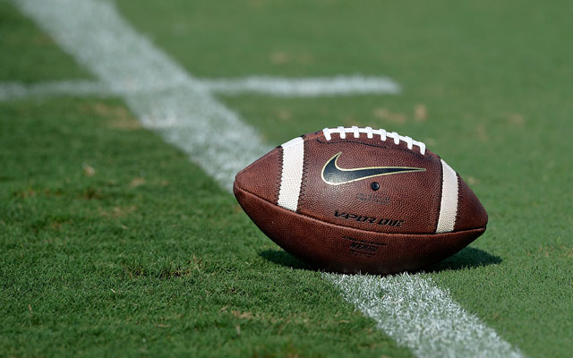
Stakeholders
  Former football players at the professional and collegiate level
  Family members and friends of former players
  Parents of young athletes
  Football Coaches
  Athletic Directors

Slide 8


Stakeholder Networks
Local Organizations and Programs in your area
  Concussion Legacy Foundation
  Gridiron Greats
  Youth Football Groups
  College Alumni Associations

Slide 9
Identify Setbacks
& Solutions
SETBACK | SOLUTION
Scheduling- visit is 3 days long | We schedule months out, so they have plenty of time to give notice if they need to change dates or take time off
Cost | We make it clear the study pays for all associated costs- travel, food, hotel
Confidentiality | We explain HIPPA and all of the laws they are protected under
NFL Concussion Settlement | We make it clear their information is protected under the study
Study Procedures | We are completely transparent about every single procedure

Slide 10
Objective 2: Recruitment and Outreach Methods
Community events: tabling
Capitalize off of what is already existing: Brain Health and Awareness month, Alzheimer's Association Research Events
Creating your own network: patients and participants
Visibility : flyers, brochures, videos, business cards, advertisements

Slide 11
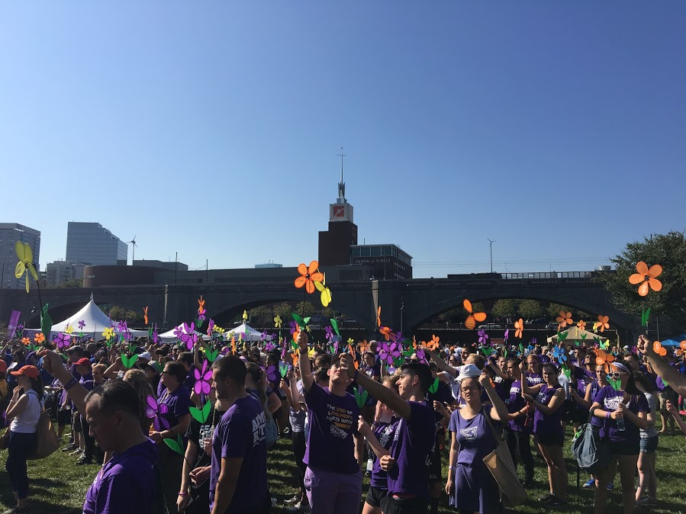
Community Events
How to make the most out of a community event:
Example: Walk to End Alzheimer's September 24th

Slide 12
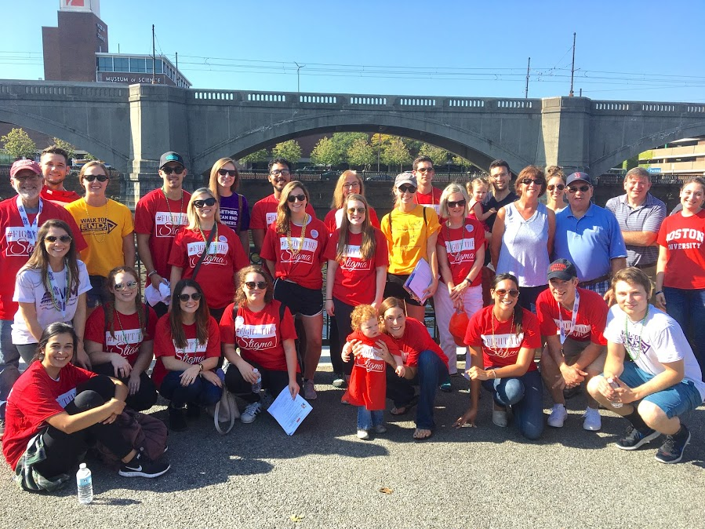
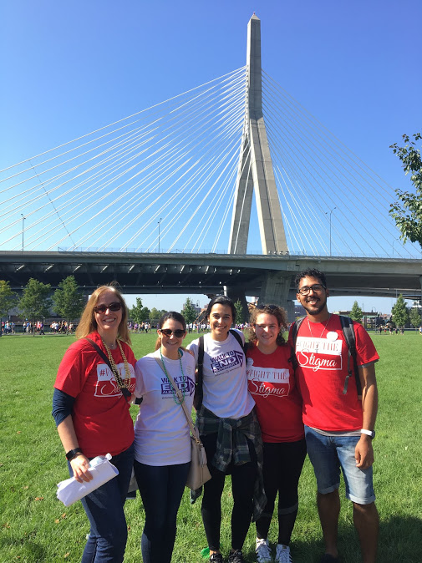
We showed up!

Slide 13
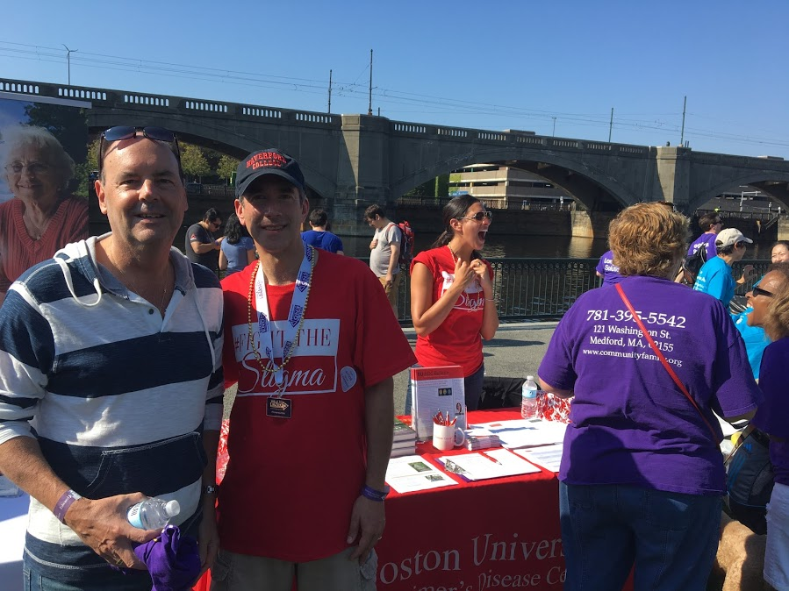
Visibility and Availability
We had a table with information for people to take, sign up sheets for follow up, and doctors and staff to educate!

Slide 14
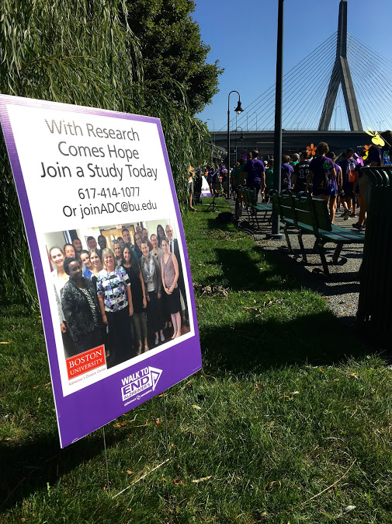
We were involved!
We had 16 staff members volunteering for the event: 2 members were on the planning committee, 3 members ran the Quiet Tent, 10 members worked on advocacy efforts, 1 person worked on Trial Match
We fundraised! So we were able to have our own poster on the route.

Slide 15




Slide 16
Outreach: Understanding Target Audience
Structure the Programming- Cater to the impaired
  Do not assume an educated audience- many caregivers will bring their loved ones
  Establishing background
  Repetition
  Not getting off topic
  Summarizing is KEY as you go along
  Always give "take aways"

Slide 17
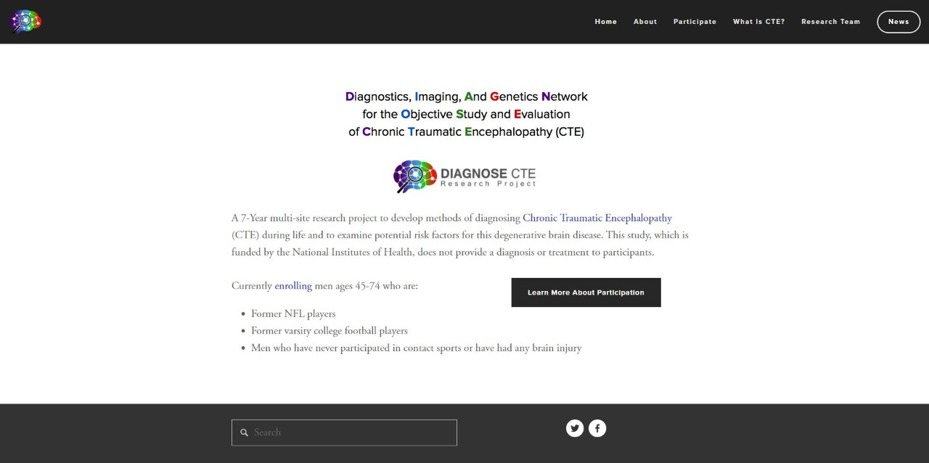
Outreach: Understanding Target Audience
Website design:
- No scrolling
- Cater to impairment: our rule of thumb is a 6th grade reading level
- Large print
- Make sure links open in a new tab
- Contrast sensitivity

Slide 18
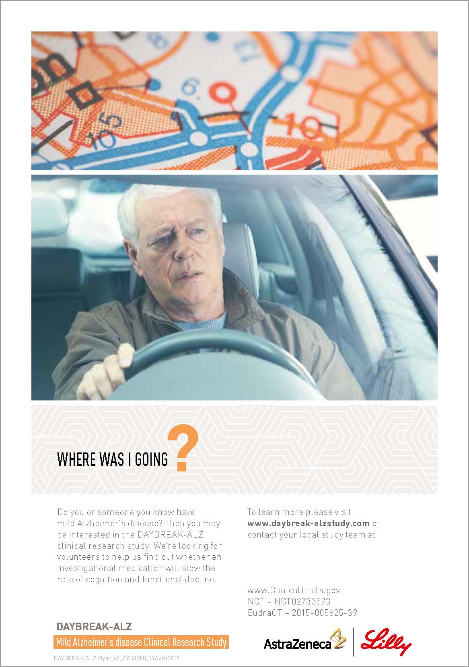
What would you assume this is about?

Slide 19
Name of the study is down here!!!

Slide 20
About the DAYBREAK-ALZ Study
The study will examine an oral investigational drug that may have some effect on the brain changes associated with Alzheimer’s disease. The study is designed to find out whether this investigational drug (or “study drug”) can slow down the decline in memory and mental functioning.
The DAYBREAK-ALZ study will include approximately 1,900 participants from around the globe.
There is no cost to participate. Volunteers who take part in the study will receive all study-related care, from a Specialist Physician, at no cost.
You may be compensated up to $150 per visit for your time and travel expenses.
Who can join the DAYBREAK-ALZ Study?
To join the study you must:
Be between 55 and 85 years old
Have a close friend, relative or partner who would be willing to be your study partner throughout the study
Have experienced a gradual loss of memory over the last 6 months (the study team will assess whether this is due to Alzheimer’s disease) or have been diagnosed with mild Alzheimer’s disease
Interested?
If you think you might like to join the DAYBREAK-ALZ study or you would like to learn more, please contact us. We can tell you more about it and explain what participating would mean for you. We will talk through the potential benefits and risks of being involved in the study, before you make your decision about joining.
We will also carry out several medical checks to see whether you are right for the study, and the study is right for you.

Slide 21
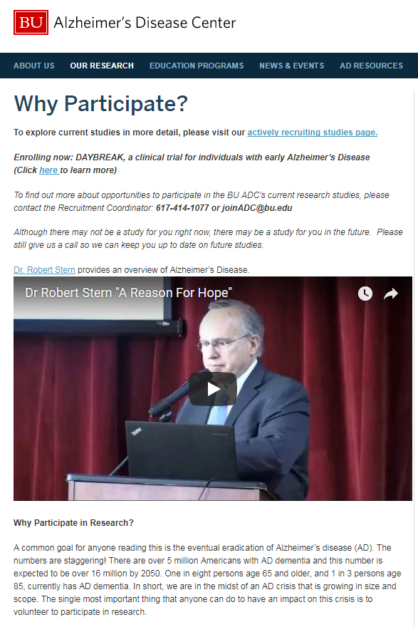
Call to action
Why Participate
FAQs

Slide 22
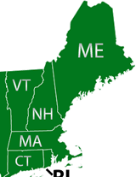
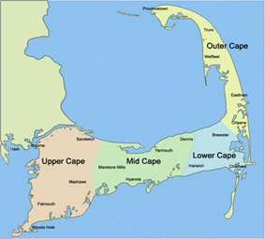
Outreach
Creating your own network- set up meetings with everyone who will sit down with you
Keep track of initial meetings and all follow up, like you would with a participant
Invite them to YOUR events and ask them to invite you to theirs!
Identifying areas in need

Slide 23
What worked
Visibility in the media
Education Programs
Physician Networking
Branding
Networking with local organizations
  E-blasts
  Social Media

Slide 24
What didn’t work
Canvassing in local coffee and gyms
Advertisements in the Metro Newspaper
Social Media
Multiple flyers

Slide 25
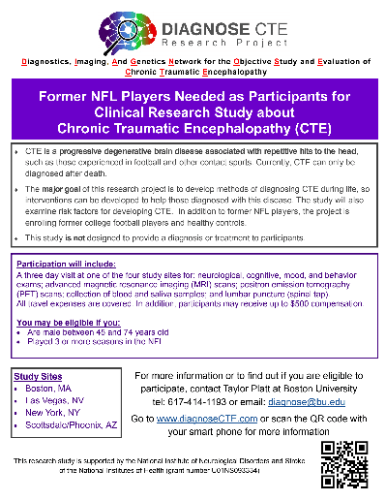
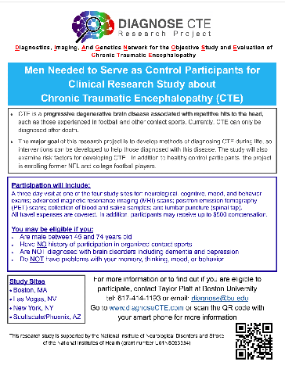
What didn't work

Slide 26
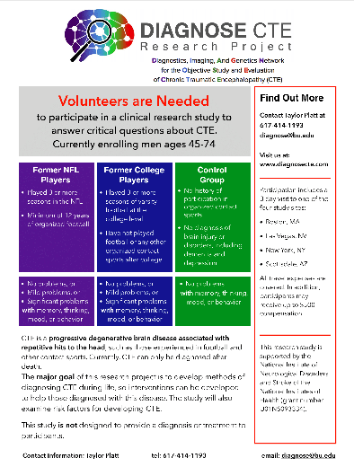
So we adjusted...
LESS Text
Easier to read
Better organization

Slide 27

Retention Methods
After Initial Contact…..
Return phone calls and emails within 24 hours
Regular Follow Up
Personalized Contact
Sign up sheets at events

Slide 28

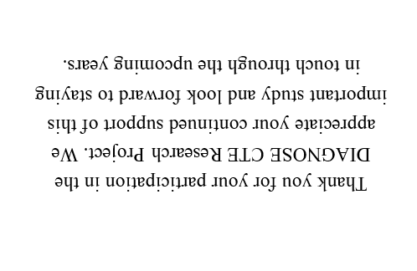
Retention Methods
After Enrollment into Study
Constant Contact with Participants!!!
  Thank You Cards

Slide 29

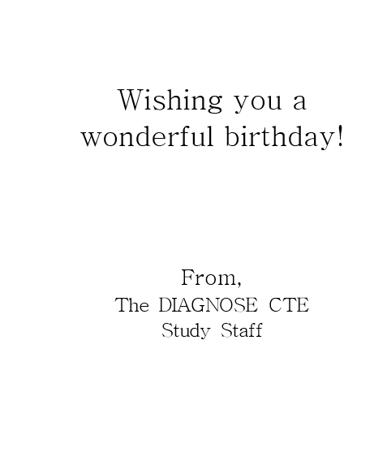
Retention Methods
After Enrollment into Study
Constant Contact with Participants!!!
  Thank You Cards
  Birthday Cards

Slide 30
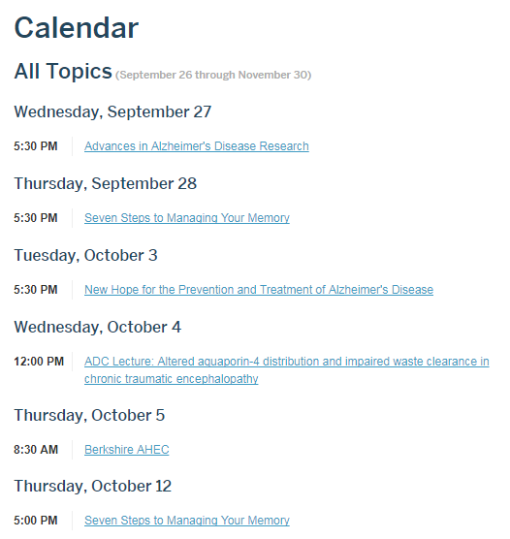
Retention Methods
After Enrollment into Study
Constant Contact with Participants!!!
  Thank You Cards
  Birthday Cards
  Invitations to educational programs

Slide 31

Retention Methods
After Enrollment into Study
Constant Contact with Participants!!!
  Thank You Cards
  Birthday Cards
  Invitations to educational programs
  Study Results Call

Slide 32
Retention Methods
After Enrollment into Study
Constant Contact with Participants!!!
  Thank You Cards
  Birthday Cards
  Invitations to educational programs
  Study Results Call
  Newsletter

Slide 33
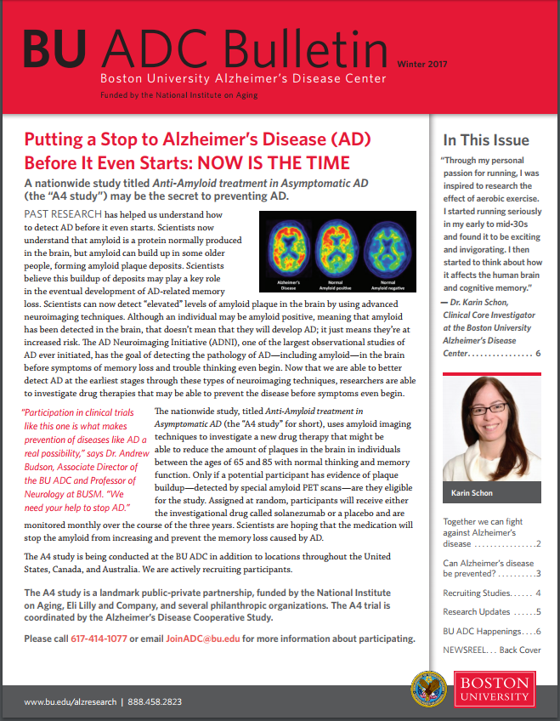

Slide 34
Thank you!

