Slide 1



What can we learn from ‘–OMICS’?
CREST Seminar
Jennifer E. Ho, MD
Assistant Professor of Medicine
10/13/15

Slide 2
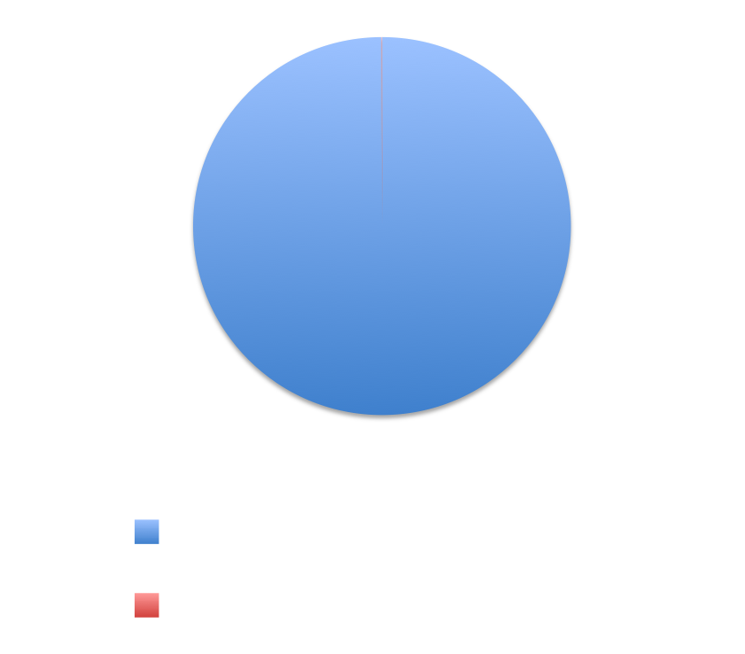
Heart Failure – the Reality
UNOS website
Go AS, Circulation, 2013

Slide 3
Prevention of Heart Failure
Risk factors
Ventricular remodeling
Heart Failure
Hypertension
Hyperlipidemia
Atherosclerosis
Diabetes mellitus
Valvular disease
Obesity
Smoking
Lifestyle habits
Myocyte hypertrophy
Myocyte dilation
Lindenfeld J, J Card Fail, 2010
Schoken DD, Circulation, 2008

Slide 4
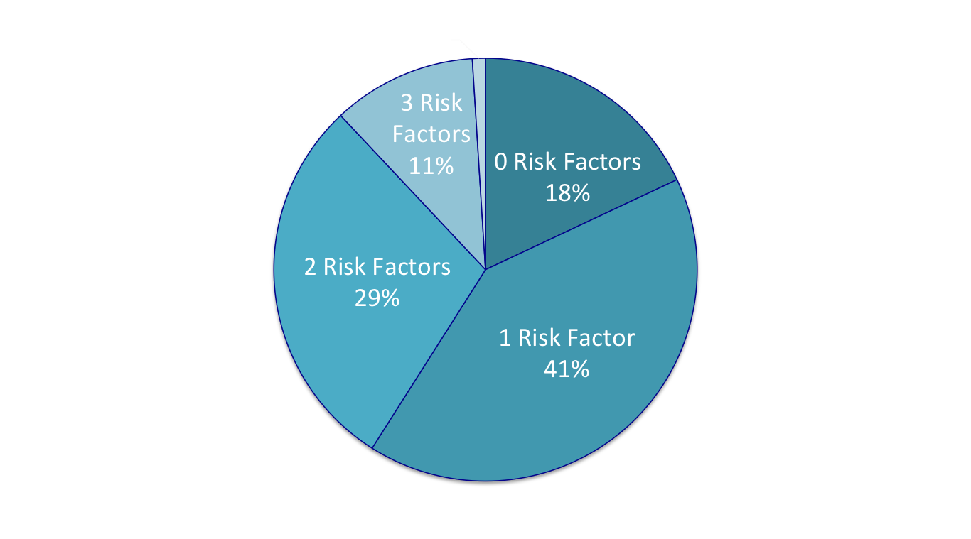
Risk Factors in CVD: Prevention Paradox
Over half of patients with CVD events had only one or no risk factors
Khot UM, JAMA, 2004

Slide 5
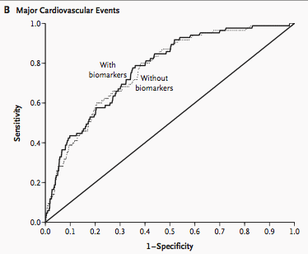
Can we use biomarkers for risk prediction?
c-statistic 0.77
c-statistic 0.76
Maybe we haven’t found the right markers yet?
Wang TJ, N Engl J Med, 2006

Slide 6
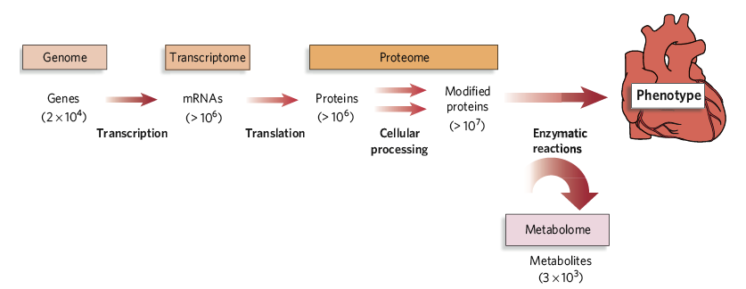
Novel biomarker discovery
Genomics
Transcriptomics
Proteomics
Metabolomics
Gerszten RE, Nature, 2008

Slide 7
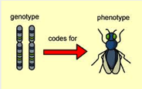
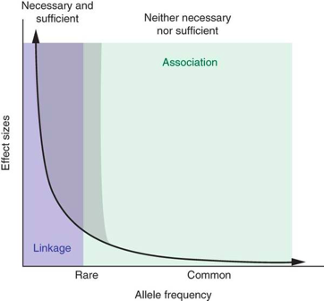
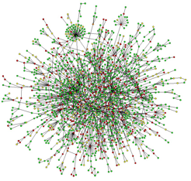
-OMICS and complex disease traits
Different from candidate gene and Mendelian diseases
Lauer MS, JAMA, 2012
State MW, Nat Neuroscience, 2011

Slide 8
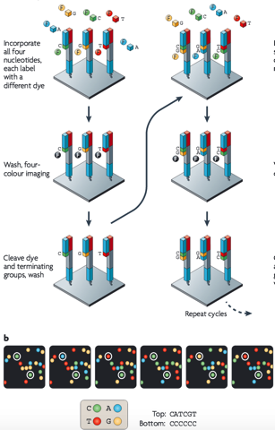
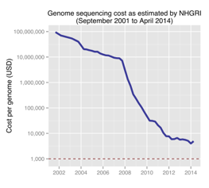
What is genomics?
Sequencing and analysis of entire genome (complete DNA within a cell)
DNA sequencing techniques:
  Sanger sequencing (shotgun)
  Next-Gen sequencing
Metzker ML, Nat Rev Genet, 2010

Slide 9
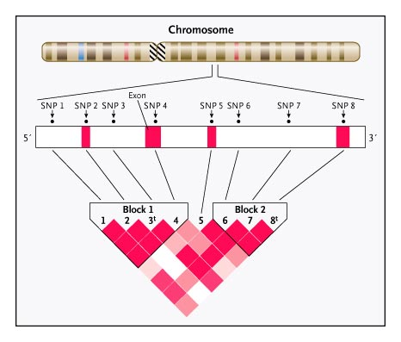
Whole genome genotyping: mapping SNPs
Christensen, NEJM, 2007
Notes:
99.5% of DNA is conserved

Slide 10
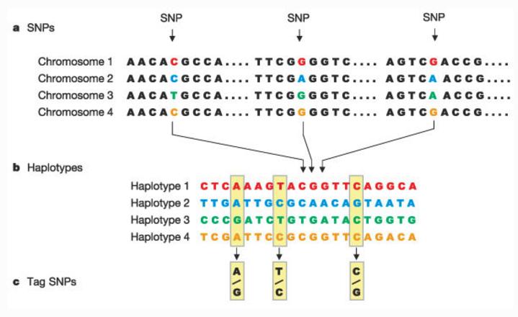
One ‘Tag SNP’ can serve as proxy for many
The International HapMap Project, Nature, 2003

Slide 11
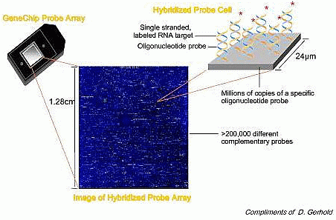
What is a genome-wide association study?
3 billion base pairs → ‘unbiased’ selection of 1 million tag SNPs
‘Fingerprint’ each individual, unconstrained by existing knowledge

Slide 12
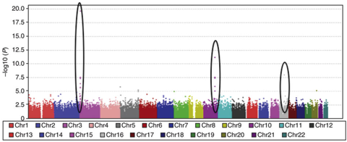
GWAS: analytical concerns
Test association of a disease trait with 1 million SNPs
Bioinformatic tools to deal with complexity of data
Need to account for multiple testing: Bonferroni corrected P-value threshold of 5 x 10⁻⁸
Validation of results is needed
Manolio TA, NEJM, 2010
Pearson TA, JAMA, 2008
Clarke GM, Nat Protocols, 2011

Slide 13
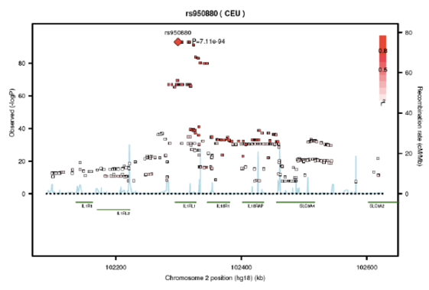
Genetic determinants of sST2
2991 FHS participants, heritability of sST2 estimated at 45%!
Genome-wide association study: top hit in IL1RL1 (P=7.1x10⁻⁹⁴)
Ho JE, Chen WY, et al, J Clin Invest, 2013

Slide 14
Missense Variants Associated with sST2
20% higher levels
Chr | nSNP | Gene | Allele | MAF | beta* | P value | Amino Acid Change
2 | rs10192036 | IL1RL1 | A/C | 0.39 | 0.08 | 3.54E-17 | Q501K (Gln-Lys)
2 | rs4988956 | IL1RL1 | G/A | 0.39 | 0.08 | 3.66E-17 | A433T (Ala-Thr)
2 | rs10204137 | IL1RL1 | A/G | 0.39 | 0.08 | 3.66E-17 | Q501R (Gln-Arg)
2 | rs10192157 | IL1RL1 | C/T | 0.39 | 0.08 | 4.06E-17 | T549I (Thr-Ile)
2 | rs10206753 | IL1RL1 | T/C | 0.39 | 0.08 | 4.33E-17 | L551S (Leu-Ser)
2 | rs1041973 | IL1RL1 | C/A | 0.27 | -0.05 | 2.15E-07 | A78E (Ala-Glu)
*beta-coefficient: change in log-sST2 relative to minor allele
10% lower levels
Ho JE, Chen WY, et al, J Clin Invest, 2013

Slide 15
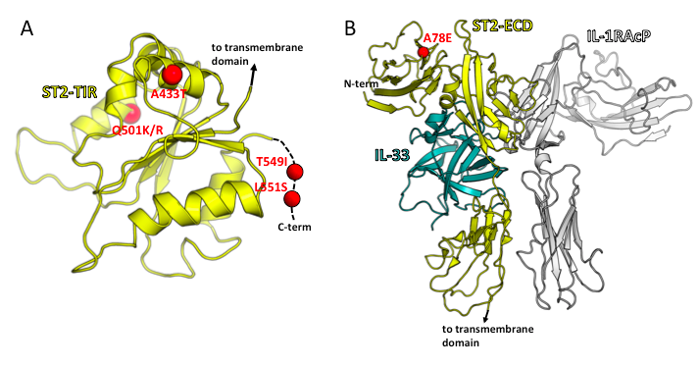
Missense Variants Associated with sST2
4 variants are intracellular!
(not part of sST2)
How do intracellular ST2L variants regulate sST2?
Ligand binding? Intracellular signaling?
Ho JE, Chen WY, et al, J Clin Invest, 2013

Slide 16
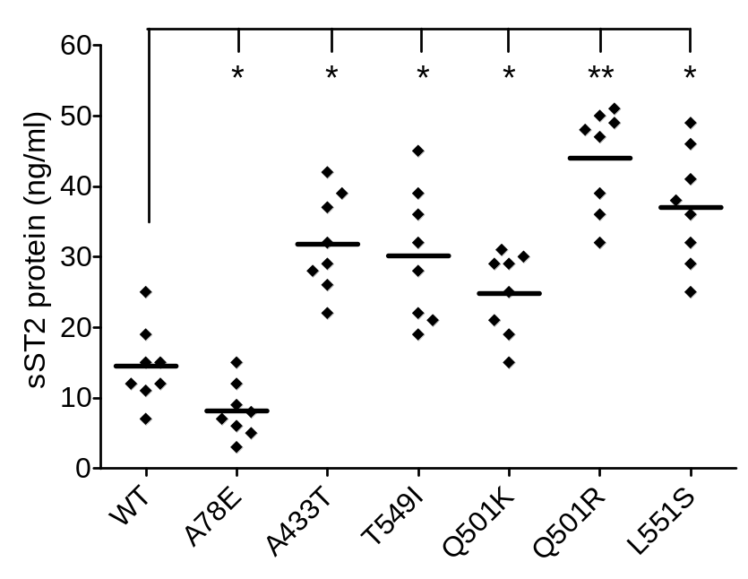
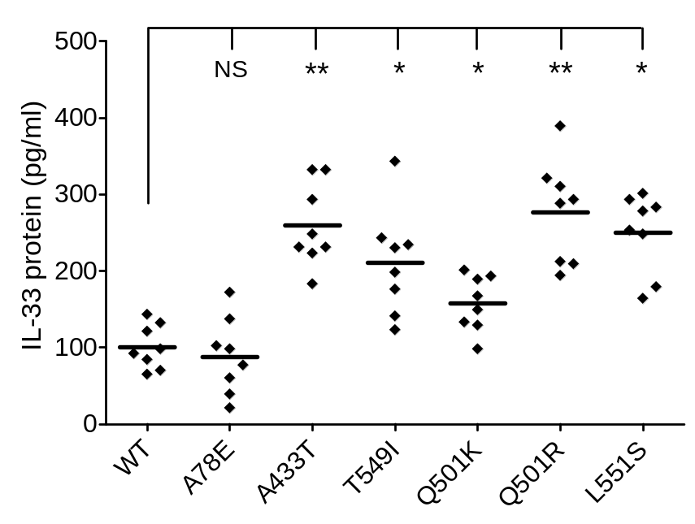
Intracellular ST2L Variants Replicate Phenotype in Cell Culture
Eight stable clones in each group. *p<0.05, **P<0.01 vs WT
Ho JE, Chen WY, et al, J Clin Invest, 2013

Slide 17
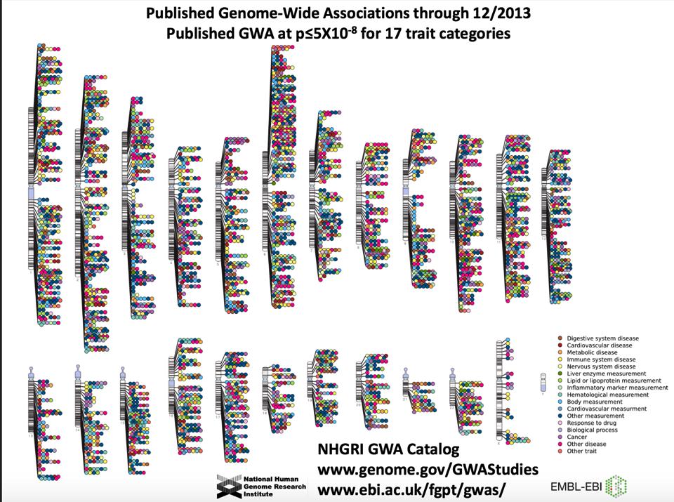

Slide 18
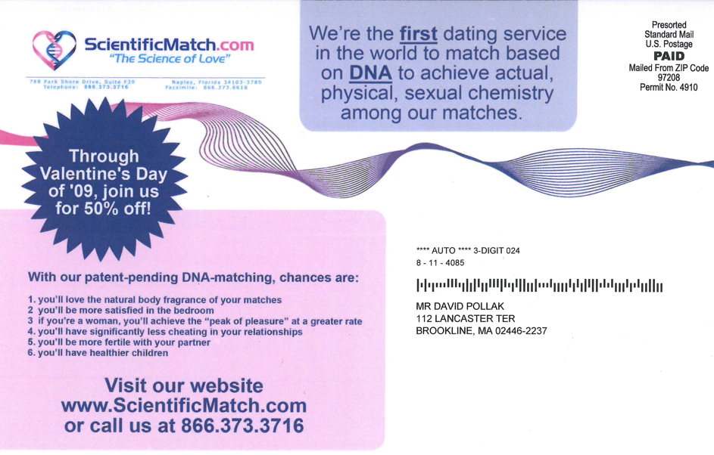

Slide 19
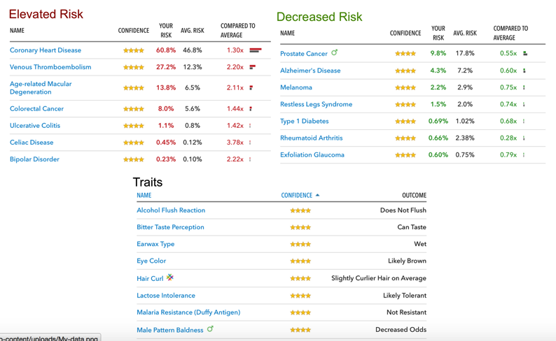
Genomic Data Revolution
Example from 23andme

Slide 20
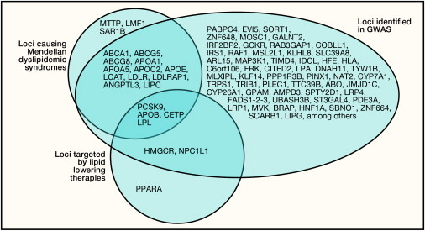
GWAS and Cardiovascular Disease
Kathiresan S, Cell, 2012

Slide 21

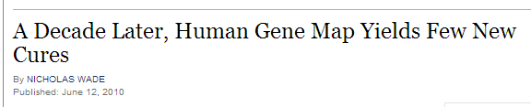
“Medical Uses Limited”
“Despite early Promise, Diseases’
Roots Prove Hard to Find”
New York Times, June 13, 2010
Slide Courtesy CS Fox

Slide 22

GWAS: Considerations
Large sample sizes needed to detect small effect sizes
Association of tag SNP and phenotype does not pinpoint causal gene or show mechanism
Need to validate finding: other cohorts, experimental studies, deep sequencing, pathway analysis, bioinformatics

Slide 23
Genome to Disease: Complex Regulation
Environment
Epigenetics
DNA methylation
histone modification
Post-translational modification
Phosphorylation
Glycosylation
microRNA
Gerszten RE, Nature, 2008

Slide 24
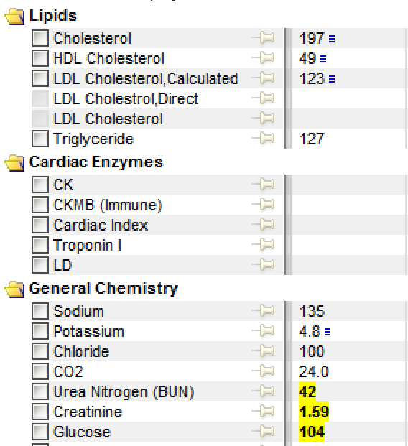
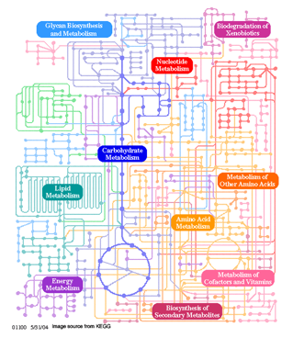
What is metabolomics?
Current day lab assessment
of metabolic status
Human metabolome
KEGG Pathway Database

Slide 25
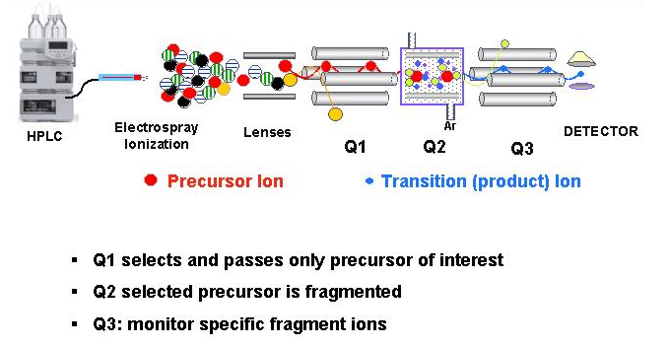
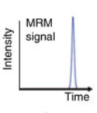
Metabolomic Platforms
slide adapted from Rob Gerszten
Yuan M, Nature Protocols, 2012

Slide 26
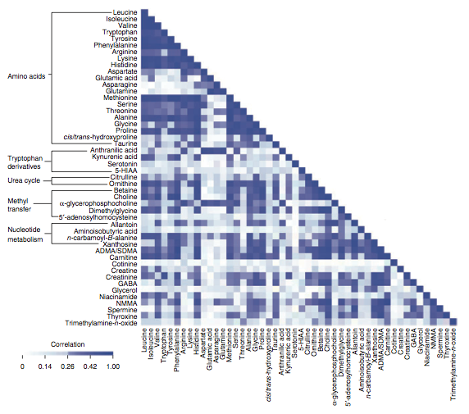
Wang TJ, Nat Med, 2011

Slide 27
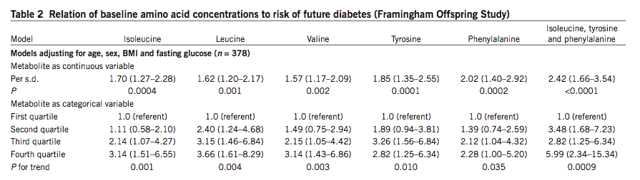
Branched Chain Amino Acids Predict DM
Wang TJ, Nat Med, 2011

Slide 28
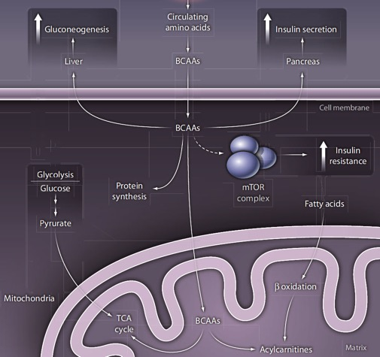
BCAA Overnutrition Hypothesis
Gerszten RE, Science Transl Med 2011
28
Notes:
28
BCAA -

Slide 29
Metabolomics in relation to phenotype
carbohydrates
amino acids
nucleotides
organic acids
lipids
diabetes
metabolic risk
cardiovascular disease
Gerszten RE, Nature, 2008
Wang TJ, Nat Med, 2011
Cheng S, Circulation, 2012
Ho JE, Diabetes, 2013
Shah SH, Circ CV Genetics, 2010

Slide 30
Integrating Genome and Metabolome
2076 Framingham Offspring cohort participants attending the 5th examination (1991-1995)
Metabolite profiling: LC-MS based platform
Genotyping: Affymetrix 500K mapping array and Affymetrix 50K gene-focused MIP array

Slide 31
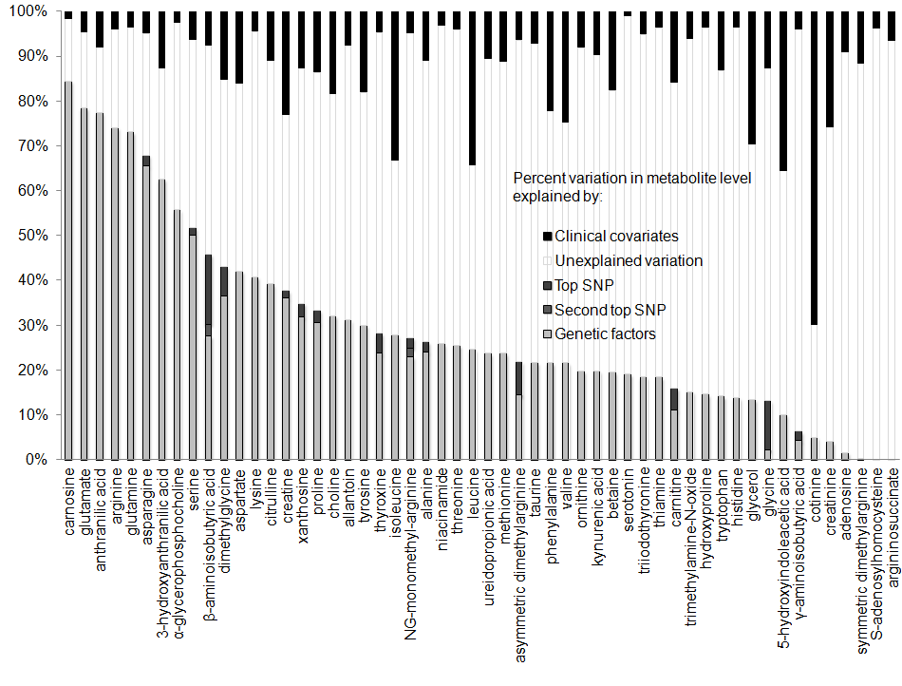
Clinical vs genetic factors
Clinical model included: age, sex, systolic BP, antihypertensive medication use, BMI, diabetes, smoking, prevalent CVD
Notes:
estimated proportion of inter-individual metabolite variation attributable to clinical fators vs heritable factors (including GWAS hits)
most influenced by clinical variables: cotinine (70%, 66% by smoking alone)
by enlarge, heritable factors played a greater role than clinical factors
highest heritability: carnosine, anthranilic acid, glutamate

Slide 32
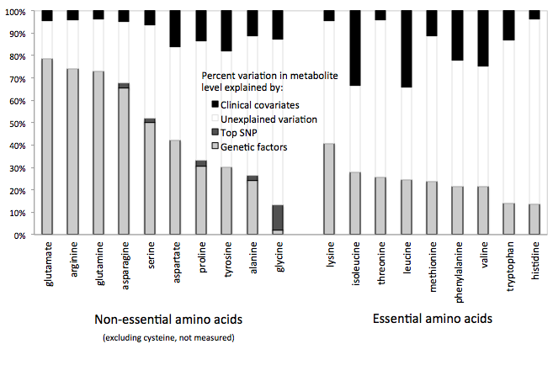
Essential vs non-essential amino acids

Slide 33
GWAS results
217 metabolites analyzed
65 with genome-wide significant hits
31 genetic loci (some loci associated with more than one metabolite)
Rhee EP*, Ho JE*, Chen MH*
Cell Metab, 2013

Slide 34
GWAS Results
Previously described gene-metabolite associations | Novel associations in directly related pathways | Novel associations in loci previously associated with disease phenotypes | Novel associations with unknown biological mechanism
PRODH (proline) PHGDH (serine) SLC16A9 (carnitine) FADS1-3 (PC 36:4 & 38:4) SLC16A10 (tyrosine) AGXT2 (BAIBA) GCKR (alanine) CPS1 (glycine) APOA1 (8TAGs, 2DAGs) | AGA (asparagine) SERPIN7A (thyroxine) DMGDH (dimethylglycine) GMPR (xanthosine) SLC6A13 (BAIBA) DDAH1 (NMMA) UMPS (orotate) | SLCO1B1 (LPE 20:4) SLC7A9 (NMMA) PDE4D (SM24:1) SYNE2 (SM14:0) DGKB (indole propionate) NTAN1 (CE 20:3) LIPC (LPE 16:0) HPS1 (ADMA) | rs6593086 (3TAGs) UGT1A5 (xanthurenate) ABP1 (GABA) CSNK1G3 (indoxyl sulfate) SEC61G (CE 20:4) GNAL (CE 16:0) TBX18 (DAG 36:1)

Slide 35
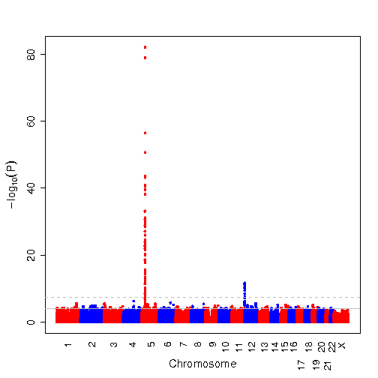
β-aminoisobutyric acid GWAS
rs37370
alanine-glycoxylate
aminotransferase 2
(AGXT2)

Slide 36
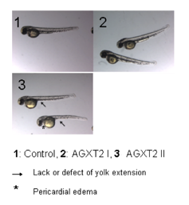
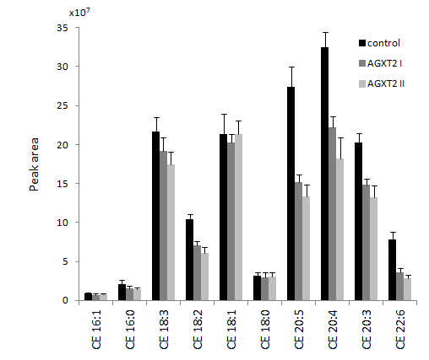
METABOLITE
β-aminoisobutyric acid
GWAS
p=5.8x10⁻⁸³
TG: p=2.3x10⁻²¹
HDL: p=0.45
GENE
AGXT2
TAG: p=0.04
CE: p=2.1x10⁻⁵
PHENOTYPE
lipid traits
Rhee EP*, Ho JE*, Chen MH*
Cell Metab, 2013

Slide 37
Mendelian Randomization
“natural” randomized trial based on genotype
genetic variant used as instrumental variable
Coronary Heart
Disease
CRP SNPs
CRP
Smoking
Diabetes
Physical activity
Lawlor DA, Stat Med, 2008
CCGC Investigators, BMJ, 2011

Slide 38
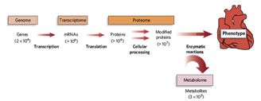
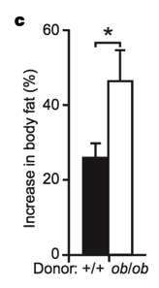
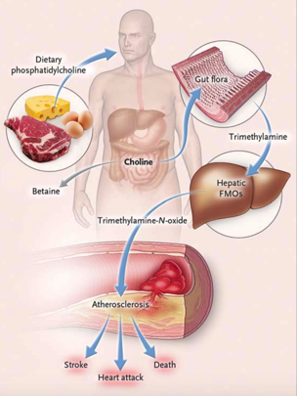
The Microbiome
Microbiome
There are more microbes in your intestine than human cells in your body!
Gerszten RE, Nature, 2008
Turnbaugh PJ, Nature, 2006
Tang WH, NEJM, 2013

Slide 39
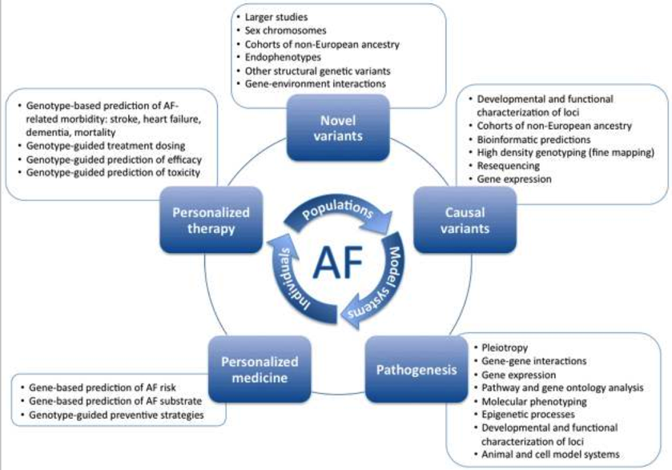
HF
Lubitz SA, Circ Arrhythm Electrophysiol, 2010

Slide 40
Summary
-OMICS encompasses everything from genome to disease phenotype
Need validation of results, integrated human and basic research – multi-disciplinary, multi-institutional, ‘team science’, systems biology and bioinformatic approaches
Ultimate goal: personalized medicine, disease prevention, targeted therapies

Slide 41
More Resources
Manolio TA, NEJM, 2010: Genomewide Association Studies and Assessment of the Risk of Disease
Thanassoulis G, JAMA, 2009: Mendelian Randomization
www.genome.gov/gwastudies
Atul Butte TEDxSF talk (Director, Institute of Computational Health Sciences, Stanford University)

Slide 42
Acknowledgments
Framingham Heart Study
Thomas J. Wang
Daniel Levy
Ramachandran S. Vasan
Martin G. Larson
Susan Cheng
Anahita Ghorbani
Others
Robert E. Gerszten
Richard T. Lee
Boston University
Emelia J. Benjamin
Naomi Hamburg
Raji Santhankrishnan
Deepa M. Gopal
Wilson S. Colucci
Research funding supported by NIH/NHLBI (K23-HL116780), Boston University of Medicine Department of Medicine Career Investment Award, and the Robert Dawson Evans Junior Faculty Merit Award

