Slide 1
How to Give a
Scientific Talk
Using Digital Media Support
Rob Schadt, Ed.D.
Teaching and Digital Learning
Boston University
School of Public Health
Notes:
Rob & Mea introduce ourselves

Slide 2

Some Examples
Research project
Notes:
Show a mediocre presentations: (Mea)
Research project: http://www.youtube.com/watch?v=PZWRpa2pdLI
Conference presentation: http://www.youtube.com/watch?v=OBuZz-YVVRc
Ask the group: reactions (Mea)

Slide 3
Some Examples
Conference presentation
Notes:
Show a mediocre presentations: (Mea)
Research project: http://www.youtube.com/watch?v=PZWRpa2pdLI
Conference presentation: http://www.youtube.com/watch?v=OBuZz-YVVRc
Ask the group: reactions (Mea)

Slide 4
Elements of Communication
Speaker
Presentation
Technology
Message
Audience

Slide 5
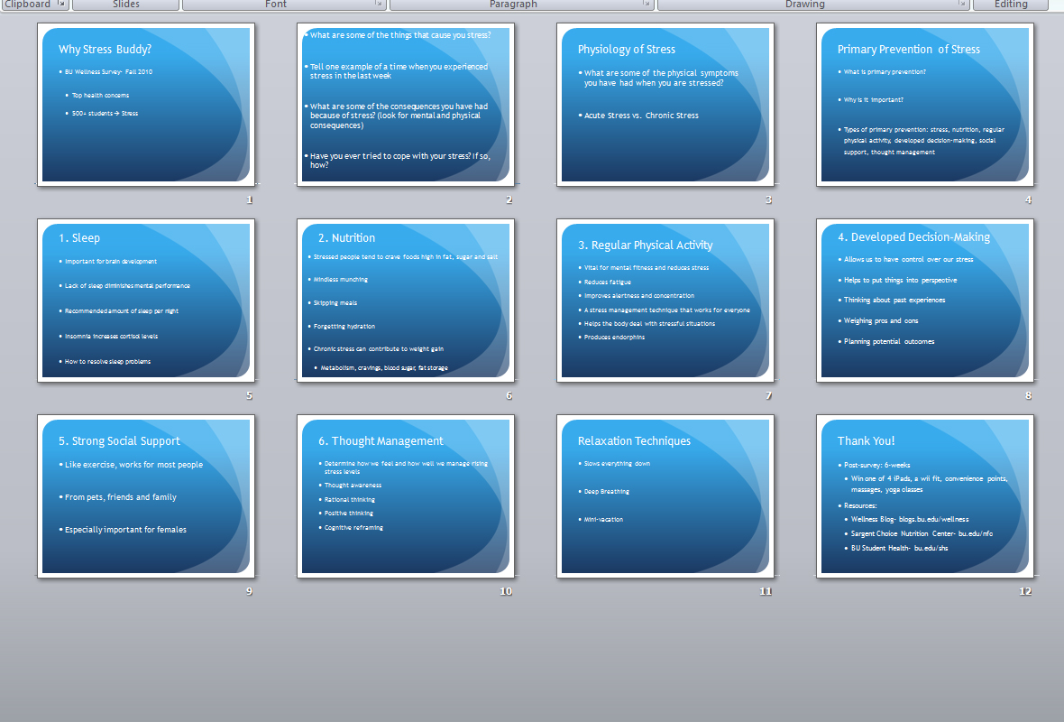

Slide 6


Remember
bullets are
for…
Remember bullets kill…
presentations
Not PowerPoint

Slide 7
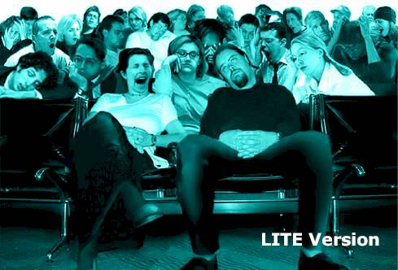
Content is the most important part of your presentation..… Really?
So how do you like it when I “hide behind my slides”
Read word for word off the slides and
I don’t pay attention to you whatsoever…
Blah, blah, blah, blah
  Blah, blah, blah, blah Blah, blah, blah, blah
  Blah, blah, blah, blah Blah, blah, blah, blah
  Blah, blah, blah, blah Blah, blah, blah, blah
  Blah, blah, blah, blah Blah, blah, blah, blah
  Blah, blah, blah, blah

Slide 8
Elements of Communication
Audience
Speaker
Presentation
Technology
Message
Audience

Slide 9

Know Your Audience and Your Venue

Slide 10

Know Your Audience
What is their background on my topic?
What are their expectations for my talk?
What is my story?
What is in it for them?

Slide 11
Know Your Audience and Your Venue
What is their background on my topic?
What are their expectations for my talk?
What is my story?
What is in it for them?
How much time do I have?
What is the venue like?
What is the time of day?
If the audience could remember only one thing what would it be?

Slide 12
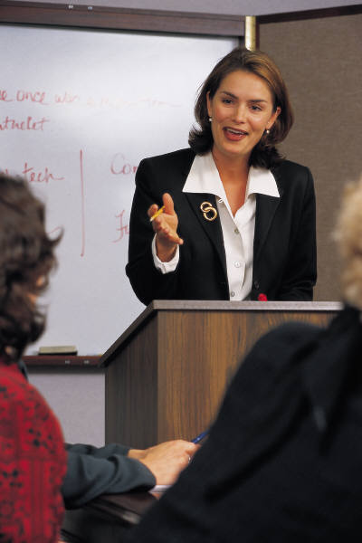
Engage the Audience
Eye contact

Slide 13
Engage the Audience
Eye contact
Be enthusiastic and expressive
Project your voice
Include purposeful pauses

Slide 14
Engage the Audience
Eye contact
Be enthusiastic and expressive
Project your voice
Include purposeful pauses
Avoid over-dependence on notes

Slide 15
Learning Theory Applied to Multimedia Presentation
Your Audience:
uses dual channels
  Include both verbal and visual
Multimedia Learning - Mayer, 2001

Slide 16
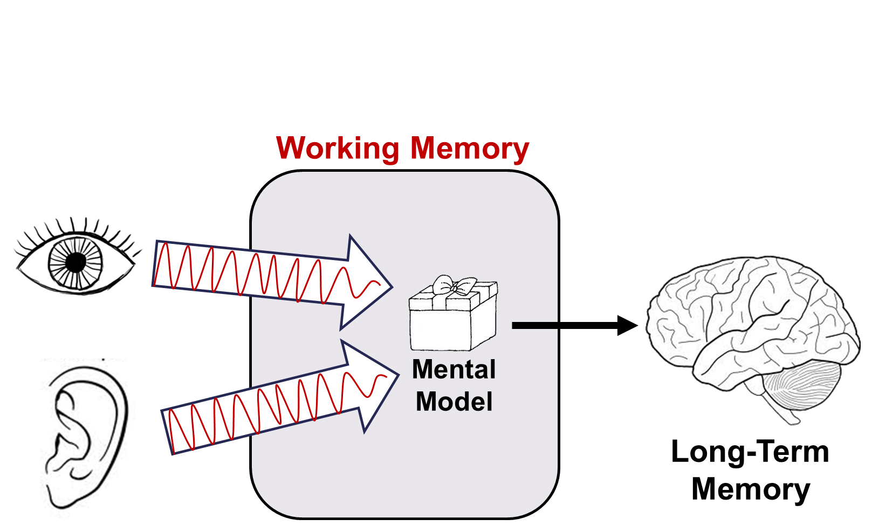
Learning Theory Applied to Multimedia Presentation

Slide 17
Use graphics to augment your words
Beverage Sugar Levels
Whiskey: .05 grams
Beer: 2 grams
Wine: 5 grams
Soda: 5 grams
Notes:
Multimedia Effect
words and graphics is better than words alone
Use graphics to augment your words (printed or spoken)

Slide 18
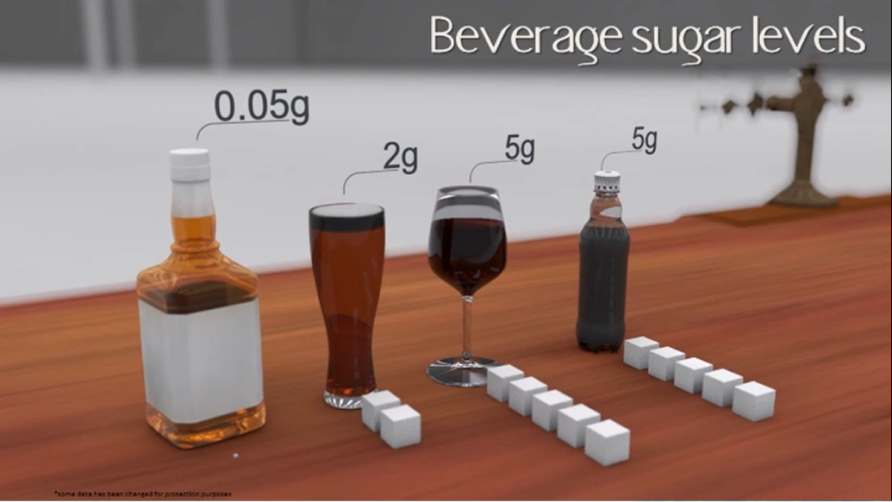
Use graphics to augment your words
Notes:
Multimedia Effect
words and graphics is better than words alone
Use graphics to augment your words (printed or spoken)

Slide 19




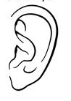
Use graphics to augment your words
Notes:
Multimedia Effect
words and graphics is better than words alone
Use graphics to augment your words (printed or spoken)
Rationale: provide the visual channel with a rich learning experience

Slide 20
Learning Theory Applied to Multimedia Presentation
Your Audience:
uses dual channels
  Include both verbal and visual
has limited capacity
  Exclude extraneous visual materials
uses active processing
  Provide a mental structure that
  can be integrated into prior knowledge
Multimedia Learning - Mayer, 2001

Slide 21

Use Written Text Sparingly
16 million kids (1 out of 5) in America struggle with hunger
Hungry kids are more likely to experience serious short- and long-term health issues
Food insecurity is most common in large cities but still exists in rural areas, suburbs and other outlying areas around large cities

Slide 22


Use Written Text Sparingly
16 million kids (1 out of 5) in America struggle with hunger
Hungry kids are more likely to experience serious short- and long-term health issues
Food insecurity is most common in large cities but still exists in rural areas, suburbs and other outlying areas around large cities
Notes:
Modality Principle
People learn better when words are presented as narration rather than text.
Limited amount of “working memory” means that in certain situations you should use printed text to support sensemaking, e.g. if words are:
Technical
Unfamiliar
Not in learners’ native language
Rationale: don’t overload the visual channel

Slide 23

Use Written Text Sparingly

Slide 24
Elements of Communication
Message
Speaker
Presentation
Technology
Message
Audience

Slide 25

Steps in Designing an Effective Message
Collect
Select
Reflect
Connect

Slide 26
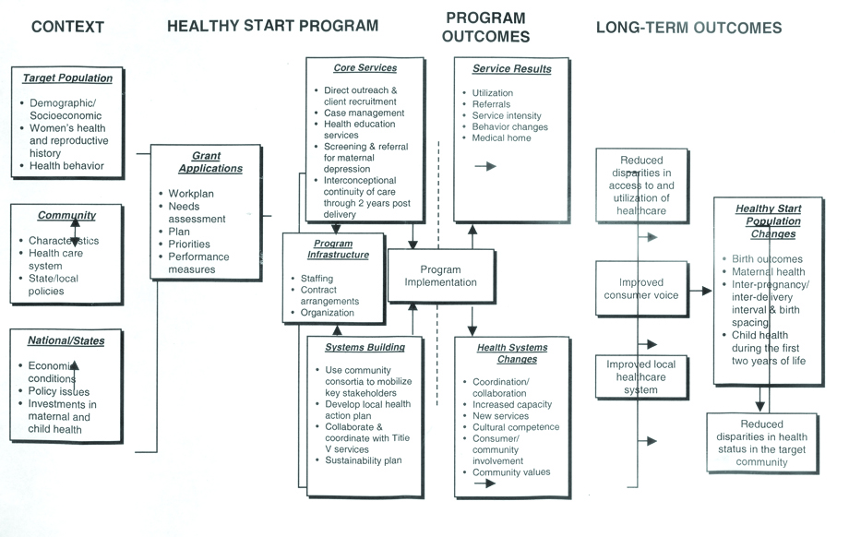
Healthy Start Logic Model
“..it seems like I'm not connecting with the audience..”

Slide 27

Maria Montoya
“I was scared…”

Slide 28

Maria and
Miguel Montoya

Slide 29

Maria and
Miguel Montoya with
Doctor Rameriz

Slide 30

Structuring an Effective Message
Capture the audience's attention with an interesting opening
Choose an appropriate organizational design
  Historical, cause/effect, problem/solution
Keep your purpose in mind
  An informative talk should focus on clarity of information
  A persuasive talk should focus on the acceptance of ideas
End with a strong, memorable conclusion
Opening
- - - - - -
Conclusion

Slide 31
Elements of Communication
Message – Presentation Design
Speaker
Presentation
Technology
Message
Audience

Slide 32
Use of Colors: Bad Combinations
❶
❷
Ouch.
Ouch.
❸
What?
Notes:
Eye strain: Red & blue, red & green
Poor contrast
Staying up with the times
http://office.microsoft.com/en-us/powerpoint-help/combining-colors-in-powerpoint-mistakes-to-avoid-HA102304125.aspx

Slide 33
Use of Fonts
Sans Serif
✓
Serif
✗
Helvetica
Arial
Verdana
Times New Roman
Garamond
Georgia
Use 30 point font as a minimum
Notes:
16
19
One or two styles per slide
Retain type styles throughout presentation

Slide 34
If You Must Use Bulleted Text
Be brief and concise
Insure legibility (30 point font)
Do not underline
DO NOT CAPITALIZE
Notes:
17
20

Slide 35
C.R.A.P.
Contrast
Repetition
Alignment
Proximity

Slide 36
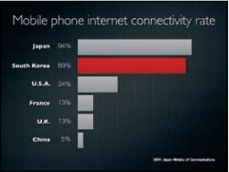
Contrast
❶
❷
80% of the freshwater
in the world is in the Antarctic
Notes:
Contrast means that you create a design in which one item is clearly dominant, helping your learners make sense of the visual. (Presentation Zen, paraphrased)
Almost any design element can be used for contrast. These examples show the use of:
Color
Size/font

Slide 37

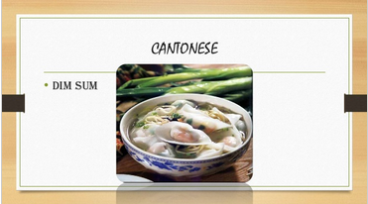
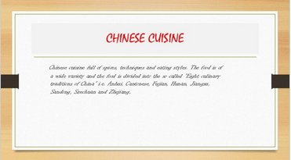
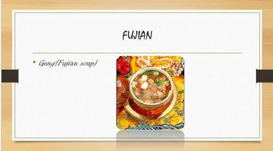
Repetition
❶
❷
❸
❹
Notes:
Repetition
Use templates for consistent placement and style of headers, text so the learner knows what to expect and can concentrate on your message
Beware of over-use of repetition – only repeat those elements that actually support your message (e.g. don’t repeat your logo on every slide!)

Slide 38

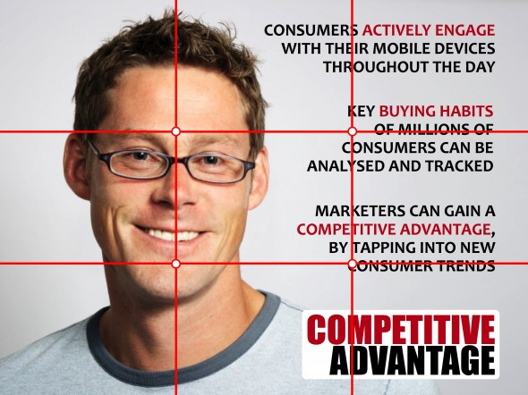
Alignment
❶
❷
Notes:
Alignment
Use of Grids for Slide Layout
http://slideguru.com/the-rule-of-thirds

Slide 39
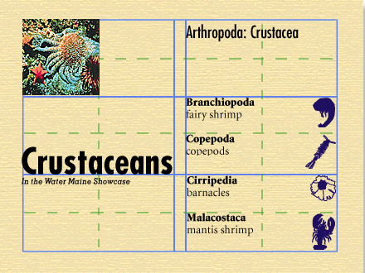
Proximity

Slide 40
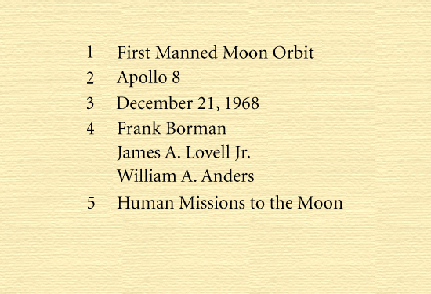
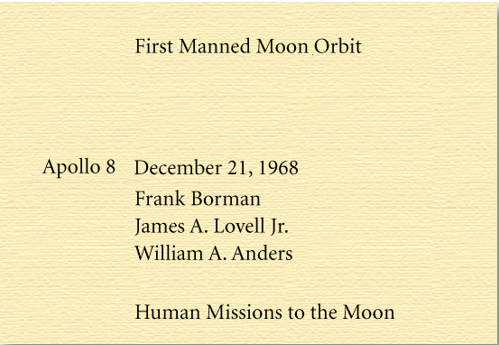
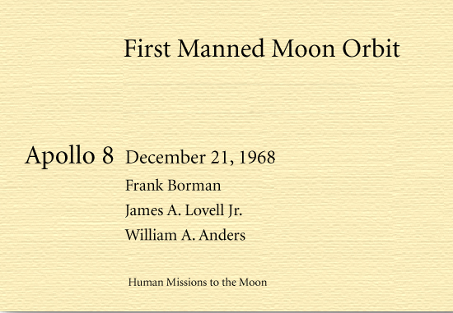
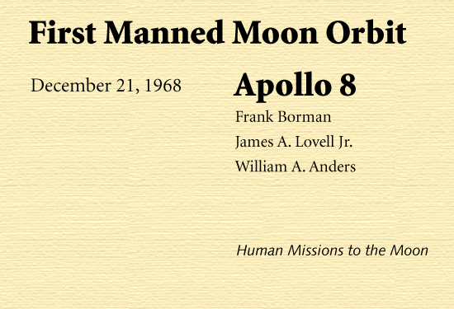
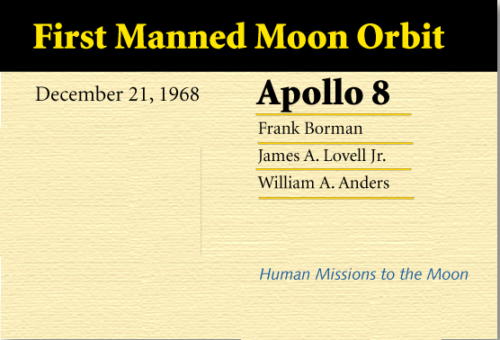
For Example
Notes:
Use CRAP for alternative slide layouts

Slide 41
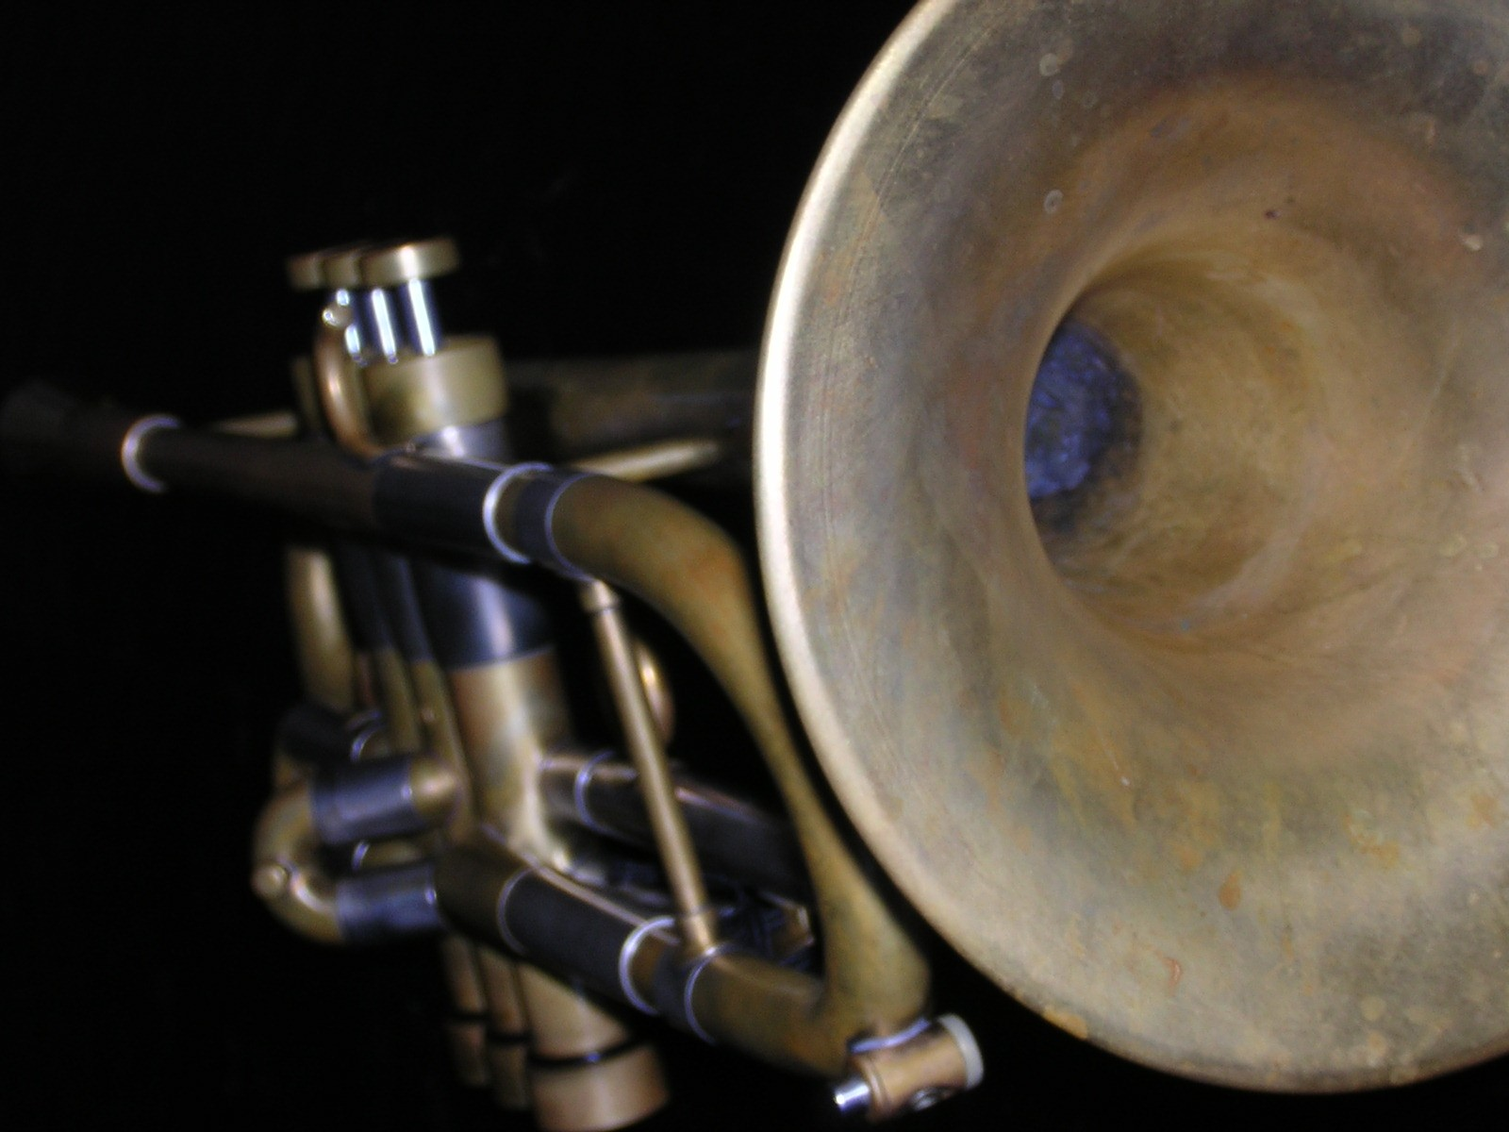
Use Visual Images
That Help Communicate

Slide 42
Use Visual Images
That Help Communicate
The ability to make the simple complex is not extraordinary.
Making complex ideas simple is very unusual and extraordinary…”
Charles Mingus

Slide 43

Present Visually with Illustrations
Illustrations present
a viewpoint or
interpretation

Slide 44
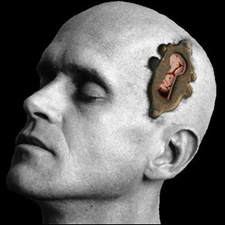
Present Visually with Illustrations
Brain Keyhole (www.billywatts.com)

Slide 45

Present Visually with Illustrations
Illustrations present
a viewpoint or
interpretation

Slide 46

Present Visually with Illustrations
Illustrations present
a viewpoint or
interpretation

Slide 47

Present Visually
with Photographs

Slide 48

Close up of neurons
Interdisciplinary Science and Math Initiative
Carelton College
Present Visually
with Photographs

Slide 49

Research that shows this generation is as much as
40 percent less empathetic than their counterparts of
20 to 30 years ago.

Slide 50
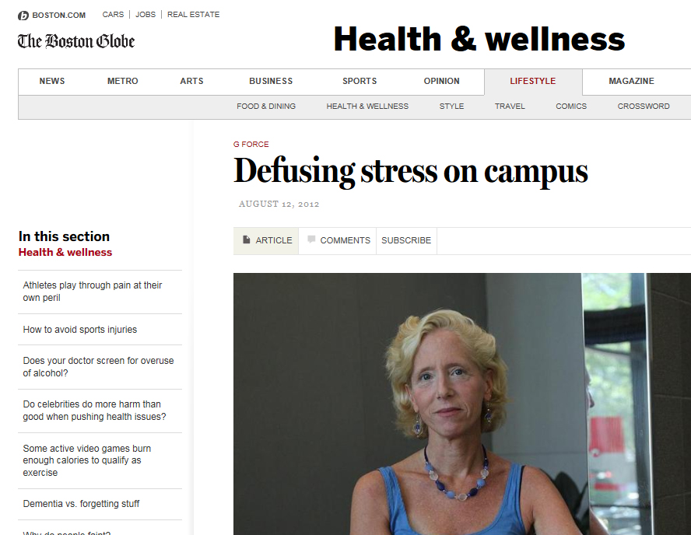
Present Visually with Online Resources
“31% of college students report feeling so depressed in the last 12 months that it was difficult to function. As many as 18% of undergraduates have thought about suicide.”
Dori Hutchinson
Behavioral Medicine Department
at Boston University

Slide 51
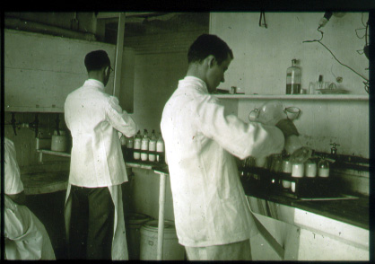
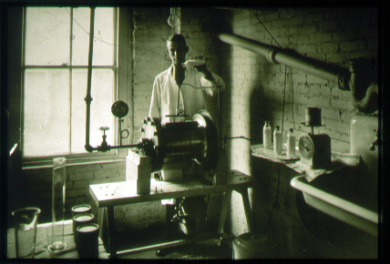
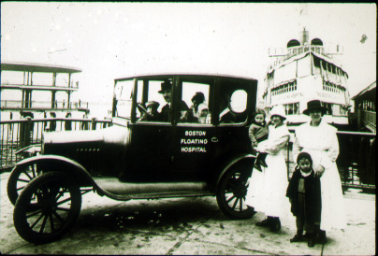
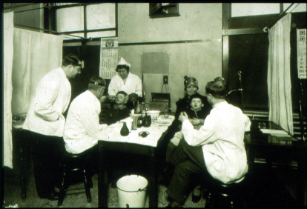
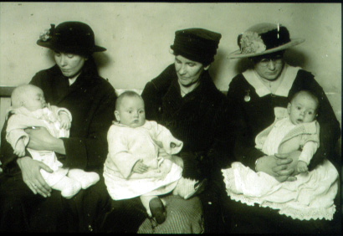
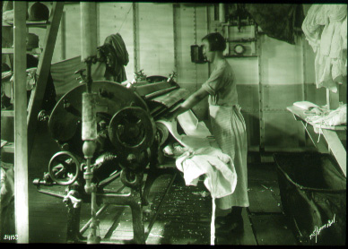
Create a visual collage paired
with verbal information

Slide 52


PowerPoint is a Flexible,
Inclusive Media
A variety of multimedia
Links to a larger body of information
http://keepvid.com

Slide 53

Present with a Metaphor
War

Slide 54

Tables – Why bother?
Tables you “have to show”
Tables that
“show what you mean””

Slide 55
Reverse Osmosis
  Seawater Reverse Osmosis (SWRO)
  Salt Concentration: 10,000 - 50,000 mg/l TDS
  Membrane Feed Pressure: 800-1400 psi
  Sources: Surface Waters or Beach Wells
  Brackish Water Reverse Osmosis (BWRO)
  Salt Concentration: 500 - 5,000 mg/l TDS
  Membrane Feed Pressure: 100-600 psi
  Sources: Recycling, Groundwater, Surface
  Water, Industrial Water
  Nanofiltration (NF) / Membrane Softening
  Salt Concentration: 100 - 500 mg/l TDS
  Membrane Feed Pressure: 50-300 psi
  Sources: Boiler Feedwater, Potable or Ultrapure applications

Slide 56

Reverse Osmosis
 | Seawater Reverse Osmosis (SWRO) | Brackish Water Reverse Osmosis (BWRO) | Nanofiltration (NF) Membrane Softening
Salt Concentration | 10,000 - 50,000 mg/l TDS | 500-5,000 mg/l TDS | 100-500 mg/l TDS
Membrane Feed Pressure | 800 - 1,400 psi | 100-600 psi | 50-300 psi
Sources | Surface Waters or Beach wells | Recycling, Groundwater, Surface water Industrial water | Boiler Feedwater, Potable or Ultrapure applications

Slide 57
Cumulative Totals
 | Item 1 | Item 2 | Item 3 | Item 4
 | 179.880 | 423.3660 | 967 | 334.07
 | 128.864 | 345.7670 | 860 | 287.74
 | 34.221 | 678.4440 | 773 | 982.21
 | 129.775 | 654.9980 | 1887 | 658.89
 | 378.664 | 379.6000 | 431 | 295.50
 | 198.856 | 189.9570 | 582 | 377.89
 | 746.599 | 879.9560 | 334 | 867.73
 | 286.675 | 385.7689 | 233 | 286.57
 | 196.999 | 285.8678 | 188 | 296.97
 | 185.868 | 289.8786 | 299 | 185.90
Totals | 2661.767 | 5058.3140 | 6737 | 4869.13

Slide 58
Cumulative Totals
Tell why a number is important
 | Item 1 | Item 2 | Item 3 | Item 4
Totals | 2661.767 | 5058.3140 | 6737 | 4869.13

Slide 59
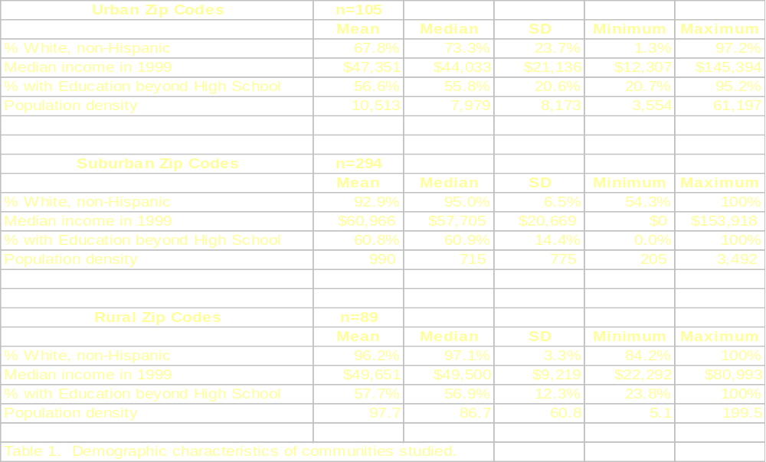
Notes:
To bring out details of a table using a hyperlink to a new slide:
1. Create multiple copies of the main slide which contains the table
(View | Slide sorter | Ctrl+ D)
2. On the first duplicate slide add the details you want to highlight in a text box. Use a large font and then fill in the text box with a color to make it stand out against the table.
3. Repeat this procedure with subsequent details and other duplicate slides.
4. Return to the main slide. Using the rectangle drawing tool form the draw menu to draw a rectangle shape around the detail of the table which you wish to highlight. (The drawing tool bar is usually at the bottom of the PowerPoint edit screen. If it is not visible display it from View | Tool Bars | Drawing) Do not add color or line to that box.
5. With that invisible box selected, go to Slide Show | Action Settings.
6.Choose “Hyperlink to”, then choose “slide”, then choose the slide that has the detail on it which you intend to show. Choose OK.
(You have now created a hyperlink to the detailed slide using an invisible button on your main slide)
7. On each of your detail slides created another button (make it a corresponding color) in an inconspicuous location (like in the corner) which will let you link back to your main slide.
8.Go to the Slide Sorter View (View| Slide Sorter) and select the detailed slide(s).
9. With those detailed slides selected, hide these slide (Slide Show | Hide Slide)
Now you can address certain details of your table depending on the interests of your audience or the points you would like to make based on your interaction with them.
10. Also create a handout of the detailed table that your audience can refer to later on…

Slide 60
Median % White, Non-Hispanic
Urban 73%
Suburban 95%
Rural 97%

Slide 61
Minimum income in 1999
Urban $12,307
Suburban $0
Rural $22,292

Slide 62



Practical Tips - Charts
Choose the right type of
graph or chart
Minimize details as much as possible
Use simple, 2-dimensional graphics
Close

Slide 63
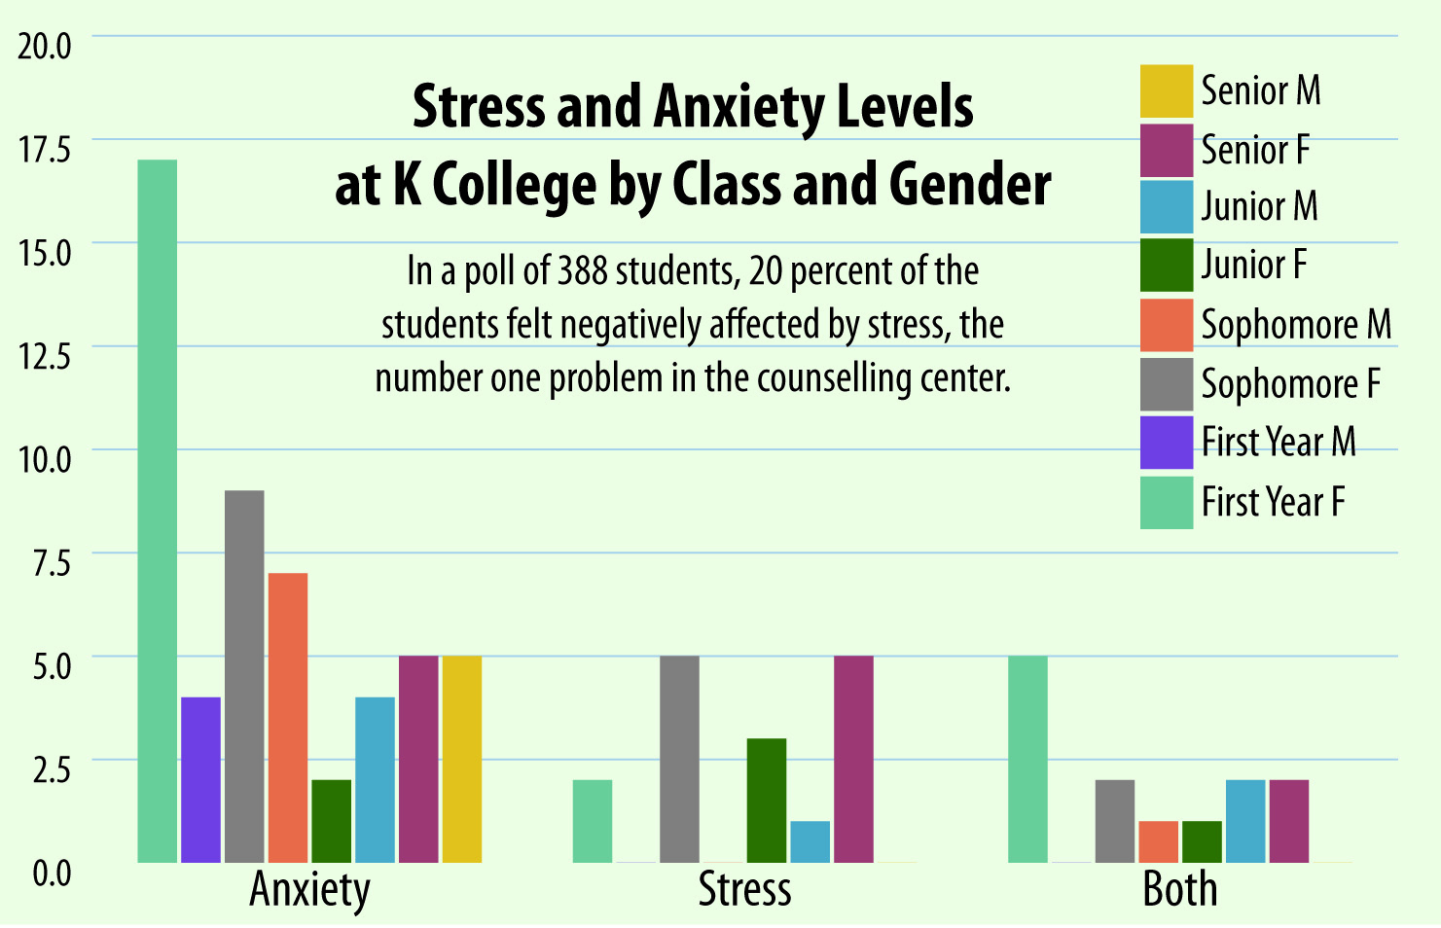
Is this graph’s message clear?

Slide 64
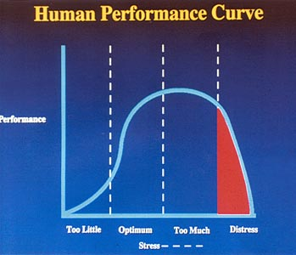
Is this graph’s message clear?

Slide 65
Percent of Cambridge High School Students Who Reported Weapon Carrying and/or Staying Home Out of Fear in the Last 30 Days (2004, 2006)
Change scale to emphasize variation
* Respondents were asked about a weapon such as a knife, gun, or club.
** This item asked “During the past 30 days, on how many days did you not go to school because you felt you would be unsafe at school or on your way to or from school?”
Notes:
SELECTED POINTS
These data illustrate the percent of students who reported carrying a weapon such as a knife, gun, or club in school or outside of school in the past 30 days, and those who stayed home from school in the past 30 days because of fear for their safety either in school or on the way to or from school.
In both 2004 and 2006, students were much more likely to report carrying a weapon in the last 30 days outside of school as opposed to in school.
Trends: Trend data reveal little change in reports between 2004 and 2006 among Cambridge youth, with the exception of carrying a weapon outside of school, which increased slightly from 11% in 2004 to 14% in 2006.
ADDITIONAL DATA
Gender: In 2006, Cambridge males were more likely than females to report carrying weapons both in school (10% males, 4% females), and outside of school (21% males, 7% females). There were no differences by gender of reports of staying home out of fear.
Grade: In 2006, reports of weapon carrying and fear for safety did not yield consistent changes by age/grade.
Comparisons: A larger percentage of 2006 Cambridge students reported staying home from school in the past 30 days because of fear for safety than 2005 Massachusetts students (7% Cambridge, 4% MA). Cambridge and Massachusetts students were similar in their rates of weapon carrying in school (7% Cambridge, 6% MA). Comparative state data are not available for rates of weapon carrying outside of school.

Slide 66
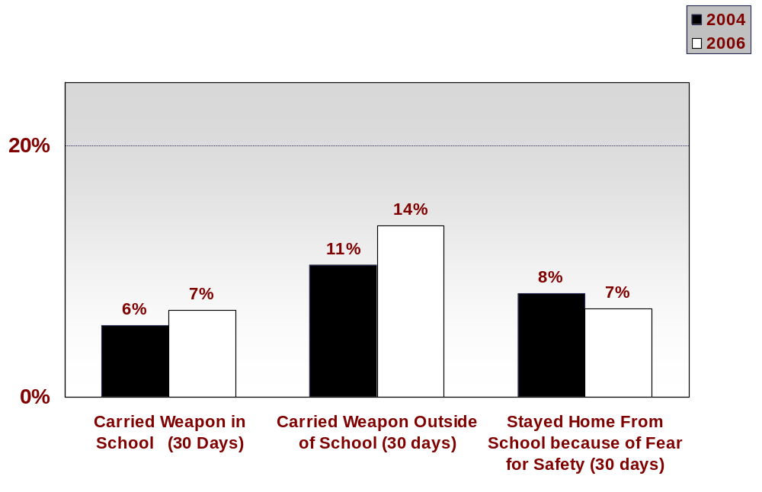
Percent of Students Reporting
Weapon Carrying and/or Staying Home in the Last 30 Days (2004, 2006)
During the past 30 days, on how many days did you not go to school because you felt you would be unsafe at school or on your way to or from school?”
Notes:
SELECTED POINTS
These data illustrate the percent of students who reported carrying a weapon such as a knife, gun, or club in school or outside of school in the past 30 days, and those who stayed home from school in the past 30 days because of fear for their safety either in school or on the way to or from school.
In both 2004 and 2006, students were much more likely to report carrying a weapon in the last 30 days outside of school as opposed to in school.
Trends: Trend data reveal little change in reports between 2004 and 2006 among Cambridge youth, with the exception of carrying a weapon outside of school, which increased slightly from 11% in 2004 to 14% in 2006.
ADDITIONAL DATA
Gender: In 2006, Cambridge males were more likely than females to report carrying weapons both in school (10% males, 4% females), and outside of school (21% males, 7% females). There were no differences by gender of reports of staying home out of fear.
Grade: In 2006, reports of weapon carrying and fear for safety did not yield consistent changes by age/grade.
Comparisons: A larger percentage of 2006 Cambridge students reported staying home from school in the past 30 days because of fear for safety than 2005 Massachusetts students (7% Cambridge, 4% MA). Cambridge and Massachusetts students were similar in their rates of weapon carrying in school (7% Cambridge, 6% MA). Comparative state data are not available for rates of weapon carrying outside of school.

Slide 67
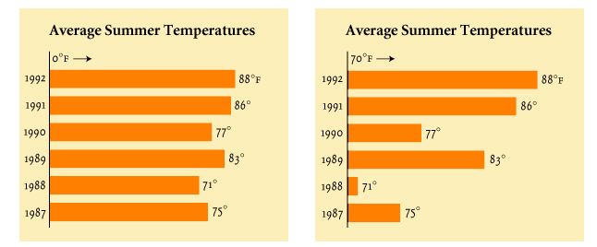
Practical Tips - Charts
Start with a zero point.
Or make it obvious that there is not one.

Slide 68
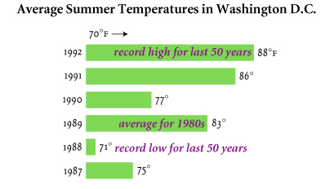
Practical Tips - Charts
Give enough context to the story so
that the graphic supports your point

Slide 69
PowerPoint Can Output….
  Screen shows using LCD projector
  Speaker notes
  Handouts
  Outlines
  Web pages
  Web conferencing
p.63
Detailed notes page provides a
“high resolution” output

Slide 70
Elements of Communication
Audience and Venue
Speaker
Presentation
Technology
Message
Audience

Slide 71

Control Your Environment
Leave the lectern … and the laptop
Keep the lights on

Slide 72
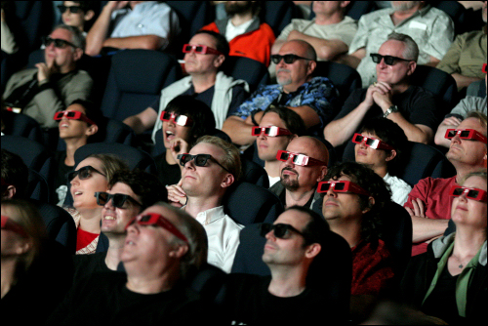
Connect with Your Audience
Notes:
42
45

Slide 73
Connect with Your Audience
Eye contact
Use stories or other examples
Use clean, simple presentation design
  Basic readable font
  Limit colors to three if possible
Use multiple slides and handouts
for complex ideas
Use a variety of images/ clear graphics
Engage your audience!!
Notes:
42
45

Slide 74
Elements of Communication
Speaker
Presentation
Technology
Message
Audience

Slide 75
Putting It All Together
What’s the first step you’ll take
when you design your next presentation?
Notes:
(Mea)
Creative process to design your own stellar presentations
Start with paper and pencil
[Ask group questions, or have them buzz in pairs…]
Group debrief - popcorn

Slide 76
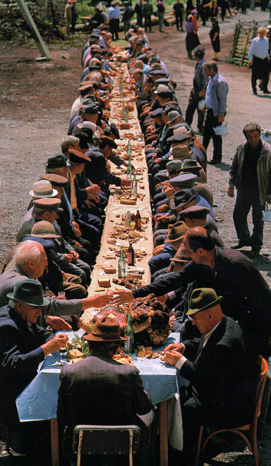
Comments !
Questions ?
Thank you…

Slide 77


Good Resources
Find our handout online:

Slide 78

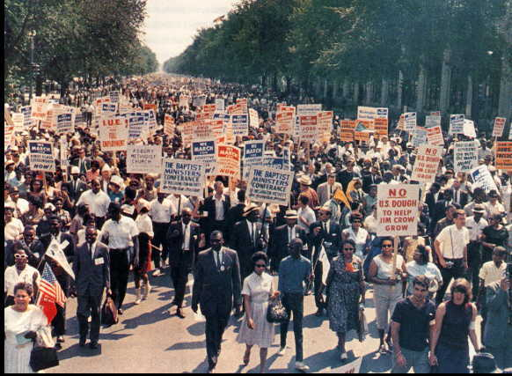
March on Washington

