Slide 1
Assessing Value in Medicine:
From Virus to Policy in HIV Disease
Kenneth A. Freedberg, MD, MSc
Divisions of Infectious Disease
and General Medicine
Massachusetts General Hospital
CREST conference, Boston University
June 9, 2015
Supported by NIAID, NIMH, CDC, CHAI, ANRS
Co-Director, CREST Program
Boston University School of Medicine
1995
Divisions of Infectious Disease
and General Medicine
Massachusetts General Hospital

Slide 2
I have no financial disclosures.

Slide 3
Patient: T.C.
24 year-old woman
Outpatient department with sore throat
Thrush noted
HIV test recommended
Positive
CD4 20/ul, viral load 122,000 copies/ml

Slide 4
Overview
Clinical Economics: brief introduction
The Cost-effectiveness of Presenting AIDS Complications (CEPAC) Model
Cost-effectiveness and policy in the United States
Cost-effectiveness in resource-limited settings
Conclusions

Slide 5
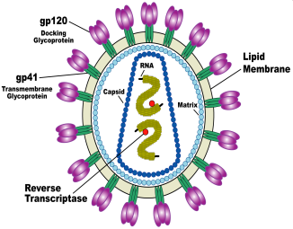

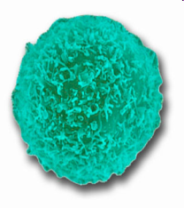


HIV Clinical Policy: US

Slide 6
HIV Clinical Policy: US

Slide 7
Medical Care, 2015…
Two questions…
1. Is it effective?*
(Does it work?)
2. Is it cost-effective?
Evidence for standards of care…
*Note – if it’s not effective, it’s not cost-effective
Notes:
7

Slide 8
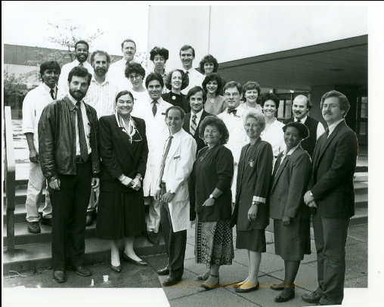
Medical Care, 1991
Notes:
11

Slide 9
CREST Take-home #1
What do you want to do?
Why do I say this?
Notes:
Malgré le succès remarquable du traitement , ART a néanmoins de nombreuses limites . Bien que beaucoup moins toxique que les schémas précédents , en cours de traitement peut encore être associée à cardiovasculaire , rénale , osseuse , et d'autres complications [ 3 , 4] . L'inflammation et l'activation immunitaire qui persistent dans de nombreux patients sous ART suppressive peuvent avoir un impact clinique négatif à long terme [ 5 ] . Thérapie aux États-Unis et en Europe reste coûteuse , et , parce qu'il n'est pas curatif , doit être poursuivi indéfiniment [ 6 , 7 ] . ART succès aussi n'élimine pas la stigmatisation associée à l'infection à VIH [ 8 ] .
Le premier rapport d'une cure réussie du VIH après une greffe de cellules souches allogéniques pour la leucémie aiguë démontré que l'éradication du VIH d'un individu est viable [ 9 ] . Bien que la transplantation allogénique en l'absence d' indications habituelles comporte des risques importants , le coût et les conséquences post-transplantation de l'immunosuppression chronique , d'autres stratégies sont actuellement à l'étude qui pourrait guérir le VIH et être pratiquement déployé [ 10-12 ] . En outre, une étude de cas récente détaillé le remède possible d'un bébé infecté par le VIH par l'initiation de ART immédiatement après la naissance [ 13 ] . Grâce à cette focalisation croissante sur les efforts de guérison du VIH , dans cette analyse , nous nous efforçons d'établir des seuils d'efficacité , la toxicité , la durabilité , le coût et la qualité de vie qui serait nécessaire pour une stratégie de traitement à la comparaison avec les traitements antirétroviraux actuellement aux États-Unis .
Despite the remarkable success of treatment, ART nonetheless has many limitations. Although much less toxic than earlier regimens, current treatment still may be associated with cardiovascular, renal, bone, and other complications [3, 4]. The inflammation and immune activation that persist in many patients on suppressive ART may have long-term negative clinical impact [5]. Therapy in the US and Europe remains costly, and, because it is not curative, must be continued indefinitely [6, 7]. Successful ART also does not eliminate the stigma associated with HIV infection [8].
The first report of a successful cure of HIV after allogeneic stem cell transplant for acute leukemia demonstrated that eradicating HIV from an individual is viable [9]. While allogeneic transplant in the absence of usual indications carries substantial risk, cost, and the post-transplant consequences of chronic immunosuppression, other strategies are currently being studied that could potentially cure HIV and be practically deployed [10-12]. Further, a recent case report detailed the possible cure of an HIV-infected baby through initiation of ART immediately after birth [13] .With this growing focus on HIV cure efforts, in this analysis we aim to establish thresholds of efficacy, toxicity, durability, cost, and quality of life that would be necessary for a cure strategy to compare favorably with current antiretroviral therapy in the United States.

Slide 10
Medical Care, 1991
Notes:
11

Slide 11
Cost Analysis
US$11,700 - $30,200/patient/year with CD4 counts >350/µL to < 50/µL
  Gebo et al., AIDS 2010
Notes:
11

Slide 12
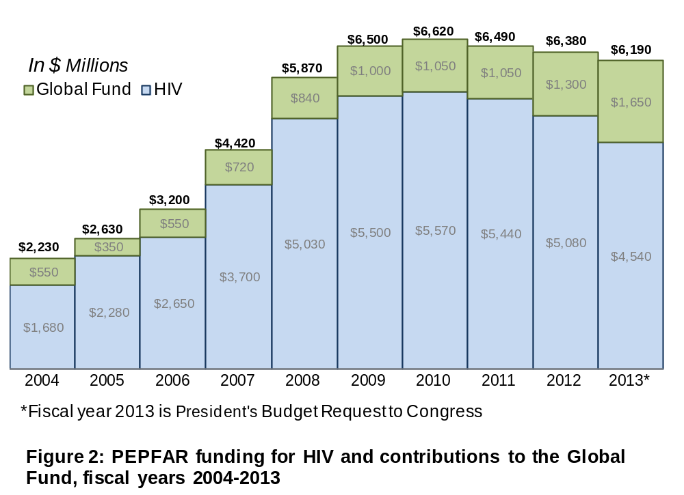
International Funding for HIV
http://www.pepfar.gov/documents
Notes:
Concern, of late, is that amidst global treatment and prevention, commitments toward AIDS assistance now remain flat and that the durability and expansion of HIV programs are at risk.

Slide 13
Cost-effectiveness Analysis
Two different outcome measures
  Cost ($, rand, CFA)
  Effectiveness: years of life saved (YLS)
        QALYs or DALYs
Cost-effectiveness ratio:
Additional Resource Use
Additional Health Benefits
The value of resources spent
Notes:
13
9
20

Slide 14

Cost-effectiveness:
Common Misconceptions
“Cost-Effective” = “Cheap”
“Cost-Effective” = “Saves Money”
“Cost-Effective” = Additional benefit worth the additional cost ($/QALY)
Notes:
14

Slide 15
Cost-effectiveness “Thresholds”
The Commission on Macroeconomics and Health and WHO have suggested that interventions are:
    Very cost-effective: the CE ratio is <1 x GDP per capita for that country
    $43,000 for US
    Cost-effective: the CE ratio is
    <3 x GDP per capita for that country
Macroeconomics and Health: WHO 2001
Notes:
15
Based on the Commission on Macroeconomics and Health, the World Health Organization suggests that interventions are “very cost-effective” if they have cost-effectiveness ratios less than the Gross Domestic Product (GDP) per capita of that country, or $803 for Cote d’Ivoire and “cost-effective” if they have ratios less than 3 times the per capita GDP of that country, or $2,409 for Cote d’Ivoire.
We used these definitions in this analysis.

Slide 16
Resources are limited

Slide 17
Resources are limited
Period.

Slide 18
CREST Take-home #2
Find a good mentor
“Mutual fund rule”
Notes:
Malgré le succès remarquable du traitement , ART a néanmoins de nombreuses limites . Bien que beaucoup moins toxique que les schémas précédents , en cours de traitement peut encore être associée à cardiovasculaire , rénale , osseuse , et d'autres complications [ 3 , 4] . L'inflammation et l'activation immunitaire qui persistent dans de nombreux patients sous ART suppressive peuvent avoir un impact clinique négatif à long terme [ 5 ] . Thérapie aux États-Unis et en Europe reste coûteuse , et , parce qu'il n'est pas curatif , doit être poursuivi indéfiniment [ 6 , 7 ] . ART succès aussi n'élimine pas la stigmatisation associée à l'infection à VIH [ 8 ] .
Le premier rapport d'une cure réussie du VIH après une greffe de cellules souches allogéniques pour la leucémie aiguë démontré que l'éradication du VIH d'un individu est viable [ 9 ] . Bien que la transplantation allogénique en l'absence d' indications habituelles comporte des risques importants , le coût et les conséquences post-transplantation de l'immunosuppression chronique , d'autres stratégies sont actuellement à l'étude qui pourrait guérir le VIH et être pratiquement déployé [ 10-12 ] . En outre, une étude de cas récente détaillé le remède possible d'un bébé infecté par le VIH par l'initiation de ART immédiatement après la naissance [ 13 ] . Grâce à cette focalisation croissante sur les efforts de guérison du VIH , dans cette analyse , nous nous efforçons d'établir des seuils d'efficacité , la toxicité , la durabilité , le coût et la qualité de vie qui serait nécessaire pour une stratégie de traitement à la comparaison avec les traitements antirétroviraux actuellement aux États-Unis .
Despite the remarkable success of treatment, ART nonetheless has many limitations. Although much less toxic than earlier regimens, current treatment still may be associated with cardiovascular, renal, bone, and other complications [3, 4]. The inflammation and immune activation that persist in many patients on suppressive ART may have long-term negative clinical impact [5]. Therapy in the US and Europe remains costly, and, because it is not curative, must be continued indefinitely [6, 7]. Successful ART also does not eliminate the stigma associated with HIV infection [8].
The first report of a successful cure of HIV after allogeneic stem cell transplant for acute leukemia demonstrated that eradicating HIV from an individual is viable [9]. While allogeneic transplant in the absence of usual indications carries substantial risk, cost, and the post-transplant consequences of chronic immunosuppression, other strategies are currently being studied that could potentially cure HIV and be practically deployed [10-12]. Further, a recent case report detailed the possible cure of an HIV-infected baby through initiation of ART immediately after birth [13] .With this growing focus on HIV cure efforts, in this analysis we aim to establish thresholds of efficacy, toxicity, durability, cost, and quality of life that would be necessary for a cure strategy to compare favorably with current antiretroviral therapy in the United States.

Slide 19
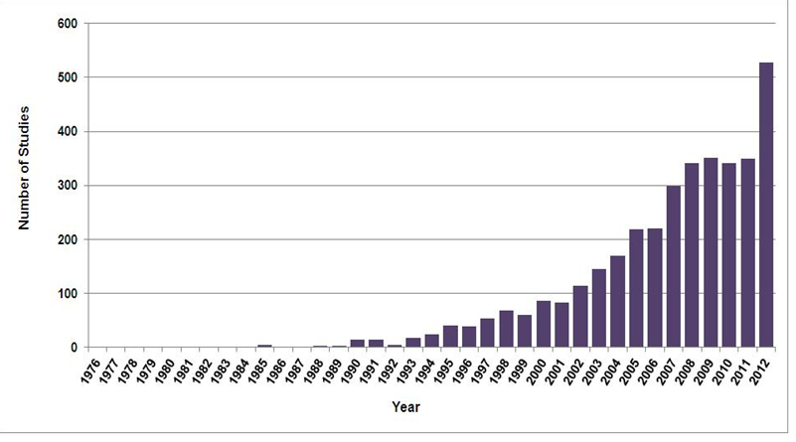
Publications on Cost-Effectiveness
Number of Studies
Year
https://research.tufts-nemc.org/cear4/AboutUs/WhatistheCEARegistry.aspx
Notes:
One of the key roles for models is in conducting cost-effectiveness analyses.
This graph is from the CEA registry, maintained by Tufts University, in which they tally all of the published CEAs in the medical literature. You can see that this is a really growing field of study, with a huge increase in the number of published studies in recent years. (From Andrea’s PHACTS talk)

Slide 20
Cost-effectiveness of Preventing AIDS Complications (CEPAC)
CEPAC is a simulation model of HIV disease and treatment that incorporates CD4, HIV RNA, ART, opportunistic infections
Data are from public use datasets, published cohorts, and clinical trials
Model outcomes are reported in projected life expectancy and costs
* Funded by NIAID, NIMH, CDC, CHAI, ANRS
Notes:
11
We used the cost-effectiveness of preventing AIDS complications (or CEPAC) model to estimate per person survival benefits. CEPAC is a computer simulation model of HIV disease that incorporates CD4 cell count, HIV RNA level, ART efficacy, OI incidence, treatment, and prophylaxis, and other important clinical details. Data for model input are from public use datasets, published cohorts and clinical trials. Model outcomes are reported in average life expectancy.

Slide 21
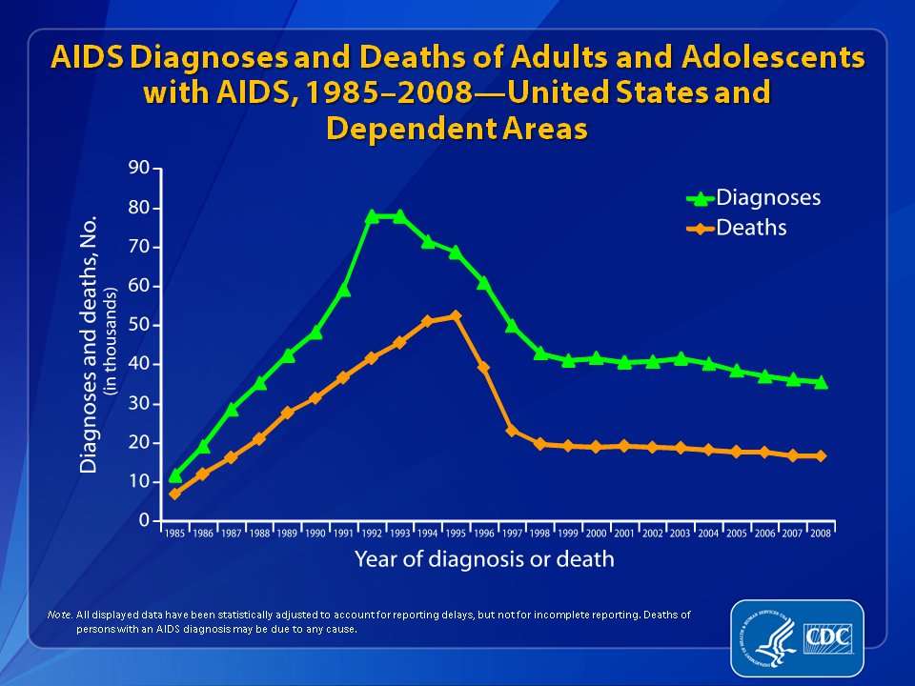
Notes:
The upper curve on the line graph represents the estimated number of AIDS diagnoses in the United States and dependent areas from 1985-2008; the lower curve represents the estimated number of deaths of adults and adolescents with an AIDS diagnosis during this time period.
The peak in AIDS diagnoses during 1993 can be associated with the expansion of the AIDS surveillance case definition implemented in January 1993. The overall declines in new AIDS cases and deaths of persons with AIDS are due in part to the success of highly active antiretroviral therapies, introduced in 1996.
In recent years, AIDS diagnoses and deaths of persons with AIDS have continued to decrease.
All displayed data have been estimated. Estimated numbers resulted from statistical adjustment that accounted for reporting delays, but not for incomplete reporting.
Deaths of persons with an AIDS diagnosis may be due to any cause (may not be AIDS-related). Deaths of persons with an AIDS diagnosis are classified as adult or adolescent based on age at death.
21

Slide 22
Is ART Cost-effective in the US?
CE Ratio
Strategy Costs ($) QALM ($/QALY)
Dupont 006 (CD4 350/μl)
No ART 59,790 47.52 ---
AZT/3TC/EFV 94,290 79.56 13,000
Johns Hopkins (CD4 217/μl)
No ART 54,150 35.04 ---
AZT/3TC/IDV 80,460 53.16 17,000
Freedberg et al, N Engl J Med 2001.
Notes:
11
13

Slide 23
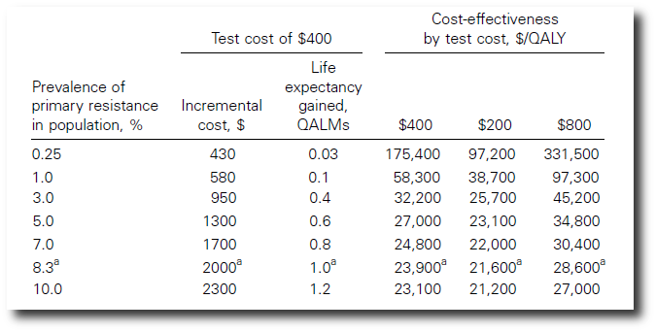
Cost-effectiveness of Genotype Testing in ART-naïve Patients
Sax et al, IAS Barcelona 2002
Notes:
23

Slide 24
CREST Take-home #3
If it’s not published it doesn’t exist.
Notes:
Malgré le succès remarquable du traitement , ART a néanmoins de nombreuses limites . Bien que beaucoup moins toxique que les schémas précédents , en cours de traitement peut encore être associée à cardiovasculaire , rénale , osseuse , et d'autres complications [ 3 , 4] . L'inflammation et l'activation immunitaire qui persistent dans de nombreux patients sous ART suppressive peuvent avoir un impact clinique négatif à long terme [ 5 ] . Thérapie aux États-Unis et en Europe reste coûteuse , et , parce qu'il n'est pas curatif , doit être poursuivi indéfiniment [ 6 , 7 ] . ART succès aussi n'élimine pas la stigmatisation associée à l'infection à VIH [ 8 ] .
Le premier rapport d'une cure réussie du VIH après une greffe de cellules souches allogéniques pour la leucémie aiguë démontré que l'éradication du VIH d'un individu est viable [ 9 ] . Bien que la transplantation allogénique en l'absence d' indications habituelles comporte des risques importants , le coût et les conséquences post-transplantation de l'immunosuppression chronique , d'autres stratégies sont actuellement à l'étude qui pourrait guérir le VIH et être pratiquement déployé [ 10-12 ] . En outre, une étude de cas récente détaillé le remède possible d'un bébé infecté par le VIH par l'initiation de ART immédiatement après la naissance [ 13 ] . Grâce à cette focalisation croissante sur les efforts de guérison du VIH , dans cette analyse , nous nous efforçons d'établir des seuils d'efficacité , la toxicité , la durabilité , le coût et la qualité de vie qui serait nécessaire pour une stratégie de traitement à la comparaison avec les traitements antirétroviraux actuellement aux États-Unis .
Despite the remarkable success of treatment, ART nonetheless has many limitations. Although much less toxic than earlier regimens, current treatment still may be associated with cardiovascular, renal, bone, and other complications [3, 4]. The inflammation and immune activation that persist in many patients on suppressive ART may have long-term negative clinical impact [5]. Therapy in the US and Europe remains costly, and, because it is not curative, must be continued indefinitely [6, 7]. Successful ART also does not eliminate the stigma associated with HIV infection [8].
The first report of a successful cure of HIV after allogeneic stem cell transplant for acute leukemia demonstrated that eradicating HIV from an individual is viable [9]. While allogeneic transplant in the absence of usual indications carries substantial risk, cost, and the post-transplant consequences of chronic immunosuppression, other strategies are currently being studied that could potentially cure HIV and be practically deployed [10-12]. Further, a recent case report detailed the possible cure of an HIV-infected baby through initiation of ART immediately after birth [13] .With this growing focus on HIV cure efforts, in this analysis we aim to establish thresholds of efficacy, toxicity, durability, cost, and quality of life that would be necessary for a cure strategy to compare favorably with current antiretroviral therapy in the United States.

Slide 25
Cost-effectiveness of Genotype Testing in ART-naïve Patients
Sax et al,
Clin Inf Dis 2005
IAS Barcelona 2002
Notes:
25

Slide 26
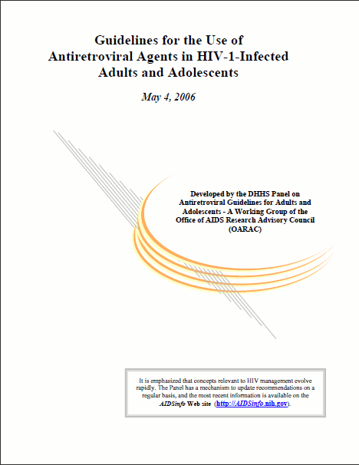


Slide 27
Patient: T.C.
24 year-old woman
Outpatient department with sore throat
How many of you would recommend to her that she have an HIV test?

Slide 28
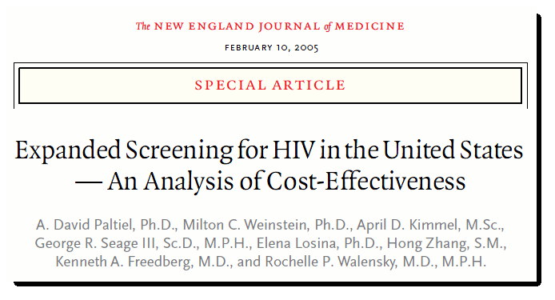
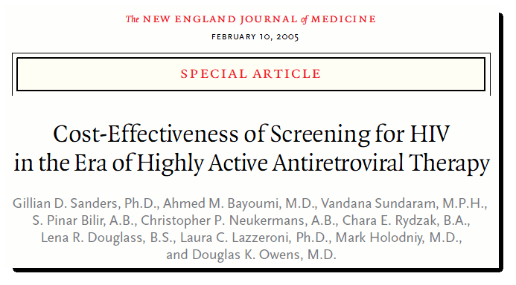

Slide 29
HIV Screening: Outpatients
At a 1% prevalence of undiagnosed HIV infection, routine testing every 5 years had a cost-effectiveness ratio of $71,000/QALY gained (Paltiel et al. NEJM 2005)
At a 1% prevalence of undiagnosed HIV infection, cost-effectiveness of routine screening was $41,700/QALY (Sanders et al. NEJM 2005)
With the inclusion of transmission effects, routine HIV screening in a population with 0.2% prevalence of undiagnosed HIV infection, had a cost-effectiveness ratio of $50,000/QALY (Paltiel et al. Ann Intern Med 2006)
Notes:
We found that in a “high risk” population, HIV testing every 5 years had a cost-effectiveness ratio of $67,000/QALY gained.
Furthermore, at the CDC 1% prevalence threshold, HIV testing every 10 years had a cost-effectiveness ratio of $57,000/QALY gained.
And finally, even in the US overall population, a one time HIV test was cost-effective at a ratio of $39,000/QALY gained.

Slide 30
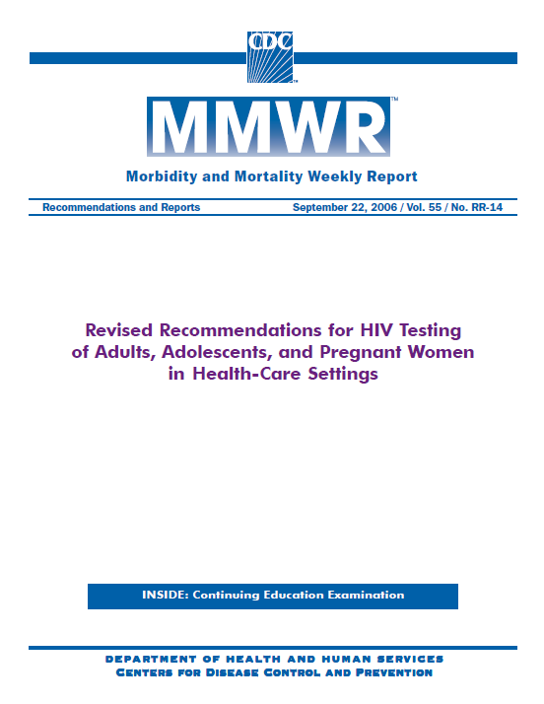
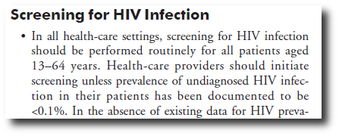

Slide 31
Cost-effectiveness Ratios for Other Screening Programs
C-E ratio
Screening Program ($/QALY)* Reference
HIV screening inpatients $38,600 Walensky AJM
HIV screening every 5 years
high risk patients $50,000 Paltiel NEJM
Breast cancer screening Salzmann
Annual mammogram, 50–69 y/o $57,500 Ann Intern Med
Diabetes Mellitus, Type 2
Fasting plasma glucose, adults >25 y/o $70,000 CDC JAMA
*All costs adjusted to 2001 US dollars
Notes:
31
10
22
How do these ratios compare with other screening programs in the US. The lower the ratio, the more cost-effective the program. Here, we see that HIV screening among inpatients, and frequent HIV screening of high risk outpatients carry similar, or lower cost-effectiveness ratios than those of other screening programs that are currently standard of care. These include screening for breast cancer, colon cancer, and diabetes.

Slide 32
Generic ART in the US
 | Life expectancy (QALY) | Per-person lifetime cost* (USD 2010) | ICER ($/QALY)
No ART | 4.05 | 131,200 | --
Branded ART | 12.45 | 342,800 | 25,200
USD: United States Dollars; QALY: quality-adjusted life year; ART: antiretroviral therapy
*QALY and costs discounted at 3% annually
Walensky et al, Annals 2013

Slide 33
Generic ART in the US
 | Life expectancy (QALY) | Per-person lifetime cost* (USD 2010) | ICER ($/QALY)
No ART | 4.05 | 131,200 | --
Generic ART | 12.08 | 300,300 | 21,100
Branded ART | 12.45 | 342,800 | 114,800
Δ 0.37
Δ $42,500
USD: United States Dollars; QALY: quality-adjusted life year; ART: antiretroviral therapy
*QALY and costs discounted at 3% annually
Walensky et al, Annals 2013

Slide 34
Generic ART:
Cost-effectiveness Plane
● No ART
❐ Generic ART
✦ Branded ART
Walensky et al, Annals 2013

Slide 35
Generic ART:
Cost-effectiveness Plane
● No ART
❐ Generic ART
✦ Branded ART
Walensky et al, Annals 2013

Slide 36
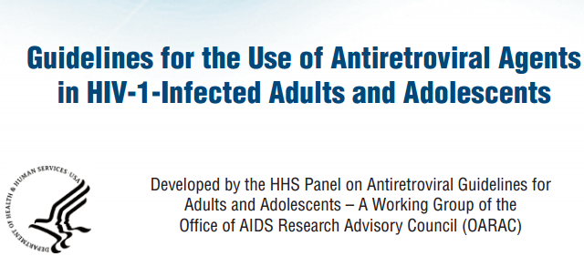
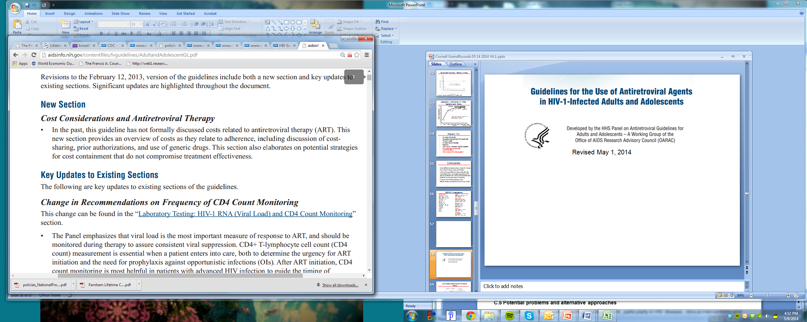
Revised May 1, 2014

Slide 37
What about HIV Cure?
Recent evidence in one bone marrow recipient and (almost…) one newborn that HIV eradication, or ‘cure’, may be viable
Major efforts focused on a variety of cure strategies: gene therapy and chemotherapy
Goal to establish thresholds of efficacy, toxicity, relapse, and cost at which a cure strategy could be cost-effective
Notes:
Malgré le succès remarquable du traitement , ART a néanmoins de nombreuses limites . Bien que beaucoup moins toxique que les schémas précédents , en cours de traitement peut encore être associée à cardiovasculaire , rénale , osseuse , et d'autres complications [ 3 , 4] . L'inflammation et l'activation immunitaire qui persistent dans de nombreux patients sous ART suppressive peuvent avoir un impact clinique négatif à long terme [ 5 ] . Thérapie aux États-Unis et en Europe reste coûteuse , et , parce qu'il n'est pas curatif , doit être poursuivi indéfiniment [ 6 , 7 ] . ART succès aussi n'élimine pas la stigmatisation associée à l'infection à VIH [ 8 ] .
Le premier rapport d'une cure réussie du VIH après une greffe de cellules souches allogéniques pour la leucémie aiguë démontré que l'éradication du VIH d'un individu est viable [ 9 ] . Bien que la transplantation allogénique en l'absence d' indications habituelles comporte des risques importants , le coût et les conséquences post-transplantation de l'immunosuppression chronique , d'autres stratégies sont actuellement à l'étude qui pourrait guérir le VIH et être pratiquement déployé [ 10-12 ] . En outre, une étude de cas récente détaillé le remède possible d'un bébé infecté par le VIH par l'initiation de ART immédiatement après la naissance [ 13 ] . Grâce à cette focalisation croissante sur les efforts de guérison du VIH , dans cette analyse , nous nous efforçons d'établir des seuils d'efficacité , la toxicité , la durabilité , le coût et la qualité de vie qui serait nécessaire pour une stratégie de traitement à la comparaison avec les traitements antirétroviraux actuellement aux États-Unis .
Despite the remarkable success of treatment, ART nonetheless has many limitations. Although much less toxic than earlier regimens, current treatment still may be associated with cardiovascular, renal, bone, and other complications [3, 4]. The inflammation and immune activation that persist in many patients on suppressive ART may have long-term negative clinical impact [5]. Therapy in the US and Europe remains costly, and, because it is not curative, must be continued indefinitely [6, 7]. Successful ART also does not eliminate the stigma associated with HIV infection [8].
The first report of a successful cure of HIV after allogeneic stem cell transplant for acute leukemia demonstrated that eradicating HIV from an individual is viable [9]. While allogeneic transplant in the absence of usual indications carries substantial risk, cost, and the post-transplant consequences of chronic immunosuppression, other strategies are currently being studied that could potentially cure HIV and be practically deployed [10-12]. Further, a recent case report detailed the possible cure of an HIV-infected baby through initiation of ART immediately after birth [13] .With this growing focus on HIV cure efforts, in this analysis we aim to establish thresholds of efficacy, toxicity, durability, cost, and quality of life that would be necessary for a cure strategy to compare favorably with current antiretroviral therapy in the United States.

Slide 38
Gene Therapy:
Efficacy, Relapse, and Cost
 |  | Cost = $50 000
Relapse (%/month) | 0.0
 | 0.5
 | 1.0
 | 1.5
 | 2.0
 |  | 10 | 20 | 30 | 40 | 50 | 60
 |  | Efficacy(%)
 |  | Cost = $200 000
Relapse (%/month) | 0.0
 | 0.5
 | 1.0
 | 1.5
 | 2.0
 |  | 10 | 20 | 30 | 40 | 50 | 60
 |  | Efficacy (%)
 |  | Cost-saving
 |  | C/E<$100 000/QALY
 |  | Not cost-effective
Sax et al., PLoS One 2014

Slide 39
Number of People Living
with HIV: US
People Living With HIV
U.S.
Year

Slide 40
Number of People Living
with HIV: US and Globally
People Living With HIV (Millions)
Global
U.S.
Year

Slide 41
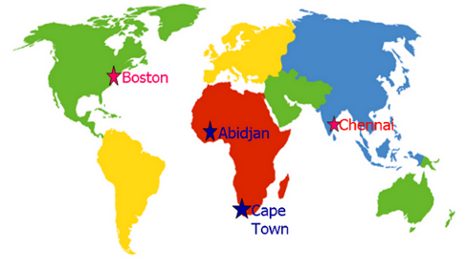
What should be the standard of care?

Slide 42
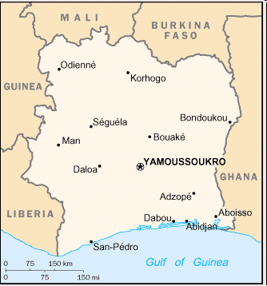
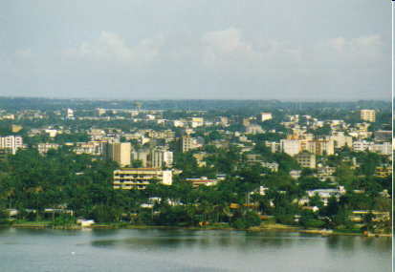
Abidjan, Côte d’Ivoire

Slide 43
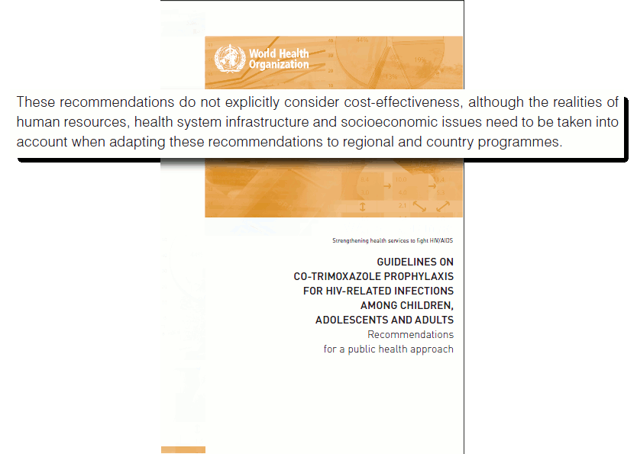

Slide 44
Policy Issue:
Cost-effectiveness of ART
ART is $270 per month
Resources are limited (drug, clinic space, personnel)
Who should get ART and when?
Notes:
44

Slide 45
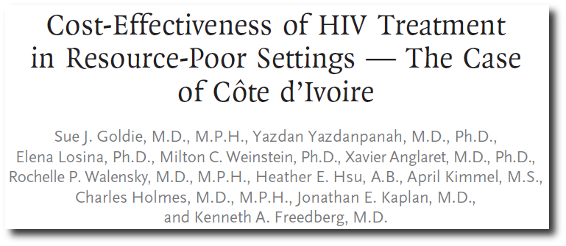
Strategy | ART starting criteria | L-E (mths) | Cost ($) | C-E Ratio ($/YLS)
No treatment | -- | 31.4 | 780 | --
ART, no CD4 | 2 OIs | 41.4 | 1,230 | 600
ART, with CD4 | CD4<200 | 69.6 | 3,400 | 1,200
Côte d’Ivoire per capita GDP = $1,100
Goldie et al., NEJM, 2006
Notes:
45
This paper by Sue Goldie and colleagues and based in Cote d’Ivoire, was among the first to examine the economic value ART in resource limited settings. Strategies of alternative scenarios of CD4 availability, ART starting and stopping criteria were examined. First, it is notable that increases in LE associated with ART, regardless of the scenario were huge, ranging from 10 to 38 months shown in yellow. The cost-effectiveness of ART without CD4 monitoring available was $590/YLS, VERY Cost-effective in Cote d’Ivoire by GDP comparison, and with CD4 availability is $1,180/YLS, COST effective in Cote d’Ivoire by GDP comparison
C’était il y a longtemps

Slide 46

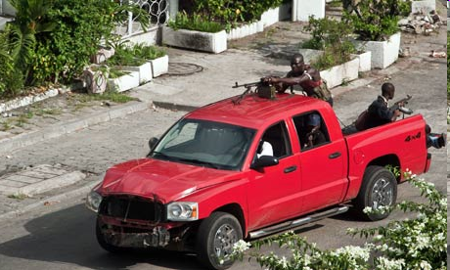
Abidjan, March 2011

Slide 47
3rd-line ART in Côte d’Ivoire
 | Clinical |  |  |  | Economic
Strategy | L-E (months) |  |  |  | Cost ($) | C-E Ratio ($/YLS)
Routine CD4 counts for failure
2nd-line ART only |  | 49.6 |  | 4,700 |  | --
Adherence intervention, then restart 2nd- line ART |  | 64.2 |  | 6,000 |  | 1,100
Adherence intervention, then 3rd-line ART if virologic failure persists |  | 90.4 |  | 13,800 |  | 3,600
Immediate change to 3rd-line ART |  | 88.3 |  | 16,600 |  | Dom.
Ouattara et al., JAIDS 2014

Slide 48
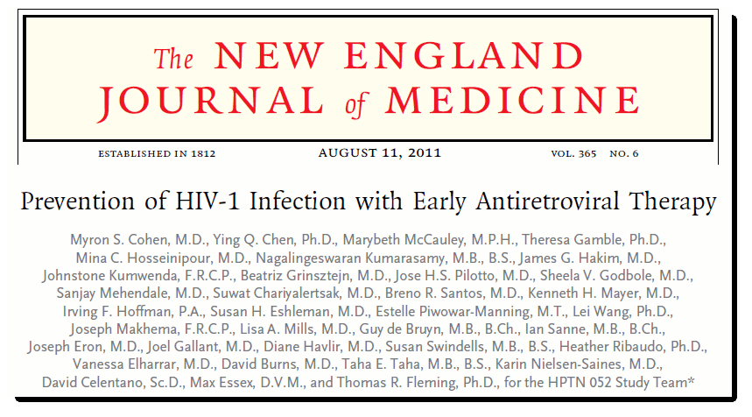
Early compared to delayed ART conferred a 96% relative reduction in linked HIV transmissions among serodiscordant couples
Cohen et al., NEJM 2011

Slide 49
Survival in South Africa
 | 5-year survival
Early ART | 93%
Delayed ART | 84%
No ART | 55%
Walensky et al., NEJM 2013

Slide 50
Transmission Rates, 5 yrs, South Africa
Early ART
Delayed ART
No ART
Walensky et al., NEJM 2013

Slide 51
Cost-effectiveness, Lifetime, South Africa
 | Life expectancy (years) | Costs (USD 2011) | ICER† ($/YLS)
Delayed ART | 13.3 | 15,970 | --
Early ART | 15.2 | 16,320 | 530
†Including projected survival losses and cost increases associated with 1st- and 2nd-order transmissions
per capita GDP for South Africa: $8,100
Walensky et al., NEJM 2013

Slide 52
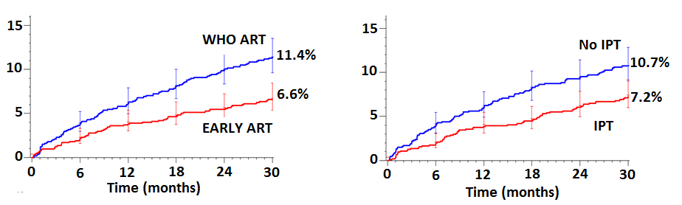
Temprano Severe HIV morbidity:
(N=2,056)
 | n | Rate /1OO PY | aHR | p
WHO ART | 111 | 4.9
Early ART | 64 | 2.8 | 0.56 | 0.0002
No IPT | 104 | 4.7
IPT | 71 | 3.0 | 0.65 | 0.005
No significant interaction between Early-ART and IPT
44% reduction in risk with Early ART
35% reduction in risk with IPT
Danel et al, CROI 2015
Notes:
This slide shows the results of the main analysis in the overall population.
There was no significant interaction between early ART and IPT;
In the graphs above, for patients in the WHO-ART arms, the probability of severe morbidity reached eleven point four percent at thirty months.
And in patients with no IPT, this probability reached ten point seven percent.
In the table below, there was a forty four percent reduction in the risk of severe morbidity with early ART as compared to WHO ART, and a thirty five percent reduction in the risk of severe morbidity with IPT as compared to no IPT.
Both reductions were significant and independent.

Slide 53
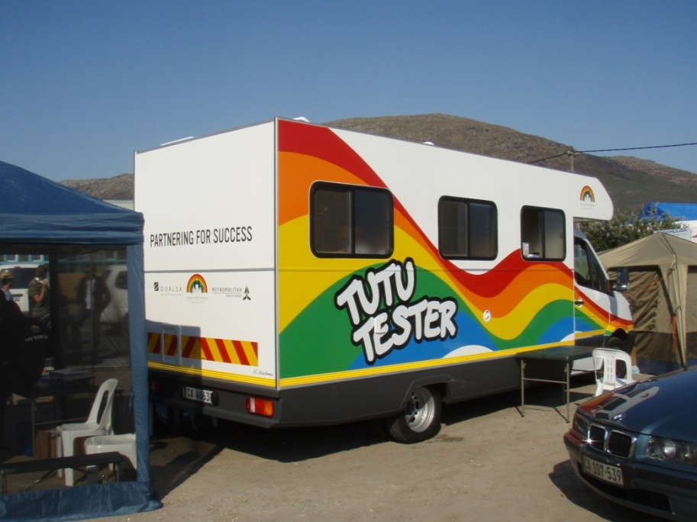
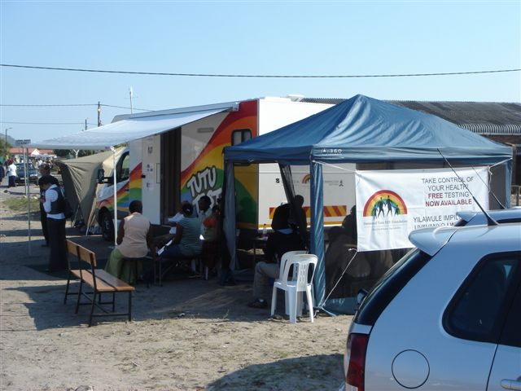
The “Tutu Tester”, Cape Town, South Africa

Slide 54
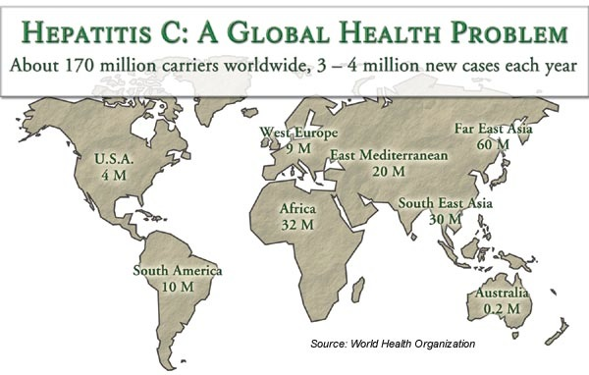
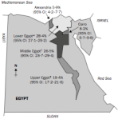

Slide 55
Cost-Effectiveness of HCV Rx:
Genotype 2, with Cirrhosis
Treatment Strategy | SVR, % | Life expectancy (QALYs) | Per-person lifetime cost* (USD 2013) | ICER ($/QALY)
Naïve
No treatment | --- | 5.1 | 94,000 | ---
24 wk of PEG-RBV | 62 | 11.3 | 150,000 | 8,700
12 wk of SOF-RBV | 90 | 14.2 | 253,000 | 35,500
Experienced
No treatment | --- | 4.1 | 85,000 | ---
12 wk of SOF-RBV | 58 | 9.3 | 230,000 | Dominated
16 wk of SOF-RBV | 77 | 10.8 | 268,000 | 27,300
Linas et al, Annals 2015

Slide 56
Cost-Effectiveness of HCV Rx:
Genotype 2, No Cirrhosis
Treatment Strategy | SVR, % | Life expectancy (QALYs) | Per-person lifetime cost* (USD 2013) | ICER ($/QALY)
Naïve
No treatment | --- | 13.9 | 169,000 | ---
24 wk of PEG-RBV | 82 | 15.5 | 173,000 | 3,000
12 wk of SOF-RBV | 98 | 15.8 | 261,000 | 238,000
Experienced
No treatment | --- | 12.3 | 163,000 | ---
12 wk of SOF-RBV | 96 | 13.8 | 258,000 | 63,700
16 wk of SOF-RBV | 99 | 13.9 | 288,000 | 468,000
Linas et al, Annals 2015

Slide 57
CREST Take-home #4
Be at the table
Ben Linas, MD, MPH
  AASLD/IDSA Guidelines Committee on HCV, 2015
Notes:
Malgré le succès remarquable du traitement , ART a néanmoins de nombreuses limites . Bien que beaucoup moins toxique que les schémas précédents , en cours de traitement peut encore être associée à cardiovasculaire , rénale , osseuse , et d'autres complications [ 3 , 4] . L'inflammation et l'activation immunitaire qui persistent dans de nombreux patients sous ART suppressive peuvent avoir un impact clinique négatif à long terme [ 5 ] . Thérapie aux États-Unis et en Europe reste coûteuse , et , parce qu'il n'est pas curatif , doit être poursuivi indéfiniment [ 6 , 7 ] . ART succès aussi n'élimine pas la stigmatisation associée à l'infection à VIH [ 8 ] .
Le premier rapport d'une cure réussie du VIH après une greffe de cellules souches allogéniques pour la leucémie aiguë démontré que l'éradication du VIH d'un individu est viable [ 9 ] . Bien que la transplantation allogénique en l'absence d' indications habituelles comporte des risques importants , le coût et les conséquences post-transplantation de l'immunosuppression chronique , d'autres stratégies sont actuellement à l'étude qui pourrait guérir le VIH et être pratiquement déployé [ 10-12 ] . En outre, une étude de cas récente détaillé le remède possible d'un bébé infecté par le VIH par l'initiation de ART immédiatement après la naissance [ 13 ] . Grâce à cette focalisation croissante sur les efforts de guérison du VIH , dans cette analyse , nous nous efforçons d'établir des seuils d'efficacité , la toxicité , la durabilité , le coût et la qualité de vie qui serait nécessaire pour une stratégie de traitement à la comparaison avec les traitements antirétroviraux actuellement aux États-Unis .
Despite the remarkable success of treatment, ART nonetheless has many limitations. Although much less toxic than earlier regimens, current treatment still may be associated with cardiovascular, renal, bone, and other complications [3, 4]. The inflammation and immune activation that persist in many patients on suppressive ART may have long-term negative clinical impact [5]. Therapy in the US and Europe remains costly, and, because it is not curative, must be continued indefinitely [6, 7]. Successful ART also does not eliminate the stigma associated with HIV infection [8].
The first report of a successful cure of HIV after allogeneic stem cell transplant for acute leukemia demonstrated that eradicating HIV from an individual is viable [9]. While allogeneic transplant in the absence of usual indications carries substantial risk, cost, and the post-transplant consequences of chronic immunosuppression, other strategies are currently being studied that could potentially cure HIV and be practically deployed [10-12]. Further, a recent case report detailed the possible cure of an HIV-infected baby through initiation of ART immediately after birth [13] .With this growing focus on HIV cure efforts, in this analysis we aim to establish thresholds of efficacy, toxicity, durability, cost, and quality of life that would be necessary for a cure strategy to compare favorably with current antiretroviral therapy in the United States.

Slide 58
Patient: T.C.
24 year old woman
Outpatient department with sore throat
Thrush noted
HIV test recommended
Positive
CD4 20/ul, viral load 120,000 copies/ml
On medication since 1999 (TDF/FTC/EFV)
May 2015: CD4 489/ul, RNA<20 copies/ml

Slide 59
CREST Take-Home Messages
What do you want to do?
Find a good mentor.
If it’s not published, it doesn’t exist.
Be at the table.
#5. Always acknowledge your funders.

Slide 60
Conclusions
Cost-effectiveness is about value for money; critical if resources are limited
… resources are limited
In the US cost-effectiveness analysis has motivated policy changes supporting ART, genotype testing for naïve and experienced patients, HIV testing, and lab monitoring
In resource-limited settings, cost-effectiveness analysis even more important
Notes:
60
In conclusion, we find that earlier initiation of ART in South Africa improves both short-term and long-term survival, and is cost-effective by international standards. The addition of TLTBI to both deferred and earlier ART strategies leads to a small survival benefit, but is cost-saving. While awaiting the results of clinical trials on the “when to start” question, the results of this study indicate that earlier ART initiation with the addition of TLTBI should be the treatment goal in South Africa.

Slide 61
CEPAC Investigators
United States
Ingrid Bassett, MD, MPH
Andrea Ciaranello, MD, MPH
Kenneth Freedberg, MD, MSc
Rochelle Walensky, MD, MPH
Milton Weinstein, PhD
Paul Sax, MD
Marc Lipsitch, PhD
Emily Hyle, MD, MPH
Anne Neilan, MD, MPH
Melanie Gaynes
Taige Hou
Margo Jacobson
Elena Losina, PhD
Rachel MacLean
A. David Paltiel, PhD
Bruce Schackman, PhD, MBA
George Seage, III DSc, MPH
Robert Parker, ScD
Jared Leff, MS
Michael Girouard
Sarah Park
India
Nagalingsewaran Kumarasamy, MBBS
Kenneth H. Mayer MD
Soumya Swaminathan, MD
South Africa
Linda-Gail Bekker, MD, PhD
Neil Martinson, MBBCh, MPH
Catherine Orrell, MBBCh, MMed
Robin Wood, MBBCh, MMed
Côte d’Ivoire
Xavier Anglaret, MD, PhD
Christine Danel, MD
Eric Ouattara, MD, MPH
Eugène Messou, MD
Hapsa Toure, MD
France
Yazdan Yazdanpanah, MD, PhD
Delphine Gabillard, PhD
Liem Luong, MD
Francois Dabis, MD
Zimbabwe
Barbara Englesmann, MD, MPH
Angela Mushavi, MBchB, MMed
Supported by NIAID, NIMH, CDC, CHAI, ANRS
Notes:
61

Slide 63
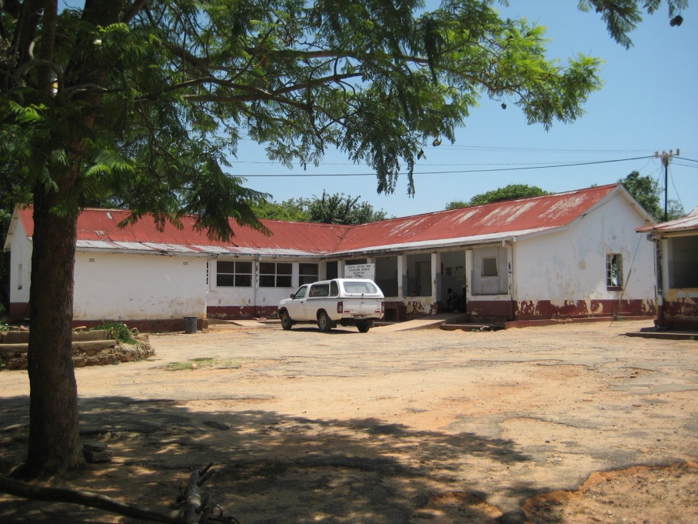
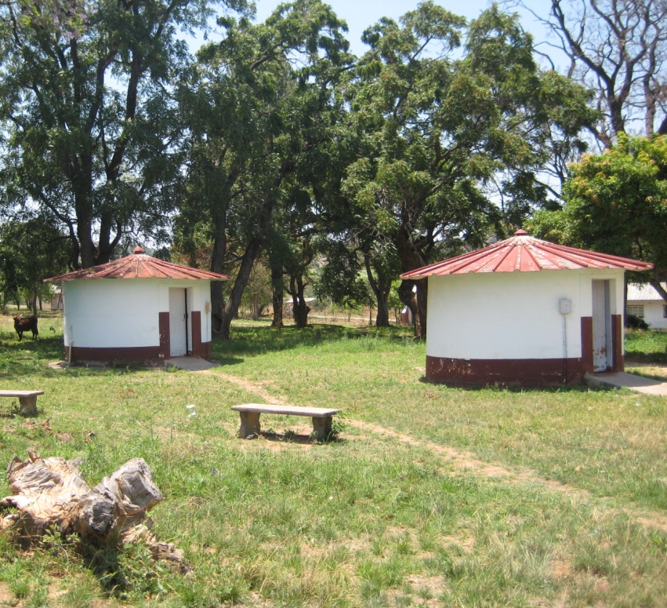
Makumbe Hospital, Zimbabwe
Inpatients,
Labor & Delivery
ART Clinic,
Isolation Ward

Slide 64
Preventing Mother to Child Transmission (PMTCT) in Zimbabwe
Computer model of MTCT
  Linked to CEPAC adult and pilot infant models
Data from Zimbabwe
  National PMTCT programs
  EGPAF, OPHID
  ZVITAMBO trial
Outcomes
  Infant infection risk
  2-year survival (mothers and infants)
  Life expectancy (mothers)
  Costs

Slide 65
Four PMTCT strategies
No antenatal care PMTCT (reference)
2009 national program (primarily single dose NVP)
WHO 2010 guidelines with Option A (AZT to mothers)
  Infant NVP through breastfeeding
WHO 2010 guidelines with Option B
  Maternal ART through breastfeeding

Slide 66
Genotype Testing at
HIV Treatment Failure
CE Ratio
Strategy Costs ($) QALM ($/QALY)
No Resistance Test 92,130 65.10 ---
Resistance Test 95,630 67.65 16,500
Weinstein et al. Ann Intern Med 2001

Slide 67
AIDS Drug Assistance Programs (ADAPs): State-Based, Uninsured
8,100 on wait lists, February 2013
FCFS < 350/μL
< 300/μL
< 250/μL
< 200/μL
< 150/μL
Linas et al. JAIDS 2009; NASTAD

Slide 68
Patient: T.C.
24 year old woman
Outpatient department with sore throat
Thrush noted
HIV test recommended
Positive
CD4 20/ul, viral load 120,000 copies/ml

Slide 69
CREST Take-Home #5
Make it a good story.

Slide 70
The Role of PrEP in the US
Evidence of efficacy of TDF/FTC
Current cost = $1,430/month
What will be the role?

Slide 71
Population-level Scenario
Based on:
  392,460 annual births in Zimbabwe
  16% ANC HIV prevalence
    ~ 63,000 HIV-infected pregnant women
  0.96% annual HIV incidence
    ~ 5,000 incident infections during breastfeeding
Current ARV uptake for PMTCT: 56%
Index Mundi, Zimbabwe ANC Survey 2009, National HIV Estimates 2009
Notes:
71

Slide 72
Summary of Findings
The transition from the 2009 national PMTCT program to Option A or B will dramatically improve pediatric outcomes
Substantial improvements in uptake of all steps of the PMTCT cascade with Option A or Option B will be necessary to approach “virtual elimination” of pediatric HIV
Option A is cost-effective, compared to sdNVP

Slide 73
Expanded Screening and ART in the US
 | Infection/20 yrs | Inc Cost/$ Billions | Inc QALYs Millions | ICER, $
Status Quo | 1,225,400
Expanded screen | -82,000 (6.7%) | 26.9 | 1.2 | 22,400
Expanded ART (75 %) | -125,800 (70.3%) | 63.8 | 3.1 | 20,300
Screen/ART | -212,300 (17.3%) | 92.6 | 4.5 | 21,600
LR-once, HR-annual
Long et al. Ann Intern Med 2010

Slide 74
Patient TC:
Presentation with an OI
24 year old woman
Outpatient department with cough
HIV positive
CD4 20/ul
Sputum positive for PCP

Slide 75
Expanded Screening and ART in the US
Starting ART at <350/μl
Earlier ART, 50% decrease
in high-risk behavior: 65% reduction
Screening and treatment:
  highly cost-effective
Will not eliminate the epidemic in US
Long et al. Ann Intern Med 2010

Slide 76
Results:
Cost-effectiveness, Lifetime, South Africa
 | Life expectancy (years) | Costs (USD 2011) | ICER† ($/YLS)
Delayed ART | 13.3 | 15,970 | --
Early ART | 15.2 | 16,320 | 530
†Including projected survival losses and cost increases associated with 1st- and 2nd-order transmissions
per capita GDP for South Africa: $8,100

Slide 77
Results
Cost-effectiveness Plane
● No ART
❐ Generic ART
✦ Branded ART

Slide 78
Potential Savings in the First-Year
Base case (75% reduction)
Generic ART: $920 million
Amount Saved (in USD millions)
Zocor®
(Simvastatin) ~66%
Methylin® (Methylphenidate HCl) ~72%
Coumadin® (Warfarin) ~85%
Generic Drug Price Reduction (%AWP)
Generic Prices Get Cheaper

Slide 79
Pre-Exposure Prophylaxis (PrEP):
Cost-effectiveness 2009
Before trials done: 50% efficacy, 1.6% annual incidence, $753/month
C-E ratio of $298,000/YLS
More cost-effective at lower cost, higher incidence, younger age, increased efficacy
Paltiel et al, CID 2009

Slide 80
C-E Ratio
Intervention Agent ($/QALY)* Reference
PCP/Toxo proph. TMP-SMX $2,800 Freedberg JAMA 1998
ART AZT/3TC/EFV $11,700 Freedberg NEJM 2001
Resistance Test --- $20,200 Weinstein Annals 2001
Resistance Test (naïve) --- $23,900 Sax CID 2005
Inpt HIV screening --- $38,600 Walensky AJM 2005
MAC proph. Azithromycin $43,300 Freedberg JAMA 1998
HIV screening q5y --- $50,000 Paltiel NEJM 2005
high risk patients
Cost-effectiveness Ratios for HIV Care
*All costs adjusted to 2001 US dollars
Notes:
To put our results into context, lower cost-effectiveness ratios are more economically efficient programs. HIV screening has a higher cost-effectiveness ratio than many interventions we are currently doing in HIV care, including trimethoprim sulfa prophylaxis, antiretroviral therapy, genotypic testing and MAC prophylaxis with azithromycin.

Slide 81
Results:
Survival for South Africa
 | 5-year survival
Early ART | 93%
Delayed ART | 84%
No ART | 55%

Slide 82
Results:
Cumulative Transmissions, South Africa
Early ART
Delayed ART
No ART

Slide 83
Laboratory Monitoring in India: Benefits and Costs
80
Strategies without
routine HIV RNA
70
Strategies with
X
routine HIV RNA
60
1 line of ART alone
50
Life expectancy (months)
40
30
Routine laboratory monitoring with confirmatory test
Routine laboratory monitoring alone
No routine laboratory monitoring
20
+
No ART
10
0
0
500
1,000
1,500
2,000
2,500
3,000
3,500
4,000
Cost ($)
Scott et al, IAS 2011
Notes:
83

Slide 84
Cost-effectiveness of Co-trimoxazole Prophylaxis in Côte d’Ivoire
Prophylaxis Strategy | Life Expectancy (mo) | Lifetime Costs ($) | Incremental CE Ratio ($/yr life saved)
Based on clinical stage
No prophylaxis | 38.0 | 1,260 | --
Co-trimoxazole at WHO stage ≥3 | 40.4 | 1,290 | 110
Co-trimoxazole at WHO stage ≥2 | 42.4 | 1,320 | 200
Based on CD4 cell count
No prophylaxis | 38.0 | 1,260 | --
Co-trimoxazole at CD4 ≤200/μl | 39.0 | 1,360 | Dominated
Co-trimoxazole at CD4 ≤500/μl | 41.4 | 1,390 | Dominated
Co-trimoxazole regardless of CD4 | 42.4 | 1,320* | 150
*CD4 test costs not included
Yazdanpanah et al. AIDS 2005
Notes:
84

Slide 85
Cost-effectiveness of HIV Treatment in Resource-Poor Settings
Strategy | CD4 Testing |  |  | ART Starting Criteria | ART Stopping Criteria | Life Expectancy (mo) | Lifetime Costs ($) | Incremental C-E Ratio ($/yr life saved)
No Treatment |  |  | -- | -- | -- | 31.4 | 783 | --
CTX alone |  | No |  | -- | -- | 32.8 | 811 | 240
CTX + ART |  | No |  | 2 ODs | 1 OD | 41.4 | 1,233 | 590
CTX + ART |  | No |  | 1 OD | 1 OD | 50.7 | 1,716 | 620
CTX + ART |  | No |  | 1 OD | 3 ODs | 56.8 | 2,171 | 890
CTX + ART |  | No |  | 1 OD | 5 ODs | 57.9 | 2,264 | 1,060
CTX + ART |  | Yes |  | CD4<200, CD4<350 and 1 severe OD | 90% in CD4 count | 69.6 | 3,423 | 1,180
Goldie et al. N Engl J Med 2006
Notes:
85

Slide 86
C-E Ratio
Intervention Agent ($/QALY)* Reference
PCP/Toxo proph. TMP-SMX $2,800 Freedberg JAMA 1998
ART AZT/3TC/EFV $11,700 Freedberg NEJM 2001
Resistance Test --- $20,200 Weinstein Annals 2001
Resistance Test (naïve) --- $23,900 Sax CID 2005
Inpt HIV screening --- $38,600 Walensky AJM 2005
MAC proph. Azithromycin $43,300 Freedberg JAMA 1998
HIV screening q5y --- $50,000 Paltiel NEJM 2005
high risk patients
Cost-effectiveness Ratios for HIV Care
*All costs adjusted to 2001 US dollars
Notes:
To put our results into context, lower cost-effectiveness ratios are more economically efficient programs. HIV screening has a higher cost-effectiveness ratio than many interventions we are currently doing in HIV care, including trimethoprim sulfa prophylaxis, antiretroviral therapy, genotypic testing and MAC prophylaxis with azithromycin.

Slide 87
CREST Take-home #4
Be at the table
Notes:
Malgré le succès remarquable du traitement , ART a néanmoins de nombreuses limites . Bien que beaucoup moins toxique que les schémas précédents , en cours de traitement peut encore être associée à cardiovasculaire , rénale , osseuse , et d'autres complications [ 3 , 4] . L'inflammation et l'activation immunitaire qui persistent dans de nombreux patients sous ART suppressive peuvent avoir un impact clinique négatif à long terme [ 5 ] . Thérapie aux États-Unis et en Europe reste coûteuse , et , parce qu'il n'est pas curatif , doit être poursuivi indéfiniment [ 6 , 7 ] . ART succès aussi n'élimine pas la stigmatisation associée à l'infection à VIH [ 8 ] .
Le premier rapport d'une cure réussie du VIH après une greffe de cellules souches allogéniques pour la leucémie aiguë démontré que l'éradication du VIH d'un individu est viable [ 9 ] . Bien que la transplantation allogénique en l'absence d' indications habituelles comporte des risques importants , le coût et les conséquences post-transplantation de l'immunosuppression chronique , d'autres stratégies sont actuellement à l'étude qui pourrait guérir le VIH et être pratiquement déployé [ 10-12 ] . En outre, une étude de cas récente détaillé le remède possible d'un bébé infecté par le VIH par l'initiation de ART immédiatement après la naissance [ 13 ] . Grâce à cette focalisation croissante sur les efforts de guérison du VIH , dans cette analyse , nous nous efforçons d'établir des seuils d'efficacité , la toxicité , la durabilité , le coût et la qualité de vie qui serait nécessaire pour une stratégie de traitement à la comparaison avec les traitements antirétroviraux actuellement aux États-Unis .
Despite the remarkable success of treatment, ART nonetheless has many limitations. Although much less toxic than earlier regimens, current treatment still may be associated with cardiovascular, renal, bone, and other complications [3, 4]. The inflammation and immune activation that persist in many patients on suppressive ART may have long-term negative clinical impact [5]. Therapy in the US and Europe remains costly, and, because it is not curative, must be continued indefinitely [6, 7]. Successful ART also does not eliminate the stigma associated with HIV infection [8].
The first report of a successful cure of HIV after allogeneic stem cell transplant for acute leukemia demonstrated that eradicating HIV from an individual is viable [9]. While allogeneic transplant in the absence of usual indications carries substantial risk, cost, and the post-transplant consequences of chronic immunosuppression, other strategies are currently being studied that could potentially cure HIV and be practically deployed [10-12]. Further, a recent case report detailed the possible cure of an HIV-infected baby through initiation of ART immediately after birth [13] .With this growing focus on HIV cure efforts, in this analysis we aim to establish thresholds of efficacy, toxicity, durability, cost, and quality of life that would be necessary for a cure strategy to compare favorably with current antiretroviral therapy in the United States.

