Slide 1


Is i2b2 for you?
Monitoring and Evaluation of Urban Health Outcomes using Open-source Population Health Software
William G. Adams, MD
Professor of Pediatrics
Director, BU-CTSI Clinical Research Informatics
Boston University School of Medicine/Boston Medical Center
Director, Community Health Informatics, Boston HealthNet
badams@bu.edu

Slide 2
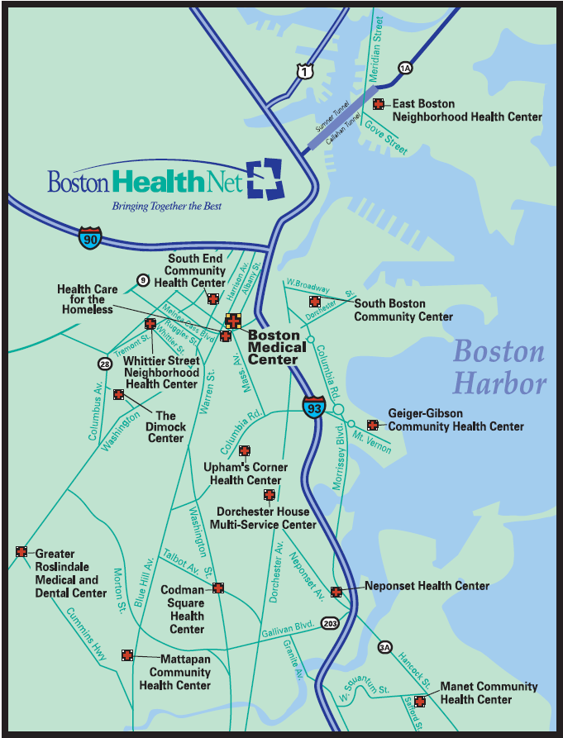
The “EcoSystem”
BMC is largest safety net provider in New England
Nearly all CHCs are FQHCs
EHR-based care
  BMC since 1999
  CHCs since 2003

Slide 3
A Vision
Data is open - privacy is protected
Researchers focus on the question - not the query
Researchers ask complex clinical research questions themselves
Data is standardized so the same question can be asked at multiple sites
10 hypotheses -> 1 great question

Slide 4
i2b2
“Informatics for Integrating Biology with the Bedside”
Open-source software based on the MGH Research Patient Data Repository (RPDR)
Collection of modules or “cells” constitute the i2b2 “hive”
  De-identified clinical data repository
  Data linked to standardized vocabularies
  Query and analytic tools
  Two applications: web-client and Workbench (java)

Slide 5
i2b2 Key Concepts
  Data integration and mapping
    Disparate data mapped to common format
  Master Patient Index (MPI)
    Data for individuals linked
  De-identification
  Patient sets
    Outcomes measured via nested queries that identify populations

Slide 6
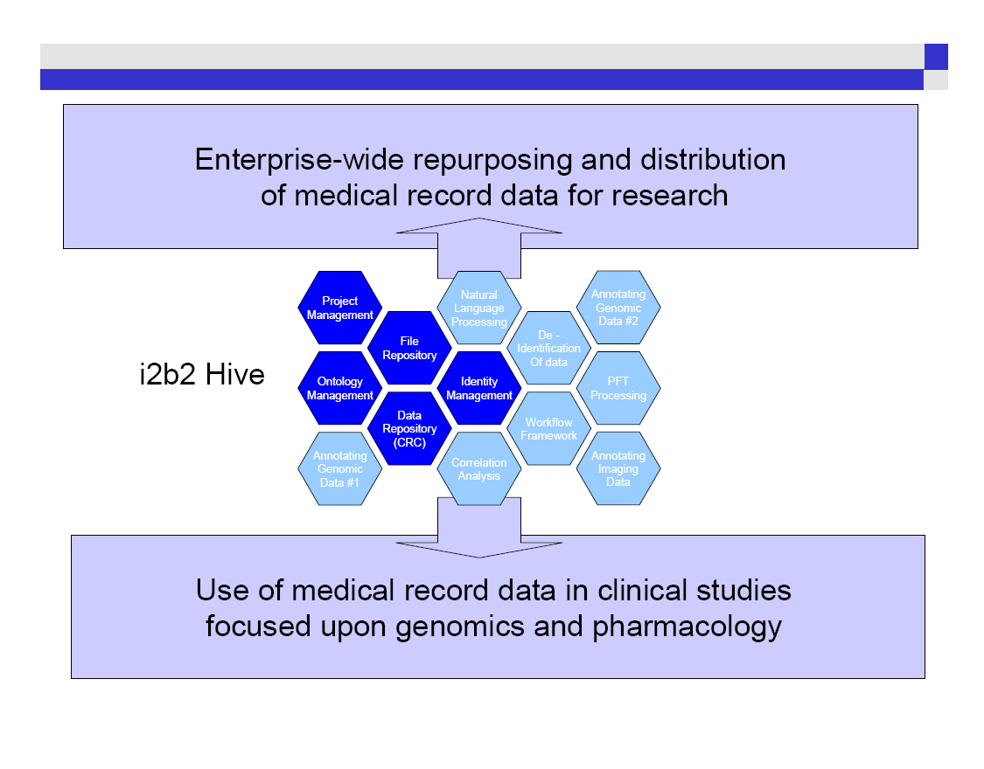

Slide 7
i2b2 Core Data Elements
  Patients
  Observations (Facts)
  Concept Libraries (Ontologies)

Slide 8
MHDR Data Exchange Model
Massachusetts Health Disparities Repository
Payer Data
Clinical Data
Data:
Claims/Services
Member details
Provider details
Data:
Demographic
Insurances
Services
Medications
Problems
Labs
Clinical Observations
Sites:
BMC HealthNet Plan
Staging Area
Functions:
MPI linkage
Data cleaning
Standardization
(LOINC, CPT, RxNorm, ICD9,SNOMED CT)
Sites:
Boston Medical Center
Dorchester House MSC
Codman Square HC
Harvard Street NHC
Healthcare for the Homeless
Greater Roslindale MDC
Whittier Street HC
Mattapan CHC
South Boston CHC
i2b2
Database
People (1.2 mil)
Facts (650 mil)
Concepts
BU-i2b2
BMC only
Web accessable
Aggregate data
No additional IRB
Tools
Query Cell
HOME Cell
MHDR
BMC + CHCs
RDP access (with SAS, STATA)
HOME Cell and data extracts
IRB approval required

Slide 9
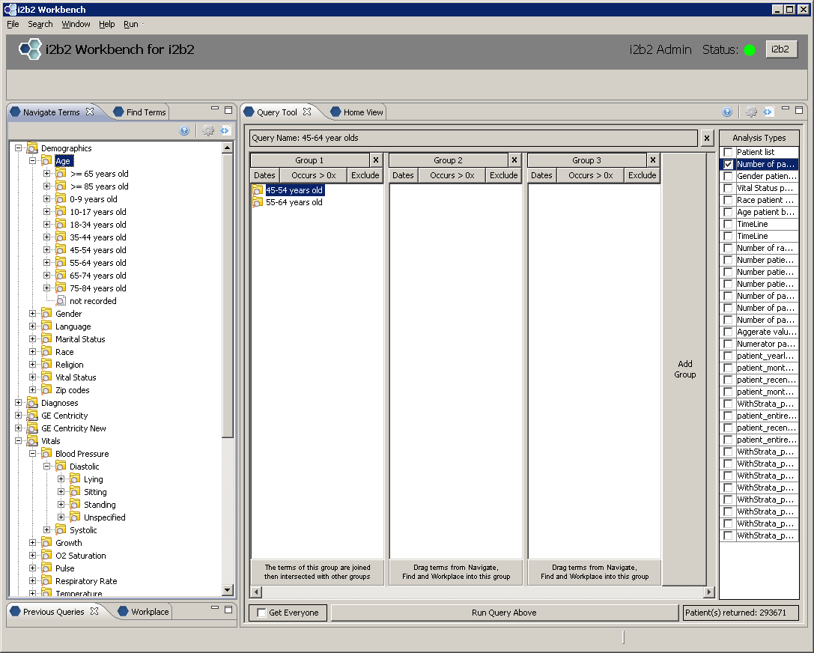
Facts
Ontology
Count

Slide 10
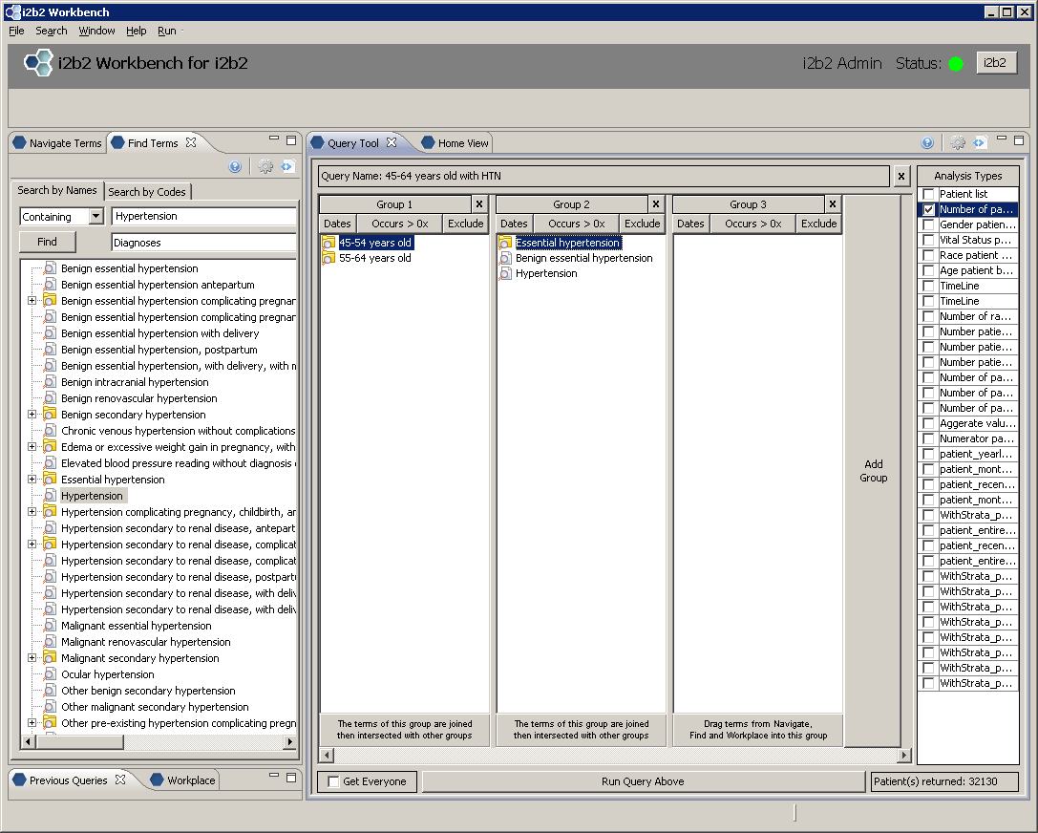

Slide 11
Patient Sets Example
MHDR Individuals
Age 45-64
Ever Diagnosed with Essential HTN
1+ Primary Care Visit

Slide 12

Staging Area (PHI containing data)
Link Table
ID | MRN | Site
12 | 1234 | Site1
12 | ABCD | Site2
Patients – Site 1
FName | Lname | DOB | MRN | Site | Gender | Race | …
PD | Patient | 10/31/2000 | 1234 | SIte1 | M | B
Link Table
ID | MRN | Site
12 | 1234 | Site1
Billing Data – Site 1
MRN | Visit_date | Location | Dx1 | Dx2 | CPT1 | CPT2 | PrimIns
1234 | 1/15/2010 | Pedi PC | 123.4 | 125.8 | 90214 | 90213 | MassHealth
Patients – Site 2
FName | Lname | DOB | MRN | Site | Gender | Race | …
Peter | Patient | 10/31/2000 | ABCD | Site2 | M | B
Billing Data – Site 2
MRN | Visit_date | Location | Dx1 | Dx2 | CPT1 | CPT2 | PrimIns
ABCD | 2/15/2010 | PediPulm | 123.4 | 125.8 | 90214 | 90213 | Uninsured
Clinical Data – Site 2
MRN | Observation_date | Observation | Value | …
ABCD | 2/15/2010 | Hct | 11.1
ABCD | 2/15/2010 | MCV | 70
i2b2 Repository (de-identified data)
Patients
ID | Birth_Date | Sex_Cd | Race_Cd | …
12 | 11/07/2000 | M | B
Observation_facts
ID | Concept_Cd | Start_Date | Value | Location_Cd | End_Date | …
12 | PrimCareVis | 1/22/2010 | Site1 | Site1
12 | Dx | 1/22/2010 | 123.4 | Site1
12 | Dx | 1/22/2010 | 125.8 | Site1
12 | Proc | 1/22/2010 | 90124 | Site1
12 | Proc | 1/22/2010 | 90254 | Site1
12 | Ins | 1/22/2010 | Medicaid | Site1
12 | PediPulm | 2/22/2010 | Site2-PediPulm | Site2
12 | Dx | 2/22/2010 | 123.4 | Site2
Observation_facts
ID | Concept_Cd | Start_Date | Value | Location_Cd | End_Date | …
12 | PrimCareVis | 1/22/2010 | Site1 | Site1
12 | Dx | 1/22/2010 | 123.4 | Site1
12 | Dx | 1/22/2010 | 125.8 | Site1
12 | Proc | 1/22/2010 | 90124 | Site1
12 | Proc | 1/22/2010 | 90254 | Site1
12 | Ins | 1/22/2010 | Medicaid | Site1
12 | PediPulm | 2/22/2010 | Site2-PediPulm | Site2
12 | Dx | 2/22/2010 | 123.4 | Site2
12 | Hct | 2/22/2010 | 11.1 | Site2
12 | MCV | 2/22/2010 | 70 | Site2
Observation_facts
ID | Concept_Cd | Start_Date | Value | Location_Cd | End_Date | …
12 | PrimCareVis | 1/22/2010 | Site1 | Site1
12 | Dx | 1/22/2010 | 123.4 | Site1
12 | Dx | 1/22/2010 | 125.8 | Site1
12 | Proc | 1/22/2010 | 90124 | Site1
12 | Proc | 1/22/2010 | 90254 | Site1
12 | Ins | 1/22/2010 | Medicaid | Site1

Slide 13
Value considerations
  i2b2 uses standard coding systems (ontologies) like ICD9, ICD10, LOINC, RxNorm, SNOMED-CT
  Observations have five main components: Pt ID, start/end dates, concept ID, and value
  Concepts with the same code can mean different things

Slide 14
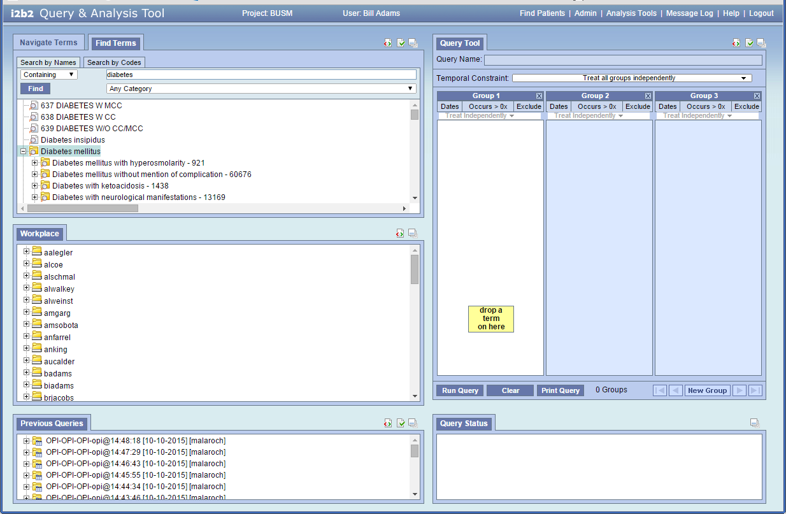

Slide 15
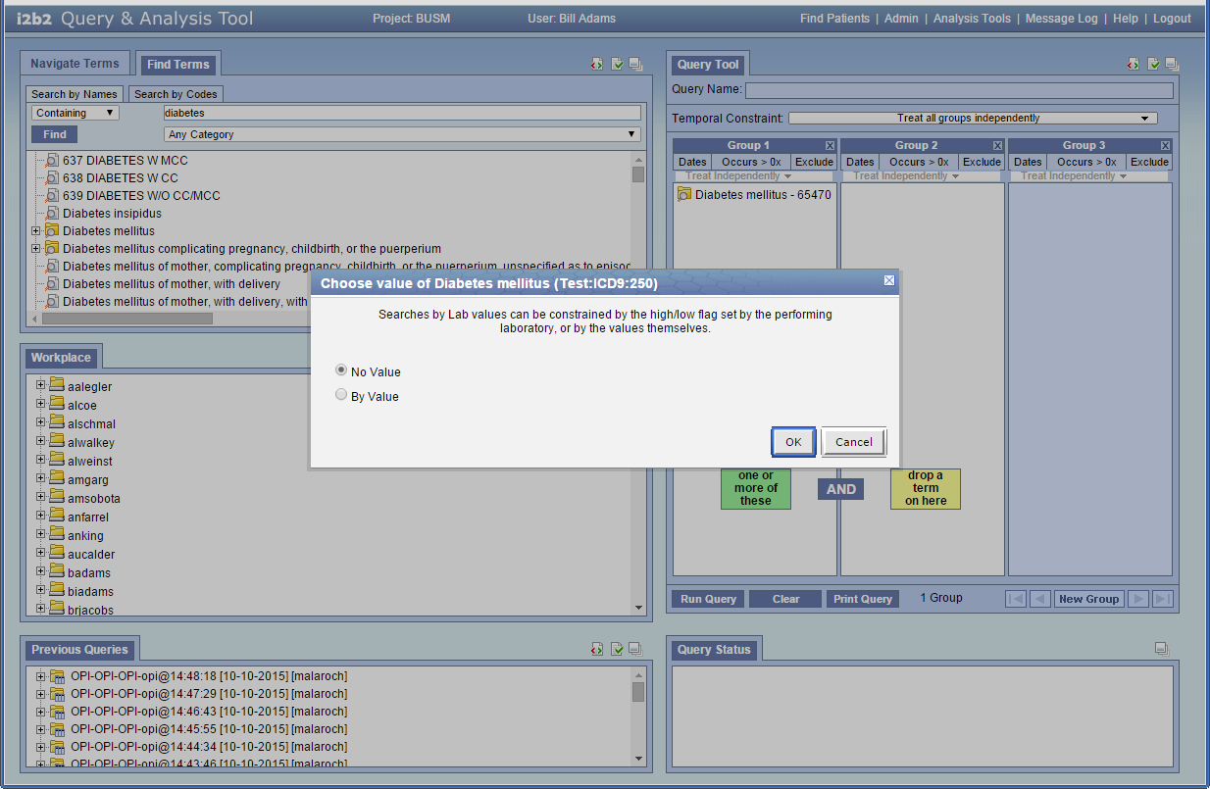

Slide 16
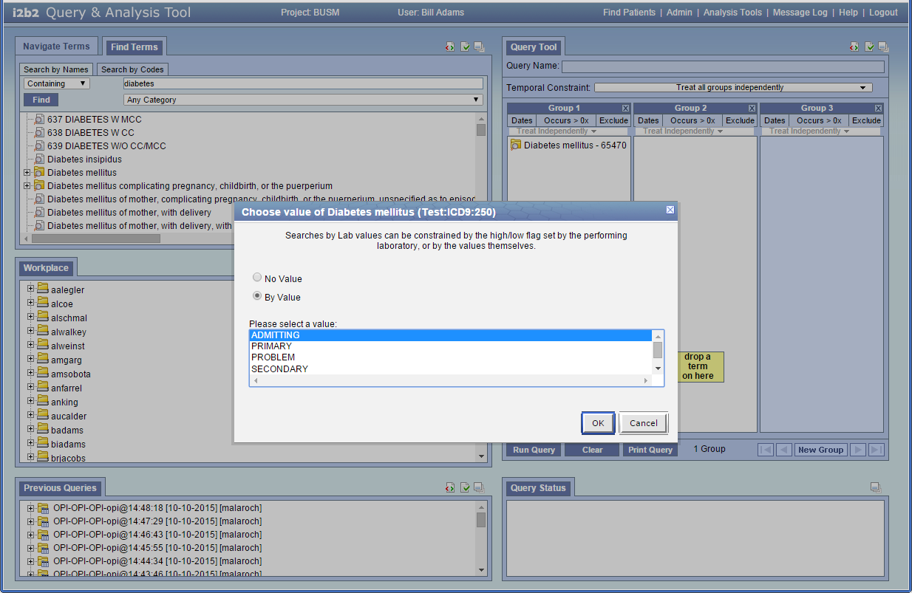

Slide 17
i2b2 Compatible Data
  Demographics
  Problems/Diagnoses
  Medications
  Clinical Observations
  Procedures
  Laboratory Data
  Genomic Data
  Much more…

Slide 18
i2b2 and Health Services Research
i2b2 excels at cohort identification
Lacked functionality to describe clinical processes and outcomes over time
Outcomes research possible with:
  New ontologies
  New data (GIS, services, insurance, etc)
  Temporal modeling of facts as exposures and outcomes

Slide 19
New MHDR Ontologies
Administrative:
Clinical Services (e.g. GIM, Pediatrics)
  By location and specialty
  Coding: custom ontology
Insurance (e.g. BCBS, Medicaid)
  By payer type (e.g. Commercial, Medicaid)
  Coding: Custom
Clinical:
Vital Signs (e.g. Blood Pressure, Growth)
  Coding: SNOMED-CT

Slide 20
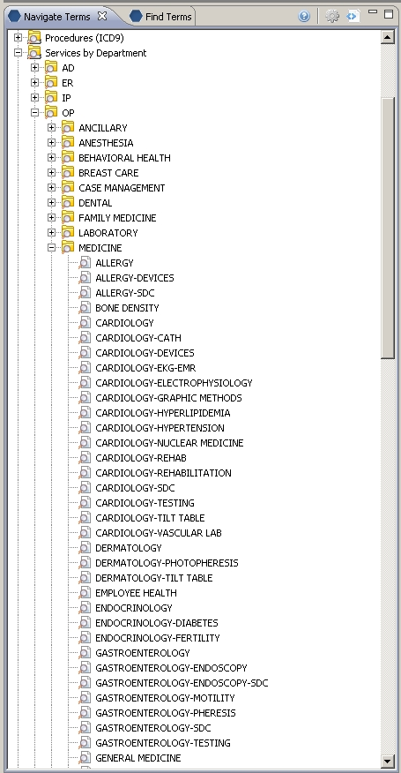
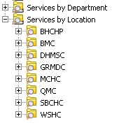
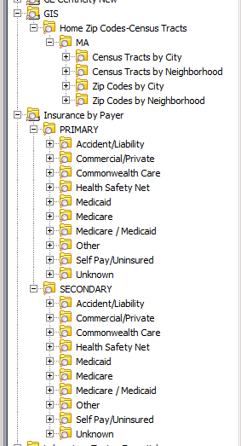
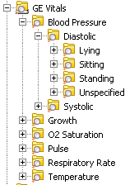
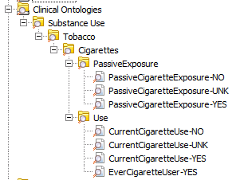
New Ontologies
Services
GIS and Insurance
Vital Signs
Coding: SNOMED-CT
Substance Use
Coding: Census - Zip Code - Custom
Coding: Custom
Coding: Custom

Slide 21
The HOME Cell
A new i2b2 Health Outcome Monitoring and Evaluation (HOME) Cell to model and assess relationships between:
  any exposure fact(s)
  any outcome fact(s)
  many temporal relationships
  stratified by any i2b2 query population
  during discrete reference intervals

Slide 22
Health Outcome Monitoring and Evaluation (HOME)

Slide 23
HOME Cell Components
Baseline query from i2b2 Query Cell
Constraints:
  Occurrence: temporal relationships between facts
  Value: extends occurrence constraint to specify numeric values/ranges
  Age: models subject’s age at time of fact
Strata: i2b2 queries define sub-populations
Reference interval: period (month, year, date interval) to optionally further constrain data

Slide 24
HOME Cell Example:
Hypertension Control 45-64 Years Old
Notes:
24

Slide 25
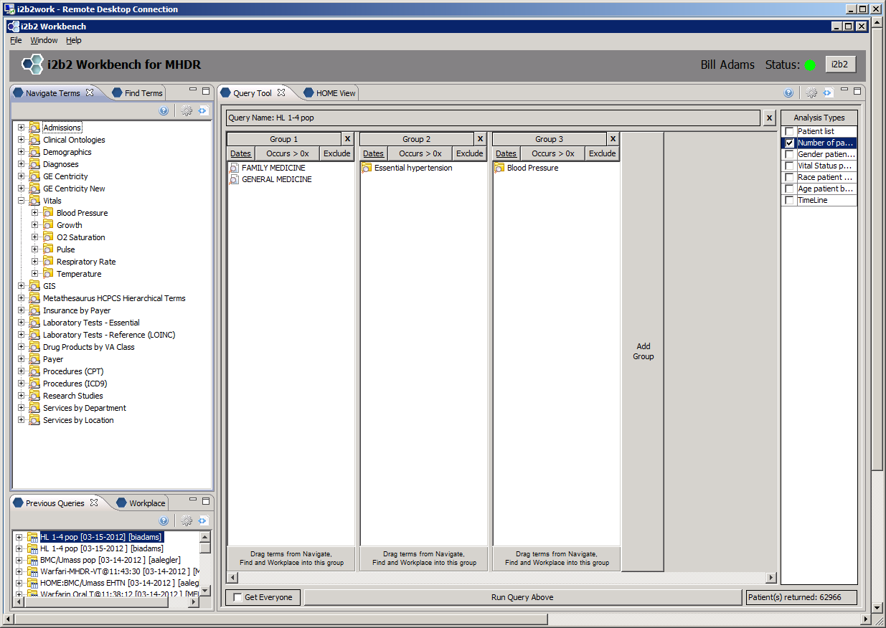
Initial Query

Slide 26
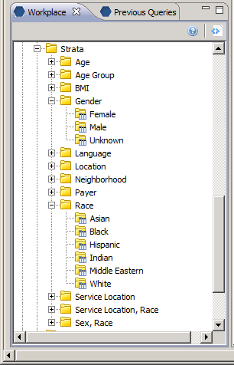
Strata Queries

Slide 27
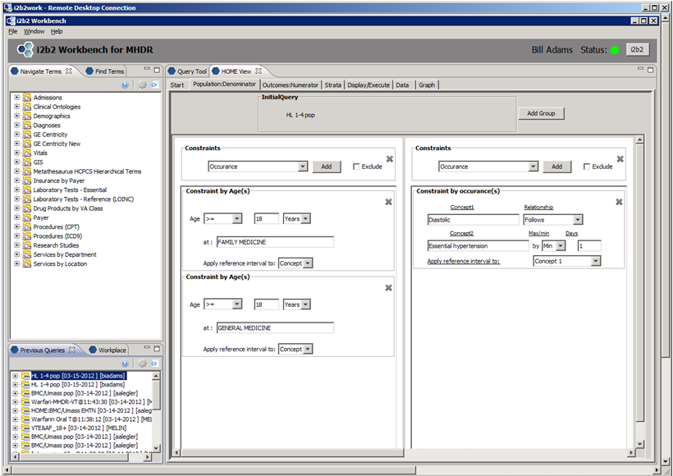
Denominator Population

Slide 28
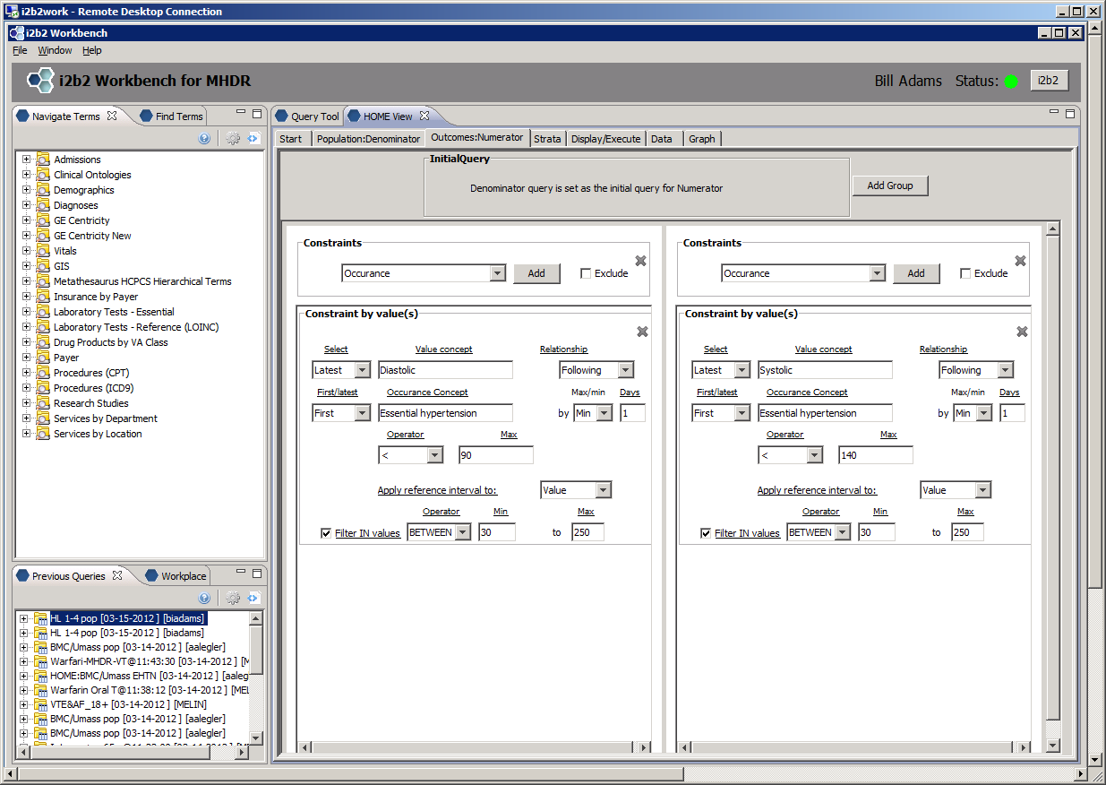
Numerator Population

Slide 29
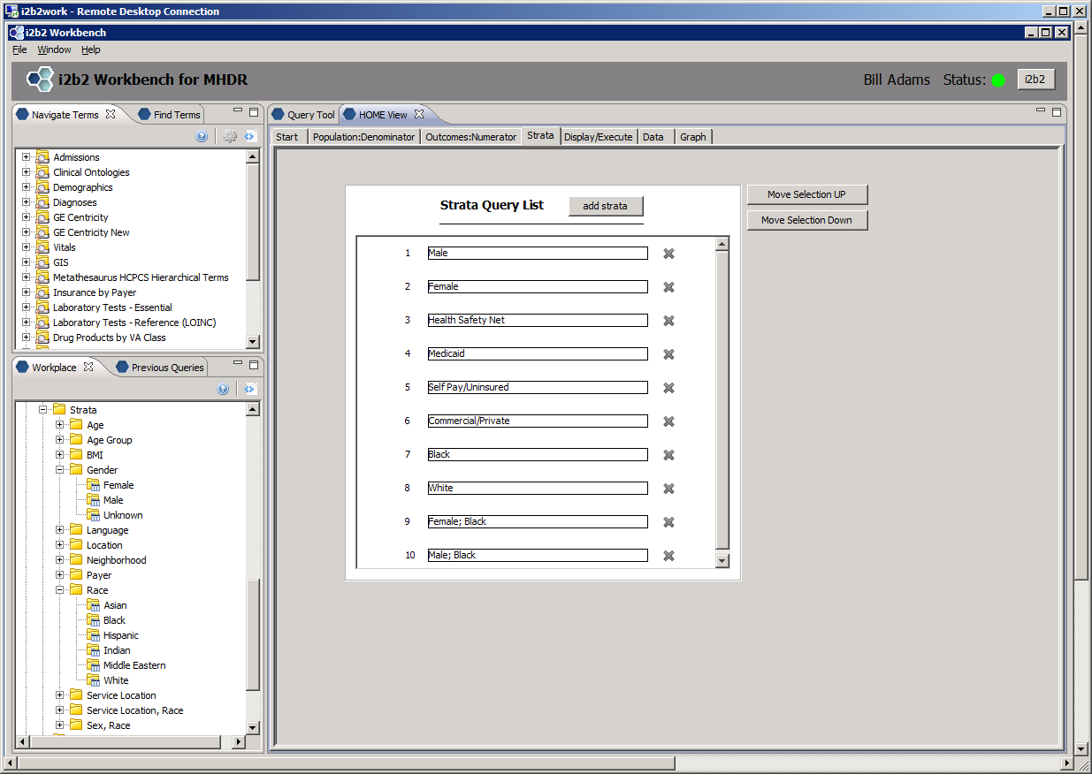
Strata

Slide 30
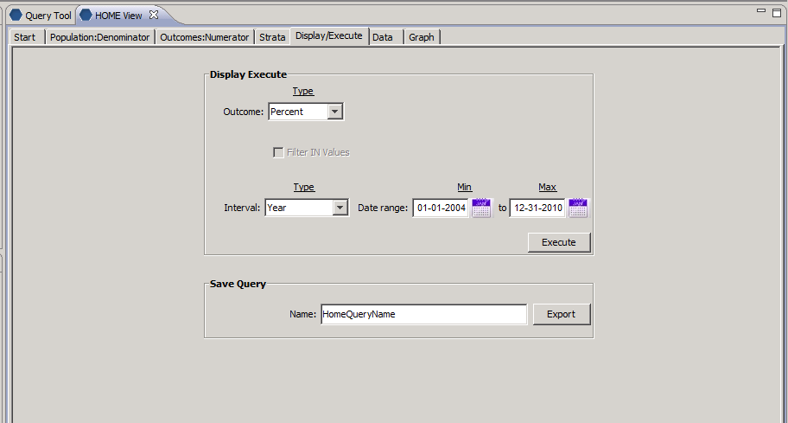
Display/Execute: Percent

Slide 31
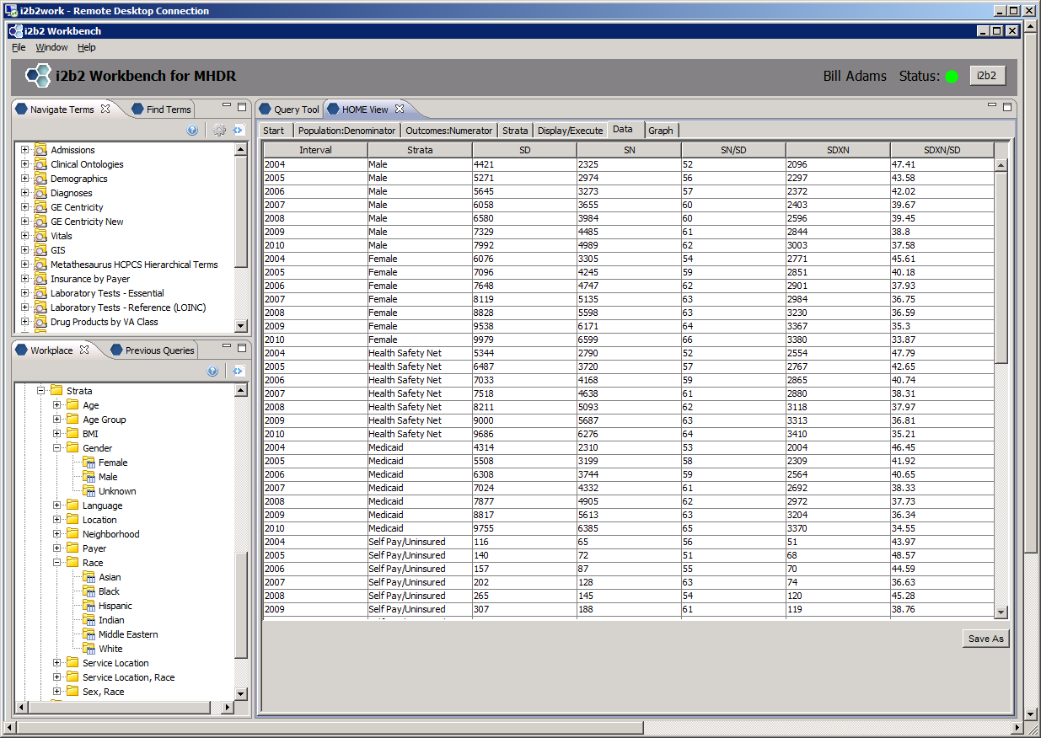
Sample Result Set
Strata Denominator Count
Strata Numerator Count
Proportion
Notes:
31

Slide 32
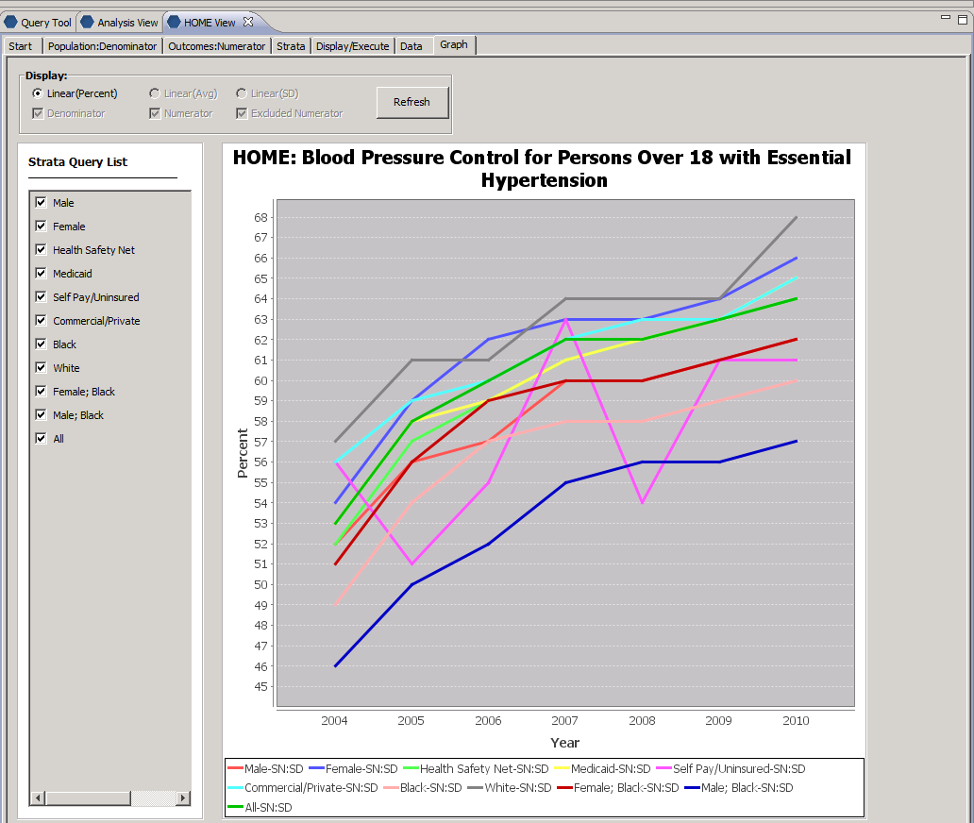

Slide 33
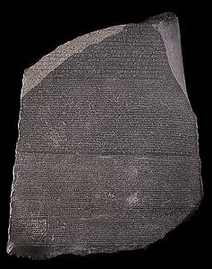

I2b2 + HOME ?

Slide 34
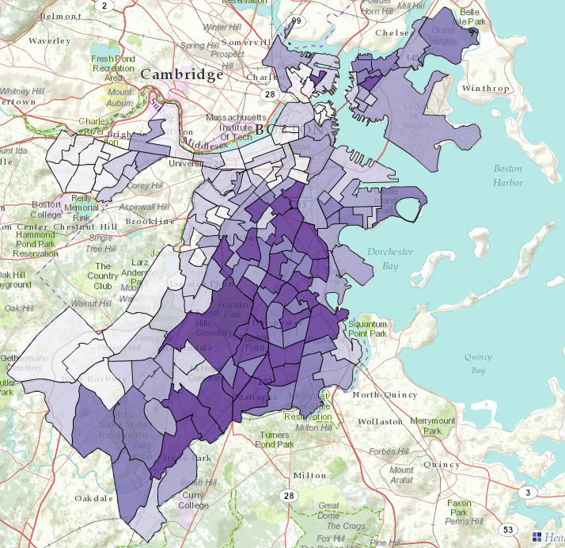
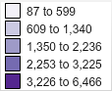
Catchment Area for the MHDR, 2005-2011
Note: This map shows the number of people, by census tract of residence (2008-2011), who had at least one visit to an MHDR clinical center from 2005-11. Census tracts with fewer than 20 patients are not included.

Slide 35
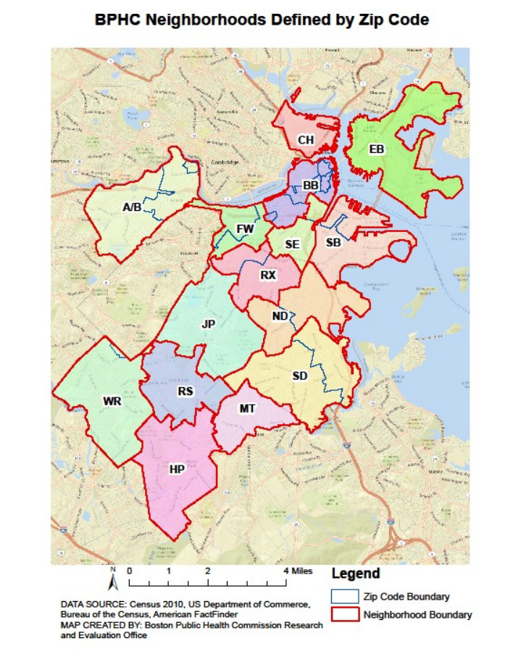
Percent of patients with any BHN Contact during 2011-2014
by Zip Code of residence 2011-2014*
Charlestown (CH) - 17%
Back Bay/Downtown (BB) - 18%
East Boston (EB) - 65%
(no local EHR data)
Allston/Brighton (A/B) - 15%
South Boston (SB) – 63%
South End/Chinatown (SE) – 84%
Fenway (FW) - 20%
Roxbury (RX) - 71%
Jamaica Plain (JP) - 30%
North Dorchester (ND) - 100%
South Dorchester (SD) - 91%
West Roxbury (WR) - 15%
Mattapan (MT) - 95%
Roslindale (RS) - 45%
Hyde Park (HP) - 65%
* % of patients with address zip code noted at least once 2011-2014 divided by 2010 US Census count for that area

Slide 36
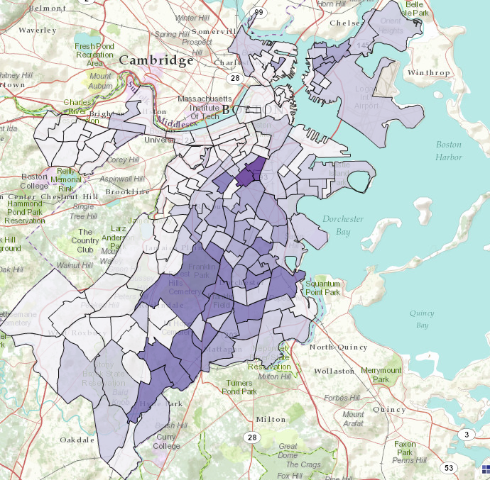
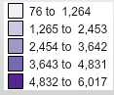
Catchment Area for Boston Medical Center
Catchment Area for Boston Medical Center
Note: Number of people, by census tract of residence (2008-2011), who had at least one visit to the clinical center from 2005-11.

Slide 37
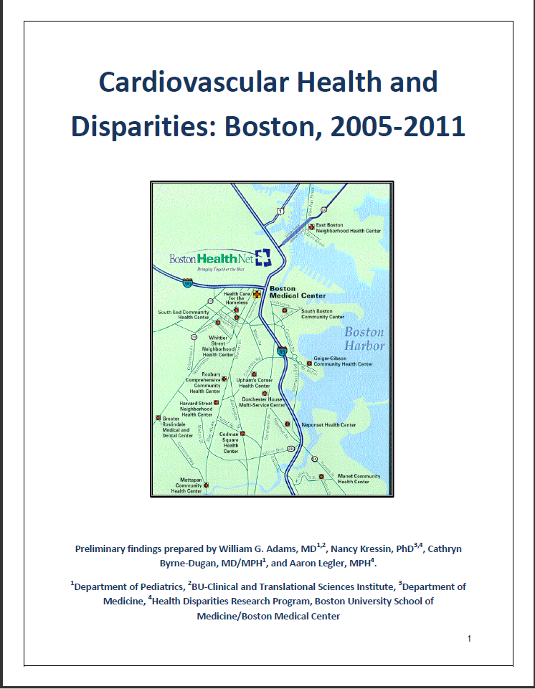

Slide 38
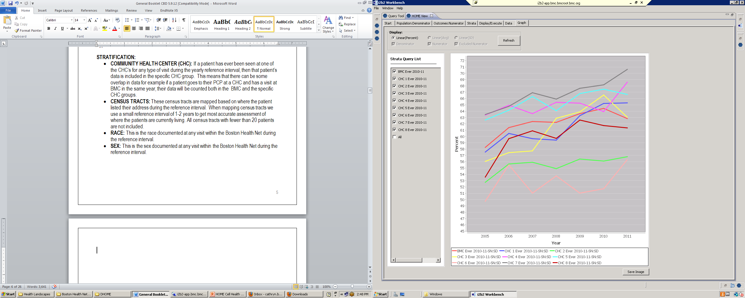
Adult Blood Pressure Control by Center
Boston, 2005-11
Note: Percent of patients with essential HTN whose latest systolic BP was < 140 and diastolic BP was < 90 during each year for each center.

Slide 39
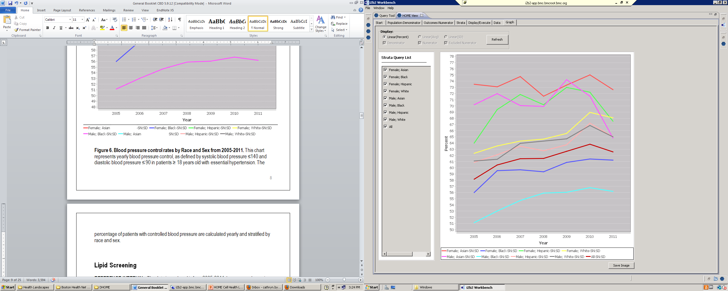
Blood Pressure Control by Sex-Race
Boston, 2005-2011
Note: Percent of patients with essential HTN whose latest systolic BP was < 140 and diastolic BP was < 90 during each year for patients of differing race and/or sex.

Slide 40
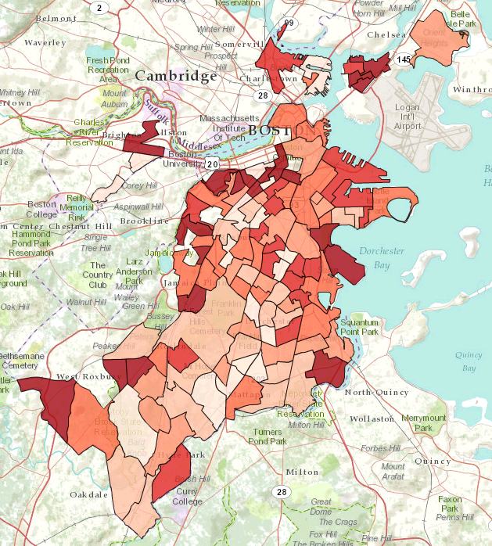
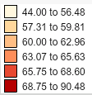
Blood Pressure Control by Census Tract
Boston, 2011
Note: Percent of primary care patients with essential HTN whose latest systolic BP was < 140 and diastolic BP was < 90 by census tract. Patients were assigned to a tract if they had at least one address listed in the tract during 2008-2011.

Slide 41
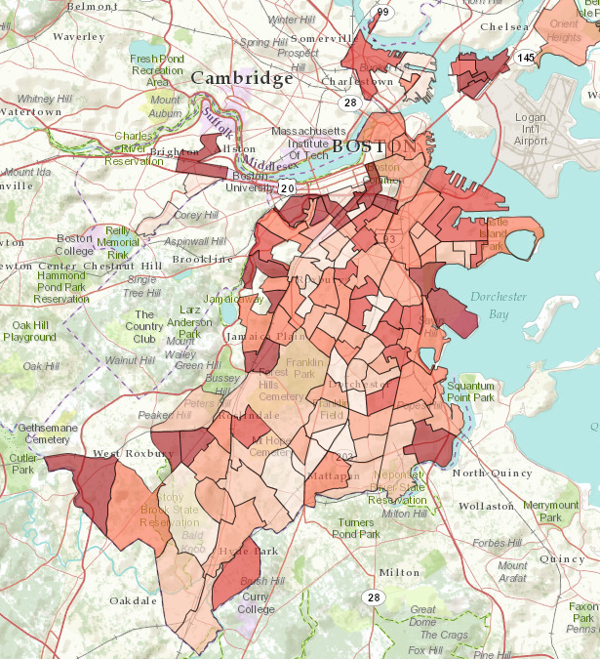
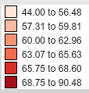
Blood Pressure Control Rates by Census Tract
Boston Medical Center, 2010-11
Note: Percent of primary care patients with essential HTN whose latest systolic BP was < 140 and diastolic BP was < 90 by census tract. Patients were assigned to a tract if they had at least one address listed in the tract during 2008-2011.

Slide 42
Lipid Screening by Center
Boston, 2005-2011
Note: Percent of patients (male ≥ 35 years old or female ≥ 45 years old) with a primary care visit during the year and at least one lipid screening test (HDL, LDL, or Total Cholesterol) within 2 years preceding or 60 days following the visit for each Center .

Slide 43
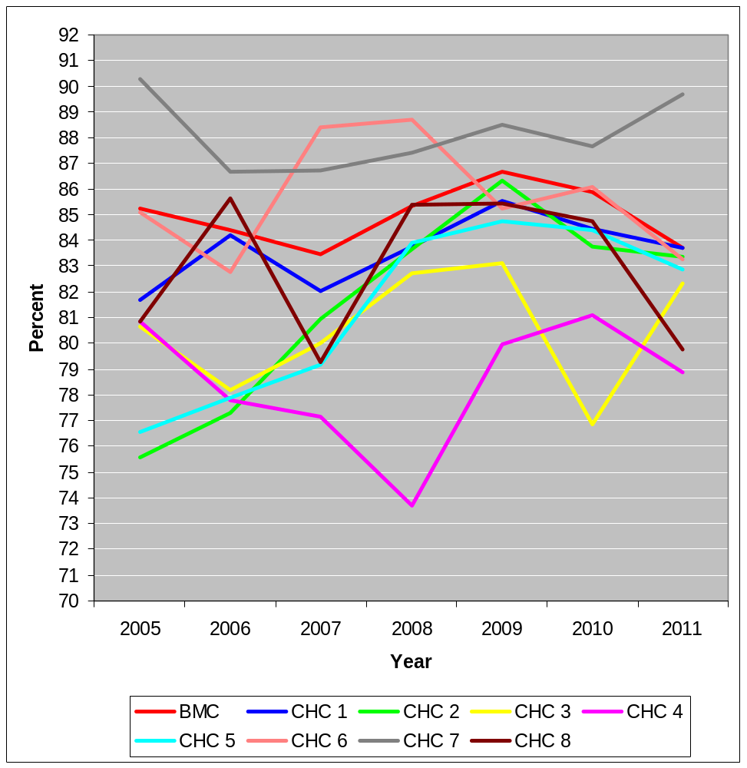
Lipid Control for High Risk CVD Patients by Center
Boston, 2005-2011
Note: Percentage of high risk CVD patients (≥ 20 years old) with a primary care visit during the reference year who had controlled lipid levels (HDL >50 in females, HDL >40 in males, or Total Cholesterol <200) stratified by CHC..

Slide 44
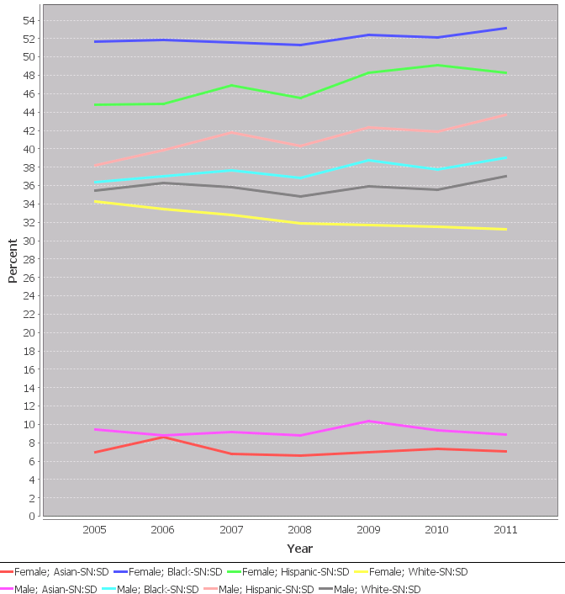
Adult Obesity by Sex-Race
Boston, 2005-2011
Note: Percent of patients with a primary care visit at 18- 65 years old during the reference year who had a BMI >30 by race and gender

Slide 45
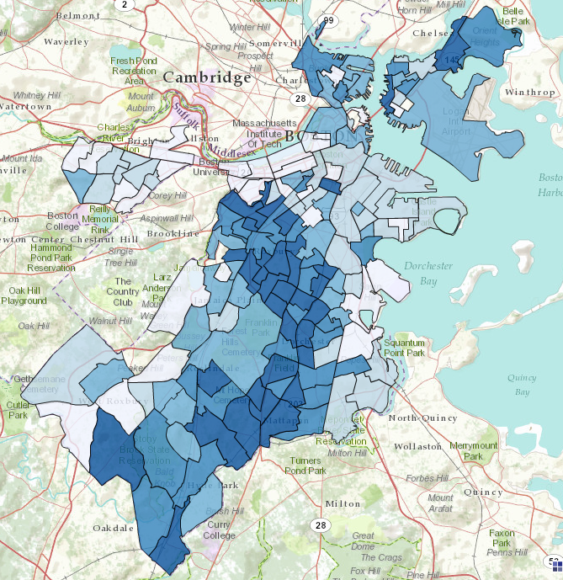

Adult Obesity in Boston, 2010-2011
Note: Percent of patients with essential HTN whose latest systolic BP was < 140 and diastolic BP was < 90 during each year for patients of differing race and/or sex.

Slide 46
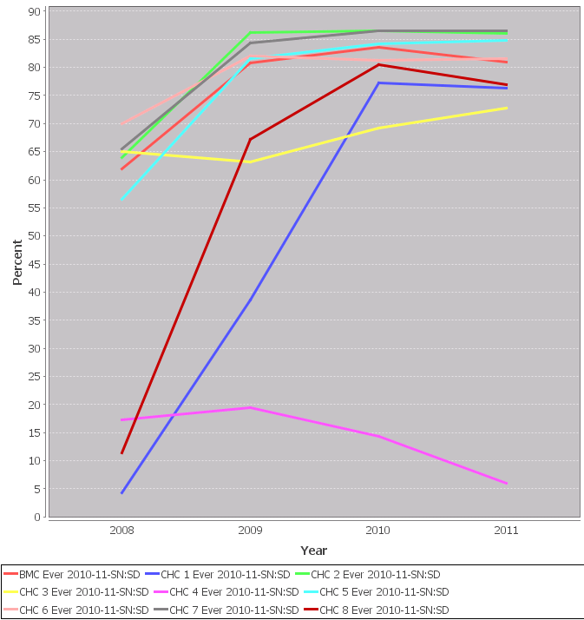
Childhood Obesity Screening by Center
Boston, 2005-2011
Note: For patients who were seen at each Center during 2010-2011, percent of patients with a primary care visit at 3-18 years old during the reference year who had a recorded BMI %’ile by Center.

Slide 47
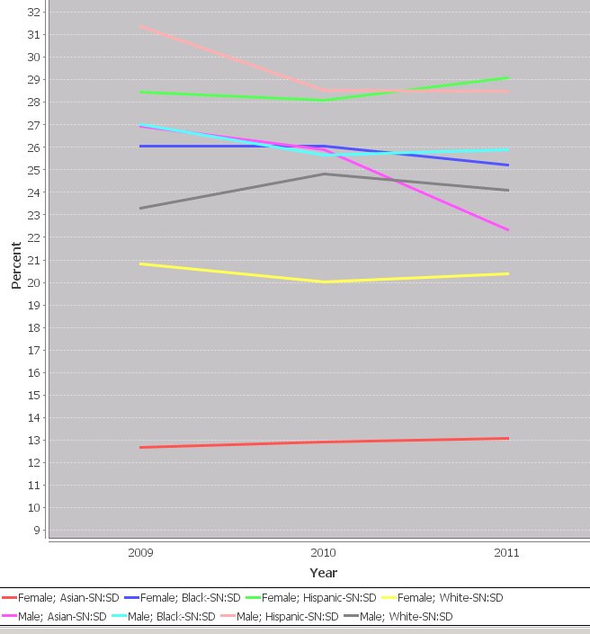
Childhood Obesity by Sex-Race
Boston, 2009-2011
Note: Percent of children with a primary care visit at 3-18 years old during the reference year who had a BMI Percentile ≥ 95%’ile by race and/or sex.

Slide 48
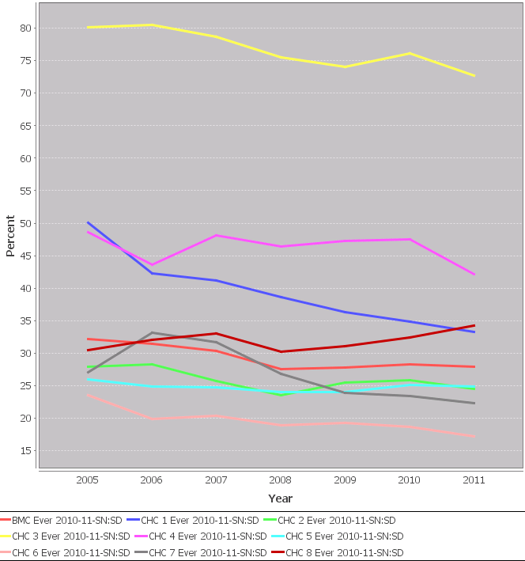
Cigarette smoking in Adults by Center
Boston, 2005-2011
Note: Patients with a primary care visit during the reference year who were ≥18 years old at the time of the visit, were screened for cigarette use, and reported being a smoker by CHC

Slide 49
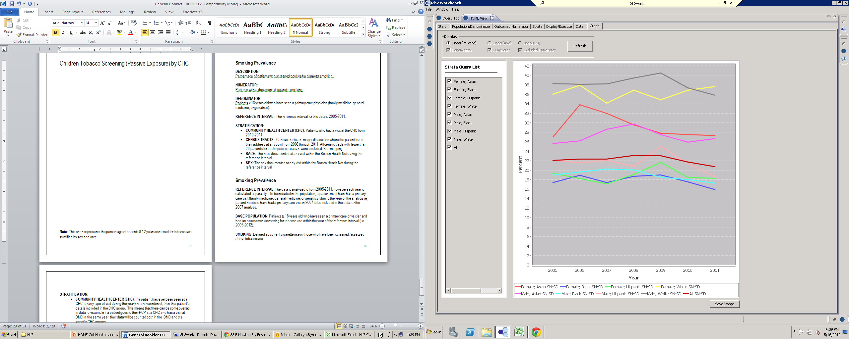
Passive Cigarette Exposure in Children by Sex-Race
Boston, 2005-2011
Note: Children with a primary care visit during the reference year who were 0-12 years old at the time of the visit, screened for passive exposure, and reported smoking in the home by race and/or sex.

Slide 50
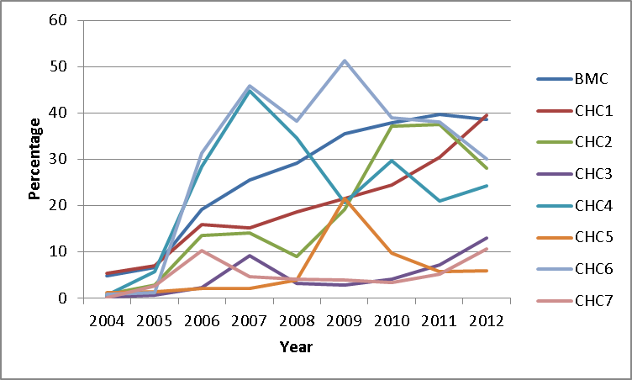
Percent of Asthma Patients with Assessment of Daytime or Nighttime Symptoms by Center*
EHR Asthma Form
Added

Slide 51
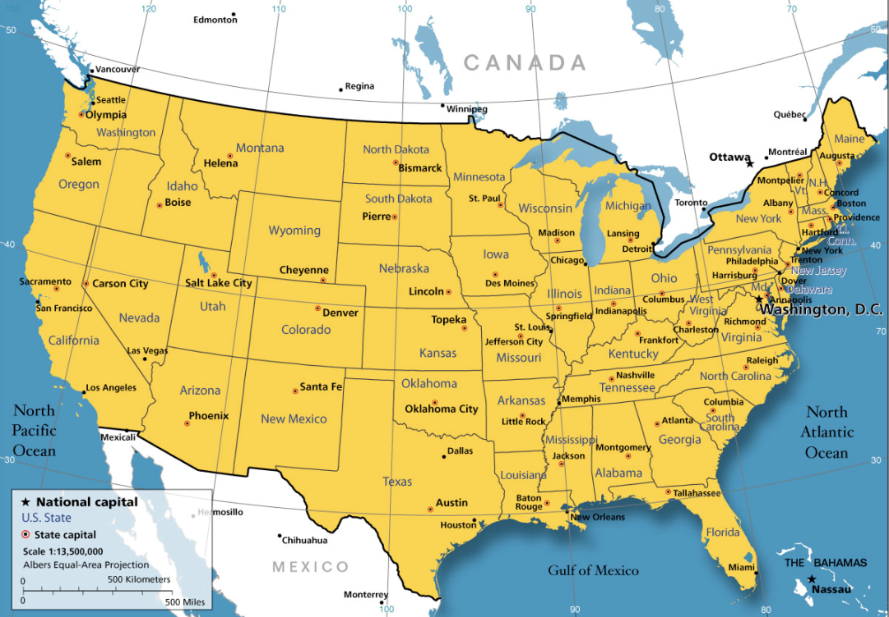
Distributed HOME Project
5 Collaborating i2b2-enabled CTSAs
Comparative effectiveness evaluation of medications for hypertension, hypercholesterolemia, childhood asthma, diabetes
Boston University
Univ. of Massachusetts
Univ. of Cincinnati
Univ. of Alabama at Birmingham
Univ. of Washington
www.dhome-project.net

Slide 52
Research Objectives
  Describe variation in cardiovascular outcomes (hypertension, dyslipidemia, diabetes) over time in 5 CTSA i2b2 instances distributed across U.S.
  Assess within medication class outcome differences (comparative effectiveness) for commonly used medications (anti-hyper tensives, statins, oral hypo-glycemics)

Slide 53
Approach
  Bi-monthly web-based teleconferences
  Shared ontology development (BP, BMI, medications)
  Technical collaborations between sites and from Recombinant/Deloitte
  Shared query development
  Distributed query execution with centralized aggregate data sharing

Slide 54
Definitions – BP control
Denominator:
  At least one primary care visit in reference year
  At least one systolic and diastolic BP that followed a diagnosis of essential hypertension during year
  Separate HOME Cell queries for all combinations of BMI (< 30 , 30+) and Age (< 65, Age 65+) during reference year
Numerator
  Most recent systolic BP during year < 140
  Most recent diastolic BP during year < 90
Strata: Race, Gender

Slide 55
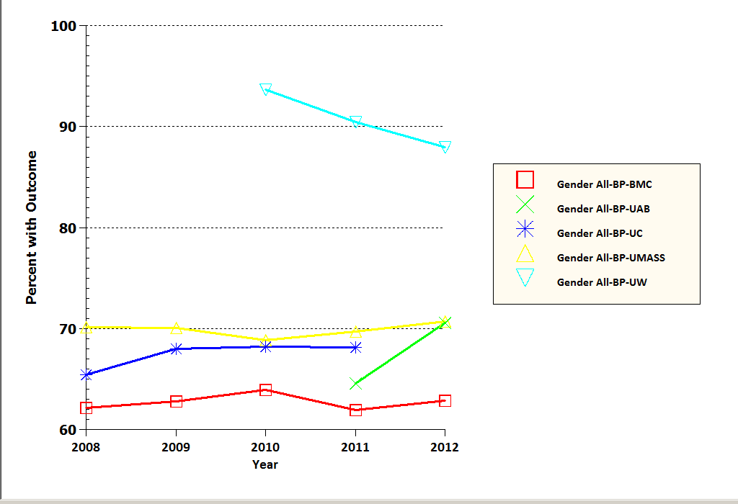
Percent of Patients with Essential Hypertension and Controlled BP*
Site | n
BMC | 24,930
UAB | 15,393
UC | 19,435
UMASS | 16,144
UW | 8,913
Total | 84,815
* n = number of patients for most recent year

Slide 56
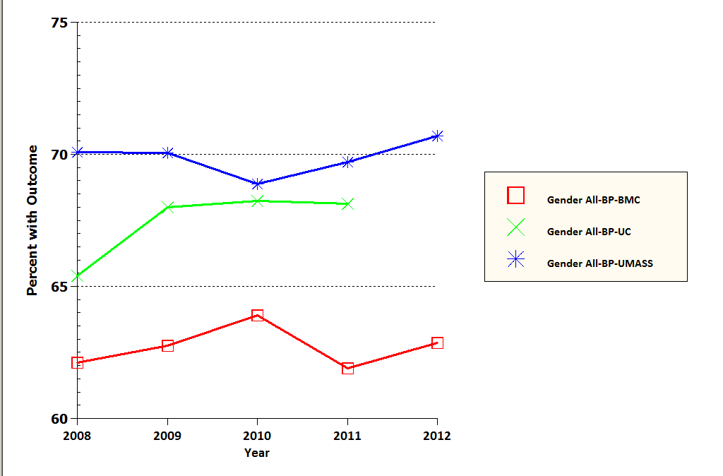
Percent of Patients with Essential Hypertension and Controlled BP on Most Recent Test
Site | n
BMC | 24,930
UC | 19,435
UMASS | 16,144
Total | 60,509

Slide 57
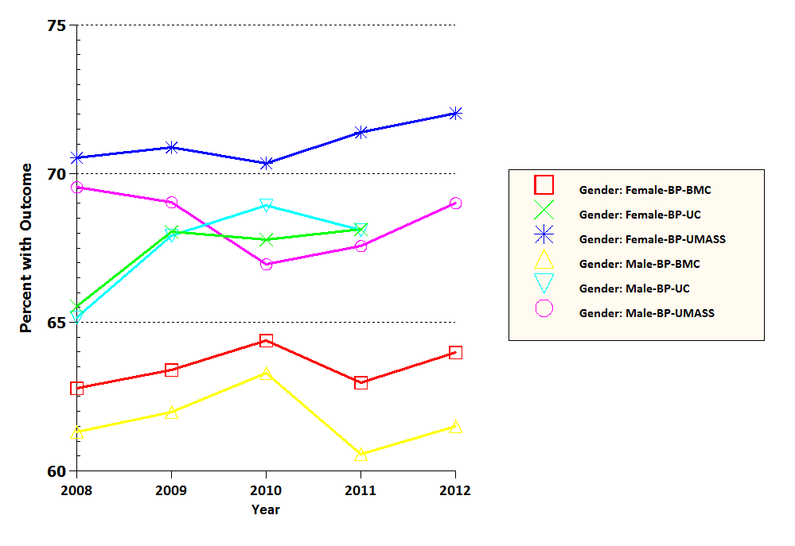
BP Control for Patients with Essential Hypertension by Gender and Site
UMASS - Female
UMASS - Male
UC – Male/Female
BMC - Female
BMC - Male

Slide 58
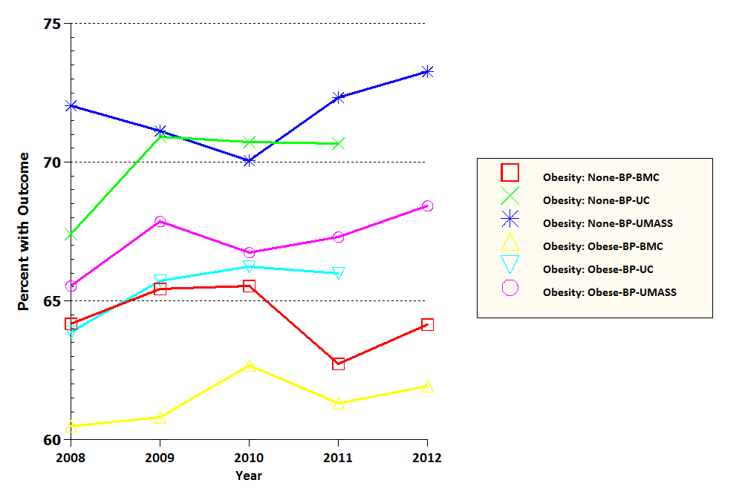
BP Control for Patients with Essential Hypertension by Obesity and Site
UMass – Not Obese
UC – Not Obese
UMASS – Not Obese
UC – Obese
BMC – Not Obese
BMC - Obese

Slide 59
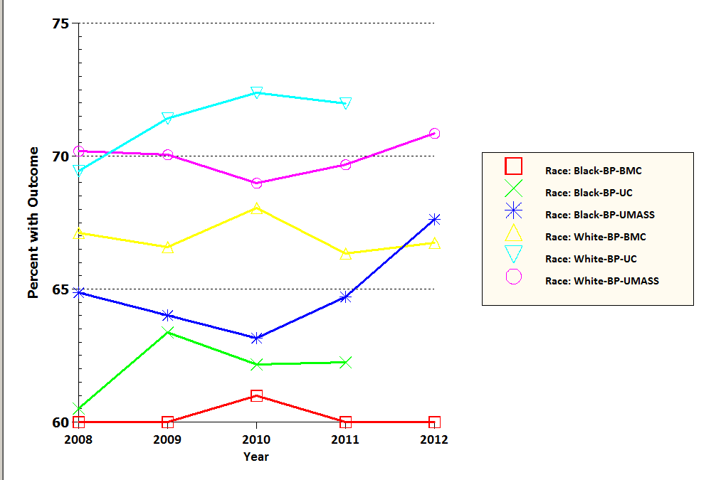
BP Control for Patients with Essential Hypertension by Race and Site
UC – White
UMASS - White
UMASS - Black
BMC - White
UC – Black
BMC - Black

Slide 60
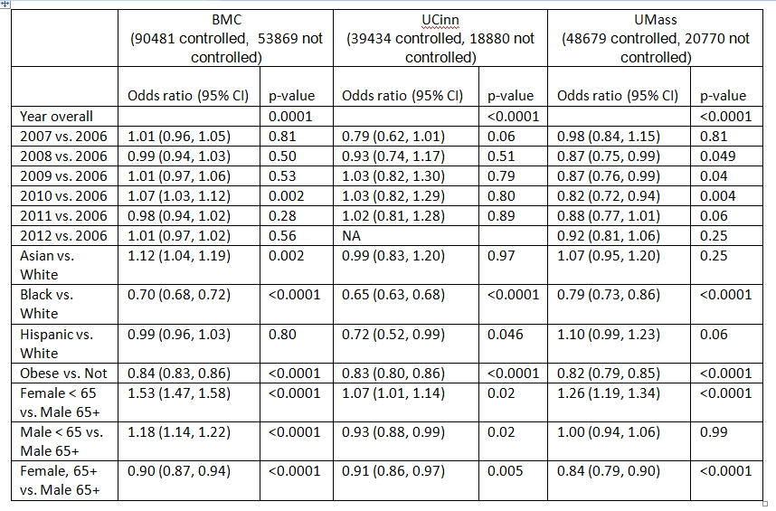
Logistic Regression Models for BP Control 2006-2012*
* Limited to comparisons with significant findings

Slide 61
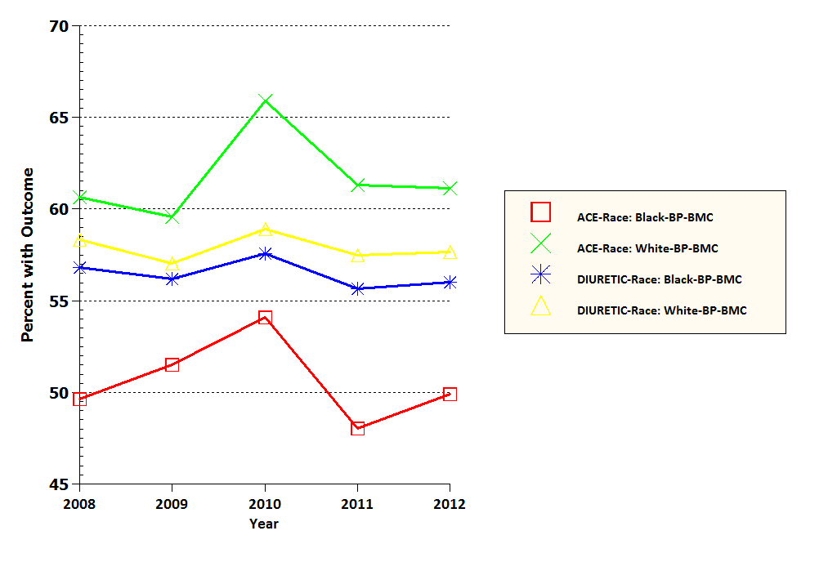
BP Control for Patients with Essential Hypertension by Medication Class at BMC
BMC – ACE: White
BMC – Diuretic: White
BMC - Diuretic: Black
BMC - ACE: Black

Slide 62
MySCILHS Telephony
Leverage experience with data-driven telephony to support IVR REDCAP
  “self-service questionnaires”
  Local and cloud-based options
  TTS (Susan) and ASR
  Staff make contact and obtain consent
Majority of call via IVR
  Scalable
  IRB- and patient-friendly

Slide 63
IVR Strengths
Conversational
  Bidirectional
  Speech-based
Accessible
  Ubiquitous technology
  Available everywhere
  Lower literacy requirements
Adaptive

Slide 64
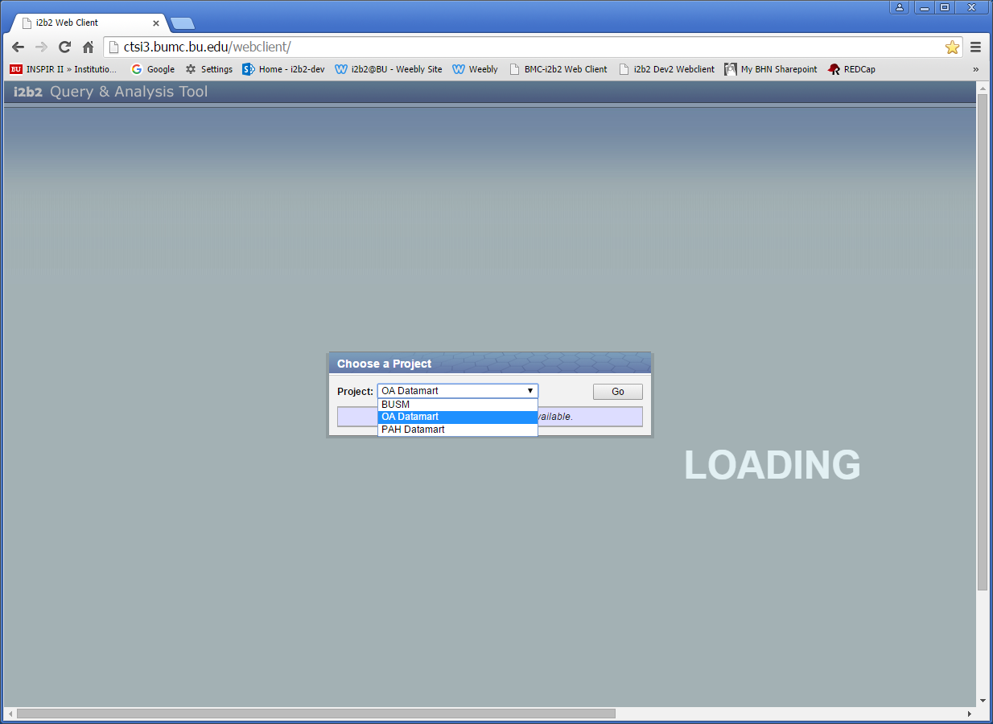

Slide 65


Slide 66


Slide 67
Conclusions
Powerful tool for exploratory analyses
“Rapid”, distributed queries are feasible and informative
The outcomes evaluated are not improving nor are racial gaps narrowing
Multi-variate approach particularly promising/important (strata enhancement work ongoing)
Notes:
67

Slide 68

Word of caution…
Numerous opportunities for “epidemiologic malpractice”
New ways of thinking and data management required (not always easy)
Lots of work to do with Epic
Lots of cheese
Plenty of holes…
Notes:
68

Slide 69
A Novel Approach
Data is open - privacy is protected
Focus is on measurement - not SQL
Researchers can ask complex questions themselves - quickly
CER, HSR, and QI supported by a common framework
Analytic software is interoperable
Logic is transparent and portable
Notes:
69

Slide 70
Additional projects/activities
BMC Cancer Registry Integration
BP Normalization and Care
VVV in BP, lipid, and Hgb1C
Sickle Cell QI (children and adults)
Sickle Cell BH
Community-based smoking cessation
Pneumonia rates in PCV vaccine era
HPV vaccination
Algorithms for Personalized Decision Making
ePROS – psychotropic medication use in kids
ePROS – on- off-label safety
PCORI-CDRN (SCILHS)
Tele-REDCAP
Insurance switching
Vital Village – geographic health effects

Slide 71
Future Plans
Spread i2b2 web-client access to BUMC research community
Expand functionality of Strata tab and query code to support multivariate, aggregate data generation
Provide a web-based version of the HOME Cell

Slide 72

Coming soon…

Slide 73
MHDR Data Exchange Model
Massachusetts Health Disparities Repository
Payer Data
Clinical Data
Data:
Claims/Services
Member details
Provider details
Data:
Demographic
Insurances
Services
Medications
Problems
Labs
Clinical Observations
Sites:
BMC HealthNet Plan
Staging Area
Functions:
MPI linkage
Data cleaning
Standardization
(LOINC, CPT, RxNorm, ICD9,SNOMED CT)
Sites:
Boston Medical Center
Dorchester House MSC
Codman Square HC
Harvard Street NHC
Healthcare for the Homeless
Greater Roslindale MDC
Whittier Street HC
Mattapan CHC
South Boston CHC
i2b2
Database
People (1.2 mil)
Facts (650 mil)
Concepts
BU-i2b2
BMC only
Web accessible
Aggregate data
No additional IRB
Tools
Query Cell
HOME Cell
MHDR
BMC + CHCs
RDP access (with SAS, STATA)
HOME Cell and data extracts
IRB approval required

