Slide 1


Teaching critical thinking in hospitality management using student ‘learntertainment’ and SAGE approach
Erinn Tucker, PhD, MBA
Boston University – School of Hospitality Administration
etucker@bu.edu 617-358-8911

Slide 2
Introduction
Critical Thinking
Bloom’s Taxonomy
Activities into the classroom

Slide 3
Problem
While critical thinking allows for a student to view any issue from a broad perspective and thereby problem solve, the lack of activities in the classroom that teaches and/enhances critical thinking has been a challenge for some instructors of record.

Slide 4
Two (2) Approaches
Learntertainment
Activity during oral presentations sessions within the classroom.
SAGE
Format used in writing deliverable outside the classroom.

Slide 5
Learntertainment
Learnterainment is the process of weaving and implementing elements of fun and entertainment into every learning experience, thereby ensuring that learning comes to life for everyone involved in the teaching-learning process. (Armoo & Garrick, 2006)
  Active learning
  Focus on learning process rather than on learning products – student engagement.
  Focus on assessment for learning rather than on assessment of learning.

Slide 6
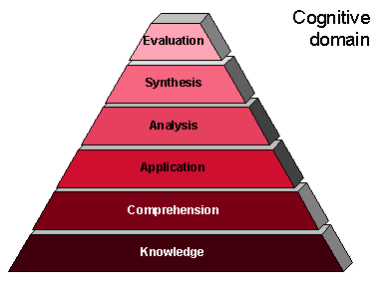
Implementation
Defend 1 solution by implementing it in a hospitality organization
Develop 3 potential options for solving the problem
Analyze the issue from a HRM perspective
Explain the issue & Identify the problem
Bloom, 1956
Select a topic

Slide 7
Course Application
HF231 Human Resources Management in the Hospitality Industry. (core course)
Lecture-type undergraduate course.
2 days a week for 90 minutes each.
Goal was to increase student critical think skills by utilizing current critical issues facing hospitality organizations.

Slide 8
Deliverable #1: Presentation
Design: Presentation was designed to inquire into students competencies.
Learnterainment: Utilized in each presentation and be authentic.
Execution: Presentations were conducted throughout the semester.
Evaluation: Group was assessed on how well they explained and articulated their points during the presentation and Q&A.
Presentation was conducted one week prior to turning in the paper.

Slide 9
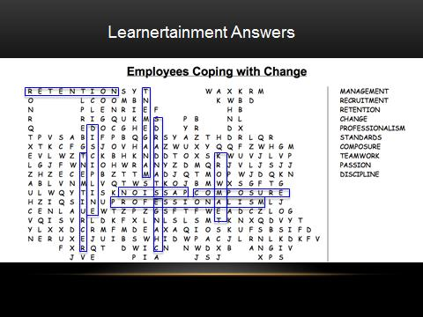
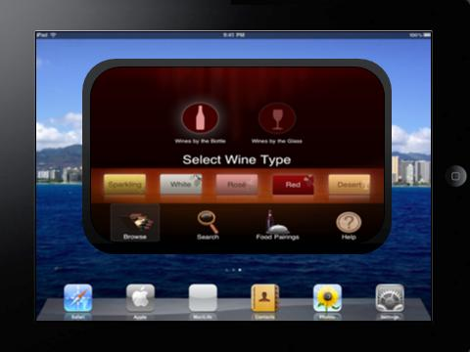
Learntertainment Examples
Train
Repetition
Assimilation
Initiate
Negotiate
Courtnall & Meghan - SHA
Weldon & Giesen - SHA
Shellito & Frankle - SHA

Slide 10
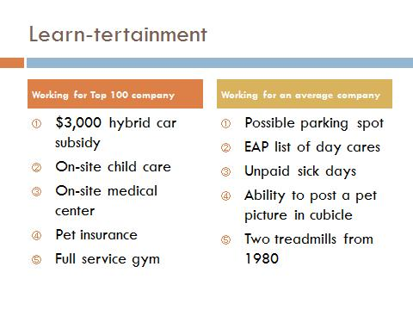
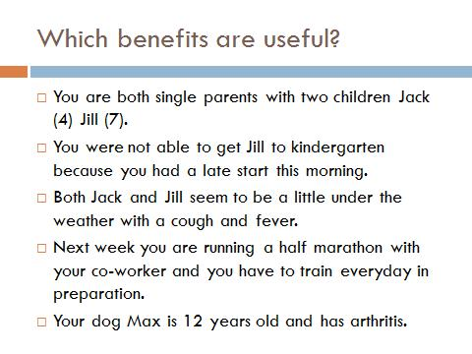
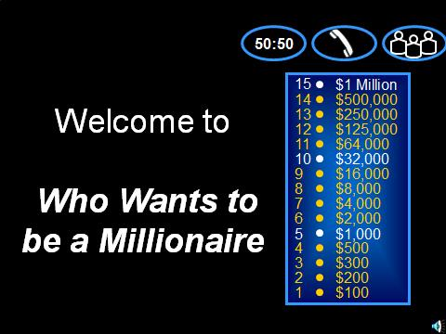
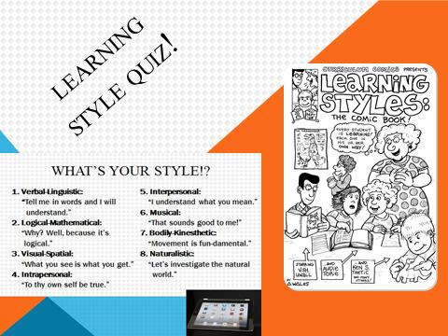
Learntertainment Examples
Lee & Giske - SHA
Moinian & Toobi - SHA
Leiber & Parry - SHA

Slide 11
Deliverable #2: Paper
See the problem
Analyze the issue
Generate options
Evaluate and implement one option
One page outline given on day of presentation.
Full report due one week after presentation.

Slide 12
Application
Applicable to any social science course where critical thinking is the primary focus for student learning and/or assessment.
Increase student engagement by actively incorporating students during the presentation.
Students evaluate each other at the end – higher collaboration.

Slide 13
Professor’s Observations
Classroom time shifts from faculty-centered to student-centered.
Better utilization of office hours.
Increase in one-on-one face time with students outside of class.
Provide feedback to students before handing in paper which improved deliverable quality.
Reduce heavy grading at the end of the semester.
Reinforced student presentation topics in my lecture making their work part of the class.

Slide 14
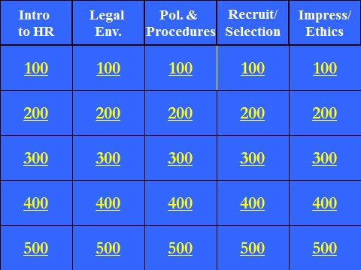
Conclusion
Learning occurs when students are:
  Actively engaged.
  Opportunities for integration with others.
  Presented with challenging situations or questions that require critical thinking skills.
  Surrounded by a nurturing fun environment.
  (Baranowski & Weir, 2011; Chickering & Gamson, 1987; Mckeachi et al., 1986)
  Instructors:
    Implement alternative techniques and strategies for questioning and discussion
    Create a supportive intellectual and emotional environment for maximum results.
    Encourage students to take risks.

Slide 15
THANK YOU
Erinn Tucker, PhD, MBA
Boston University – School of Hospitality Administration
etucker@bu.edu 617-358-8911

