Slide 1
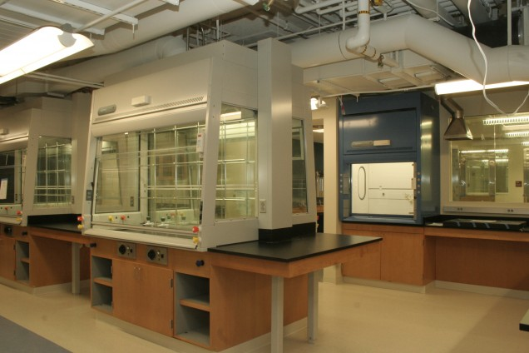

The Paperless Laboratory
Using Technology to Maximize the Organic Chemistry Laboratory Experience
Seann P. Mulcahy, Ph.D.
Professor John Snyder
Professor Scott Schaus

Slide 2
Intensive Organic Chemistry I/II (CH211/CH212)
  Approximately 40 students
  Primarily chemistry majors (also physics, biology, biochemistry/molecular biology, engineering)
  Advanced instruction
    non-standard textbook, fast-paced, modern
  Rigorous laboratory component
    Weekly, 4 hour laboratories
    Extensive data analysis
    Journal-style writing component
    Roughly 50% turnover of experiments each year

Slide 3
Implementation of Technology in the Organic Chemistry Laboratory
Innovation Goals:
  Perform experiments relevant to 21st century organic chemistry
  Expose students to cutting-edge instrumentation
  Enable fast and efficient data analysis
  Focus on problem-solving and critical thinking
  Use industry as a model for organic chemistry education

Slide 4
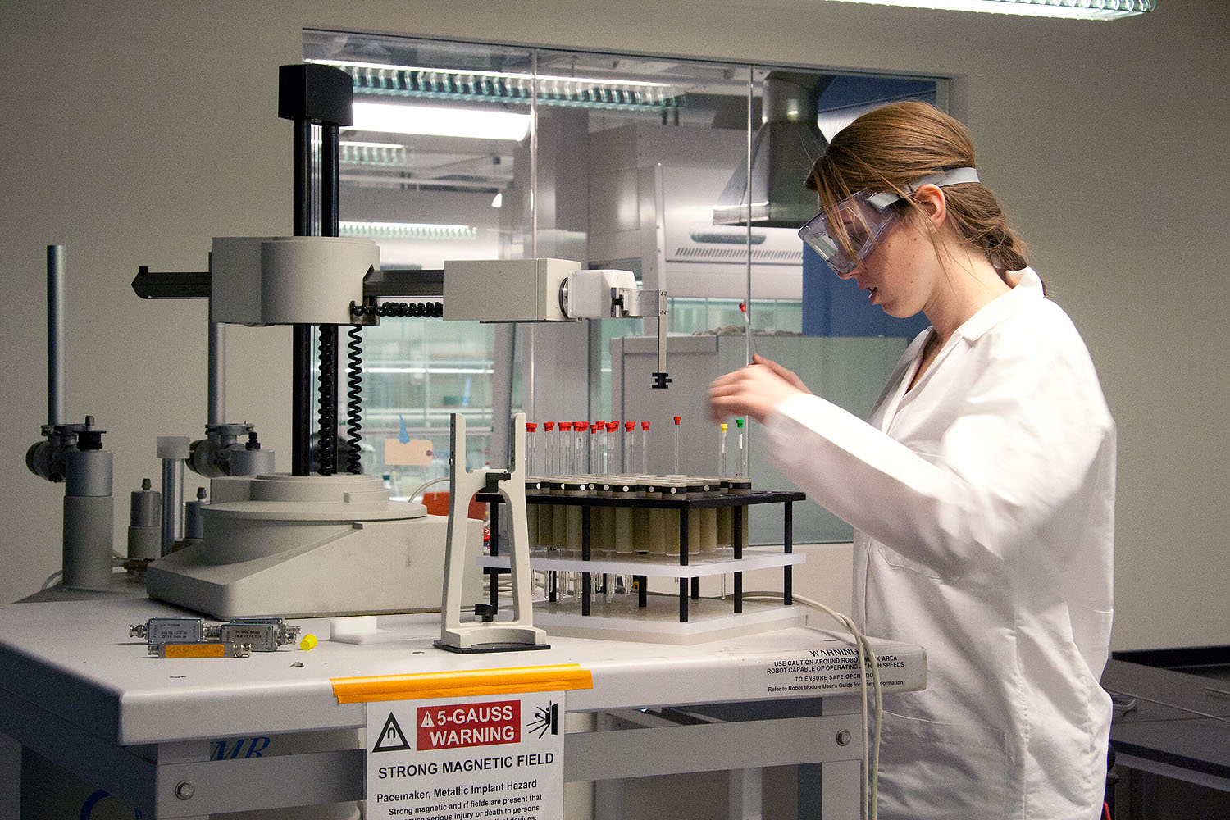
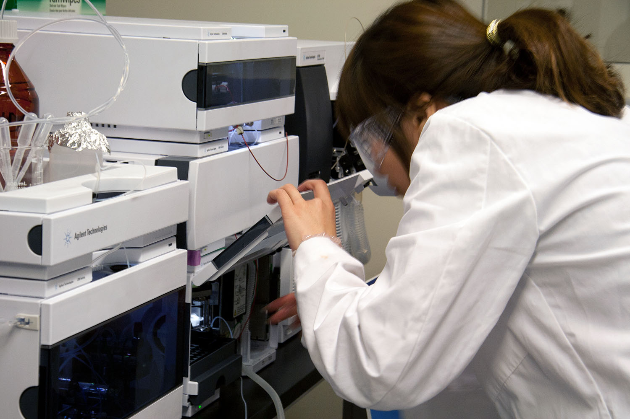
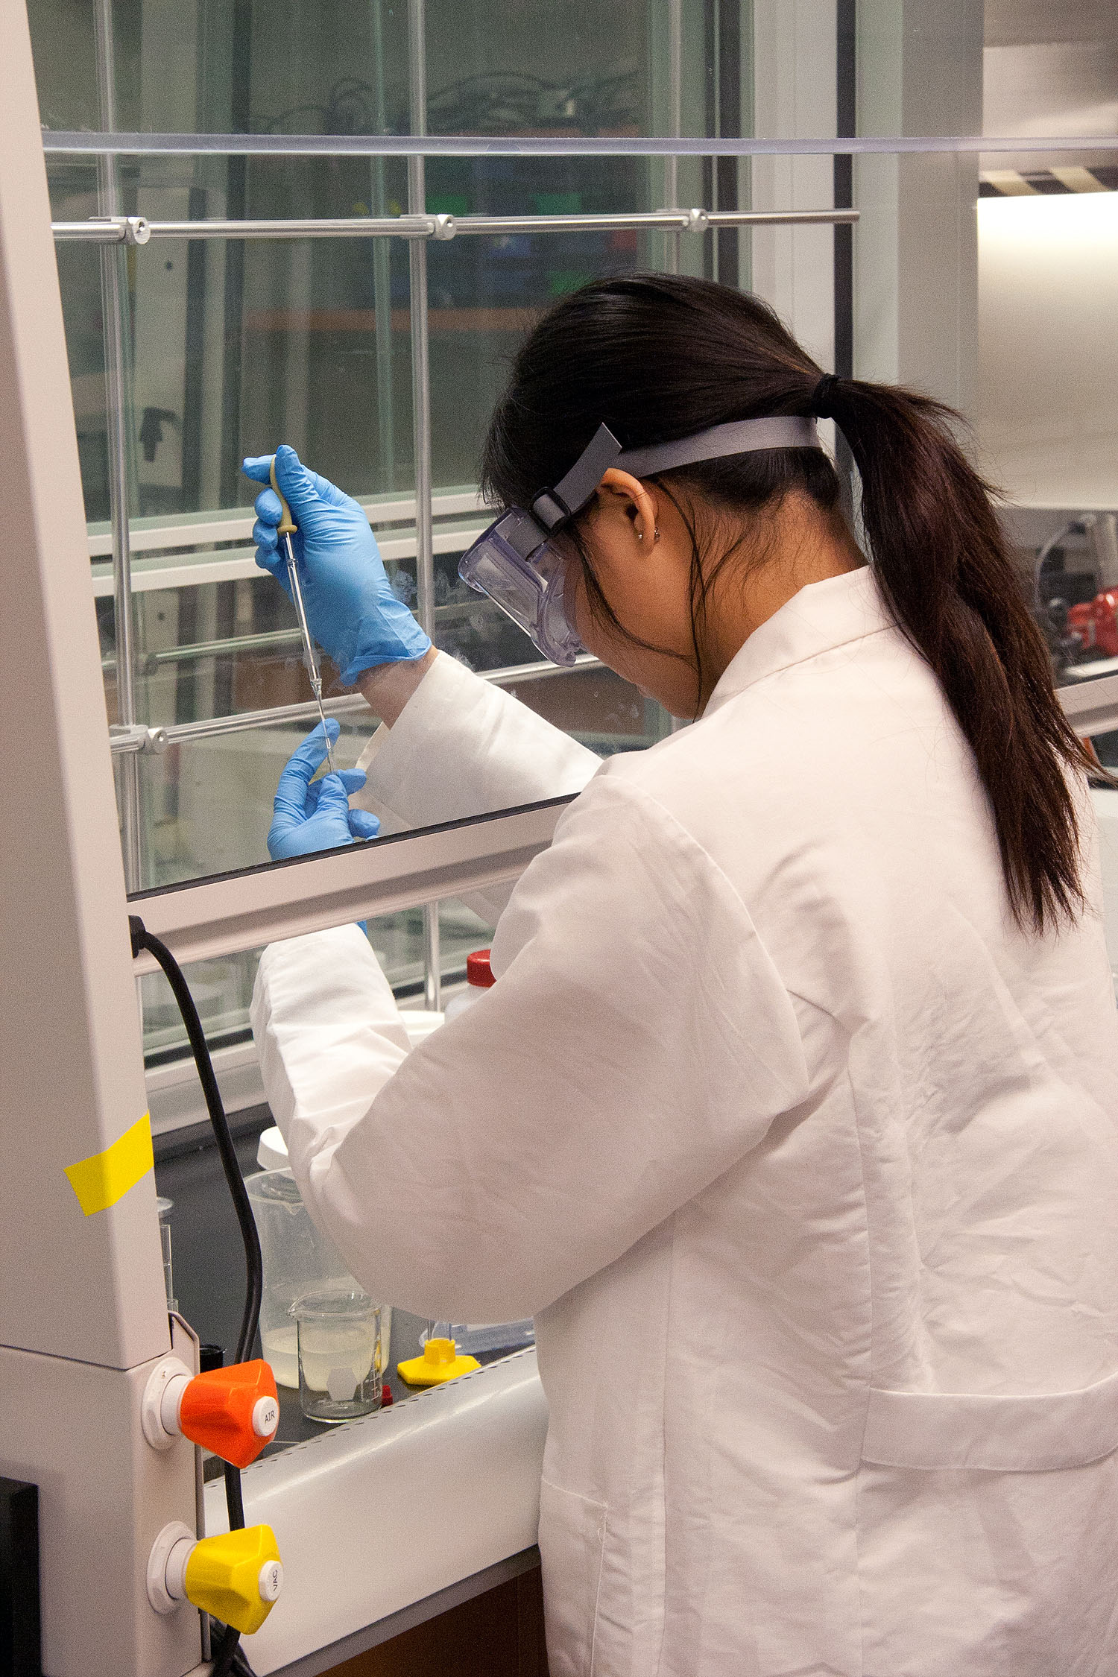
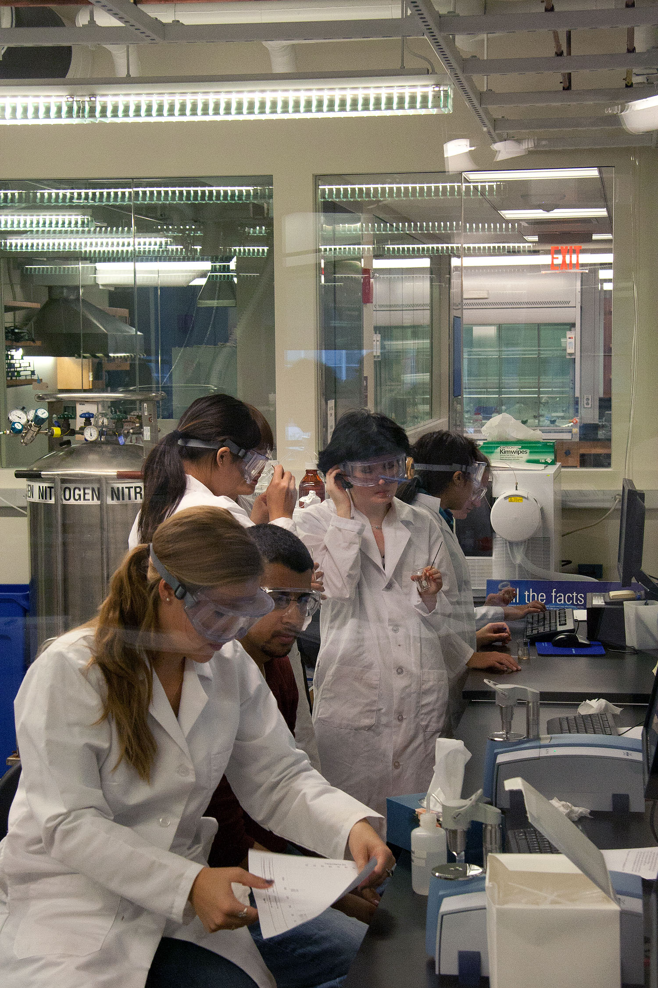
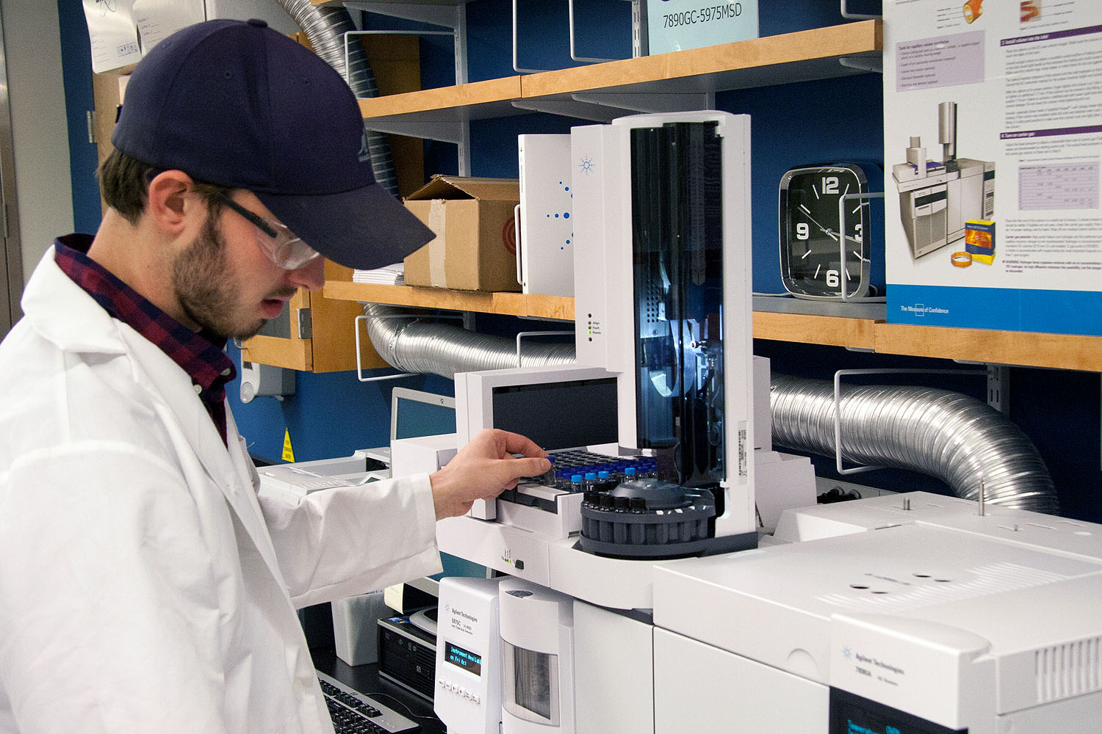
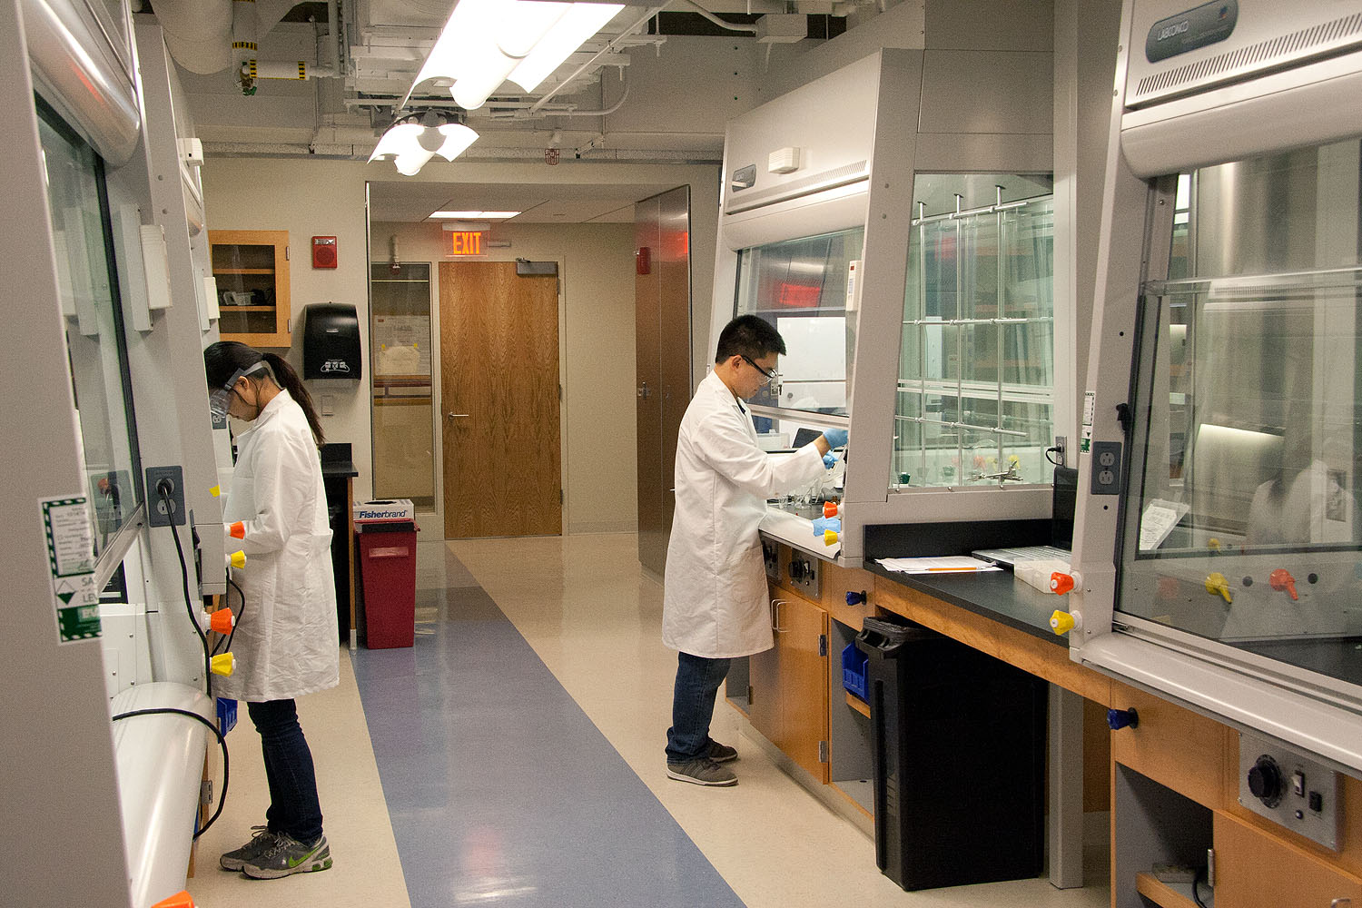
New Organic Lab Space

Slide 5
Public Dissemination of Protocols
Boston University Digital Common (DCommon)
  Open-access repository of organic chemistry experiments for the teaching laboratory
    Free download/upload
    Dynamic
    Replaces textbooks and lab manuals
    Network of faculty with commitment to undergraduate learning
    Available worldwide (747 hits since late July)
      Italy, Japan, China, Russia, U. K., Germany, France, Australia, India
      U. S. cities: Cambridge, Chicago, State College, Buffalo, Greensboro, Thousand Oaks, Champaign, Seattle, San Francisco, San Antonio, Brooklyn
Organic Chemistry Labs: http://dcommon.bu.edu/xmlui/handle/2144/1415

Slide 6
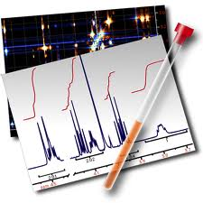
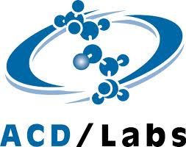

Use of State-of-the-Art Instrumentation
How do students know what they have made in the lab?
Analytical data collection is all automated
  Saves students time, enables implementation of more difficult/lengthy experiments
Chemistry server hosts folder for all data
  Student access via ResNet or via e-mail
  Data manipulation on personal computers
    Analysis and interpretation all done by students
Notes:
Comprehensive product characterization

Slide 7

Cloud Computing
Electronic Laboratory Notebook
  electronic documentation of laboratory experiments
  easily searchable, more secure, and instructor has access controls
  foster collaboration or data sharing among students
  intelligent database of chemicals
  ArtusLabs Ensemble
  Industrial model of scientific documentation
      Completely paperless
      Students bring laptops to lab
      Stoichiometry calculations are done by the software
      Experimental procedure is written as it is performed
      Electronic upload of analytical data (IR, GC/MS, LC/MS, ¹H NMR, ¹³C NMR)
      Electronic upload of laboratory report (Org. Syn. Prep.)
https://artuslabs.bu.edu/ch211/index.jsp

Slide 8
Innovation outcomes
Movement away from passive, “cookbook” protocols to “discovery-based” experiments
Students are better prepared for graduate school/industrial careers
  12 new experiments designed since implementation
    Applications to real world creates excitement
    Extensions of classroom themes is relevant to lecture, but exposes students to more chemistry
    Different set of reagents fosters ownership and independence in synthesis and analysis
    Compiling of results allows students to construct structure-property correlations and solidify conceptual understanding
    Collaborations with other disciplines
      Inorganic Chemistry (CH232) – Caradonna
      Genetics Lab (BI513) – Celenza
Notes:
What does this innovation allow us to do now that we couldn’t do before.
Trend toward organic chemistry used today.

Slide 9
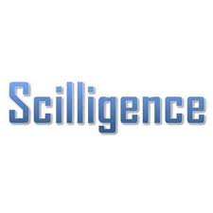




Acknowledgements
  Paul Sanschagrin Mick Timony
  Paul Ralifo Norman Lee
  Vika Zafrin Mertin Betts
  Katinka Csigi Prof. John Straub
  PFF Committee BU Chemistry
  BU CAS BU CEIT

