Slide 1
CEIT 2012
Using Podcasts as a Supplement to Lecture in Order to Free Up Class Time
Kabrina Krebel Chang, JD
Assistant Professor
School of Management

Slide 2
My Classes
Introduction to Business Law, approx. 55 students per section, requirement for all SMG graduates, the majority are sophomores.
Employment Law, approx. 60 students, elective, the majority are seniors.
Both are traditional lecture/discussion format using cases.

Slide 3
An Idea was Born
With the help of our IT department, incredible support.
Free-up class time so that we can focus on more in-depth and interesting examples.
Reduce the amount of dry lecture while still delivering relevant and required material.

Slide 4
Choose Material Carefully
Waited until five weeks into the semester.
Chose material that was straightforward and easy to organize, such as the elements of a contract.
Stayed away from material that was controversial, such as discrimination.
KEEP IT SHORT! 12 minutes is my longest.

Slide 5
So Easy to Do
SMG IT Department, Rick Seaholm
Small web camera on top of my monitor n my office
Echo360 software, can record video, audio and screen of monitor

Slide 6
So Easy to Do
Small web camera on top of my monitor n my office
Echo360 software, can record video, audio and screen of monitor.
Created Power Point slides of the material.
Launch Echo360, and “Start Recording”

Slide 7
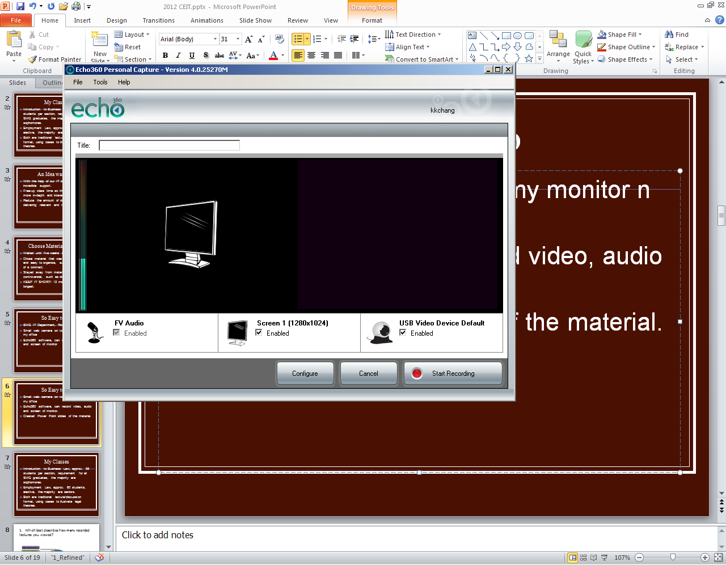
So Easy to Do

Slide 8
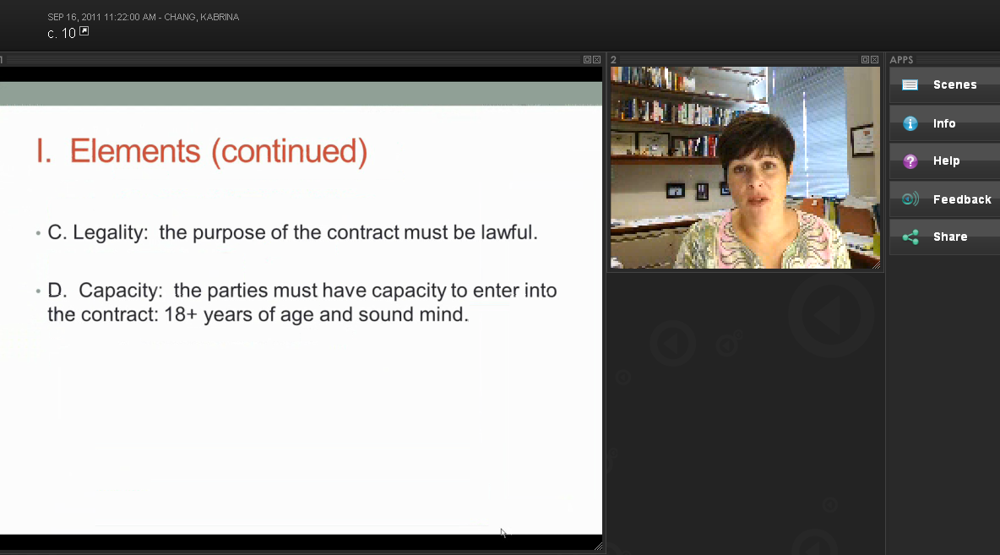
What the Student Sees

Slide 9
So Easy to Do
I post the entire podcast (video, audio, and power point)
  Slides only
  Audio only

Slide 10
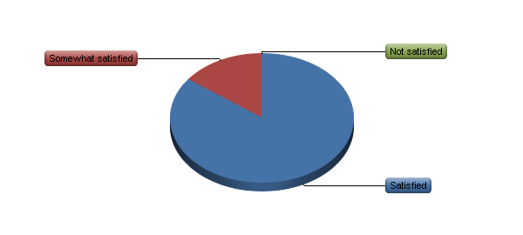
How do Students Like the Podcasts?

Slide 11
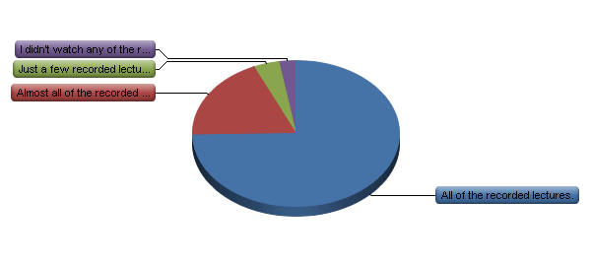
They Watched Almost All of Them

Slide 12
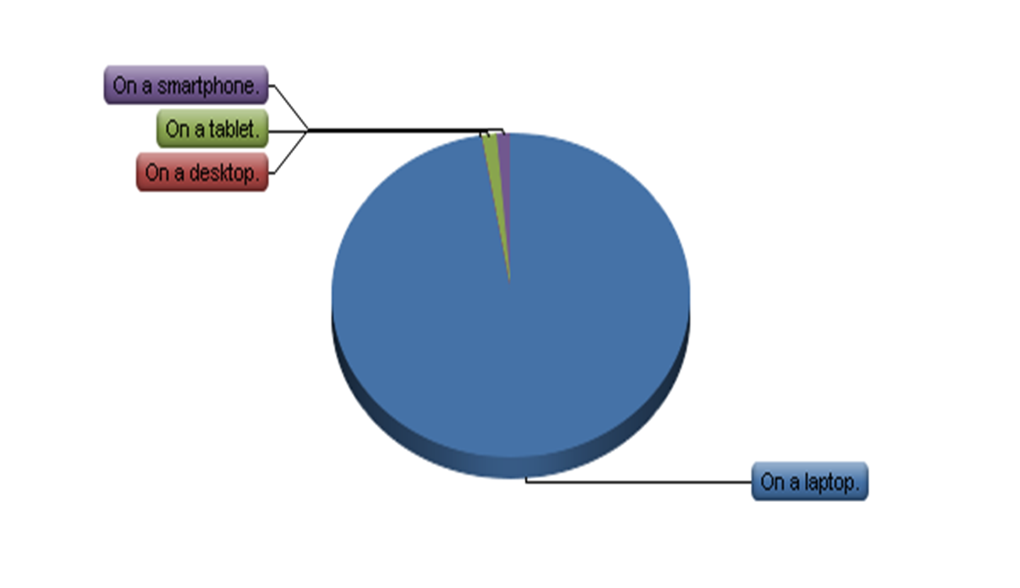
On Their Laptops

Slide 13
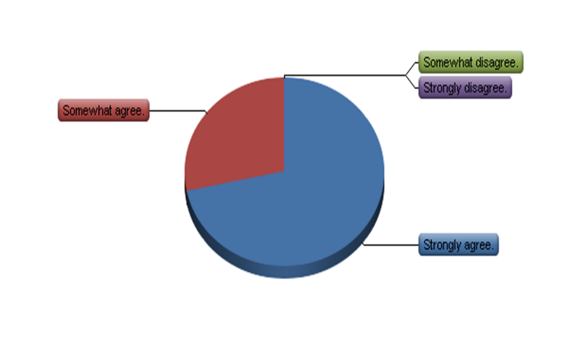
It Helped Them Understand the Class Material

Slide 14
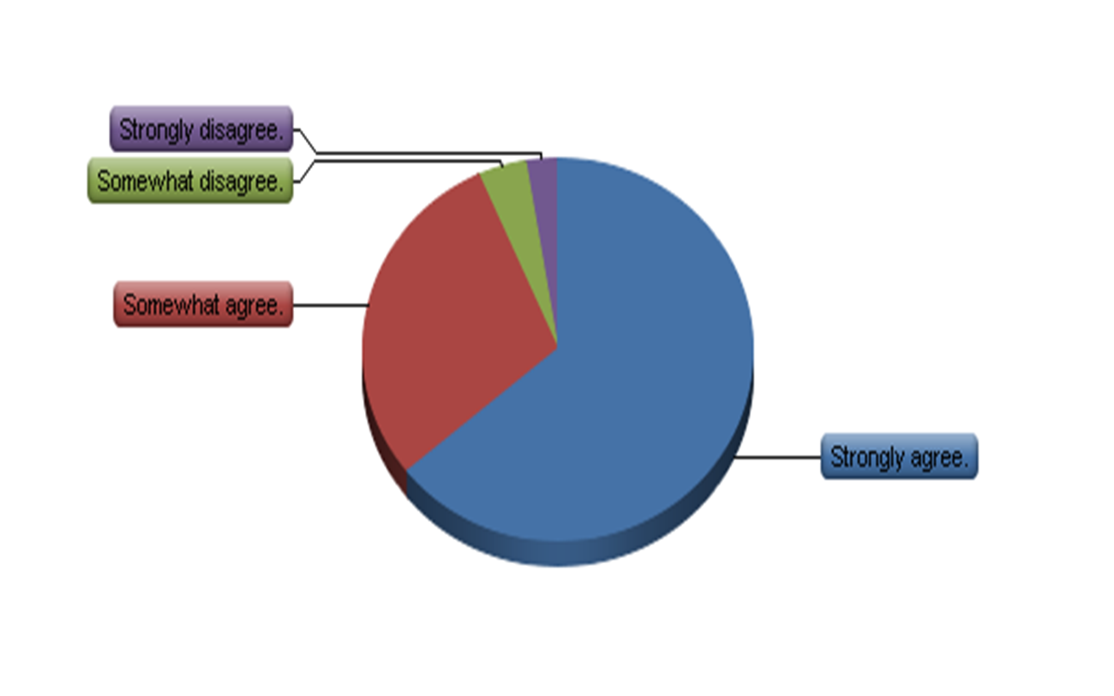
And They Want More for My Class

Slide 15
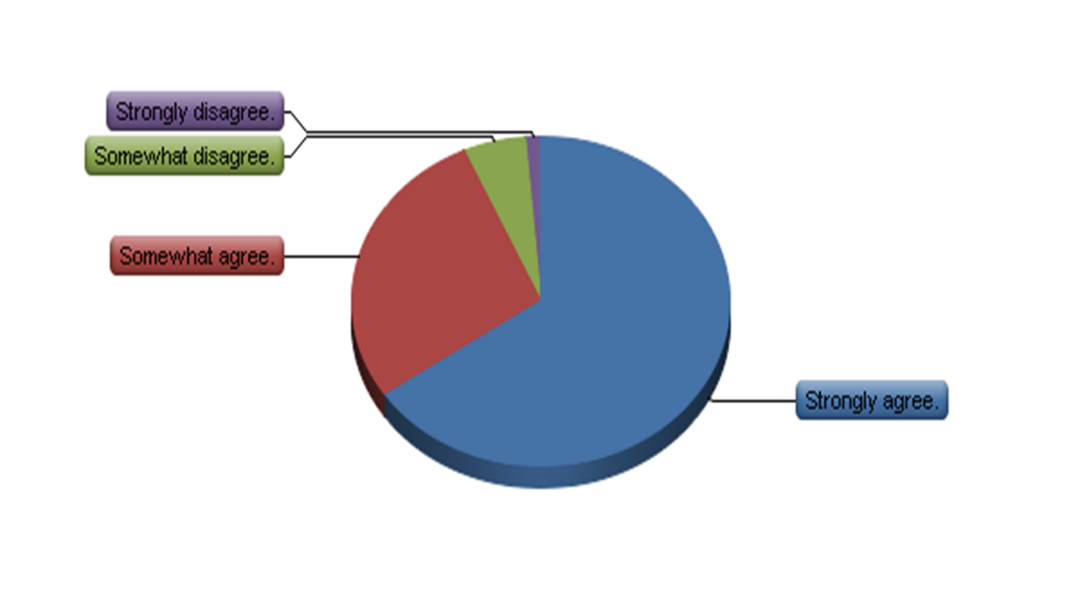
And They Want More in SMG

Slide 16
Work in Progress
Discovered there was one more subject that could be effective in a podcast
Need to prepare my students for them better; explain it.
Want to incorporate other things in the podcasts, like video clips.

