Slide 1
MAKING
GLOBAL PUBLIC
HEALTH EDUCATION
REAL
Connecting with International Partners in the Classroom
Malcolm Bryant, MBBS, MPH
Jessica Charles, MPH
James Wolff, MD, MPH

Slide 2
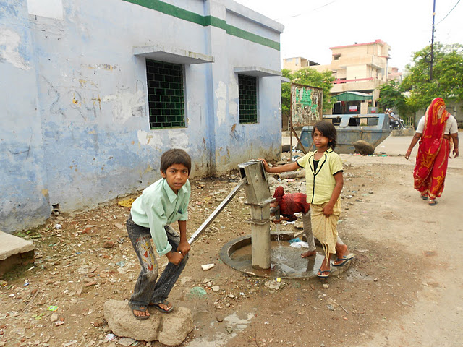
Our Challenge
Program management is an important field of work for International Health graduates
Department of International Health is responding to the need to provide opportunities for building practice-based skills
Our task:
  To build a course that provided practical program implementation skills

Slide 3
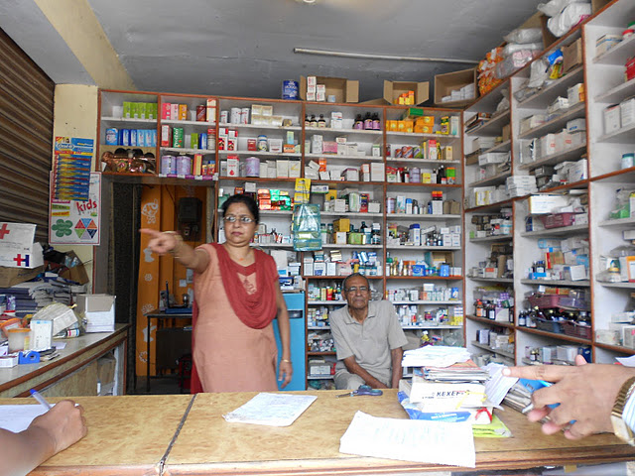
Course Criteria
Engages students in real work situations
Takes place in low and middle income countries
Provides exposure to current organizational problems at the program level

Slide 4

Resources Available
To meet our criteria with available resources we:
  Recruited overseas faculty in international health
  Identified health organizations as partners
  Designed specific scopes of work for students to address in the five focus areas of the course

Slide 5
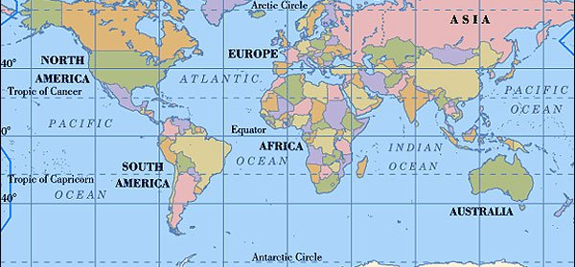
Country Partner Sites
India
Zambia
South Africa
Lesotho

Slide 6
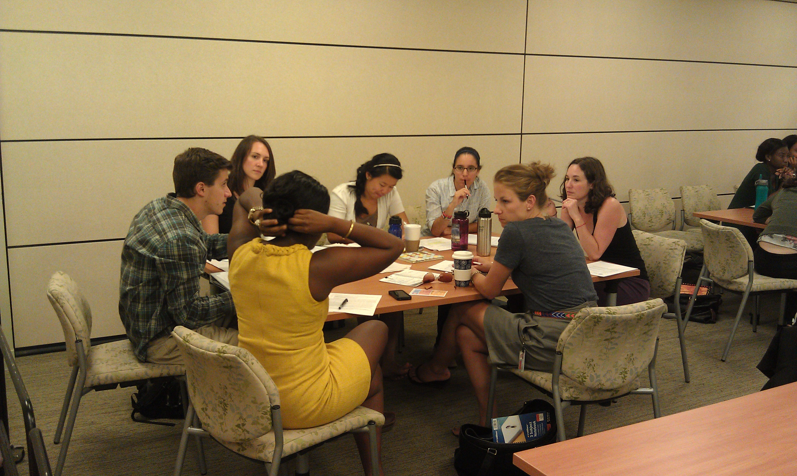
Principles Course Design
Didactic materials presented prior to class using video lectures
Devote class time to apply and practice program management skills
Explore program management in four different country, cultural, political, and social contexts.
Opportunity to work in teams and learn about team process

Slide 7
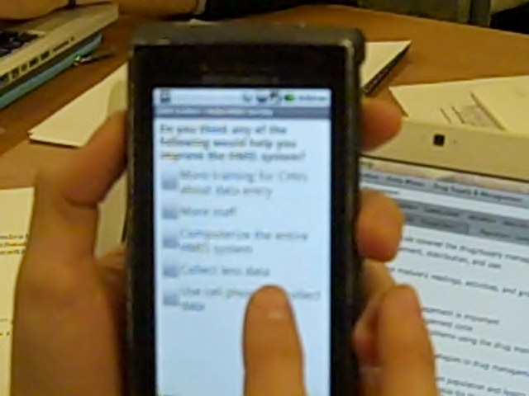
Specific Content Areas
Class divided into two-week modules for each program area:
  Work planning
  Human Resources
  Pharmaceutical Management
  Mobile health/information systems
  Quality Improvement
  Financial Management

Slide 8
Use of Modular Design
Preparation with out of class reading and video lectures
First Class: Apply skills and concepts through exercises
Students implement scope of work for their organization
Students report out on their deliverables and process
Peer, faculty and organizational review and feedback
E-Portfolio documentation of individual and group reflections on process
Two-week Module for each
Program Focus
Area

Slide 9
Benefits of the innovation
Practical program implementation experience
Exposure to multiple contexts
Improved ability to work in teams
Ability to work on complex problems over long distances
Complete assignments with incomplete data
Develop report writing, presentation skills
Individual leadership skills

Slide 10
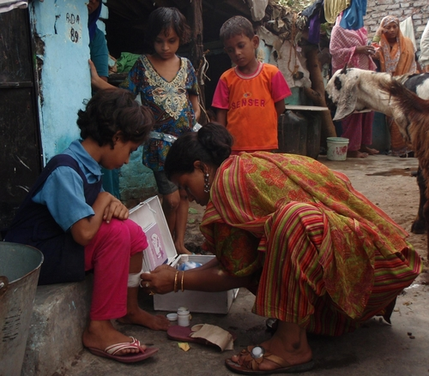
Real world experience in multiple cultural, organizational & country contexts
“The real world experience this class can give you, matches no other.”
“Working with a partner organization made this class worth every second put into it
“We worked on real problems for a real organization rather than dealing with theory”
“Real life scenarios with our foreign liaisons where our inputs had real impacts on our organizations”

Slide 11
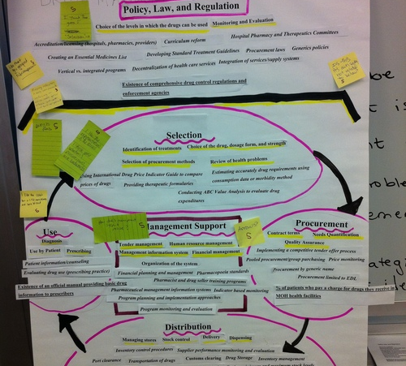
Complex programs over long distances with incomplete information
“This course encouraged us to use our creativity, professional skills, and experiences, and to transform challenges and obstacles into experiences to learn from.”
“We were required to use all kinds of media to communicate with field liaisons, organizations, and fellow classmates.”

Slide 12
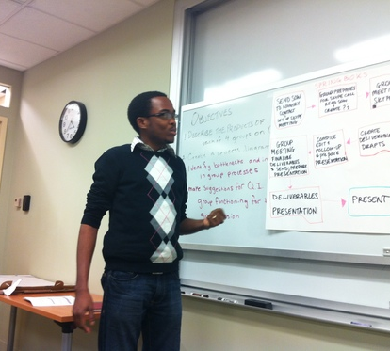
Consulting skills
“The organization we were working with did not necessarily support the collaboration 100%.... At times we felt a little awkward”
“The challenges we encountered with the scopes of work taught us many useful lessons about the realities of consulting with international health organizations.”

Slide 13
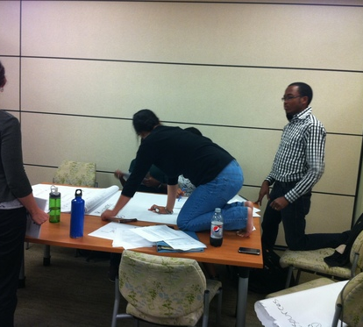
Team and Leadership skills
“All the work in the course is group based (with the same group). I have never had such a highly functioning group in my time at the school”
“We were encouraged to take risks in this class and think outside the box”
“Groups met with the professors at the end of every module so that if there were group problems they could be worked through.”

Slide 14
What we accomplished
Linked students to organizations in the field and to BU’s international faculty
Connected field-based faculty more directly to the mission of the department and enriched their experience
Provided opportunity for real work experience in the international arena

Slide 15
Movie Madness Wrap-up

Slide 16
Conclusions
BU has many international connections and faculty overseas
Virtual modalities make communicating with international faculty and organizations possible
Partnering with International faculty and international organizations can provide students a real-world international experience in many fields such as education, agriculture, engineering, and economics.

Slide 17
THANK YOU
Malcolm Bryant: bryantm@bu.edu
Jessica Charles: misscharles@hotmail.com
James Wolff: jwolff@bu.edu

