Slide 1
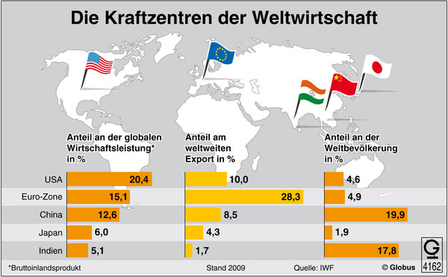
Economics in a Foreign Language Course
Beate Alhadeff, CAS/MLCL

Slide 2
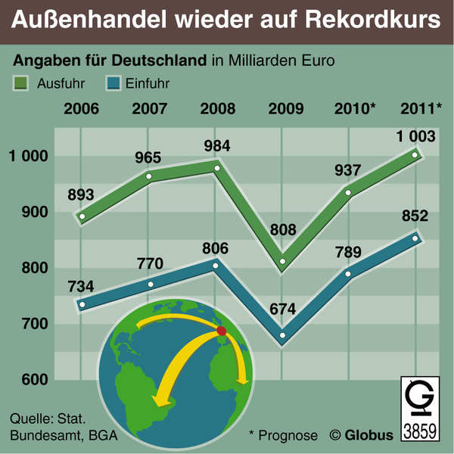

Slide 3
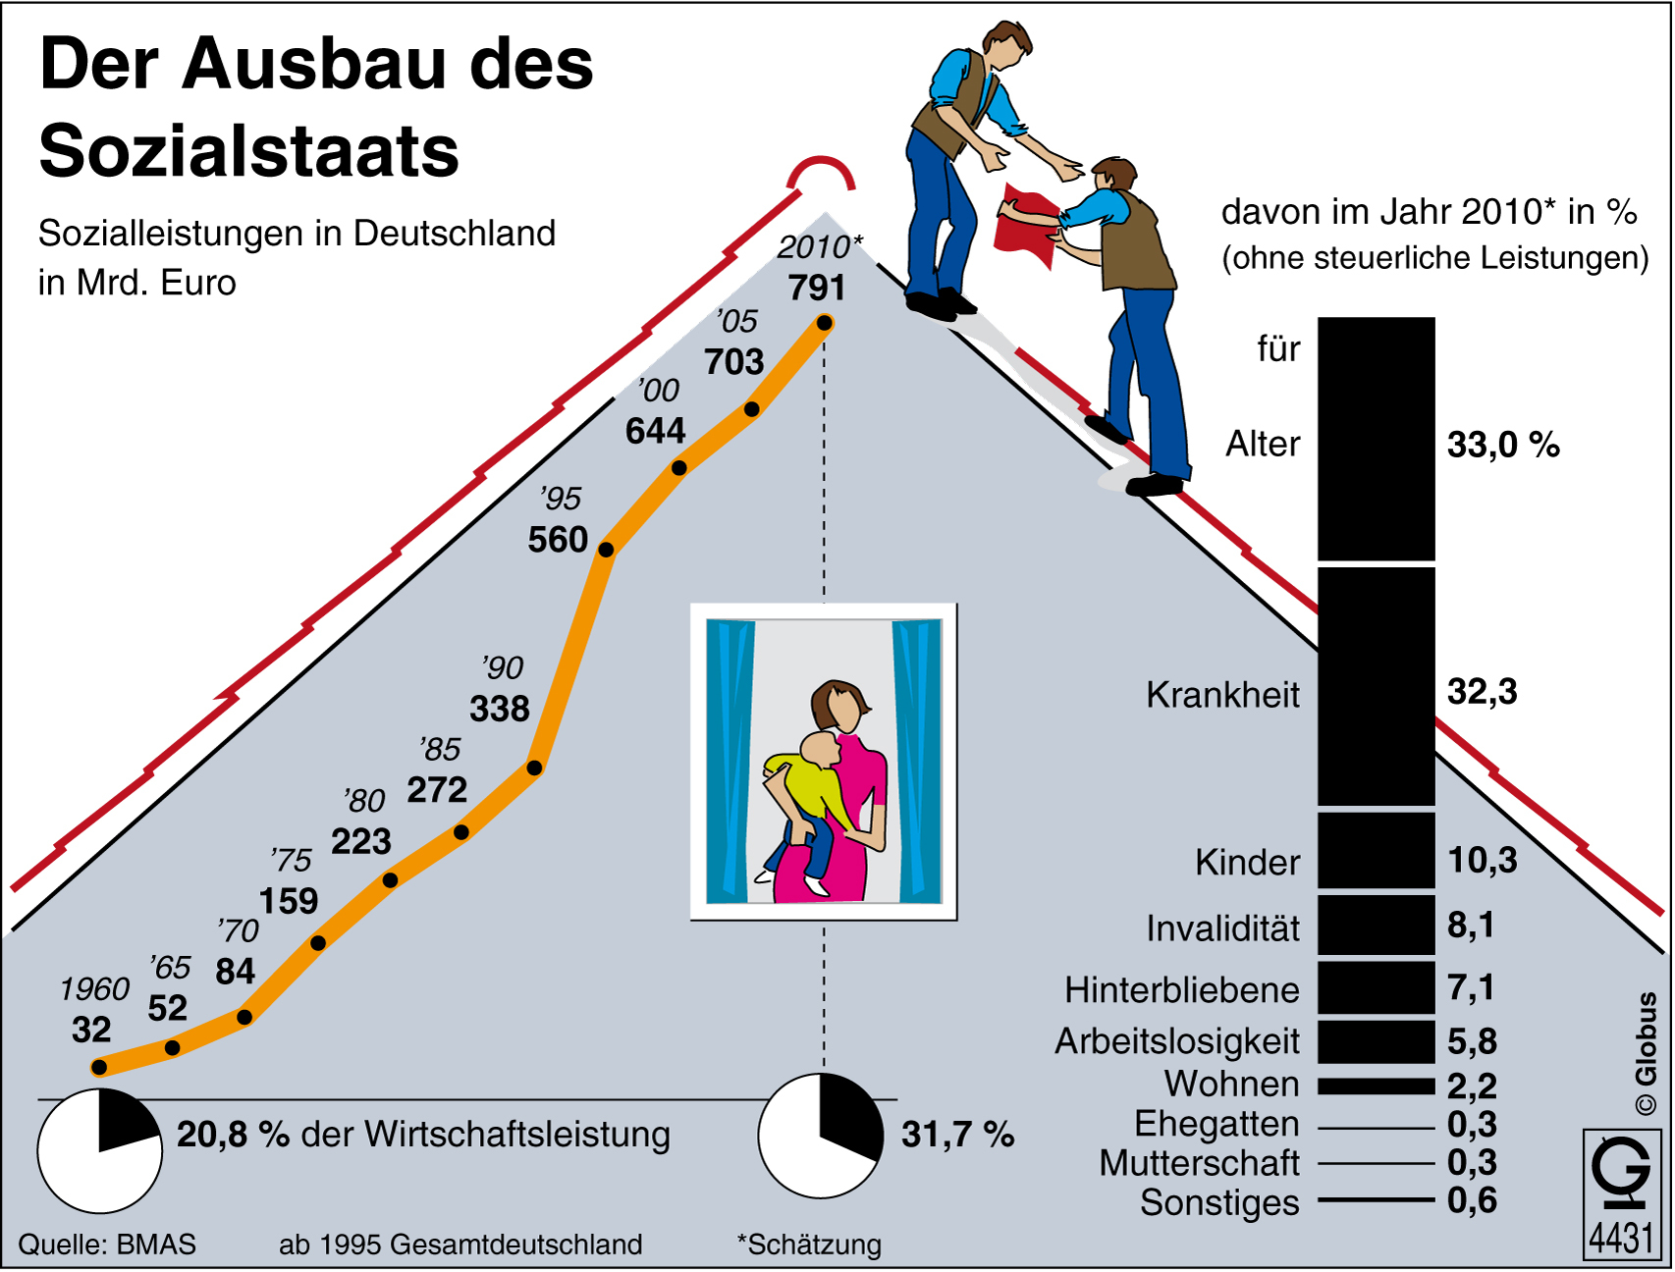
Assignment: Discuss the pros and cons of a Sozialstaat like Germany.

Slide 4
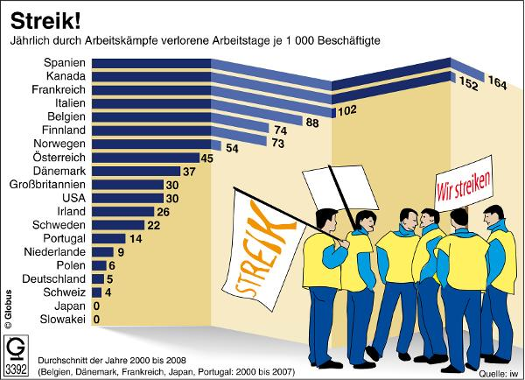

Slide 5
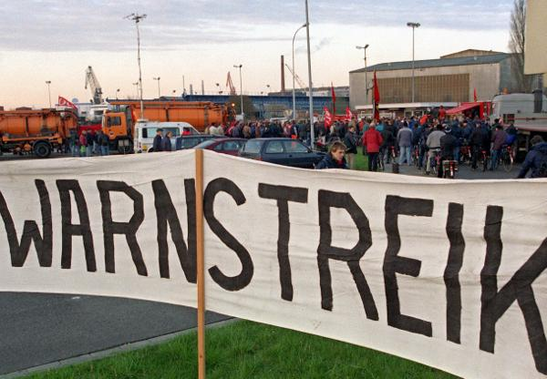

Slide 6
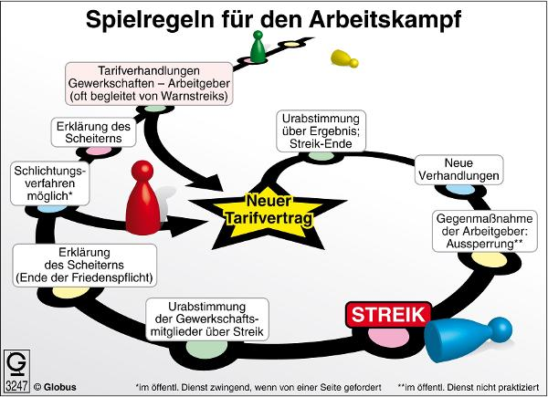
German Collective Bargaining Rules

Slide 7
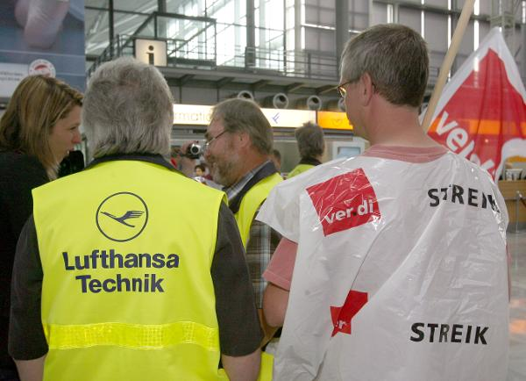

Slide 8
Role Play: collective bargaining based on events in February – June 2010
Lufthansa Pilots • expansions abroad/cuts affect work conditions 6.4% salary raise • more profit sharing • threat of four-day strike | Lufthansa Management • cheaper airlines are gaining market share • pilots already earn well ( €62,000 – €250, 000 ) • rising fuel prices • insolvency problems of other airlines

Slide 9
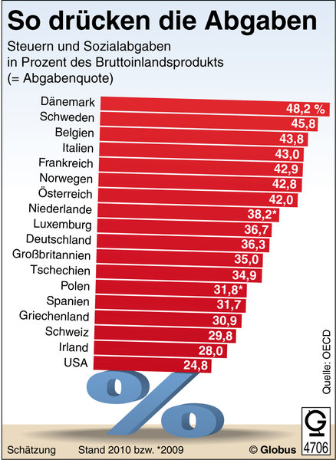
Taxes & Social Welfare Contributions in % of GDP

Slide 10
Famous US Tax Returns (2010)
 | Income | Tax | Donations
Romney | $21,6 Mio. | $3 Mio. 13,9% | $2,98 Mio. 13,8%
Gingrich | $3,1 Mio. | $995 000 31,6% | $81 000 2,6%
Obama | $1, 8Mio. | $454 000 26% | $245 000 13,6%

Slide 11
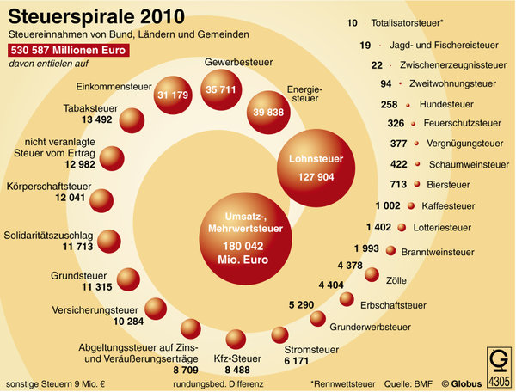

Slide 12
Measures against German “Tax Sinners”
Steuerhinterziehungsbekämpfungsgesetz
– law to combat tax evasion –
Strafbefreiende Selbstanzeige
– immunity from prosecution for self-denunciation –
Assignment:
Search the German press for examples of tax evasion
in other European countries

Slide 13
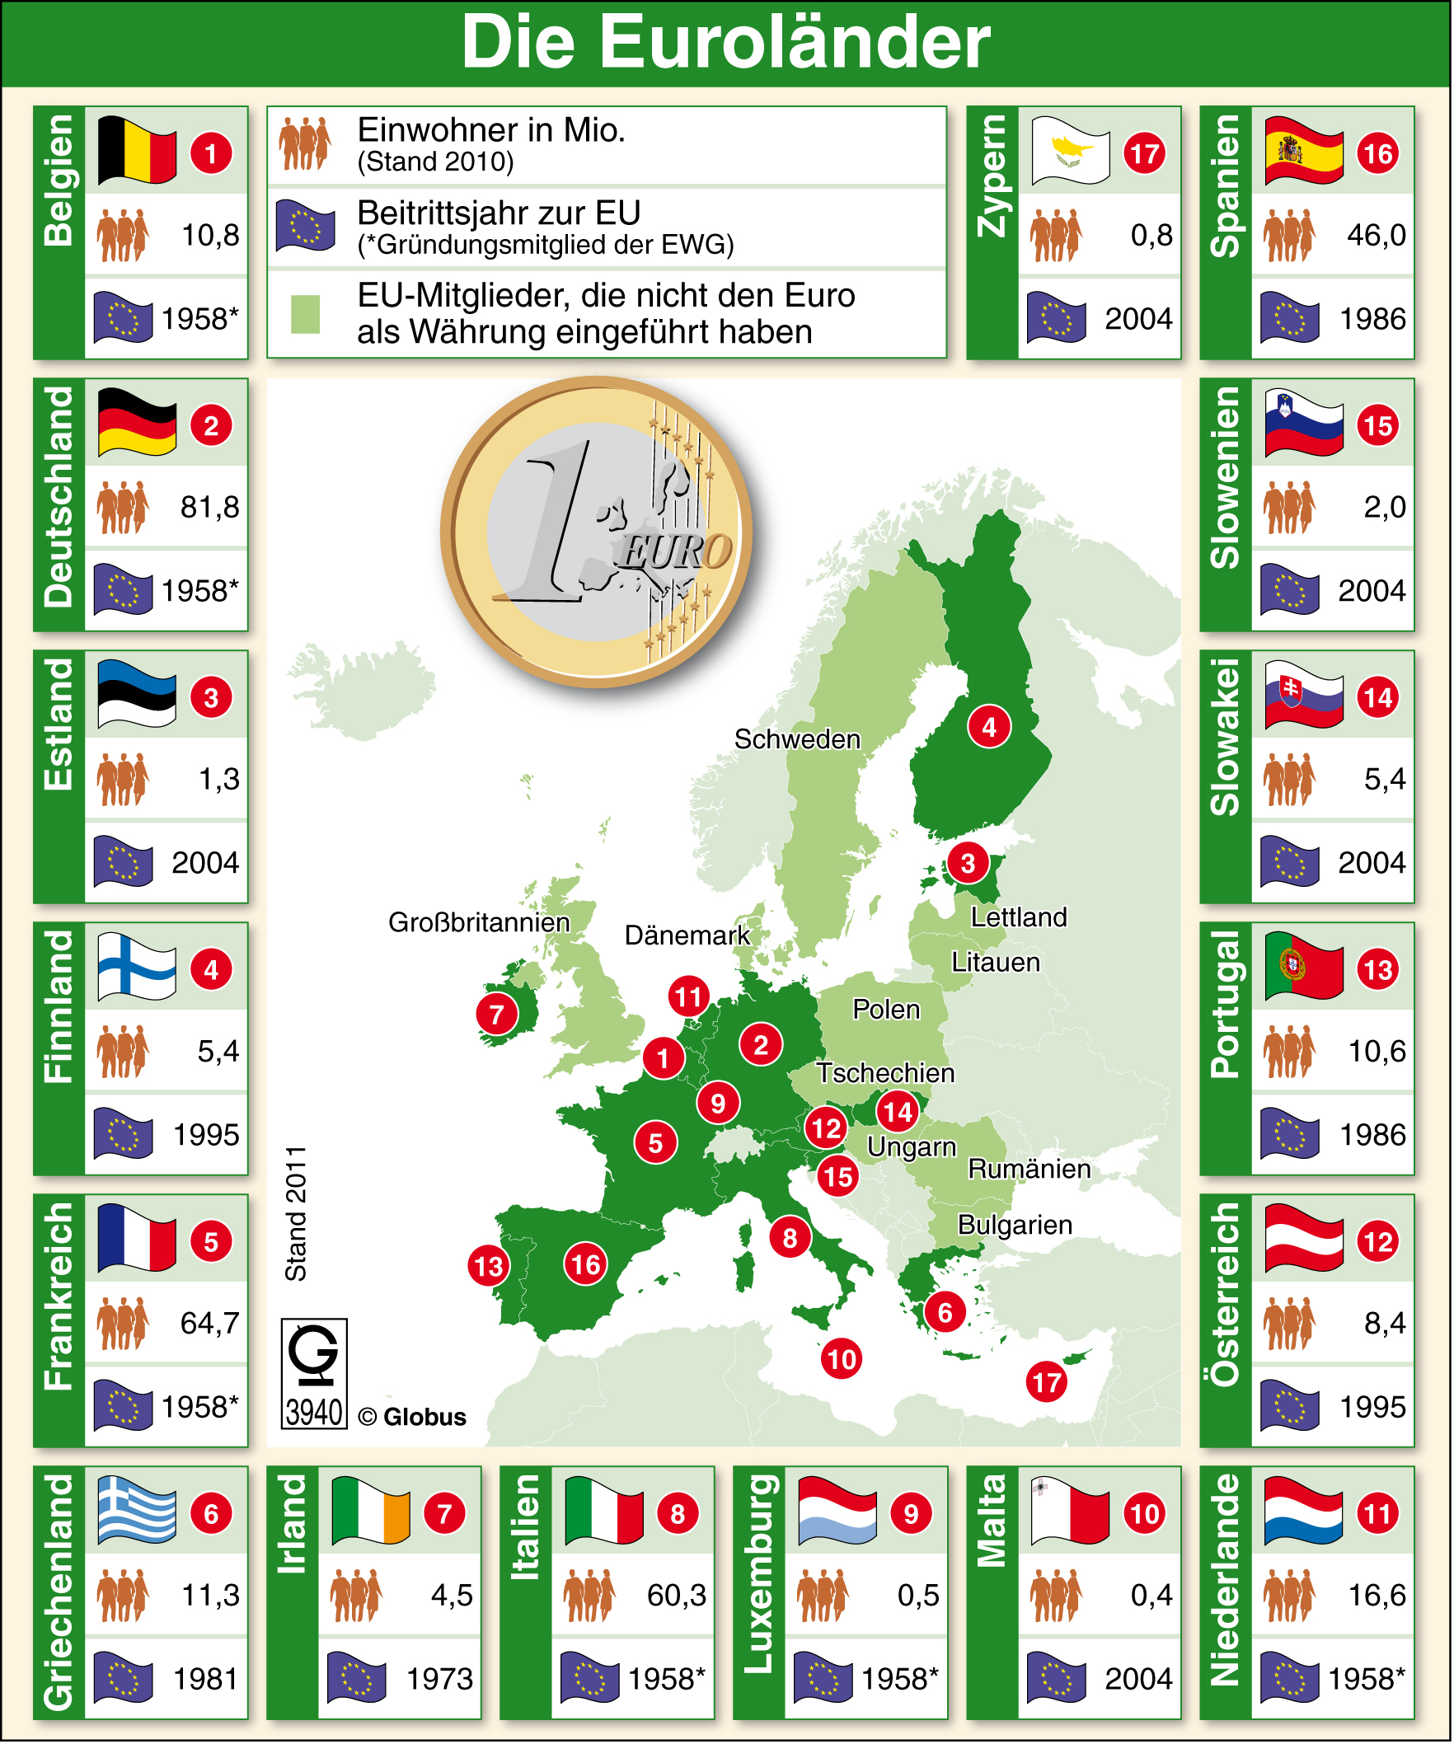

Slide 14
Reasons for European Currency Union
• to eliminate fluctuating exchange rates and the uncertainties and transaction costs involved
• to intensify trade in Europe
• to diminish the gap between richer and poorer member states
• ………….?

Slide 15
Pros and Cons of the Euro for Germany (prior to the crisis)
Euro Advocates It made reunification more acceptable to other European nations. Without the euro Germany would not have been the world’s biggest exporter between 2003 and 2008. | Euro Skeptics Imports became more expensive, a drawback for an industry that needs parts and raw materials from abroad. “The euro subsidized the southern States.”

Slide 16
Pros and Cons of the Euro for Greece (prior to the crisis)
Euro Advocates In the 70s & 80s the Greek drachme had double digit inflation rates. Thanks to the euro Greece could borrow cheaply and enjoy relative price stability. | Euro Skeptics Prices of products and services increased. Exports, 7 % of the Greek GDP, became more expensive.

Slide 17
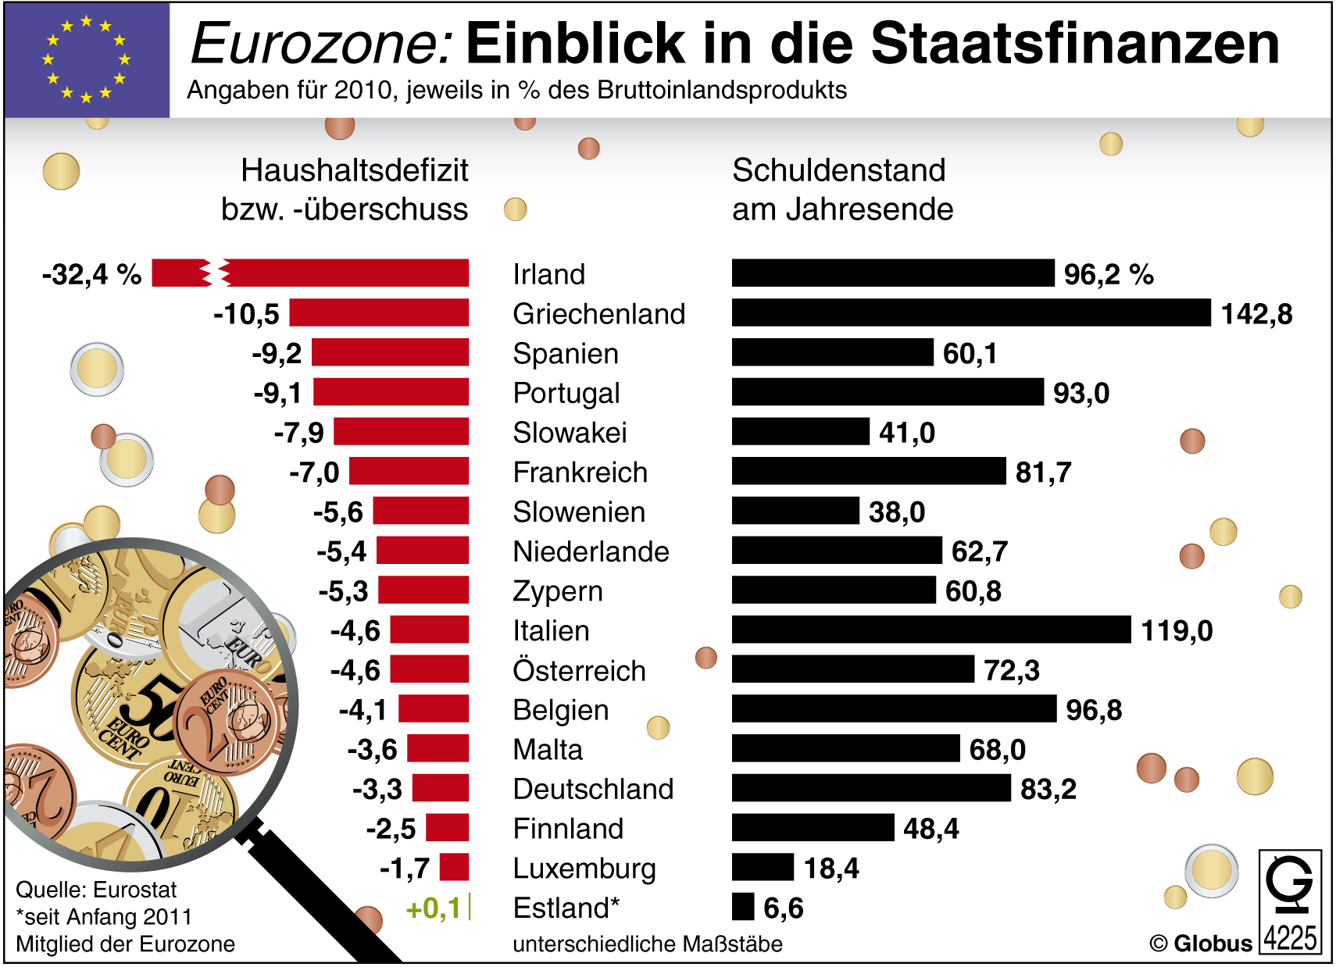

Slide 18
What caused the Euro-Crisis?
• A consequence of the global financial crisis
• Some European banks also took high risks
• The EU broke its own rules and regulations
• The euro-zone economies are too different
for common financial policies
• Rampant tax evasion
Assignment: study information sheet!

Slide 19
Greece in 2010
• Greece can no longer pay the interest on its
sovereign debt.
• EU and IMF grant first rescue package of €110
billions and demand strict austerity measures.
• Strikes and riots create chaos in Athens.
• Greeks show growing resentment against
Germany because of WWII.

Slide 20
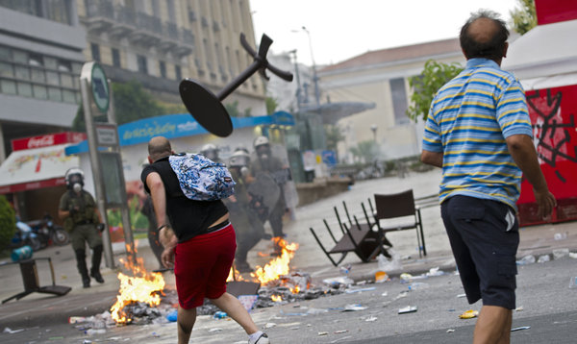
Street Riots in Athens

Slide 21
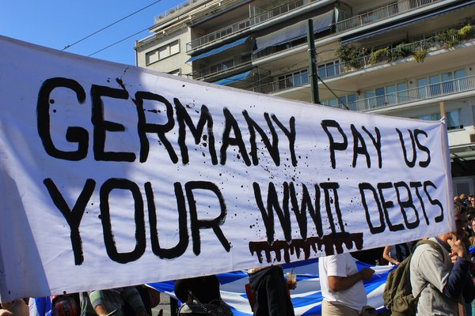
Demonstration in Greece

Slide 22
Possible Panel Discussions about the Euro Crisis
• A discussion among Greeks and Germans
• “Non-profligate” countries versus “profligate” countries
• Euro skeptics versus euro supporters

Slide 23
If Greece Dropped the Euro …
• The new currency would depreciate overnight, because …
• This would worsen the crisis, because…
• ……….?

Slide 24
If Germany Dropped the Euro …
• The new currency would appreciate overnight, because …
• The price of German products would increase tremendously (30-50%).
• Firms would outsource.
• Unemployment in Germany would rise.
• ……….?

Slide 25
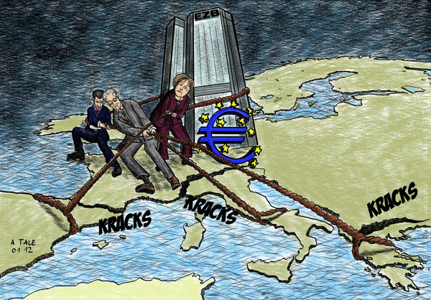

Slide 26
Greece: Spring – Fall 2011
• Despite reduction of current deficit, the threat of a melt-down was looming
• Approval of second rescue package in the amount of €130 provided that Greece implements drastic cuts and reforms
• Creditors forgo 50% of Greek debt

Slide 27
The Euro Crisis at the End of 2011
• Growing concern over Italy’s debt and the fact
that its economy is too big to bail out
• European leaders agree that
• … more oversight of economic and fiscal policies in the euro zone is needed
• … leading Europeans banks have to increase their core capital form 4% to 9%
•… changes to EU treaties have to be made

Slide 28
