Slide 1
BEYOND BELIEF
God’s nature revealed through practices of care

Slide 2
The genius of practical theology lies in its integrative activity of keeping theory and practice in critical dialogue.

Slide 3
Practical theologians affirm that we learn about God through practice and action
that significant and substantial knowledge about the nature and activity of God may in fact be gained through practice and action.

Slide 4

Theology is always tentative,
God’s presence subtle.

Slide 5

Knowledge of God is always provisional
Theology entails exploring and listening to the ‘different’

Slide 6
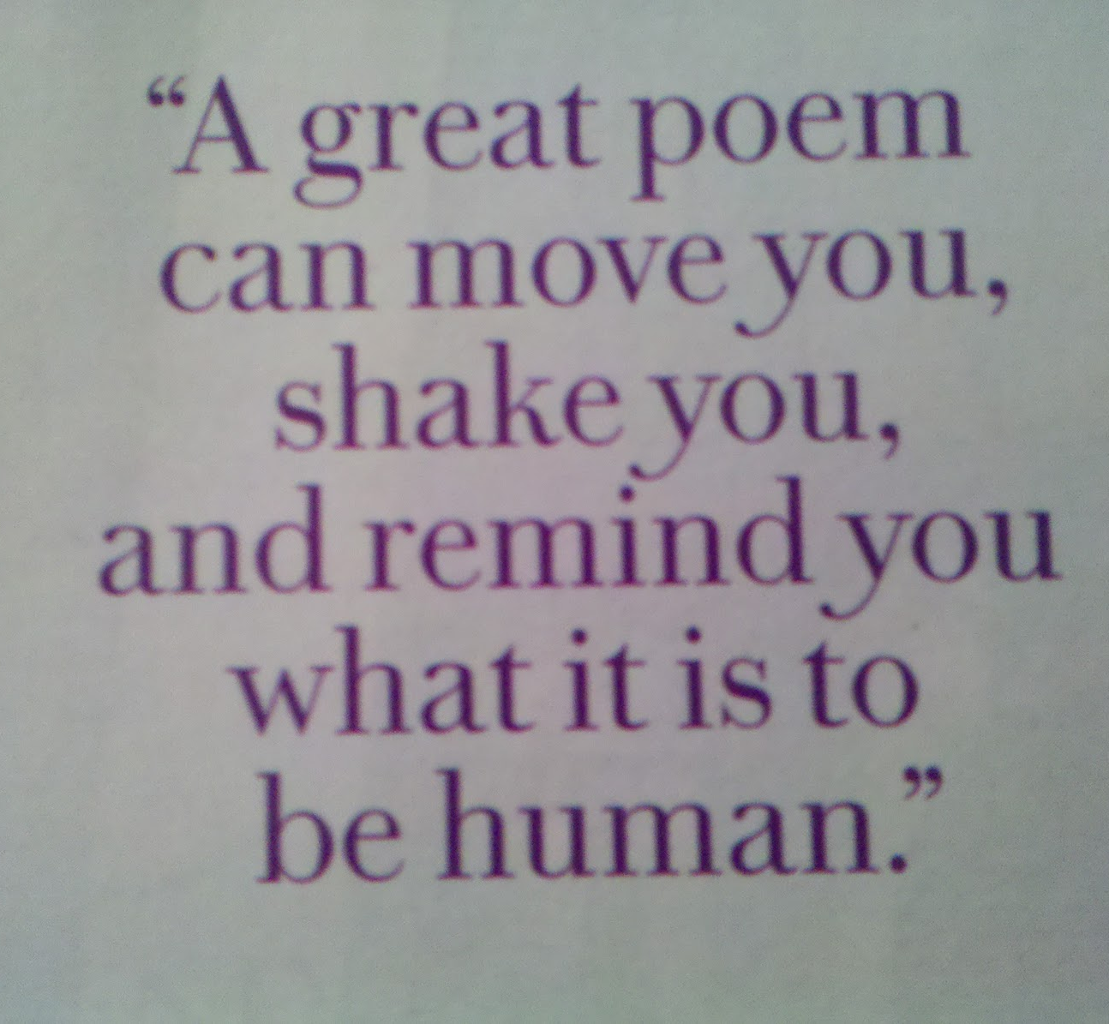
The Divine is better articulated in verse than in prose
Theology needs to be poetic.

Slide 7

Divine
Vulnerability
God as weak in the world

Slide 8

THEOLOGY AS DESIRE FOR GOD’S ELUSIVE LOVE

Slide 9

God as Being in Relation
Humanity in the image of God

Slide 10

Embracing the mystery
IN SEARCH OF AN ENIGMATIC GOD

Slide 11

God and Humanity are Communal
THEOLOGY AS A GLOBAL COMMUNITY AFFAIR

Slide 12
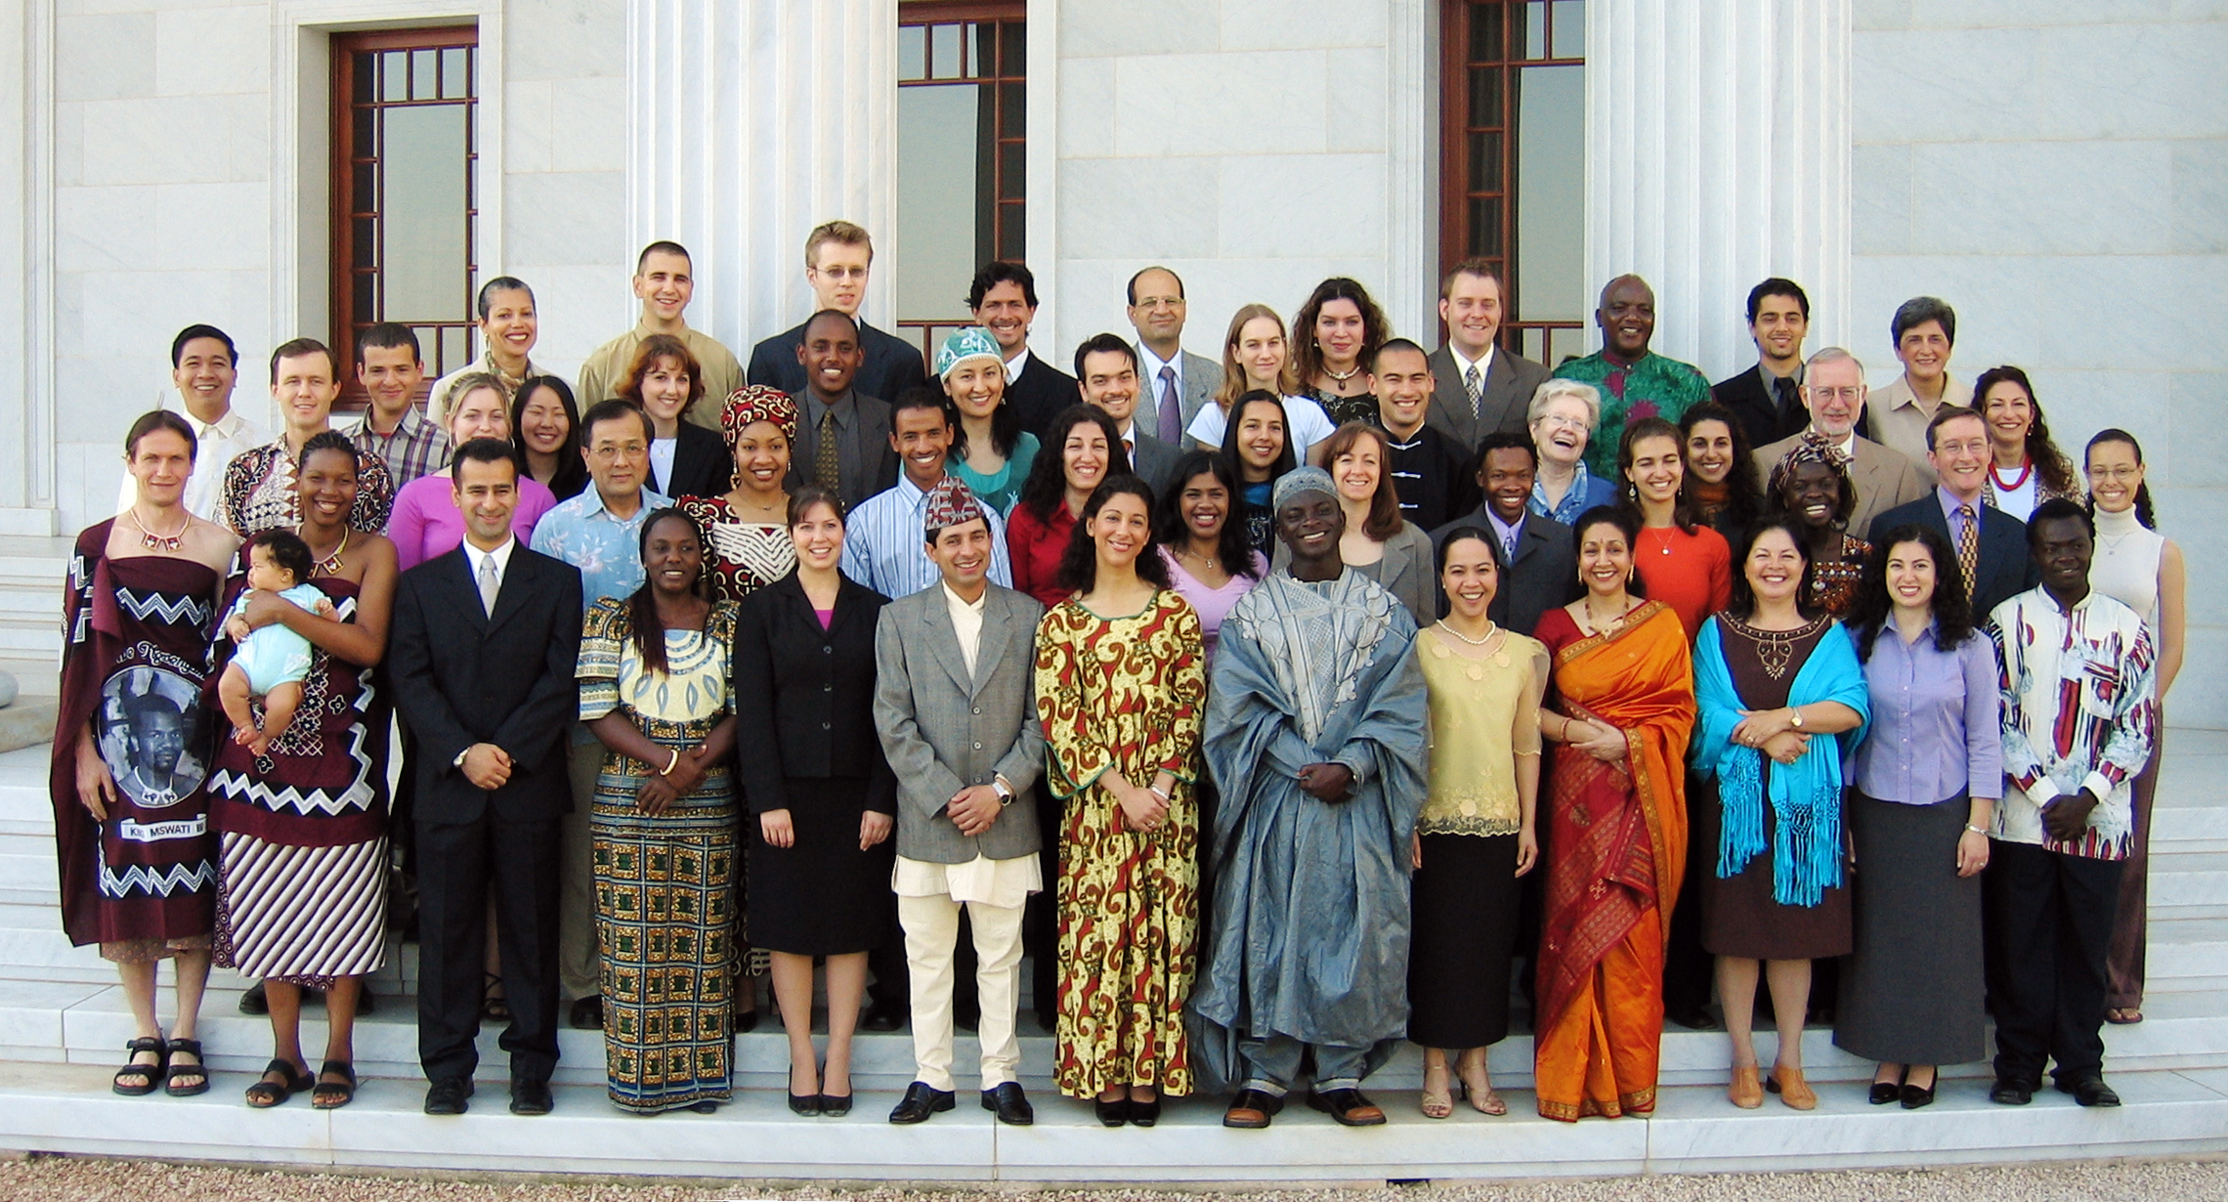
It takes the whole world to do theology

