Slide 1
IT’S THE SONG, NOT THE SINGER (ITSNTS*) THINKING: WHY, WHAT, WHERE
FORD DOOLITTLE
DALHOUSIE UNIVERSITY**
29 OCTOBER 2018
* PRONOUNCED “IT’S NUTS”
** NOT “UNIVERSITY OF DALHOUSIE”

Slide 2
WHY?

Slide 3
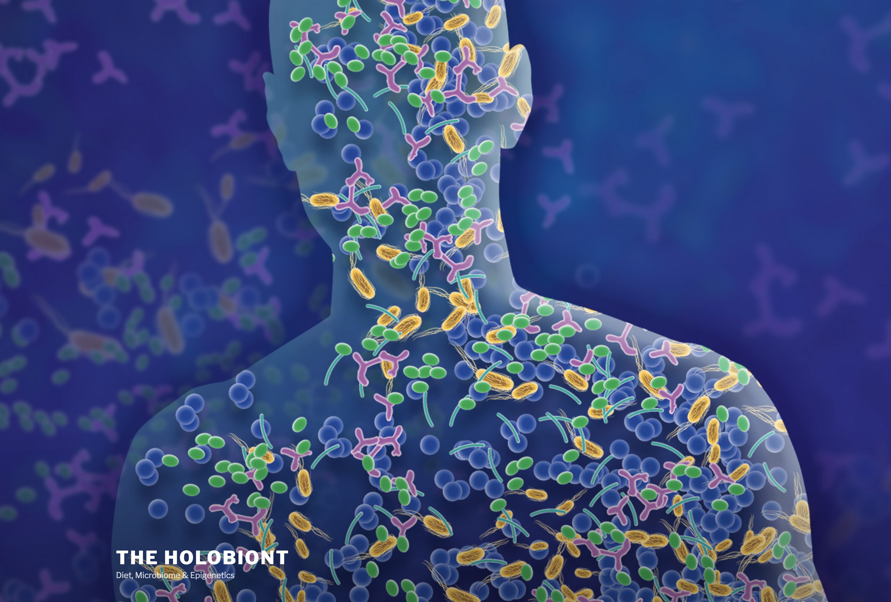
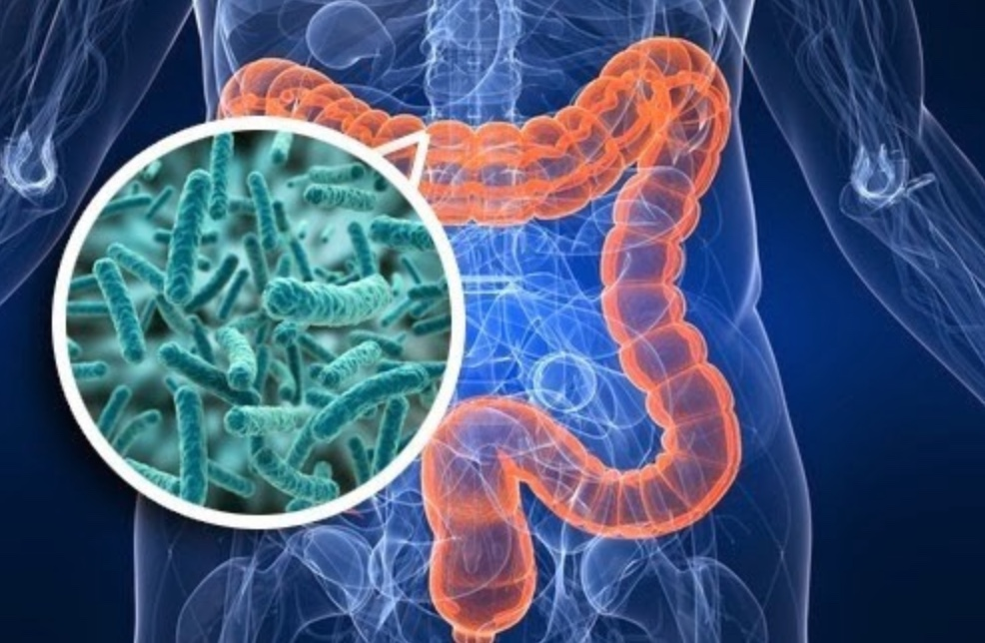
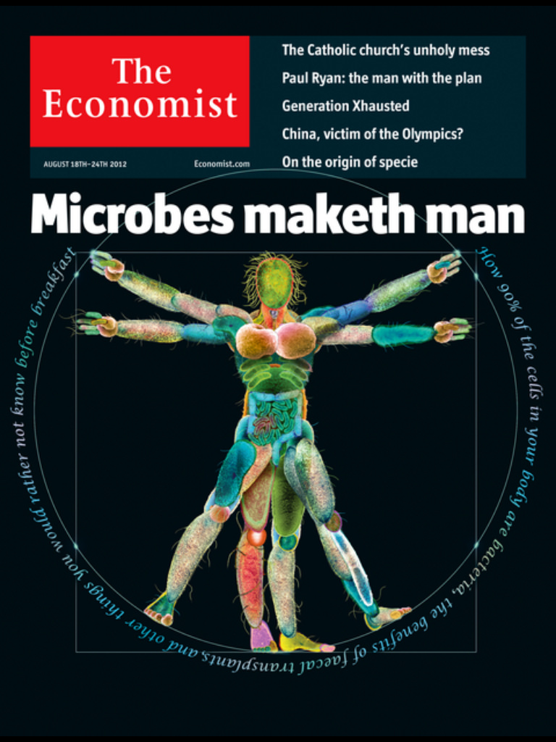
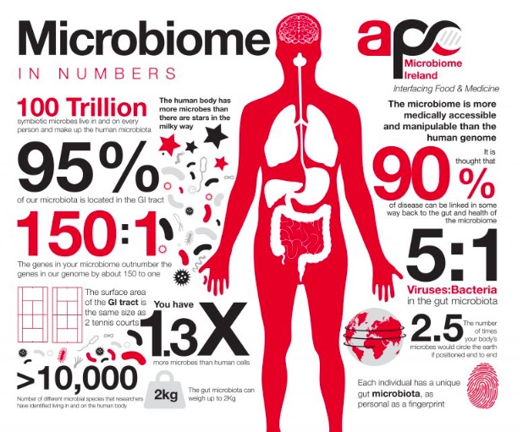
Notes:
No doubt all aware of the hype around this.

Slide 4
microbial
‘‘ … the holobiont, i.e., the host including all symbionts, should be regarded as the unit of selection …’’ (Feldhaar 2011).
‘‘The hologenome theory of evolution considers the dynamic holobiont as a single unit for natural selection … ’’ (Singh et al. 2013).
‘‘Thus, the holobiont, with its integrated community of species, becomes a unit of natural selection …’’ (Gilbert 2014).
‘‘The hologenome concept is a holistic view of genetics in which animals and plants are polygenomic entities. Thus, variation in the hologenome can lead to variation in phenotypes upon which natural selection … can operate’’ (Bordenstein and Theis 2015).
Quotations collected by Derek Skillings (2016)
Notes:
Many have leapt on the bandwagon, including some philosophers, like Marc Ereshefsky.

Slide 5
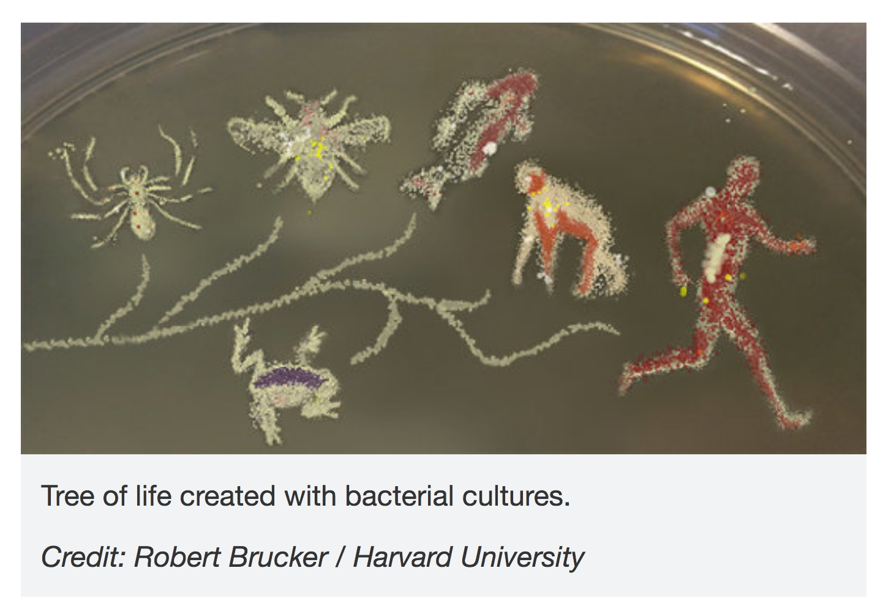
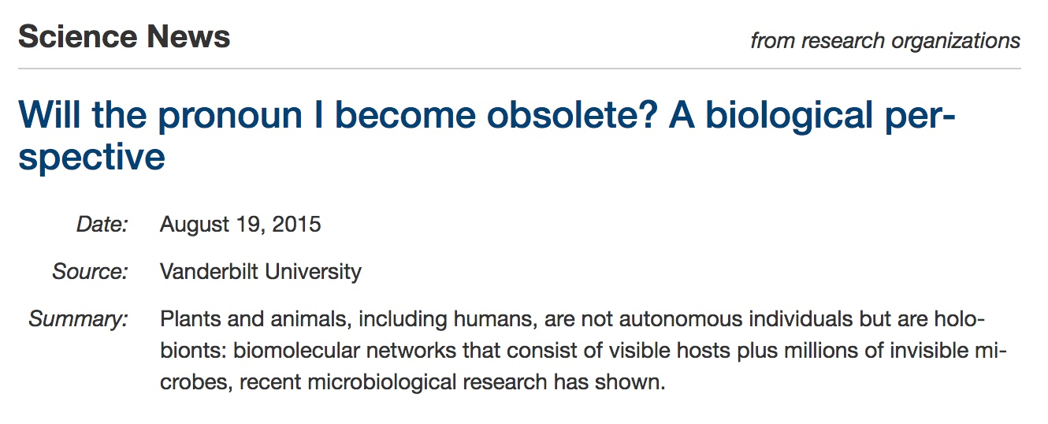

Slide 6
Notes:
Good people have objected to this, and we have proposed a theory which I am about to articulate.

Slide 7
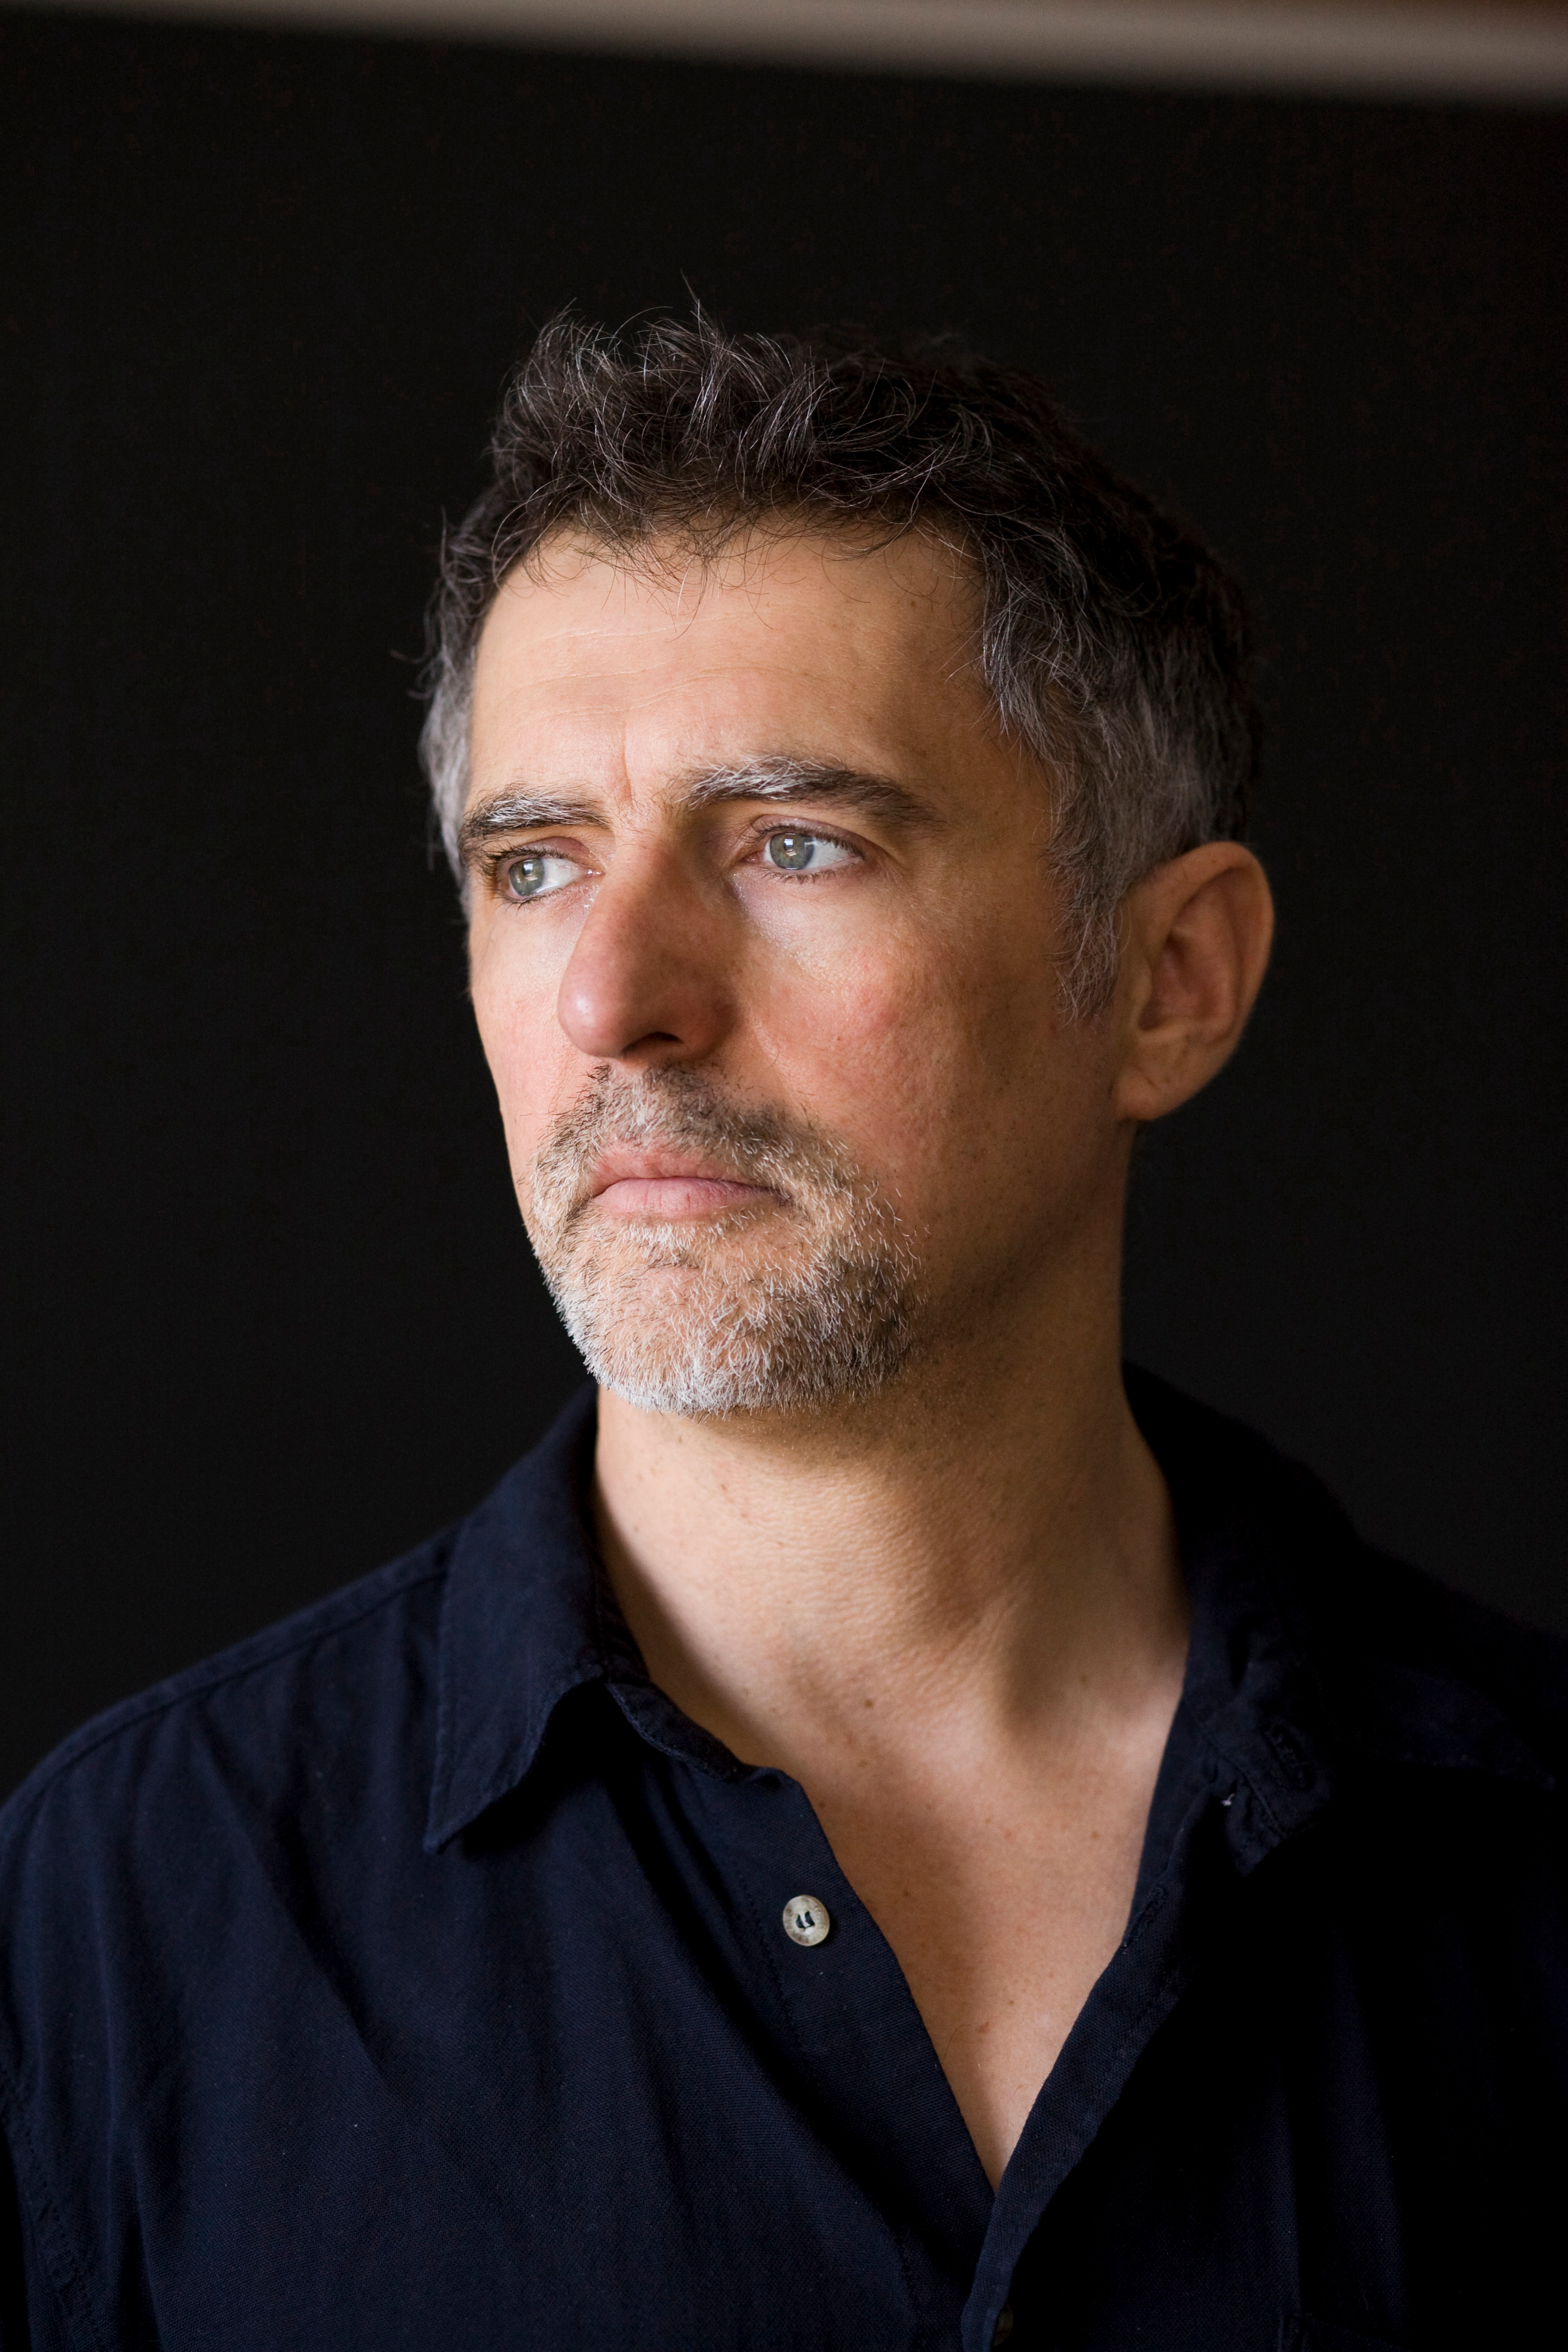
WHY THIS PUSHBACK?
“Evolution by natural selection [ENS] is change in a population owing to variation, heredity and differential reproductive success. … the criteria required are abstract; genes, cells, social groups and species can all, in principle, enter into change of this kind. For any objects to be units of selection in this sense, however, they must be connected by parent–offspring relations; they must have the capacity to reproduce.”
Peter Godfrey-Smith (2012)
Notes:
Presented in this way, evolution by natural selection seems to be about differential reproduction of things. This is spelled out in more detail here by another philosopher, Peter Godfrey-Smith. I will argue that this view, which is the standard one, is too restrictive, but that it can be reconciled with a more generous conception.

Slide 8
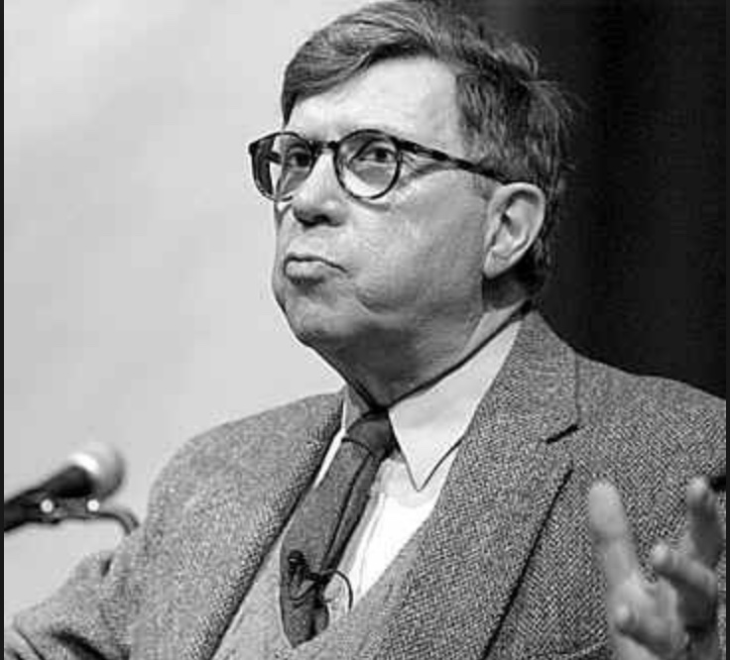
ACCORDING TO LEWONTIN’S RECIPE
“A sufficient mechanism for evolution by natural selection is contained in three propositions.
There is variation (in phenotypic properties) ....
2. The variation is … heritable …
Different variants leave different numbers of offspring
because of their properties (fitness) …
All three conditions are necessary as well as sufficient for evolution by natural selection …”
ENTAILS REPRODUCTION AND
PARENT-OFFSPRING LINEAGES
Richard Lewontin (1985)
Notes:
A process which is understood by the majority of contemporary biologists and philosophers of biology to entail three propositions, here as laid out (with much editing) by Richard Lewontin.

Slide 9
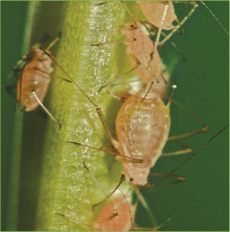
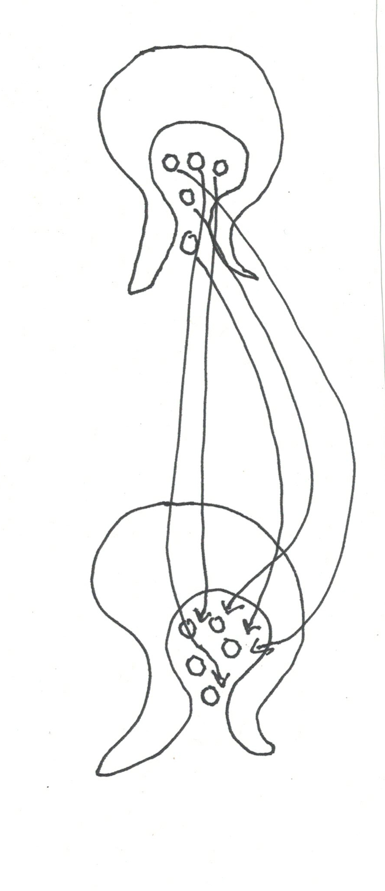
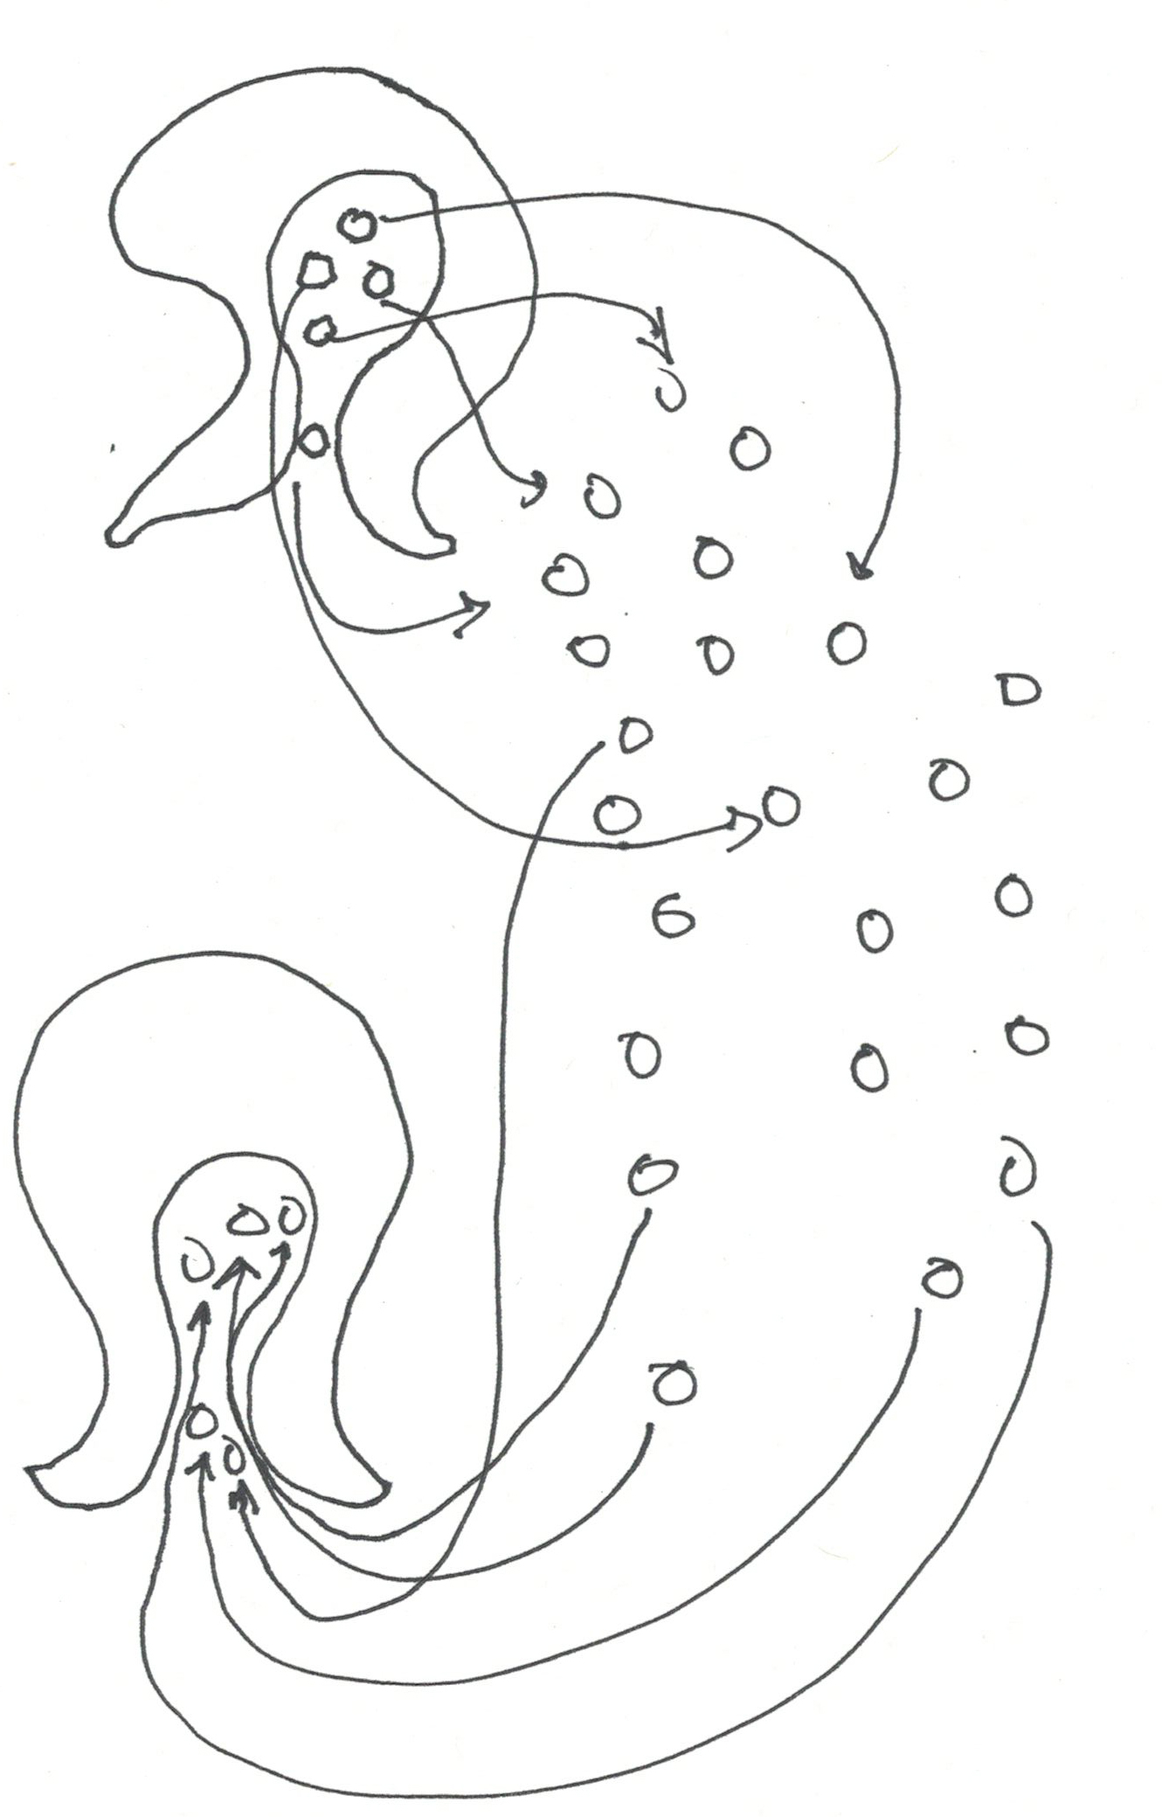
VERTICAL HORIZONTAL
INHERITANCE INHERITANCE
(RECRUITMENT)
old symbionts
APHID -
BUCHNERA
HUMAN -
GUT MICROBES
host parent
host parent
symbiont parents
discarded
symbionts
enormous environmental pool
host offspring
host offspring
new symbionts
recruited from environment
symbiont offspring
HAS CAPACITY TO REPRODUCE AS A
SINGLE UNIT OF SELECTION.
PARENT-OFFSPRING RELATIONS
READILY DEFINED.
LACKS CAPACITY TO REPRODUCE AS A SINGLE UNIT OF SELECTION.
PARENT-OFFSPRING RELATIONS
NOT READILY DEFINED.
Notes:
What we particularly object to is the notion of holbionts being a “unit of selection”. Sometimes they are, but sometimes not, as on this slide. There is no hologenome in this case, and though species may co-evolve to their mutual benefit, there is no sense in which the host and its symbionts comprise a single unit evolving under selection. ENS is generally thought to involve differential replication, and in this case, replication of the partners is disconnected. The host might be a unit of selection and the symbiont might be, but together they do not comprise a new and higher unit of selection.

Slide 10
VERTICAL HORIZONTAL
INHERITANCE INHERITANCE
(RECRUITMENT)
old symbionts
APHID -
BUCHNERA
HUMAN -
GUT MICROBES
host parent
host parent
symbiont parents
discarded
symbionts
enormous environmental pool
SYMBIONTS AND HOSTS MAY CO-EVOLVE AS SPECIES (EACH USING THE OTHER AS ITS ‘ENVIRONMENT’). BUT AN INDIVIDUAL HOST AND ITS SYMBIONTS DO NOT COMPRISE A UNIT OF SELECTION, BECAUSE THEY LACK THE CAPACITY TO REPRODUCE AS A UNIT.
host offspring
host offspring
new symbionts
recruited from environment
symbiont offspring
HAS CAPACITY TO REPRODUCE AS A
SINGLE UNIT OF SELECTION.
PARENT-OFFSPRING RELATIONS
READILY DEFINED.
LACKS CAPACITY TO REPRODUCE AS A SINGLE UNIT OF SELECTION.
PARENT-OFFSPRING RELATIONS
NOT READILY DEFINED.
Notes:
What we particularly object to is the notion of holbionts being a “unit of selection”. Sometimes they are, but sometimes not, as on this slide. There is no hologenome in this case, and though species may co-evolve to their mutual benefit, there is no sense in which the host and its symbionts comprise a single unit evolving under selection. ENS is generally thought to involve differential replication, and in this case, replication of the partners is disconnected. The host might be a unit of selection and the symbiont might be, but together they do not comprise a new and higher unit of selection.

Slide 11
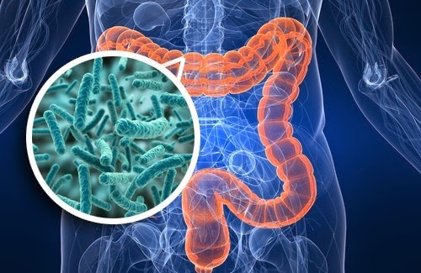
BUT STILL , COLLECTIVE METABOLISM (“FUNCTION”) SEEMS MORE STABLE (CONSERVED) THAN IS TAXONOMY.
“This conservation suggests a high degree of redundancy in the gut microbiome and supports an ecological view of each individual as an ‘island’ inhabited by unique collections of microbial phylotypes: as in actual islands, different species assemblages converge on shared core functions provided by distinctive components.”
Turnbaugh et al. (2009)
Lozupone et al. (2102)
Notes:
This has long been known. Quote from Turnbaugh et al, more recent figure from Human Microbiome Project.

Slide 12
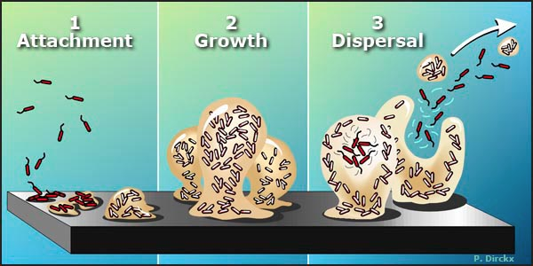
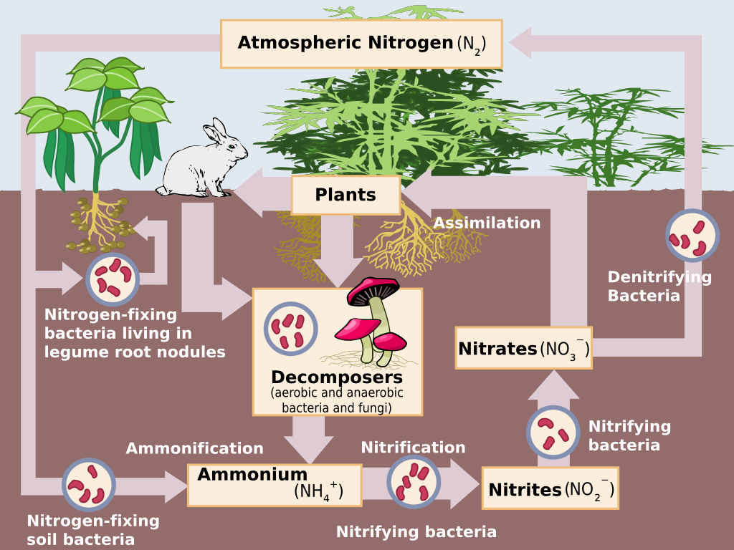
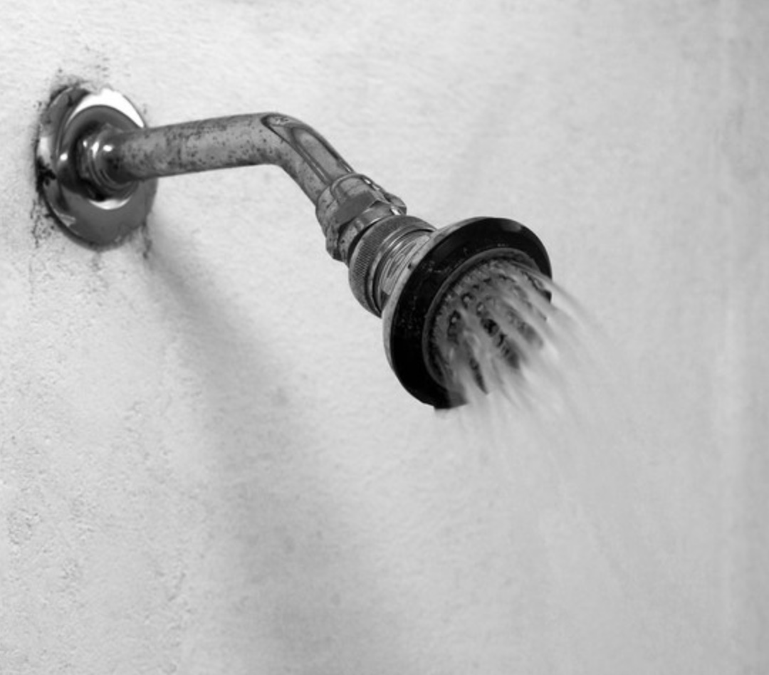
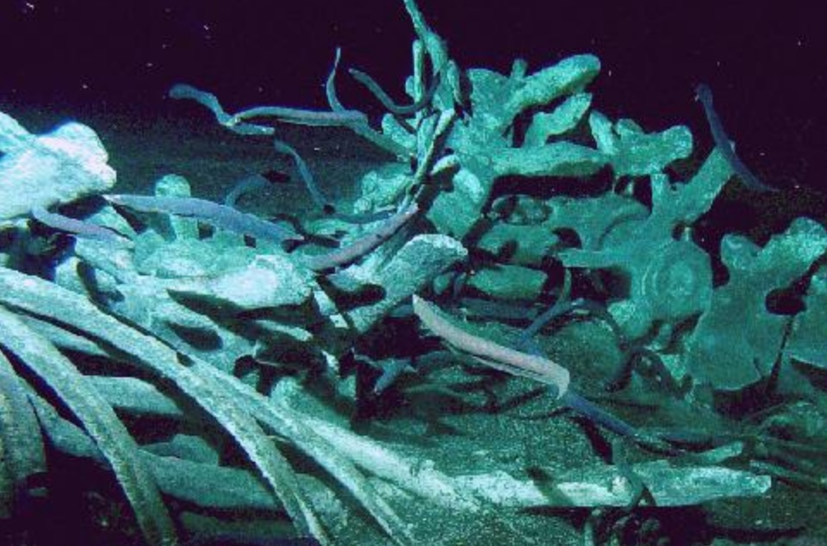
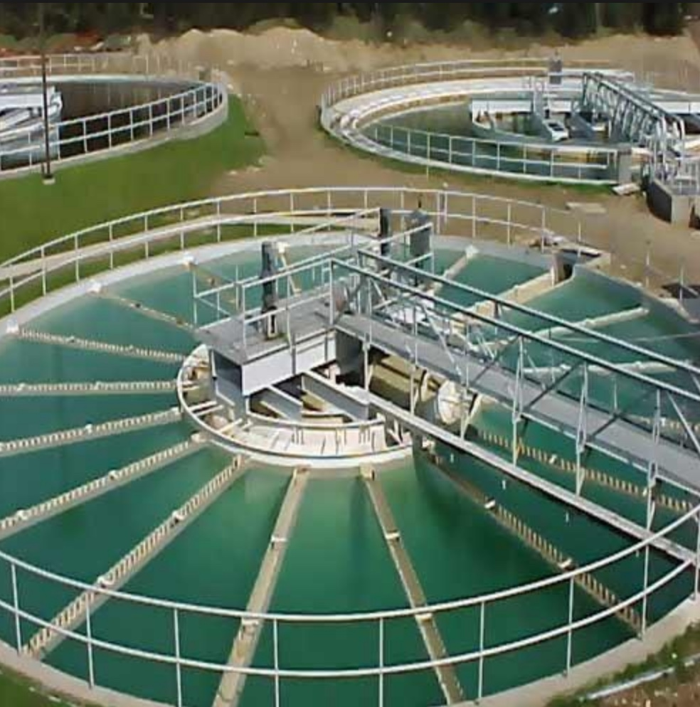
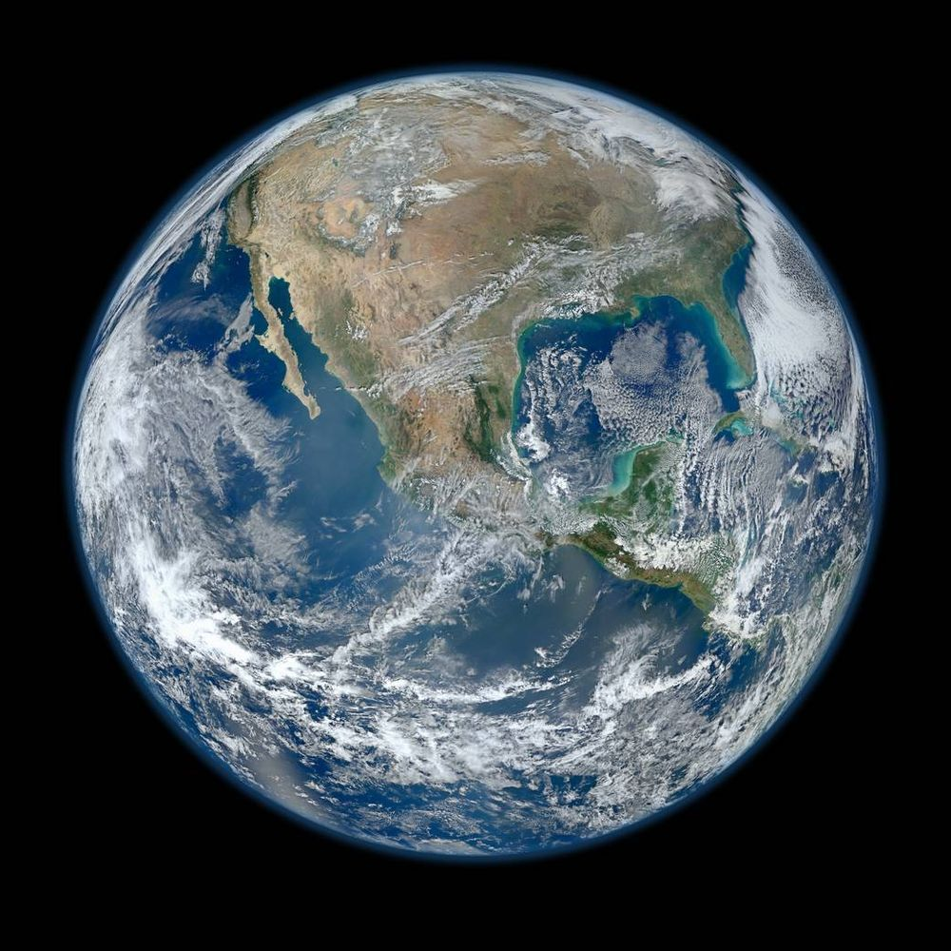
AND THIS IS TRUE FOR MANY SORTS OF MICROBIAL COMMUNITIES, NOT JUST THOSE THAT ARE PARTS OF “HOLOBIONTS”.

Slide 13

HOW COULD THIS BE?
If the individual organisms or taxa (the singers) involved do not collectively comprise a single unit of selection, and yet the pattern of “functional” (aka metabolic) interactions between them (the song) remains more-or-less the same (possibly evolving over time), then just maybe …
It’s actually the interaction pattern itself (the song), and not the singers, that should be considered the unit of selection, and as the bearer of function. (Thing ontology → process ontology)
Notes:
I think yes, and its called “It’s the song, not the singer”, or ITSNTS or “It’s nuts!” theory, which is based on this philosophical move [READ] …

Slide 14
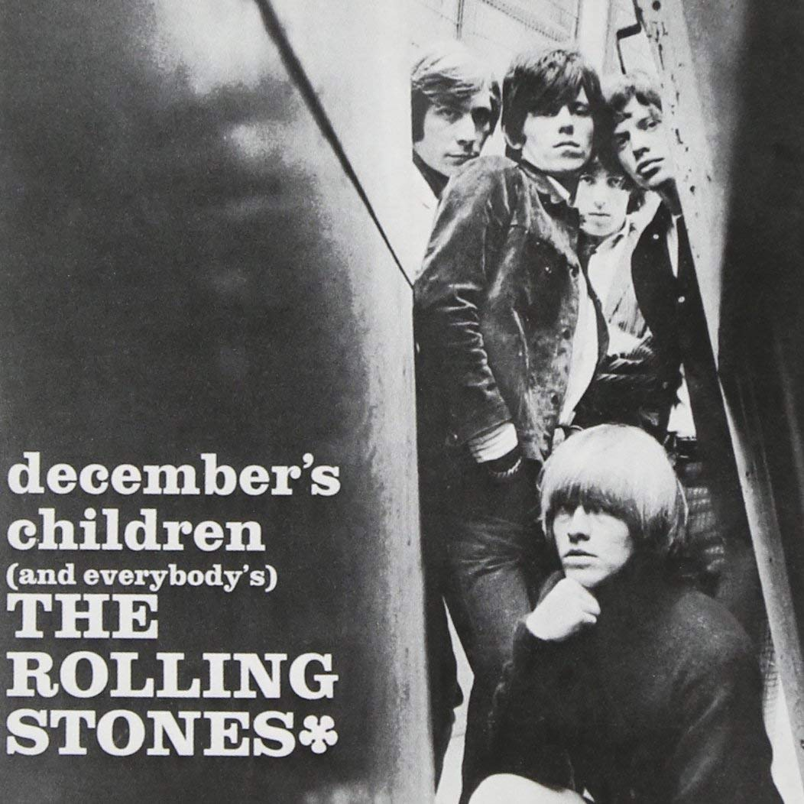
Everywhere you want I always go
I always give in because, babe, you know
You just say so cause you give me that
Feeling inside that I know must be right
It's the singer not the song
It's not the way you give in willingly
Others do it without thrilling me
Giving me that same old feeling inside that I
Know I must be right
It's the singer not the song
The same old places and the same old songs
We've been going there for much too long
There's something wrong and it gives me that feeling
Inside that I know I must be right
It's the singer not the song
It's the singer not the song
It's the singer not the song
1965

Slide 15
THE TAXA ARE THE SINGERS AND THEIR COLLECTIVE METABOLISM IS THE SONG.
“This conservation suggests a high degree of redundancy in the gut microbiome and supports an ecological view of each individual as an ‘island’ inhabited by unique collections of microbial phylotypes: as in actual islands, different species assemblages converge on shared core functions provided by distinctive components.”
Turnbaugh et al. (2009)
SINGERS SONGS
Lozupone et al. (2102)
Notes:
This has long been known. Quote from Turnbaugh et al, more recent figure from Human Microbiome Project.

Slide 16
WHAT?
(IS ITSNTS)

Slide 17
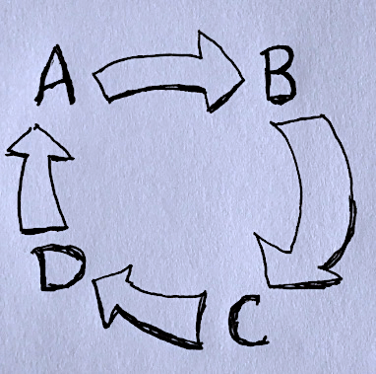
Microbial neopleomorphism.
Biol Philos 28: 351-378 (2013)
It’s the song, not the singer: an exploration of holobiosis and evolutionary theory. (With Austin Booth). Biol Philos 32: 5-24 (2017)
Processes and patterns of interaction as units of selection: an introduction to ITSNTS thinking. (With Andrew Inkpen). Proc Natl Acad Sci USA 115: 4006-4014 (2018)
SINGERS
SINGERS
SONG
SINGERS
SINGERS
A CYCLE OR OTHER INTERACTION PATTERN. ARROWS ARE SUCCESIVE STEPS PRODUCING INTERMEDIATES A, B, C AND D.
EACH STEP MAY BE CATALYZED BY ANY MEMBER OF A GUILD OF TAXA WITH THE ABILITY TO PERFORM THAT SPECIFIC STEP. NO TAXON PERFORMS ALL STEPS.
Notes:
So this idea has been developed in three papers. AND WHAT THE SYMBOL ON THE RIGHT IS IS [READ]

Slide 18
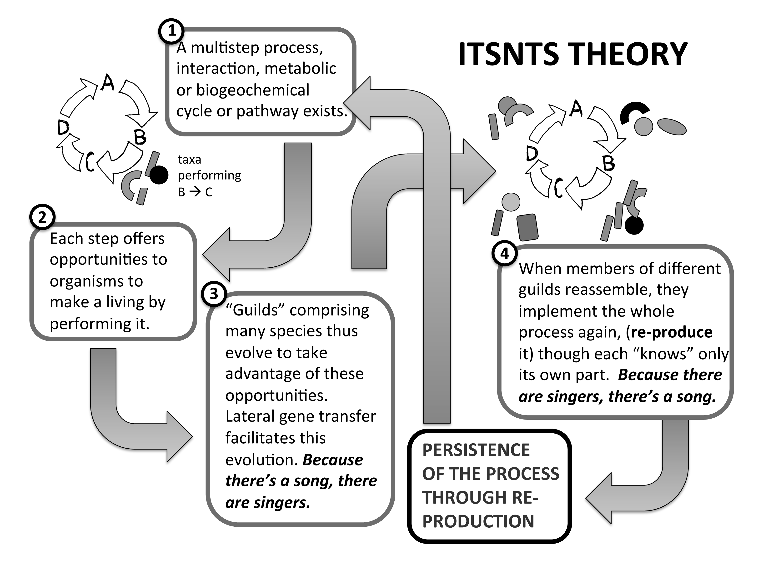
ITSNTS THEORY
ITSNTS TO THE RESCUE
*
* Persistence through producing again: re-producing but not reproducing.
(Thus no parent-offspring relationships.)
Notes:
EXPLAIN

Slide 19
“Evolution by natural selection [ENS] is change in a population owing to variation, heredity and differential reproductive success. … the criteria required are abstract; genes, cells, social groups and species can all, in principle, enter into change of this kind. For any objects to be units of selection in this sense, however, they must be connected by parent–offspring relations; they must have the capacity to reproduce.”
ITSNTS THINKING REQUIRES THAT WE RELAX THIS REQUIREMENT FOR ENS, REPLACING DIFFERENTIAL REPRODUCTION WITH DIFFERENTIAL RE-PRODUCTION (AKA PERSISTENCE) AND NOT REQUIRING PARENT-OFFSPRING LINEAGES.
Peter Godfrey-Smith (2012)
Notes:
Presented in this way, evolution by natural selection seems to be about differential reproduction of things. This is spelled out in more detail here by another philosopher, Peter Godfrey-Smith. I will argue that this view, which is the standard one, is too restrictive, but that it can be reconciled with a more generous conception.

Slide 20
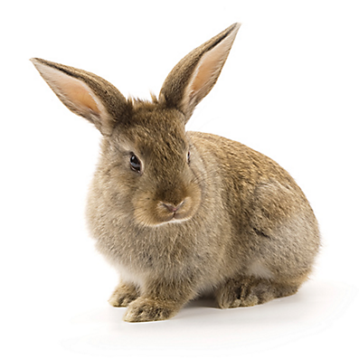
REPRODUCTION
PARENT-OFFSPRING LINEAGES CLEARLY TRACEABLE, WITH PARENT-OFFSPRING RESEMBLANCE (HEREDITY), MATERIAL OVERLAP. LEWONTIN’S RECIPE WORKS.
RE-PRODUCTION
PARENT-OFFSPRING RELATIONS COMPLEX AND UNTRACEABLE, VANISHING RESEMBLANCE, SINGERS DISPERSED IN SPACE AND TIME. STANDARD LEWONTIN RECIPE FAILS, AND YET THE SONG PERSISTS.
Notes:
So I’ve substituted re-production (with a hyphen) for reproduction, as well as rewriting Lewontin’s recipe to allow persistence.

Slide 21
REWRITING LEWONTIN’S RECIPE
SELECTED ENTITIES SELECTED ENTITIES
TOTAL ENTITIES TOTAL ENTITIES
IT IS SUFFICIENT AND NECESSARY FOR EVOLUTION BY NATURAL SELECTION THAT THIS RATIO INCREASES. INCREASE CAN OCCUR EITHER BY:
1. INCREASE IN THE NUMERATOR (AS IN DIFFERENTIAL
REPRODUCTION*), OR
2. DECREASE IN THE DENOMINATOR (AS IN DIFFERENTIAL
PERSISTENCE).
PROPERTIES OF SELECTED ENTITIES LEADING TO SUCH A RESULT ARE ADAPTATIONS, THEIR SELECTED EFFECTS FUNCTIONS.
- - - - - - - - - - - - - - - - - - - - - - - - - - - - - - - - - - - - - - - - - - - - - - - - - - - - - - - - - - - - - - - *WITH OR WITHOUT RESOURCES CONSTRAINING POPULATION SIZE
Notes:
So, I’ve rewritten Lewontin’s recipe, as follows … You have to accept this to accept what follows, PROBABLY.

Slide 22
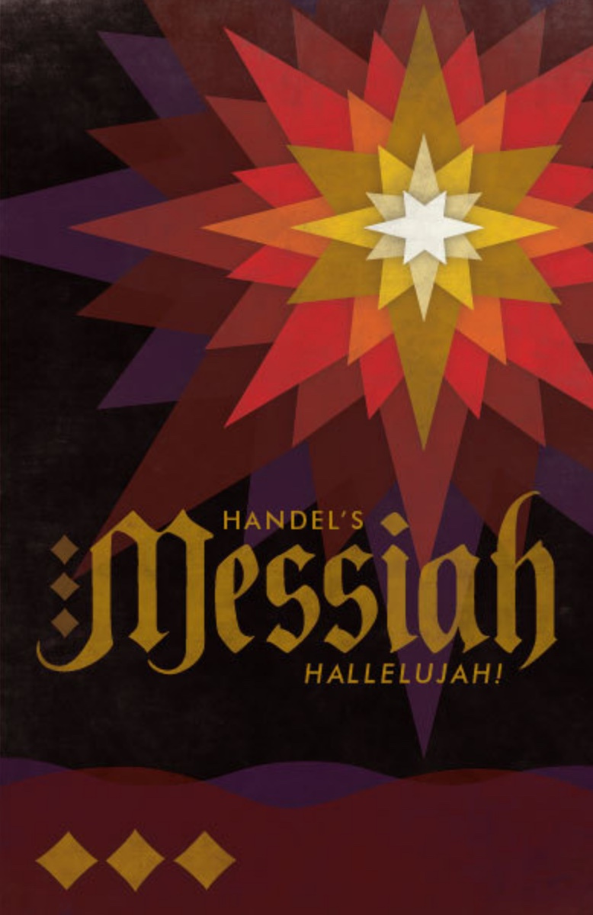
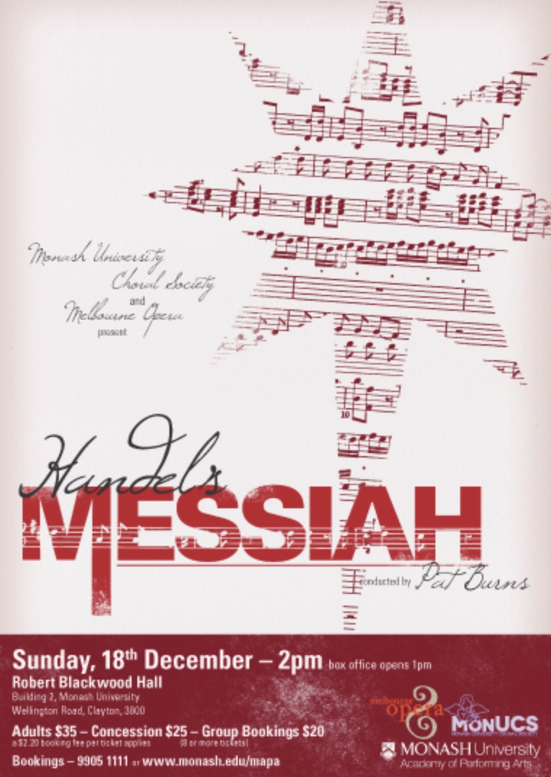
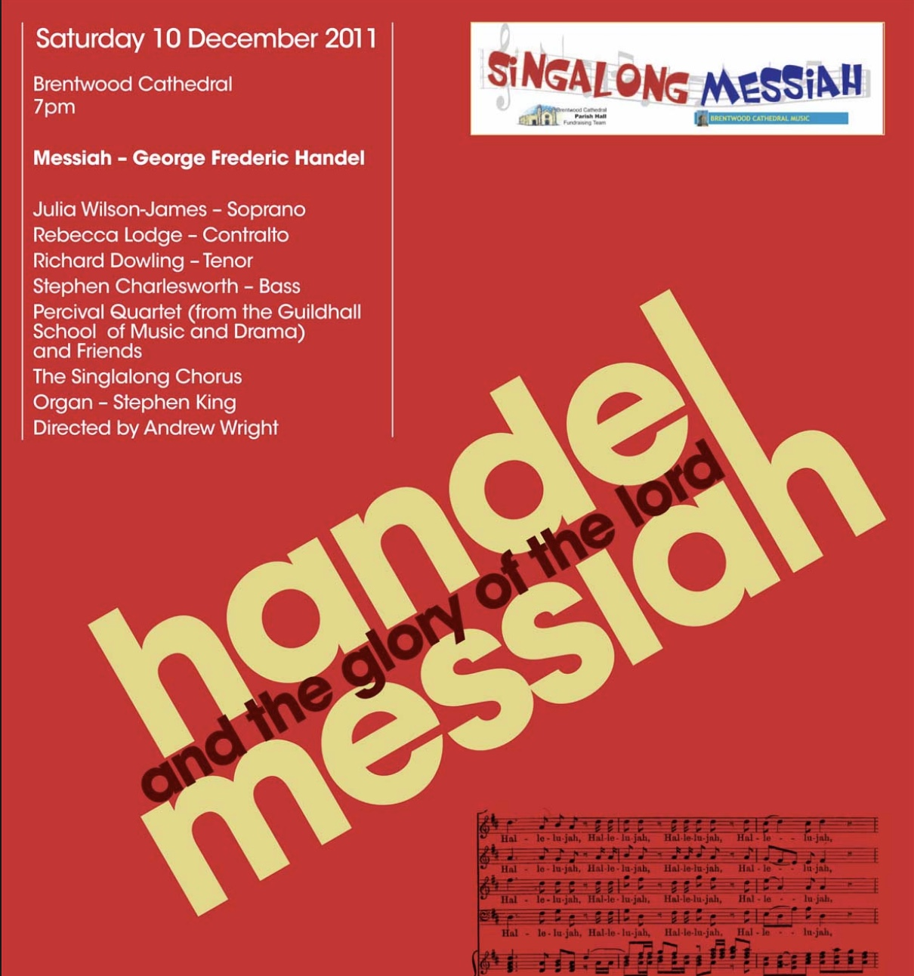
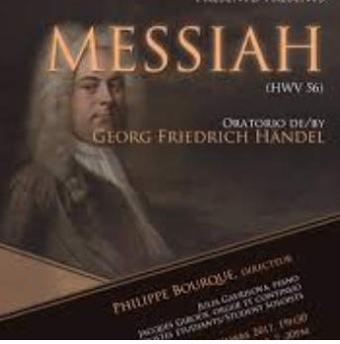
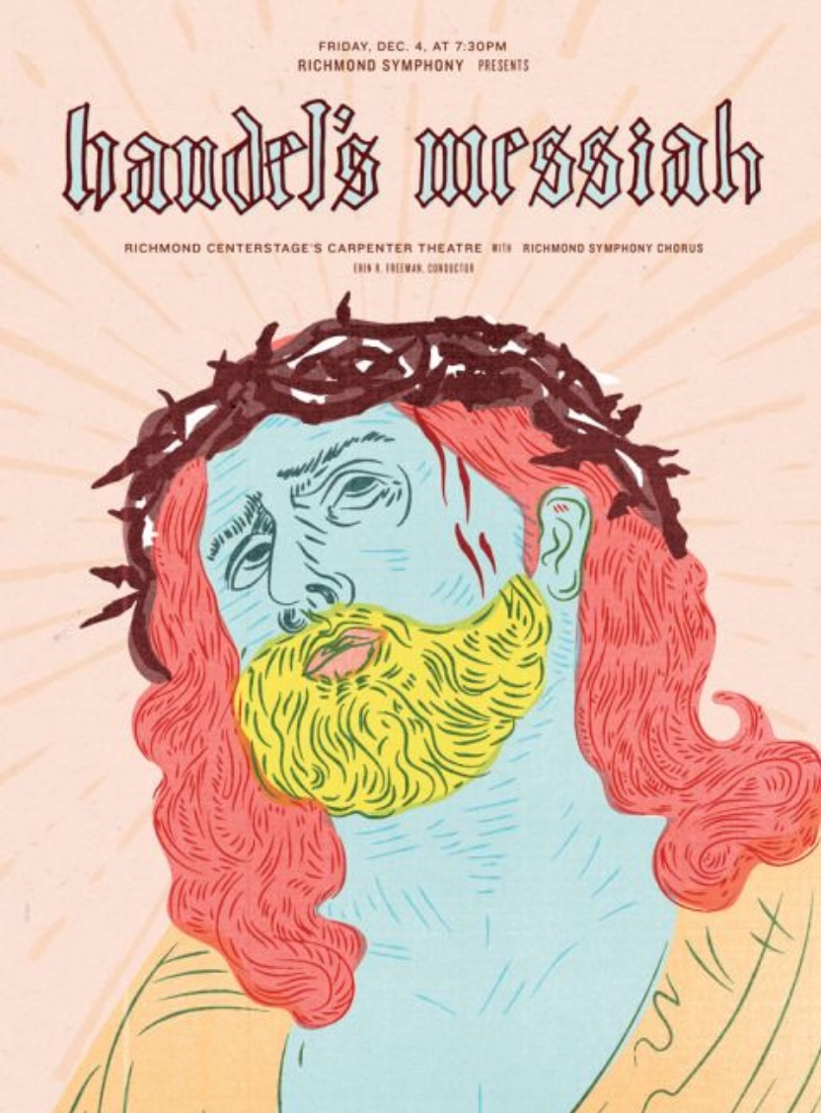
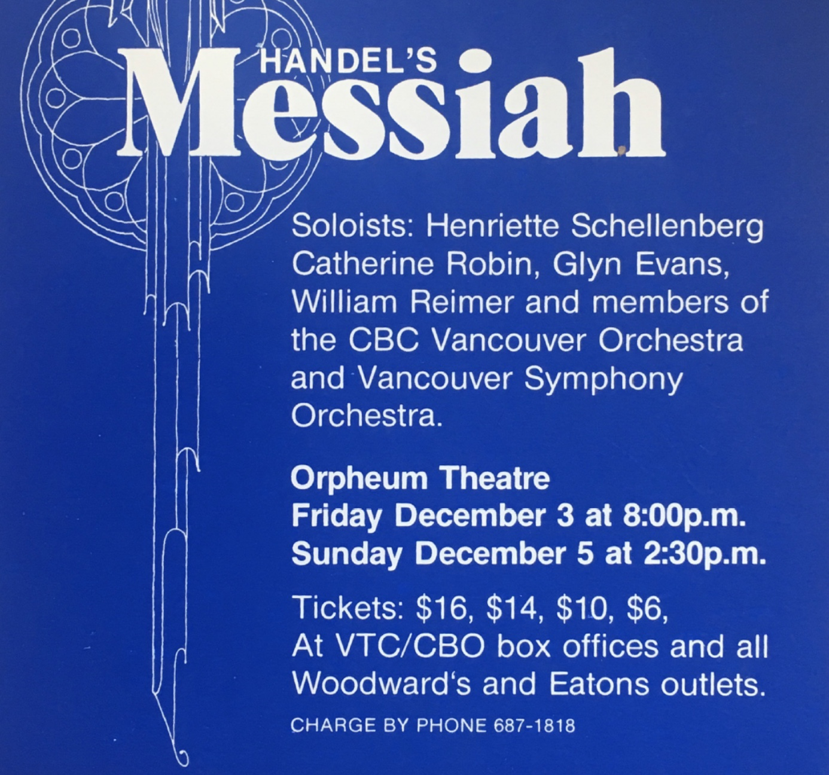
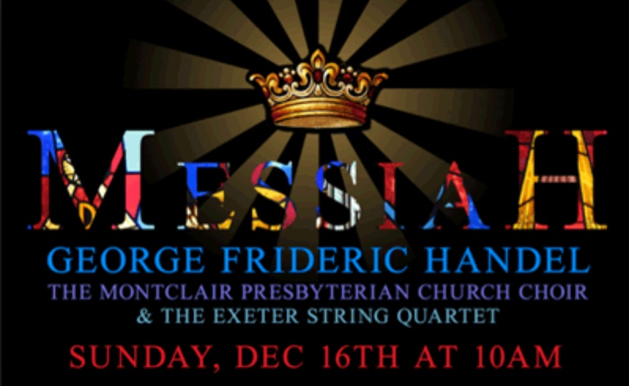
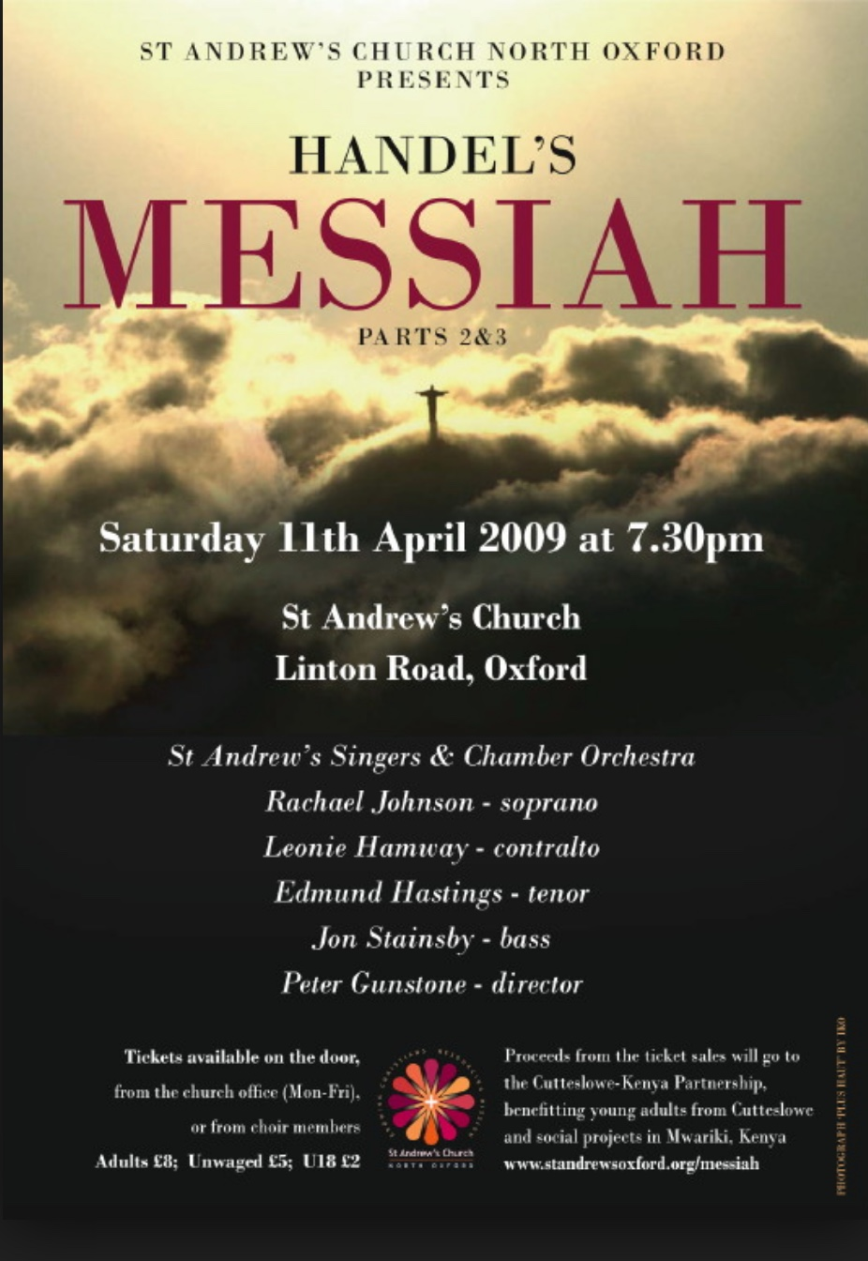
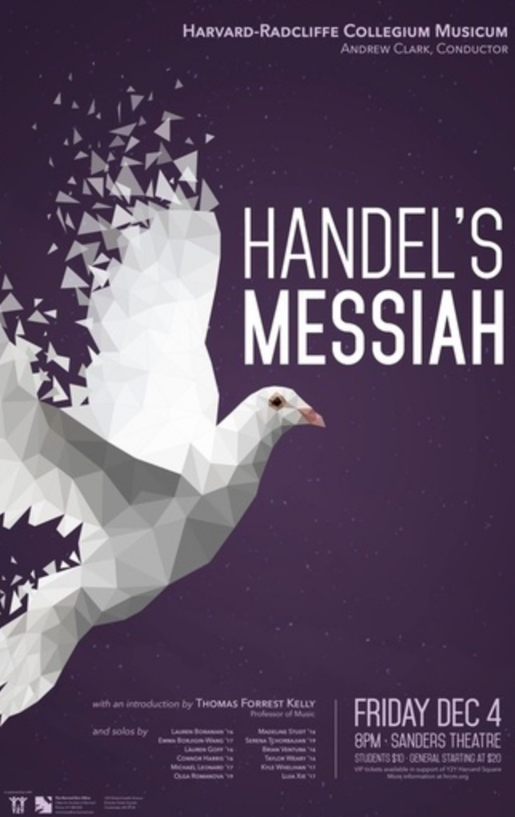
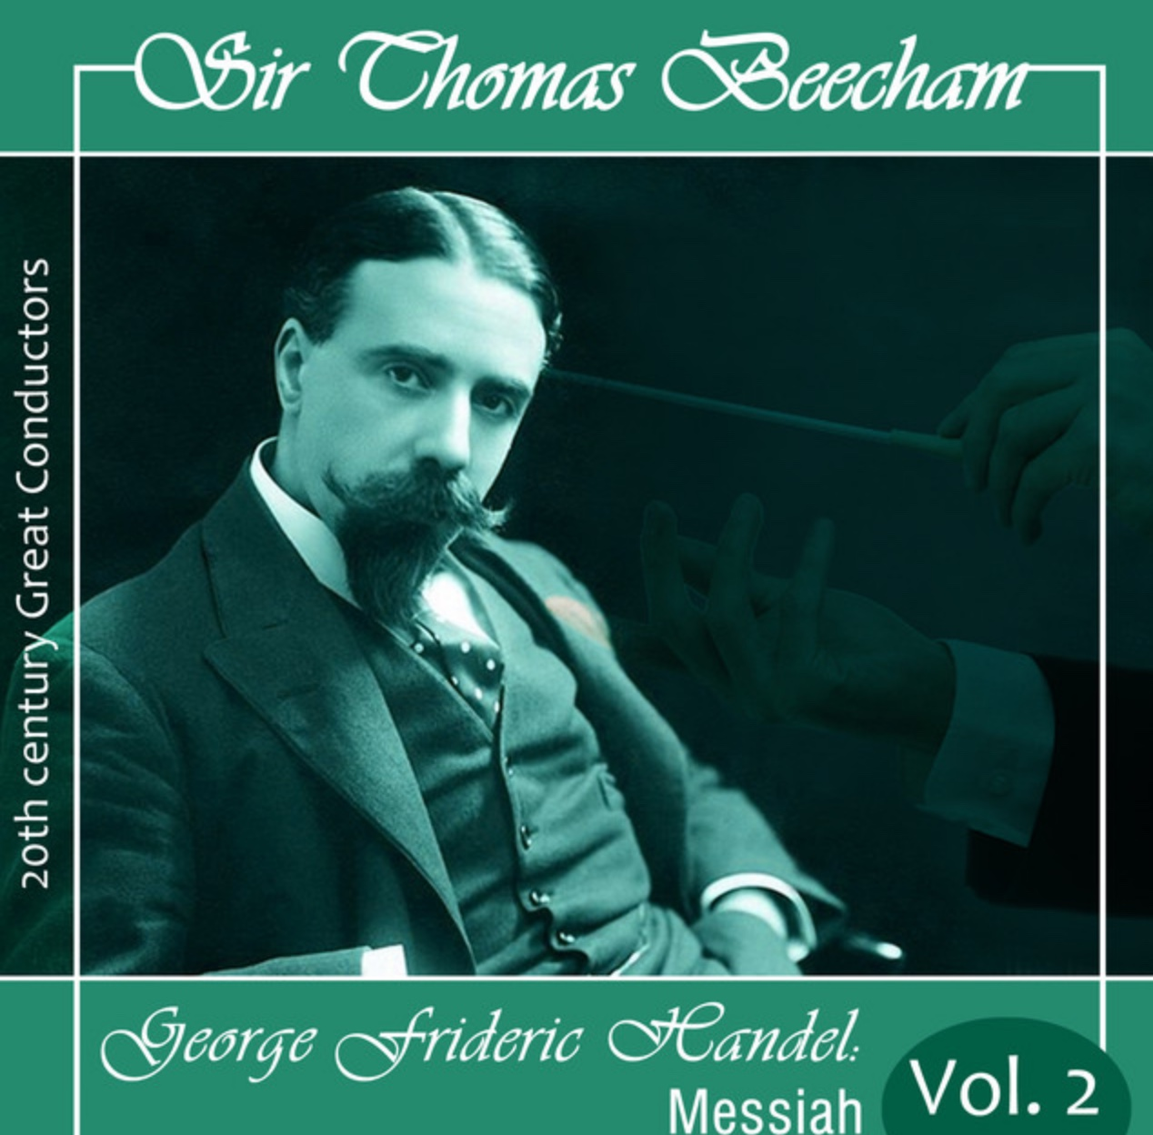
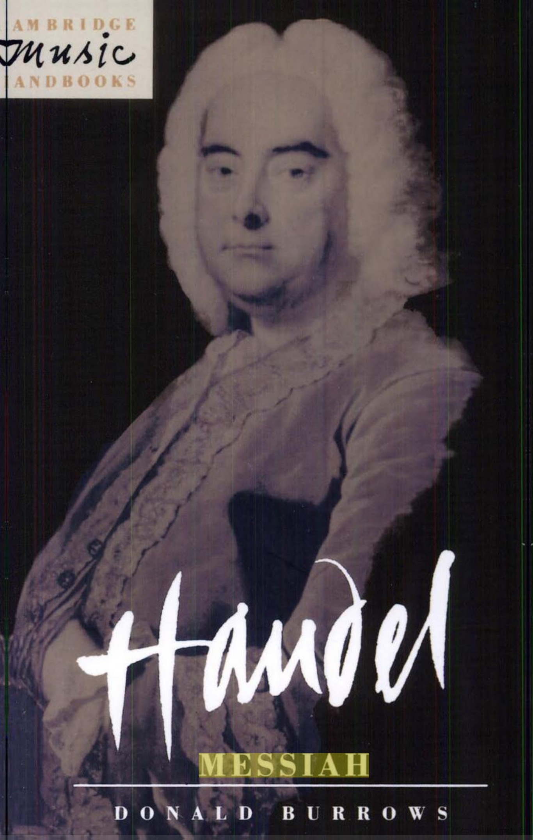

WHAT ITSNTS IS
MEMETICS RE-BIOLOGIZED
PERSISTENCE WITH CHANGE OVER TIME

Slide 23
HANDEL’S MESSIAH
AS A TYPE
EACH PERFORMANCE AS A TOKEN

Slide 24
WHAT ITSNTS IS NOT
• PURELY PROCESSURAL
“Whenever what is remarkable about a biological or cultural phenomenon is the persistence of a process or pattern of interactions (a song) that can be carried out by a variety of cooperating entities (singers), each of these having evolved because individual participation has (as in standard ENS) favored its differential reproduction, that is ITSNTS.”
PROCESS
THINGS*
METABOLIC
IMPLEMENTATION
EVOLUTIONARY
RECRUITMENT
* As commonly understood.

Slide 25
WHAT ITSNTS IS NOT
• PURELY PROCESSURAL
• ANOTHER MAJOR TRANSITION, OR
ANOTHER LEVEL IN THE HIERARCHY OF LIFE
ECOSYSTEMS
SPECIES
POPULATIONS
MULTICELLULAR ORGANISMS
CELLS
GENES
SONGS ARE NOT
MADE UP OF
SINGERS.
MOREOVER,
THERE ARE
SELECTABLE
PROCESSES AT
EACH LEVEL.

Slide 26
ECOSYSTEMS
SPECIES
POPULATIONS
MULTICELLULAR ORGANISMS
CELLS
GENES
Medina et al. (2016)

Slide 27
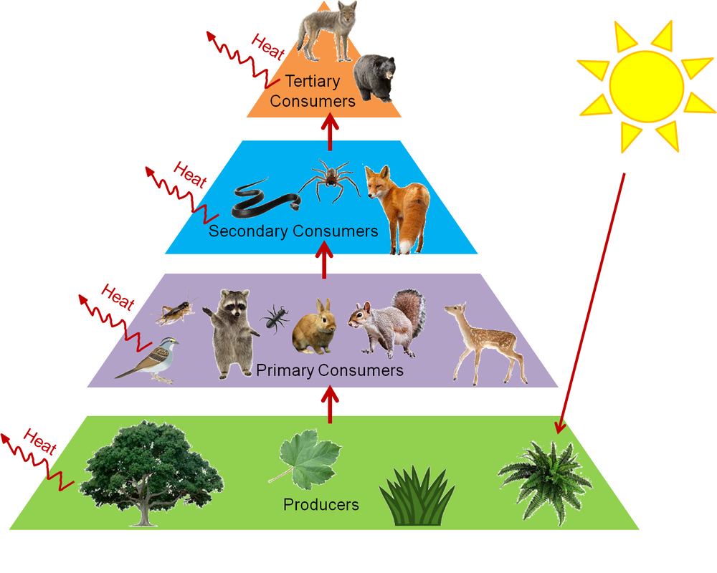
ECOSYSTEMS
SPECIES
POPULATIONS
MULTICELLULAR ORGANISMS
CELLS
GENES
Medina et al. (2016)

Slide 28
THE BIOSPHERE
ECOSYTEMS
SPECIES
POPULATIONS
MULTICELLULAR ORGANISMS
CELLS
GENES
Medina et al. (2016)

Slide 29
NITROGEN CYCLE AS EXAMPLE*
* proximity in time and space not required
Notes:
Obvious example

Slide 31
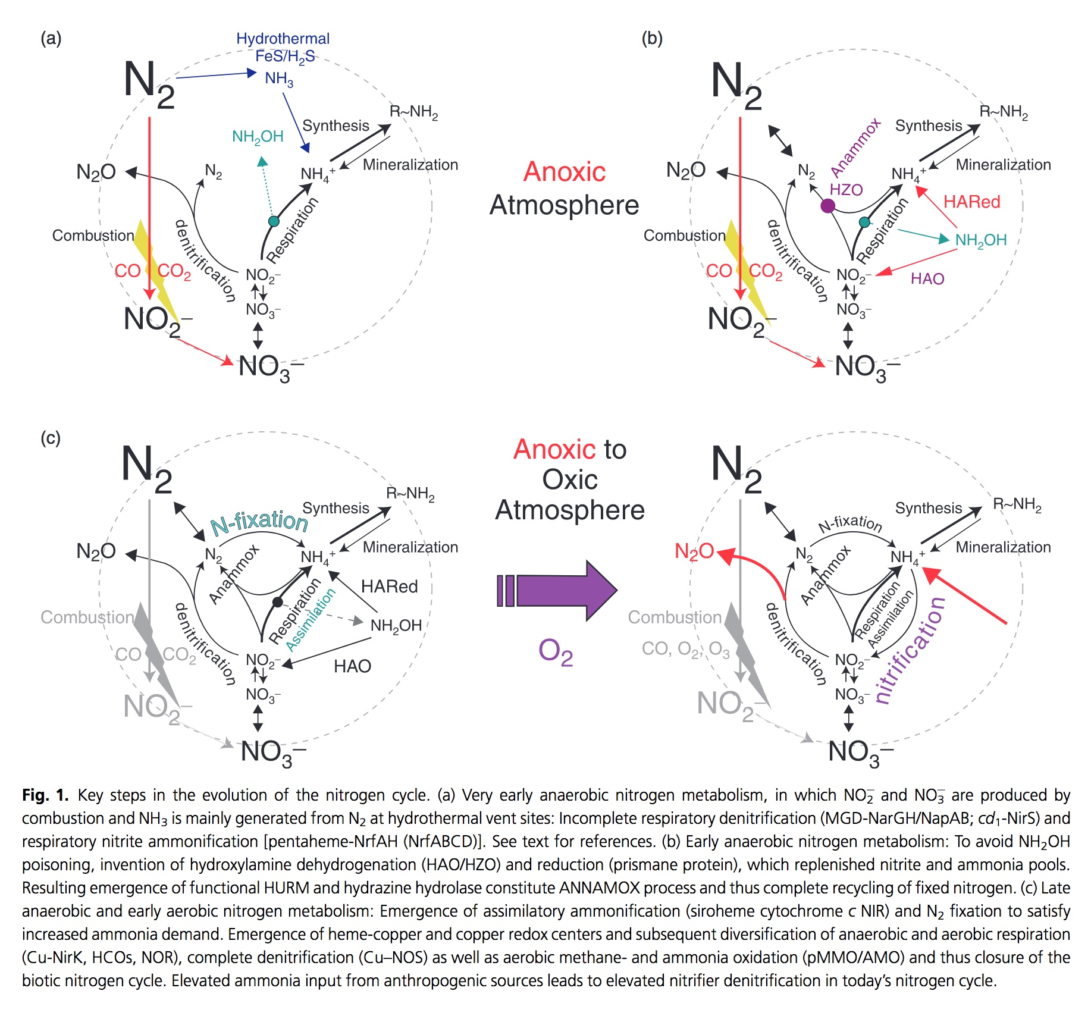
Klotz and Stein (2007)

Slide 32
WHERE?

Slide 33
WHERE?
(ARE WE GOING
WITH ITSNTS THINKING?)

Slide 34
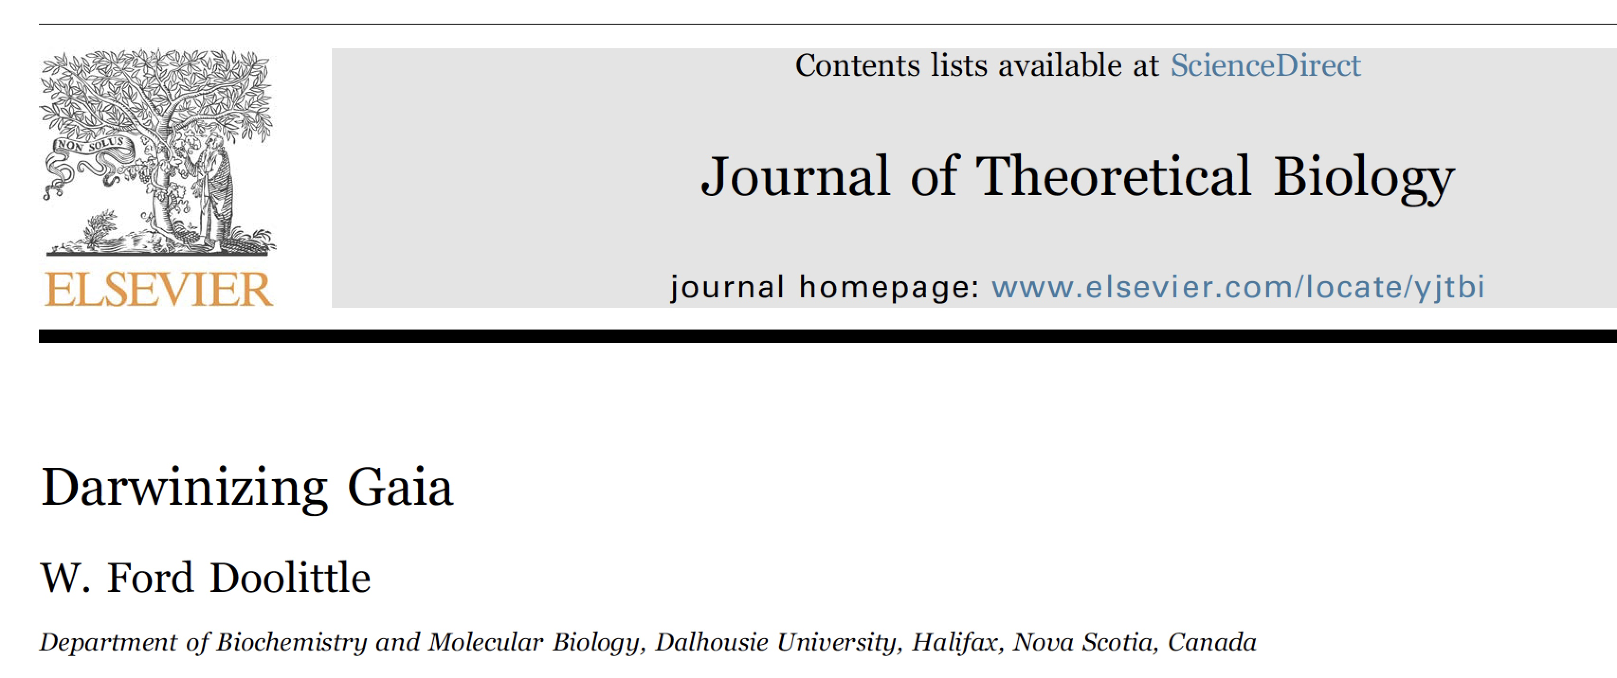
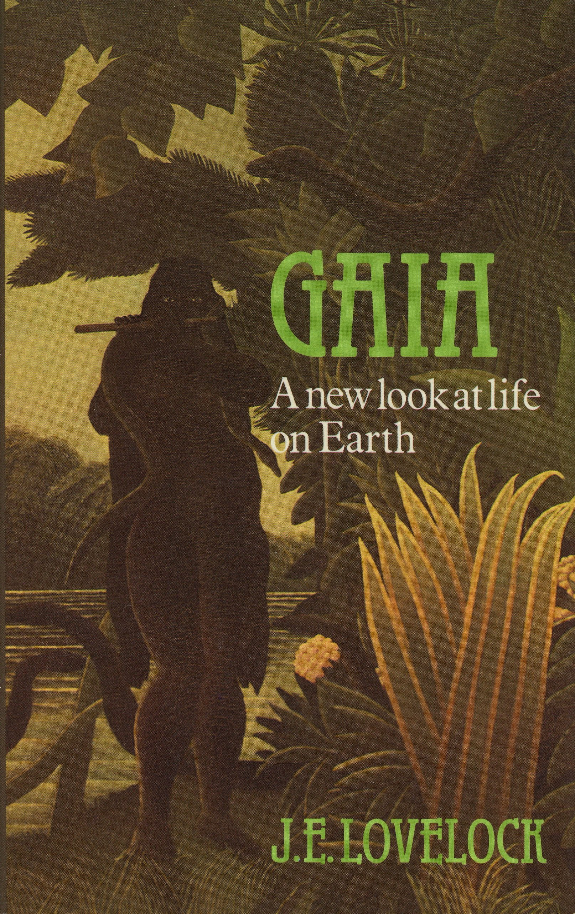
“… the largest living creature
on Earth”.
Lynn Margulis
James Lovelock

Slide 35
“… no serious student of evolution would suggest that natural selection could favor the development in one species of a behavior pattern which is beneficial to another … if this behavior were either detrimental or of no selective value to the species itself.
… selective pressure against irresponsible behavior will not be felt for thousands or millions of years, during which time irresponsible mutants, which may well have a temporary selective advantage, would have replaced all responsible members of the species.
I do not doubt that some of the feedback loops which Lovelock claims exist do exist, but I do doubt that they were caused by natural selection, or that they are anything but accidental.”
Doolittle (1980)
Notes:
Actually, I scooped Dawkins, though, saying, two years earlier in a piece in a hippy journal called the CoEvolution Quarterly, which Lynn Margulis helped me get into, the following three things … And several other more prominent evolutionary biologists, including my hero John Maynard Smith, had similar complaints …

Slide 36
“… no serious student of evolution would suggest that natural selection could favor the development in one species of a behavior pattern which is beneficial to another … if this behavior were either detrimental or of no selective value to the species itself.
… selective pressure against irresponsible behavior will not be felt for thousands or millions of years, during which time irresponsible mutants, which may well have a temporary selective advantage, would have replaced all responsible members of the species.
I do not doubt that some of the feedback loops which Lovelock claims exist do exist, but I do doubt that they were caused by natural selection, or that they are anything but accidental.”
John Maynard Smith … “an evil religion”.
Stephen Jay Gould … “a metaphor, not a mechanism”.
Paul Ehrlich … “radical and dangerous”
Robert May … Lovelock a “holy fool”.
AT THE LEVEL OF ORGANISMS OR SPECIES
(THAT IS, AT THE LEVEL OF THINGS)
Doolittle (1980)
Notes:
Actually, I scooped Dawkins, though, saying, two years earlier in a piece in a hippy journal called the CoEvolution Quarterly, which Lynn Margulis helped me get into, the following three things … And several other more prominent evolutionary biologists, including my hero John Maynard Smith, had similar complaints …

Slide 37
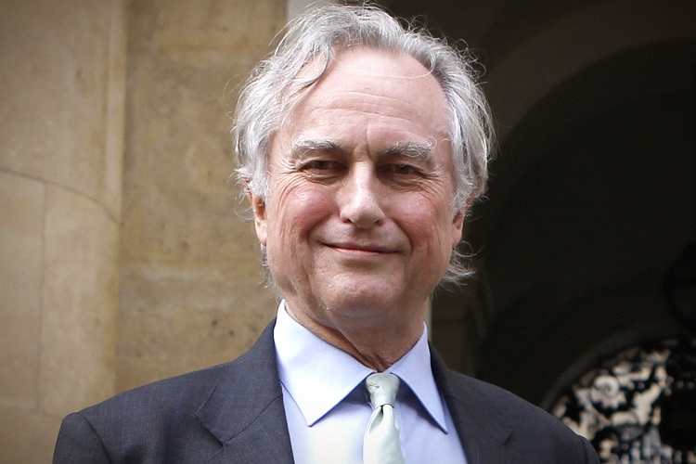
How does a species of one evolve?
“The Universe would have to be full of dead planets whose homeostatic regulation systems had failed, with, dotted around, a handful of successful, well-regulated planets, of which the Earth is one. Even this improbable scenario is not sufficient to lead to the evolution of planetary adaptations of the kind Lovelock proposes. In addition we would have to postulate some kind of reproduction, whereby successful planets spawned copies of their life forms on new planets.”
Dawkins (1982)
RICHARD DAWKINS
Notes:
Dawkins, as you will recall, argued thusly against Gaia. He was concerned that planets or biospheres do not make up populations, and do not reproduce.

Slide 38
“According to Lucky Gaia, it is just good luck that the Earth happens to possess predominantly regulatory feedbacks that have helped maintain a habitable state…
Probable Gaia postulates that there are some basic principles at work that lead one to expect regulatory feedbacks to predominate …
In our view, the present debate about Gaia boils down to whether Lucky Gaia or Probable Gaia is closer to the truth. “
Tim
Lenton
2011
Andrew Watson
Notes:
And Tim and Andrew Watson noted that it was around this issue that the debate revolves.

Slide 39
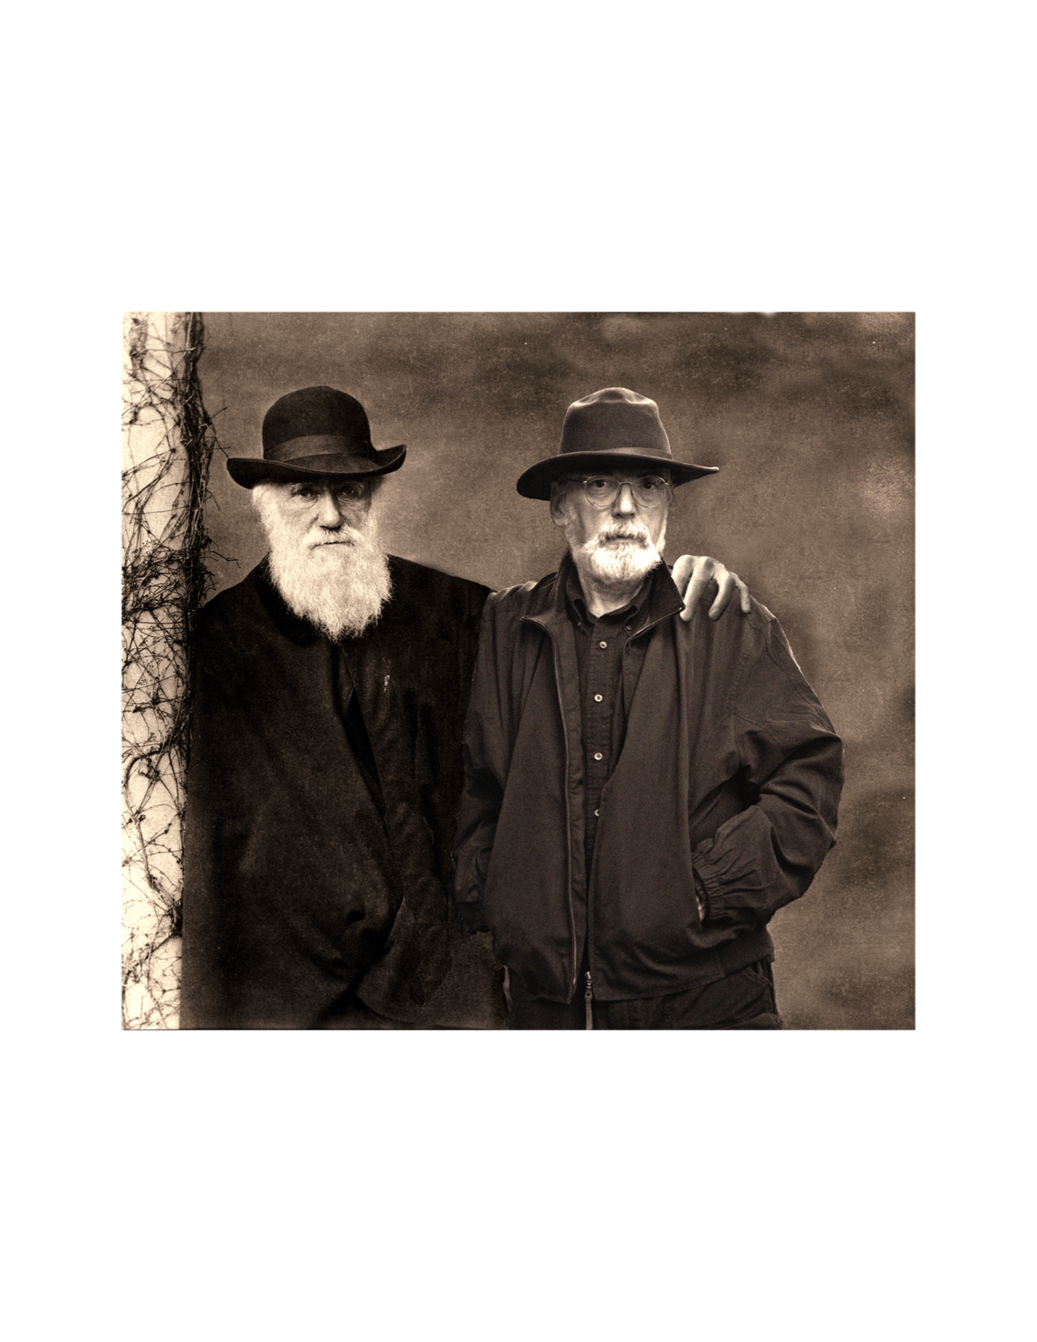
HOW MIGHT ITSNTS THEORY SUPPORT A “PROBABLE GAIA” IN A WAY THAT DARWIN MIGHT ACCEPT?
Notes:
And …

Slide 40
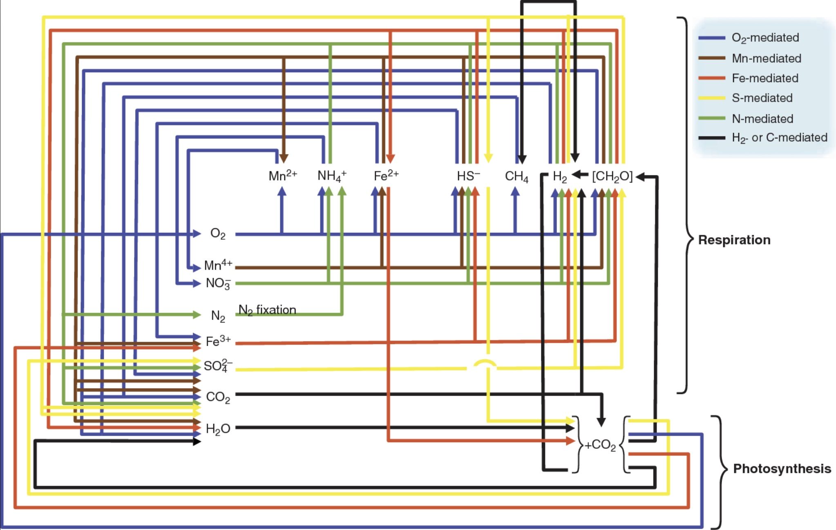
global, interconnected network of the biologically mediated cycles for hydrogen, carbon, nitrogen, oxygen, sulfur, and iron.
PAUL FALKOWSKI AND OTHERS
Notes:
And cycles are connected, so in a sense one very complex song and gazillions of singers, each having a vested interest only in how playing its particular role helps it. NO ALTRUISM OR TRUE CO-OPERATION

Slide 41
global, interconnected network of the biologically mediated cycles for hydrogen, carbon, nitrogen, oxygen, sulfur, and iron.
A SINGLE (COMPLEX) PROCESS
PAUL FALKOWSKI AND OTHERS
Notes:
And cycles are connected, so in a sense one very complex song and gazillions of singers, each having a vested interest only in how playing its particular role helps it. NO ALTRUISM OR TRUE CO-OPERATION

Slide 42
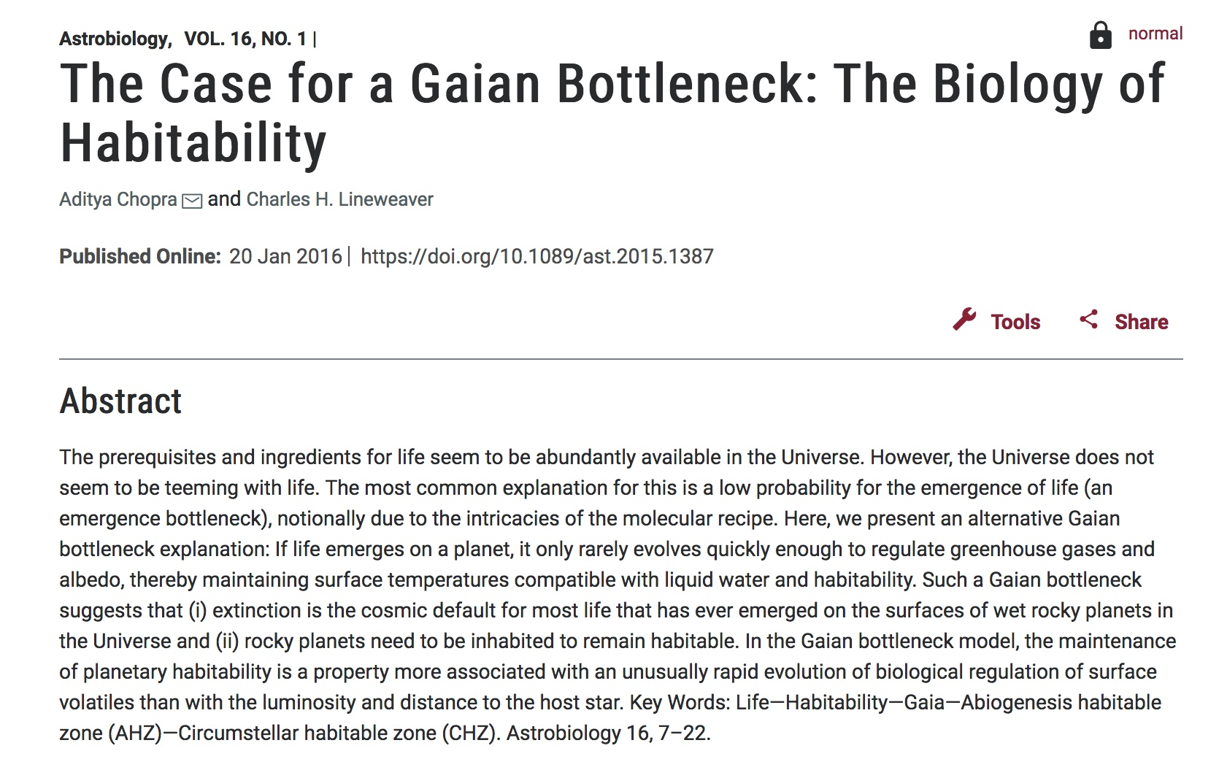
Notes:
In fact, in my penultimate paper in the series, I rely on this by two astrophysicists.

Slide 43
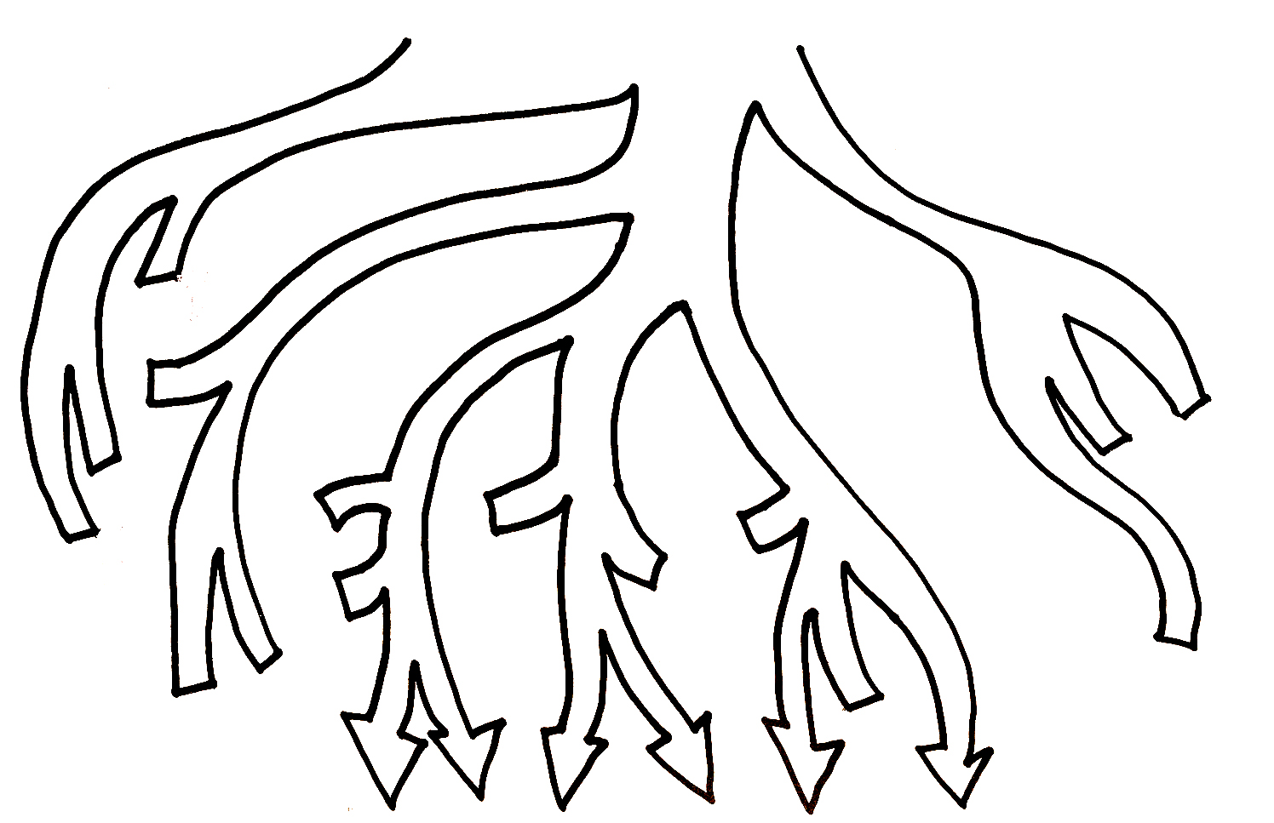
LIFE ON EARTH
(LIFE) IS A
SURVING
CLADE
Life
SURELY THERE ARE REASONS WHY “LIFE” SURVIVED.
BACTERIA EUKARYA ARCHAEA
EXTINCT CLADE
EXTINCT
CLADE
EXTINCT CLADE
LUCA
surviving taxon
ORIGINS
Notes:
In fact, that’s what we do think! We imagine that at the time of the last universal common ancestor, or LUCA, there where other potential clade founders that have now gone extinct.

Slide 44
SOME OF THOSE REASONS
“… This biosphere, be it alone or one of many, is, accordingly, itself a product of
natural selection, since the overall evolvability conferred by its coding concept (nucleic acids as information carriers with the “rulebook of meanings ”provided by codons* …) certainly played a key role in enabling this biosphere to survive up to the present … . We submit that … a particular coding concept, with its respective potential to give rise to a biosphere, or class of biospheres, of a certain evolvability, may itself be regarded as a unit (indeed the arch-unit) of natural selection.”
- - - - - - - - - - - - -
* also, of course, potential for lateral gene transfer
Notes:
And there will be reasons for this …

Slide 45
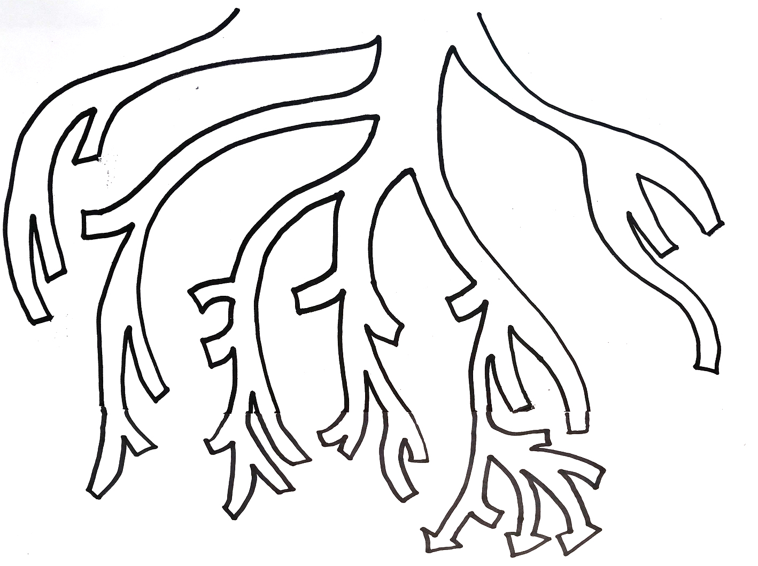
Life
THE VIEW FROM A
FAR DISTANT FUTURE
BACTERIA
EXTINCT CLADE
EUKARYA
EXTINCT CLADE
ARCHAEA
A THOUGHT EXPERIMENT
EXTINCT CLADE
NEW
LUCA
EXTINCT CLADE
EXTINCT
CLADE
OLD LUCA
ORIGINS
Notes:
And, if we are consistent we might imagine that if Life persists, perhaps the clade we know today as Archaea and Eukaryotes will also have gone extinct, and there will be. A new LUCA, possibly a bacterium.

Slide 46
How does a species of one evolve?
“The Universe would have to be full of dead planets whose homeostatic regulation systems had failed, with, dotted around, a handful of successful, well-regulated planets, of which the Earth is one. Even this improbable scenario is not sufficient to lead to the evolution of planetary adaptations of the kind Lovelock proposes. In addition we would have to postulate some kind of reproduction, whereby successful planets spawned copies of their life forms on new planets.”
Dawkins (1982)
(2) PERSISTENCE
THROUGH
RE-PRODUCTION
ALSO DRIVES
EVOLUTION BY
NATURAL
SELECTION.
(1) WHO SAYS
IMPROBABLE? AND
IN ANY CASE, GAIA
IS THE SURVIVING
MEMBER OF A
LARGE POPULATION.
RICHARD DAWKINS
Notes:
To which we can now say … (1) and (2)

Slide 47
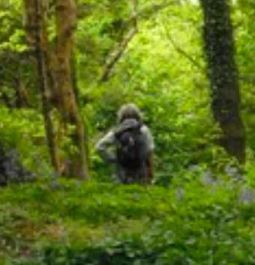
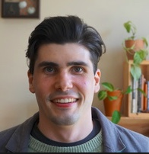

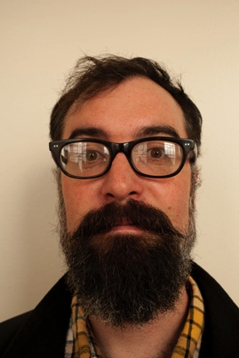
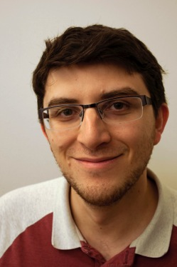


THANKS TO …
MAUREEN
O’MALLEY
ANDREW INKPEN
TYLER BRUNET
AUSTIN BOOTH
CARLOS MARISCAL
AARON NOVICK
JEREMY WIDEMAN
Notes:
Start off by acknowledging I am not a philosopher of biology, but for the last little while have been trying to remake myself into one, with the aid of some smart postdocs with PhDs in philosophy, and a student. And perhaps it all started with Maureen O”Malley, a long-ago postdoc who then went on to work with John Dupre, and created a whole new discipline – philosophy of microbiology.

Slide 49
REWRITING LEWONTIN’S RECIPE
SELECTED ENTITIES SELECTED ENTITIES
TOTAL ENTITIES TOTAL ENTITIES
IT IS SUFFICIENT AND NECESSARY FOR EVOLUTION BY NATURAL SELECTION THAT THIS RATIO INCREASES. INCREASE CAN OCCUR EITHER BY:
1. INCREASE IN THE NUMERATOR (AS IN DIFFERENTIAL
REPRODUCTION*), OR
2. DECREASE IN THE DENOMINATOR (AS IN DIFFERENTIAL
PERSISTENCE).
PROPERTIES OF SELECTED ENTITIES LEADING TO SUCH A RESULT ARE ADAPTATIONS, THEIR SELECTED EFFECTS FUNCTIONS.
- - - - - - - - - - - - - - - - - - - - - - - - - - - - - - - - - - - - - - - - - - - - - - - - - - - - - - - - - - - - - - - *WITH OR WITHOUT RESOURCES CONSTRAINING POPULATION SIZE
Notes:
So, I’ve rewritten Lewontin’s recipe, as follows … You have to accept this to accept what follows, PROBABLY.

Slide 50
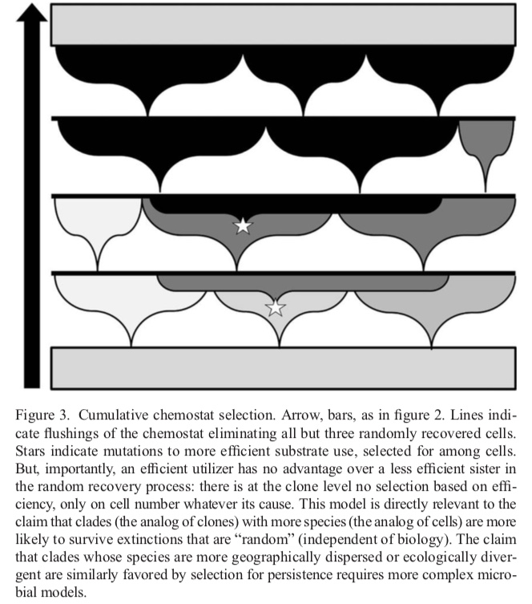
Making the most of clade selection. Phil Sci 84: 275-295 (2017)
CLADES ARE THOUGHT BY MOST NOT TO EVOLVE BY NATURAL SELECTION, BECAUSE THEY DO NOT REPRODUCE (BY DEFINITION).
BUT CLADES ARE LIKE CLONES: THE NUMBER, DIVERSITY AND DISPERSAL OF CONSTITUENT SPECIES ARE CLADE-LEVEL PROPERTIES AFFECTING CLADE SURVIVAL, REGARDLESS OF “LOWER” LEVEL CAUSES.
ONLY ONE OF THREE CLADES SURVIVING
THREE CLADES PRESENT
Lines indicate periodic flushings of the chemostat eliminating all but three randomly recovered cells. Stars indicate mutations to more efficient substrate use, selected for among cells. But, importantly, an efficient utilizer has no advantage over a less efficient sister during the flushing process: there is at the clone level no selection based on efficiency, only on cell number, whatever its cause.
Notes:
In this paper, I make an analogy between clades and clones in a chemostat, because neither reproduces but both have parts that do. [READ legend first, then red text.].

Slide 51
CONTINUITY OF PROCESSES DEPENDS ON UNINTERRUPTED CAUSAL
CHAINS OF EVOLUTIONARY RECRUITMENT AND RE-PRODUCTION
PROCESS
THINGS
PROCESS
THINGS
PROCESS
THINGS
PROCESS
THINGS
PROCESS
THINGS
PROCESS
THINGS
IF AN IDENTICAL NITROGEN CYCLE AROSE INDEPENDENTLY
ON MARS, IT WOULD NOT BE THE SAME CYCLE
PROCESS
THINGS
PROCESS
THINGS
PROCESS
THINGS
PROCESS
THINGS
PROCESS
THINGS
PROCESS
THINGS
BUT BECAUSE OF SPATIOTEMPORAL NON-BOUNDEDNESS OF ITS
INTERMEDIATES, THERE MAY BE ONLY ONE NITROGEN CYCLE ON EARTH
THE NUMBER OF SONGS SUNG BY HUMAN GUTS MIGHT BE DEPENDENT ON DIET, AND HOST POPULATION STRUCTURES

Slide 52
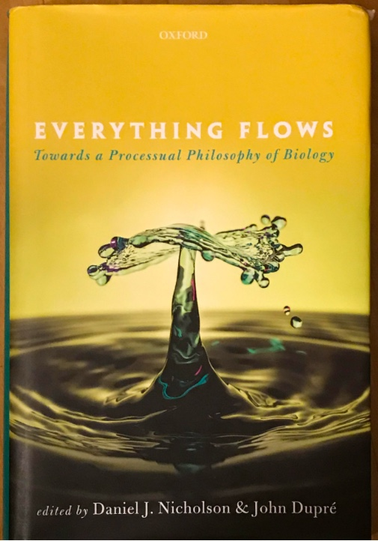

Slide 53
“One of the merits of an ontology of processes—by comparison with one of substances—is that it makes it possible to embrace the vagueness naturally suggested by such cases. It appears that distinguishing discrete individuals within the deeply entangled flux of interdependent living processes is often a matter of conceptual decision motivated by specific theoretical or practical interests.” (Dupré and Nicholson, p. 22)
“So what is it that makes the various temporal stages of the Great Red Spot temporal stages of the same process? We take it that the answer must be sought in various forms of causal connection and continuity between the relevant stages.… We suspect that this is the general form of explanation that is needed to account for the persistence of a process. An obvious advantage of this way of explaining persistence is that it poses no restrictions on the amount of change that can take place between the properties of a process at different moments in time.” (Dupré and Nicholson, p. 25)

Slide 54
“If species or lineages are individual processes, how do they manage to maintain their coherence and stability over time? It would seem that, just as organisms persist by renewing the cells that compose them through constant metabolic turnover, so lineages persist by replacing the organisms that make them up through continuous cycles of reproduction …
… the persistence of a lineage is dependent on natural selection, understood here not as a cause of change but as a stabilizing force. Stabilizing selection leads to the continued production of very similar phenotypes in a lineage (namely the most adaptive ones), and this helps maintain its stability over long periods of time.
Of course, despite these numerous forms of stabilization, lineages do gradually change, and this results in their evolution …
… We offer one last and more speculative suggestion. Processual systems such as organisms and cells respond to their environment in ways that are conducive to their persistence. A growing number of theorists maintain that such responses are not merely automatic reactions elicited by environmental stimuli, but rather reflect purposive actions. ” (Dupré and Nicholson, p. 35-36)

Slide 55
“… although our metaphysical account could focus on processes and minimize the role that individuals play in explanations, this would be a pyrrhic victory, for it would be difficult to offer an operationally equivalent definition of these processes in an evolutionary explanation. Biological individuals may be temporary ‘eddies in the constant flux of process’, but viewing them as genuine individuals is necessary for evolutionary explanations nonetheless. In a naturalistic metaphysics, this may be an indication that individuals are real enough and should retain a prominent role in our explanations.” (Bouchard, p. 188)
PROCESS
THINGS
PROCESS
THINGS
PROCESS
THINGS
PROCESS
THINGS
PROCESS
THINGS

