Slide 1
Structures and Categories John Stachel
Center for Einstein Studies
Boston University
Florence Category Day
16 June 2010
16 giugno1610

Slide 2
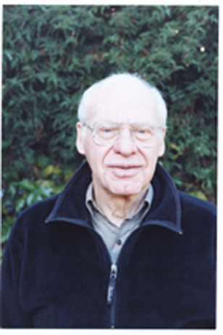
Mi spiace molto di non poter èssere qui oggi

Slide 3
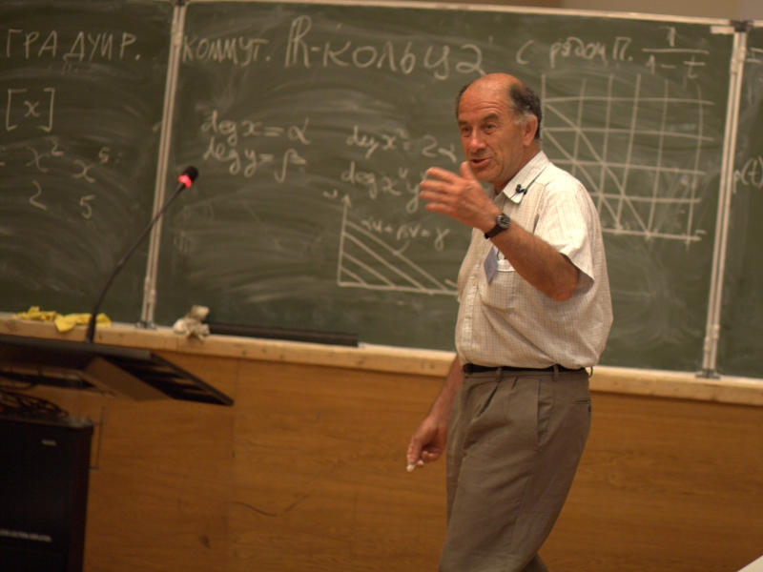
In Memoriam: Vladimir Arnold

Slide 4
Lorenzo De' Medici
Quant’è bella giovinezza
che si fugge tuttavia!
Chi vuol esser lieto, sia:
di doman non c’è certezza.

Slide 5
“On Teaching Mathematics” (Arnold 1997)
“Mathematics is a part of physics.
Physics is an experimental science, a part of natural science.
Mathematics is the part of physics where experiments are cheap.”

Slide 6
Theory and “Concrete-in-Thought”
Every theory deals with models, every model is a model of some sort of structure.
Let me emphasize that the concrete as well as the abstract structures under discussion here are objects at the level of theory. One must not make the empiricist error of pretending that our theories deal directly with objects of the external world. The “concrete-in-thought” must not be confused with the entity in the external world that is its object.

Slide 7
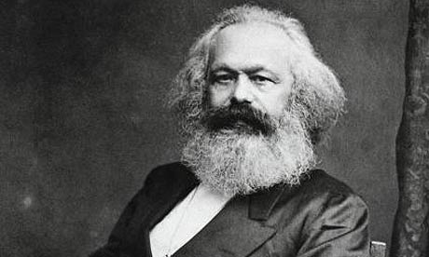
Karl Marx

Slide 8
“Introduction” to the Grundrisse, (Nikolaus translation, modified)
Hegel fell into the illusion of conceiving the real as the product of thought concentrating itself, probing its own depths, and unfolding itself out of itself, by itself, whereas the method of advancing from the abstract to the concrete is only the way in which thought appropriates the concrete, reproduces it as the concrete-in-thought.

Slide 9
Surely, no one falls into this Hegelian trap today!
-Or do They?

Slide 10
Cecilia Flori,"Topoi for Physics"
Platonically speaking, one can view a Physics Theory as a concrete realization, in the realm of a Topos, of an abstract “idea” in the realm of logic. Therefore, this view presupposes that at a fundamental level, what there is, are logical relations among elements, and a Physics Theory is nothing more than a representation of these relations as applied/projected to specific situations/systems. For a detailed analysis of the above ideas see the series of papers: Isham, Döring, I 2007, Isham, Döring, II 2007, Isham, Döring, III 2007, Isham, Döring, IV 2007 .

Slide 11
Logic-Language-World
Three steps:
Logic is about Language*,
Language is about The World.
Panlogism
  The attempt to “short circuit” this process by identifying the real object and the “concrete-in- thought” leads to the assertion:
Logic is about The World
* “Language” includes other symbolic systems

Slide 12
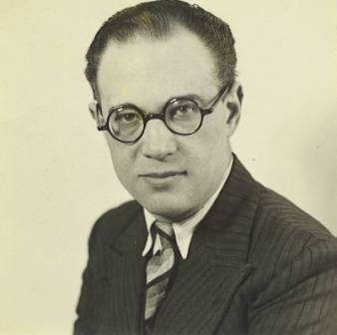
Aron Gurwitsch

Slide 13
Leibniz: Philosophie des Panlogismus
“Things are realizations of concepts of reason. It is not sufficient to maintain that the logical and the ontological viewpoints can never be fully distinguished from each other, or that no separation, no abyss exists between reason and reality. One seems most faithful to the situation, if one speaks of an identity, or better of an equivalence of the logical and the ontological”

Slide 14
Panlogism redivivus!
“ By panlogism I mean the philosophical tendency to obliterate the distinction between logical and ontological principles” JS, “Do Quanta Need a New Logic?” (1986)
I have been combating this viewpoint for over 35 years:
”The ‘Logic’ of Quantum Logic” in PSA 1974 (Dordrecht: Reidel 1976), pp. 515-526.

Slide 15
Enough! Having Looked, Let us Pass On
« Fama di loro il mondo esser non lassa;
misericordia e giustizia li sdegna:
non ragioniam di lor, ma guarda e passa. »
Divina Commedia, Inferno, Canto III, 49- 51
“To all memory of them, the world is deaf.
Mercy and justice disdain them
Let us not speak of them: look and pass on. (tr. Robert Pinsky)

Slide 16
The Primacy of Process

Slide 17
Things and Processes
A particular, concrete structure is characterized by some concrete objects (the relata) together with a set of concrete relations between them. The word “object” is here used in a very broad sense, which allows objects to be (elements of) processes as well as states.

Slide 18
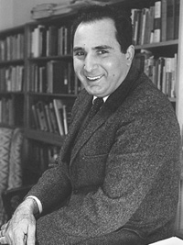
Marx Wartofsky

Slide 19
Conceptual Foundations of Scientific Thought
“[A] thing, insofar as it is more than an instantaneous occurrence and has duration through time, is a process. This introduces some odd results in our ways of talking. For example, talking would be a process but we would hardly talk of it as a “thing”; similarly, it is not usual to talk of a rock or a human being as a process.”

Slide 20
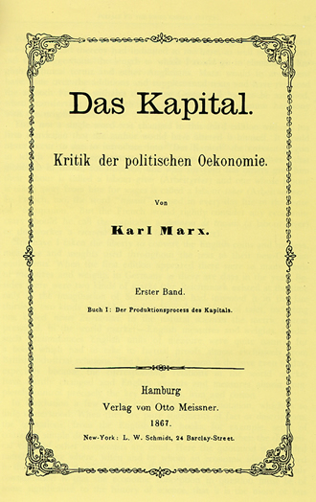
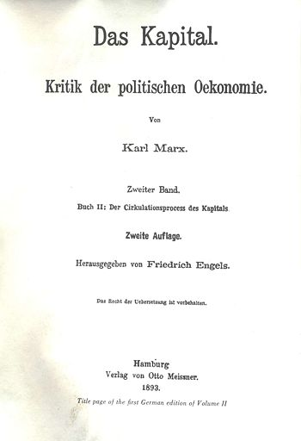
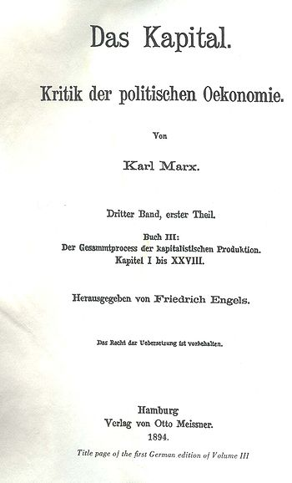
Capital: I. The Production Process, II. The Circulation Process, III.The Complete Process

Slide 21
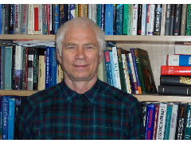
Hans Ehrbar

Slide 22
Annotations to Karl Marx’s Introduction to Grundrisse
Notice that ‘The subject, society’ is indeed a process, as are labor, capital and so many other categories considered by Marx.

Slide 23
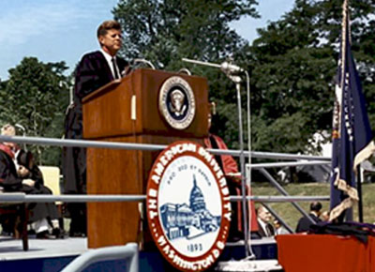
John F. Kennedy

Slide 24
1963 Commencement Address, American University
“Genuine peace must be the product of many nations, the sum of many acts. It must be dynamic, not static, changing to meet the challenge of each new generation.
For peace is a process– a way of solving problems.”

Slide 25
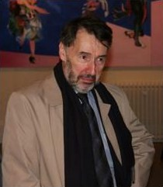
Chris Isham

Slide 26
“Is it True; or is it False; or Some-where In Between? The Logic of Quantum Theory”
"A key feature of classical physics is that, at any given time, the system has a definite state, and this state determines-- and is uniquely determined by-- the values of all the physical quantities associated with the system.“
Realism is "the philosophical view that each physical quantity has a value for any given state of the system.“

Slide 27
In a Letter to Chris Isham, I Raised Two Problems:
1) Conditional Properties:
“each physical quantity has a value”
2) The Primacy of Process:
“for any given state of the system”

Slide 28
Two Problems:
1) Conditional Properties:
“each physical quantity has a value”
2) The Primacy of Process:
“for any given state of the system.”

Slide 29
1) Conditional Properties
This is just not true of conditional properties, as discussed in detail in my paper ["Do Quanta Need a New Logic?" ]. The example I use concerns the properties "hardness h" and "viscosity v": Given a system defined by its chemical composition, the property "hardness" will only apply-- let alone have a numerical value on Moh's scale-- if the system is in a solid state; while "viscosity" will only apply if the system is in a fluid (liquid or gaseous) state.

Slide 30
1) Conditional Properties
So they are conditional, mutually exclusive properties of a classical system, giving a much better analogy to the problems with the context-dependent properties and/or propositions that you introduce for a QM system …"What this discussion implies is that the truth value assigned to a projection operator P should be contextual."

Slide 31
1) Conditional Properties
With the definition of the logical 'negation' operator, [logic] has already gotten as compli-cated as it gets. … [M]y article … discusses the difference between choice and exclusion negation in general, and the inevitability of choice negation for a conditional predicate … if one wants to derive other predicates from it, and what follows from this choice even before getting to the special case of QM.

Slide 32
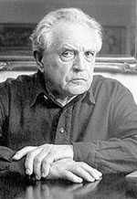
Aleksandr Zinov’ev

Slide 33
Logische Sprachregeln. Eine Einführung in die Logik
Zinov'ev speaks of "intrinsic negation" of a predicate and "extrinsic negation" of proposition, and agrees that there are cases in which intrinsic negation may be indeterminate. All non-standard logics in Zinov'ev’s sense are based on the existence of these two negations.

Slide 34
Two Problems
1) Conditional Properties:
“each physical quantity has a value”
2) The Primacy of Process:
“for any given state of the system”

Slide 35
2) Primacy of Process
Phrases such as "at any moment of time", "at any given time” are appropriate in Newtonian-Galileian physics, which is based on a global absolute time. But from SR on to GR, this phrase involves a convention defining a global time.

Slide 36
2) Primacy of Process
The only convention-invariant things are processes, each involving a space-time region. This suggests-- as do many other considerations-- that the fundamental entities in quantum theory are the transition amplitudes, and that states should be taken in the c.g.s. system (cum grano salis).

Slide 37
2) Primacy of Process
And this is true of our measurements as well: any measurement involves a finite time interval and a finite 3-dimensional spatial region. Sometimes, we can get away with neglecting this, and talking, for example in NR QM, about ideal instantaneous measurements.

Slide 38
2) Primacy of Process
But sometimes we most definitely cannot, as Bohr and Rosenfeld demonstrated for E-M QFT, where the basic quantities defined by the theory (and therefore measurable-- I am not an operation-alist!) are space-time averages. Their critique of Heisenberg shows what happens if you forget this!

Slide 39
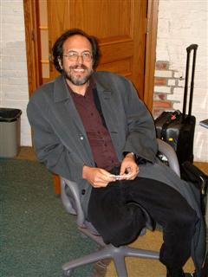
Lee Smolin

Slide 40
Three Roads to Quantum Gravity
“[R]elativity theory and quantum theory each ... tell us-- no, better, they scream at us-- that our world is a history of processes. Motion and change are primary. Nothing is, except in a very approximate and temporary sense. How something is, or what its state is, is an illusion.

Slide 41
Three Roads to Quantum Gravity
It may be a useful illusion for some purposes, but if we want to think fundamentally we must not lose sight of the essential fact that 'is' is an illusion. So to speak the language of the new physics we must learn a vocabulary in which process is more important than, and prior to, stasis.

Slide 42
Naturalness in Mathematics
What is It?

Slide 43
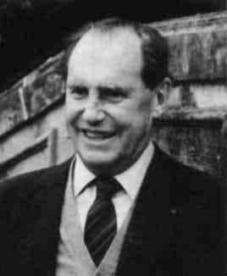
Jean Dieudonné

Slide 44
A History of Algebraic and Differential Topology 1900-1960
[T]he typical ‘unnatural’ isomorphisms [are] those between a finite dimensional vector space (resp. a finite commutative group) and its dual vector space (resp. its Pontrjagin dual), whereas there is a unique ‘natural’ isomorphism of that space and its second dual (resp. its second Pontrjagin dual). ... [U]ntil 1930 almost all mathematicians had been gleefully identifying vectors and linear forms…

Slide 45

Jiří Adámek, Horst Herrlich & George Strecker

Slide 46
Abstract and Concrete Categories
Each finite dimensional vector space is isomorphic to its dual and hence also to its second dual. The second correspondence is considered “natural”, but the first is not. Category theory allows one to precisely make the distinction via the notion of natural isomorphism.

Slide 47
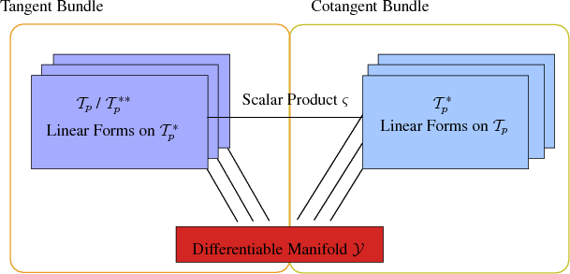
The Tangent Bundle and Cotangent Bundle of a Differentiable Manifold

Slide 48
Category Theory
Category theory is a way of studying the abstract structural features common to many concrete structures:
“Category theory provides a language to describe precisely many similar phenomena that occur in different mathematical fields. ... a general theory of structures …” (AHS).
Such study often enables us to discern structural features common to seemingly quite disparate concrete structures.
Example: The analogy between electric circuits and mechanical systems.

Slide 49
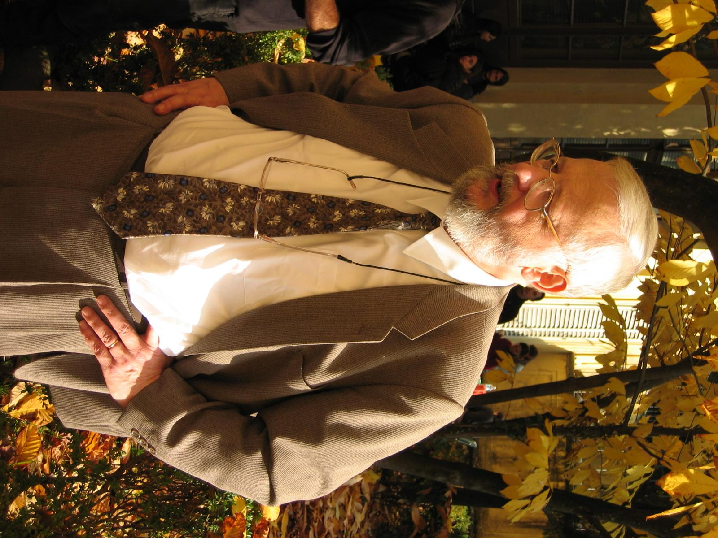
William Lawvere

Slide 50
“Grassman’s Dialectics and Category Theory”
“The natural structure (in the technical sense of my 1963 doctoral thesis) of any functor consists of all natural operations, where a natural operation is an assignment to every value of the functor of an operation which commutes with all the morphisms which are values of the functor.”

Slide 51
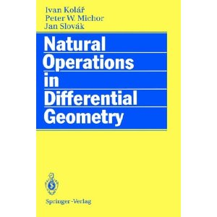
Ivan Kolář, Peter W. Michor, and Jan Slovák

Slide 52
Natural Operations in Differential Geometry
“If we interpret geometric objects as bundle functors defined on a suitable category over manifolds, then some geometric constructions have the role of natural transformations. Several others represent natural operators, i.e., the map sections of certain fiber bundles to sections of other ones and commute with the action of local isomorphisms. So geometric means natural in such situations.”

Slide 53
Naturalness in Mathematics
Natural Bundles

Slide 54
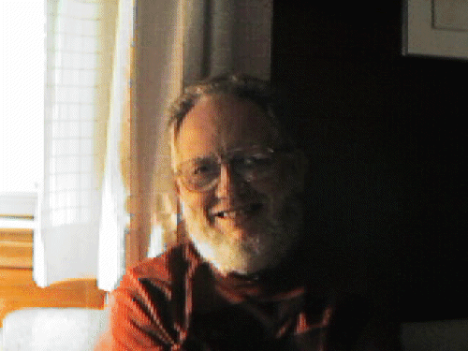
Albert Nijenhuis

Slide 55
“Natural Bundles and Their General Properties”
Natural bundles … are defined through func-tors that, for each type of geometric object, associate a fiber bundle with each manifold. To formalize this, we need two categories.
First, consider the category Mf_{m} of m-dimen-sional (smooth) manifolds. Its morphisms are diffeomorphisms (into). Every open set of an m-manifold belongs to Mf_{m}: the theory is fundamentally a local one.

Slide 56
“Natural Bundles and Their General Properties”
Second, consider the category FM of fibered manifolds (N, p, M), where M,N are manifolds and p: N→M is a surjective submersion. The inverse images p⁻¹(x), for x ε M, are the fibers, N is the total space, and M the base space. The morphisms of FM are the fiber-preserving (smooth) maps. The base functor B: FM→ Mf assigns to each fibered manifold (N, p, M) its base manifold M and to each morphism in FM the induced map on the base spaces.

Slide 57
“Natural Bundles and Their General Properties”
With these definitions, a bundle functor on Mf_{m} , or a natural bundle over m-manifolds, is a covariant functor F : Mf_{m} → FM with these simple properties:
(1) (Prolongation) The base space of the fibered manifold FM is M itself.
(2) (Locality) If U is an open subset of M, then the total space of FU is p⁻¹(U),
the part of N above U.

Slide 58
“Natural Bundles and Their General Properties”
Hidden in this definition (because of the use of the term functor) is the essence of natural bundles, namely, that every local diffeomorphism of the base spaces (morphism of Mf_{m} ) “lifts" uniquely to the total spaces defined over them by F. …
The sharp distinction between point trans-formations and coordinate transformations has disappeared: coordinate systems are simply local diffeomorphisms into R^{m} , which belongs to Mf_{m}, and the functor F does the rest.

Slide 59
Naturalness in Mathematics
Gauge Natural Bundles

Slide 60

Paolo Matteucci

Slide 61
"Einstein-Dirac Theory on Gauge-natural Bundles"
It is commonly accepted nowadays that the appro-priate mathematical arena for classical field theory is that of fibre bundles or, more precisely, of their jet prolongations. What is less often realized or stressed is that, in physics, fibre bundles are always considered together with some special class of mor-phisms, i.e. as elements of a particular category. The category of natural bundles was introduced about thirty years ago and proved to be an extremely fruitful concept in differential geometry.

Slide 62
"Einstein-Dirac Theory on Gauge-natural Bundles"
But it was not until recently, when a suitable generalization was introduced, that of gauge-natural bundles that the relevance of this functorial approach to physical applications began to be clearly perceived. Indeed, every classical field theory can be regarded as taking place on some jet prolongation of some gauge-natural (vector or affine) bundle associated with some principal bundle over a given base manifold.

Slide 63
Natural Operations in Differential Geometry (KMS)
[I]n both differential geometry and mathematical physics one can meet fiber bundles associated to an 'abstract‘ principal bundle with an arbitrary structure group G. If we modify the idea of bundle functor to such a situation, we obtain the concept of gauge natural bundle. This is a functor on principle fiber bundles with structure group G and their local isomorphisms with values in fiber bundles, but with fibration over the original base manifold.

Slide 64
Physical Concepts and Mathematical Structures
At the level of physics (or any other natural science that has reached the level of abstraction, at which mathematical structures may be usefully correlated with the concepts of this science), the following correlations between physical concepts and mathematical structures play an important role:

Slide 65
Physical Concepts and Mathematical Structures
Theories and Bundles
Models and Sections
Particular Theory and Rule
Jet Extensions, Forgetful Functors

Slide 66
Theories and Bundles
A theory of a certain type or type of theory is correlated with a natural or gauge natural bundle.
Example: electromagnetic theory, treated as the gauge-invariant theory of an electromagnetic potential, is correlated with a gauge natural bundle of one-form fields over Minkowski space-time as base manifold.

Slide 67
Physical Concepts and Mathematical Structures
Theories and Bundles
Models and Sections
Particular Theory and Rule
Jet Extensions, Forgetful Functors

Slide 68
Models and Sections
A model of a particular type of theory is correlated with a section of the corresponding natural bundle or a class of gauge-equivalent sections of the corresponding gauge natural bundle
Example: A particular model of an electromagnetic field is correlated with a class of gauge-equivalent cross-sections of the gauge natural bundle of one-forms.

Slide 69
Physical Concepts and Mathematical Structures
Theories and Bundles
Models and Sections
Particular Theory and Rule
Jet Extensions, Forgetful Functors

Slide 70
Particular Theory and Rule
A particular theory is correlated with a rule for selecting a class of sections of the corresponding (gauge) natural bundle.
Examples: Maxwell (Born-Infeld) theory is a rule for selecting the class of sections of the gauge natural bundle of one-form fields that obey the linear (non-linear) gauge-invariant Maxwell (Born-Infeld) equations.

Slide 71
Physical Concepts and Mathematical Structures
Theories and Bundles
Models and Sections
Particular Theory and Rule
Jet Extensions, Forgetful Functors

Slide 72
Jet Extensions, Forgetful Functors
In both of these cases, as in most others, we would have to go to the second jet extension of the bundle in order to formulate the relevant differential equations, and thus make the rule precise. But, with the use of forgetful functors, we may abstract from differentiability and even continuity in order to give definitions that apply to a much wider class of theories, to which the concepts of continuity and differentiability may not be applicable.

Slide 73
General Relativity
Einstein’s Vision
Realizing Einstein’s Vision
Background-Dependence versus Background- Independence
Background-Independence and Diffeomorphisms
Geometry versus Algebra
Global versus Local
Closed versus Open

Slide 74
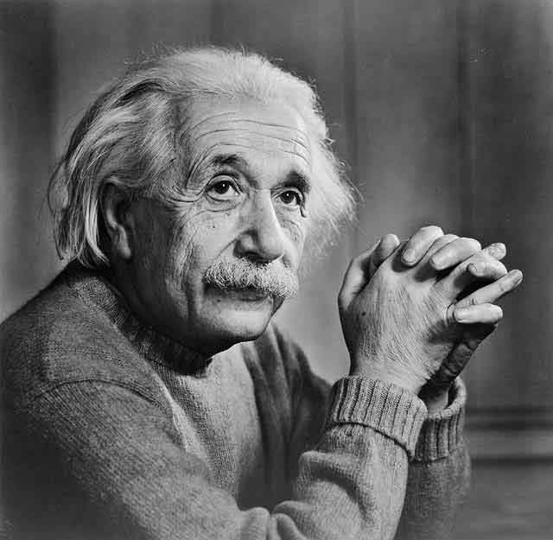
Albert Einstein

Slide 75
“The Theory of Relativity” (1925)
The general theory of relativity brings with it a much deeper modification of the doctrine of Space and Time than in the special theory. … [T]here is no geometry and kinematics independent of the remainder of physics since the behavior of measuring rods and clocks is conditioned by the gravitational field.

Slide 76
“The Theory of Relativity” (1925)
To be sure, one arranges the system of occurrences, that is, the point-events also here in a four-dimensional continuum (space-time); however, the behavior of rods and clocks (the geometry, that is, in general the metric) is determined in the continuum by the gravitational field. The latter is therefore a physical condition of space that simultaneously determines gravitation, inertia and the metric.

Slide 77
“Relativity and the Problem of Space“ (1952)
On the basis of the general theory of relativ-ity ... space as opposed to ‘what fills space’ ... has no separate existence. If we imagine the gravitational field to be removed, there does not remain a space of the type [of SR], but absolutely nothing, not even a ‘topological space’... There is no such thing as an empty space, i.e., a space without field. Space-time does not claim existence on its own, but only as a structural quality of the field.

Slide 78
General Relativity
Einstein’s Vision
Realizing Einstein’s Vision
Background-Dependence versus Background- Independence
Background-Independence and Diffeomorphisms
Geometry versus Algebra
Global versus Local
Closed versus Open

Slide 79
Realizing Einstein’s Vision
The concepts of fiber bundles and sheaves enable a mathematical formulation of general relativity consistent with Einstein's vision.
No formalism can resolve a philosophical issue, such as absolute versus relational concepts of space-time, but:

Slide 80
Traditional Approach: Manifold First
The traditional approach followed by most current textbooks, starts from a manifold M and defines various geometric object fields on it.
This gives absolutists an initial advantage: A relationalist somehow must explain away the apparent priority of M.

Slide 81
Modern Approach: Bundles
A modern approach starts from a principal fiber bundle P with structure group G and defines M as the quotient P/G.
This gives relationalists an initial advantage: The whole package, which includes some geometric object field(s), a connection and a manifold, is there from the start, and an absolutist must explain why priority should be given to the manifold.

Slide 82
Realizing Einstein’s Vision
Traditional approaches to general relativity, based exclusively on the metric, can be reformulated in terms of natural bundles
Modern approaches, which place equal emphasis on metric and connection from the start, are better suited to gauge natural bundles

Slide 83
General Relativity
Einstein’s Vision
Realizing Einstein’s Vision
Background-Dependence versus Background- Independence
Background-Independence and Diffeomorphisms
Geometry versus Algebra
Global versus Local
Closed versus Open

Slide 84
Background-Dependence versus Background-Independence
GR is a background independent theory, a "things-between relations" theory. Both the inertio- gravitational and the chrono-geometrical structures are dynamical fields. In a background-free theory, with no non-dynamical structures, kinematics and dynamics cannot be separated. The slogan is:

Slide 85
No Kinematics Without Dynamics!

Slide 86
A Few Implications of Background-Independence
1) There are no "empty" regions of space-time: Wherever there are space and time (chrono-geometric structure), there is always (at least) an inertio-gravitational field (affine structure).
2) Space-time structures are not independent of other processes. Chrono-geometry and inertio-gravitation obey field equations coupling them to each other and to all other physical processes.
3) Thus, there is now reciprocal interaction between space-time and other processes. Physical processes do not take place in space-time. Space-time is just an aspect of the totality of physical processes.

Slide 87
General Relativity
Einstein’s Vision
Realizing Einstein’s Vision
Background-Dependence versus Background- Independence
Background-Independence and Diffeomorphisms
Geometry versus Algebra
Global versus Local
Closed versus Open

Slide 88
Background-Independent Theories and Diffeomorphisms
In a background-independent theory, there are no non-dynamical relations to be preserved on the set of space-time points; so all possible permutations of the points of space-time are permissible. If one adds the demand that these permutations be continuous (because space-time is a manifold) and differentiable (because it is a differentiable manifold), one gets the diffeomorphism group. As noted above, in GR the points of space-time have no inherent properties that individuate them.

Slide 89
General Relativity
Einstein’s Vision
Realizing Einstein’s Vision
Background-Dependence versus Background- Independence
Background-Independence and Diffeomorphisms
Geometry versus Algebra
Global versus Local
Closed versus Open

Slide 90
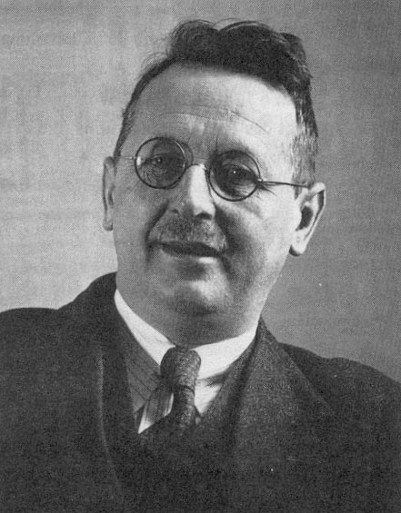
Hermann Weyl

Slide 91
Geometry (Philosophy of Mathematics and Natural Science)
A geometry consists of a set of elements, together with certain relations between them, such that the elements are homogeneous under the group of automorphisms (permutations) that preserves all these relations. In such a case, since the relations are primary, one may speak of the elements as “the things between relations“
Example: Euclidean plane geometry, a manifold homeomorphic to R2, together with the group of translations and rotations acting on the points of the manifold.

Slide 92
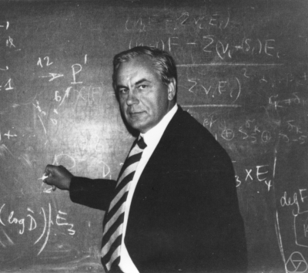
Igor Shafarevich

Slide 93
Algebra (Basic Notions of Algebra)
An algebra consists of a set of elements, together with some relations between them, such that each element is individuated independently of the relations between it and the other elements. In such a case, since the elements are primary, one may speak of “the relations between things"
Example: The plane rotation group, each element is characterized by an angle 0 ≤ θ <2π.

Slide 94
Coordinatization (Weyl’s term)
A coordinatization is a one-one correspondence between the elements of an algebra and those of a geometry.
A representation of an abstract space (geometry) is called algebraic if it characterizes the space by means of some coordinatization of its elements (points)

Slide 95
A Dialectical Detour
But one coordinatization negates the homogeneity of all points of the geometry. The only way to restore it is to negate the indiviual coordinatization:
Require the invariance of every geometrically significant result under all admissible coordinatizations. Based on the given algebra, they usually forming a group isomorphic to the automorphism group of the geometry.

Slide 96
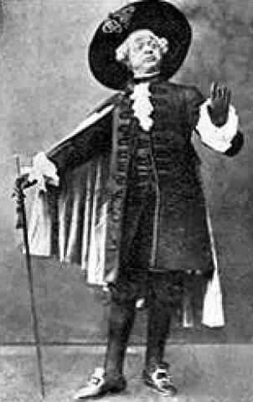
W.S. Gilbert, The Gondoliers
“In short, whoever you may be,
to this conclusion you’ll agree:
When everyone is somebody,
then no-one’s anybody!”
--Don Alhambra del Bolero,
The Grand Inquisitor

Slide 97
General Relativity
Einstein’s Vision
Realizing Einstein’s Vision
Background-Dependence versus Background- Independence
Background-Independence and Diffeomorphisms
Geometry versus Algebra
Global versus Local
Closed versus Open

Slide 98
Global versus Local
All is well as long as we confine ourselves to local diffeomorphisms and local sections.
Complications arise in going from local to global, especially in the case of background-independent theories, like GR, in which the global topology of the manifold is not fixed in advance, but varies with the maximal global extension of a local section (cf. analytic functions and Riemann surfaces-- SOS: sheaf theory).

Slide 99
General Relativity
Einstein’s Vision
Realizing Einstein’s Vision
Background-Dependence versus Background- Independence
Background-Independence and Diffeomorphisms
Geometry versus Algebra
Global versus Local
Closed versus Open

Slide 100
Closed versus Open Systems
System Key Concept
Closed Determinism
Open Causality
Determinism means fatalism: nothing can change what happens
Causality means control: by manipulating the causes, one can change the outcome
“Determinism is really an article of philosophical faith, not a scientific result” (JS 1968).

Slide 101
Do We Really Want Global?
The systems we actually model are finite processes, and all finite processes are open.
A finite process is a bounded region in space- time: Its boundary is where new data (information) can be fed into the system and the resulting data can be extracted from it.
Example: Asymptotically free in- and out-states in a scattering process.

Slide 102
The Dogma of Closure
When classical physics treated open systems, it was tacitly assumed (as an article of faith) that, by suitable enlargement of the system, it could always be included in closed system of a deterministic type. … The contrast between open and closed should not be taken as identical with the contrast between ‘phenomenological’ and ‘fundamental’ …
(JS: “Comments on ‘Causality Requirements and the Theory of Relativity,” 1968)

Slide 103
A Topos Foundation for Theories of Physics: Isham and Döring (2007)
[T]he Copenhagen interpretation is inappli-cable for any system that is truly closed’ (or ‘self-contained’) and for which, therefore, there is no ‘external’ domain in which an observer can lurk. … When dealing with a closed system, what is needed is a realist interpretation of the theory, not one that is instrumentalist.

Slide 104
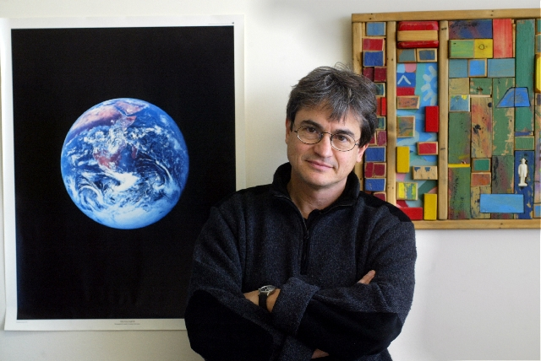
Carlo Rovelli

Slide 105
Quantum Gravity
The data from a local experiment (measurements, preparation, or just assumptions) must in fact refer to the state of the system on the entire bound-ary of a finite spacetime region. The field theoretical space ... is therefore the space of surfaces Σ [where Σ is a 3d surface bounding a finite spacetime region] and field configurations φ on Σ . Quantum dynamics can be expressed in terms of an amplitude W[Σ , φ].

Slide 106
Quantum Gravity
Following Feynman’s intuition, we can formally define W[Σ , φ] in terms of a sum over bulk field configurations that take the value φ on Σ. … Notice that the dependence of W[Σ , φ] on the geometry of Σ codes the spacetime position of the measuring apparatus. In fact, the relative position of the components of the apparatus is determined by their physical distance and the physical time elapsed between measurements, and these data are contained in the metric of Σ.

Slide 107
Quantum Gravity
Consider now a background independent theory. Diffeomorphism invariance implies immediately that W[Σ , φ] is independent of Σ ... Therefore in gravity W depends only on the boundary value of the fields. However, the fields include the gravitational field, and the gravitational field determines the spacetime geometry. Therefore the dependence of W on the fields is still sufficient to code the relative distance and time separation of the components of the measuring apparatus!

Slide 108
Quantum Gravity
What is happening is that in background-dependent QFT we have two kinds of measurements: those that determine the distances of the parts of the apparatus and the time elapsed between measurements, and the actual measurements of the fields’ dynamical variables. In quantum gravity, instead, distances and time separations are on an equal footing with the dynamical fields. This is the core of the general relativistic revolution, and the key for background-independent QFT.

Slide 109
Beyond General Relativity?
Principle of Maximal Permutability
Generalization and Abstraction
Functors: Faithful and Forgetful
The Search for Quantum Gravity

Slide 110
Structure, Individuality, and Quantum Gravity (JS)
[T]he way to assure the inherent indistinguish-ability of the fundamental entities of the theory is to require the theory to be formulated in such a way that physical results are invariant under all possible permutations of the basic entities of the same kind … I have named this requirement the principle of maximal permutability. … The exact content of the principle depends on the nature of the fundamental entities.

Slide 111
Structure, Individuality, Quantum Gravity (cont’d)
For theories, such as non-relativistic quantum mechanics, that are based on a finite number of discrete fundamental entities, the permutations will also be finite in number, and maximal permutability becomes invariance under the full symmetric group. For theories, such as general relativity, that are based on fundamental entities that are continu-ously, and even differentiably related to each other, so that they form a differentiable manifold, permu-tations become diffeomorphisms.

Slide 112
Structure, Individuality, Quantum Gravity (cont’d)
For a diffeomorphism of a manifold is nothing but a continuous and differentiable permutation of the points of that manifold. So, maximal permutability becomes invariance under the full diffeomorphism group. Further extensions to an infinite number of discrete entities or mixed cases of discrete-continuous entities, if needed, are obviously possible.

Slide 113
Beyond General Relativity?
    Principle of Maximal Permutability
    Generalization and Abstraction
    Functors: Faithful and Forgetful
    The Search for Quantum Gravity

Slide 114
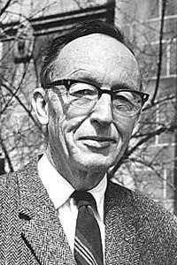
Saunders MacLane, Mathematics,
Form and Function, 1986).
Generalization: from cases refers to the way in which several specific prior results may be sub-sumed under a single more general theorem" Abstraction: by deletion ... One carefully omits parts of the data describ-ing the mathematical concepts ... to obtain the more abstract concept”

Slide 115
Beyond General Relativity?
Principle of Maximal Permutability
Generalization and Abstraction
Functors: Faithful and Forgetful
The Search for Quantum Gravity

Slide 116
Functors and People
Functors are like people:
They can be faithful, they can be forgetful
People can be faithful and forgetful-- so can functors: There are functors that are
faithful in some respects, forgetful in others
People can be fully faithful-- so can functors:
There are fully faithful functors

Slide 117
Forgetful Functor
A covariant functor F from category C to category C‘ that ignores some (or all) of the structure that is present in C, so it is a functor that is less rich in structure. So we can abstract by using a forgetful functor.
Example: we can go from bundles over a manifold to stacks over a set by forgetting continuity and differentiability

Slide 118

Forgetful Functors: Examples
the following diagram of forgetful functors commutes:

Slide 119
Faithful Functor (Wikipedia)
Let C and D be (locally small) categories and F a functor from C to D F : C → D. F induces a function for every pair of bjects X and Y in C. F is said to be:
faithful if F_{X,Y} is injective
full if F_{X,Y} is surjective
fully faithful if F_{X,Y} is bijective for each X and Y in C.
an equivalence if it is fully faithful and isomorphism dense: for any c in C , there is a d in D such that F(d) is isomorphic to c

Slide 120
Generalization and Abstraction:
Functors
We can use these functors for generalization and abstraction
Examples: Abelian → Groups is fully faithful. Grp → Set is forgetful and faithful. Mat(R) (real matrices) and FinVect(R) (finite-dim real vector spaces) are equivalent

Slide 121
Beyond General Relativity?
Principle of Maximal Permutability
Generalization and Abstraction
Functors: Faithful and Forgetful
The Search for Quantum Gravity

Slide 122
The Search for Quantum Gravity
Processes of generalization and abstraction are currently being used in the search for a theory of quantum gravity. None of the current approaches has been completely successful in solving the basic problem : reconciliation of QFT with GR. I feel the principle of maximal permutability provides a touchstone for judging all such attempts.

Slide 123
A New Formal Principle?
In 1905, Einstein faced a similar situation in his attempts to reconcile Newtonian mechanics with Maxwell’s electrodynamics.
”Gradually I despaired of the possibility of discovering the true laws by means of constructive efforts based on known facts. The longer and more desperately I tried, the more I came to the conviction that only the discovery of a universal formal principle could lead us to assured results.”
(Autobiographical Notes, 1949)

Slide 124
Maximal Permutability
The way to assure the inherent indistinguishability of the fundamental entities of the theory is to require the theory to be formulated in such a way that physical results are invariant under all possible permutations of basic entities of the same kind.

Slide 125
Background-Independent Physics
My conjecture: Whatever form a future fundamental physical theory (such as some version of quantum gravity, or something even farther from our current conceptual framework) may take, there will be no absolute elements in it

Slide 126
Background-Independent Physics
Rather, its basic entities –whatever their nature – will be inherently indistinguishable and embedded in some (discrete or continuous) relational structure: The result will be a completely background-independent physics.

Slide 127
I Hope You Will Be Moved to Say
Se non è vero,
è ben trovato!

Slide 128
Thank You !
Grazie Tanti!

Slide 129



The following table depicts the correspondence between discrete and continuous concepts
discrete setting |  | continuous setting
p-cell |  |  | p-dimensional domain
boundary of a p-cell |  |  | boundary of a p-dimensional domain
p-chain |  |  | weighted p-domain
p-cochain |  |  | p-differential form
pairing of p-chain and p-cochain |  |  | weighted p-integral of a p-form
coboundary operator |  |  | exterior differential operator

Slide 130
In the language of category theory, diffeomorphisms and permutations are both special cases of automorphisms.

Slide 131
Categories, Fibered Sets, and G-Spaces
A general map g X →S between two sets is also called sorting, stacking or
fibering of X into S fibers (or stacks). A section for g is a map S → X such
that g ◦ = idS. A retraction is a sort of inverse operation to a section . A
retraction for g is a map S r→X such that r ◦ g = idX. If g is not surjective,
some of the fibers of g are empty. If there are empty fibers, then the map g has no section. If X and S are finite sets and all the fibers are non-empty,
then the map g has a section and it is said that g is a partitioning of X into
B fibers. In what follows we will consider only the case when g is a surjective
map.

Slide 132
Karl Marx, “Introduction” to the Grundrisse, Nikolaus translation
“The concrete is concrete because it is the concentration of many determinations, hence unity of the diverse. It appears in the process of thinking, therefore, as a process of concentration, as a result, not as a point of departure, even though it is the point of departure in reality and hence also the point of departure for observation [Anschauung] and conception. Along the first path the full conception was evaporated to yield an abstract determination; along the second, the abstract determinations lead towards a reproduction of the concrete by way of thought.

Slide 133
Therefore, to the kind of consciousness – and this is characteristic of the philosophical consciousness – for which conceptual thinking is the real human being, and for which the conceptual world as such is thus the only reality, the movement of the categories appears as the real act of production – which only, unfortunately, receives a jolt from the outside – whose product is the world; and – but this is again a tautology – this is correct in so far as the concrete totality is a totality of thoughts, concrete in thought, in fact a product of thinking and comprehending; but not in any way a product of the concept which thinks and generates itself outside or above observation and conception; a product, rather, of the working-up of observation and conception into concepts. The totality as it appears in the head, as a totality of thoughts, is a product of a thinking head, which appropriates the world in the only way it can, a way different from the artistic, religious, practical and mental appropriation of this world. The real subject retains its autonomous existence outside the head just as before; namely as long as the head’s conduct is merely speculative, merely theoretical”

Slide 134
Relations, internal and external
Intrinsic properties of an entity serve to characterize its essence, nature or natural kind. (Extrinsic properties don’t)
Relata: the entities that a relation relates.
A relation is:
internal if one or more essential properties of the relata depend on the relation; one may speak of " things between relations“ (Stachel 2002)
external if no essential property so depends; the more familiar case of "relations between things”

Slide 135
NB: All these distinctions are theory-laden
Whether a relation is internal or external may depend on the level at which the objects involved are treated. For example, as biological organisms, the social relation of master and slave between two people is external; while as two human beings, it is internal: one cannot be a master without a slave and vice versa.

Slide 136
Quiddity and Haecceity
Quiddity is what characterizes all entities of the same nature.
Haecceity is what enables us to individuate entities of the same quiddity.
Example: As organisms, all human beings are of the same quiddity; but by means of anatomical differences they are individuated biologically, quite independently of any social relations into which they have entered.
But they are only socially individuated by such social relations.

Slide 137
Quiddity and Haecceity (cont’d)
Up until the last century, it was assumed that entities of the same quiddity also had intrinsic haecceity
i.e., could always be individuated independently of any relations, into which they entered.
"For there are never two things in nature that are perfectly alike and in which it is impossible to find a difference that is internal, or founded on an intrinsic denomination." G. W. Leibniz, "The Monadology"
Any further individuation due to such relations supervened on this basic individuation.
Example: Bill Gates naked could be identified by his physical description, but he could not be so identified as the Chairman of Microsoft.

Slide 138
With the advent of quantum statistics, it has come be recognized that there are entities– e.g., the elementary particles-- that have quiddity but no inherent haecceity. So one had to admit the utility of introducing a category of entities with quiddity but no inherent haecceity in theoretical physics.
Example: Every electron has same mass, charge and spin, which fix its quiddity

Slide 139
Structures, algebraic and geometric
There is a fundamental distinction between geometric (Weyl) and algebraic (Shafarevich) structures.
Geometry: The elements of a geometry have the same quiddity but lack inherent haecceity; a set of internal relations between these elements defines a particular geometry. The group of permutations of the elements that preserves all these defining relations is the symmetry or automorphism group of the geometry.
Example: Euclidean geometry. The properties of a triangle are preserved under the automorphism group of the Euclidean plane, consisting of all translations and rotations.

Slide 140
Structures, algebraic and geometric cont’d)
Algebra: The elements of an algebra possess both haecceity and quiddity; a set of external relations between (or operations on) these elements defines a particular algebraic structure.
Example: The real numbers, each element of which is uniquely defined. They form a field under the relations (or operations) of addition and multiplication.

Slide 141
Coordinatization (Weyl’s word)
Since Descartes’ introduction of analytic geometry, it has been realized that it is often convenient, and sometimes even necessary, to apply algebraic methods to formulate and solve geometrical problems.
This gave rise to the concept of the coordinatiza-tion of a geometry by an appropriate algebra. By assigning an element of an algebra to each point of a geometry, one can carry out certain algebraic operations that now have a geometrical interpretation.

Slide 142
A Dialectical Detour
But one coordinatization negates the homogeneity of all points of the geometry. The only way to restore it is to negate the coordinatization:
Introduce the entire class of all admissible coordinatizations based on the given algebra (usually forming a group). Each point of the geometry will have every element of the algebra as its coordinate in (at least) one of the admissible coordinate systems. We call the transformations between admissible coordinate systems admissible coordinate transformations.

Slide 143
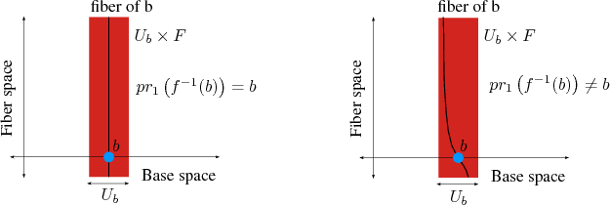
Left: a fiber bundle with the homeomorphism. Right: A homeomorphism into , which does not preserve the projection, thus not revealing a fiber bundle

Slide 144
Cecilia Flori,"Topoi for Physics"
The reason why I have decided to build this site is because, although Topos Theory is a very fascinating branch of mathematics, it is not at all well known by the majority of Physicists.
I hope this site will be a means of divulgation of the subject and a way of getting people interested in the use of Topos Theory, not just in a mathematical context, but in a physical one as well, since, in my opinion, Topos theory could be very useful in physics.

Slide 145
Chris Isham, “Is it True; or is it False; or Some-where In Between? The Logic of Quantum Theory”
Consider the following two statements concerning a physical quantity A and a real number a. The critical words are italicised.
“If a measurement of A is made, the probability that the result will be a is p.”
“The quantity A has a value, and the probability that this value is a is p.”
The first statement is an instrumentalist way of talking about physics: it does not concern itself with what ‘is the case’ but only with the results of measurements. The essential counterfactuality is captured by the opening ‘If’: the statement asserts what would happen (or, more precisely, the probability of what would happen) if a certain action is taken. It is silent about the situation in which no measurement is made.
The second statement is very different. It reflects a typical realist view of the world in which, at any moment of time, any physical quantity is deemed to possess a value, even if we do not know what that value is.

Slide 146
Karl Marx, From the manuscripts for Capital
We have seen that [the concept of] value rests upon the circumstance that men relate reciprocally to their labors as equivalent and general and, in this form, social labor. This is an abstraction, like all human thought, and social relations between men only exist insofar as they think and possess this power of abstraction from individuality and accident as apprehended by the senses. That sort of economist who attacks the determination of value by labor time because the labors of two individuals during the same time are not absolutely equal (even though in the same occupation) still does not understand at all wherein human social relations differ from those of beasts. They are beasts [last sentence in English].

Slide 147
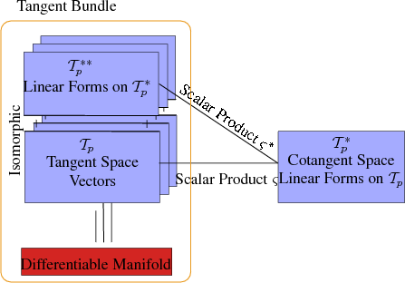
Illustration of the correlation of tangent space and cotangent space.

Slide 148
But the abstract structure is independent of these particulars. It is what many concrete structures have in common. ² Marx long ago singled out importance of the power of abstraction:

Slide 149
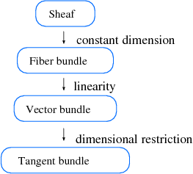
A hierarchy of concepts with partial specialization. The most general form is represented by a sheaf concept. The concept of fiber bundles is obtained by using fibers with a certain dimension. If the fiber space satisfies linear vector space properties, the concept of a vector bundle is derived. Finally, by confining the dimension of the base and fiber space, a tangent bundle is obtained

Slide 150
Stachel and Iftime,“Fibered Manifolds, Natural Bundles,
Structured Sets, G-Sets and all that: The Hole Story from Space Time to Elementary Particles”
[T]he essence of the hole argument does not depend on the continuity or differentiability properties of the manifold. To get to this deeper significance one must abstract from the topological and differentiable properties of manifolds, leaving only sets. We shall start by defining the basic structures upon which our study of hole argument for sets will be based. As usual one gets a clearer idea of the basic structure of the argument by formulating it in the language of categories.

Slide 151
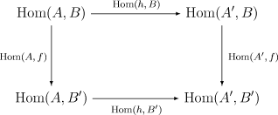
Faithful Functor (AHS)
Let F: A → A’ be a functor. F is called faithful provided that all the hom-set restrictions
F: hom_{A}(A, B) → hom_{A’}(A’, B’) are injective.

Slide 153
What ‘Realist Means to I &D
1. The idea of ‘a property of the system’ (i.e., ‘the value of a physical quantity’) is meaningful, and representable in the theory.
2. Propositions about the system are handled using Boolean logic. This requirement is compelling in so far as we humans think in a Boolean way.
3. There is a space of microstates’ such that specifying a microstate leads to unequivocal truth values for all propositions about the system. The existence of such a state space is a natural way of ensuring that the first two requirements are satisfied.

Slide 154
The ‘Neo-Realist’ Interpretation
In regard to the three conditions listed above for a ‘realist’ interpretation, our scheme has the following ingredients:
1. The concept of the ‘value of a physical quantity’ is meaningful, although this ‘value’ is associated with an object in the topos that may not be the real-number object. With that caveat, the concept of a ‘property of the system’ is also meaningful.

Slide 155
The ‘Neo-Realist’ Interpretation
2. Propositions about a system are represent-able by a Heyting algebra associated with the topos. A Heyting algebra is a distributive lattice that differs from a Boolean algebra only in so far as the law of excluded middle need not hold.
3. There is a ‘state object’ in the topos. However, generally speaking, there will not be enough ‘microstates’ to determine this. Nevertheless, truth values can be assigned to propositions with the aid of a ‘truth object’. These truth values lie in another Heyting algebra.

Slide 156
The ‘Neo-Realist’ Interpretation
This neo-realism is the conceptual fruit of the mathematical fact that a physical theory expressed in a topos ‘looks’ very much like classical physics. This fundamental feature stems from (and, indeed, is defined by) the existence of two special objects in the topos: the ‘state object’…and the ‘quantity-value object, R. Then: (i) any physical quantity, A, is represented by an arrow A→ R in the topos; and (ii) propositions about the system are represented by sub-objects of the state object.

Slide 157
A Topos Foundation for Theories of Physics: Isham and Döring (2007)
One deep result in topos theory is that there is an internal language associated with each topos. In fact, not only does each topos generate an internal language, but, conversely, a language satisfying appropriate conditions generates a topos. Topoi constructed in this way are called ‘linguistic topoi’, and every topos can be regarded as a linguistic topos. In many respects, this is one of the profoundest ways of understanding what a topos really ‘is’.

Slide 158
Stachel, “Prolegomena to Any Future Quantum Gravity”
General relativity (GR) and special relativistic quantum field theory (SRQFT) do share one fundamental feature that often is not sufficiently stressed: the primacy of processes over states. The four-dimensional approach, emphasizing processes in regions of S-T, is basic to both … In non-relativistic quantum mechanics, one can choose a temporal slice of S-T so thin that one can speak meaningfully of "instantaneous measurement" of the state of a system, but this is not so for measurements in SR QFT, let alone in GR

