Slide 1
Where is Knowledge?
John Stachel
Center for Einstein Studies,
Boston University
11th Conference on Frontiers of the Foundations of Physics
Paris, 6-9 July 2010

Slide 2
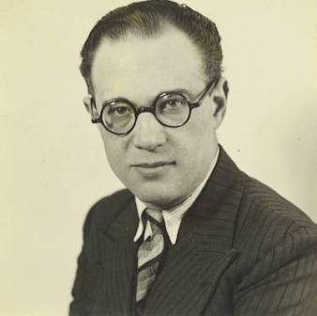
Aron Gurwitsch

Slide 3
Studies in Phenomenology and Psychology (1966)
If the existence of Western man appears critical and problematic, it is because he has allowed himself to become unfaithful to his idea, the very idea that defines and constitutes him as Western man. That idea is no other than the idea of philosophy itself:

Slide 4
Studies in Phenomenology and Psychology (1966)
the idea of a universal knowledge concerning the totality of being, a knowledge which contains within itself whatever special sciences may grow out of it as its ramification, which rests upon ultimate foundations and proceeds throughout in a completely evident and self-justifying fashion and in full awareness of itself.

Slide 5

Jean Toussaint Desanti

Slide 6
La philosophie silencieuse ou critique des philosophies de la science (1975)
Il n’existe plus de point fixe, d’où l’un d’entre nous pourrait espérer ressaisir, fût-ce en sa simple forme, la configuration du savoir et, par là, en proposer la fermeture. Ce n’est pas la tentation qui manque, mais l’instrument qui permettrait d’y céder d’une manière convaincante.

Slide 7
La philosophie silencieuse (1975)
A fixed point no longer exists, from which one could hope to recapture, even in its simple form, the configuration of knowledge and thereby propose its closure. It’s not the temptation that is lacking but the instrument that would allow one to give in to it in a convincing manner.

Slide 8
La philosophie silencieuse ou critique des philosophies de la science (1975)
Ni du côté du Sujet, ni du côté du Concept, ni du côté de la Nature nous ne trouvons aujourd’hui de quoi nourrir et achever un discours totalisant. Mieux vaut en prendre acte, et renoncer à livrer sur ce point un anachronique combat d’arrière-garde.

Slide 9
La philosophie silencieuse (1975)
Neither from the side of the Subject, nor of the Concept, nor of Nature do we find something today to nourish and attain a totalizing discourse. It is better to take note of this and to renounce an anachronistic rear-guard battle on this score.

Slide 10
Next few slides are from:
WHERE IS CREATIVITY?
The Case of Albert Einstein
John Stachel
Center for Einstein Studies,
Boston University
International Congress of Philosophy
Braga, 19 November 2005

Slide 11
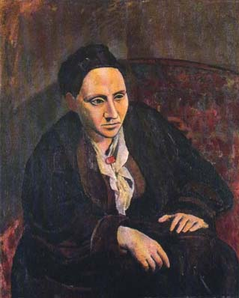
Gertrude Stein- American Author
(Portrait by Picasso)
"What is the answer?" [ I was silent ] "In that case, what is the question?"
Gertrude Stein’s last words (July 1946) as told by Alice B. Toklas in What Is Remembered (1963)

Slide 12
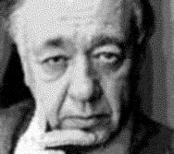
Eugene Ionescu
“It is not the answer that enlightens, but the question”

Slide 13
Changing the question can transform how you search for the answer

Slide 14
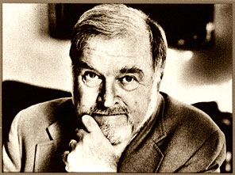
Mihalyi Csikszentmihalyi:
From “What is Creativity?” to

Slide 15
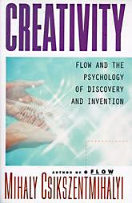
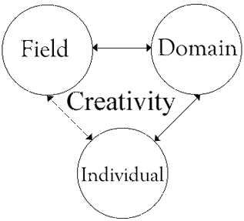
“Where is Creativity?”

Slide 16
Individual Talent
Field
(judges, institutions)
Domain/Discipline

Slide 17
Csikszentmihalyi’s Definitions Creativity (1993)
1) Domain: e.g. mathematics or biology, "consists of a set of symbols, rules and procedures”
2) Field: "the individuals who act as gatekeepers to the domain...decide whether a new idea, performance, or product should be included”
3) Individual: creativity is "when a person... has a new idea or sees a new pattern, and when this novelty is selected by the appropriate field for inclusion in the relevant domain"

Slide 18
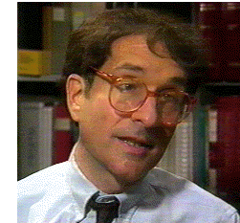
Bringing it Closer to Home: Howard Gardner

Slide 19
Howard Gardner, Creating Minds
In Czikszenmihalyi’s persuasive account, creativity does not inhere in any single node, nor, indeed, in any pair of nodes. Rather, creativity is best viewed as a dialectical or interactive process, in which all three of these elements participate:

Slide 20
Individual
(as a child and as a master)
Other Persons
Childhood: Family, peers
Mature years:
Rivals, judges, in the domain/discipline
The Work
(supporters in the field)

Slide 21
Mihalyi Csikszentmihalyi
"Creativity does not happen inside people's heads, but in interaction between a person's thoughts and a socio-cultural context."

Slide 22
Now Back To:
Where is Knowledge?
11th Conference on Frontiers of the Foundations of Physics
Paris, 6-9 July 2010

Slide 23

Philip Kitcher

Slide 24
"Public Knowledge and the Difficulties of Democracy“ (2006)
Most philosophy since 1640 [a reference to Descartes] has been obsessed with the concept of knowledge as an individual possession…. [T]he central epistemological problems for our times are not those about individual knowledge (questions probed in contemporary Anglophone philosophy with an astonishing attention to minutiae and an equally astonishing disregard of what might really matter).

Slide 25
"Public Knowledge and the Difficulties of Democracy“
They are instead about the character of knowledge as a public good and the systems that generate and sustain that good.

Slide 26
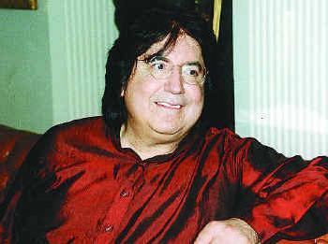
Roy Bhaskar

Slide 27
A Realist Theory of Science
Any adequate philosophy of science must find a way of grappling with this central paradox of science: that men in their social activity produce knowledge which is a social product much like any other,

Slide 28
A Realist Theory of Science
which is no more independent of its production and the men who produce it than motor cars, armchairs or books, which has its own craftsmen, technicians, publicists, standards and skills and which is no less subject to change than any other commodity. This is one side of `knowledge.'

Slide 29
A Realist Theory of Science
The other is that knowledge is 'of' things which are not produced by men at all: the specific gravity of mercury, the process of electrolysis, the mechanism of light propagation. None of these 'objects of knowledge' depend upon human activity.

Slide 30
A Realist Theory of Science
If men ceased to exist sound would continue to travel and heavy bodies fall to the earth in exactly the same way, though ex hypothesi there would be no-one to know it.

Slide 31
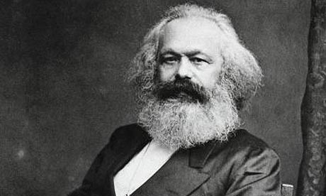
Karl Marx

Slide 32
“Introduction” to the Grundrisse, (Nikolaus translation, modified)
Hegel fell into the illusion of conceiving the real as the product of thought concentrating itself, probing its own depths, and unfolding itself out of itself, by itself, whereas the method of advancing from the abstract to the concrete is only the way in which thought appropriates the concrete, reproduces it as the concrete-in-thought.

Slide 33
Surely, no one falls into this Hegelian trap today!
-Or do They?

Slide 34
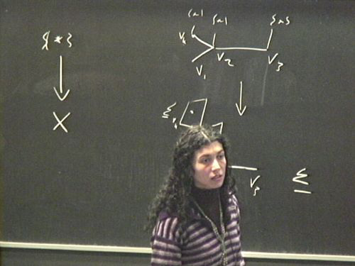
Cecilia Flori

Slide 35
Topoi for Physics
Platonically speaking, one can view a Physics Theory as a concrete realization, in the realm of a Topos, of an abstract “idea” in the realm of logic. Therefore, this view presupposes that at a fundamental level, what there is, are logical relations among elements, and a Physics Theory is nothing more than a repre-sentation of these relations as applied/ projected to specific situations/systems.

Slide 36

_{Sunny Auyang}

Slide 37
How is Quantum Field Theory Possible?
We must mark the logical distinction between substantive and general concepts, or the substantive content and the categorial framework of a theory. Electron, electrically charged, a dozen, and in between are substantive concepts, which characterize the subject matter of the empirical sciences.

Slide 38
How is Quantum Field Theory Possible?
Object, property, quantity, and relation are general concepts that constitute the categorial framework within which the substantive contents are acknowledged as a description of the world. ...

Slide 39
How is Quantum Field Theory Possible?
Modern physical theories introduce radically new substantive concepts but maintain the continuity of the categorial framework. They do not overthrow general common concepts but rethink them and make them their own, effectively clarifying and reinforcing them.

Slide 40
Measure and Units
In physical theory, the step from physical to mathematical concepts can only be taken on the basis of some system of units. It is only the ratio of a physical quantity to some unit of that quantity that can be treated as a “pure number.”

Slide 41
Measure and Units
Here is where the question of measurement enters unavoidably into the foundations of physics, quite apart from any philosophical issues of "instrumentalism," which I dislike as much as anyone else.

Slide 42
Measure and Units
1) Marx on Measure
2) D’Alembert on Role of Units
3) Schouten on Difference Between Mathematical and Physical Components

Slide 43
Capital, Volume One, third paragraph
Every useful thing, for example, iron, paper, etc., must be considered from the two points of view, quality and quantity. Every such thing is a totality of many properties and can therefore be useful in various ways. The discovery of these various ways and hence of the manifold uses of things is the work of history.

Slide 44
Capital, Volume One (cont’d)
So too the invention of social standards of measure for the quantities of useful objects. The diversity of the measures for commodities arises in part from the diverse nature of the objects to be measured, in part from convention.

Slide 45
Measure and Units
1) Marx on Measure
2) D’Alembert on Role of Units
3) Schouten on Difference Between Mathematical and Physical Components

Slide 46
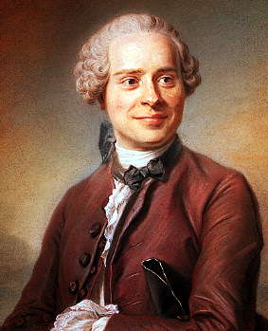
Jean le Ronde D’Alembert

Slide 47
Traité de Dynamique, 1743
One cannot compare with each other two things of a different nature, such as space and time; but one can compare the relation of portions of time with that of the portions of the space traversed.

Slide 48
Traité de Dynamique, 1743
[Such an equation will] express, not the relation of the times to the spaces, but, if one may so put it, the relation of the relation that the parts of time have to their unit, to that which the parts of space have to their unit.

Slide 49
Measure and Units
1) Marx on Measure
2) D’Alembert on Role of Units
3) Schouten on Difference Between Mathematical and Physical Components

Slide 50
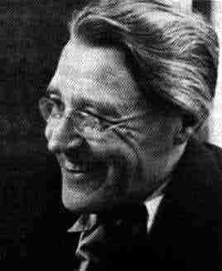
Jan Arnoldus Schouten

Slide 51
Tensor Analysis for Physicists
Quantities such as scalars, vectors, densities, etc., occurring in physics are not by any means identical with the [geometrical] quantities introduced in Chapter II.

Slide 52
Tensor Analysis for Physicists
For instance, though a velocity may be represented by an arrow, it is not true that it is simply a contravariant vector. In order to draw the vector belonging to a velocity it is necessary to introduce a unit of time and if this unit is changed the figure of the velocity changes.

Slide 53
Tensor Analysis for Physicists
From this we see that quantities in physics have a property that geometric quantities do not have. Their components change not only with transformations of coordinates but also with the transformation of certain units.

Slide 54
Coordinatization vs Spatio-temporal Identification
There is still a lot of confusion on this issue in discussions of the nature of space-time. Some still seem to identify a purely mathe-matical coordinatization of events with their

Slide 55
Coordinatization vs Spatio-temporal Identification
spatio-temporal identification, which of course requires some physical process(es): rods, clocks, light rays or wave fronts, values of some non-gravitational quantities, Kretschmann-Komar coordinates, or what have you.

Slide 56
What is Mathematics?
Cultural Origins: Language and Mathematics

Slide 57
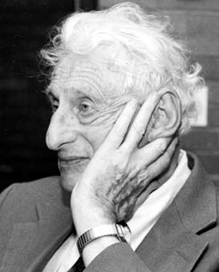
Philip. J. Davis

Slide 58
Applied Mathematics as Social Contract
The view that mathematics represents a timeless ideal of absolute truth and objectivity and is even of nearly divine origin is often called Platonist. It conflicts with the obvious fact that we humans have invented or discovered mathematics, that we have installed mathematics in a variety of places both in the arrangements of our daily lives and in our attempts to understand the physical world. In most cases, we can point to the individuals who did the inventing or made the discovery or the installation, citing names and dates.

Slide 59
Applied Mathematics as Social Contract
Platonism conflicts with the fact that mathematical applications are often conventional in the sense that mathematizations other than the ones installed are quite feasible (e.g., the decimal system). The applications are of ten gratuitous, in the sense that humans can and have lived out their lives without them (e.g., insurance or gambling schemes). They are provisional in the sense that alternative schemes are often installed which are claimed to do a better job. (Examples range all the way from tax legislation to Newtonian mechanics.)

Slide 60
Applied Mathematics as Social Contract
Opposed to the Platonic view is the view that a mathematical experience combines the external world with our interpretation of it, via the particular structure of our brains and senses, and through our interaction with one another as communicating, reasoning beings organized into social groups.

Slide 61
Applied Mathematics as Social Contract
The perception of mathematics as quasi-divine prevents us from seeing that we are surrounded by mathematics because we have extracted it out of unintellectualized space, quantity, pattern, arrangement, sequential order, change, and that as a consequence, mathematics has become a major modality by which we express our ideas about these matters.

Slide 62
Applied Mathematics as Social Contract
The conflicting views, as to whether mathematics exists independently of humans or whether it is a human phenomenon, and the emphasis that tradition has placed on the former view, leads us to shy away from studying the processes of mathematization, to shy away from asking embarrassing questions about this process: how do we install the mathematizations, why do we install them, what are they doing for us or to us, do we need them, do we want them, on what basis do we justify them.

Slide 63
Applied Mathematics as Social Contract
But the discussion of such questions is becoming increasingly important as the mathematical vision transforms our world, often in unforeseen ways, as it both sustains and binds us in its steady and unconscious operation. Mathematics creates a reality that characterize our age.

Slide 64
Applied Mathematics as Social Contract
The traditional philosophies of mathematics: platonism, logicism, formalism, intuitionism, in any of their varieties, assert that mathematics expresses precise, eternal relationships between atemporal mental objects. These philosophies are what Thomas Tymoczko has called “private” theories. In a private theory, there is one ideal mathematician at work, isolated from the rest of humanity and from the world, who creates or discovers mathematics by his own logico-intuitive processes.

Slide 65
Applied Mathematics as Social Contract
As Tymoczko points out, private theories of the unfolds. philosophy of mathematics provide no account either for mathematical research as it is actually carried out, for the applications of mathematics as they actually come about, or for the teaching process as it actually

Slide 66
Applied Mathematics as Social Contract
When teaching goes on under the banner of conventional philosophies of mathematics, if often becomes to a formalist approach to mathematical education: “do this, do that, write this here and not there, punch this button, call in that program, apply this definition and that theorem”.

Slide 67
Applied Mathematics as Social Contract
It stresses operations. It does not balance operations with an understanding of the nature or the consequences of the operations. It stresses syntactics at the expense of semantics, form at the expense of meaning. … Opposed to “private” theories, there are “public” theories of the philosophy of mathematics in which the teaching process is of central importance.

Slide 68

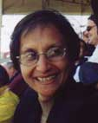
Christine Keitel, Renuka Vithal

Slide 69
Mathematical Power as Political Power
Since the beginnings of social organization, social knowledge of exposing, exchanging, storing and controlling information in either ritualized or symbolized (formalized) ways was needed, therefore developed and used, and in particular information that is closely related to production, distribution and exchange of goods and organization of labor.

Slide 70
Mathematical Power as Political Power
Early concepts of number and number operations, concepts of time and space, have been invented as means for governance and administration in response to social needs. Mathematics served early on as a distinctive tool for problem solving in social practices and as a means social power.

Slide 71
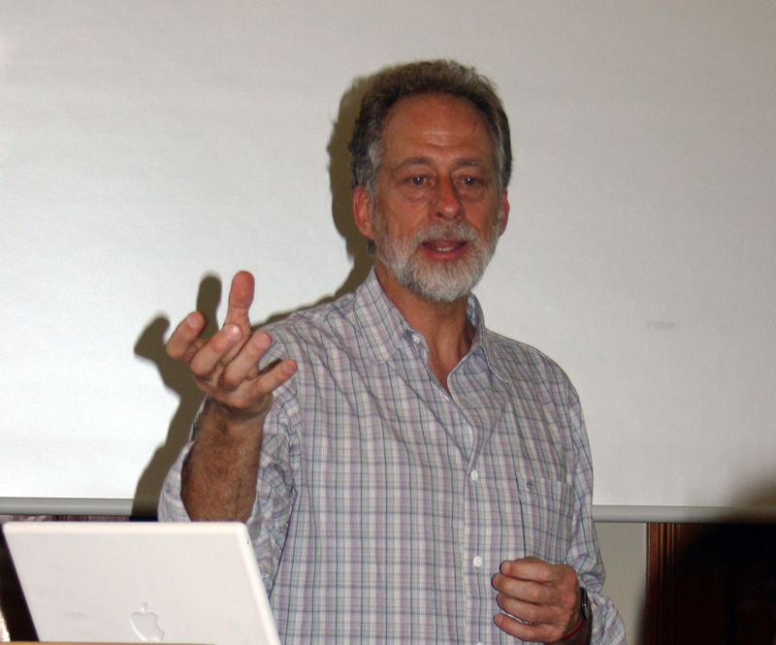
Michael Tomasello

Slide 72
The Cultural Origins of Human Cognition
The case of the other intellectual pillar of Western civilization, mathematics, is interestingly different from the case of language (and indeed it bears some similarities, but also some differences, to writing). Like language, mathematics clearly rests on universally human ways of experiencing the world (many of which are shared with other primates) and also on some processes of cultural creation and sociogenesis.

Slide 73
The Cultural Origins of Human Cognition
But in this case the divergences among cultures are much greater than in the case of spoken languages. All cultures have complex forms of linguistic communication, with variations of complexity basically negligible, whereas some cultures have highly complex systems of mathematics (practiced by only some of their members) as compared with other cultures that have fairly simple systems of numbers and counting.

Slide 74
The Cultural Origins of Human Cognition
In general, the reasons for the great cultural differences in mathematical practices are not difficult to discern. First different cultures and persons have different needs for mathematics. Most cultures and persons have the need to keep track of goods, for which a few number words expressed in natural language will suffice. When a culture or person needs to count objects or measure things more precisely—for example, in complex building projects or the like – the need for more complex mathematics arises.

Slide 75
The Cultural Origins of Human Cognition
Modern science as an enterprise, practiced by only some people in some cultures, presents a whole host of new problems that require complex mathematical techniques for their solution. But—and this is the analogy to writing—complex mathematics as we know it today can only be accomplished through the use of certain forms of graphic symbols. In particular, the Arabic system of numeration is much superior to older Western systems for the purposes of complex mathematics (e.g., Roman numerals).

Slide 76
Logic-Language-World
Three steps:
Logic is about Language,
Language is about The World.
Panlogism
  The attempt to “short circuit” this process by identifying the linguistic object the “object in the world” leads to the assertion:
Logic is about The Worldand

Slide 77
Mathematics- Concrete-in-Thought - Real Object
Three steps:
Mathematics is about Concrete-in-Thought,
Concrete-in-Thought is about The Real Object
Platonism
  The attempt to “short circuit” this process by identifying the “concrete-in- thought” and the real object leads to the assertion:
Mathematics is about The World

Slide 78
Simplest Example-The Integers
Everyone knows that geometry originated in land measurement; but many don't know about the similar origins of arithmetic. Recent work on Mesopotamian numerical symbolism shows that the "pure" integers are not so pure in origin.

Slide 79
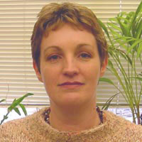
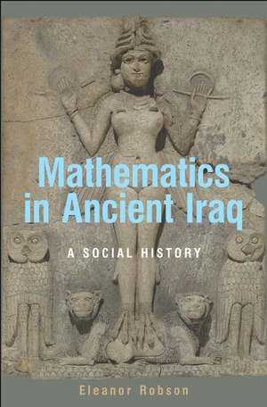
Eleanor Robson

Slide 80
Reviewed by Peter Damerow
The third chapter, “The Later Third Millennium”, focuses on the origins of what was probably the most influential innovation in southern Mesopotamia to foster the development of Babylonian mathematics, i.e., the invention of the sexagesimal place value system.

Slide 81
Reviewed by Peter Damerow
Before this invention, all mathematical activities in Mesopotamia were based on commodity-specific metrological notations and context-dependent symbolic operations.

Slide 82
Reviewed by Peter Damerow
Robson documents in this chapter how the administrative needs of developing empires led to the expansion, standardization, and integration of metrological systems and the development of ever more sophisticated methods of predicting and managing the storage and distribution of commodities, the allocation of labor, and the distribution of arable land.

Slide 83
Reviewed by Peter Damerow
This development eventually resulted in the invention of an abstract numerical notation system, the sexagesimal place value system, which brought about a radical unification and simplification of all kinds of calculation as applied by the scribes of the state bureaucracy.

Slide 84
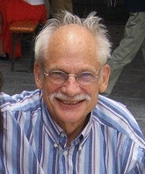
Peter Damerow
Abstraction and Represen-tation/ Essays on the Cultural Evolution of Thinking.

Slide 85
“Numerals” are not Numbers
[T]he 'numerals’ of the archaic texts do not represent numbers in our modern sense, for they do not have a context-independent meaning; their arithmetical function depends on the context in which they are used …The early standards of measurement did not yet represent context-independent dimensions of reality with an internal arithmetical structure.

Slide 86
Simplest Example-The Integers
Historically, counting arose from the need of ruling elites to have a way of keeping track of goods that came into their possession. The written records show that there were different number symbols for different types of things. So historically, abstract integers are a second-order abstraction from a multiplicity of what we might call concrete integers.

Slide 87
Simplest Example-The Integers
And logically, one may recall Russell and Whitehead's definition of integers, which is also a second-order abstraction. For example: Three is the class of all classes of things that can be put into one-one correspondence with John, Jane and Mary.
So I think there is no escape from units-- in principle, of course-- even in counting.

Slide 88
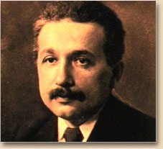
Albert Einstein

Slide 89
“Remarks on Bertrand Russell’s Theory of Knowledge” (1944)
[T]he series of integers is obviously an invention of the human mind, a self-created tool which facilitates the ordering of certain sensory experiences. But there is no way by which this concept can be made to grow directly out of these experiences. I choose here the concept of number just because it belongs to pre-scientific thought and in spite of that its constructive character is still easily recognizable.

Slide 90
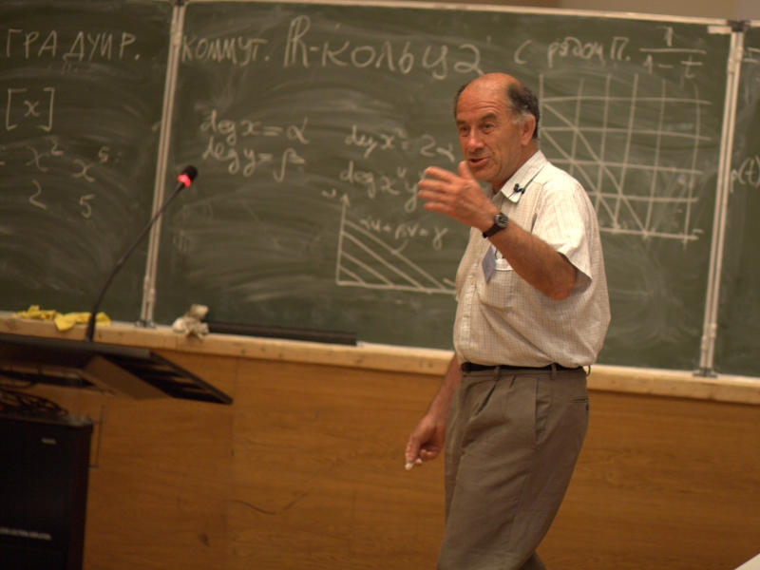
In Memoriam: Vladimir Arnold

Slide 91
On teaching mathematics
Palais de Découverte, 7 March 1997
Mathematics is a part of physics. Physics is an experimental science, a part of natural science. Mathematics is the part of physics where experiments are cheap. …In the middle of the twentieth century it was attempted to divide physics and mathematics. The consequences turned out to be catastrophic. Whole generations of mathematicians grew up without knowing half of their science and, of course, in total ignorance of any other sciences.

Slide 92
On teaching mathematics
Palais de Découverte, 7 March 1997
I even got the impression that scholastic mathematicians (who have little knowledge of physics) believe in the principal difference of the axiomatic mathematics from modeling which is common in natural science and which always requires the subsequent control of deductions by an experiment. Not even mentioning the relative character of initial axioms, one cannot forget about the inevitability of logical mistakes in long arguments (say, in the form of a computer breakdown caused by cosmic rays or quantum oscillations).

Slide 93
On teaching mathematics
Palais de Découverte, 7 March 1997
Every working mathematician knows that if one does not control oneself (best of all by examples), then after some ten pages half of all the signs in formulae will be wrong and twos will find their way from denominators into numerators. The technology of combatting such errors is the same external control by experiments or observations as in any experimental science and it should be taught from the very beginning to all juniors in schools.

Slide 94
On teaching mathematics
Palais de Découverte, 7 March 1997
Attempts to create "pure" deductive-axiomatic mathematics have led to the rejection of the scheme used in physics (observation - model - investigation of the model - conclusions - testing by observations) and its substitution by the scheme: definition - theorem - proof. It is impossible to understand an unmotivated definition but this does not stop the criminal algebraists-axiomatisators.

Slide 95
On teaching mathematics
Palais de Découverte, 7 March 1997
For example, they would readily define the product of natural numbers by means of the long multiplication rule. With this the commutativity of multiplication becomes difficult to prove but it is still possible to deduce it as a theorem from the axioms. It is then possible to force poor students to learn this theorem and its proof (with the aim of raising the standing of both the science and the persons teaching it). It is obvious that such definitions and such proofs can only harm the teaching and practical work.

Slide 96
On teaching mathematics
Palais de Découverte, 7 March 1997
What is a group? Algebraists teach that this is supposedly a set with two operations that satisfy a load of easily-forgettable axioms. This definition provokes a natural protest: why would any sensible person need such pairs of operations? … We get a totally different situation if we start off not with the group but with the concept of a transformation (a one-to-one mapping of a set onto itself) as it was historically. A collection of transformations of a set is called a group if along with any two transformations it contains the result of their consecutive application and an inverse transformation along with every transformation.

Slide 97
On teaching mathematics
Palais de Découverte, 7 March 1997
This is all the definition there is. The so-called "axioms" are in fact just (obvious) properties of groups of transformations. What axiomatisators call "abstract groups" are just groups of trans-formations of various sets considered up to iso-morphisms (which are one-to-one mappings preserving the operations). As Cayley proved, there are no "more abstract" groups in the world. So why do the algebraists keep on tor-menting students with the abstract definition?

Slide 98
On teaching mathematics
Palais de Découverte, 7 March 1997
The return of mathematical teaching at all levels from the scholastic chatter to presenting the important domain of natural science is an especially hot problem for France. I was astonished that all the best and most important-in-approach to method mathematical books are almost unknown to students here (and, seems to me, have not been translated into French).

Slide 99
On teaching mathematics
Palais de Découverte, 7 March 1997
Among these are Numbers and figures by Rademacher and Töplitz, Geometry and the imagination by Hilbert and Cohn-Vossen, What is mathematics? by Courant and Robbins, How to solve it and Mathematics and plausible reasoning by Polya, Develop-ment of mathematics in the 19th century by F. Klein.

Slide 100
Physics
From Craft to Industry
The Primacy of Process
Closed vs Open Systems
A Theory of Everything?

Slide 101
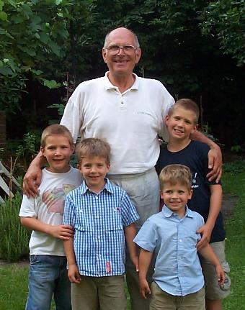
Hans Günter Dosch

Slide 102
Beyond the Nanoworld/Quarks, Leptons, and Gauge Bosons
Detectors that were originally the size of cigar boxes, are today as big as houses. The quantity of data flowing from a typical measurement is impressive even to communications specialists. It is no wonder that the Internet was developed at CERN. As a result of such growing complexity, ever larger numbers of scientists are involved in a single experiment.

Slide 103
Beyond the Nanoworld/Quarks, Leptons, and Gauge Bosons
In 1933, C. D. Anderson proved the existence of antimatter. His article in Physical Review Letters was four pages long. By contrast, the discovery of the top quark in 1995 resulted from research undertaken by two large groups of scientists. When this discovery was described in print, the list of authors and institutions alone filled nearly four pages.

Slide 104
Physics
From Craft to Industry
The Primacy of Process
Closed vs Open Systems
A Theory of Everything?

Slide 105
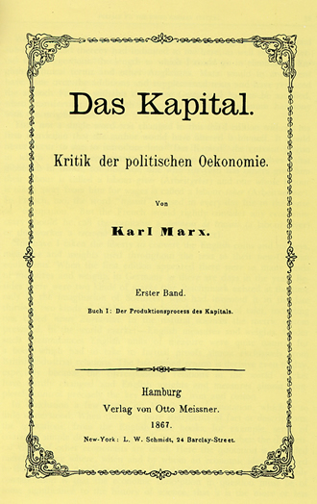
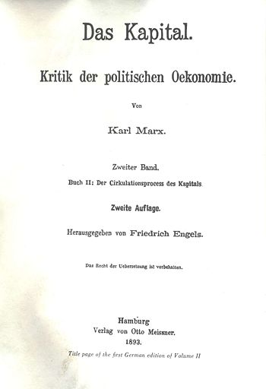
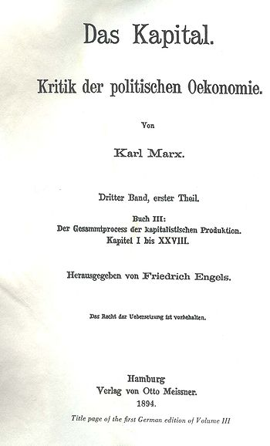
Capital: I. The Production Process, II. The Circulation Process, III.The Complete Process

Slide 106
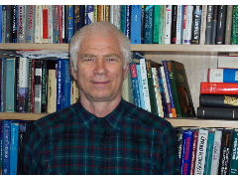
Hans Ehrbar

Slide 107
Annotations to Karl Marx’s Introduction to Grundrisse
Notice that ‘The subject, society’ is indeed a process, as are labor, capital and so many other categories considered by Marx.

Slide 108
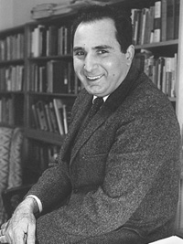
Marx Wartofsky

Slide 109
Conceptual Foundations of Scientific Thought
“[A] thing, insofar as it is more than an instantaneous occurrence and has duration through time, is a process. This introduces some odd results in our ways of talking. For example, talking would be a process but we would hardly talk of it as a “thing”; similarly, it is not usual to talk of a rock or a human being as a process.”

Slide 110
Things and Processes
A particular, concrete structure is characterized by some concrete objects (the relata) together with a set of concrete relations between them. The word “object” is here used in a very broad sense, which allows objects to be (elements of) processes as well as states.

Slide 111
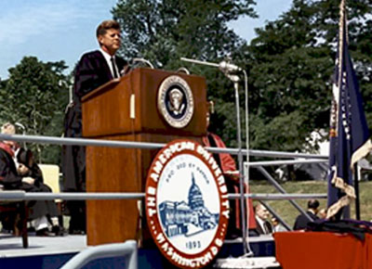
John F. Kennedy

Slide 112
1963 Commencement Address, American University
“Genuine peace must be the product of many nations, the sum of many acts. It must be dynamic, not static, changing to meet the challenge of each new generation.
For peace is a process– a way of solving problems.”

Slide 113
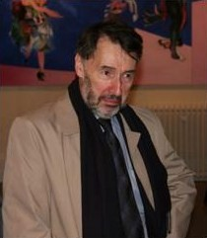
Chris Isham

Slide 114
“Is it True; or is it False; or Some-where In Between? The Logic of Quantum Theory”
"A key feature of classical physics is that, at any given time, the system has a definite state, and this state determines-- and is uniquely determined by-- the values of all the physical quantities associated with the system.“
Realism is "the philosophical view that each physical quantity has a value for any given state of the system.“

Slide 115
Primacy of Process
Phrases such as "at any moment of time", "at any given time” are appropriate in Newtonian-Galileian physics, which is based on a global absolute time. But from SR on to GR, this phrase involves a convention defining a global time.

Slide 116
Primacy of Process
The only convention-invariant things are processes, each involving a space-time region. This suggests-- as do many other considerations-- that the fundamental entities in quantum theory are the transition amplitudes, and that states should be taken in the c.g.s. system (cum grano salis).

Slide 117
Primacy of Process
And this is true of our measurements as well: any measurement involves a finite time interval and a finite 3-dimensional spatial region. Sometimes, we can get away with neglecting this, and talking, for example in NR QM, about ideal instantaneous measurements.

Slide 118
Primacy of Process
But sometimes we most definitely cannot, as Bohr and Rosenfeld demonstrated for E-M QFT, where the basic quantities defined by the theory (and therefore measurable-- I am not an operationalist!) are space-time averages. Their critique of Heisenberg shows what happens if you forget this!

Slide 119
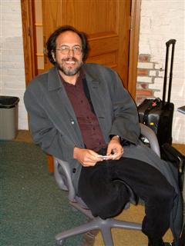
Lee Smolin

Slide 120
Three Roads to Quantum Gravity
“[R]elativity theory and quantum theory each ... tell us-- no, better, they scream at us-- that our world is a history of processes. Motion and change are primary. Nothing is, except in a very approximate and temporary sense. How something is, or what its state is, is an illusion.

Slide 121
Three Roads to Quantum Gravity
It may be a useful illusion for some purposes, but if we want to think fundamentally we must not lose sight of the essential fact that 'is' is an illusion. So to speak the language of the new physics we must learn a vocabulary in which process is more important than, and prior to, stasis.

Slide 122
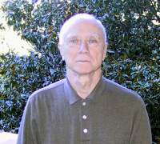
David Finkelstein

Slide 123
A Process Conception of Nature
The powerful conceptions of nature surveyed … incorporate two recent revolutions [relativity and quantum-JS] and yet may still be upside-down … They employ spacetime to describe matter and process as though spacetime were primary and process secondary .. I believe the way has been prepared to turn over the structure of present physics, to take process as fundamental at the microscopic level and spacetime and matter as semimacroscopic statistical constructs akin to temperature and entropy.

Slide 124
Physics
From Craft to Industry
The Primacy of Process
Closed vs Open Systems
A Theory of Everything?

Slide 125
Closed versus Open Systems
System Key Concept
Closed Determinism
Open Causality
Determinism means fatalism: nothing can change what happens
Causality means control: by manipulating the causes, one can change the outcome
“Determinism is really an article of philosophical faith, not a scientific result” (JS 1968).

Slide 126
The Dogma of Closure
When classical physics treated open systems, it was tacitly assumed (as an article of faith) that, by suitable enlargement of the system, it could always be included in closed system of a deterministic type. … The contrast between open and closed should not be taken as identical with the contrast between ‘phenomenological’ and ‘fundamental’ …
(JS: “Comments on ‘Causality Requirements and the Theory of Relativity,” 1968)

Slide 127
Do We Really Want Closed?
The systems we actually model are finite processes, and all finite processes are open.
A finite process is a bounded region in space- time: Its boundary is where new data (information) can be fed into the system and the resulting data can be extracted from it.
Example: Asymptotically free in- and out-states in a scattering process.

Slide 128
Cosmology
Open: Steady State – continuous creation
Closed (after initial input): Big Bang
choice based on observations, not prejudices
N.B.: Div T = 0 does not imply conservation of matter without some conditions on the form of the stress-energy tensor

Slide 129
“A Topos Foundation for Theories of Physics”:
Isham and Döring (2007)
[T]he Copenhagen interpretation is inappli-cable for any system that is truly closed’ (or ‘self-contained’) and for which, therefore, there is no ‘external’ domain in which an observer can lurk. … When dealing with a closed system, what is needed is a realist interpretation of the theory, not one that is instrumentalist.

Slide 130
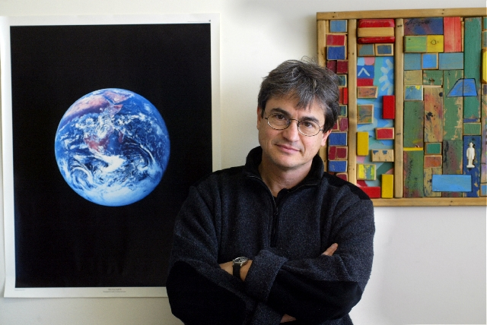
Carlo Rovelli

Slide 131
Quantum Gravity
The data from a local experiment (measurements, preparation, or just assumptions) must in fact refer to the state of the system on the entire bound-ary of a finite spacetime region. The field theoretical space ... is therefore the space of surfaces Σ [where Σ is a 3d surface bounding a finite spacetime region] and field configurations φ on Σ . Quantum dynamics can be expressed in terms of an amplitude W[Σ , φ].

Slide 132
Quantum Gravity
Following Feynman’s intuition, we can formally define W[Σ , φ] in terms of a sum over bulk field configurations that take the value φ on Σ. … Notice that the dependence of W[Σ , φ] on the geometry of Σ codes the spacetime position of the measuring apparatus. In fact, the relative position of the components of the apparatus is determined by their physical distance and the physical time elapsed between measurements, and these data are contained in the metric of Σ.

Slide 133
Quantum Gravity
Consider now a background independent theory. Diffeomorphism invariance implies immediately that W[Σ , φ] is independent of Σ ... Therefore in gravity W depends only on the boundary value of the fields. However, the fields include the gravitational field, and the gravitational field determines the spacetime geometry. Therefore the dependence of W on the fields is still sufficient to code the relative distance and time separation of the components of the measuring apparatus!

Slide 134
Quantum Gravity
What is happening is that in background-dependent QFT we have two kinds of measurements: those that determine the distances of the parts of the apparatus and the time elapsed between measurements, and the actual measurements of the fields’ dynamical variables. In quantum gravity, instead, distances and time separations are on an equal footing with the dynamical fields. This is the core of the general relativistic revolution, and the key for background- independent QFT.

Slide 135
Physics
From Craft to Industry
The Primacy of Process
Closed vs Open Systems
A Theory of Everything?

Slide 136
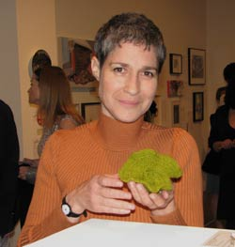
Margaret Wertheim

Slide 137
Pythagoras’ Trousers (1997)
[A] major psychological force behind the evolution of physics has been the a priori belief that the structure of the natural world is determined by a set of transcendent mathematical relations. This is a scientific variant of what is known as Platonism. … [T]he emergence of a mathematically based physics was linked to the notion that God himself was a divine mathematician.

Slide 138
Pythagoras’ Trousers (1997)
[I]n the last few decades the physics community has become almost fanatically obsessed with a goal that I suggest offers very few benefits for our society. That is the dream of finding a unified theory of the particles and forces of nature– a set of mathematical equations that would encompass not only matter and force but space and time as well.

Slide 139
Pythagoras’ Trousers (1997)
In such a synthesis, everything that is would supposedly be revealed as a complex vibration in a universal force field. Protons, pulsars, petunias, and people would all be enfolded into a mathematical “symmetry,” wherein the entire universe would be described as math made manifest. This is what physicists envisage when they talk about a “theory of everything,” … a TOE.

Slide 140
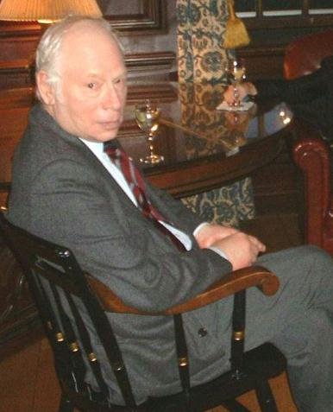
Steve Weinberg

Slide 141
Waiting for a Final Theory
Lake Views: This World and the Universe (2000)
To qualify as an explanation, a fundamental theory has to be simple– not necessarily a few short equations, but equations that are based on a simple physical principle, in the way that the equations of General Relativity are based on the principle that gravitation is an effect of the curvature of space-time. And the theory has to be compelling– it has to give us the feeling that it could scarcely be different from what it is.

Slide 142
Waiting for a Final Theory
Lake Views: This World and the Universe
When at last we have a simple, compelling, mathematically consistent theory …. It will be a good bet that this theory really is final. Our description of nature has become increasing-ly simple. More and more is being explained by fewer and fewer fundamental principles. But simplicity can’t increase without limit. It seems likely that the next major theory that we settle on will be so simple that no further simplification would be possible.

Slide 143
Waiting for a Final Theory
Lake Views: This World and the Universe
The final theory will let us answer the deepest questions of cosmology. Was there a beginning to the present condition of the universe? What determined the conditions at the beginning. And is what we call our universe … really all there is, or is it only one part of a much larger “multiverse,” in which the expansion we see is just a local episode?

Slide 144
Waiting for a Final Theory: Footnote added in 2009
Indeed, the distance we still have to go in understanding the funda-mental laws of nature seems even greater in 2009 than it did in 2000.

Slide 145
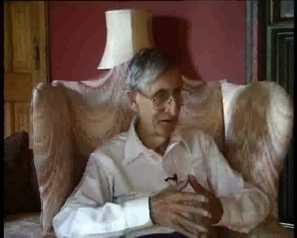
Freeman Dyson

Slide 146
Dyson on Weinberg (NY Review of Books, June 10, 2010)
I find it ironic that Weinberg, after declaring so vehemently his hostility to religious beliefs, emerges in his writing about science as a man of faith. He believes passionately in the possibility of a Final Theory. He wrote a book with the title Dreams of a Final Theory, and the notion of a Final Theory permeates his thinking in this book too.

Slide 147
Dyson on Weinberg (cont’d)
A Final Theory means a set of mathematical rules that describe with complete generality and complete precision the way the physical universe behaves. Complete generality means that the rules are obeyed everywhere and at all times. Complete precision means that any discrepancies between the rules and the results of experimental measurements will be due to the limited accuracy of the measurements.

Slide 148
Dyson on Weinberg (cont’d)
For Weinberg, the Final Theory is not merely a dream to inspire his brilliant work as a mathema-tical physicist exploring the universe. For him it is an already existing reality that we humans will soon discover. It is a real presence, hidden in the motions of atoms and galaxies, waiting for us to find it. The faith that a Final Theory exists, ruling over the operations of nature, strongly influences his thinking about history and ethics as well as his thinking about science.

Slide 149
Dyson on Weinberg (cont’d)
I distrust his judgment about philosophical questions because I think he overrates the capacity of the human mind to comprehend the totality of nature. He has spent his professional life within the discipline of mathematical physics, a narrow area of science that has been uniquely successful. In this narrow area, our theories describe a small part of nature with astonishing clarity.

Slide 150
Dyson on Weinberg (cont’d)
Our ape-brains and tool-making hands were marvelously effective for solving a limited class of puzzles. Weinberg expects the same brains and hands to illuminate far broader areas of nature with the same clarity. I would be disappointed if nature could be so easily tamed. I find the idea of a Final Theory repugnant because it diminishes both the richness of nature and the richness of human destiny.

Slide 151
La philosophie silencieuse (1975)
A fixed point no longer exists, from which one could hope to recapture, even in its simple form, the configuration of knowledge and thereby propose its closure. It’s not the temptation that is lacking but the instrument that would allow one to give into it in a convincing manner.

Slide 152
La philosophie silencieuse (1975)
Neither from the side of the Subject, nor of the Concept, nor of Nature do we find something today to nourish and attain a totalizing discourse. It is better to take note of this and to renounce an anachronistic rear-guard battle on this score, .

Slide 153
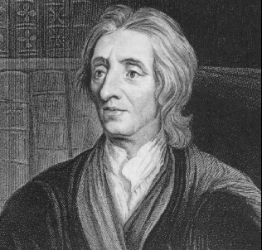
" ‘Tis Ambition enough to be employed as an Under-Labourer in clearing Ground a little, and removing some of the Rubbish, that lies in the way to Knowledge“
John. Locke, An Essay Concerning Human Understanding

Slide 154
Thank You !

