Slide 1
Bohr: Complementarity and Correspondence
John Stachel
Center for Einstein Studies, Boston University
HQ-3, MPIWG, Berlin June 29,2020

Slide 2
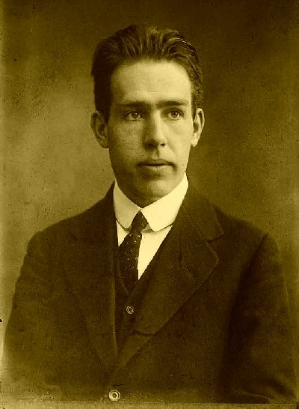
The Young Niels Bohr

Slide 3
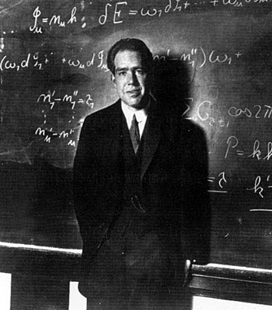
The Mature Niels Bohr

Slide 4
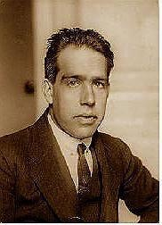
The Quantum of Action
"Anyone who is not dizzy after his first acquaintance with the quantum of action has not understood a word."
Niels Bohr

Slide 5
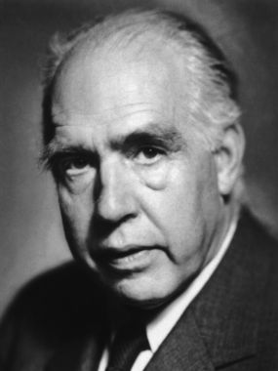
The Sage of Copenhagen

Slide 6
The Quantum of Action h
[There is] an element of wholeness, so to speak, in the physical processes, a feature going far beyond the old doctrine of the restricted divisibility of matter. This element is called the universal quantum of action. It was discovered by Max Planck in the first year of this [twentieth] century and came to inaugurate a whole new epoch in physics and natural philosophy.

Slide 7
The Quantum of Action h (cont’d)
We came to understand that the ordinary laws of physics, i.e., classical mechanics and electrodynamics, are idealizations that can only be applied in the analysis of phenomena in which the action involved at every stage is so large compared to the quantum that the latter can be completely disregarded.
(Niels Bohr: “Atoms and Human Knowledge,” 1957).

Slide 8
Outline of my talk
1) The Correspondence Principle
2) Complementarity:
a) The role of Einstein’s experiments
b) First formulation of the Principle
c) Evolution of Bohr’s formulations
3) Complementarity and Correspondence
a)Electrons vs Electromagnetic Fields
b) Einstein and Bohr

Slide 9
Outline of my talk
1) The Correspondence Principle
2) Complementarity:
a) The role of Einstein’s experiments
b) First formulation of the Principle
c) Evolution of Bohr’s formulations
3) Complementarity and Correspondence
a)Electrons vs Electromagnetic Fields
b) Einstein and Bohr

Slide 10
The Correspondence Principle
It was probably Einstein's new derivation of Planck's black-body radiation law (1916-17) that most directly inspired Bohr's formulation of the Correspondence Principle around 1918, which thereafter played such a large role in his attempts to understand quantum phenomena.

Slide 11
The Bohr-Einstein Dialogue
As photographed by Paul Ehrenfest

Slide 12
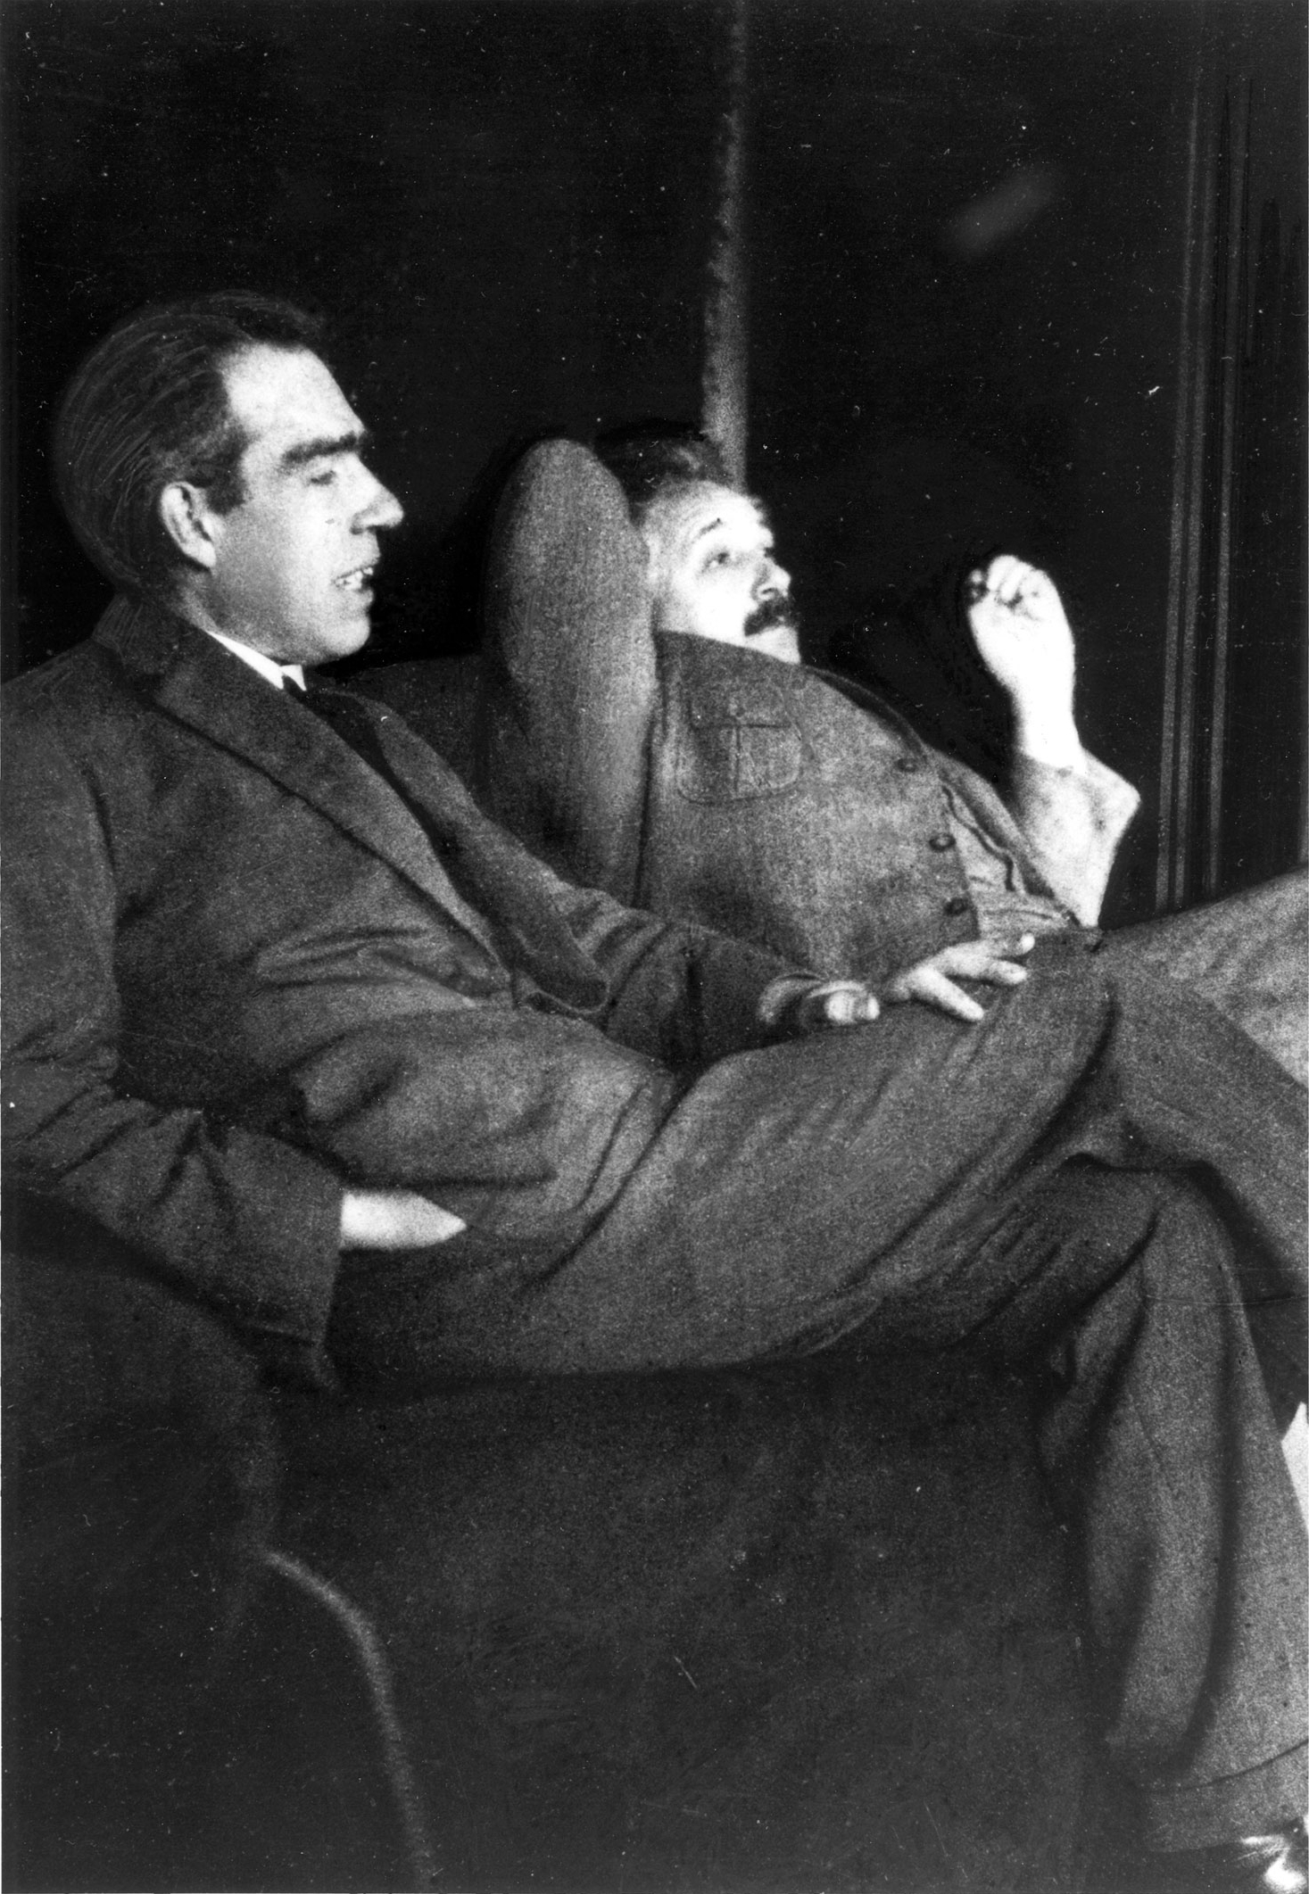

Slide 13
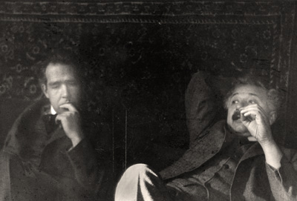

Slide 14
The Correspondence Principle
Bohr's reliance on the correspondence principle seems to have been a principal motive for his distrust of the photon concept and related willingness to give up energy-momentum conservation to save the classical wave picture of electromagnetic radiation.

Slide 15
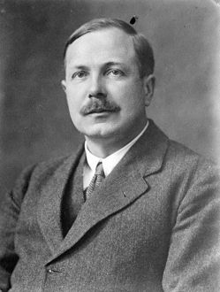
Charles Galton Darwin
Worked at the University of Manchester with Rutherford and Bohr on the Rutherford model of the atom. After WWI he worked on statistical mechanics.
Next he worked on problems of quantum mechanics

Slide 16
Bohr: Letter to C. G. Darwin, 1919
[A]s regards the wave theory of light I feel inclined to take the often proposed view that the fields in free space (or rather in gravitational fields) are gov-erned by the classical electrodynamical laws & that all difficulties are concentra-ted on the interaction between the electromagnetic forces and matter.

Slide 17
Bohr: Letter to C. G. Darwin, 1919 (cont’d)
Here I feel on the other hand inclined to take the most radical or rather mystical views imaginable. On the quantum theory conservation of energy seems quite out of question and the frequency of the incident light would just seem to be the key to the lock which controls the starting of the interatomic process.

Slide 18
“Applications of the Quantum Theory to Atomic Problems in General,” 1921 ms.
[I]t would appear, that the interesting argu-ments brought forward more recently by Einstein, and which are based on a considera-tion of the interchange of momentum between the atom and the radiation rather than supporting the theory of light quanta will seem to bring the legitimacy of a direct application of the theorems of conservation of energy and momentum to the radiation processes into doubt.

Slide 19
Notes for the 1923 Second Silliman Lecture
Einstein's … suggestion that the transmission of light does not take place by waves but is atomic in nature …. cannot however be considered as a serious theory of light transmission.

Slide 20
Notes for the 1923 Second Silliman Lecture
Light is not only a flow of energy, but our description of radiation involves a large amount of physical experience involving optical apparatus including our eyes for the understanding of the working of which nothing seems satisfactory except wave theory of light.

Slide 21
“Problems of The Atomic Theory,” 1923-24 ms.
It is more probable that the chasm appearing between these so different conceptions of the nature of light is an evidence of unavoidable difficulties of giving a detailed description of atomic processes without departing essentially from the causal description in space and time that is characteristic of the classical mechanical description of nature.

Slide 22
Outline of my talk
1) The Correspondence Principle
2) Complementarity:
a) The role of Einstein’s experiments
b) First formulation of the Principle
c) Evolution of Bohr’s formulations
3) Complementarity and Correspondence
a)Electrons vs Electromagnetic Fields
b) Einstein and Bohr

Slide 23
The role of Einstein’s experiments
Einstein attempted twice, in 1921 and 1926, to design a "crucial" optical experiment that would distinguish between the light quantum hypothesis and the classical wave theory of light. In both cases, it became clear to him-- after considerable resistance-- that his experiment actually did not predict a different result for light quanta than was predicted by the classical theory.

Slide 24
Einstein’s Two Experiments
1) “Ein den Elementarprozess der Lichtemission betreffendes Experiment,” Sitzungsberichte der Preussischen Akademie der Wissenschaften, Phys.-math. Klasse, 1921
“Theorie der Lichtfortpflanzung in dispergierenden Medien,” ibid., 1922
2) “Vorschlag zu einem die Natur des elementaren Strahlungs-emissions-prozesses betreffenden Experiment,” Naturwissenschaften, 1925
“Interferenzeigenschaften des durch Kanalstrahlen emittierten Lichtes,” Sitzungsberichte der Preussischen Akademie der Wissenschaften, Phys.-math. Klasse, 1926

Slide 25
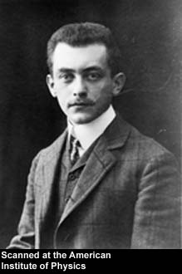
Max Born

Slide 26
Einstein to Born, 22 August 1921
I have just thought of a very interesting and fairly simple experiment on the nature of the emission of light. I hope to be able to carry it out soon.

Slide 27
Einstein to Born, 30 December 1921
The experiment on light emission has now been completed …. The result: the light emitted by moving particles of canal rays is strictly monochromatic while, according to the wave theory, the color of the elementary emission should be different in different directions. It is thus proved that the wave field does not really exist …. This has been my most impressive scientific experience in years.

Slide 28
Einstein to Born, ? January 1922
[T]he experiment …how simple it is. The trick is this: the positive ray particle, according to the wave theory, continuously emits variable colors in different directions. Such a wave travels in dispersive media with a velocity that is a function of position. Thus the wave surfaces should be bent as in terrestrial refraction. But the experimental result is reliably negative.

Slide 29
Einstein to Born, 18 January 1922
Laue is violently opposed to my experiment, or rather my interpretation of it. He maintains that the wave theory does not involve any deflection of rays whatsoever. … Today there was a great dispute at the Colloquium, to be continued next time.

Slide 30
Einstein to Born, Undated 1922
I too committed a monumental blunder some time ago (my experiment on the emission of light with positive rays), but one must not take it too seriously. Death alone can save one from making such blunders. I greatly admire the sure instinct that guides all of Bohr’s work.

Slide 31
Einstein to Born, 29 April 1924
Bohr’s opinion about radiation is of great interest. But I should not want to be forced into abandoning strict causality without defending it more strongly than I have so far. I find the idea quite intolerable that an electron exposed to radiation should choose of its own free will, not only the moment to jump off, but also its direction. In that case I would rather be a cobbler, or even an employee in a gaming house, than a physicist.

Slide 32
Einstein’s Two Experiments
1) “Ein den Elementarprozess der Lichtemission betreffendes Experiment,” Sitzungsberichte der Preussischen Akademie der Wissenschaften, Phys.-math. Klasse, 1921
“Theorie der Lichtfortpflanzung in dispergierenden Medien,” ibid., 1922
2) “Vorschlag zu einem die Natur des elementaren Strahlungs-emissions-prozesses betreffenden Experiment,” 16 March 1926, die Naturwissenschaften “Interferenzeigenschaften des durch Kanalstrahlen emittierten Lichtes,” 8 July 1926, Sitzungsberichte der Preussischen Akademie der Wissenschaften, Phys.-math. Klasse

Slide 33
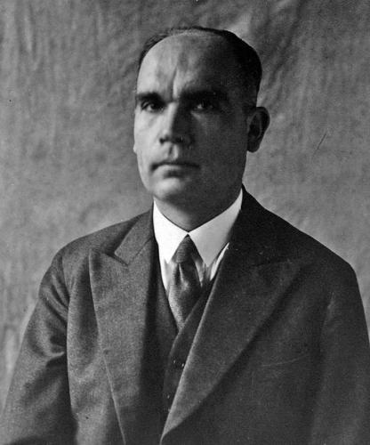
Emil Rupp

Slide 34
“Interferenzuntersuchungen an Kanalstrahlen,” October 1925
Rupp’s Habilitationsschrift, University of Heidelberg, published in Annalen der Physik, February 1926. In it he proposed a way to carryout out Einstein’s proposed experiment, which he proceeded to do. The results were reported in:

Slide 35
“Über die Interferenzfähigkeit des Kanalstrahllichtes”
Dated August 1926, presented by Einstein at the 21 October meeting of the Prussian Academy, published in the 1926 volume of the Academy’s Sitzungsberichte.
It confirmed Einstein’s predicted results, which Joos had already shown to be indistinguishable from the wave theory’s predictions.

Slide 36
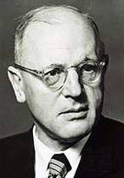
Georg Joos

Slide 37
“Modulation und Fourieranalyse im sichtbaren Spektralbreich,” 18 May 1926, Physikalische Zeitschrift
Joos analyzed Einstein’s proposed experiment and showed that the predicted results did not differ from those of the wave theory. So the experiment did not allow one to arrive at any decision between the wave and particle pictures.

Slide 38
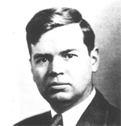
John C. Slater
Received his PhD in physics from Harvard University in 1923. He then studied at Cambridge and Copenhagen, and returned to Harvard in 1925. From 1930 to 1966, Slater was a professor of physics at the Massachusetts Institute of Technology

Slide 39
Report on Conversation in Leiden (Bohr to Slater, 28 January 1926).
“I believe that Einstein agrees with us in the general ideas, and that especially he has given up any hope of proving the correctness of the light quantum theory by establishing contradictions with the wave theory description of optical phenomena”

Slide 40
Outline of my talk
1) The Correspondence Principle
2) Complementarity:
a) The role of Einstein’s experiments
b) First formulation of the Principle
c) Evolution of Bohr’s formulations
3) Complementarity and Correspondence
a)Electrons vs Electromagnetic Fields
b) Einstein and Bohr

Slide 41
First formulation of the Principle
Analysis of the failure of such attempts as Einstein’s proposed experiments may well have been one of the important clues that led Bohr to formulate his complementarity interpretation of the new quantum mechanics of Born and Heisenberg, together with the new wave mechanics of de Broglie and Schroedinger

Slide 42
First formulation of the Principle
At any rate, as noted by Jørgen Kalckar, it was in a letter to Einstein (which included the page proofs of Heisenberg's "uncertainty principle" paper) that Bohr seems first to have sketched out the complementarity concept.

Slide 43

The project to publish the Niels Bohr Collected Works was conceived by Bohr’s close collaborator Léon Rosenfeld (1904–1974), a physicist, historian of science and Bohr’s close and long-time collaborator. Upon Rosenfeld’s death, another of Bohr’s colleagues, Jens Rud Nielsen (1894–1979), temporarily took responsibility for the publication. In 1977, Erik Rüdinger (1934–2008) was assigned Rosenfeld’s combined tasks as leader of the Niels Bohr Archive and General Editor of the Niels Bohr Collected Works. At the centennial of Bohr’s birth in 1985, the Niels Bohr Archive, which previously had led an unofficial existence in offices provided by the Niels Bohr Institute, was established formally as an independent institution under the auspices of the Danish Ministry of Education on the basis of a deed of gift from Bohr’s widow, Margrethe, who had died the year before.

Slide 44
First formulation of the Principle
This discussion of Einstein’s second experiment is the first example I know, in which Bohr discusses what he would soon call the complementary nature of a description in terms of the conservation laws and one in terms of a space-time picture; an example in which he goes into great detail in discussing two particular complementary physical situations.

Slide 45
Bohr to Einstein, 15 April 1927
It has of course long been recognized how intimately the difficulties of quantum theory are connected with the concepts, or rather the words that are used in the customary description of nature, and which all have their origin in the classical theories. These concepts leave us only with the choice between Scylla and Charybdis, according to whether we direct our attention towards the continuous or discontinuous aspect of the description.

Slide 46
Bohr to Einstein, 15 April 1927
Through the new formulation we are presented with the possibility of bringing the requirement of conservation of energy into harmony with the consequences of the wave theory of light, since according to the character of the description, the different aspects of the problem never appear at the same time.

Slide 47
Bohr’s Analysis of the Experiment
First Bohr analyzes the experiment from the viewpoint of classical wave theory, showing that a certain range of uncertainty in the frequency of the diffracted light is to be expected classically.
Then he analyzes it from the viewpoint of the light quantum hypothesis, using conservation of energy for the individual light quanta.

Slide 48
Bohr’s Analysis of the Experiment
Bohr shows that the frequency range to be expected on the basis of the classical optical picture just corresponds to the range of energies expected for the light quanta because of the different recoil energies associated with the beam of emitting atoms, depending on the range of possible directions of their emission.

Slide 49
Bohr to Einstein, 15 April 1927
“That one can observe not merely a statistical, but an individual energy balance is connected to the fact that, as you indicate in your footnote, no possible ‘light quantum description’ can ever explicitly do justice to the geometrical relations of the ‘ray path’."
Einstein’s footnote to “Interferenzeigenschaften des durch Kanalstrahlen emittierten Lichtes,” 8 July 1926:
“In particular, one may not assume that the quantum process of emission, which is energetically determined by position, time, direction and energy, is also determined in its geometrical characteristics by these quantities.”

Slide 50
Outline of my talk
1) The Correspondence Principle
2) Complementarity:
a) The role of Einstein’s experiments
b) First formulatin of the Principle
c) Evolution of Bohr’s formulations
3) Complementarity and Correspondence
a)Electrons vs Electromagnetic Fields
b) Einstein and Bohr

Slide 51
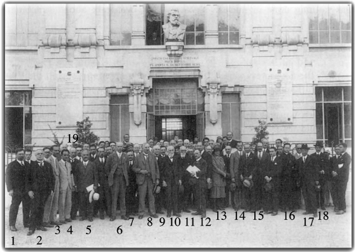
The Como Lecture 1927

Slide 52
The Como Lecture 1927
Gruppo di partecipanti al Congresso di Como (fotografia Mazzoletti, Como):
1) P. Lazarev, 2) G. Giorgi, 3) F. Rasetti, 4) E. Fermi,
5) Sommerfeld, 6) F. W. Aston, 7) O. M. Corbino,
8 ) E. Rutherford, 9) R. A. Millikan,
10) H. A. Lorentz, 11) M. Brillouin,
12) A. Amerio, 13) R. Brunetti, 14) A. H. Compton,
15) W. L. Bragg, 16) G. Gianfranceschi (alle cui spalle di intravede E. Persico), 17) Q. Majorana,
18) A. Pontremoli, 19) O. W. Richardson.

Slide 53
“The quantum postulate and the recent developments of atomic theory,” Nature, 1928.
On the one hand, the definition of the state of a physical system, as ordinarily understood, claims the elimination of all external disturbances. But in that case, according to the quantum postulate, any observation will be impossible, and, above all, the concepts of space and time lose their immediate sense. On the other hand, if in order to make observation possible we permit certain interactions with suitable agencies of measurement, not belonging to the system, an unambiguous definition of the state of the system is naturally no longer possible, and there could be no question of causality in the ordinary sense of the word.

Slide 54
“The quantum postulate and the recent developments of atomic theory,” Nature, 1928.
The very nature of the quantum theory thus forces us to regard the space-time coordina-tion and the claim of causality, the union of which characterizes the classical theories, as complementary but exclusive features of the description, symbolizing the idealization of observation and definition, respectively.

Slide 55

Kristian Camillieri

Slide 56
“Bohr, Heisenberg and the divergent views of complementarity”
It has often gone unnoticed that in the introduction to the Como paper, in which he first publicly announced his view of complementarity, Bohr had intended to deal with the problem of stationary states, and he did not invoke an argument for the use of mutually exclusive experimental arrangements, characteristic of his later versions of the complementarity thesis. … [S]cholars have tended to ignore the original formulation of complementarity … In the 1927 Como lecture, Bohr employed the term ‘causal description’ to refer to the conservation of energy, while a space–time description referred to pinpointing the electron’s position in space at a given time.

Slide 57
Bohr to Schrödinger, 23 May 1928
There remains always--as stated in the article--an absolute exclusion between the application of the concept of stationary states and the tracking of the behavior of an individual particle in the atom. This exclusion provides in my opinion a particularly striking example of the general complementary nature of the description. As I have tried to show in my article, a quite definite meaning can be ascribed to the concept of stationary states as well as to the discrete energy values within their domain of applicability

Slide 58
Bohr: Introduction to Atomic Theory and the Description of Nature, 1934
It would be a misconception to believe that the difficulties of the atomic theory may be evaded by eventually replacing the concepts of classical physics by new conceptual forms. …No more is it likely that the fundamental concepts of the classical theories will ever become superfluous… [I]t continues to be the application of these concepts alone that make it possible to relate the symbolism of the quantum theory to the data of experience.

Slide 59
Bohr: Introduction to Atomic Theory and the Description of Nature, 1934
At the same time, however, we must bear in mind that the possibility of an unambiguous use of these fundamental concepts solely depends upon the self-consistency of the classical theories from which they are derived and that therefore the limits imposed on the application of these concepts are naturally determined by the extent to which we may, in our account of the phenomena, disregard the element which is foreign to classical theories and symbolized by the quantum of action.

Slide 60
Einstein-Podolsky-Rosen Paper
“Can Quantum-Mechanical Description of Physical Reality to be Considered Complete?” Physical Review 47 (1935): 777-780.

Slide 61
Bohr’s 1935 Reply
“Can quantum-mechanical description of physical reality be considered complete?” Physical Review 48: 696-702

Slide 62
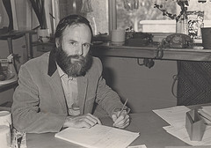
Clifford Hooker

Slide 63
The Nature of Quantum Mechanical Reality: Einstein vs Bohr (1972)
[T]here is no suggestion, that I can detect, that EPR did alter Bohr's conception of quantum theory. … It may … be true that, as Bohr himself seems to allow, Einstein's penetrating criticisms of quantum theory served to crystallize the elements of the doctrine of complementarity, giving impetus to a more precise development and to the broadening of their scope.

Slide 64
Bohr’s Diaphragms
Tongdong Bai* and John Stachel**
* Department of Philosophy, Xavier University
** Center for Einstein Studies, Boston University

Slide 65
Bohr’s Diaphragms
Central to his analysis of all such experiments is the presence of “a [material] support which defines the space frame of reference,” tacitly assumed to be inertial. The coordinates and momenta are defined with respect to this inertial frame, and the instruments for measuring these quantities are located, spatially and temporally, with respect to it. It is also assumed that the material support is so massive that

Slide 66
Bohr’s Diaphragms
“the momentum exchanged between the particle and the diaphragm will, together with the reaction of the particle on the other bodies [rigidly attached to the support], pass into this common support” (Bohr 1935, 697)
without significant effect on its state of motion.

Slide 67
Bohr’s Diaphragms
Bohr refers to "some ultimate measur-ing instruments, like the scales and clocks which determine the frame of space-time coordination-- on which, in the last resort, even the definitions of momentum and energy quantities rest…" (Bohr: “The Causality Problem in Atomic Physics,” 1938 ).

Slide 68
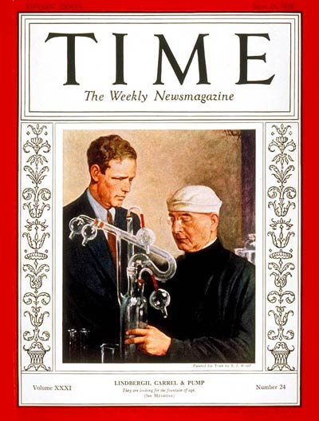

Slide 69
Science: Confusion in Warsaw
Time Magazine ,13 June 1938
No remarkable new contributions to physical theory came out of Warsaw, Poland last week, and none was expected. Nevertheless, an International Conference on New Theories in Physics, sponsored by the League of Nations International Institute of Intellectual Cooperation, was in session there, attended by some 30 giants of theoretical physics. On hand were Denmark's Niels Bohr and France's Louis de Broglie.

Slide 70
Science: Confusion in Warsaw
The physicists' talk was lively and brilliant. But they spent most of their time trying to find some way to mend the painful gap between Relativity and Quantum Mechanics, bickering politely about the validity and application of physical theories, asking themselves what physical reality is after all. Bohr criticized de Broglie and almost everyone present criticized Sir Arthur Eddington. Altogether they gave the impression of giants wallowing in a quagmire.

Slide 71
“The Causality Problem in Atomic Physics,” I.I.I.C., Warsaw 1938
The essential lesson of the analysis of measure-ments in quantum theory is thus the emphasis on the necessity, in the account of the phenomena, of taking the whole experimental arrangement into consideration, in complete conformity with the fact that all unambiguous interpretation of the quantum mechanical formalism involves the fixation of the external conditions, defining the initial state of the atomic system concerned and the character of the possible predictions as regards subsequent observable properties of that system.

Slide 72
“A Well-defined Phenomenon”
Any measurement in quantum theory can in fact only refer either to a fixation of the initial state or to the test of such predictions, and it is first the combination of measurements of both kinds which constitutes a well-defined phenomenon.

Slide 73
From Closed vs Open to
Choice of Phenomenon
Bohr’s original approach to complementarity contrasted closed states governed by a wave function (e.g., to define sharp energy) to open systems defined by a measurement( e.g., position at some time).
Bohr’s later approach places emphasis on the complementary nature of the conditions defining the entire experimental arrangement in which an open system is embedded (phenomenon).

Slide 74
From States to Processes
Bohr’s original approach to complementarity placed primary emphasis on the three-dimen-sional state of the system; from this point of view, a process is just a succession over time of different states of the system
Bohr’s later approach places primary emphasis on four-dimensional processes; from this point of view, a ‘state’ is just a particular spatial cross-section of a process , of secondary importance: all such cross-sections are equally valid: each sequence of states represents a different ‘perspective’ on the same process.

Slide 75
Atomic Physics and Human Knowledge
On the lines of objective description, it is indeed more appropriate to use the word phenomenon to refer only to observations obtained under circumstances whose description includes an account of the whole experimental arrangement. In such terminology, the observational problem in quantum physics is deprived of any special intricacy

Slide 76
Atomic Physics and Human Knowledge
and we are, moreover, directly reminded that every atomic phenomenon is closed in the sense that its observation is based on registrations obtained by means of suitable amplification devices with irreversible functioning such as, for example, permanent marks on a photographic plate, caused by the penetration of electrons into the emulsion.

Slide 77
Outline of my talk
1) The Correspondence Principle
2) Complementarity:
a) The role of Einstein’s experiments
b) First formulatin of the Principle
c) Evolution of Bohr’s formulations
3) Complementarity and Correspondence
a) Electrons vs Electromagnetic Fields
b) Einstein and Bohr

Slide 78
The Bohr-Einstein Dialogue
Copenhagen, 1930

Slide 79
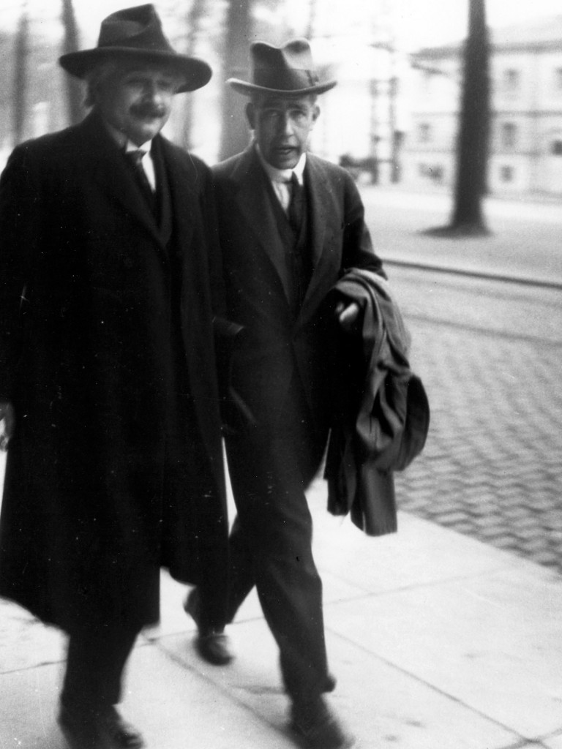

Slide 80
1930 Faraday Lecture
The extreme fertility of wave pictures in accounting for the behavior of electrons must, however, not make us forget that there is no question of a complete analogy with ordinary wave propagation in material media or with non-substantial energy transmission in electromagnetic waves. Just as in the case of radiation quanta, often termed "photons," we have here to do with symbols helpful in the formulation of the probability laws governing the occurrence of the elementary processes which cannot be further analysed in terms of classical physical ideas.

Slide 81
1930 Faraday Lecture (cont’d)
In this sense, phrases such as "the corpuscular nature of light" or "the wave nature of electrons" are ambiguous, since such concepts as corpuscle and wave are only well defined within the scope of classical physics, where, of course, light and electrons are electromagnetic waves and material corpuscles respectively.

Slide 82
Maxwell Centenary in 1932
When one hears physicists talk nowadays about ‘electron waves' and 'photons', it might perhaps appear that we have completely left the ground on which Newton and Maxwell built; but we all agree, I think, that such concepts, however fruitful, can never be more than a convenient means of stating characteristics consequences of the quantum theory which cannot be visualized in the ordinary sense.

Slide 83
Maxwell Centenary in 1932 (cont’d)
It must not be forgotten that only the classical ideas of material particles and electromagnetic waves have a field of unambiguous application, whereas the concepts of photons and electron waves have not. Their applicability is essentially limited to cases in which, on account of the existence of the quantum of action, it is not possible to consider the phenomena observed as independent of the apparatus utilised for their observation.

Slide 84
Maxwell Centenary in 1932 (cont’d)
I would like to mention, as an example, the most conspicuous application of Maxwell's ideas, namely, the electromagnetic waves in wireless transmission. It is a purely formal matter to say that these waves consist of photons, since the conditions under which we control the emission and the reception of the radio waves preclude the possibility of determining the number of photons they should contain. In such a case we may say that all trace of the photon idea, which is essentially one of enumeration of elementary processes, has completely disappeared.

Slide 85
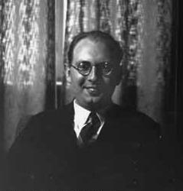
Leon Rosenfeld
Worked with Pauli on quantum field theory
First to quantize linearized gravitational field
Moved to Copenhagen and worked with Bohr on interpretation of formalism for quantizing the electromagnetic field
Lifelong defender of Bohr’s interpretation of quantum theory
Worked extensively on history of physics and Marxist interpretation of its philosophy

Slide 86
“Zur Frage der Messbarkeit der elektromag-netischen Feldgrössen,” Bohr & Rosenfeld 1933
[T]here are, in the quantum domain, the peculiar fluctuation phenomena which derive from the basically statistical character of the formalism....
The fluctuations in question are intimately related to the impossibility, which is characteristic of the quantum theory of fields, of visualizing the concept of light quanta in terms of classical concepts. In particular, they give expression to the mutual exclusiveness of an accurate knowledge of the light quantum composition of an electromagnetic field and of knowledge of the average value of any of its components in a well-defined space time region.

Slide 87
“Zur Frage der Messbarkeit der elektromag-netischen Feldgrössen,” Bohr & Rosenfeld 1933
In field measurements, this complementary feature of the description, essential for consistency, corresponds to the fact that the knowledge of the light quantum composition of the field is lost through the field effects of the test body; and in fact, the more so, the greater the desired accuracy of the measurement. Moreover, it will appear from the following discussion that any attempt to re-establish the knowledge of the light quantum composition of the field through a subsequent measurement by means of any suitable device would at the same time prevent any further utilization of the field measurement in question.

Slide 88
Outline of my talk
1) The Correspondence Principle
2) Complementarity:
a) The role of Einstein’s experiments
b) First formulatin of the Principle
c) Evolution of Bohr’s formulations
3) Complementarity and Correspondence
a) Electrons vs Electromagnetic Fields
b) Einstein and Bohr

Slide 89
Einstein to Paul Bonofield, September 18, 1939
“I do not believe that the light-quanta have reality in the same immediate sense as the corpuscles of electricity [i.e., electrons]. Likewise I do not believe that the particle-waves have reality in the same sense as the particles themselves. The wave-character of particles and the particle-character of light will-- in my opinion-- be understood in a more indirect way, not as immediate physical reality."

Slide 90
The Bohr-Einstein Dialogue
Last phase, Princeton 1954

Slide 91
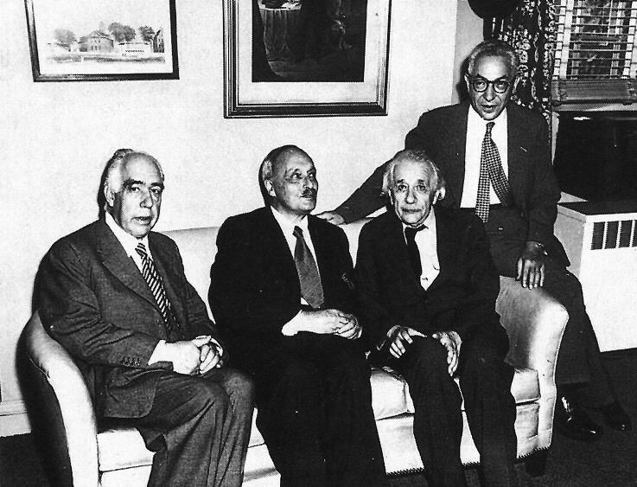

Slide 92
Thank You !

