Slide 1
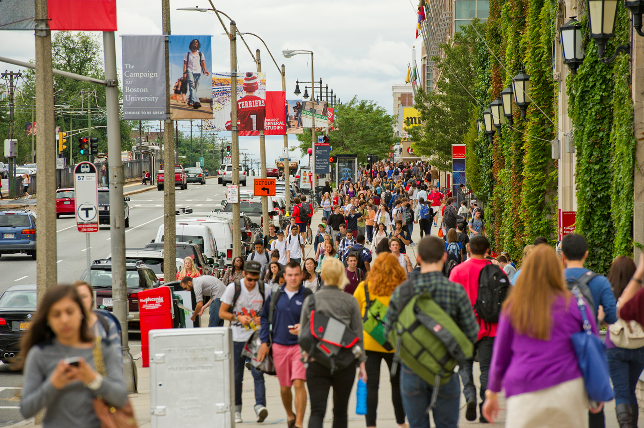

Notes:
Welcome to Boston University! Now that you have successfully set up your University Kerberos account, it is important to understand how to keep the BU data you will work with safe and secure.

Slide 3
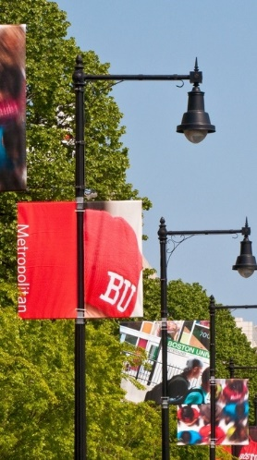
Follow the rules.
Use BU systems for BU data.
If you work remotely, work securely.
Report anything suspicious.
Notes:
Your job will determine what data you have access to and what you need to do to protect specific types of data. You will learn more about that from your department. However, there are five basic principles that apply to everyone at BU.

Slide 4
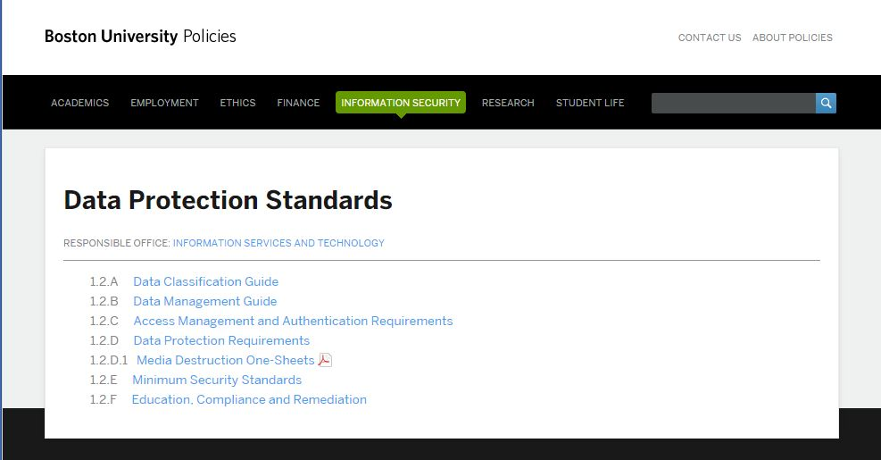
Follow the rules.
www.bu.edu/policies
Notes:
Boston University has developed Data Protection Standards that describe exactly how to collect, access, store, share or destroy specific types of data securely.

Slide 5
Follow the rules.
        Restricted Use
        Confidential
        Internal
Notes:
Broadly speaking, there are three types of data that require special protection: restricted use, confidential, and internal data.

Slide 6
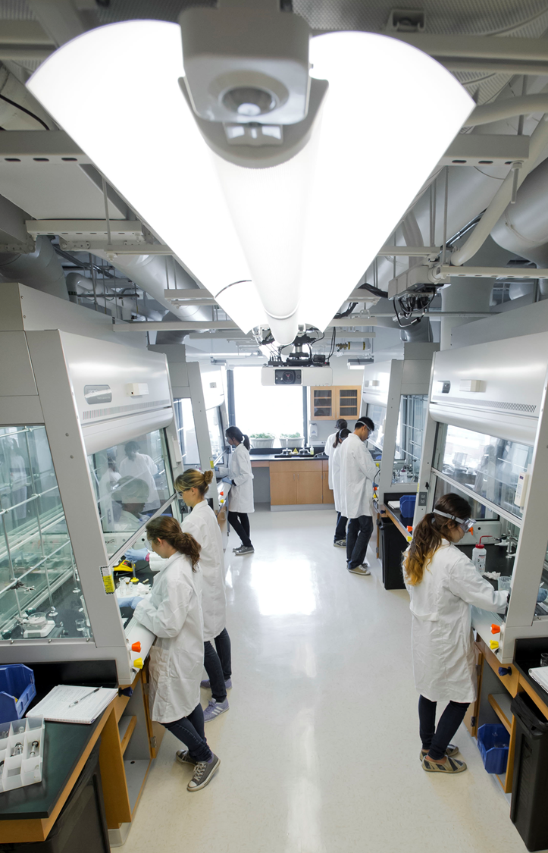
    Restricted
      Social Security numbers
      Financial account information
      Protected health information
Notes:
Restricted Use data includes information that Boston University is legally required to safeguard in the most stringent manner. If the data is breached, the University may be required to notify affected individuals as well as federal or state authorities. Restricted Use data includes

Slide 7

Confidential
Student education records
Any information
subject to a
confidentiality agreement
Notes:
Confidential data is information that, if made available to unauthorized parties, could adversely affect members of our community or the business of Boston University. Confidential data includes students records and any information subject to a confidentiality agreement.

Slide 8
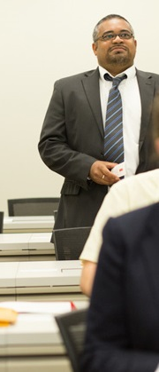
  Internal
  Sensitive internal memoranda
  Meeting minutes
  Protocols
  Employee contact lists with home addresses or phone numbers
Notes:
Internal data is sensitive information that should not be shared with the public. Internal data includes sensitive internal memoranda, meeting minutes, protocols, and employee contact lists with home addressed or phone numbers.

Slide 9
Follow the rules.
Use BU systems for BU data.
If you work remotely, work securely.
Report anything suspicious.
Notes:
Boston University has a variety of programs, applications, and systems that have been evaluated to ensure that the data in those systems is safe and secure. Use those systems for BU data.

Slide 10

Use BU systems for BU data.
Personal cloud services
are not for BU data.
Notes:
Do not store Restricted Use, Confidential or Internal data in personal cloud applications like Dropbox.

Slide 11
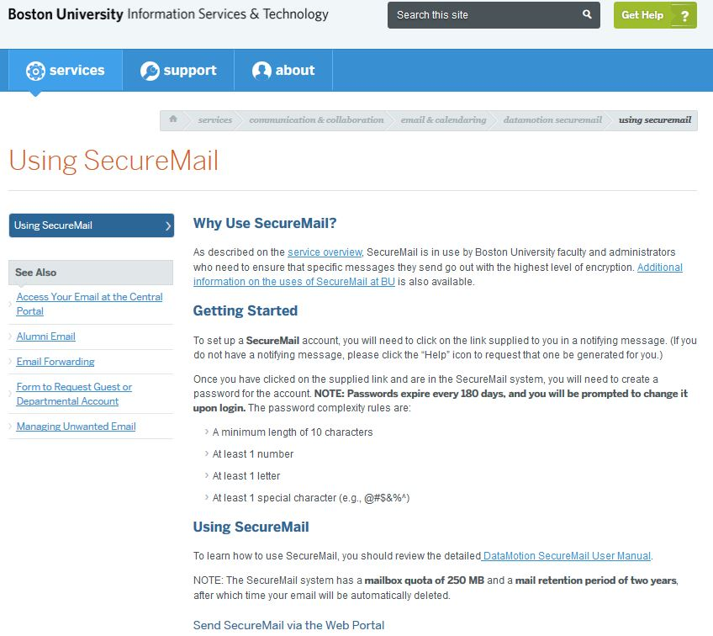
Use BU systems for BU data.
Notes:
For example, use the University’s encrypted email system, SecureMail, for Restricted Use or other sensitive information.

Slide 12
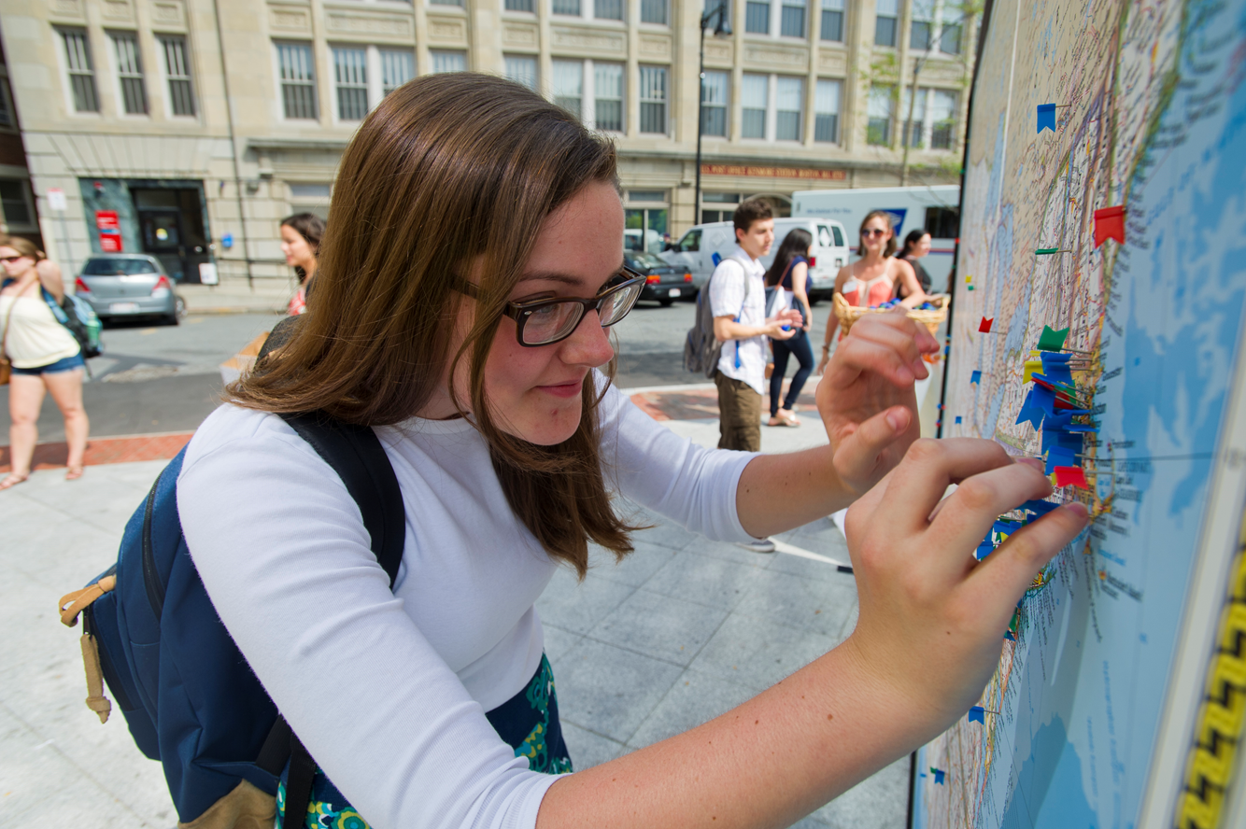
Notes:
Be sure to use BU applications that are appropriate for the type of data you work with.

Slide 13
Follow the rules.
Use BU systems for BU data.
If you work remotely, work securely.
Report anything suspicious.
Notes:
If you access BU data away from BU, or are using your own electronic devices, make sure your device is secure and you have a secure connection to BU.

Slide 14
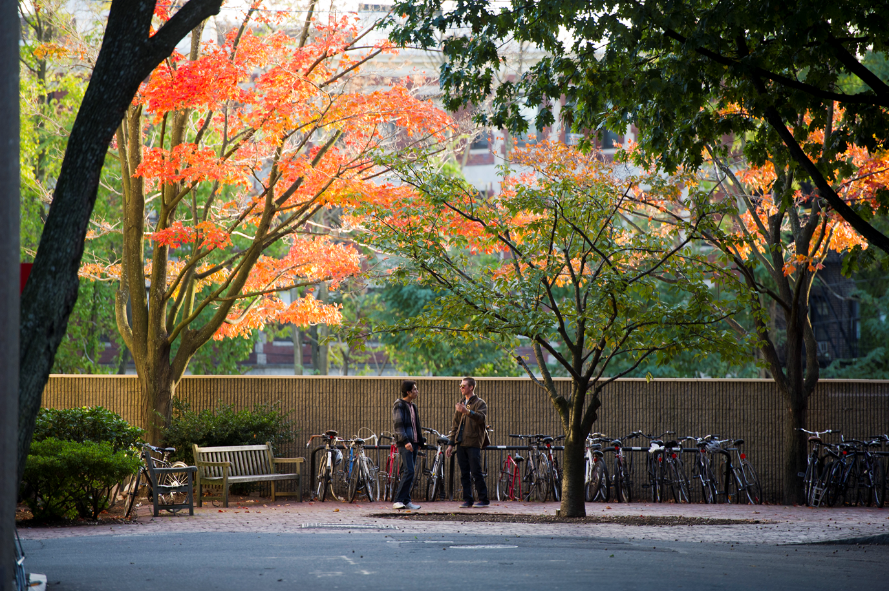
Notes:
Be sure to use the University’s Virtual Private Network or VPN, if you are working with University data at home or away from your office.

Slide 15
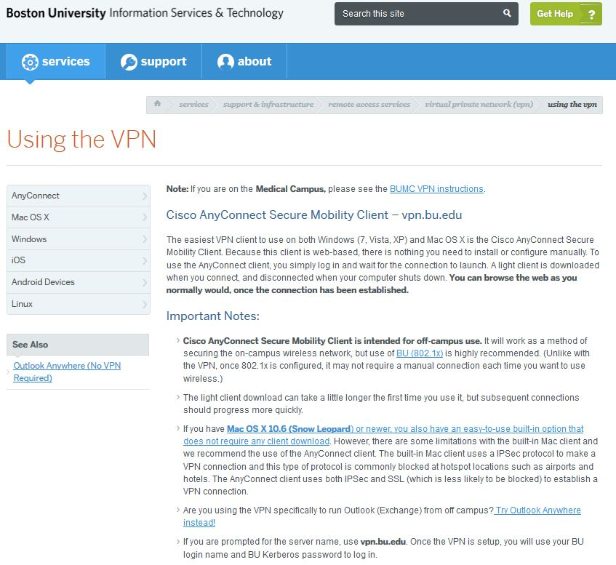
If you work remotely, work securely.
Notes:
The BU VPN creates a secure “tunnel” between your computer and the campus network.

Slide 16
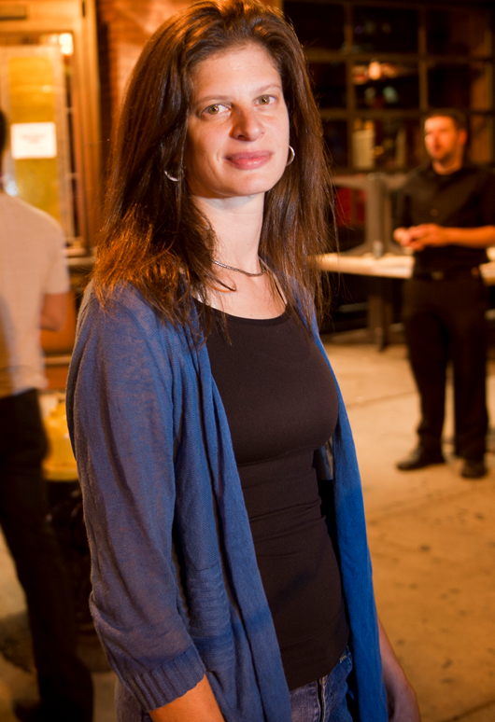
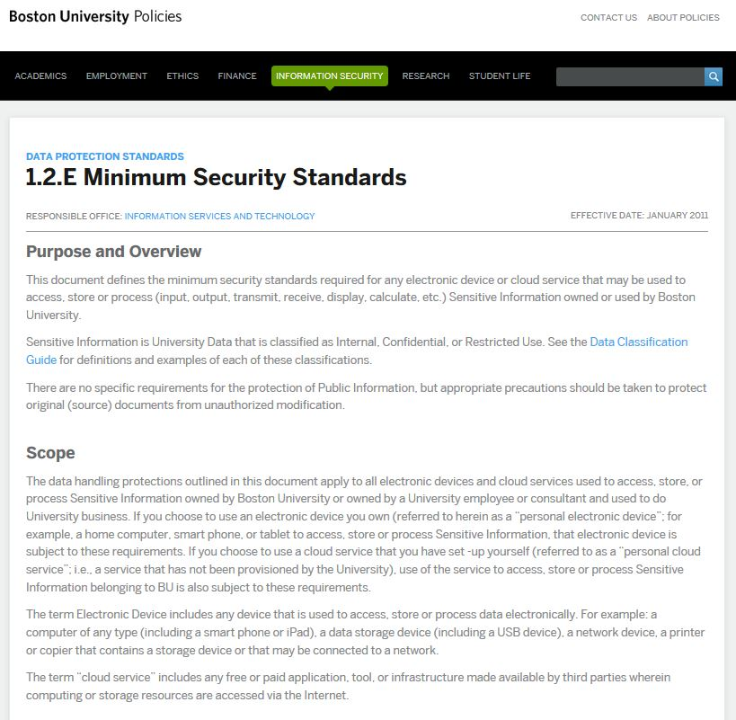
Notes:
You can use your personal computer, tablet or phone as long as it meets the Minimum Security Standards, which are part of the Data Protection Standards.
You can find the minimum security standards on the policies website under the information security tab.

Slide 17
Follow the rules.
Use BU systems for BU data.
If you work remotely, work securely.
Report anything suspicious.
Notes:
Report anything suspicious. Ask the IS&T Help Desk if you aren’t sure about something. We are here to help.

Slide 18
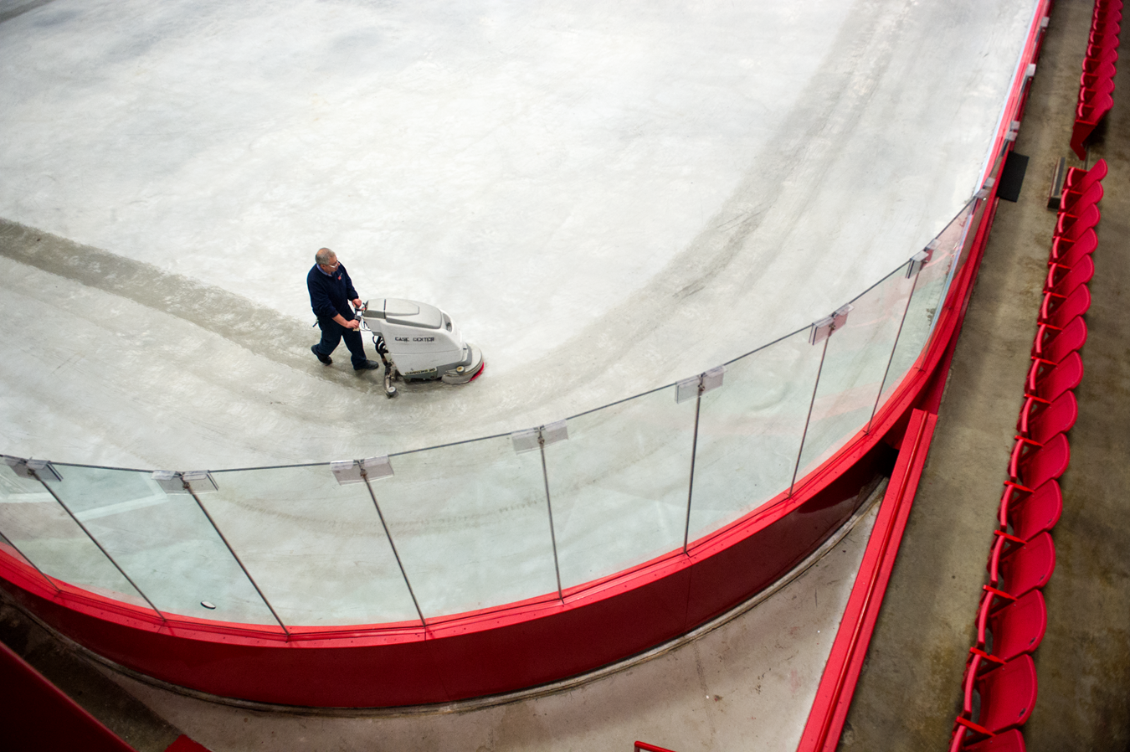
abuse@bu.edu
Notes:
If you receive a suspicious email, forward it to abuse@bu.edu and then delete it.

Slide 19
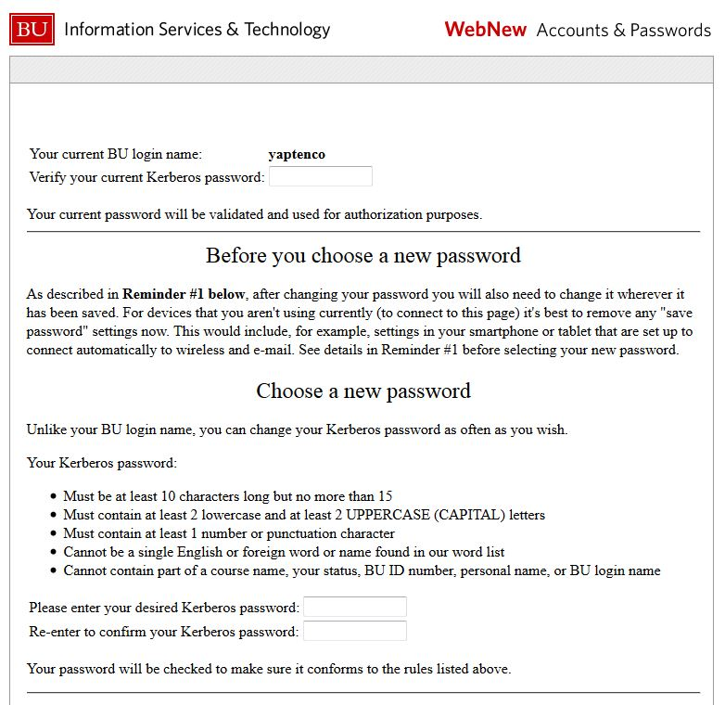
https://weblogin.bu.edu/accounts/changepw
Notes:
If you suspect that your Kerberos password has been compromised, reset the password immediately and call the IS&T Help Center to report what happened.

Slide 20
IS&T Help Center
617-353-HELP (4357)
Notes:
If you suspect your computer has a virus or other malwear, call the IS&T Help Center at 617-353-HELP.

Slide 21
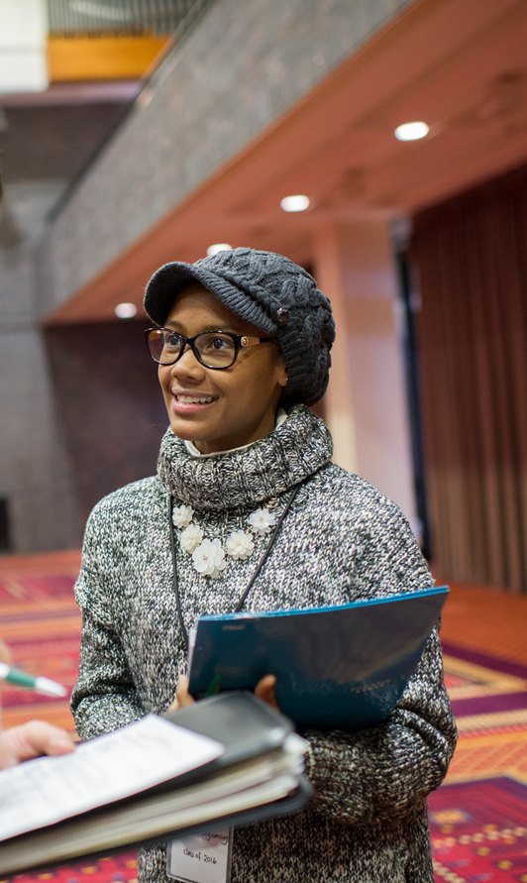
    Report any
    suspected data breach
    immediately.
    Incident Response Team
    Email: irt@bu.edu
    Phone: 617-358-1100
Notes:
Report any suspected data breach immediately.
A data breach includes any unauthorized access or use of sensitive information that creates a substantial risk of identity theft or other harm.
Don’t delay. Report the incident and ask for help.

Slide 22
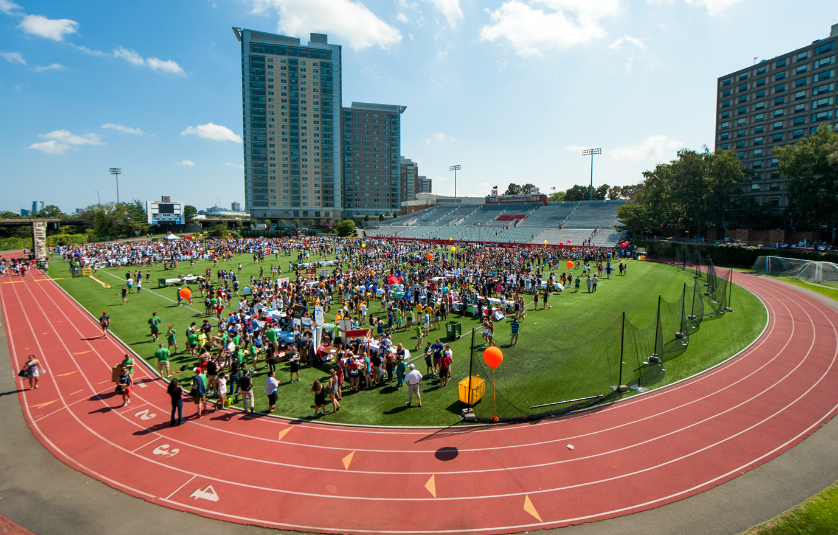
www.bu.edu/tech
www.bu.edu/compliance
Notes:
If you have any questions, need more help or want to give us feedback, just get in touch with IS&T or Compliance Services.
You can find more information on the tech and compliance websites.
Thank you for taking the time to listen. Now you are officially part of the BU community!

