Slide 1
Jason (Iason) and Medea
The
Foreign Legions

Slide 2
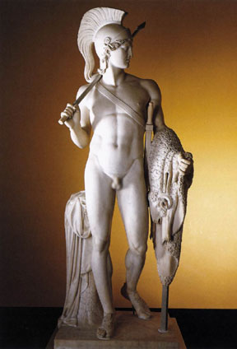
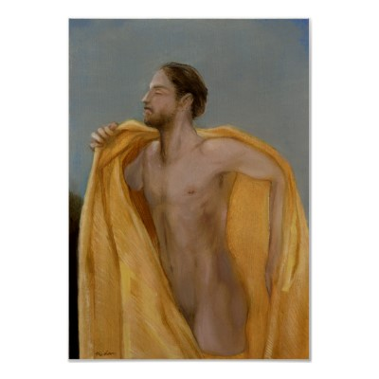
Jason with the Golden Fleece

Slide 3
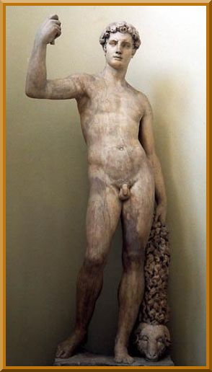
Jason with the Golden Fleece

Slide 4
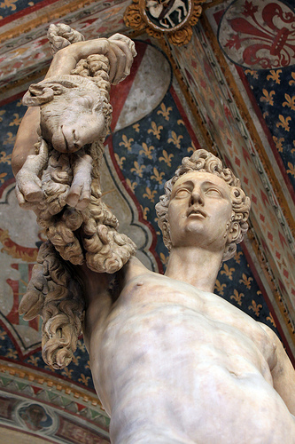
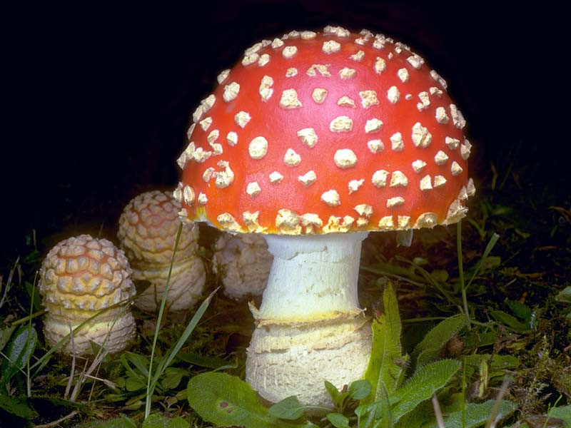
Jason with the Golden Fleece

Slide 5
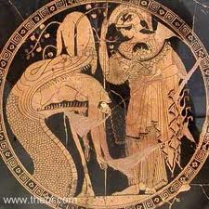
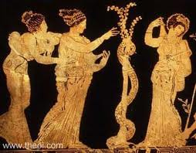
Fleece and Apple are Homonymous

Slide 6
Chrysomallos
Golden Fleece, in Greek mythology, the magic fleece of the winged ram that saved Phrixos and Helle, the children of Nephele and Athamas, from the jealousy of Ino, Athamas' second wife. The ram flew to Colchis, but Helle fell into the sea, which was thereafter known as the Hellespont. Phrixos arrived safely, sacrificed the ram, and hung its fleece in a wood guarded by a dragon. The ram became the constellation Aries. Phrixos married a daughter of King Aeëtes of Colchis and begot Argos and three other sons. The quest of Jason and the Argonauts was for this fleece.

Slide 7
Warring Brothers, Two Fathers, Turncoat Mother
Pelias (Aeson's half-brother) was very power-hungry, and he wished to gain dominion over all of Thessaly. Pelias was the product of a union between their shared mother, Tyro ("high born Tyro") the daughter of Salmoneus, and allegedly the sea god Poseidon. In a bitter feud, he overthrew Aeson (the rightful king), killing all the descendants of Aeson that he could. He spared his half-brother for unknown reasons. Alcimede I (wife of Aeson) already had an infant son named Jason whom she saved from being killed by Pelias, by having women cluster around the newborn and cry as if he were still-born. Alcimede sent her son to the centaur Cheiron for education, for fear that Pelias would kill him — she claimed that she had been having an affair with him all along. Pelias, still fearful that he would one day be overthrown, consulted an oracle which warned him to beware of a man with one sandal.

Slide 8
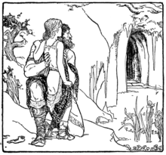
Aeson takes Jason to Mount Pelion
And there he saw the singer lying upon bearskins and fragrant boughs: Cheiron, the ancient centaur, the wisest of all things beneath the sky. Down to the waist he was a man, but below he was a noble horse; his white hair rolled down over his broad shoulders, and his white beard over his broad brown chest; and his eyes were wise and mild, and his forehead like a mountain wall.

Slide 9
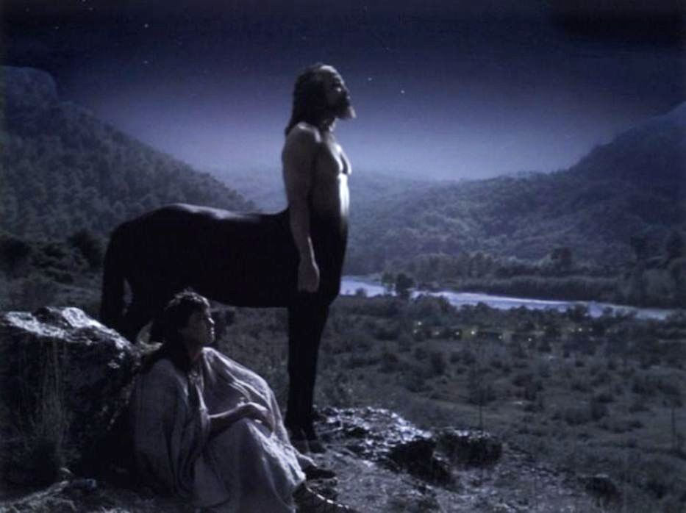
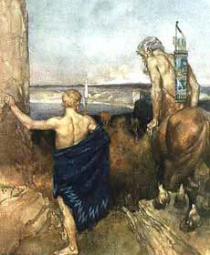
Jason educated by Cheiron

Slide 10
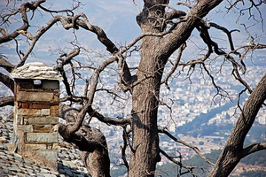
Volos from Mount Pelion

Slide 11
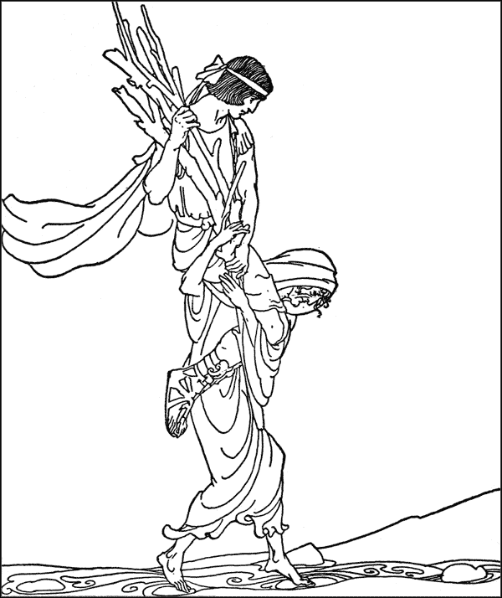
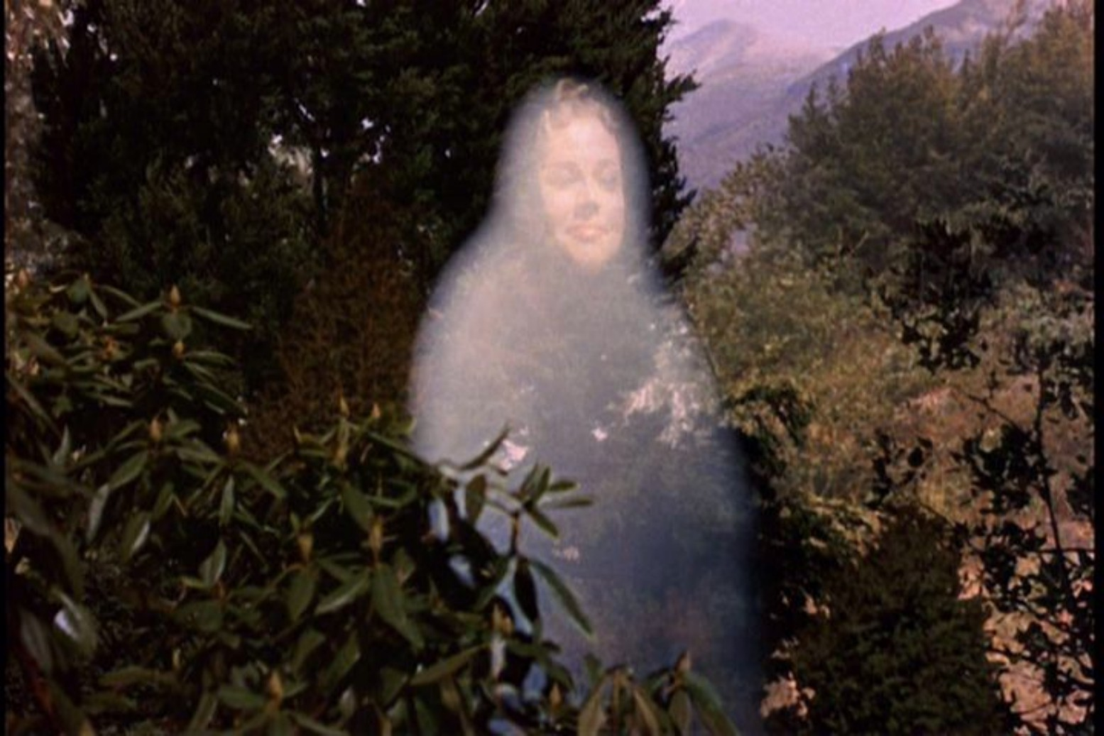
Hera, Jason one-sandal

Slide 12
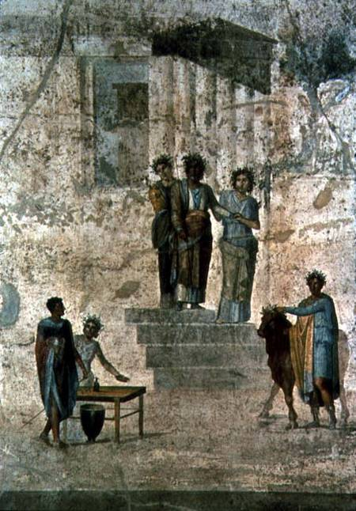
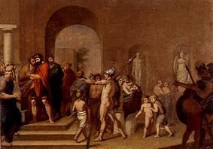
Jason arrives in Iolcos with one sandal

Slide 13
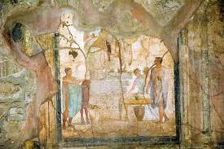
Jason one-sandal arrives before his uncle Pelias

Slide 14
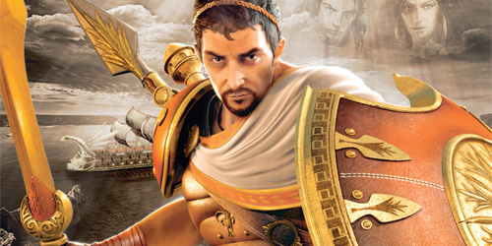
Pelias
The classical Greek myth of Jason and the Argonauts begins with Jason returning to Iolcos after being raised in exile to claim the throne from his uncle Pelias. Thinking quickly Pelias says that he will surrender the throne to Jason if he can bring him the legendary Golden Fleece. Jason agrees and sets about getting the great ship Argo built before crewing it with some of the greatest heroes of the time and setting off on his quest.

Slide 15
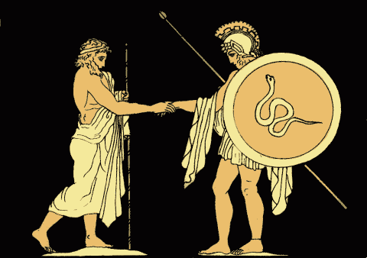
Pelias Sends Jason on the Quest
When Jason entered Iolcus (modern-day city of Volos), he was announced as a man wearing one sandal. Jason, knowing that he was the rightful king, told Pelias that and Pelias said, "To take my throne, which you shall, you must go on a quest to find the Golden Fleece." Jason happily accepted the quest.

Slide 16
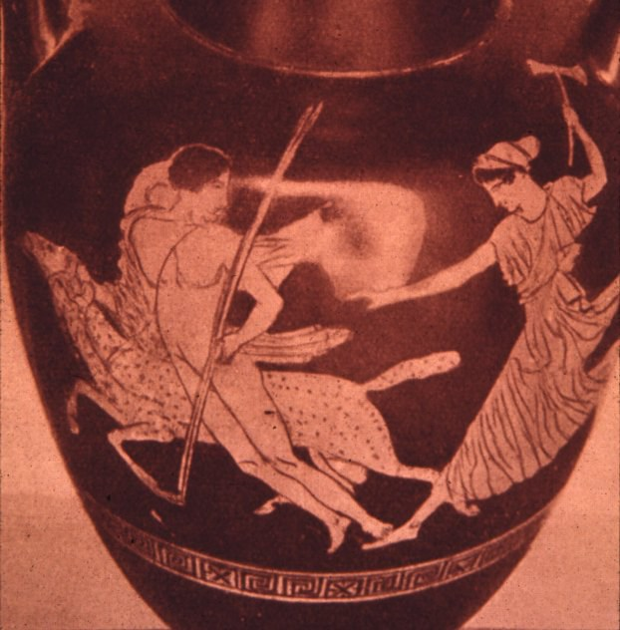
Phrixos flees from Ino
Phrixus and Helle, twin children of Athamas and Nephele, were hated by their stepmother, Ino. Ino hatched a devious plot to get rid of the twins, roasting all the towns crop seeds so they would not grow. The local farmers, frightened of famine, asked a nearby oracle for assistance. Ino bribed the men sent to the oracle to lie and tell the others that the oracle required the sacrifice of Phrixus. Athamus reluctantly agreed.

Slide 17
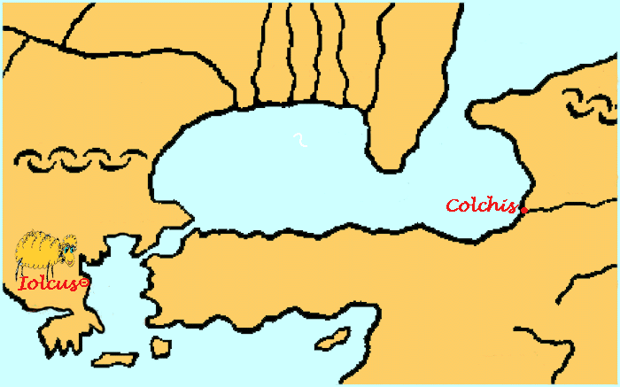
Iolcos to Colchis

Slide 18
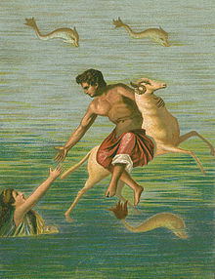
Phrixos and Helle
During their flight Helle swooned, fell off the ram and drowned in the Dardanelles, renamed the Hellespont (sea of Helle), but Phrixos survived all the way to Colchis, where King Aeëtes, the son of the sun god Helios, took him in and treated him kindly, giving Phrixos his daughter, Chalciope, in marriage. In gratitude, Phrixos sacrificed the ram to Zeus and gave the king the golden fleece of the ram, which Aeëtes hung in a tree in the holy grove of Ares in his kingdom, guarded by a dragon that never slept.

Slide 19
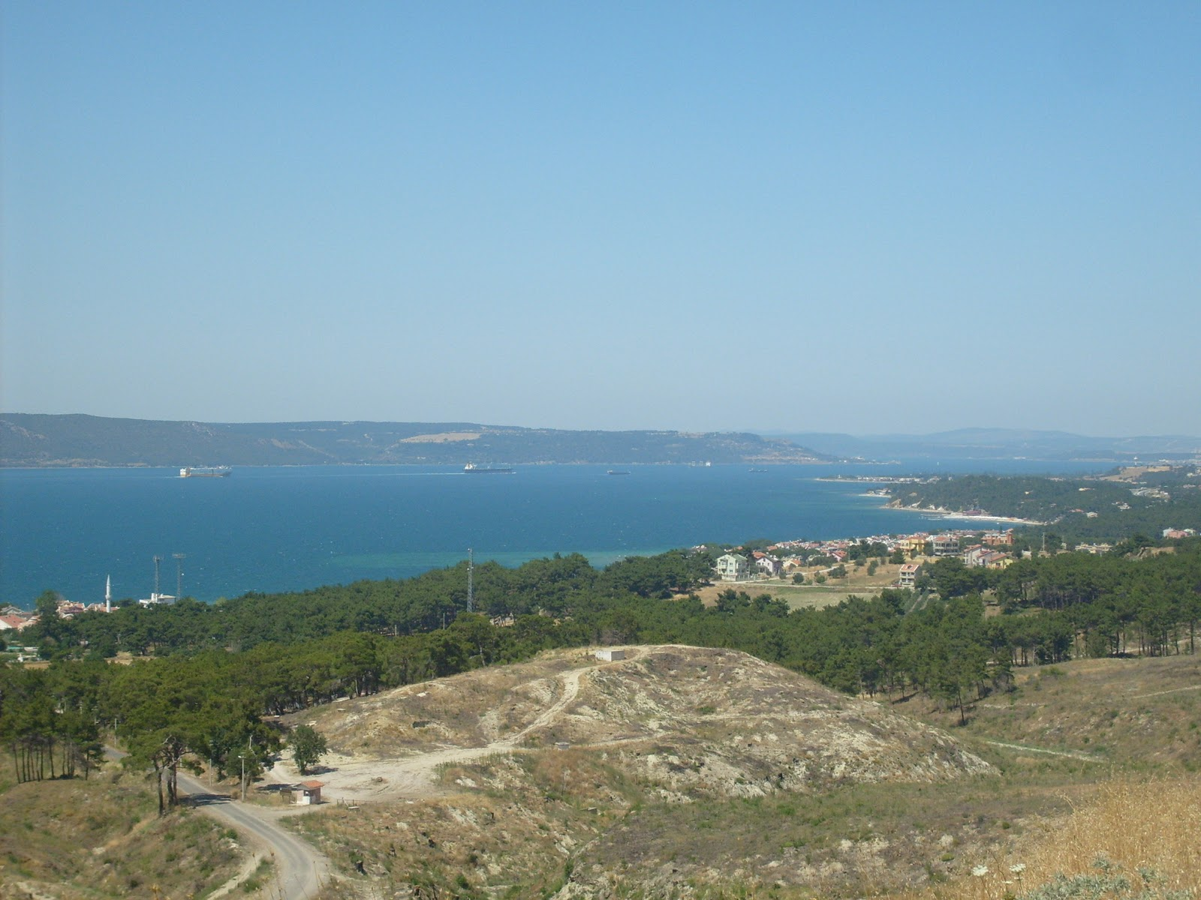
Hellespont

Slide 20
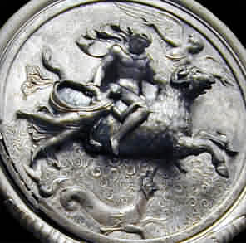
Phrixos and Helle on the Ram

Slide 21
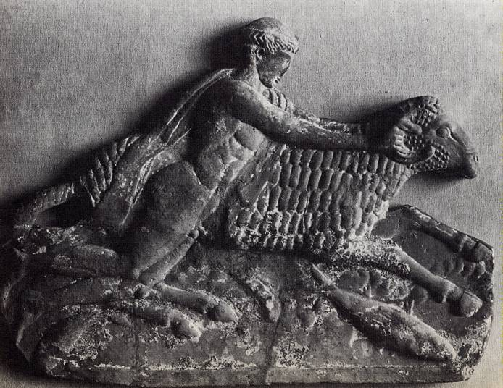
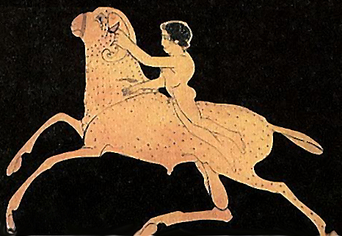
Phrixos on the Ram

Slide 22
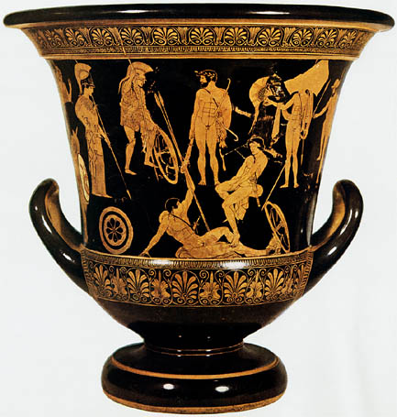
Assembling of the Argonauts
Jason assembled a great group of heroes, known as the Argonauts after their ship, the Argo. The group of heroes included the Boreads (sons of Boreas, the North Wind) who could fly, Heracles, Philoctetes, Peleus, Telamon, Orpheus, Castor and Pollux, Atalanta, and Euphemus.

Slide 23
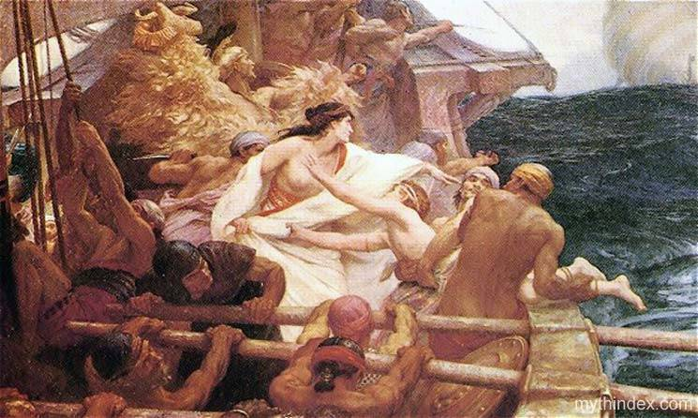
Argonauts

Slide 24
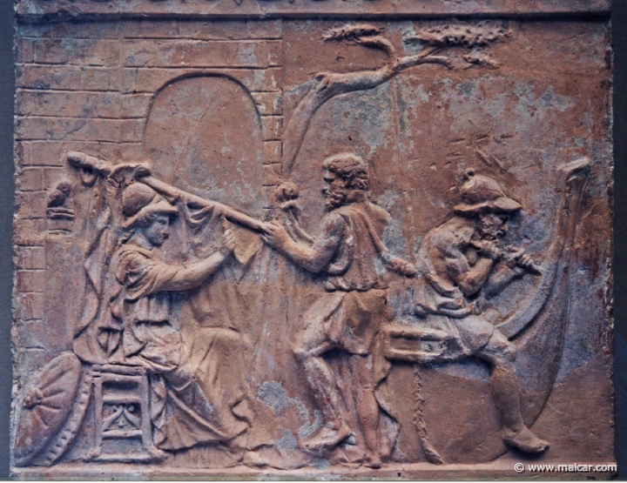
Athena as anima, making the Ship Argo

Slide 25
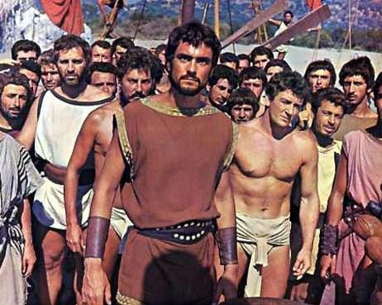
Assembling of the Argonauts

Slide 26
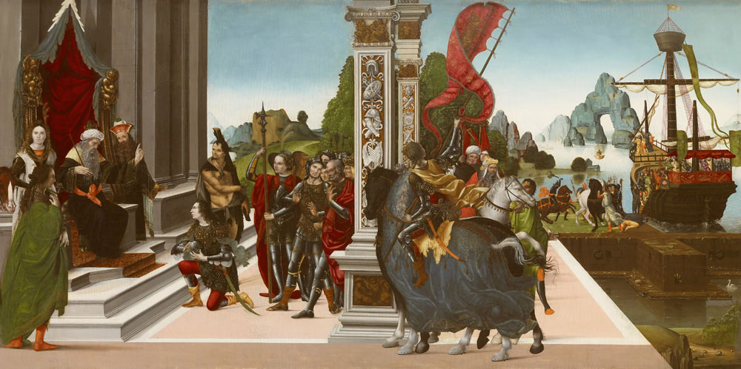
Departure of the Argonauts

Slide 27
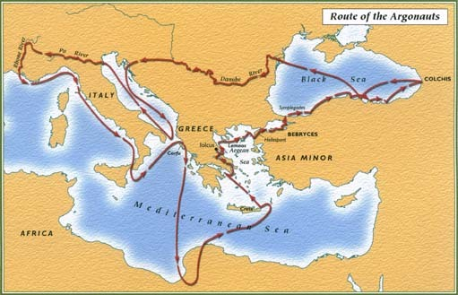
Route of the Argonauts

Slide 28
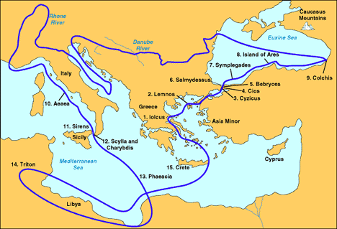
Route of the Argonauts

Slide 29
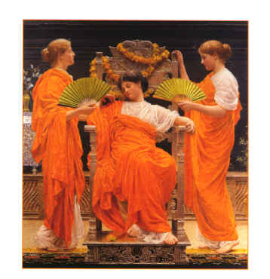
Lemnian Women
The women had neglected their worship of Aphrodite, and as a punishment the goddess made the women so foul in stench that their husbands could not bear to be near them. The men then took concubines from the Thracian mainland opposite, and the spurned women, angry at Aphrodite, killed all the male inhabitants while they slept. The king, Thoas, was saved by Hypsipyle, his daughter, who put him out to sea sealed in a chest from which he was later rescued. The women of Lemnos lived for a while without men, with Hypsipyle as their queen.

Slide 30
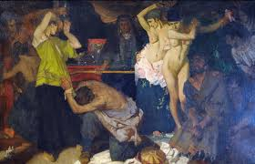
Stench of the Lemnian Women

Slide 31
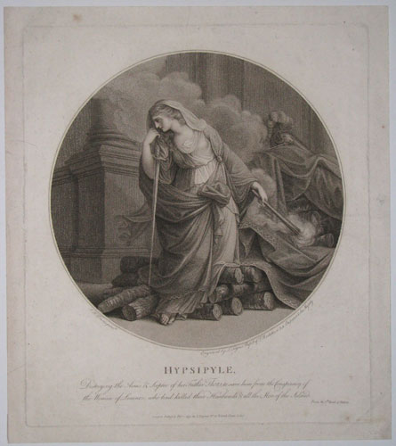
Hypsipyle, ‘High Gate’

Slide 32
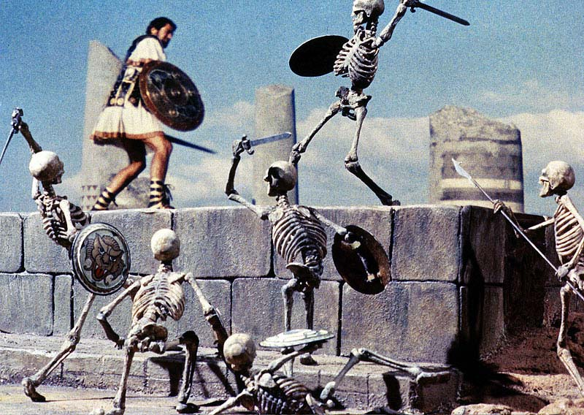
Cyzicus
After Lemnos the Argonauts landed among the Doliones, whose king Cyzicus treated them graciously. He told them about the land beyond Bear Mountain, but forgot to mention what lived there. What lived in the land beyond Bear Mountain were the Gegeines which are a tribe of Earthborn giants with six arms and wore leather loincloths. While most of the crew went into the forest to search for supplies, the Gegeines saw that a few Argonauts were guarding the ship and raided it.

Slide 33
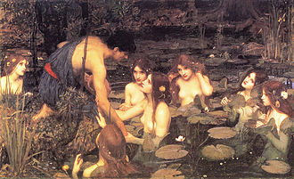
Hylas
After Heracles killed Theiodamas in battle, he took on Hylas as arms bearer and taught him to be a warrior. The poet Theocritus (about 300 BCE) wrote about the love between Heracles and Hylas: "We are not the first mortals to see beauty in what is beautiful. No, even Amphitryon's bronze-hearted son, who defeated the savage Nemean lion, loved a boy—charming Hylas, whose hair hung down in curls. And like a father with a dear son he taught him all the things which had made him a mighty man, and famous.” Heracles took Hylas with him on the Argo, making him one of the Argonauts. Hylas was kidnapped by nymphs of the spring of Pegae, (Dryope), that fell in love with him in Mysia and vanished without a trace). This upset Heracles greatly, so he searched for him a great length of time. The ship set sail without them.

Slide 34
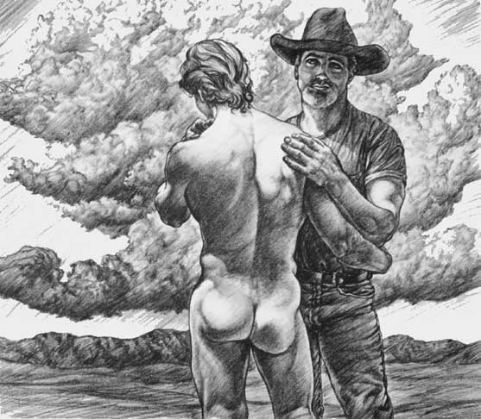
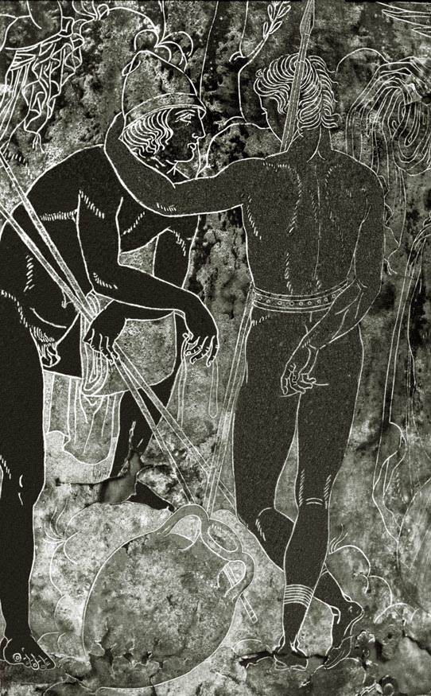
Herakles and Hylas

Slide 35
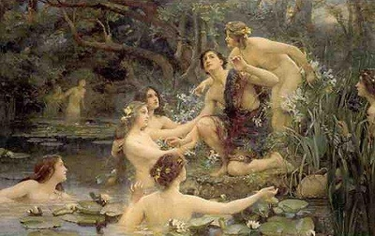
Hylas and the Water Nymphs

Slide 36
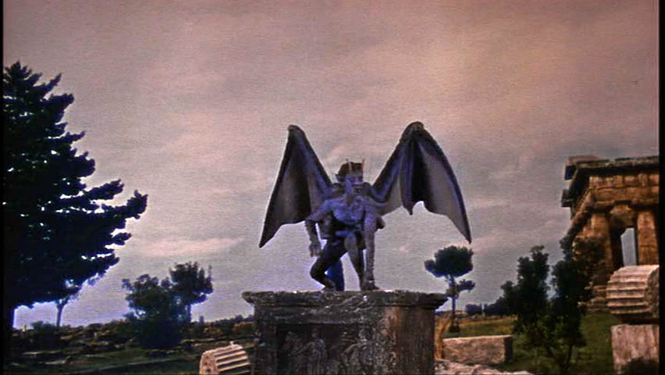
Phineas and the Harpies
Soon Jason reached the court of Phineas of Salmydessus in Thrace. Zeus had sent the Harpies to steal the food put out for Phineas each day. Jason took pity on the emaciated king and killed the Harpies when they returned; in other versions, Calais and Zetes chase the Harpies away. In return for this favor, Phineas revealed to Jason the location of Colchis and how to pass the Symplegades, or The Clashing Rocks, and then they parted.

Slide 37
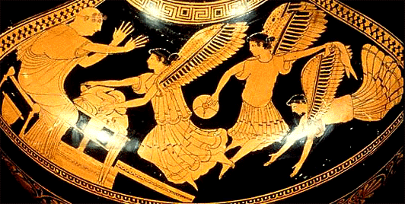
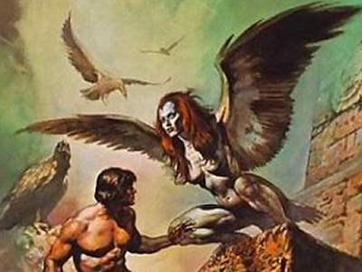
Phineas and the Harpies

Slide 38
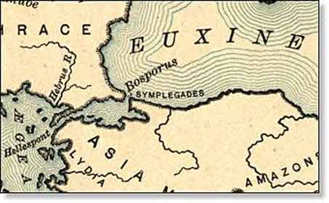
Symplegades
The only way to reach Colchis was to sail through the Symplegades (Clashing Rocks), huge rock cliffs that came together and crushed anything that traveled between them. Phineas told Jason to release a dove when they approached these islands, and if the dove made it through, to row with all their might. If the dove was crushed, he was doomed to fail. Jason released the dove as advised, which made it through, losing only a few tail feathers. Seeing this, they rowed strongly and made it through with minor damage at the extreme stern of the ship. From that time on, the clashing rocks were forever joined leaving free passage for others to pass.

Slide 39
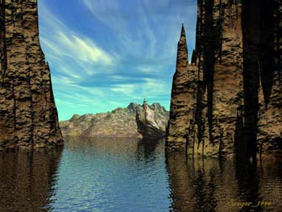
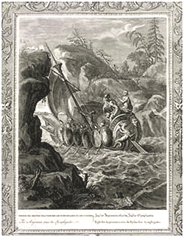
Symplegades

Slide 40
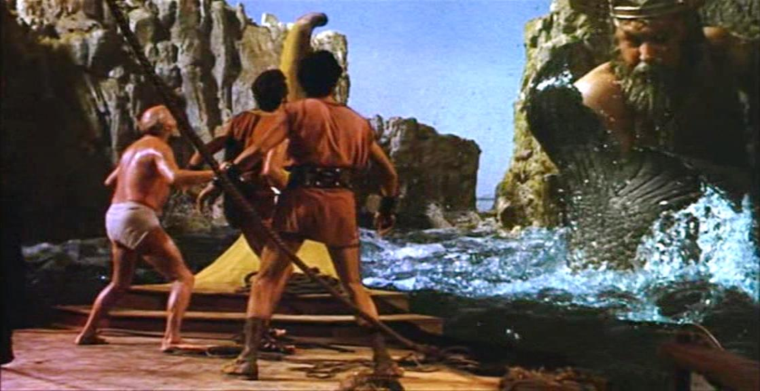
Poseidon

Slide 41
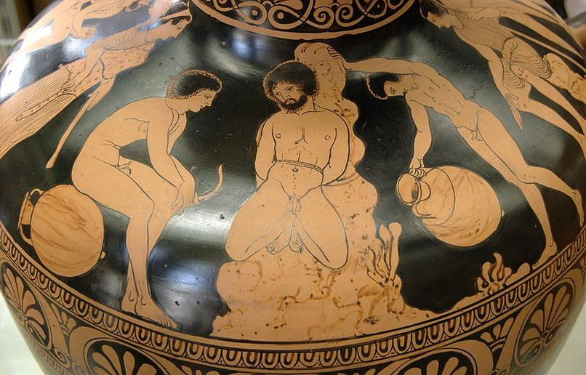
The Argonauts bind Amycus
Amycus (Ἄμυκος) was the son of Poseidon and Melia. He was a boxer and King of the Bebryces, a mythical people in Bithynia. Polydeuces beat him in a boxing match when the Argonauts passed through Bithynia

Slide 42
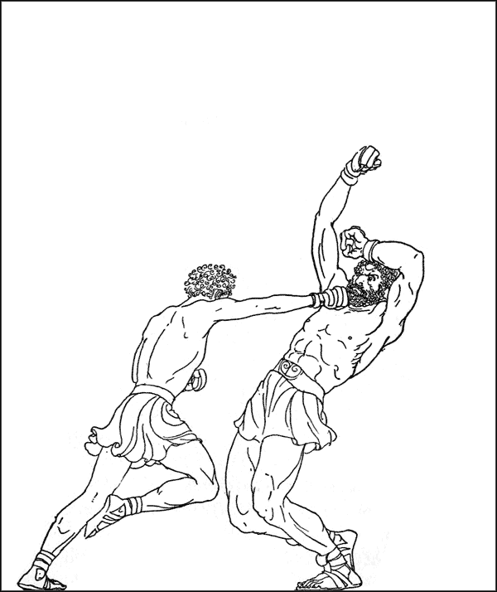
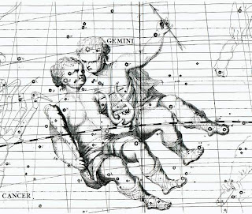
Dioskouroi
Polydeuces boxes Amycus
Castor and Pollux as Gemini

Slide 43

Medea prepares the chrism
John William Waterhouse
Aeëtes promised to give the Fleece to Jason only if he could perform three certain tasks. Presented with the tasks, Jason became discouraged and fell into depression. However, Hera had persuaded Aphrodite to convince her son Eros to make Aeëtes's daughter, Medea, fall in love with Jason.

Slide 44


Jason and Medea
Gustave Moreau

Slide 45

Medea Pharmacist
Evelyn de Morgan
As a result, Medea aided Jason in his tasks. First, Jason had to plow a field with fire-breathing bulls, the Khalkotauroi, that he had to yoke himself.

Slide 46

Brazen Bulls
Medea provided an ointment that protected him from the bulls. flames.

Slide 47

Medea Pharmacist
Then, Jason sowed the teeth of a dragon into a field. The teeth sprouted into an army of warriors. Medea had previously warned Jason of this and told him how to defeat this foe. Before they attacked him, he threw a rock into the crowd. Unable to discover where the rock had come from, the soldiers attacked and defeated one another.

Slide 48


Sowing the Dragon Teeth
Jason sows the teeth
The teeth were half of those from Cadmos at Thebes

Slide 49

Medea Pharmacist
His last task was to overcome the sleepless dragon which guarded the Golden Fleece. Jason sprayed the dragon with a potion, given by Medea, distilled from herbs. The dragon fell asleep, and Jason was able to seize the Golden Fleece.

Slide 50

Jason puts the dragon to sleep

Slide 51

Medea, Jason, and the Fleece

Slide 52

Jason puts the dragon to sleep

Slide 53


Jason and the Dragon

Slide 54

Jason, Medea, Fleece and Serpent. Marble sarcophagus 2nd century CE.

Slide 55


The Golden Fleece

Slide 56


Jason and the Dragon, with Athena as anima

Slide 57
Plow the field with fire-breathing brazen bulls

Slide 58

Sirens
Cheiron had told Jason that without the aid of Orpheus, the Argonauts would never be able to pass the Sirens — the same Sirens encountered by Odysseus in Homer's epic poem the Odyssey. The Sirens lived on three small, rocky islands called Sirenum scopuli and sang beautiful songs that enticed sailors to come to them, which resulted in the crashing of their ship into the islands. When Orpheus heard their voices, he drew his lyre and played music that was more beautiful and louder, drowning out the Sirens' bewitching songs.

Slide 59


The Argonauts and the Sirens

Slide 60

Orpheus and the Sirens

Slide 61

Scylla and Charybdis

Slide 62

Circe Pharmacist
Zeus, as punishment for the slaughter of Medea's own brother, sent a series of storms at the Argo and blew it off course. The Argo then spoke and said that they should seek purification with Circe, a nymph living on the island of Aeaea. After being cleansed, they continued their journey home.

Slide 63

Triton of Africa

Slide 64

Talos of Crete
The Argo then came to the island of Crete, guarded by the bronze man, Talos. As the ship approached, Talos hurled huge stones at the ship, keeping it at bay. Talos had one blood vessel which went from his neck to his ankle, bound shut by only one bronze nail (as in metal casting by the lost wax method). Medea cast a spell on Talos to calm him; she removed the bronze nail and Talos bled to death. The Argo was then able to sail on.

Slide 65


Talos of Crete

Slide 66

Jason presents the fleece to Pelias

Slide 67

Medea and the Daughters of Pelias
Jason and Medea and the Argonauts went back to Pelias’ kingdom, but Pelias refused to honor his oath and give Jason the kingdom. So Medea tricked the daughters of Pelias into thinking they could make old Pelias young again by boiling him in water (see sculpture) that had magic herbs in it; but Medea did not give them the right herbs, so they ended up killing their father.

Slide 68


Medea and the Cauldron

Slide 69

Medea and Pelias

Slide 70

Medea and Pelias

Slide 71


Medea stews Pelias

Slide 72

Jason in Corinth
In Corinth, Jason became engaged to marry Creusa (sometimes referred to as Glauce), a daughter of the King of Corinth, to strengthen his political ties. When Medea confronted Jason about the engagement and cited all the help she had given him, he retorted that it was not she that he should thank, but Aphrodite who made Medea fall in love with him.

Slide 73

Medea, with Aegeus

Slide 74


Medea and Aegeus

Slide 75

Medea contemplates the murder of her sons

Slide 76

Medea sends gift to Kreon’s daughter Glauke

Slide 77

The sons bring the anointed crown to Creon’s daughter Glauke

Slide 78

Glauke receives the Crown

Slide 79

Death of Glauke

Slide 80

Medea and her Sons

Slide 81

Sacrifice of Medea’s sons

Slide 82

Sacrifice of Medea’s Sons

Slide 83

Medea in her flying chariot

Slide 84

Medea flees to Athens

