Slide 1
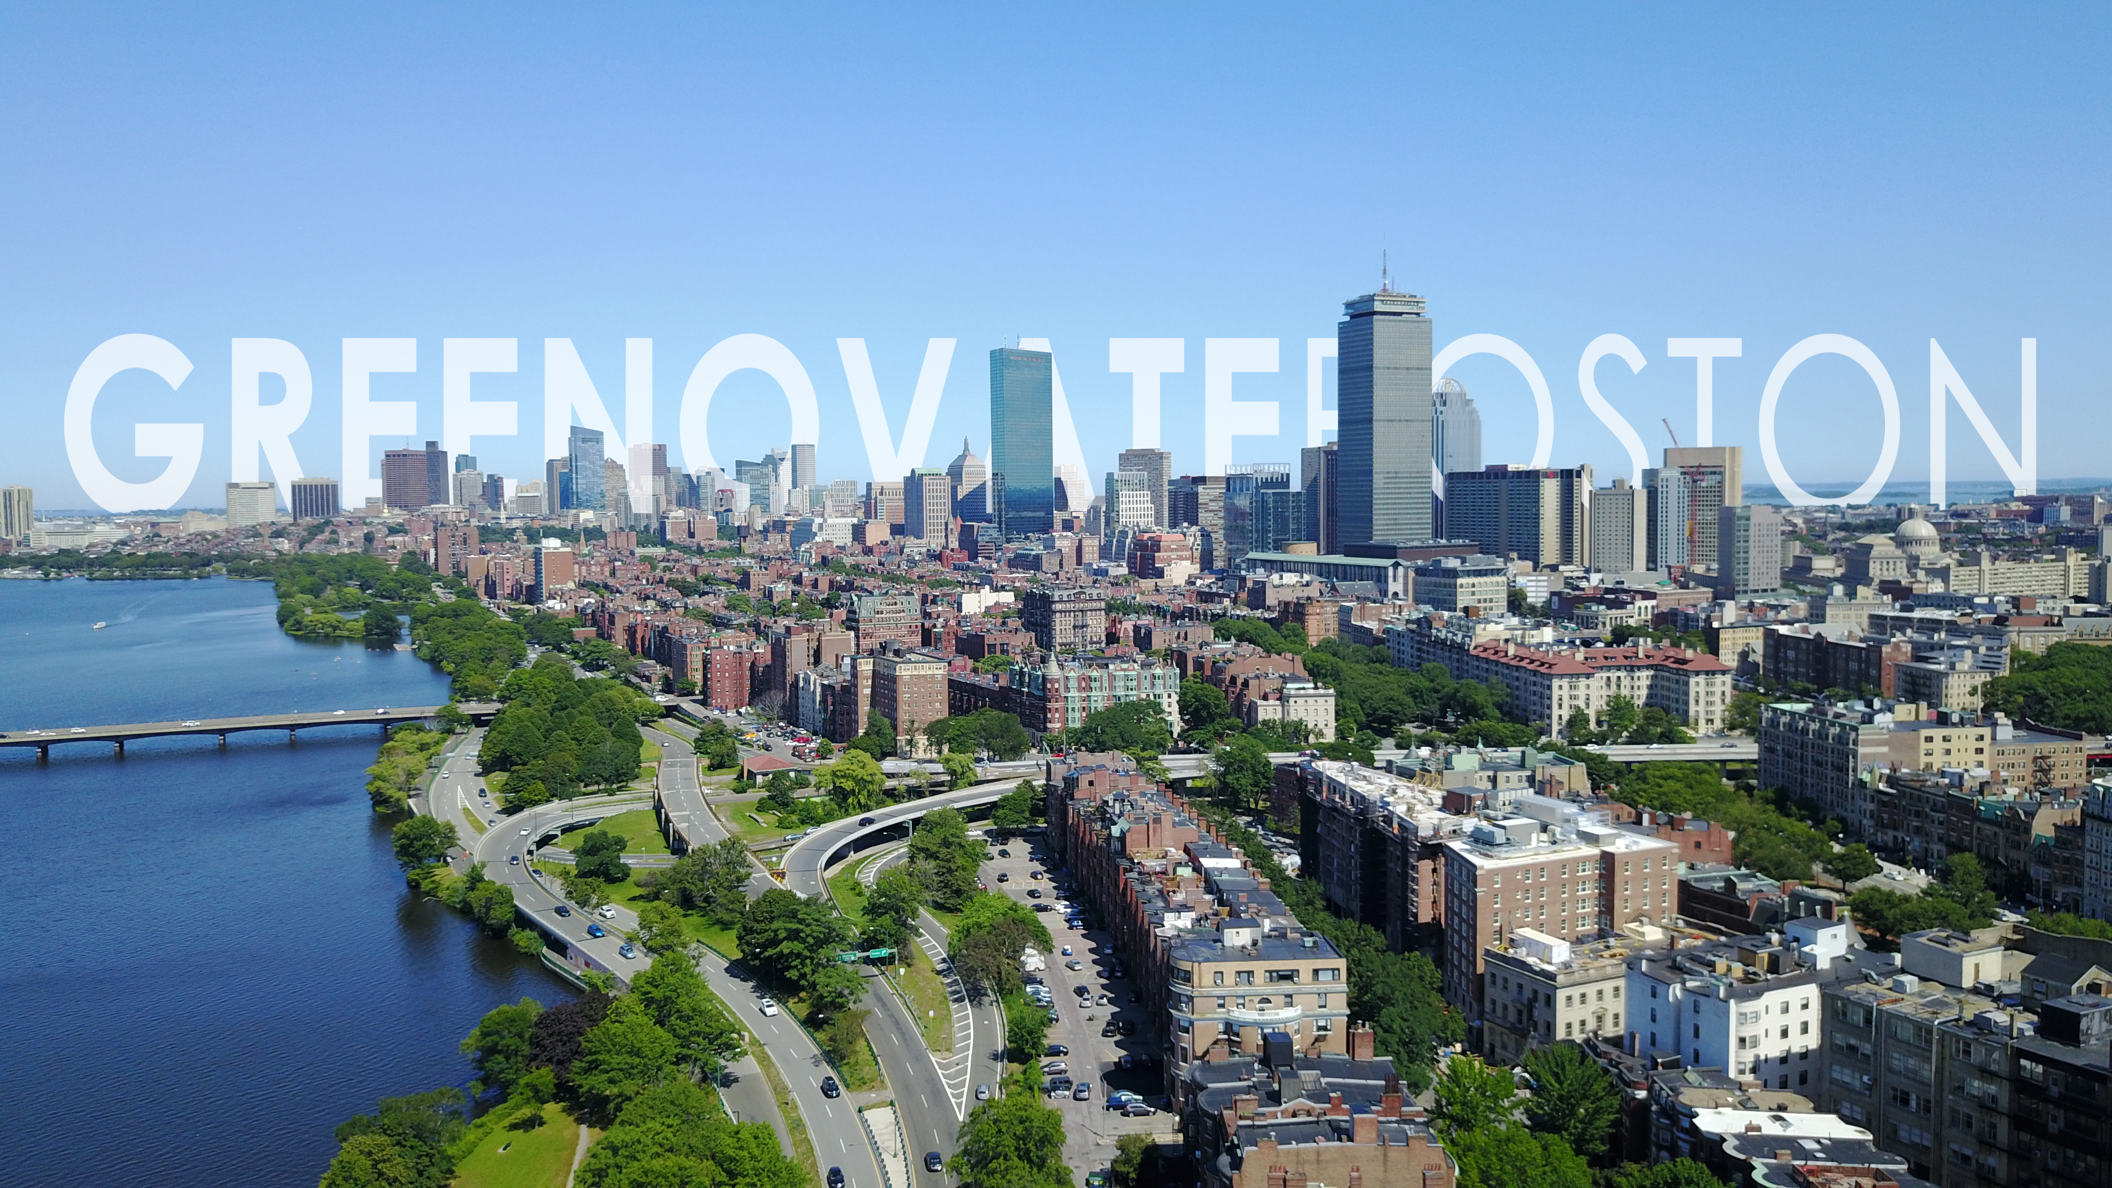

UA-805 URBAN STUDIES CAPSTONE
Diego Lomelli
Jess Martinez
Kate White
Ruben Ceron

Slide 2

A COMPARATIVE STUDY ON EFFECTIVE MARKETING STRATEGIES TO IMPROVE BOSTON COMMUTER BIKE RIDERSHIP.

Slide 3
Abstract
Greenovate Boston: A comparative study on effective marketing strategies to improve Boston commuter bike ridership
Greenovate is the City of Boston’s movement to reduce greenhouse gas emissions 25% by 2020 and to become carbon neutral by 2050, as outlined in the City’s Carbon Free Boston, Climate Ready Boston, and Zero Waste Boston plans. They are tasked to: (1) serve as a central resource for climate and environment information, (2) coordinate collaborations between the community and the City’s policy and program implementation, and (3) act as a community liaison to help create bigger collective impact. The Greenovate team most recently has focused its efforts around promoting coastal resiliency planning due to the topical interest around sea leavel rising. Considering the city’s second largest carbon emitter is transportation (~25%); this study reviews the opportunity of improved promotion of marketing and communication around bicycle commuting as an effective and low-cost method of reducing carbon emissions and meeting the City’s goal to increase bike ridership from today’s 2% to 10% by 2030.

Slide 4
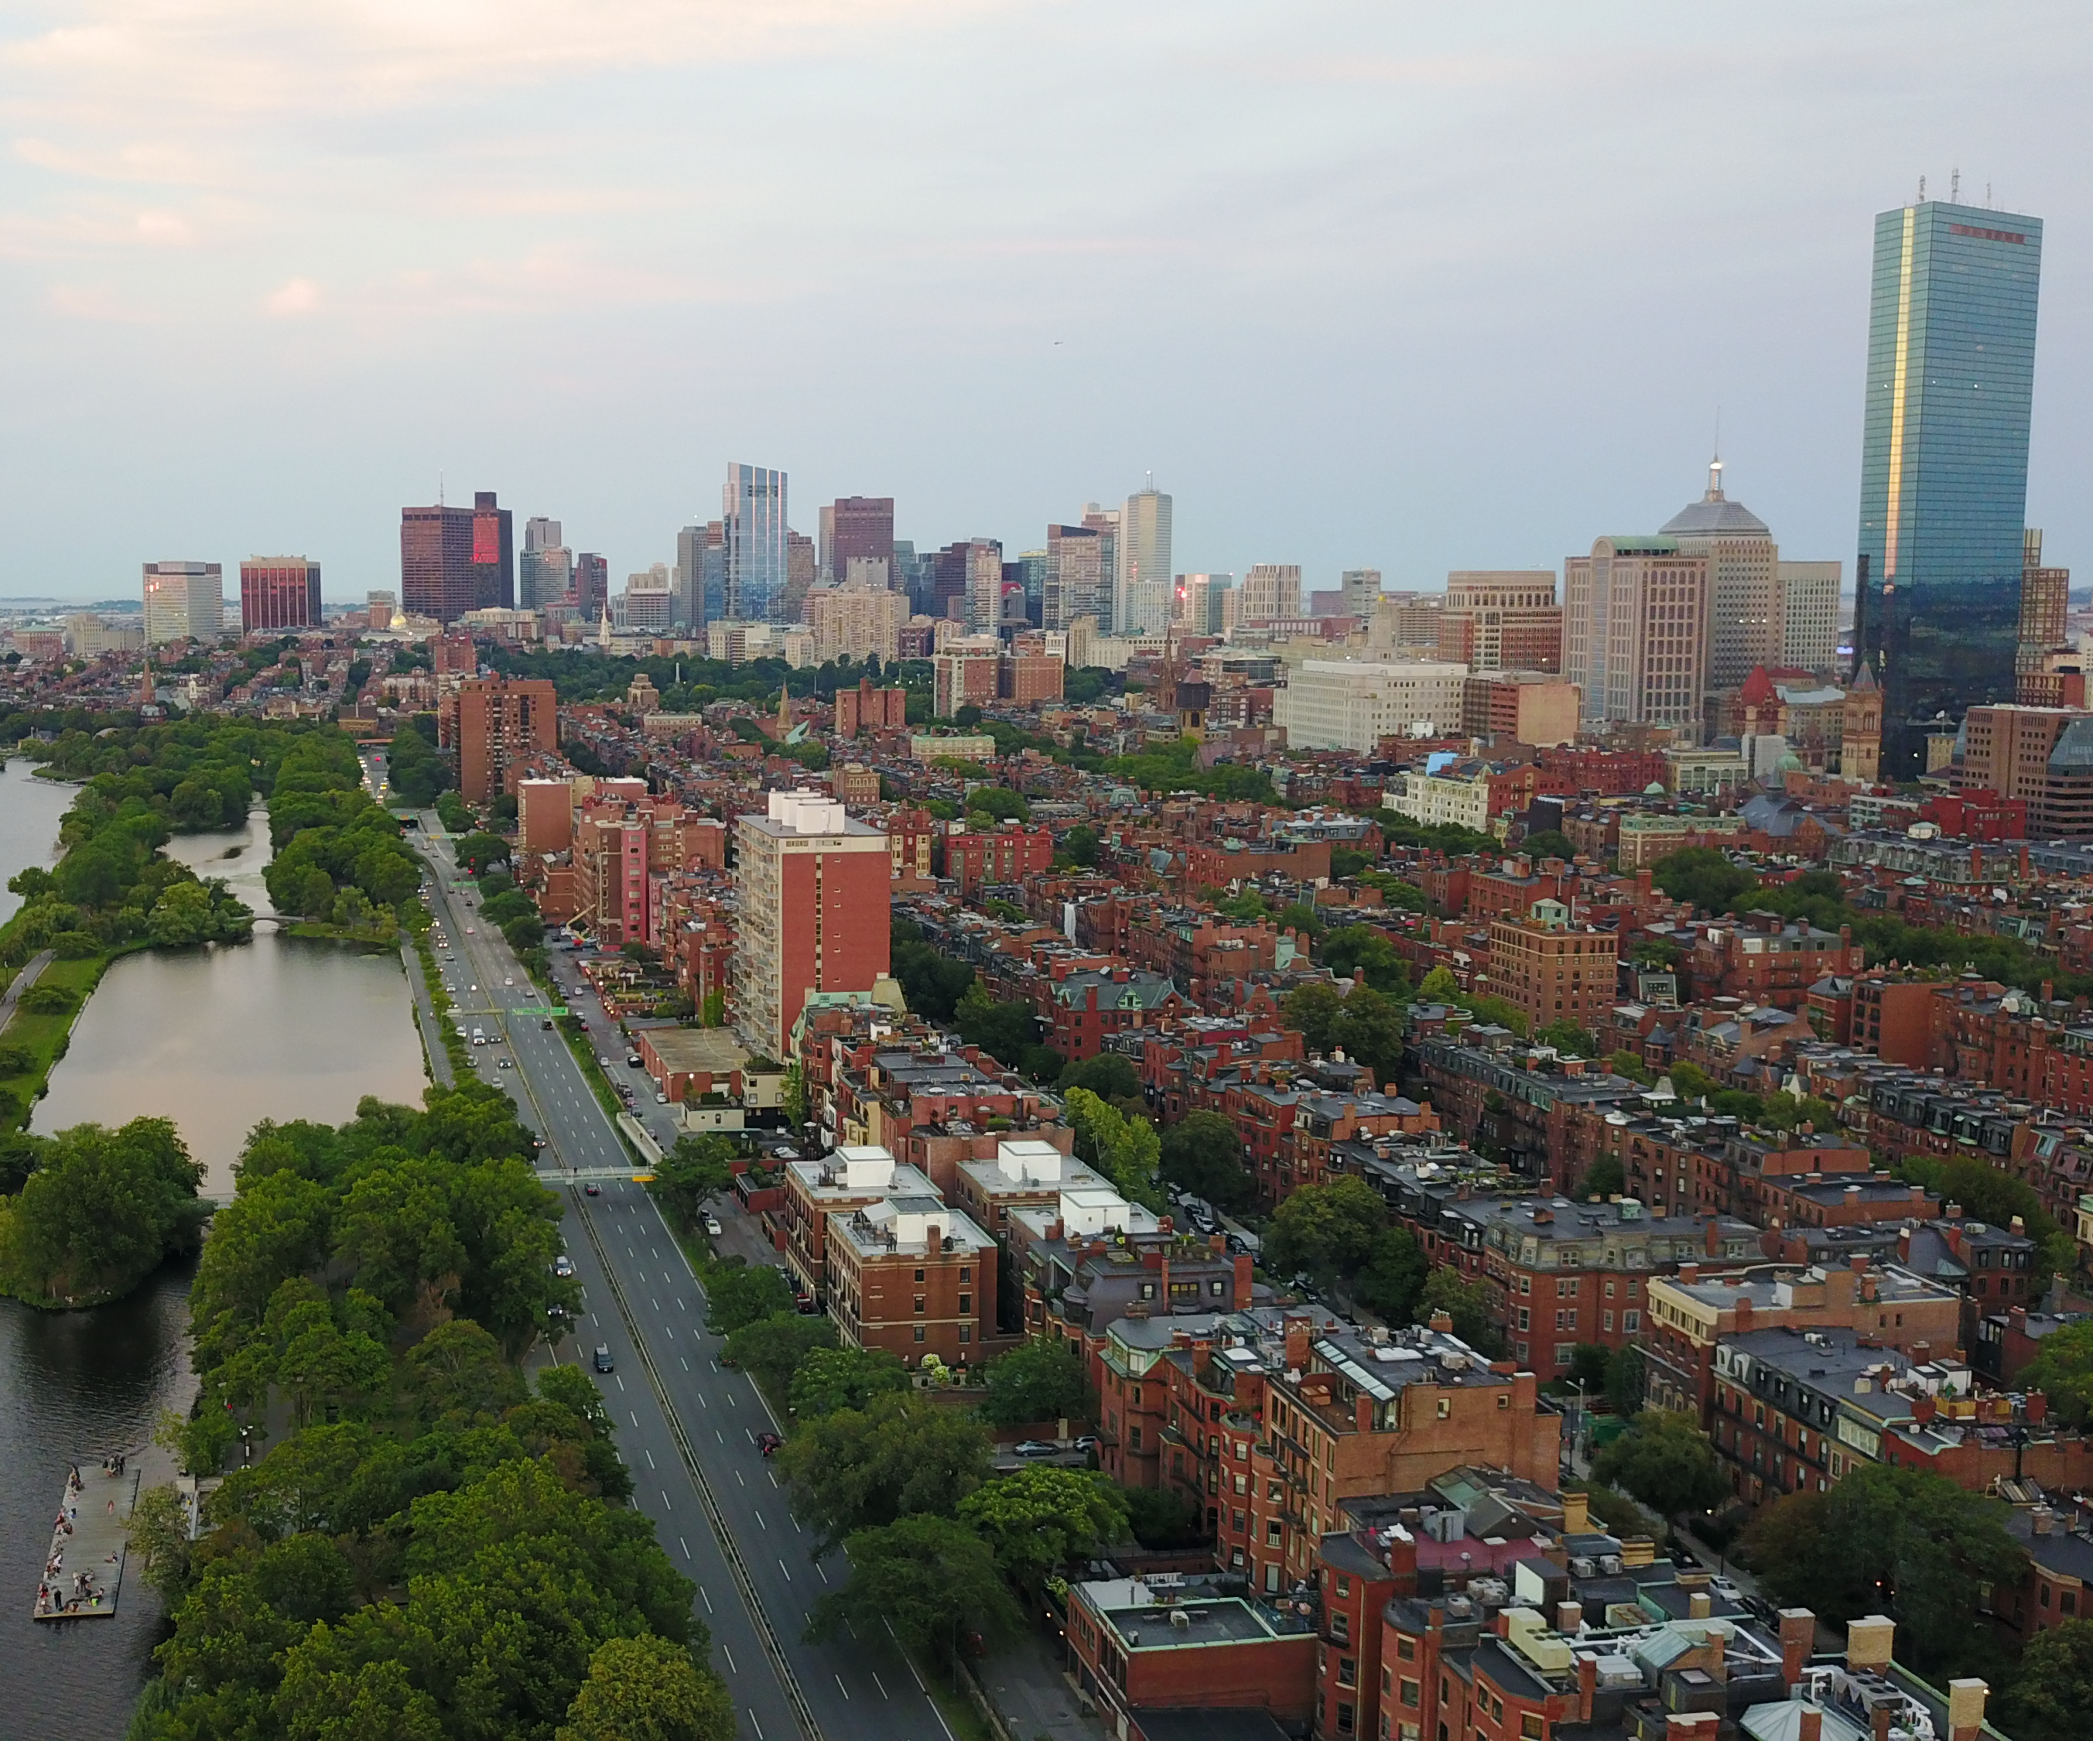
AGENDA
1.
2.
3.
4.
5.
6.
7.
Problem Identification
Research Question
Communication Theory
Comparing Cities
The Power of Media
Where is Boston Today?
Actions and Recommendations
Credits: @droneceron

Slide 5











PROBLEM IDENTIFICATION
Reduce GHG emission below 2005 levels
Measure Progress
CARBON FREE BOSTON
Coordinates collaboration between the community and City of Boston to effect policy and program implementation
ZERO WASTE BOSTON
Prepare Boston for the impacts of Climate Change
Acts as a community convener and connector to help create a bigger collective impact
CLIMATE READY BOSTON
Central resource about climate and environment issues in Boston
1

Slide 6
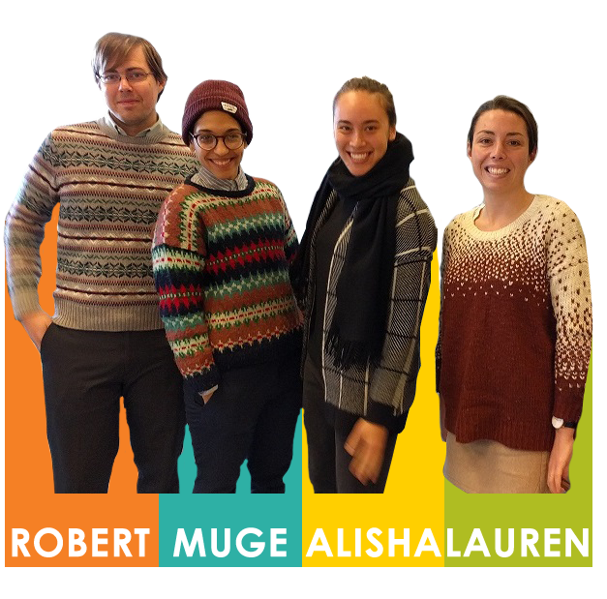
PROBLEM IDENTIFICATION
Reduce GHG emission below 2005 levels
Measure Progress
CARBON FREE BOSTON
Coordinates collaboration between the community and City of Boston to effect policy and program implementation
ZERO WASTE BOSTON
Prepare Boston for the impacts of Climate Change
Acts as a community convener and connector to help create a bigger collective impact
CLIMATE READY BOSTON
Central resource about climate and environment issues in Boston
1

Slide 7
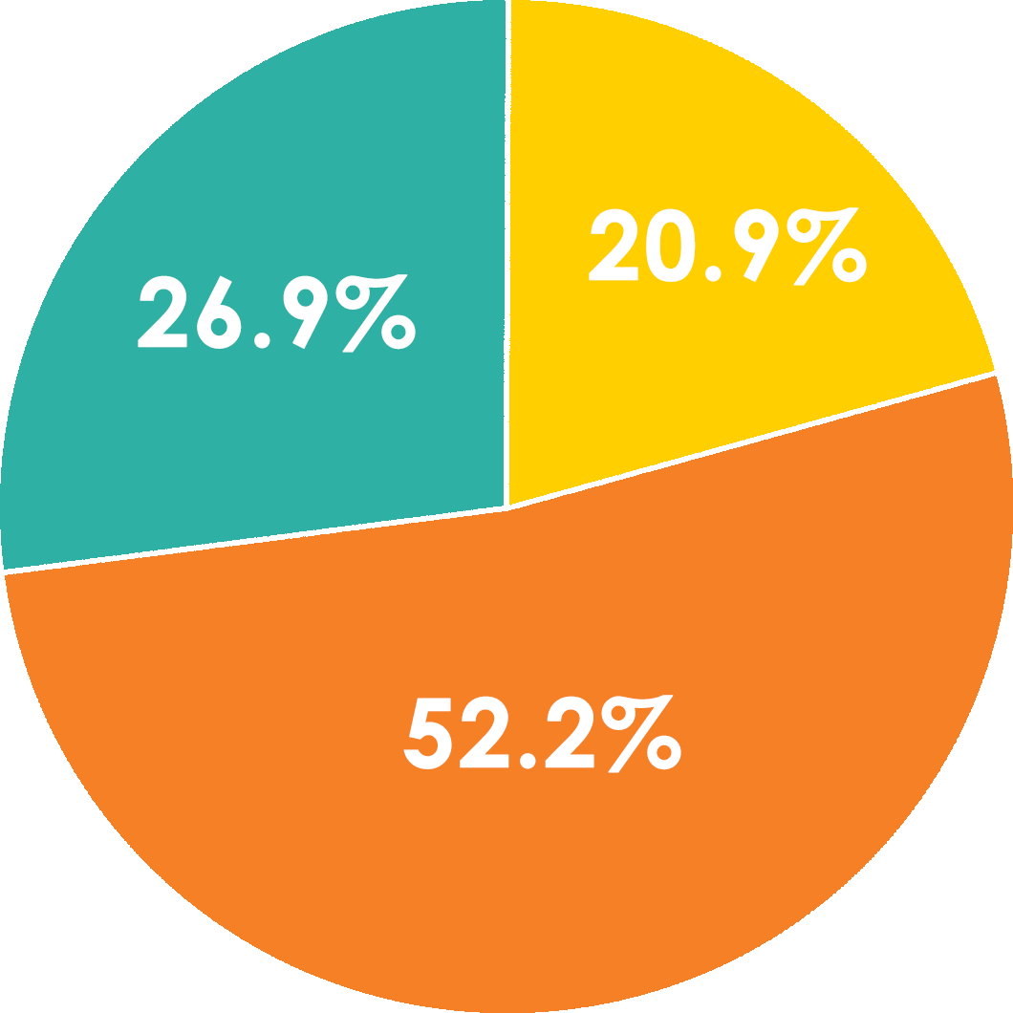
PROBLEM IDENTIFICATION
WHY
ACTIVE
TRANSPORTATION?
GHGs BY SECTOR 2013
RESIDENTIAL
COMMERCIAL
TRANSPORTATION
2
Source: City of Boston Community Gas Inventory 2005-2013

Slide 8
RESEARCH QUESTION
HOW CAN GREENOVATE BOSTON
IMPROVE ENGAGEMENT
AND COMMUNICATION
TO THE COMMUTING AGE POPULATION IN ORDER TO
STRENGTHEN BIKE RIDERSHIP
AND CONTRIBUTE TO THE CITY’S
2050 CARBON-NEUTRAL GOAL?
3

Slide 9
AGENDA
1.
2.
3.
4.
5.
6.
7.
Problem Identification
Research Question
Communication Theory
Comparing Cities
The Power of Media
Where is Boston Today?
Actions and Recommendations
Source: @droneceron

Slide 10
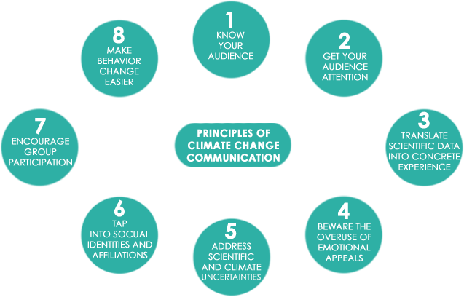
COMMUNICATION THEORY
Shome, D., & Marx, S. (2009). The Psychology of Climate Change Communication: A Guide for Scientists, Journalists, Educators, Political Aides and the Interested Public. The Center for Research on Environmental Decisions, Columbia University ,1-48.
4

Slide 11
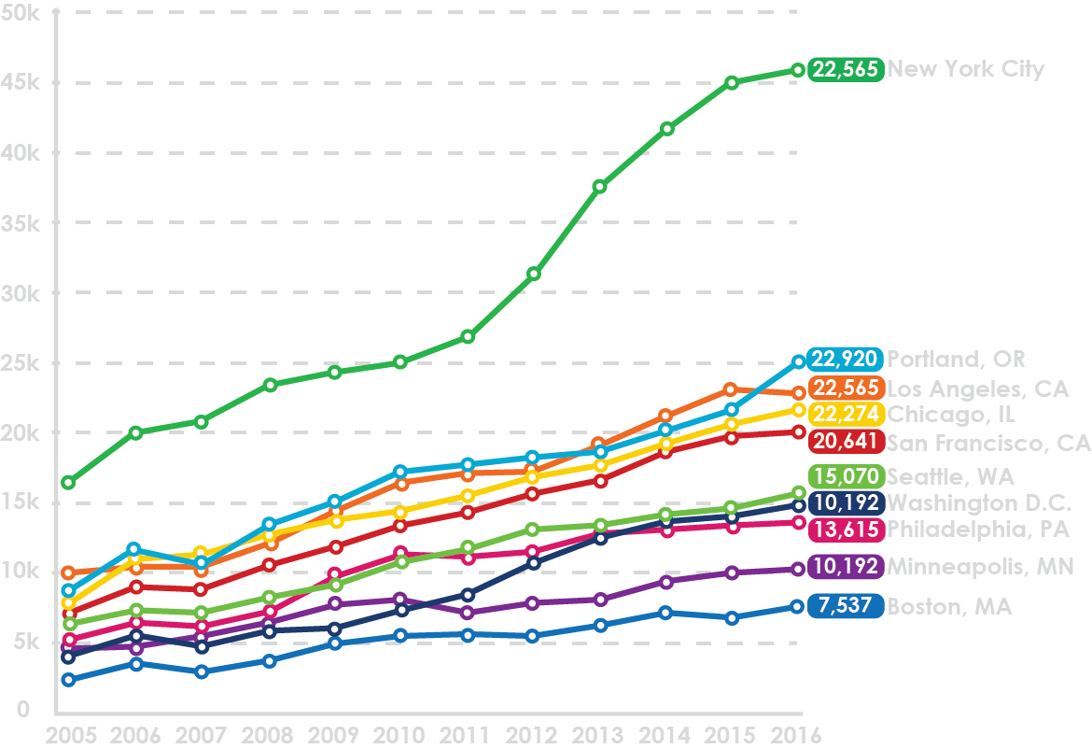
PERCENTAGE GROWTH
2011-2016
COMPARING CITIES
+70% NEW YORK CITY
+37% PEER CITIES
+32% LOS ANGELES, CA
+30% PORTLAND, OR
+44% CHICAGO, IL
+43% SAN FRANCISCO, CA
+30% SEATTLE, WA
+77% WASHINGTON DC
+20% PHILADELPHIA, PA
+41% MINNEAPOLIS, MN
+34% BOSTON, MA
Bicycle Commuters
Peer cities include Los Angeles, San Francisco, Portland, Seattle, Washington DC, Minneapolis, Chicago, Boston, Philadelphia.
5
NYC Cycling in the City report, 2018.

Slide 12
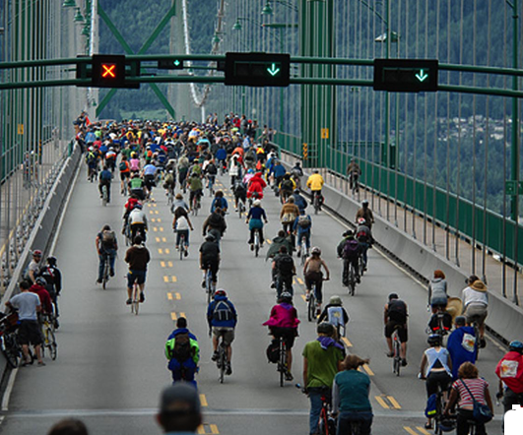

COMPARING CITIES
1
DEDICATED
MARKETING PLAN
2
EDUCATION
PROGRAMMING
3
BUILDING A
BRAND
6

Slide 13
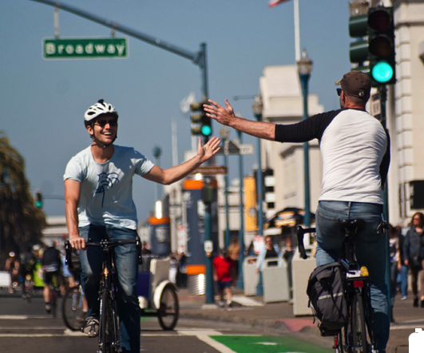

COMPARING CITIES
1
SIMPLIFYING AND
SHARING DATA
2
DEDICATED
FULL-TIME STAFF
3
POSITIONING S.F.
AS A BRAND
7
Credits: San Francisco Bicycle Coalition.

Slide 14
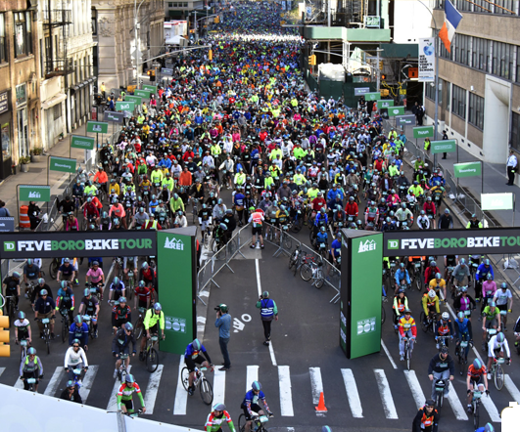

COMPARING CITIES
1
INNOVATIVE
CAMPAIGNS
2
MASSIVE
EVENTS
3
STRONG
ADVOCACY
8
Credits: Ed Haas / Bike New York.

Slide 15
COMPARING CITIES
1
1
1
DEDICATED
MARKETING PLAN
SIMPLIFYING AND
SHARING DATA
INNOVATIVE
CAMPAIGNS
2
EDUCATION
PROGRAMMING
2
DEDICATED
FULL-TIME STAFF
2
MASSIVE
EVENTS
3
3
3
BUILDING A
BRAND
POSITIONING S.F.
AS A BRAND
STRONG
ADVOCACY
9

Slide 16
COMPARING CITIES
1
1
1
DEDICATED
MARKETING PLAN
SIMPLIFYING AND
SHARING DATA
INNOVATIVE
CAMPAIGNS
2
EDUCATION
PROGRAMMING
2
DEDICATED
FULL-TIME STAFF
2
MASSIVE
EVENTS
3
3
3
BUILDING A
BRAND
POSITIONING S.F.
AS A BRAND
STRONG
ADVOCACY
9
Notes:
They all applied some of the principles of communication that we already mentioned!c

Slide 17
AGENDA
1.
2.
3.
4.
5.
6.
7.
Problem Identification
Research Question
Communication Theory
Comparing Cities
The Power of Media
Where is Boston Today?
Actions and Recommendations
Source: @droneceron

Slide 18
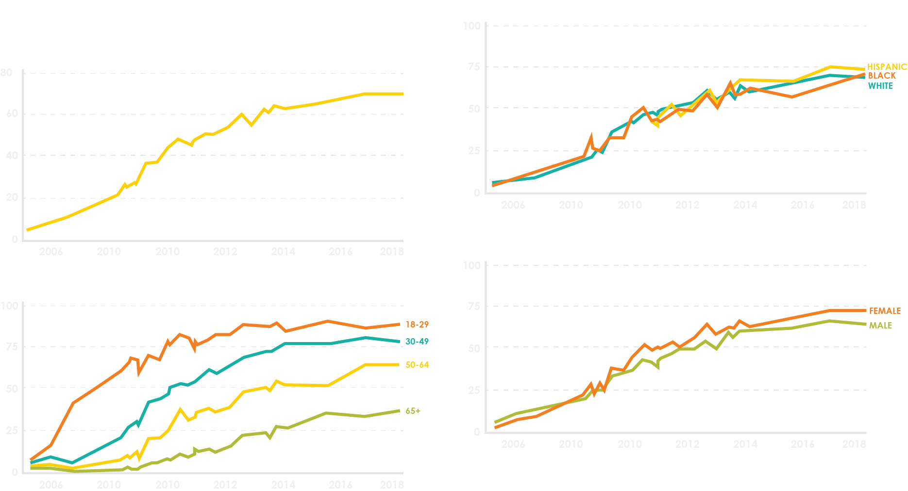
THE POWER OF SOCIAL MEDIA
10
Credits: Pew Research Center, surveys conducted 2005-2018.
Notes:
They all applied some of the principles of communication that we already mentioned!c

Slide 19

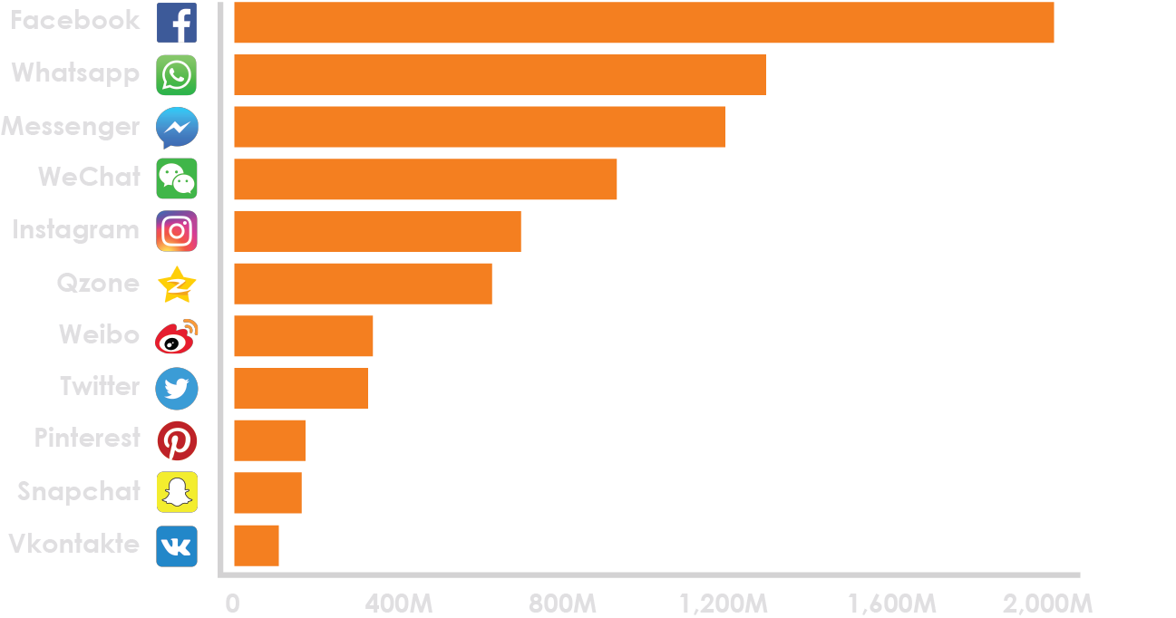
THE POWER OF SOCIAL MEDIA
MONTLY ACTIVE USERS OF SELECTED SOCIAL MEDIA NETWORKS AND MESSAGING SERVICES
11
Credits: Business Insider, Mike Nudelman, 2016-2017.
Notes:
They all applied some of the principles of communication that we already mentioned!c

Slide 20




THE POWER OF SOCIAL MEDIA
WHAT IS
GREENOVATE’S
PRESENCE
ON SOCIAL MEDIA
COMPARED TO THE CITY OF BOSTON?
12
Notes:
They all applied some of the principles of communication that we already mentioned!c

Slide 21
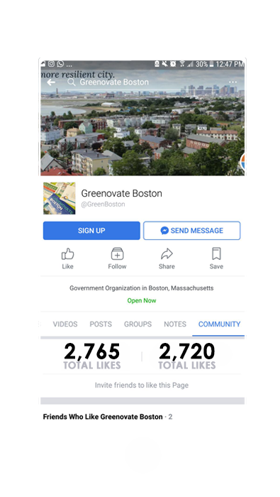
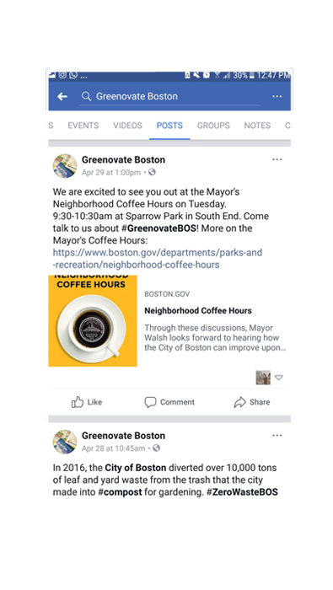
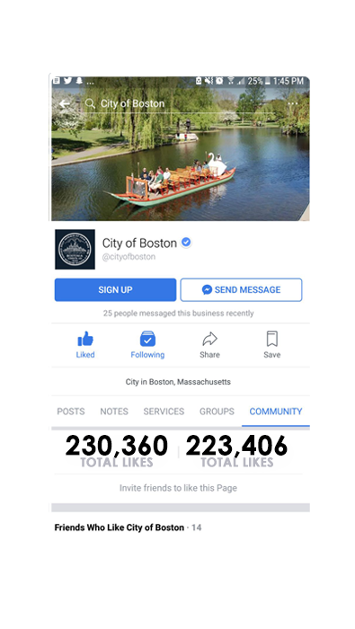
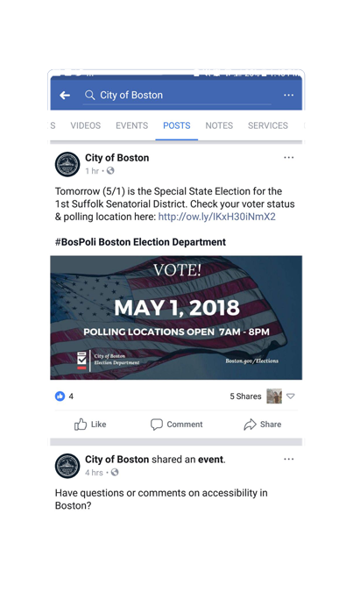
THE POWER OF SOCIAL MEDIA
WHAT IS
GREENOVATE’S
PRESENCE
ON SOCIAL MEDIA
COMPARED TO THE CITY OF BOSTON?
Greenovate: 2,765Followers 2,765Likes 1Day
City of Boston: 230, 360Followers 223,406Likes 3Hours
Greenovate:
City of Boston:
Greenovate:
City of Boston:
12
Notes:
They all applied some of the principles of communication that we already mentioned!c

Slide 22

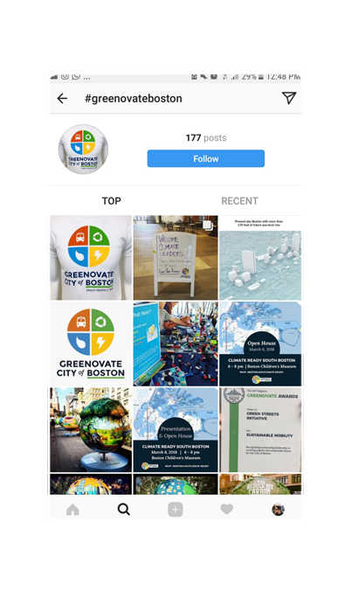
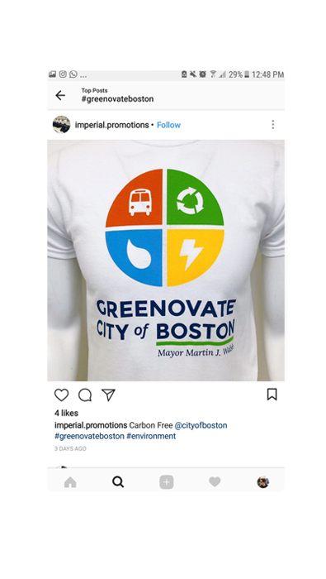
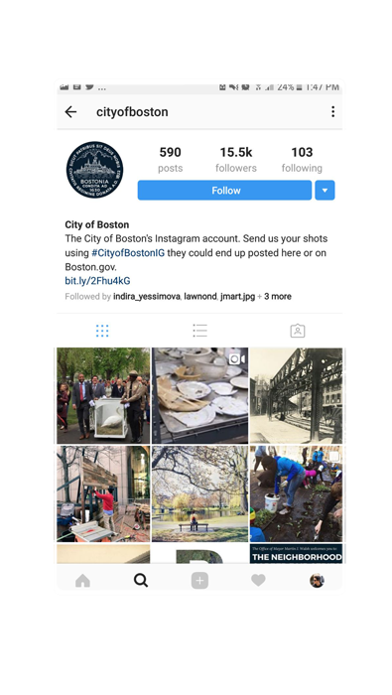
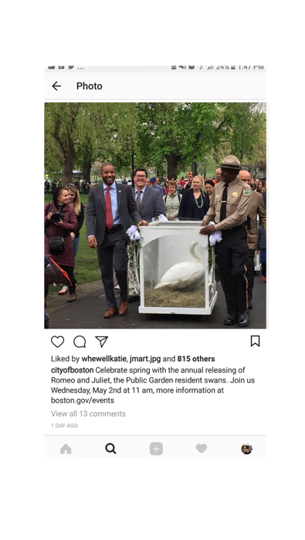
THE POWER OF SOCIAL MEDIA
WHAT IS
GREENOVATE’S
PRESENCE
ON SOCIAL MEDIA
COMPARED TO THE CITY OF BOSTON?
Greenovate: 2,765Followers 2,765Likes 1Day
City of Boston: 230, 360Followers 223,406Likes 3Hours
Greenovate: NO Account 177Posts 3Days
City of Boston: 15kFollowers 590Posts 1Day
Greenovate:
City of Boston:
12
Notes:
They all applied some of the principles of communication that we already mentioned!c

Slide 23
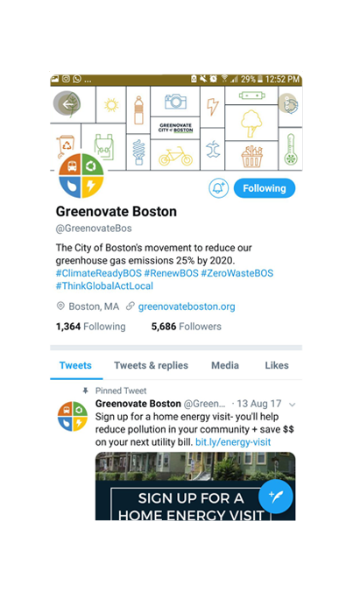
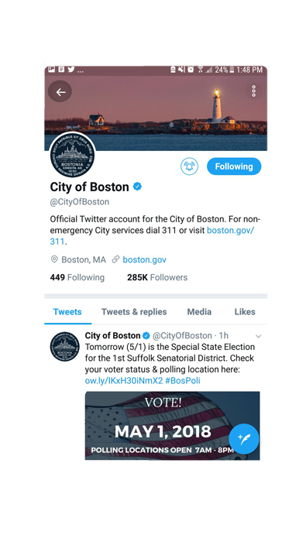
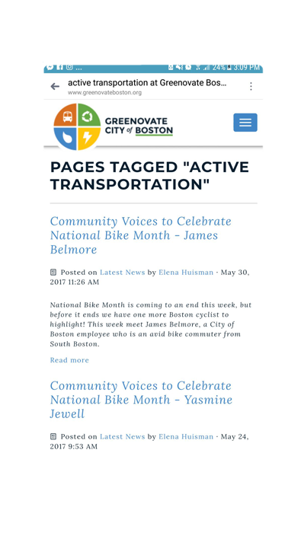
THE POWER OF SOCIAL MEDIA
WHAT IS
GREENOVATE’S
PRESENCE
ON SOCIAL MEDIA
COMPARED TO THE CITY OF BOSTON?
Greenovate: 2,765Followers 2,765Likes 1Day
City of Boston: 230, 360Followers 223,406Likes 3Hours
Greenovate: 0Followers 177Posts 3Days
City of Boston: 15kFollowers 590Posts 1Day
Greenovate: 5,680Followers 4Hours
City of Boston: 285kFollowers 3Hours
12
Notes:
They all applied some of the principles of communication that we already mentioned!c

Slide 24
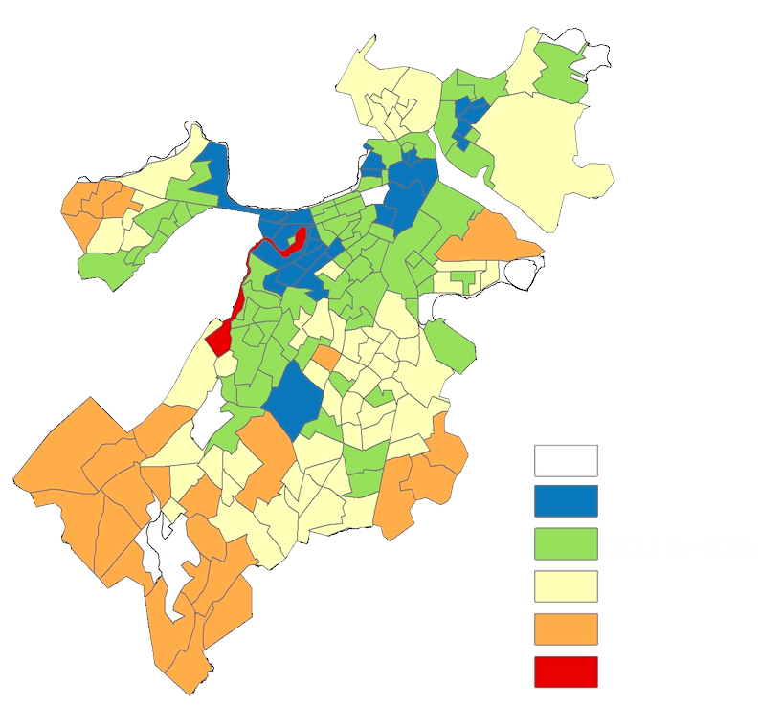
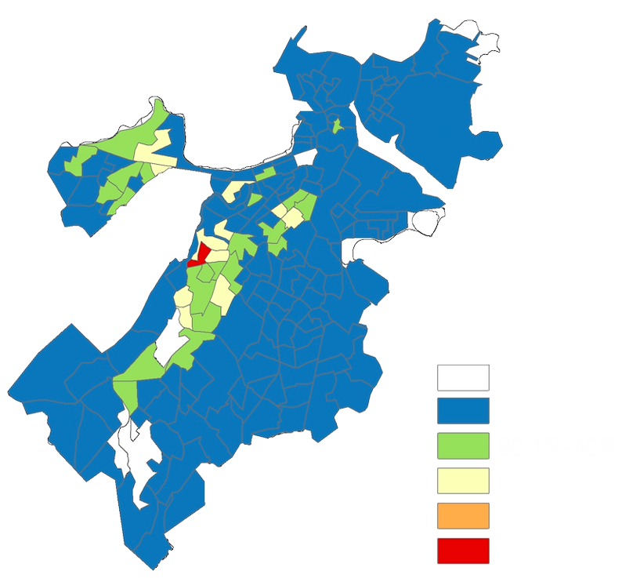
WHERE IS BOSTON TODAY
% TOTAL WORKERS WHO COMMUTE ALONE BY CAR
2012-2016
% TOTAL WORKERS WHO COMMUTE BY BIKE
2012-2016
13
American Community Survey 5-Years estimate. Adaptation from Table S0801 for Census Tracts within the City of Boston, year 2016.
Notes:
They all applied some of the principles of communication that we already mentioned!c

Slide 25
WHERE IS BOSTON TODAY
% TOTAL WORKERS WHO COMMUTE ALONE BY CAR
2012-2016
% TOTAL WORKERS WHO COMMUTE BY BIKE
2012-2016
ON AVERAGE, BETWEEN 2012-2016
347,608 PEOPLE
COMMUTED TO WORK:
39% DROVE ALONE
(135,142 PEOPLE) AND
2% BIKED
(7,192 PEOPLE) TO WORK
13
American Community Survey 5-Years estimate. Adaptation from Table S0801 for Census Tracts within the City of Boston, year 2016.
Notes:
They all applied some of the principles of communication that we already mentioned!c

Slide 26
AGENDA
1.
2.
3.
4.
5.
6.
7.
Problem Identification
Research Question
Communication Theory
Comparing Cities
The Power of Media
Where is Boston Today?
Actions and Recommendations
Source: @droneceron

Slide 27





MARKETING: ACTIONS AND RECOMMENDATIONS
LONG-TERM
NEAR-TERM
LEVERAGE EXISTING SOCIAL MEDIA CHANNELS
STRENGTHEN PARTNERSHIPS AND FACILITATE CONNECTIONS WITHIN THE BIKE COMMUNITY
EMPLOY THE USE OF A SOCIAL MEDIA MANAGEMENT TOOLS
HIRE DEDICATED MARKETING MANAGER
ALLOCATE FUNDS EXCLUSIVELY FOR MARKETING
14
Notes:
They all applied some of the principles of communication that we already mentioned!c

Slide 28
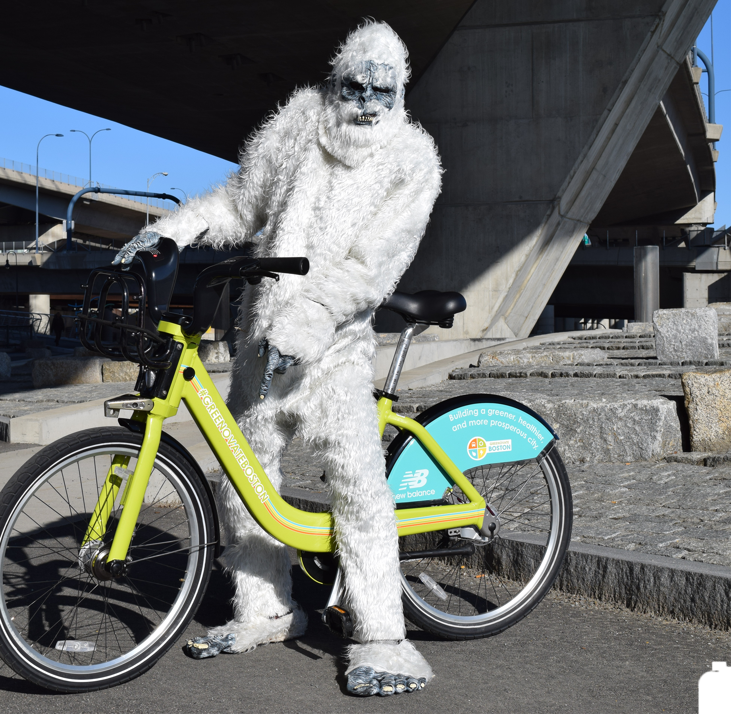
MARKETING: ACTIONS AND RECOMMENDATIONS
1
REQUEST FOR
PROPOSALS
2
SERVICE LEARNING
PROPJECTS
3
“RETURN OF
THE YETI”
4
SHOWCASE
EXISTING INNITIATIVES
5
ENGAGEMENT
CHALLENGES
15
Notes:
They all applied some of the principles of communication that we already mentioned!c

Slide 29
VIDEO
16
Notes:
They all applied some of the principles of communication that we already mentioned!c

Slide 30
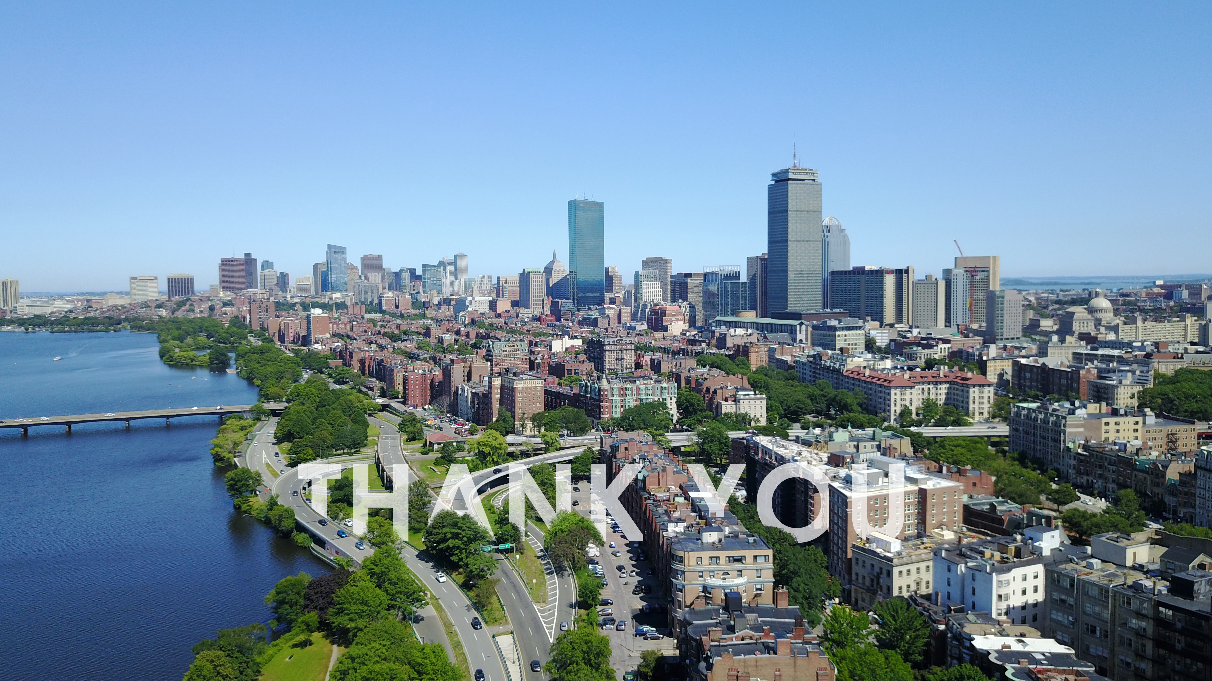

Slide 31
REFERENCES
Analyze Boston. City of Boston's open data hub. (n.d.). Retrieved March 29, 2018, from https://data.boston.gov/
Geospatial Datasets.
Bike New York. (n.d.). Retrieved April 20, 2018, from https://www.bike.nyc/
Boston Department of Transportation. Boston Bike Network Plan 2013 [Bike Network 2005-2043] (pp. 19). Retrieved March 30, 2018, from https://www.cityofboston.gov/images_documents/Boston%20Bike%20Network%20Plan%2C%20Fall%202013_FINAL_tcm3-40525.pdf
Canada, City of Vancouver, Streets and Transportation. (2013). Active Transportation Promotion & Enabling Plan:(pp. 1-36). Vancouver.
City of Boston. GHG by sectors 2013. Community Greenhouse Gas Inventory 2005-2013. Retrieved March 17, 2018, from https://www.cityofboston.gov/images_documents/Community%20GHG%20Inventory%202013_tcm3-49977.pdf
City of Boston. Transformational Investments In Streets and Transportation. Retrieved April 19, 2018, from https://budget.boston.gov/featured-analysis/streets/
Greenovate Boston. (2016, September 23). The Massachusetts Clean Air Challenge May Be Winding Down, But You Can Choose Clean Air Commutes All Year 'Round [Green Commutes]. Retrieved April 27, 2018, from http://www.greenovateboston.org/cleanaircommutes
Greenovate Boston. What We Do. Retrieved from http://www.greenovateboston.org/about-us
NYC DOT. (n.d.). Bicyclists. Retrieved April 20, 2018, from http://www.nyc.gov/html/dot/html/bicyclists/bicyclists.shtml
NYC DOT. (2018). Cycling in the City: Cycling Trends in NYC. Retrieved April 27, 2018, from http://www.nyc.gov/html/dot/downloads/pdf/cycling-in-the-city.pdf
Shome, D., & Marx, S. (2009). The Psychology of Climate Change Communication: A Guide for Scientists, Journalists, Educators, Political Aides, and the Interested Public. Center for Research on Environmental Decisions,1-54.
Transportation Alternatives. (n.d.). Retrieved April 20, 2018, from https://www.transalt.org/
USA, City of Chicago, Chicago Department of Transportation. (2015). Chicago Streets for Cycling Plan 2020(pp. 1-84). Chicago, IL.
San Francisco Bike Coalition. About. Retrieved April 26, 2018, from http://www.sfbike.org/
US Census Bureau: American FactFinder tool. (n.d.). Retrieved March 29, 2018, from https://factfinder.census.gov/faces/nav/jsf/pages/searchresults.xhtml?refresh=t
Wisniewski, M. (2016, September 19). Chicago tops NYC as most bike-friendly city in U.S., magazine finds. Retrieved from http://www.chicagotribune.com/news/local/breaking/ct-bicycling-magazine-rating-20160917-story.html
17
Notes:
They all applied some of the principles of communication that we already mentioned!c

