Slide 1
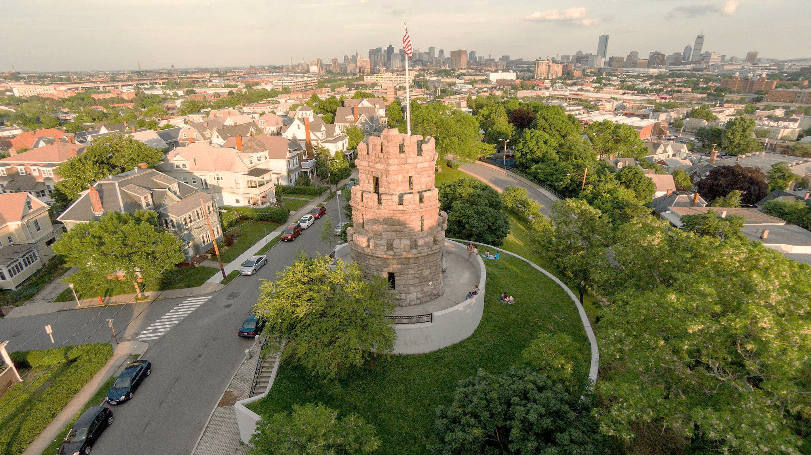
Preservation of Affordable Housing: Displacement Mitigation Strategies
Somerville, MA Spring 2018
Stacy Cawley, Dongyue Li, Sophia Wang

Slide 2
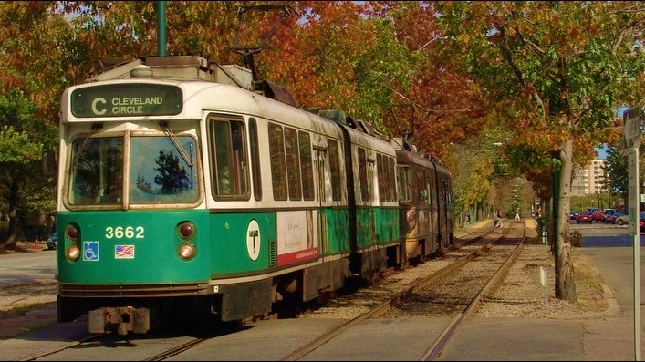
Content
Introduction
Research & Analysis
Toolkit

Slide 3
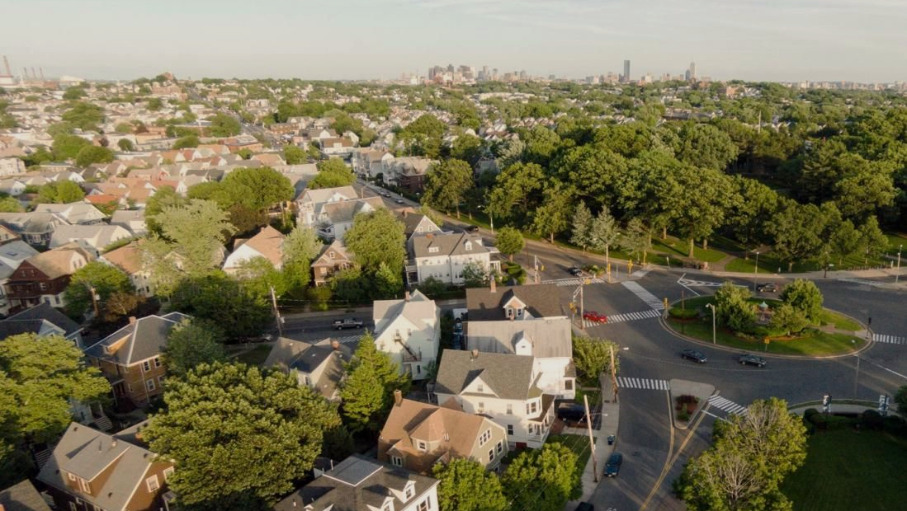
RESEARCH QUESTION:
What strategies, policies and programs can be effective in mitigating potential displacement in urban communities with transit stations?

Slide 4
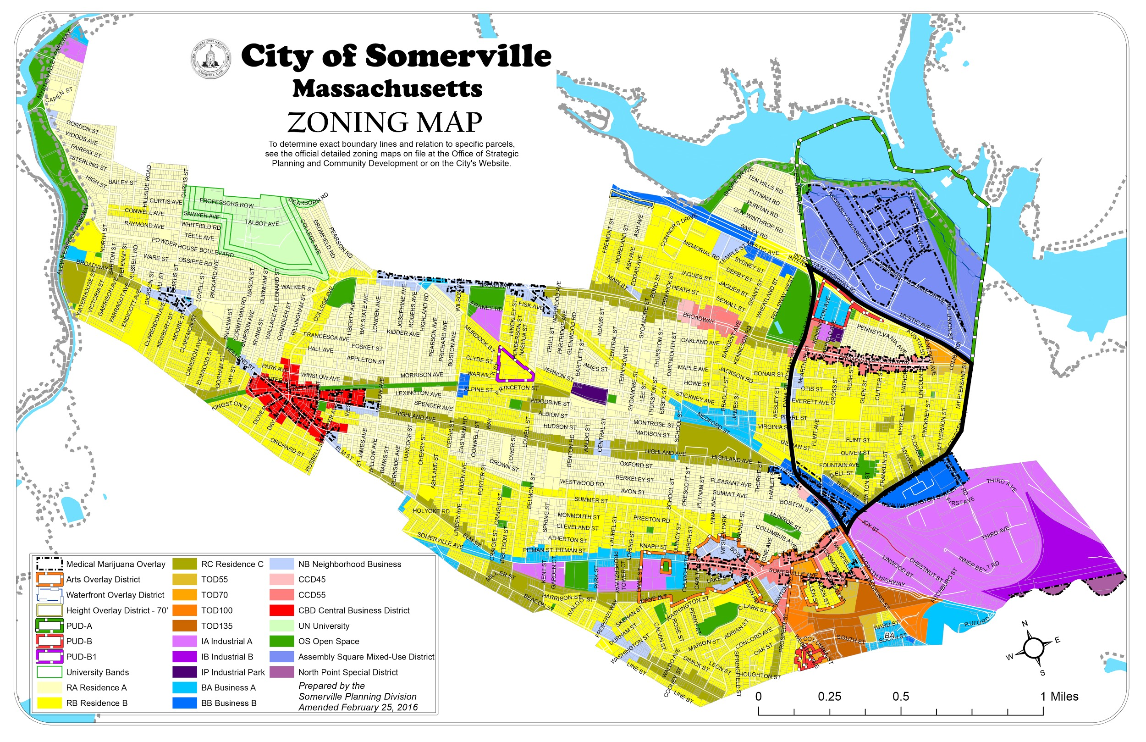
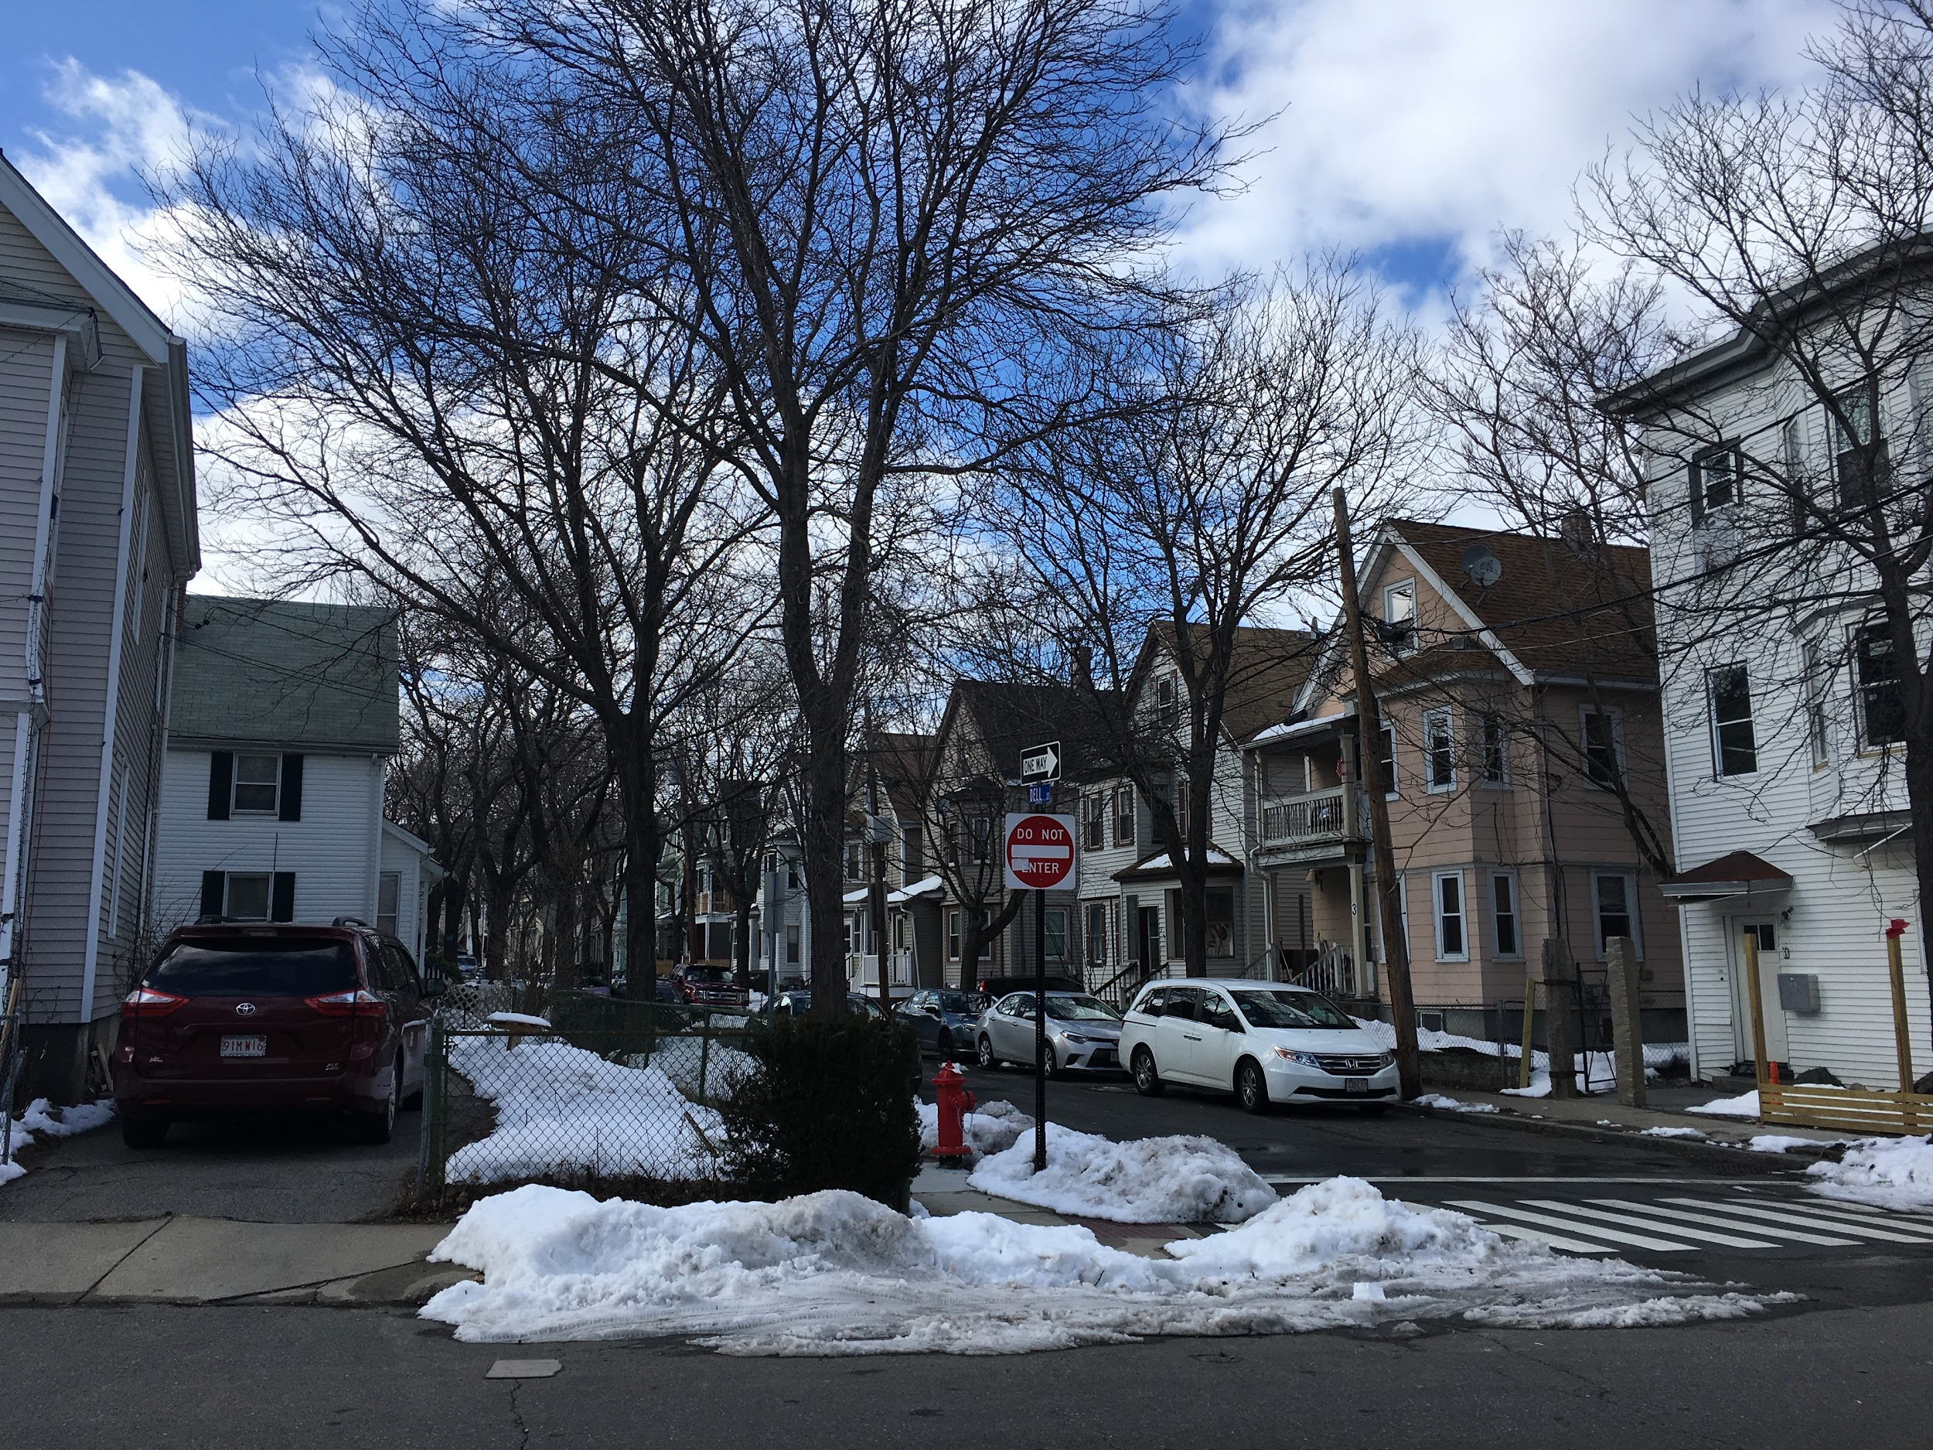
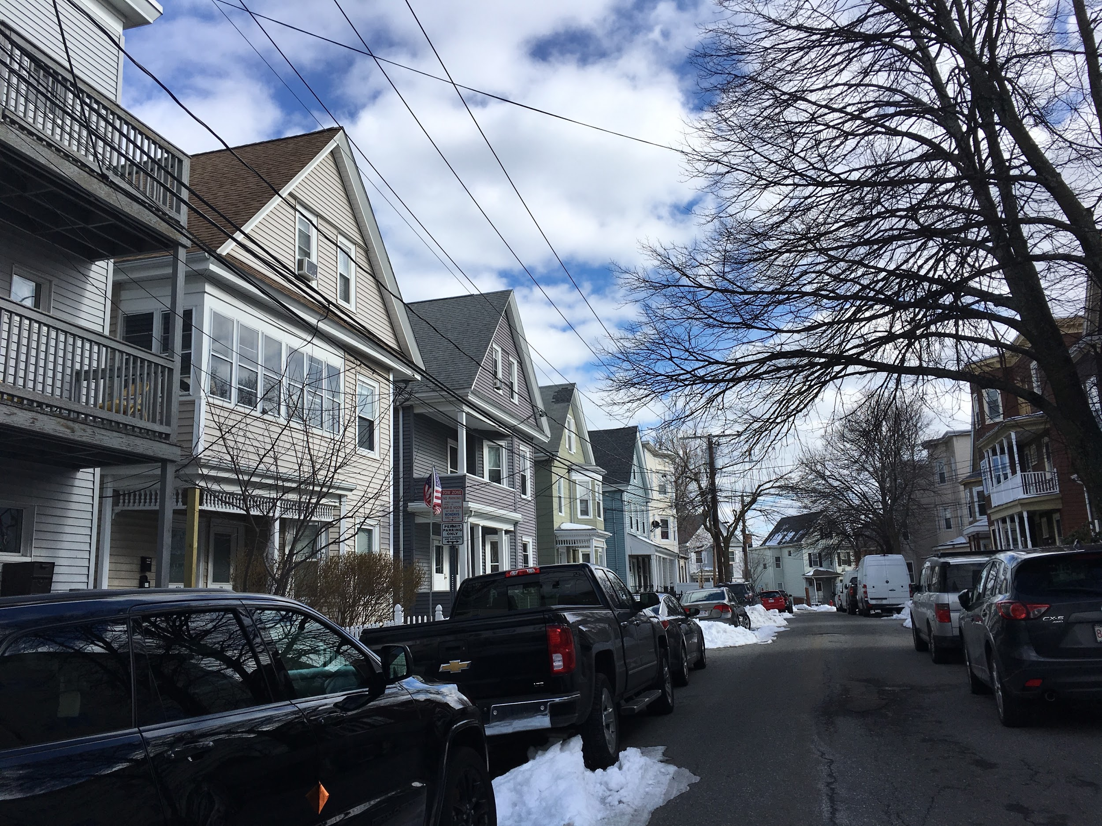
Existing Housing Shortage: Need 6,300 housing units between 2010-2030
Metropolitan Area Planning Council. (2011, May). Managing Neighborhood Change: Selected Anti-Displacement Strategies in Practice. Page 45.
Notes:
Green Line

Slide 5
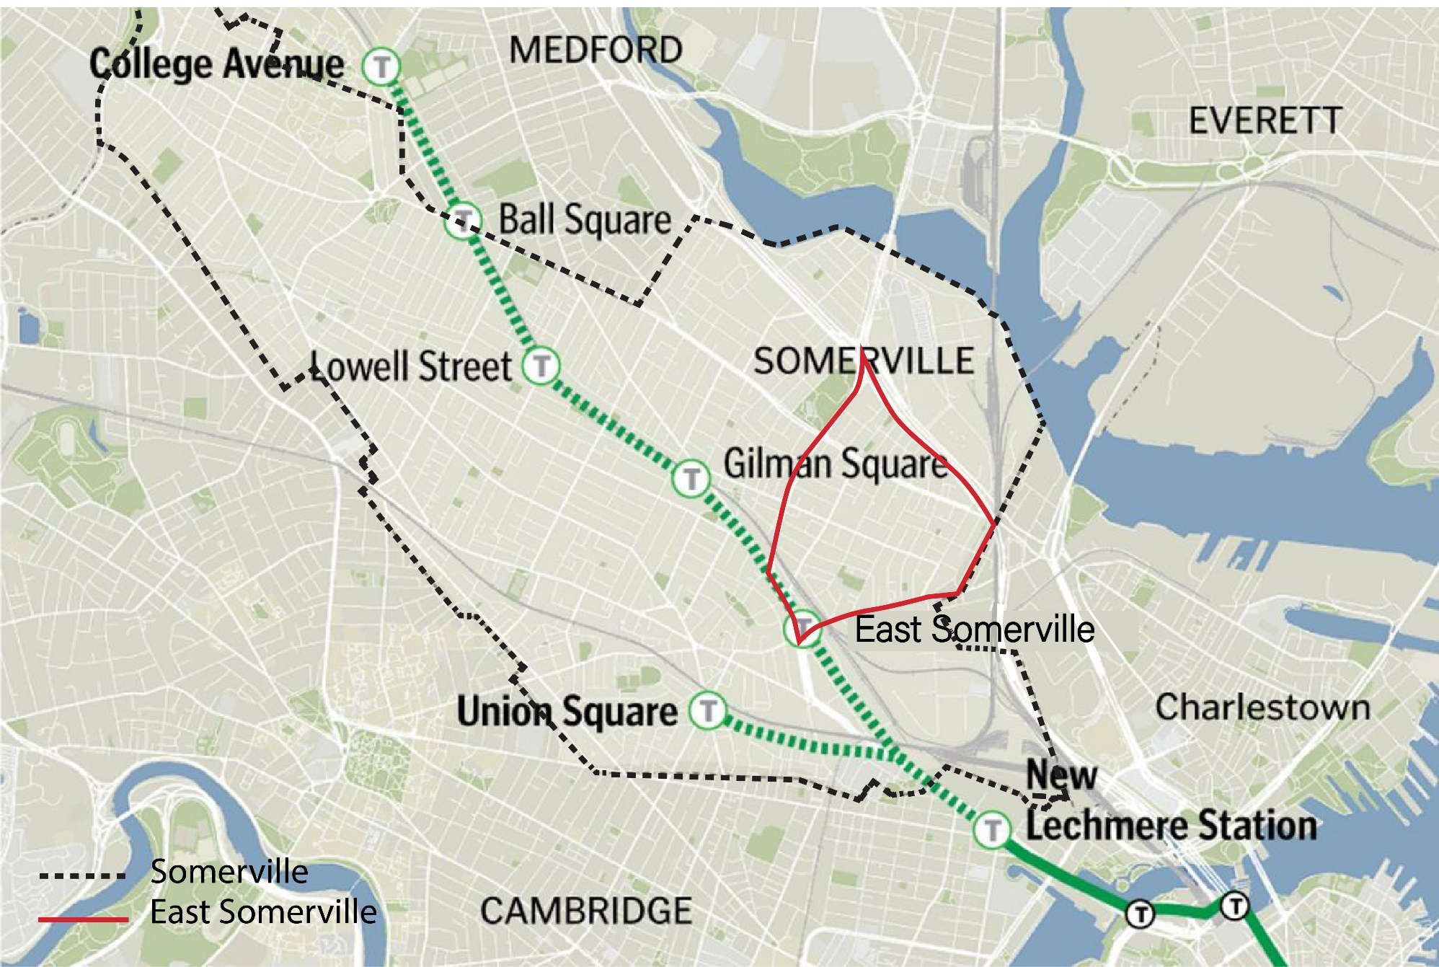

Focus Area
LARGE % OF RENTERS
INVESTMENT IN NEW TRANSIT
LOW INCOME COMMUNITIES
Notes:
Boundary of Somer N East Somer

Slide 6
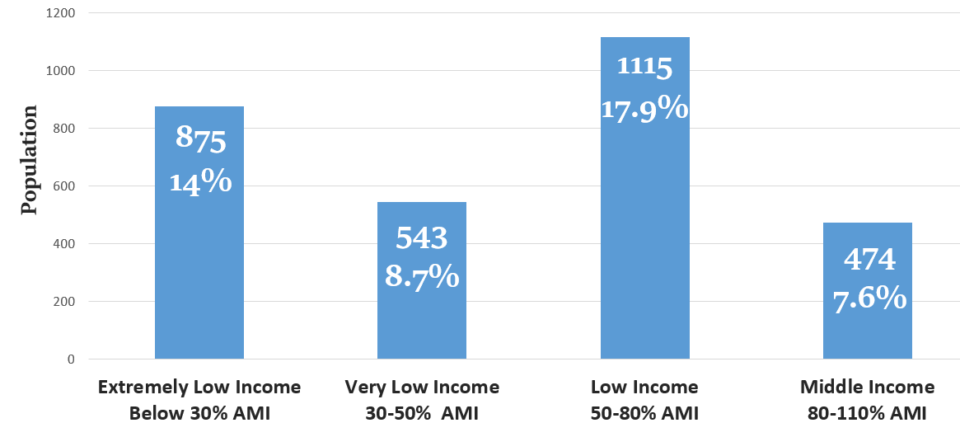
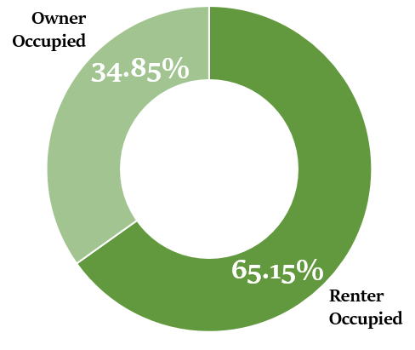
Displacement Risk Factors in East Somerville
61.2% Rent Burdened
65.15%
Renter Occupied
Source: US Census Bureau, 2016, 5-years

Slide 7
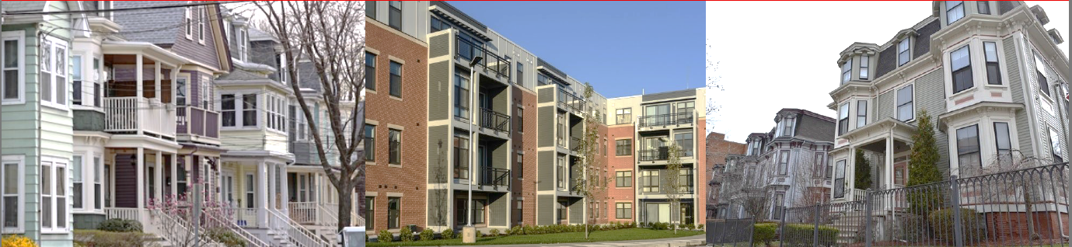
Affordable Homes Preservation: Displacement Mitigation
What strategies, policies and programs can be effective in mitigating potential displacement in urban communities with transit stations?
Affordability
Financing
Density
Inclusionary Zoning (IZ)
Deed Restricted Housing
Condo Conversion
Short Term Rental Regulation
Transfer Fee
Linkage Fee
Payment in Lieu of Taxes (PILOT)
Accessory Dwelling Units (ADU)
Up Zoning
Land Infill

Slide 8
AFFORDABILITY
Definition | Pro | Con | Example
Inclusionary Zoning (IZ): Requiring a percentage of units in residential developments to be affordable | Provides more affordable housing | Potential barrier for developments | New Jersey & California Davis, CA
Deed Restricted Housing: Affordable housing with affordability protected in deed | Preserving deed-restricted affordable housing stock | Owners not able to maximize profit | Massachusetts Chicago
Condo Conversion: Regulations on the conversion of rental properties to condominiums | Helps to keep rental units on the market | Constrains residential property owners rights | LA County does not allow condo conversions when vacancy rates fall below 4%
Short Term Rental Regulation: Regulations on short term rental platforms | Preserving housing stock for residents | Restrict homeowners ability to maximize profit | Cambridge, MA Boston, MA Santa Monica, CA

Slide 9
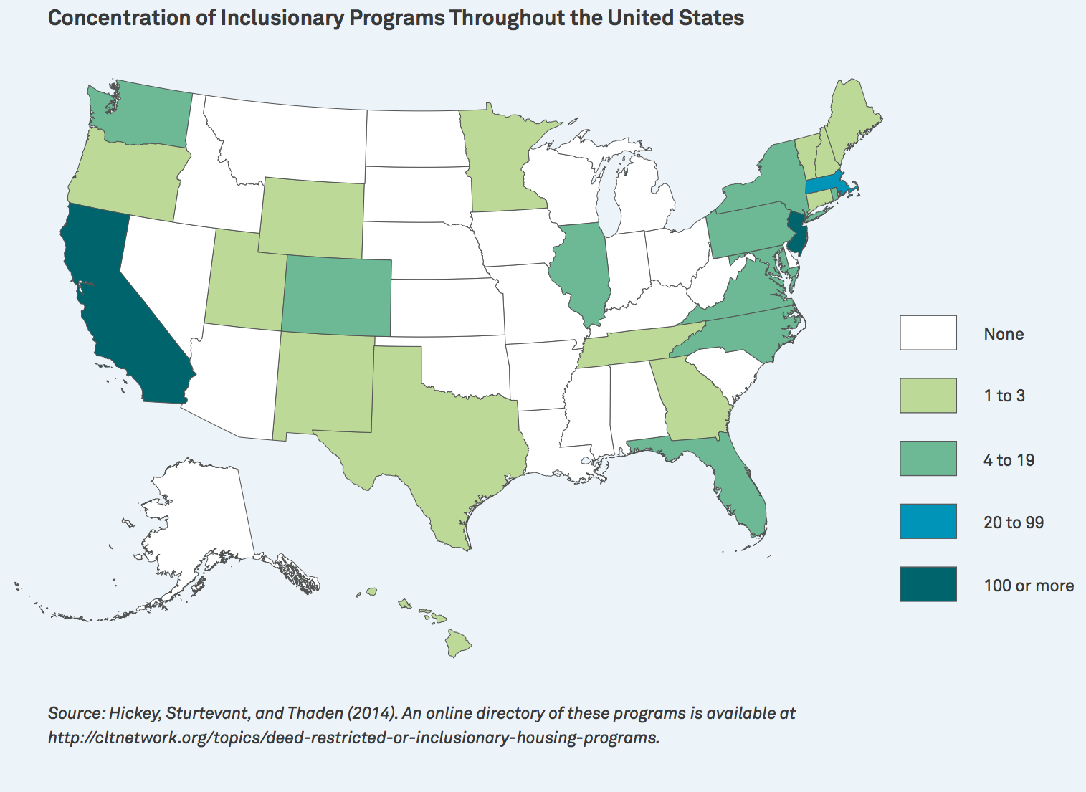
Inclusionary Zoning (IZ)
Source: Lincoln Institute of Land Use et al. (2015). Inclusionary Housing: Creating and Maintaining Equitable Communities.

Slide 10
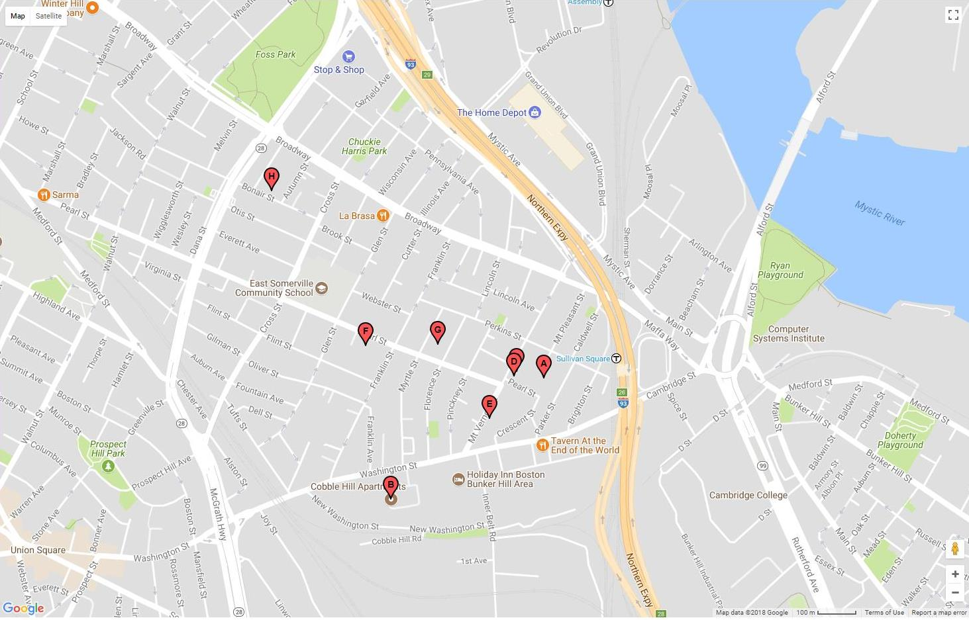
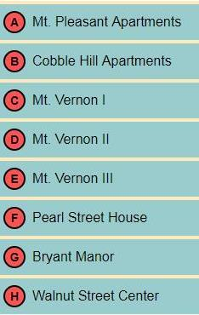
Deed Restricted Housing: East Somerville
Existing Deed- Restricted Affordable Housing
    8 properties (total of 485 units) expiring by 2035:
    31% or 152 units will expire by 2020
    69% or 333 units will expire by 2035
Source: Community Economic Development Assistance Corporation Expiring Use Inventory, March 2018

Slide 11
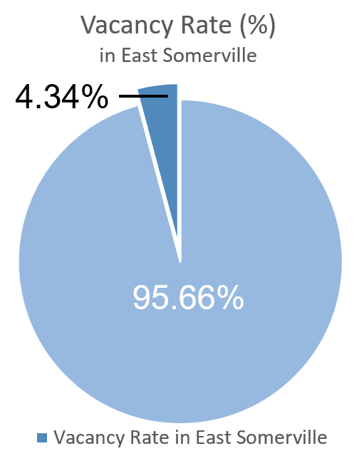
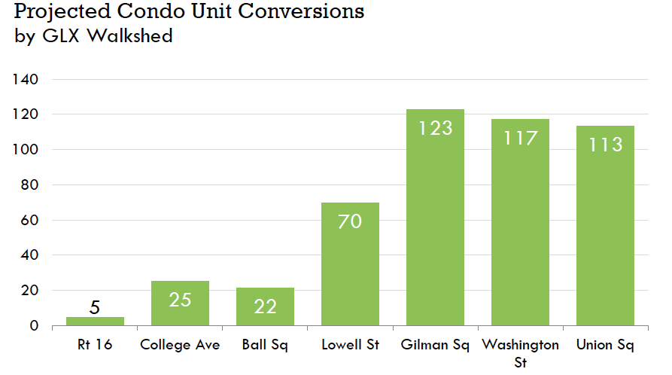
Condominium Conversions: East Somerville
Source: Metropolitan Area Planning Council: The Dimensions of Displacement; US Census Bureau

Slide 12
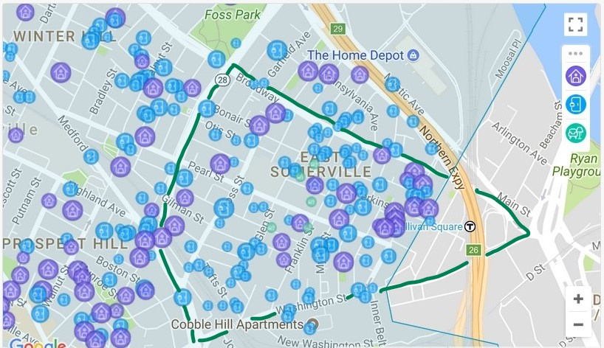

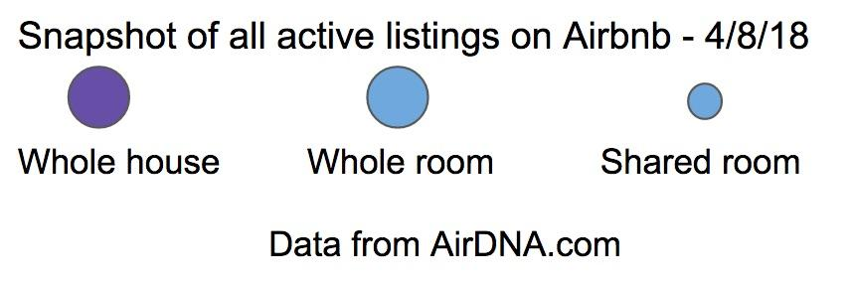
Short Term Rental Regulations: East Somerville
Source: City of Somerville Sustainable Neighborhoods Working Group Recommendations Report

Slide 13
Affordability Takeaways
IMPERATIVE to preserve existing housing stock
With 62% of renters it is vital to keep rental options available for residents
Inclusionary Zoning adds much needed affordable housing to existing inventory

Slide 14
FINANCING
Definition | Pro | Con | Example
Transfer Fee: A tax imposed on the sale of real estate | A significant amount of funds for investment in affordable housing | May deter potential buyers from the market | Nantucket & Martha’s Vineyard: 2% transfer fee
Linkage Fee: A fee paid by commercial developments for funding affordable housing | Funds for affordable housing | Potential barrier for development | Somerville, Boston, Cambridge, Boulder
Payment in Lieu of Taxes (PILOT): Payment made to compensate a government from some of the property tax revenue lost due to the tax-exempt ownership of the real property | Funds for affordable housing | Increasing the fee could deter future (or current expansion) of tax exempt ownerships | Boston based working group, recommends a PILOT contribution of 25% of taxes

Slide 15
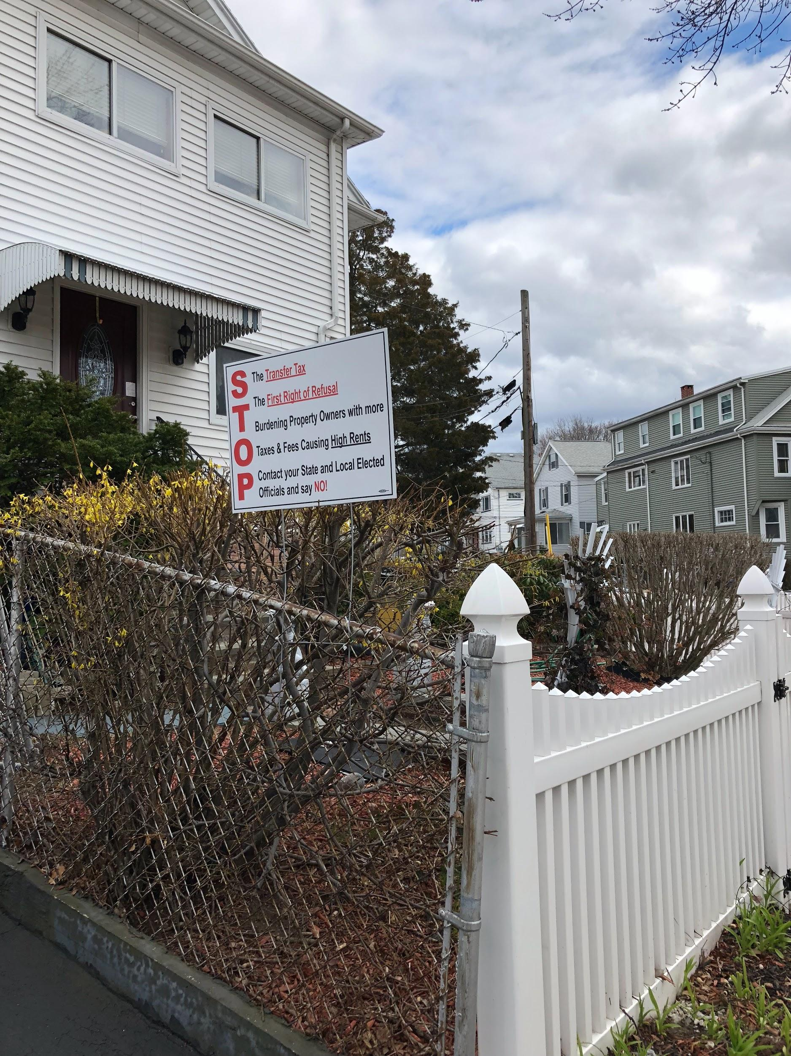
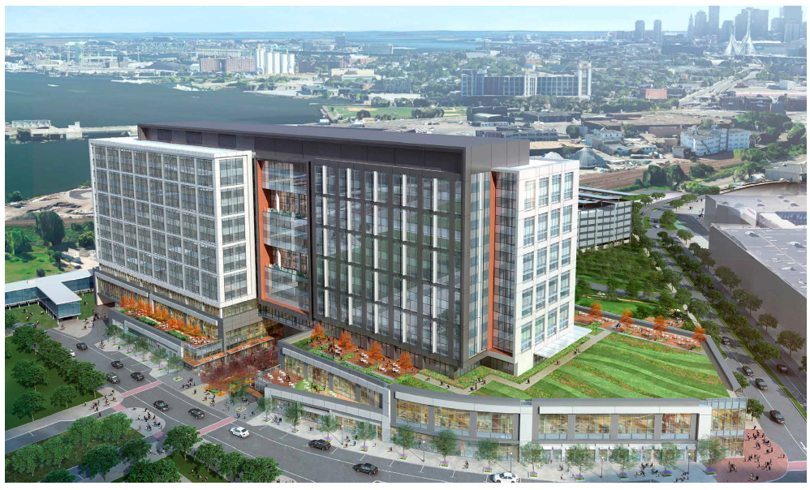
Transfer Fee
Linkage Fee
  Projected annual revenues: Between
  $3-5 million
Partners Healthcare: Linkage Fees will total approximately $4.3 million paid over 5 years
Source: Wicked Local Somerville, Boston Municipal Research Bureau , Wicked Local Cambridge; City of Somerville Sustainable Neighborhoods Working Group Recommendations Report

Slide 16


PILOT Agreement: Tufts Payment in Lieu of Taxes
Current agreement expires June 30, 2018
*Negotiated between Somerville Mayor & University President

Slide 17

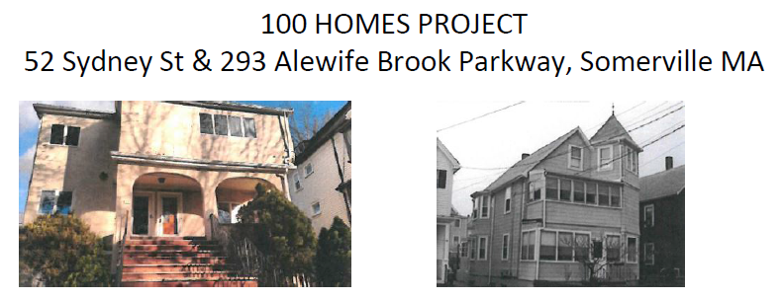
Somerville Community Corporation
Source: City of Somerville Sustainable Neighborhoods Working Group Recommendations Report

Slide 18
Financing Takeaways
Importance of leveraging funds from existing programs which also have less impact on residents (Linkage Fee & PILOT funds).
Transfer Fee has potential for large impact but with potential for strong resistance
Additional funds are essential in creating more affordable housing options

Slide 19
DENSITY
Definition | Pro | Con | Case Study
Accessory Dwelling Units (ADU): Suite considered “secondary” or “accessory” to the primary residence | Compact land use Affordable options for renters | Increase density Strain on parking resources | Lexington, MA Portland, OR
Up Zoning: Allowing for higher density and residential uses in zoning regulations | Compact land use Affordable options for renters | Increase density Strain on parking | Somerville, MA Seattle, WA Washington D.C.
Land Infill: The use of land within a built-up area for further construction | The tool for community development and growth management | More costly for developers | Lancaster, England Koln, Germany

Slide 20
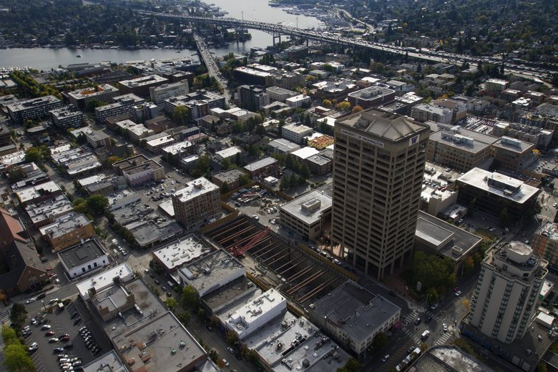
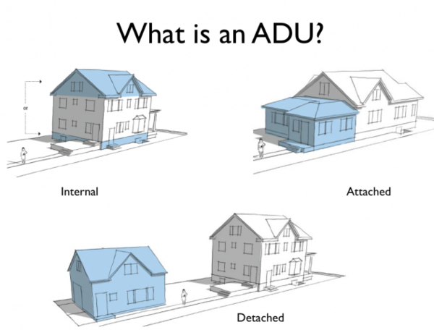
Accessory Dwelling Units
Up Zoning: Seattle

Slide 21
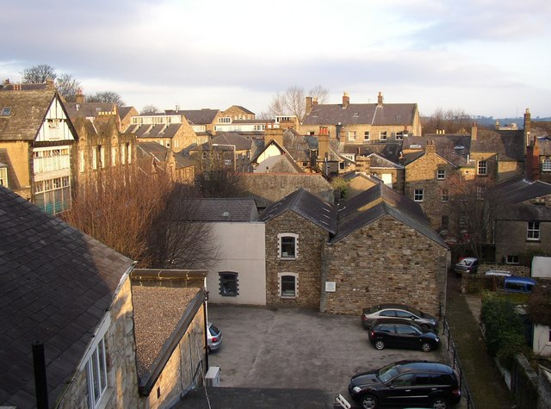
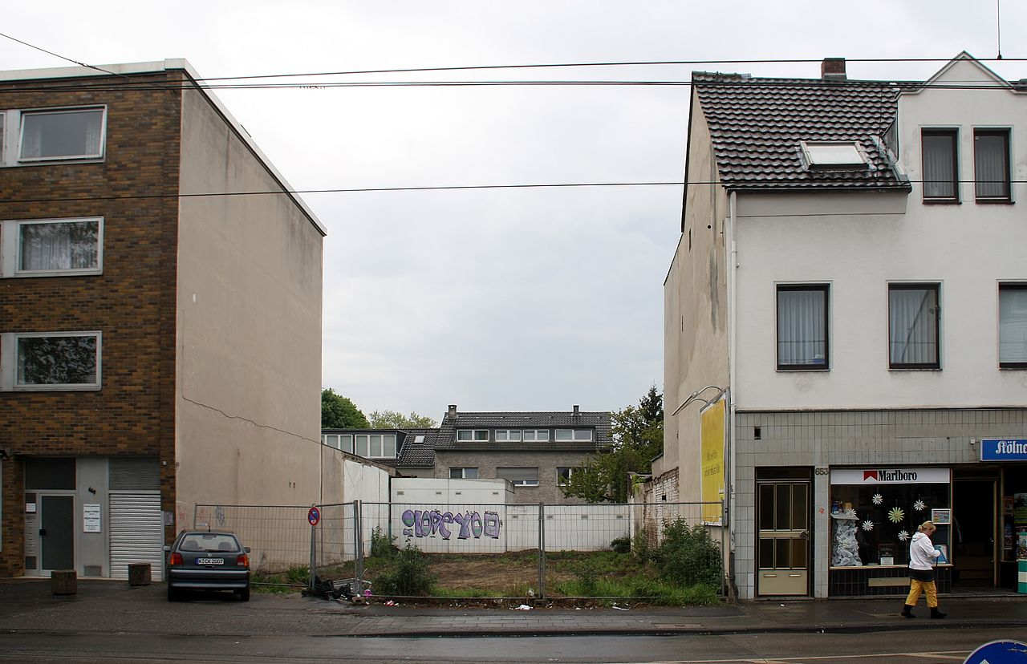
Land Infill
Lancaster, England
Koln, Germany

Slide 22
Density Takeaways
Low vacancy and limited supply drive the costs of housing and rents up
Flexible zoning and permitting can assist with increasing housing options in a very constrained market
This should be considered in the context of maintaining the character and livability of a city while allowing for more density zoning flexibility

Slide 23
Less Impactful
MORE IMPACTFUL
Condo Conversions
Short Term Rental
Occupancy Limit
ADU
Linkage Fee
Inclusionary Zoning
Expiring Affordable Housing
PILOT
Most Feasible
Land Infill
Up Zoning
Transfer Fee Tax
Less Feasible

Slide 24
Most Impactful: Affordability
Tool | Current | Potential
Inclusionary Zoning (IZ): | 6,000 New Housing Units – 1,200 Permanently Affordable 20% | 6,000 New Housing Units – 2,100 Permanently Affordable 35%
Deed Restricted Housing: | 3,341 Units | 1,658 Units
Source: Mayor’s Office of Strategic Planning and Community Development (Feb. 18, 2016). Draft Staff Report and Preliminary Recommendations Regarding Inclusionary Zoning.

Slide 25
Most Impactful: Financing
Tool | Current | Potential
Transfer Fee: | 0 | $4,000,000
Linkage Fee: | $330,000 | $990,000
Payment in Lieu of Taxes (PILOT): | $275,000 | $1,600,000
Total | $605,000 | $6,590,000
Source: Karl Seidman Consulting Services and ConsultEcon Inc. (Sept. 2017). Linkage Nexus Study: Final Report to the Mayor’s Office of Strategic Planning and Community Development.

Slide 26

Somerville: an Exceptional Place to
LIVE, Work, Play, and Raise a Family

Slide 27




Thanks for our advisors
Danny LeBlanc
Somerville Community Corporation
Kathy Naczas
Federal Home Loan Bank
Brandon Wilson
Somerville Historic Preservation
Ithzel Polanco
Somerville Housing Division

