Slide 1
Bu spark! @CDS
November 9, 2022
*Name TBD
Notes:
Daniel Sussman, Data Science in R class
Brenda Heaton, epidemiologist – SPH and Dental Medicine – simulation modeling for population health with Wesley Wildman
Christopher Robertson, Law school – health law, healthcare decision making, health insurance, health insurance uptake
Daryl Ireland, School of Theology, trying to map Christianity in China from 1550 – have enough data, now what do we do about it
Eugenio Menegon, co-investigator in China Christianity mapper – French, Spanish, and Chinese colleagues, interested in artificial intelligence, hand written text recognition, neural network architecture to extract language from databases, pushing for more offerings of courses not only in super technical matters but also in introductory courses for ugrads and grads in to learn basic tools and start projects on their own
January – focus on education side
Guarav Koley – first year PhD at CDS, haven't worked a lot, some research on social media analysis, previos work on assigning quantitative value on good will person experiences in social media space (digital ethnography is important!)
Heather Mooney – 6 year PhD candidate amazing partner
Ian Sue Wing – Earth and Environment – trained as an economist, applied and energy economics, collaborations with folks do a lot of research on climate change on energy, agriculture systems, training in economic simulation models – interested in fundamental, parallelization of fixed point problems, integrated assessment models, simulated at very fine spacial scales to learn something about shocks, who tools are developing to do this work
Margarita Guillory – collaboration possibilities, department of religion and African American societies, digital religion, Africana religionism in the digital age, teaching a new course in Spring called religion in the digital age – hands on, religious mobile applications, gaming, etc. – how to make pedagogical experience rewarding for students
Parker Shipton – anthropology and African studies, no immediate need for numerical analysis, spent years doing surveys in West Africa mostly on land, money, food and what have to do to each other, working on stereotypes and prejudice and language use and what words people use, Endgram at Google, human relations area file, most comprehensive ethnic database, comparing languages and ways people chose words to describing each other. Raise a question up front – use of data where numbers are more precise where possible to get data about
Sarah Miller – lecturer in sociology, what its been like to work with Spark! project, school shootings
William Regan – what is the future of CISS, undergraduate in CS, Sociology, Statistics
Emancipator
Herbaria

Slide 2
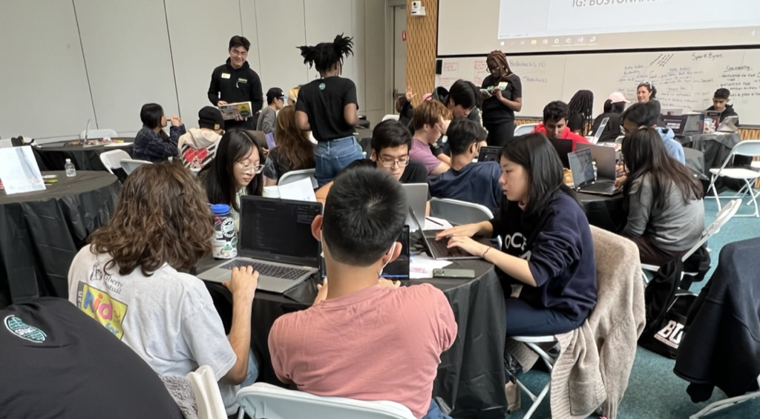
computer science
math & stats
computing & data science
computer engineering
+ other disciplines
An Innovation and Experiential Learning Lab for Computing & Data Science Projects
Notes:
Langdon

Slide 3
Spark! @CDS
Help students discover their passion(s), find community, and prepare for life by providing high quality* computing & data science centric experiential learning engagements with real-world impact
[EXPERIENTIAL LEARNING]
Powered by
*ethical, inclusive, technically robust, positive, and impactful

Slide 4
Spark!
2500+ students 650+ semester-long projects since 2017

Slide 5
STUDENT
INNOVATION PROJECTS
X-LAB
partner PROJECTS
INCLUSION &
COMMUNITY
Courses & Internships
Courses & Internships
In-person & Physical Events
Notes:
INNOVATION: ~100 Students/ year AND 14-20 projects/ year
X-LAB: 600+ Students/ year AND 130 projects/ year
INCLUSIVE COMMUNITY: 4000+ Students/ year AND 210 events/ year

Slide 6
CDS Impact areas: computing + Data Science application priorities
SUSTAINABILITY
CIVIC TECHNOLOGY
HEALTH
EQUITY
Notes:
INNOVATION: ~100 Students/ year AND 14-20 projects/ year
X-LAB: 600+ Students/ year AND 130 projects/ year
INCLUSIVE COMMUNITY: 4000+ Students/ year AND 210 events/ year

Slide 7
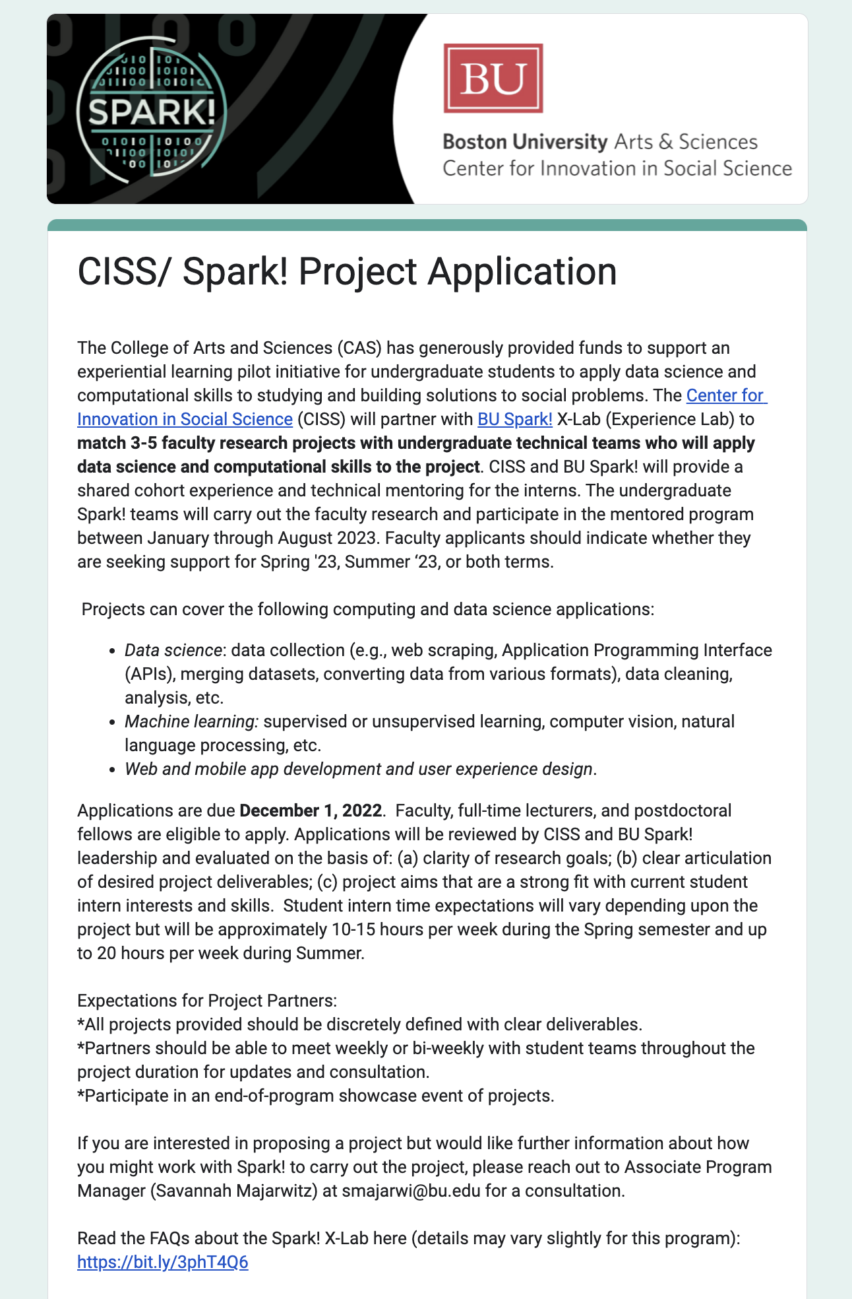
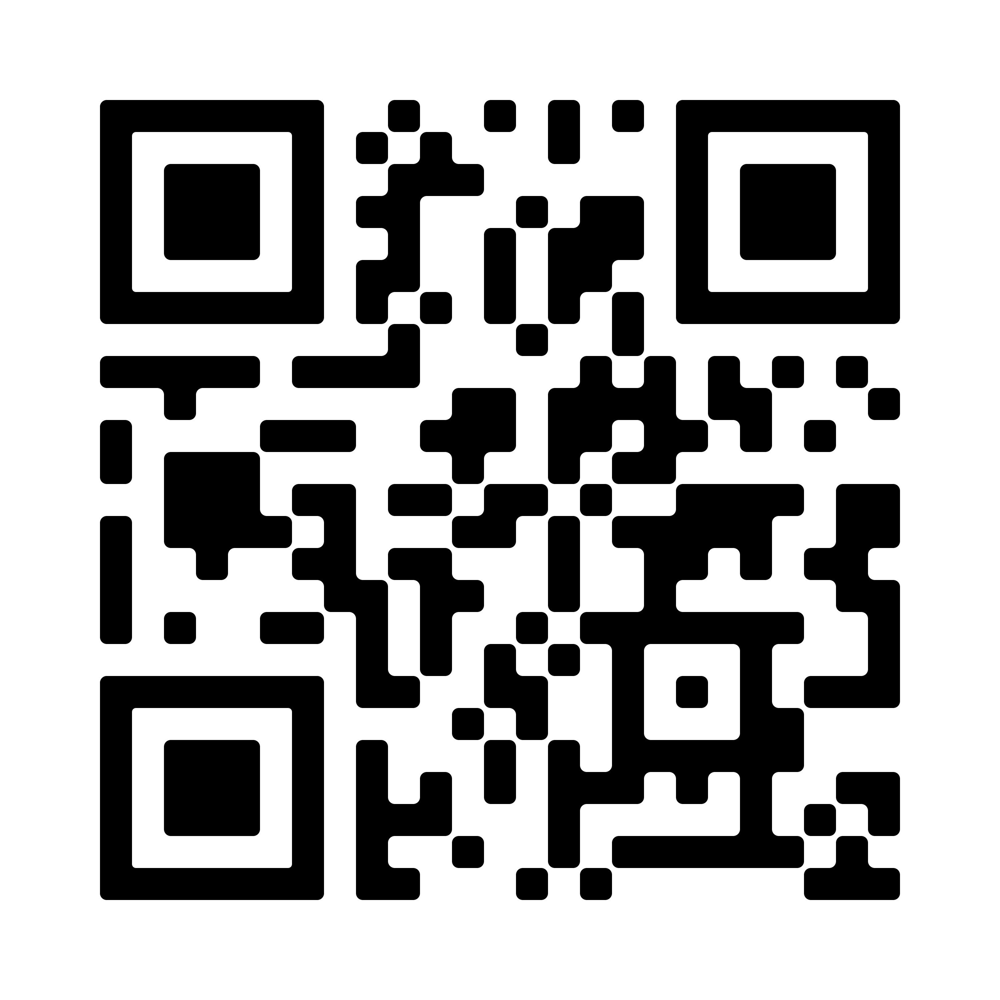
CISS/ Spark! Call for projects
3-5 faculty projects with Spark! supported undergraduate computing/ DS teams
Data science, machine learning, web and mobile apps
Apply by December 1, 2022 for Spring semester
Generously funded by CAS
Notes:
SPRING 2022
180 DS4G

Slide 8
Team support/ Client expectations
Client
Spark! Student Teams (~2 students/ each)
Provide project scope and vision
Attend bi-weekly or weekly check-ins: more frequency = better results
Advise on project scope and feasibility
Ensure technical quality and support; translation role
Spark! Staff & EIRS
(project, technical & student support)
Project managers: manage scheduling, documentation, deadlines
Tech engineers: technical troubleshooting with student team
Spark! project managers & technical engineers
10 hours/ week x 13 weeks each semester; weekly sprints
Notes:
SPRING 2022
180 DS4G

Slide 9
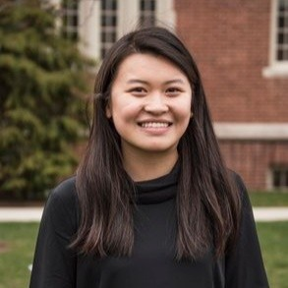
Spark! @CDS team
Ziba Cranmer
Director
James Grady
.10 FTE Creative Director (CFA)
Langdon White
.5 FTE Technical Director (SE)
Savannah Majarwitz
.5 FTE Program Manager
Lydia Holck
Operations Director
Hiring!
Community & Outreach Manager
Thao Nguyen
.10 FTE UXD Program Manager
Ian Saucy
Assistant Solutions Engineer
Michelle Voong
Data Solutions Engineer
Hiring!
.5 FTE Tech Director (DS/ML)

Slide 10
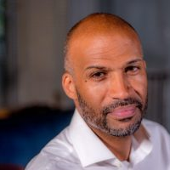
Resources: EXPERTS IN RESIDENCE
EXPERTS IN RESIDENCE (SUPER MENTORS) SUPPLEMENT STAFF OVERSIGHT
Tom Hopper
Mass Housing Partnership
Data Science
Housing
Land Use
Kevin Hatchoua
Red Hat
Opensource
UX Design
Adam Friedman
Elections Stats/ Rank the Vote
Voting Rights
Open Data
Imani Kirika
Dianthus
Data Science
Machine Learning
Carl Williams
Cornell/ CPCS
Criminal Legal Reform
Open Data
Notes:
Michelle

Slide 11
Project examples

Slide 12
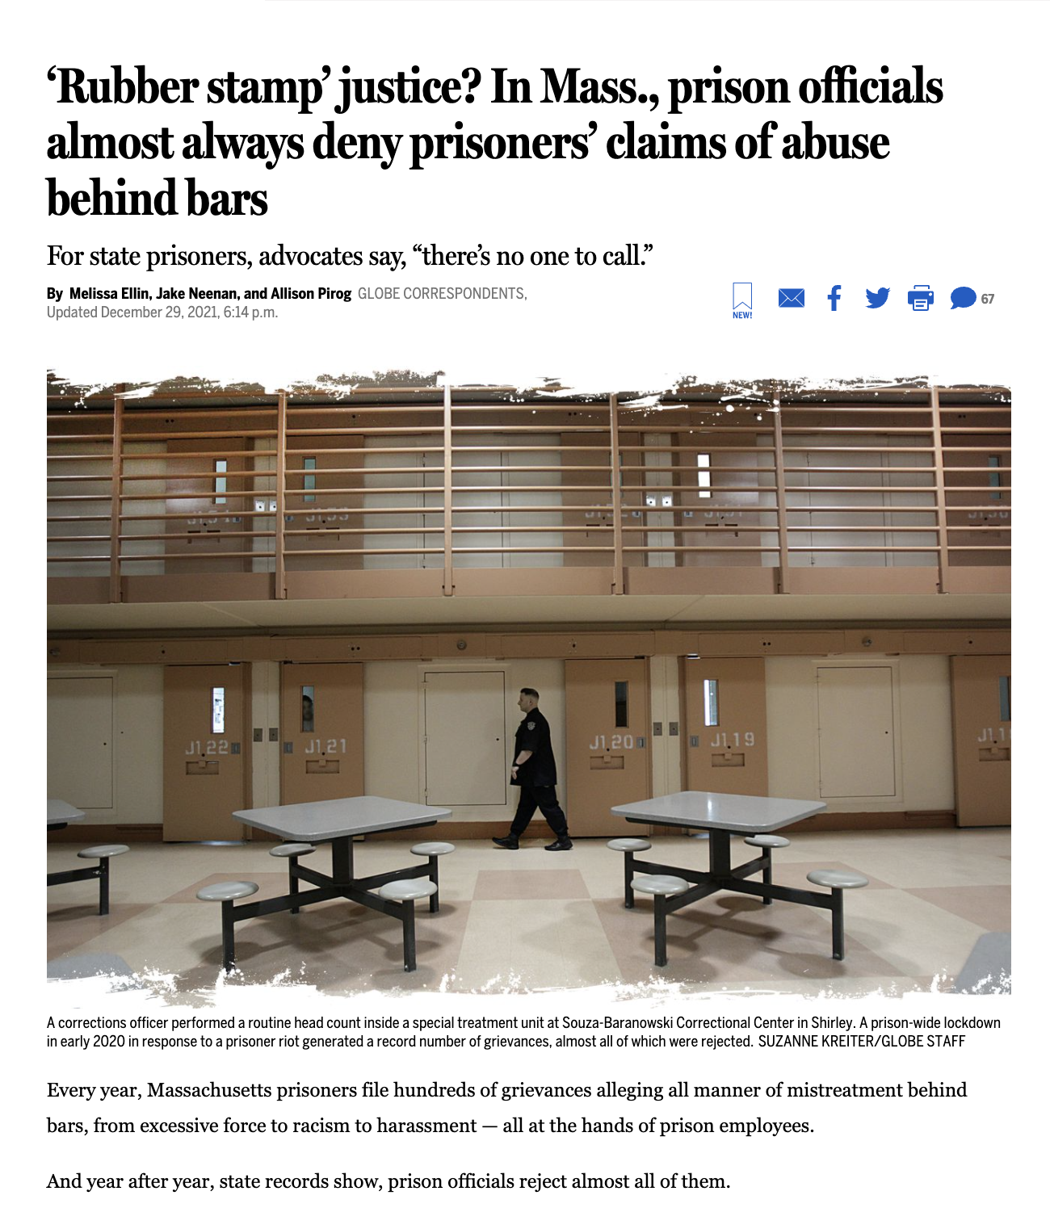
Data Science [prison grievances]
Project Summary: A review of more than 1,500 prisoner grievances filed from 2018 to 2021 at six of the largest prisons in Massachusetts Data was provided in PDF format, converted to a machine readable dataset for analysis and reporting. Front page article published in collaboration with the Boston Globe’s Spotlight team.
Notes:
https://www.wgbh.org/news/local-news/2021/11/17/boston-could-begin-to-fine-contractors-under-its-diversity-hiring-policy-but-not-for-missing-the-hiring-targets
Equal number with equivalent impact – research results,

Slide 13
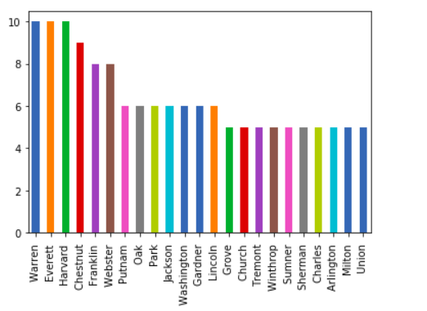
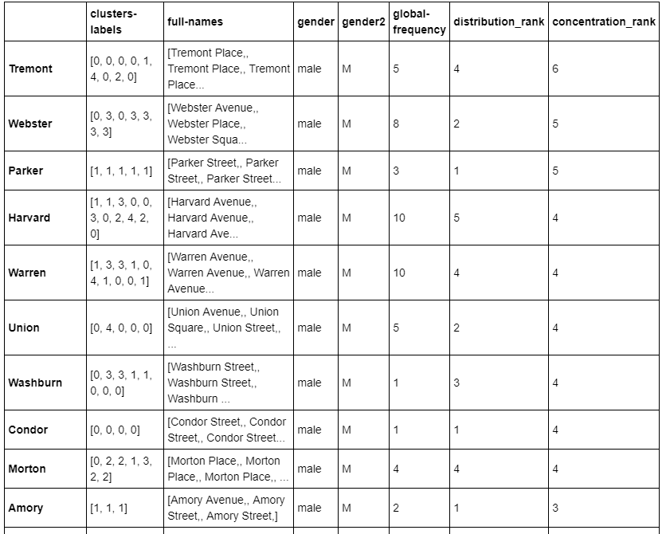
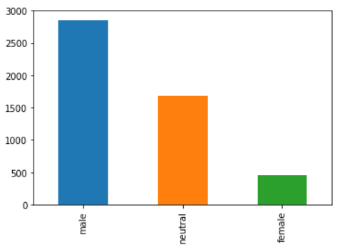
DATA science: aging in prison
Project Summary:
Collect and analyze national and state data from the National Archive of Criminal Justice Data for prisoners over 55 by age, race, ethnicity and gender, crimes committed, and deaths in prison and state policy for compassionate release.
Notes:
The Spark! X-Lab provides opportunities for computer science and engineering students to complete technology projects on behalf of external project partners*
startups * government agencies * companies * nonprofits * journalists

Slide 14
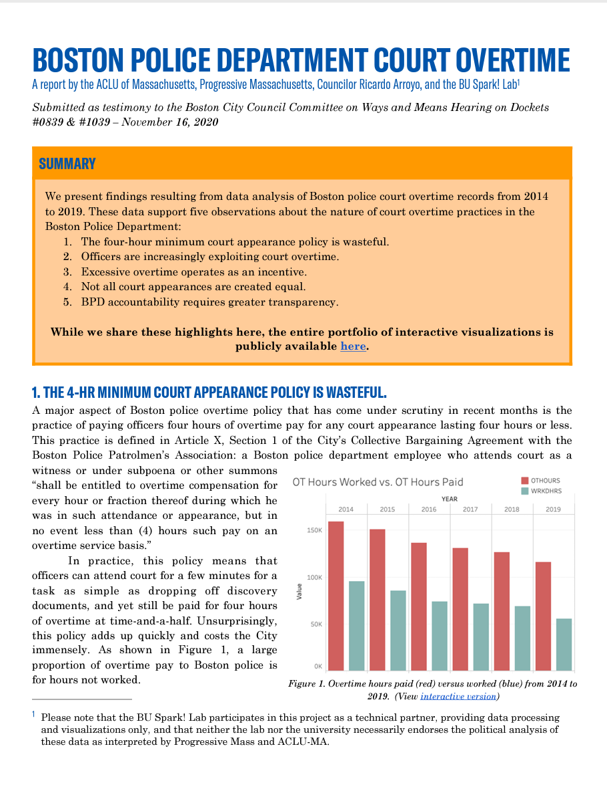
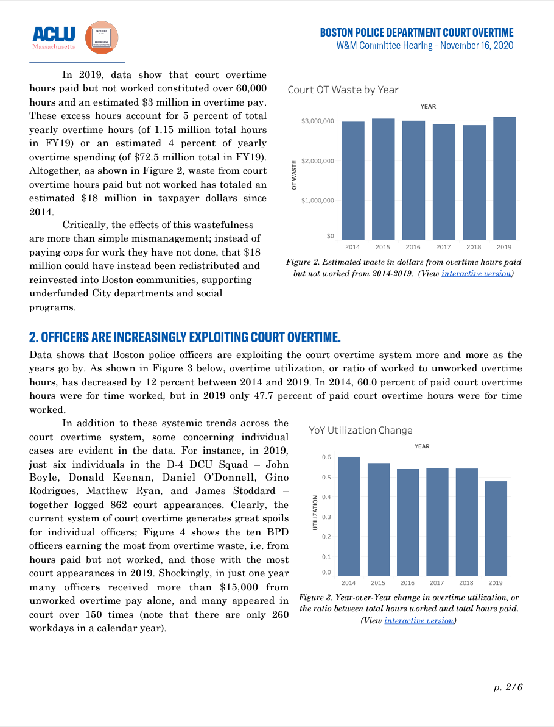
Data Science [Police overtime]
Police Budget analysis for ACLU’s Data for Justice program including in depth investigation on court overtime, police overtime, and annual budget expenditures to inform city budgeting.

Slide 15
Data science [school to prison pipeline]
Project Summary: Collect data and conduct a town by town linking and analysis of arrest and school suspension/expulsion to inform policy makers. Examine differences across geographies, by race and ethnicity and gender, relationship between school spending, school exclusions, and juvenile arrests

Slide 16
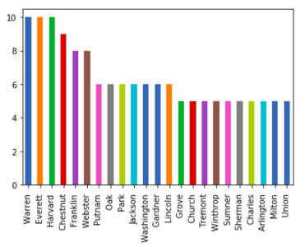
DATA science: Boston’s GENDERED STREETS
Project Summary:
Analyze Boston streets by gendered names; Identify commonly used street names for possible renaming with minimal disruption.
Notes:
The Spark! X-Lab provides opportunities for computer science and engineering students to complete technology projects on behalf of external project partners*
startups * government agencies * companies * nonprofits * journalists

Slide 17
Data Science [Racial Segregation in Hospital Access During COVID]
Assessing whether racial residential segregation coupled with other factors contributed to COVID-19 fatalities in American cities including whether individuals from predominantly Black and Hispanic/Latinx neighborhoods were more likely to visit lower quality hospitals and whether hospital quality is associated with neighborhood composition. Data source: cell phone mobility data from safegraph.
Notes:
Assessing equitable access to hospitals across different racial/ethnic groups was during the COVID pandemic. Several studies suggest that racial residential segregation coupled with other factors contributed to COVID-19 fatalities in American cities. The hypothesis that individuals from neighborhoods with a higher percentage of Black and Hispanic/Latinx populations were more likely to visit hospitals in neighborhoods with similar racial/ethnic compositions, and similarly for individuals from white neighborhoods. We will also assess whether individuals from predominantly Black and Hispanic/Latinx neighborhoods were more likely to visit lower quality hospitals and whether hospital quality is associated with neighborhood composition. This lends insight into whether individuals living in segregated neighborhoods were likely to receive quality care during the COVID-19 pandemic.
Expected Outcome: Students will create a report showing the ranking of neighborhoods based on racial segregation (standard data) and the location of hospitals that individuals from various neighborhoods visit. The client also has specific questions regarding equity and access that will be included in the report.

Slide 18
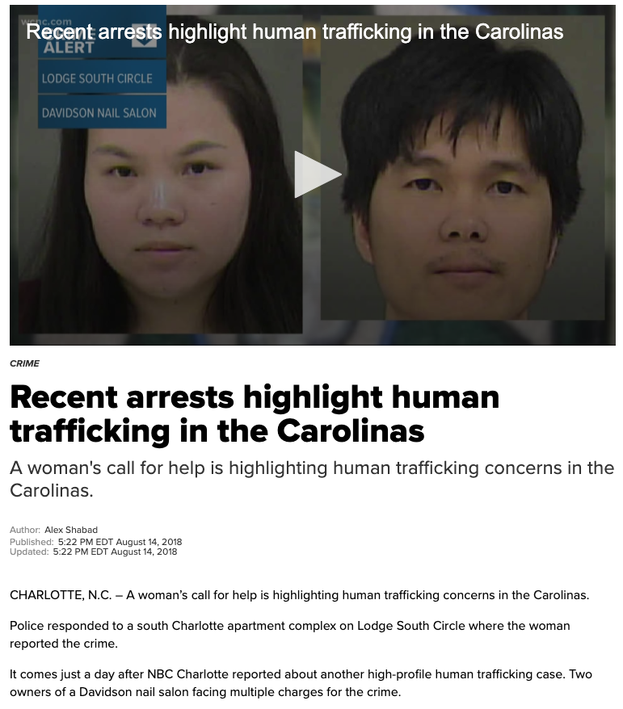
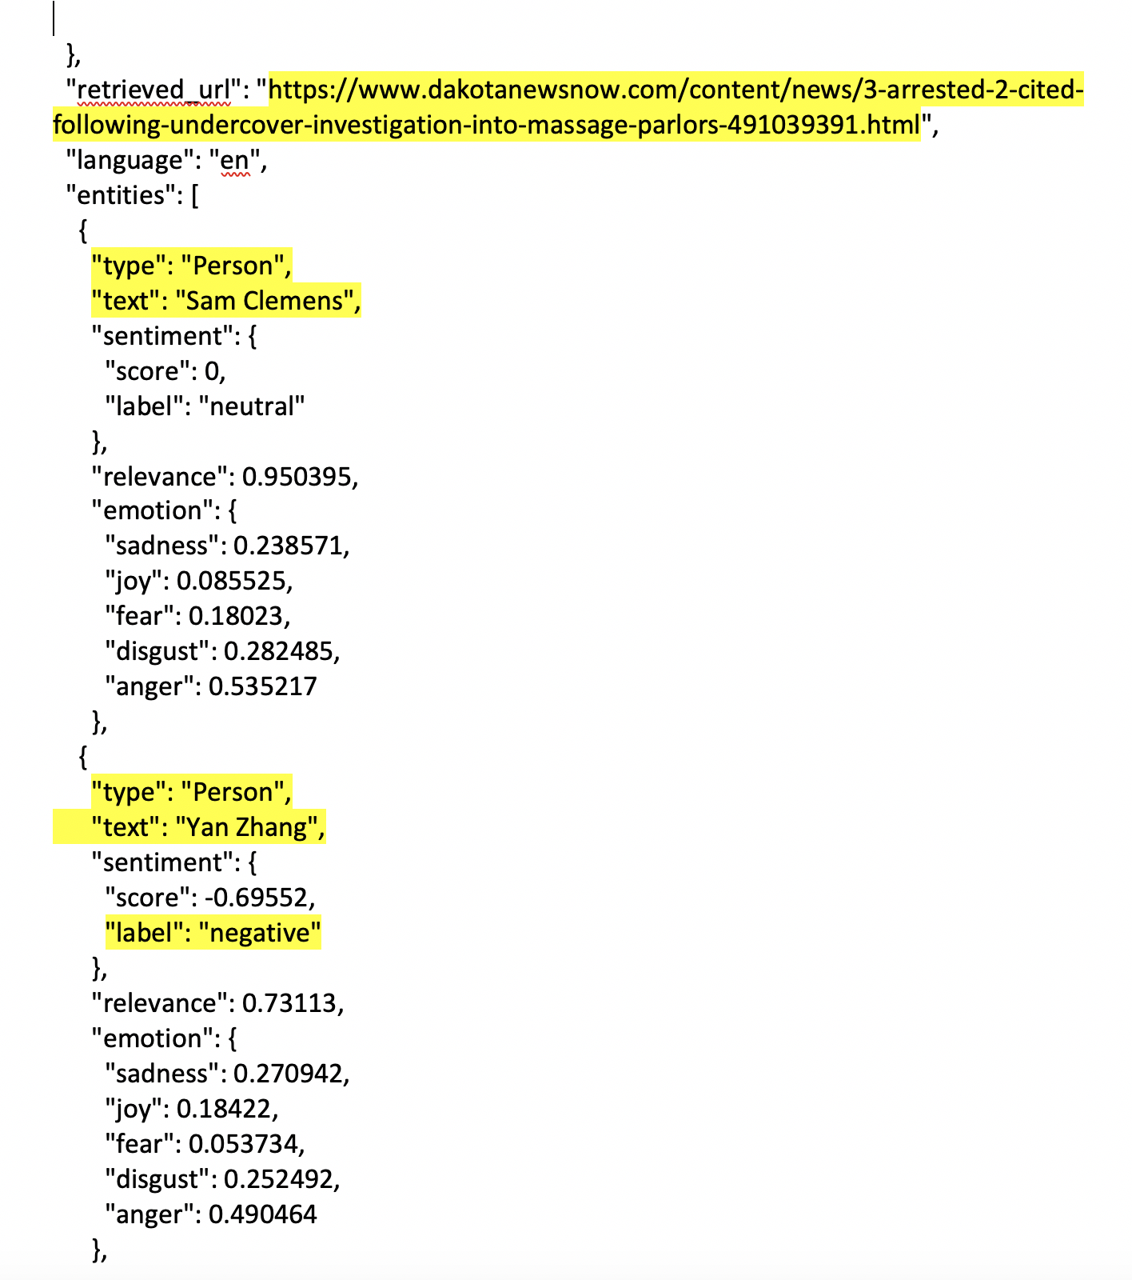
natural language processing [mapping coverage of sexual exploitation]
Project Summary:
The language of sexual exploitation has changed over time as has the awareness of exploitation in the illicit massage industry. This project built a media tracking and NLP analysis tool to collect data related to the framing of this issue over time.

Slide 19
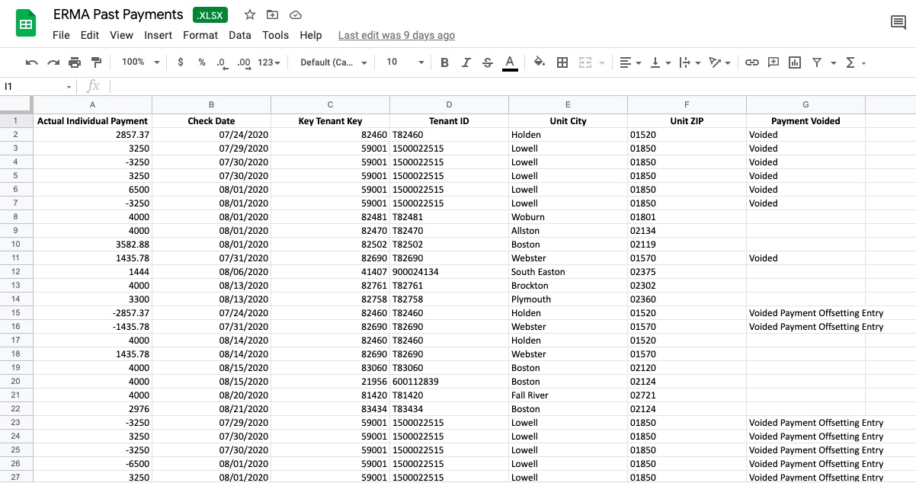
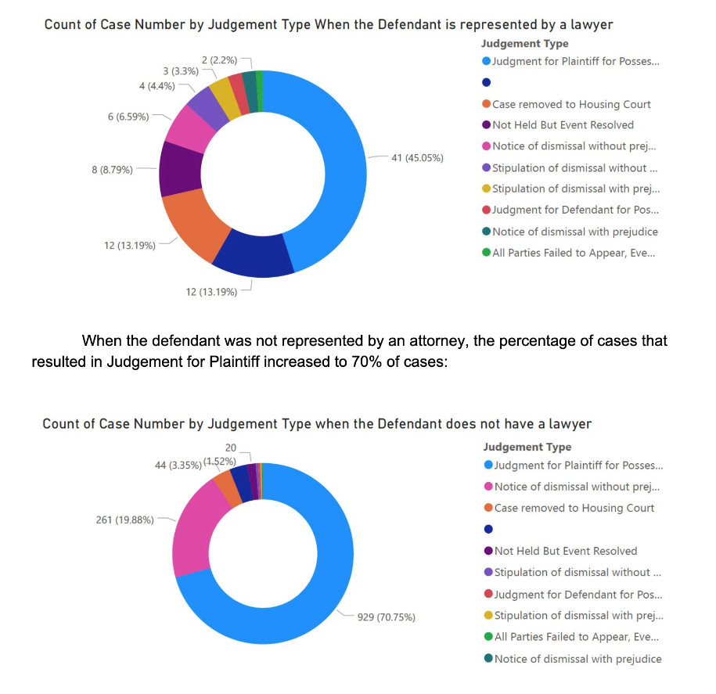
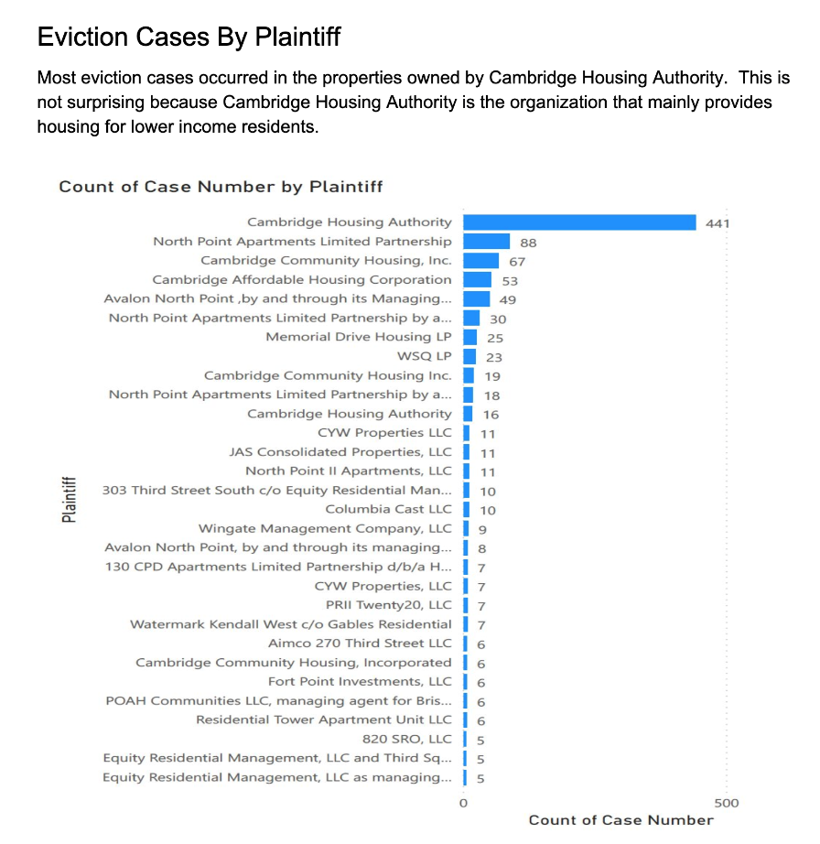
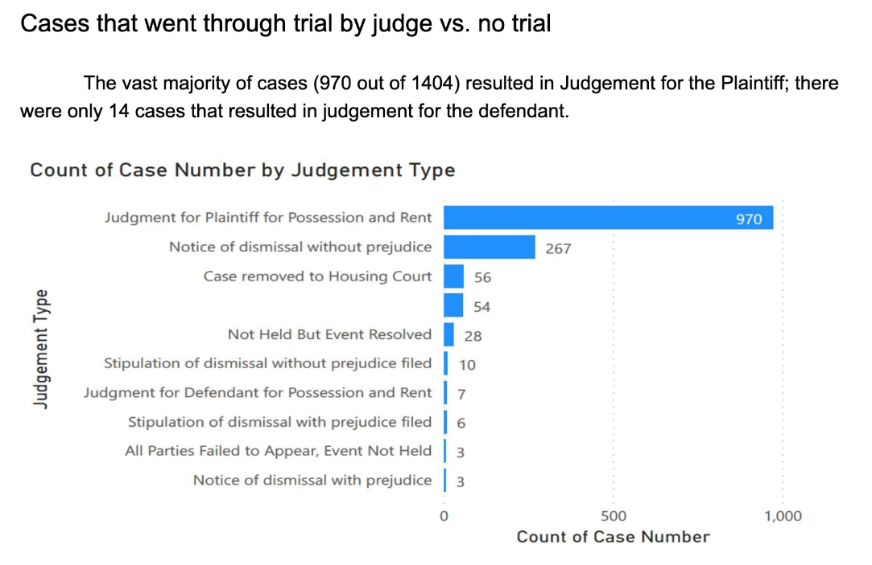
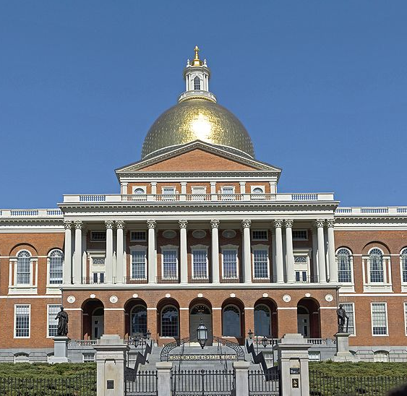
Data Science [Rental Assistance & Evictions]
A variety of projects focused on trends related to court filings for evictions, rental assistance and outcomes during Covid

Slide 20
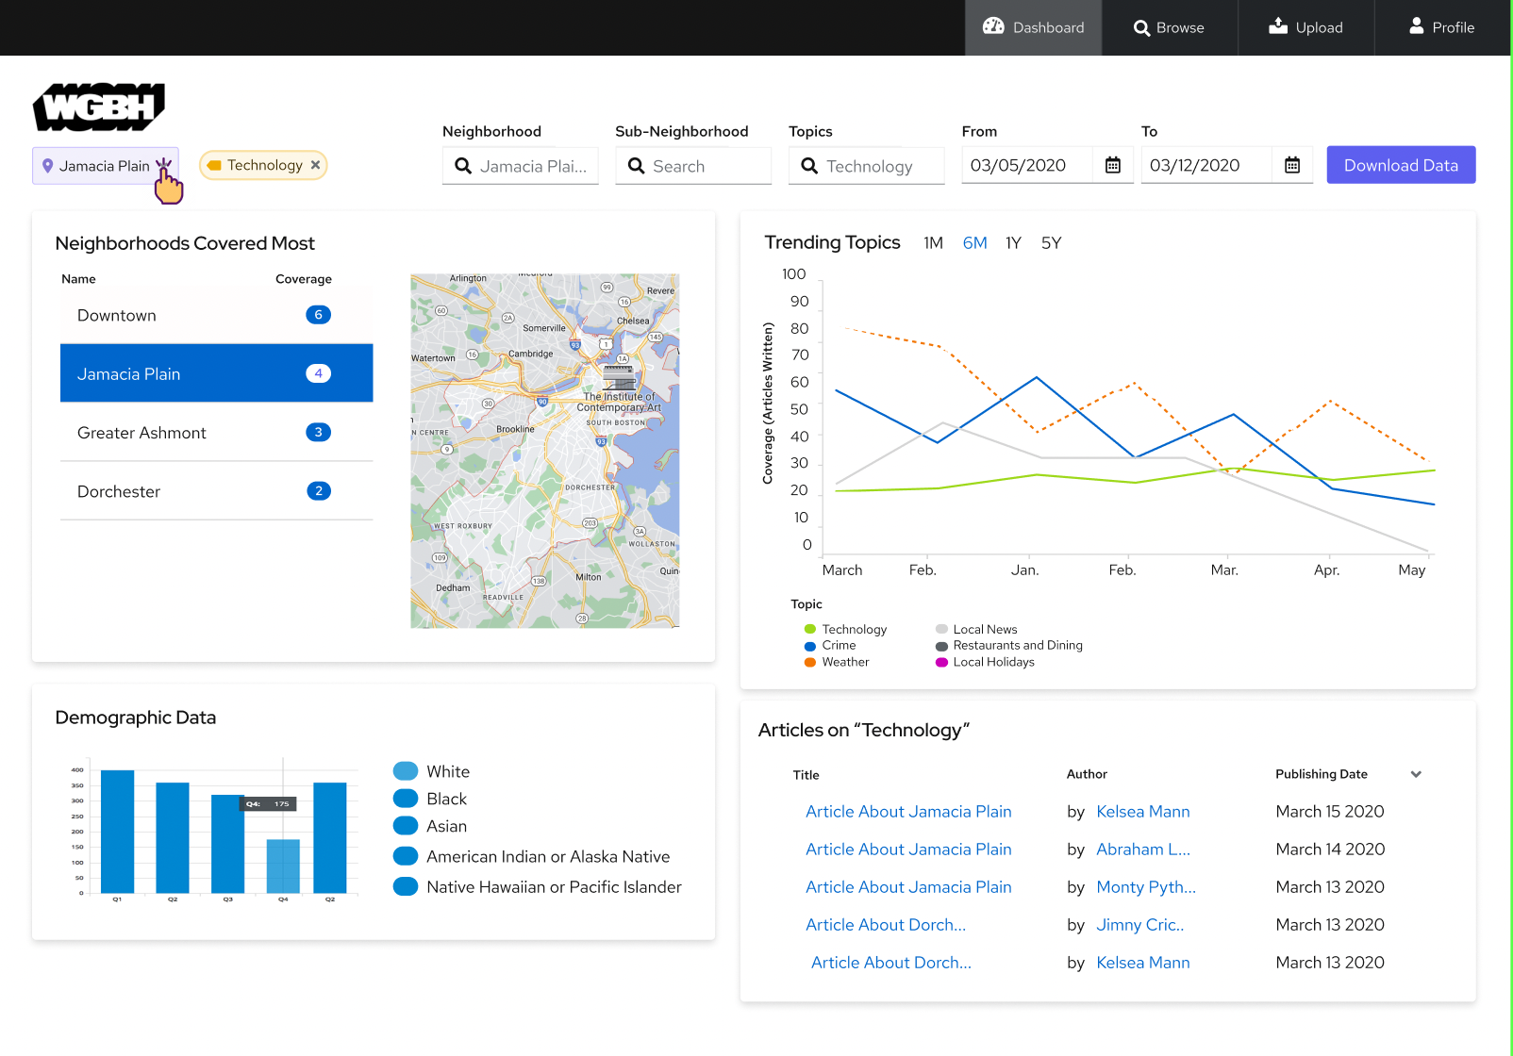
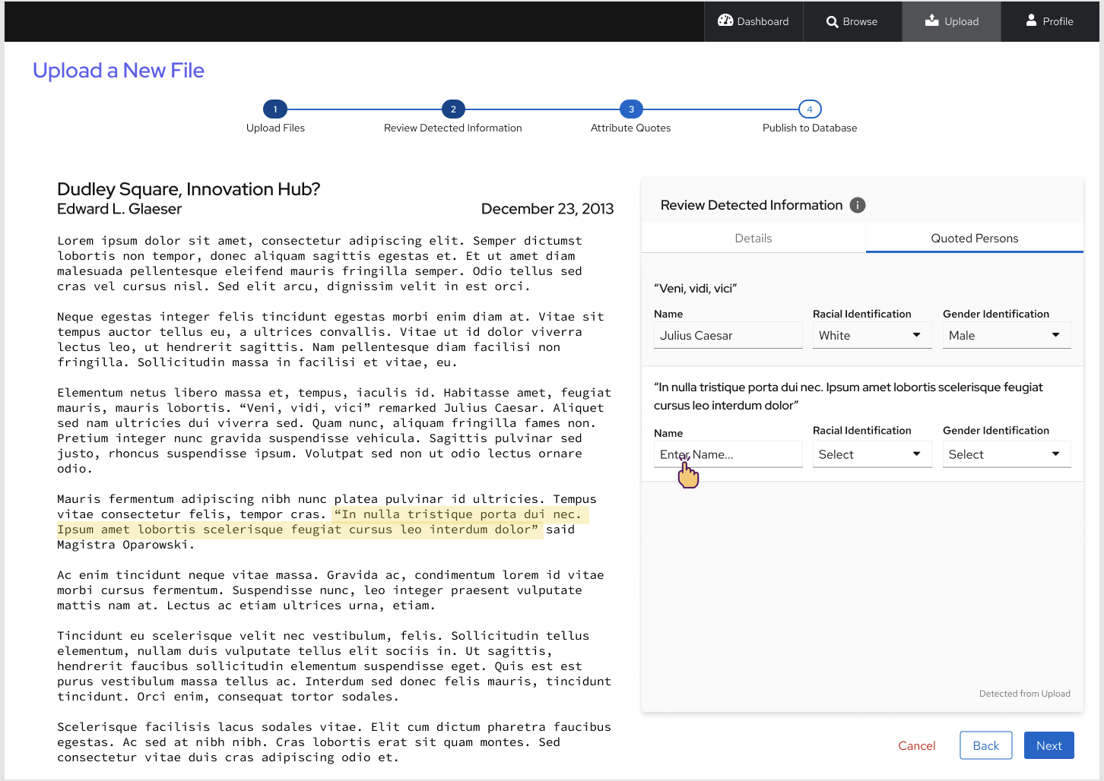
Web app & machine learning: naacp/ GBH media coverage
A data tool for GBH created at the request of NAACP Boston to track coverage of Black communities in Boston including volume of coverage, topics covered, and source tracking.
Notes:
Assessing equitable access to hospitals across different racial/ethnic groups was during the COVID pandemic. Several studies suggest that racial residential segregation coupled with other factors contributed to COVID-19 fatalities in American cities. The hypothesis that individuals from neighborhoods with a higher percentage of Black and Hispanic/Latinx populations were more likely to visit hospitals in neighborhoods with similar racial/ethnic compositions, and similarly for individuals from white neighborhoods. We will also assess whether individuals from predominantly Black and Hispanic/Latinx neighborhoods were more likely to visit lower quality hospitals and whether hospital quality is associated with neighborhood composition. This lends insight into whether individuals living in segregated neighborhoods were likely to receive quality care during the COVID-19 pandemic.
Expected Outcome: Students will create a report showing the ranking of neighborhoods based on racial segregation (standard data) and the location of hospitals that individuals from various neighborhoods visit. The client also has specific questions regarding equity and access that will be included in the report.

Slide 21
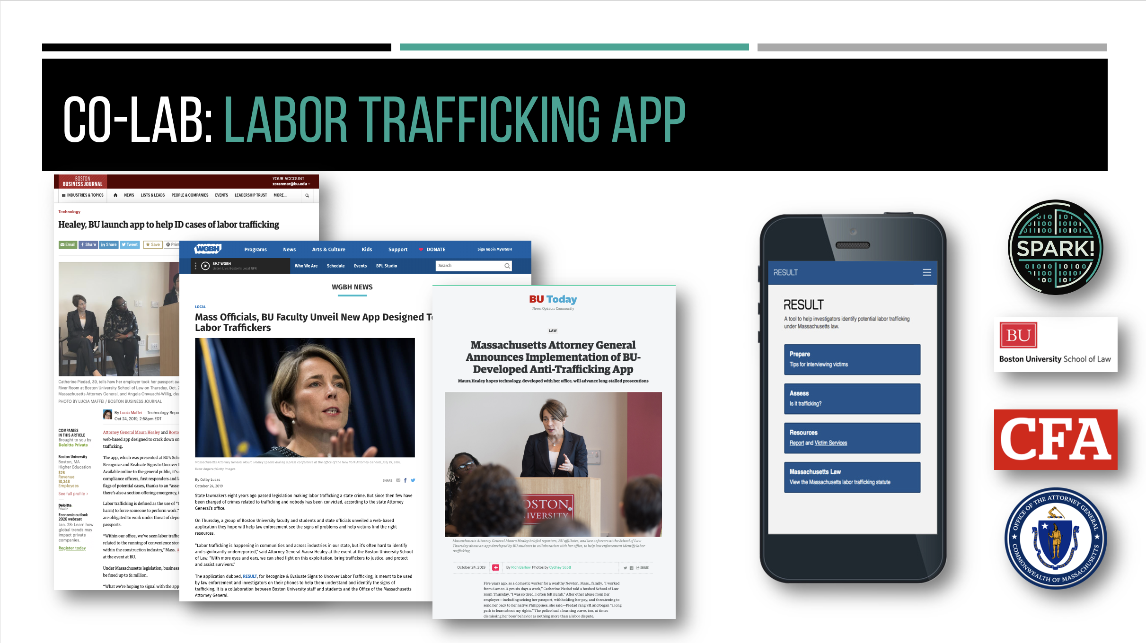
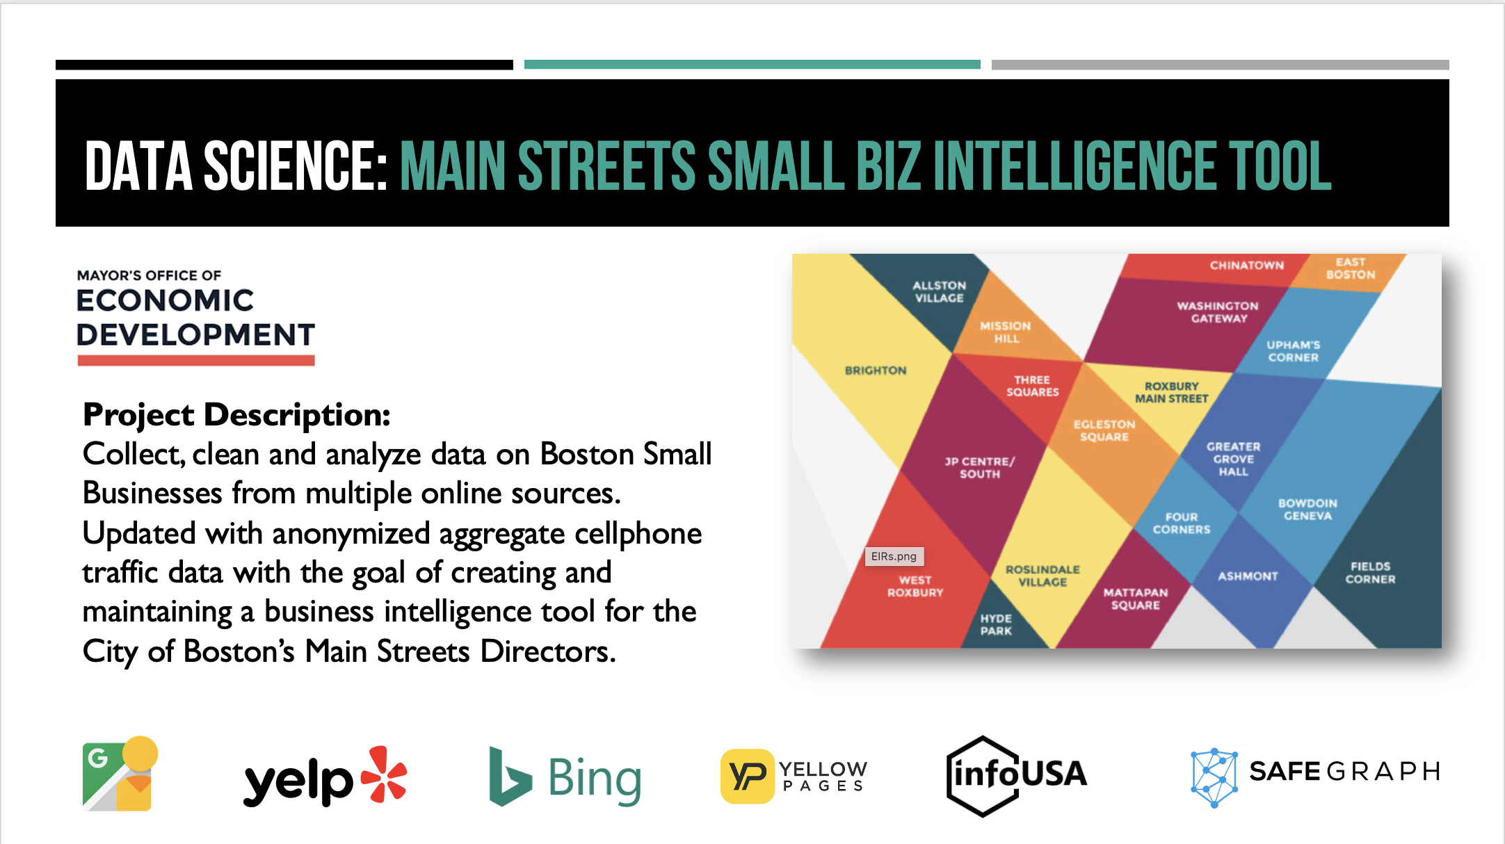
DATA SCIENCE PROJECT EXAMPLES

Slide 22
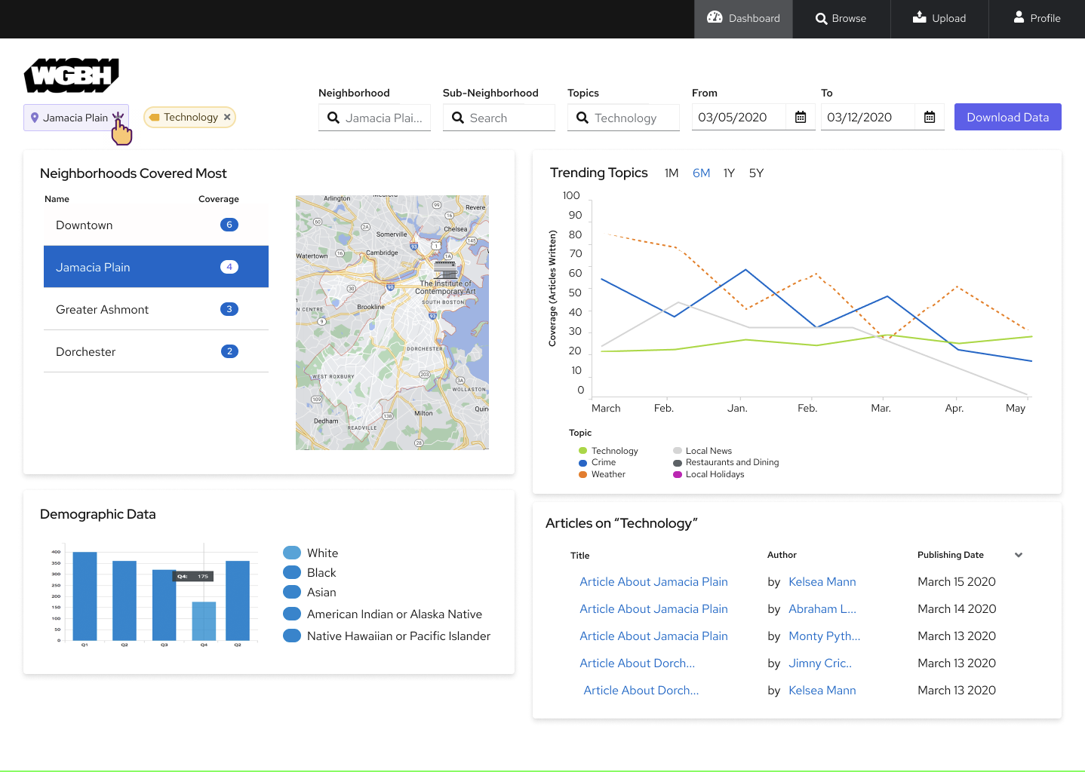

Slide 23
DATA SCIENCE PROJECT EXAMPLES

Slide 24
DATA SCIENCE PROJECT EXAMPLES

Slide 27
CISS/ Spark! Call for projects
3-5 faculty projects with Spark! supported undergraduate computing/ DS teams
Data science, machine learning, web and mobile apps
Apply by December 1, 2022 for Spring semester
Generously funded by CAS
Notes:
SPRING 2022
180 DS4G

Slide 28
Project recruitment timeline
SPRING SEMESTER PROJECTS
SUMMER INTERNSHIP
FALL SEMESTER PROJECTS
OCT-DEC 2021
FEB-MAY 2022
MAR-APR 2022
JUNE-AUG
JUL-AUG 2022
SEPT-DEC 2022
PROJECT RECRUITMENT & SCOPING
SUMMER STUDENT & PROJECT RECRUITMENT AND SCOPING
PROJECT RECRUITMENT & SCOPING

Slide 29
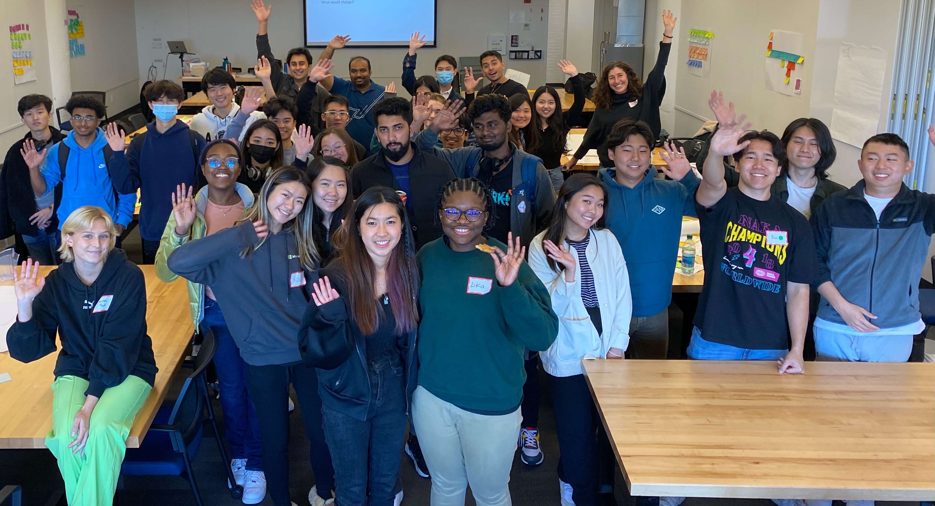
Thank you!
Notes:
Langdon

Slide 30
appendix

Slide 31
PRACTICUM COURSES: no-cost student projects through courses
Software Engineering
Practicum
CS/DS 519
Machine Learning
Practicum
CS/DS 549
Data Science
CS506
Data Science
Practicum
UX Design
Practicum
XCC
Innovation
XCC
Justice Media
XCC
DS4G: Housing
XCC
DS4G: CJR
XCC
Sustainability
XCC
Health
Notes:
SPRING 2022
180 DS4G

