Slide 1




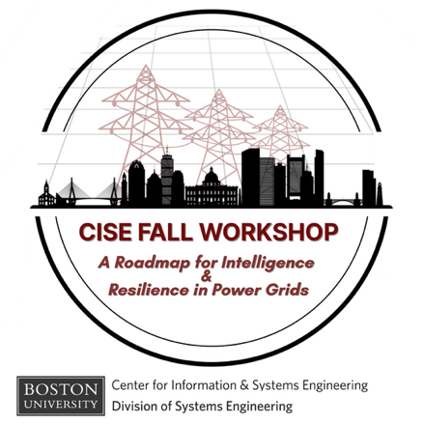

Scalable Grid Architectures
for Intelligent Electrification
Mads R. Almassalkhi
CISE Fall Workshop
A Roadmap for Intelligence and Resilience in Power Grids
Boston, Madsachusetts, USA
November 14th, 2025
L. Richard Fisher Associate Professor
Electrical & Computer Engineering
Founding Director
Grid Architect
Chief Scientist

Slide 2

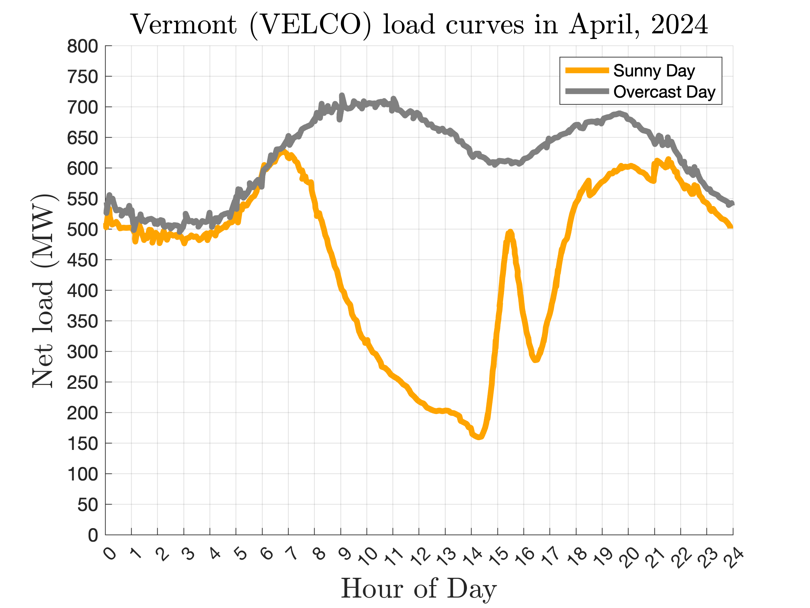





Vermont is a great platform for resilient power grids
First U.S. efficiency utility (2000)
First 100% renewable
utility in the U.S. (2014)
#1 in 2018 (Energy)
#5 in 2019 (Energy) #2 in 2023 (Energy)
One of the most innovative coop utilities!
“More than 200MW gen but only 50MW load.”
Coordination?
2

Slide 3
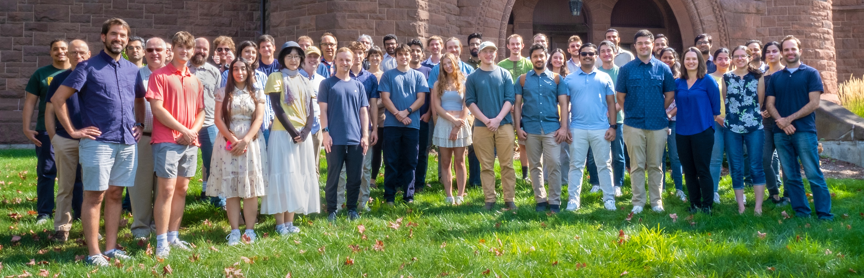
Vermont is a great platform for resilient power grids
Our labs Our offices
40 PhD students | 15 TT faculty | 7 grad programs

Slide 4
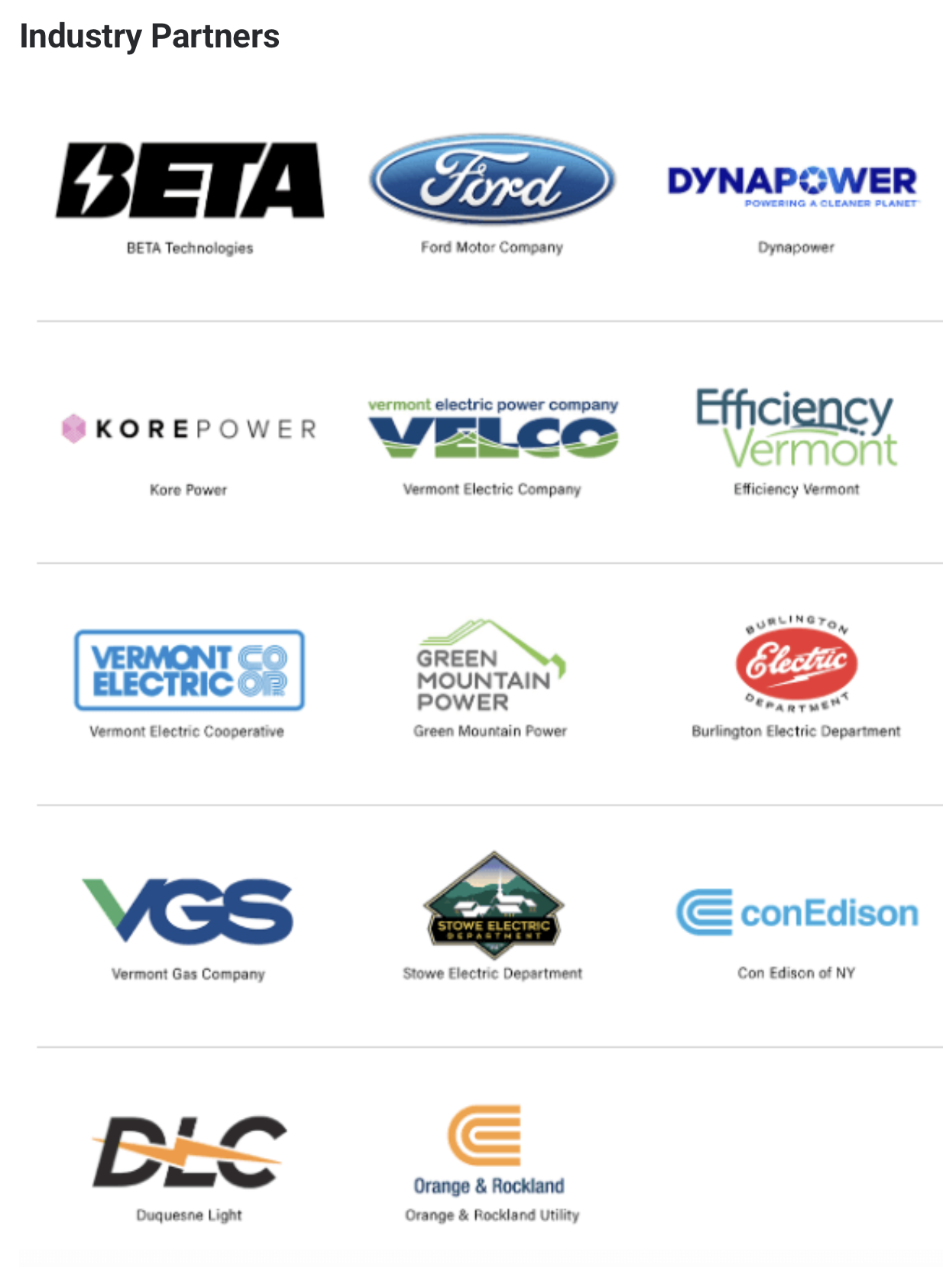








Recent and current R&D partners

Slide 5


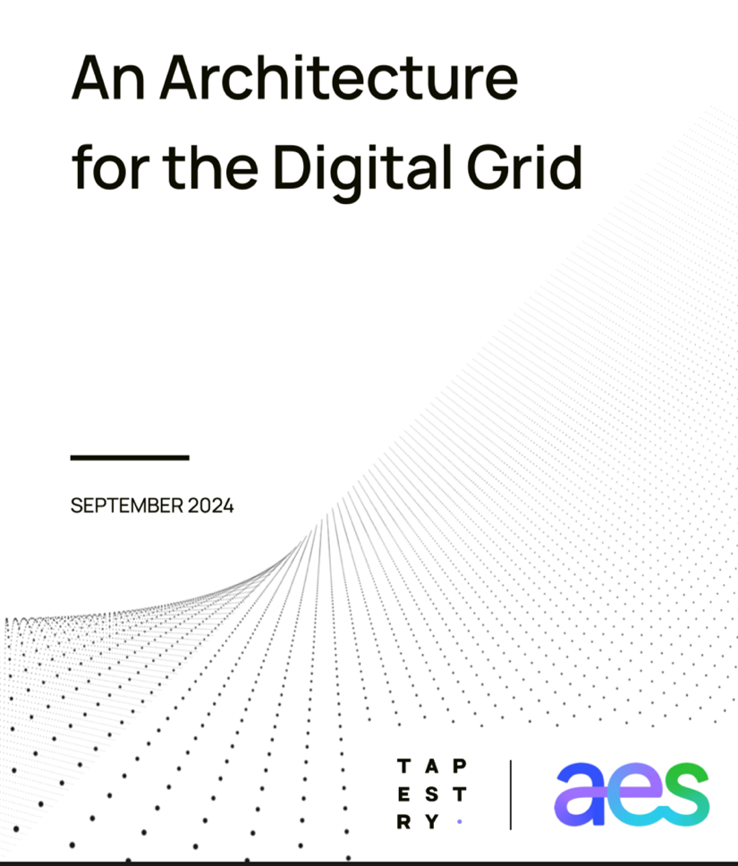
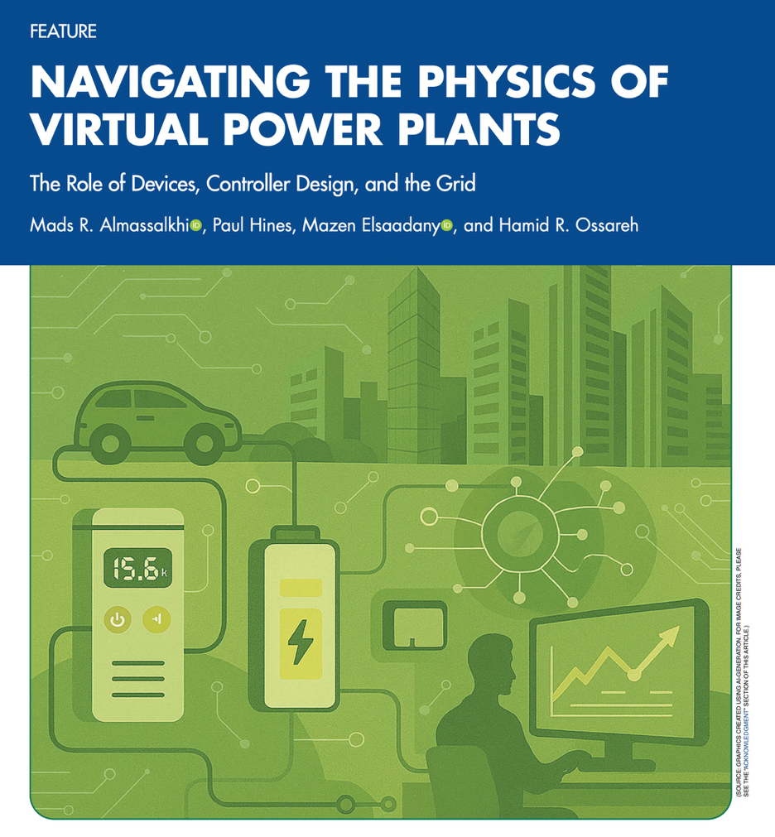
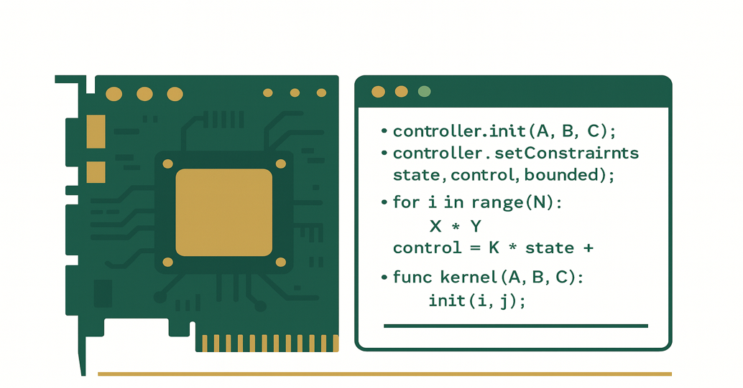
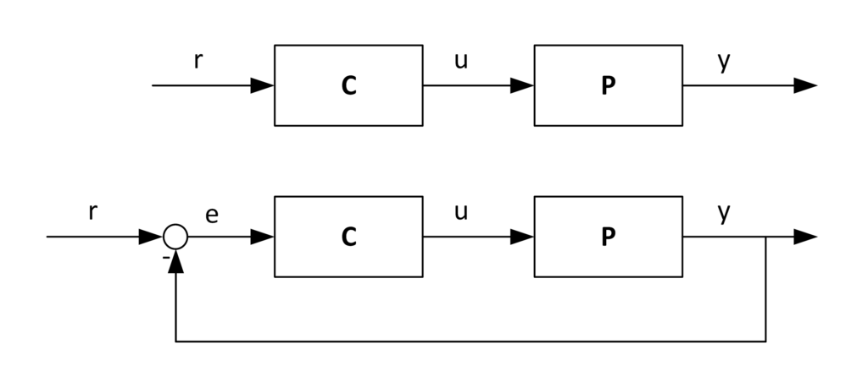

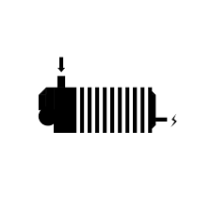
What we think about in CREATE
Theoretical Foundations
Impact people & planet
Compute at Scale
Control & optimization of complex dynamical systems
Numerical methods and GPU acceleration
Autonomous energy grids
Trustworthy, efficient AI
5

Slide 6
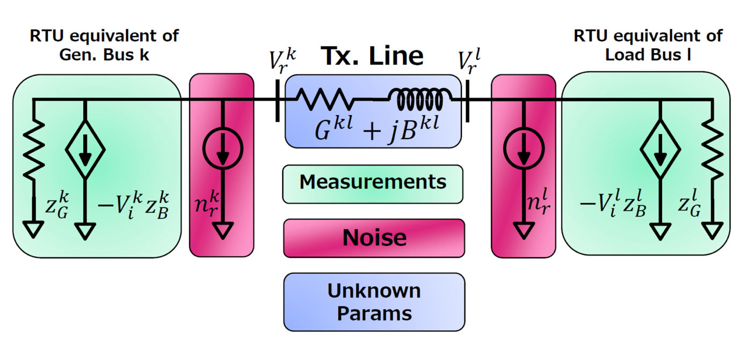
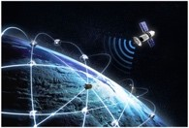
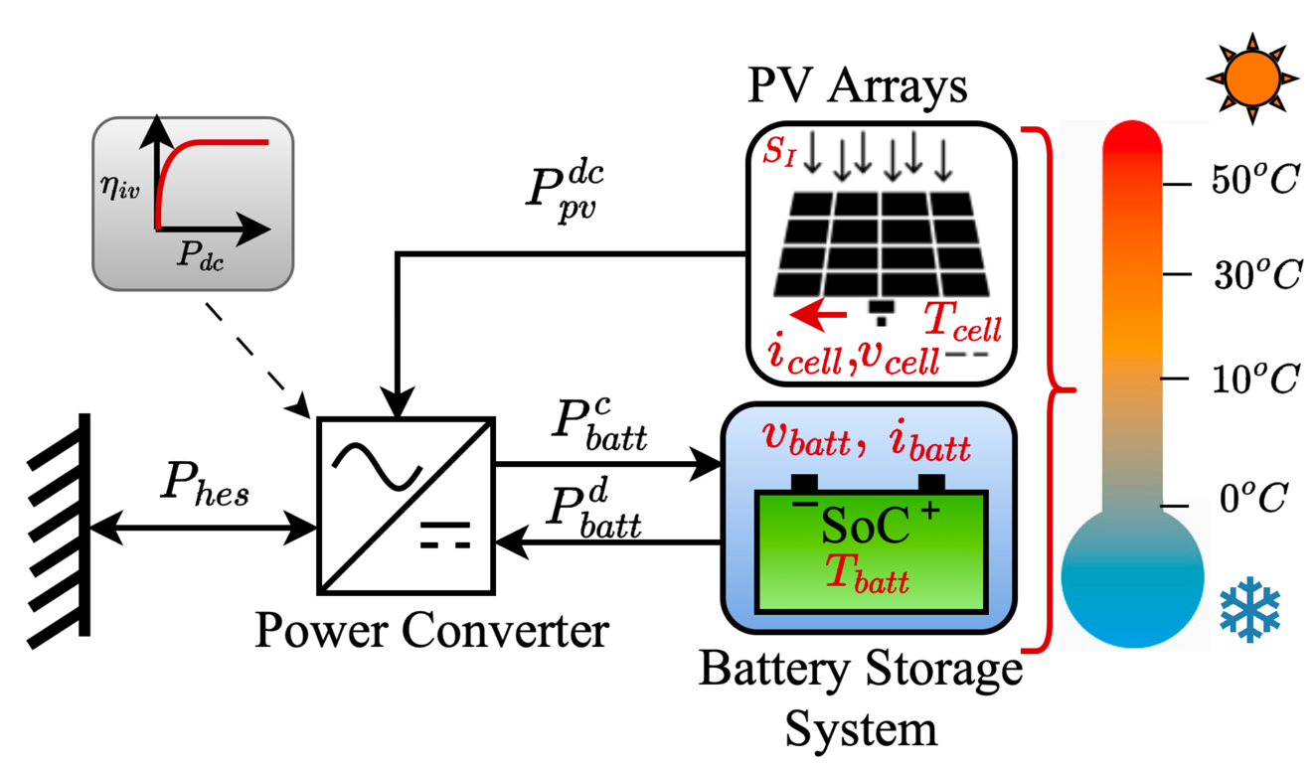
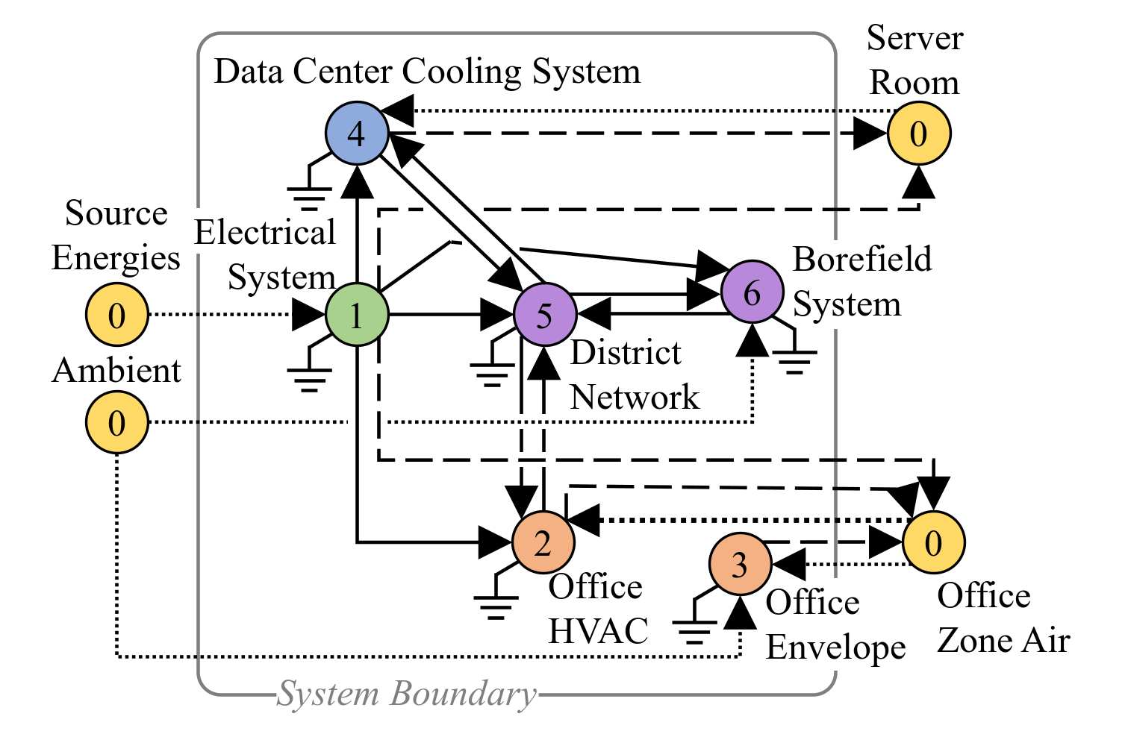
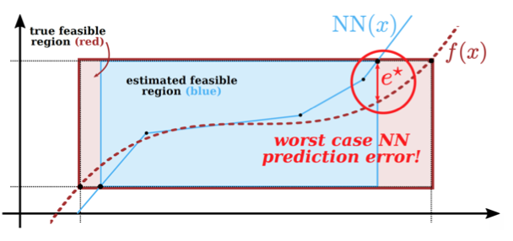
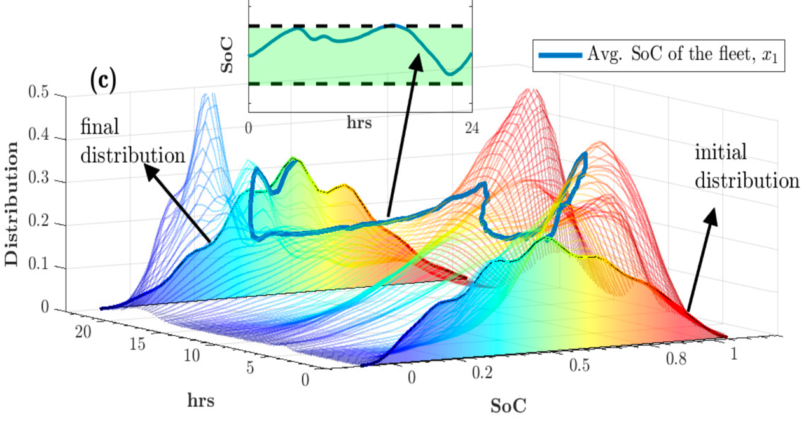
Examples of active research in CREATE today
Digital Twins and State Estimation
Autonomy & Control
Hybrid Energy Systems (HES) Optimization
System Integration & Resilience
ML/AI for Safety-Critical Systems
Distributed Control & Optimization

Slide 7
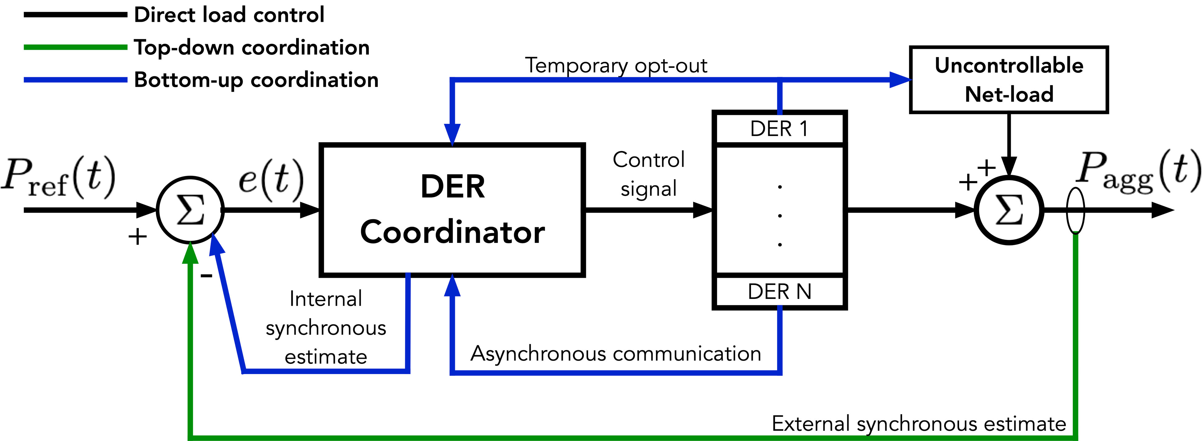
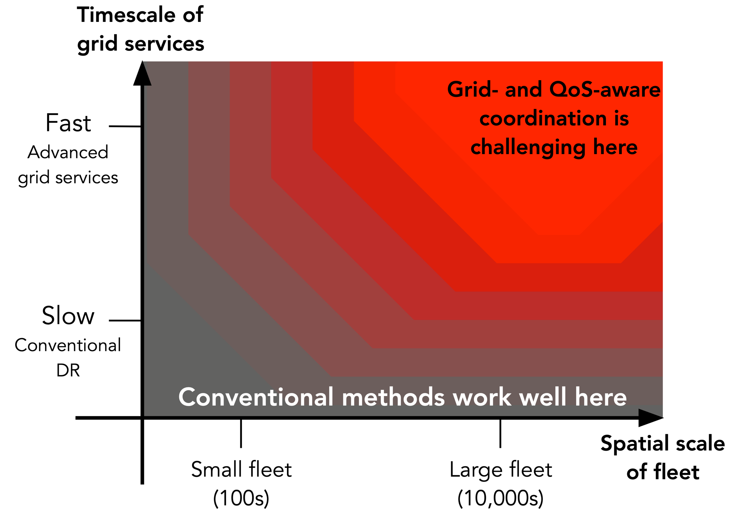
Mads R. Almassalkhi and Soumya Kundu, "Intelligent Electrification as an enabler of Clean Energy and Decarbonization," Current Sustainable/Renewable Energy Reports, September 2023 (Invited paper).
Architecting DER control systems: top-down & bottom-up
How to coordinate resources? What’s measured/estimated? How to model?
S. Brahma, A. Khurram, H. Ossareh, and M. Almassalkhi, "Optimal Frequency Regulation using Packetized Energy Management," IEEE TPWRS, 2022.
A. Khurram, M. Amini, L. Duffaut Espinosa, P. H. Hines, and M. Almassalkhi, "Real-time Grid and DER Co-simulation Platform for Validating Large-scale DER Control Schemes," IEEE TSG, 2022.
H. Mavalizadeh and M. R. Almassalkhi "Methodology for comparing the performance of DER coordination schemes in providing frequency regulation," IEEE PES General Meeting, 2023.
Mads R. Almassalkhi and Soumya Kundu, "Intelligent Electrification as an enabler of Clean Energy and Decarbonization," Current Sustainable/Renewable Energy Reports, 2023 (Invited paper).

Slide 8
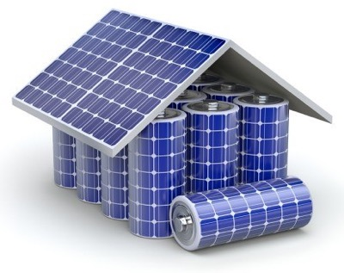
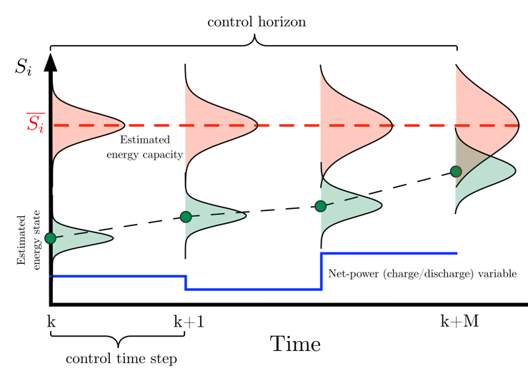
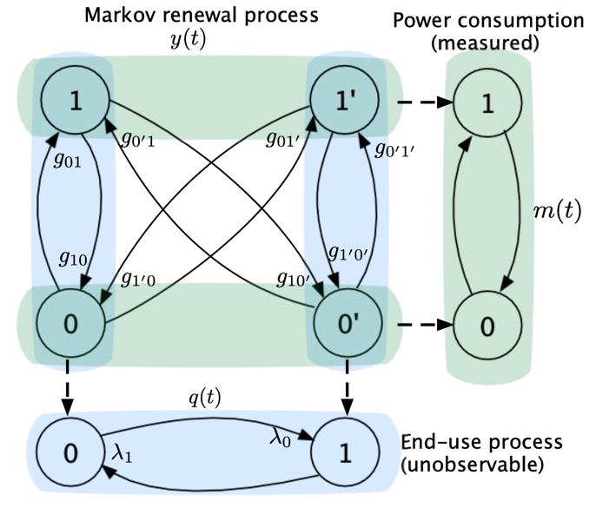
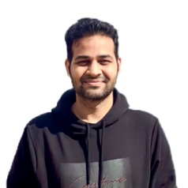
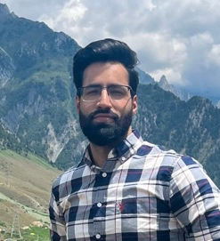
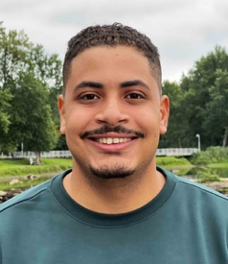
Ongoing R&D topics for DER orchestration
3
1
Optimize dispatch
Identify end-use parameters
Stochastic end-use
Uncertain flexibility
2
Modeling & Control
(1a) A. Khurram, Luis Duffaut Espinosa, Roland Malhamé, Mads Almassalkhi, “Identification of Hot Water End-use Process of EWHs from Energy Measurements,” PSCC, 2020
(1b) M. Matar, H. Mavalizadeh, et al, “Learning the state-of-charge of heterogeneous fleets of distributed energy resources with temporal residual networks”, J of Energy Storage, 2023.
(2a) L. Duffaut, A. Khurram, and M. Almassalkhi “Reference-Tracking Control Policies for Packetized Coordination of Diverse DER Populations,” IEEE Trans. on Control Systems Tech., 2021
(2b) M. Hassan, M. Almassalkhi “Aggregate Modeling of Air-Conditioner Loads Under Packet-based Control with Both On and Off Grid Access Requests,” HICSS, January 2026 (to appear)
(3a) M. Amini and M. Almassalkhi, “Corrective optimal dispatch of uncertain virtual energy resources,” IEEE Transactions on Smart Grid, 2020
(3b) N. Qi, P. Pinson, M. Almassalkhi, et al, "Chance Constrained Economic Dispatch of Generic Energy Storage under Decision-Dependent Uncertainty," IEEE TSE. 2023

Slide 9
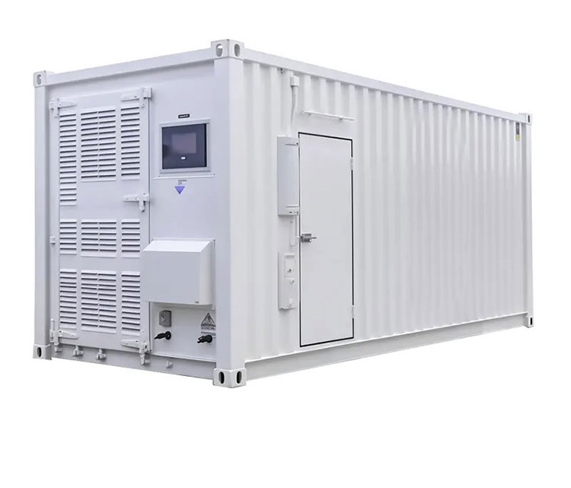
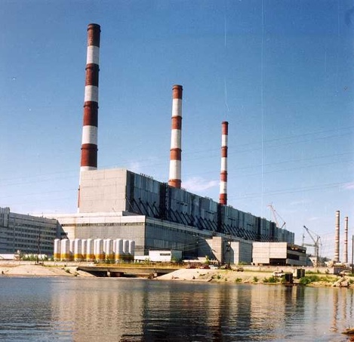

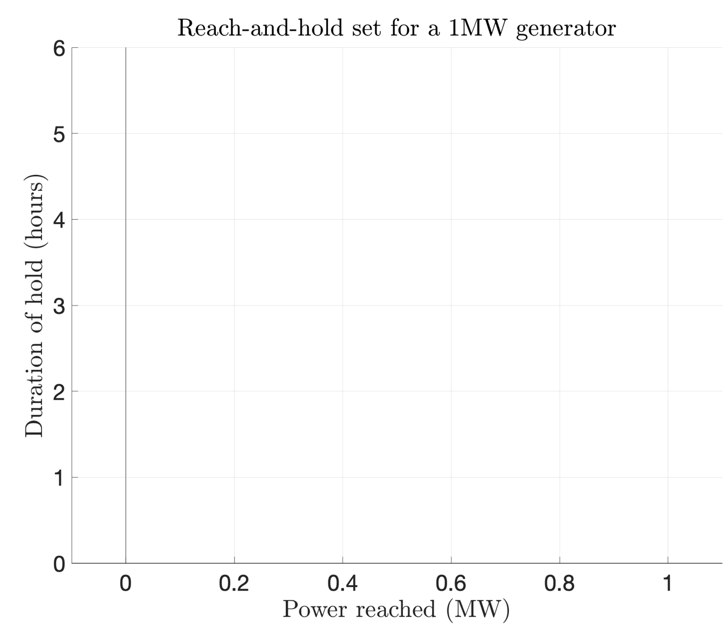
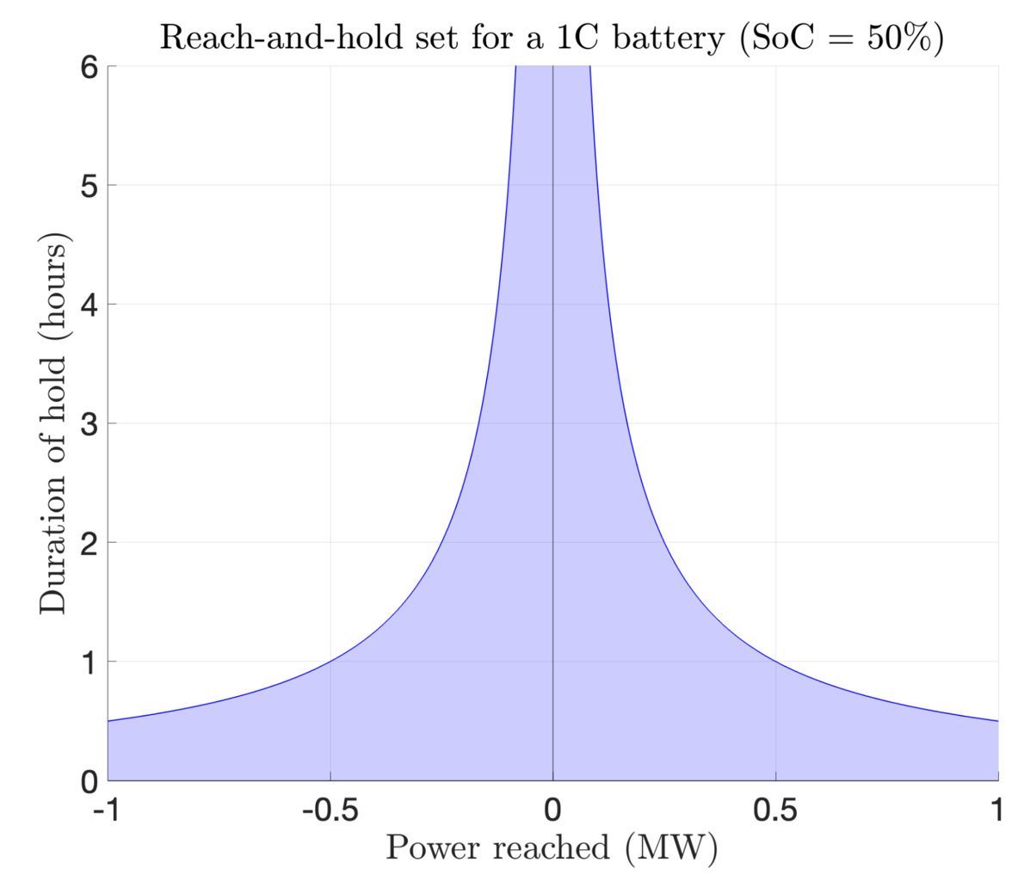
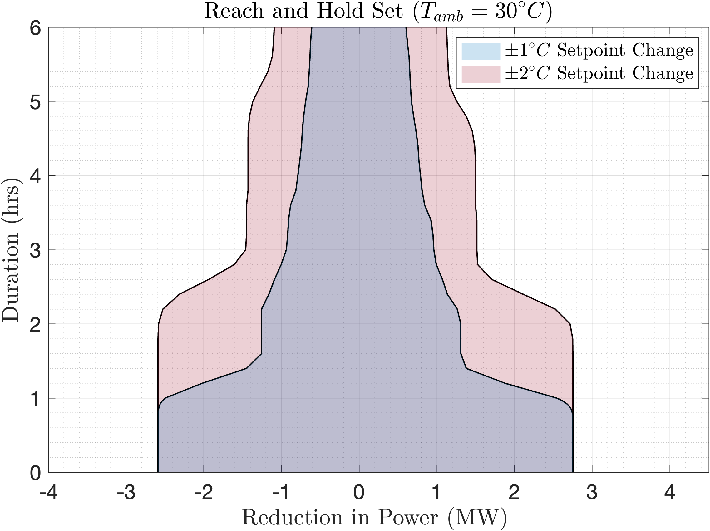
Physical limits of Virtual Power Plants (VPPs): devices
How to quantify flexibility: (i) power, (ii) energy (duration), (iii) ramp-rates
Reach-and-Hold Set(P,T): we can reach power output P and hold for T hrs
M. Elsaadany, H. Ossareh, M. Almassalkhi, “Reach and hold flexibility characterization and trade-off analysis for aggregations of thermostatically controlled loads,” arXiV, 2025
M. Almassalkhi, P. Hines,, M. Elsaadany, H. Ossareh, “Navigating the Physics of Virtual Power Plant”, IEEE Power & Energy Magazine, November, 2025

Slide 10

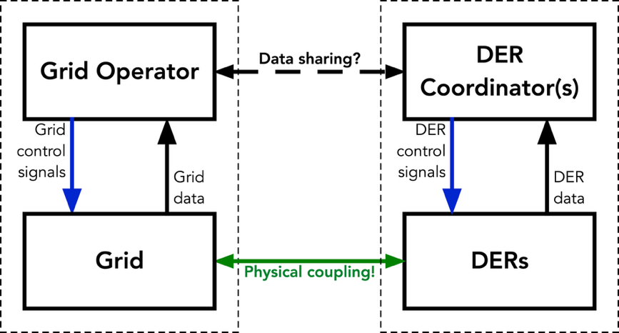
Physical limits of Virtual Power Plants (VPPs): control system
Coordination across multiple scales
Who knows what? Who controls what?
Who is responsible for resilience?
Challenges: constraints (devices/grid), uncertainty (DIU/DDU),
data (who/when/what)

Slide 11
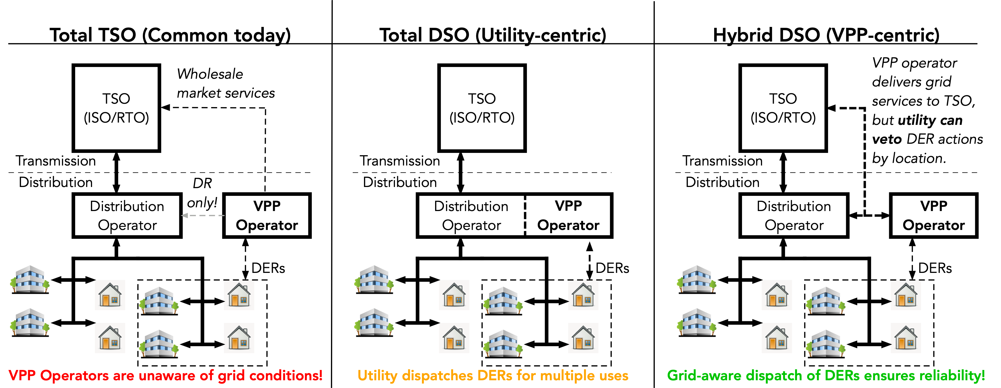

Grid architectures for a scalable, reliable, affordable grid
Most likely utility grid future in the U.S.?
M. Almassalkhi, P. Hines,, M. Elsaadany, H. Ossareh, “Navigating the Physics of Virtual Power Plant”, IEEE Power & Energy Magazine, November, 2025 M. Almassalkhi, S. Brahma, N. Nazir, H. Ossareh, et. al., "Hierarchical, grid-aware, and economically optimal coordination of distributed energy resources in realistic distribution systems," Energies (Invited Special issue: Building-to- Grid Integration through Intelligent Optimization and Control), vol. 13, no. 23, p. 6399, 2020.

Slide 12

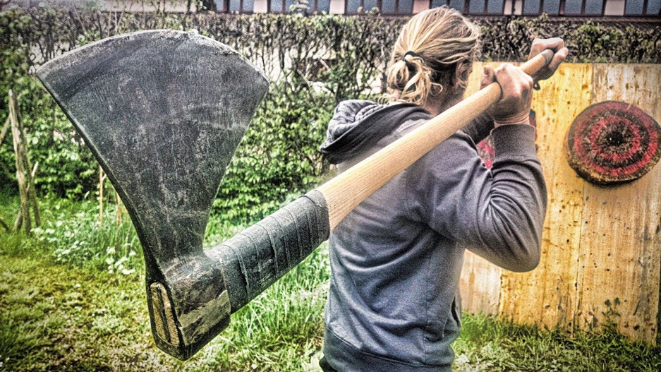

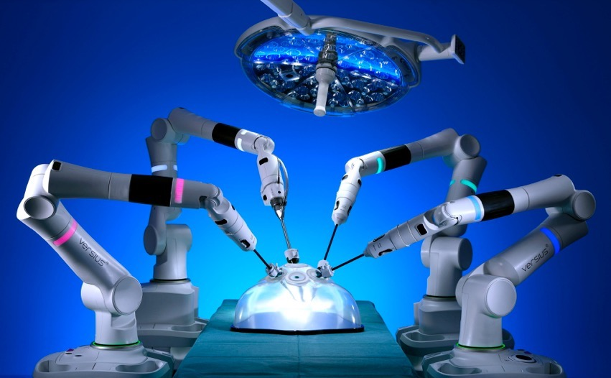
Thank you!
malmassa@uvm.edu
@theEnergyMads
https://madsalma.github.io
The grid we have today
The grid for everyone!
The grid we need!

